Slide 1
MarkeTrak Training
SCR 817 Enhancements
November 2024 Implementation

Slide 2
Antitrust Admonition
To avoid raising concerns about antitrust liability, participants in ERCOT activities should refrain from proposing any action or measure that would exceed ERCOT’s authority under federal or state law. For additional information, stakeholders should consult the Statement of Position on Antitrust Issues for Members of ERCOT Committees, Subcommittees, and Working Groups, which is posted on the ERCOT website.

Slide 3
Marketrak SCR 817 Enhancements
Revise Inadvertent Gain/Inadvertent Loss/Customer Rescission workflows to remove Ready to Receive transition
Develop a unique set of Unexecutable Reasons for each applicable Subtype
Add a 150 day validation on the Proposed Regain Date for Inadvertent Gain, Inadvertent Loss workflows
Reduce 25 day validation on the Customer Rescission workflow to 15 days
Creation of a new Meter Cycle Change Request subtype
Creation of a new 867 vs. Sum of LSE – Dispute subtype
Redesign AMS LSE-Dispute subtype
Add drop down field to Usage & Billing-Dispute subtype to clarify expected results
Expand validations on the Submit transition for Missing Enrollment TXNs subtype

Slide 4
Marketrak SCR 817 Enhancements Cont.
Modify Switch Hold Removal subtype to all TDSPs to execute Time Limit Exceeded transition
Create additional validations on the Submit transition for Switch Hold Removal subtype
Modify Switch Hold Removal subtype for ERCOT to auto populate the holding CR
Change the name of the Complete transition to Agree/Complete on Siebel Change/Info subtype
Add a warning message on the Submit transition for Inadvertent Gain, Inadvertent Loss, Customer Rescission subtypes for third party transactions that are in ‘Scheduled’ or ‘In Review’
Revise the Reject TXNs subtype – ERCOT requirement to support TX Set 5.0

Slide 5
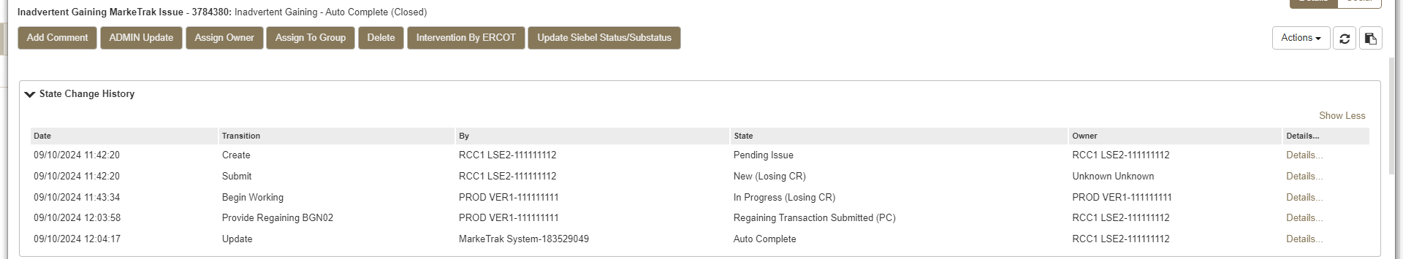
Marketrak SCR 817 Enhancement 1 – Revise Inadvertent Gain workflow to remove TDSP transitions.
The Inadvertent Gaining subtype has been revised to eliminate the TDSP transitions from the workflow. With the creation of a new ‘IA’ indicator in the 814_16, which is being implemented with TX SET 5.0, the TDSPs will no longer need to prepare their systems in advance to receive a backdated Move In and, therefore, no longer need to be an active participant in the resolution of an Inadvertent Gaining MarkeTrak issue. TDSPs will continue to be an ‘MP Involved’ on the issues and will have the ability to add comments if necessary but they will no longer have transitions to execute in the workflow.
INADVERTENT GAINING

Slide 6
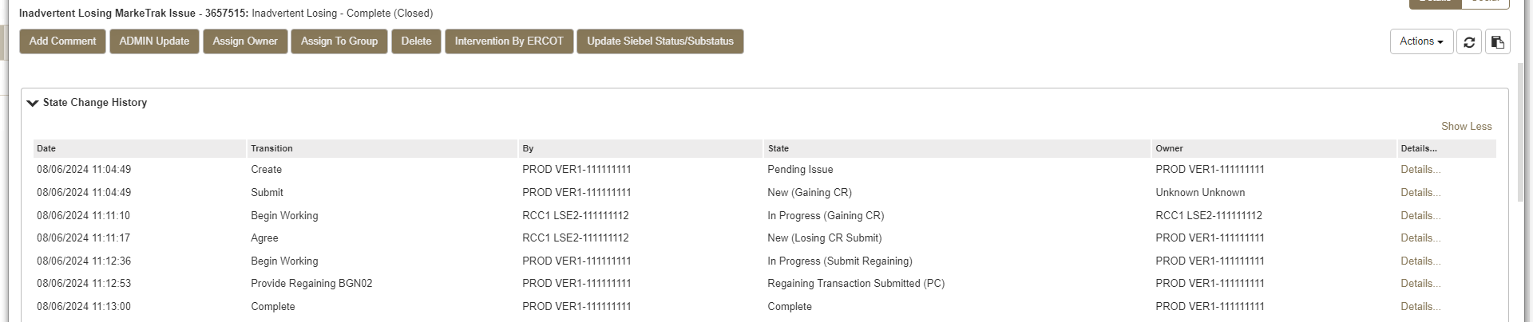
Marketrak SCR 817 Enhancement 1 – Revise Inadvertent Loss workflow to remove TDSP transitions.
The Inadvertent Losing subtype has also been revised to eliminate the TDSP transitions from the workflow; however, the TDSPs will continue to have visibility to the issues and add comments if needed. The ‘IA’ indicator, located in the BGN07 field of the 814_16, will be required when sending a backdated Move In Request due to an Inadvertent Loss situation. This eliminates the need for TDSP participation in the resolution of Inadvertent Losing MarkeTrak issues.
INADVERTENT LOSING

Slide 7
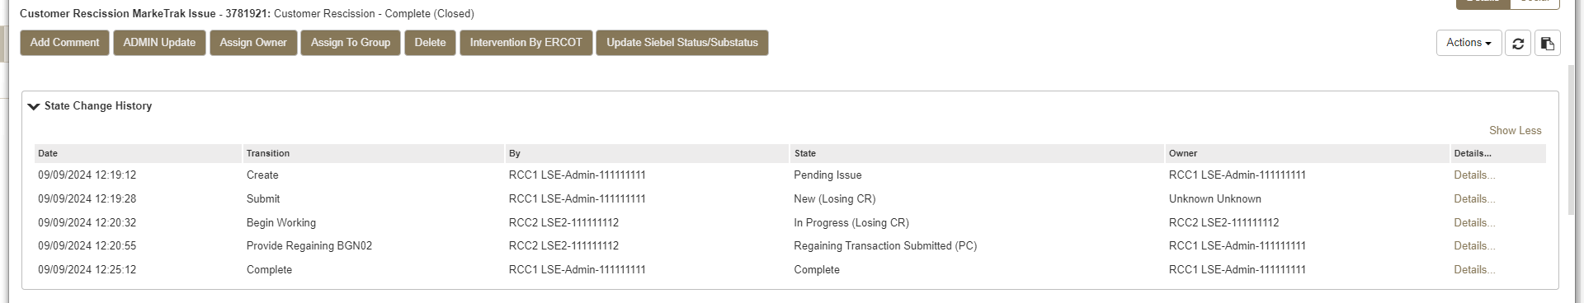
Marketrak SCR 817 Enhancement 1 – Revise Customer Rescission workflow to remove TDSP transitions.
As with the changes to the IAG and IAL workflows just reviewed, the Customer Rescission subtype has also been revised to eliminate the TDSP transitions from the workflow. A new ‘CR’ indicator in the 814_16 Move In Request is being implemented for Customer Rescission scenarios. TDSPs will continue to be an ‘MP Involved’ on the issues and will have the ability to add comments if necessary but they will no longer have transitions to execute in the workflow.
CUSTOMER RESCISSION

Slide 8
Marketrak SCR 817 Enhancement 1 – Revise Inadvertent Gain/Loss/Rescission workflows to remove TDSP transitions.
The illustrations for Inadvertent Gaining, Inadvertent Losing, and Customer Rescission in this presentation are all representations of the “happy path”. There are other workflow pathways representing a more negative path that will remain in place. For example, the ‘Unexecutable’ transition will still be available for the Gaining or Losing CR when there is a market approved reason for Unexecuting the issue. There will still be opportunities to move the issue back and forth between the two CRs for additional dialog by using the ‘Send To Losing CR’ or ‘Send To Gaining CR’ transitions.
For all three workflows, once both CRs have agreed to the Gain/Loss or Customer Rescission situation, the Losing CR must include either the ‘IA’ or the ‘CR’ indicator in the BGN07 field of their backdated 814_16 Move In Request. If the regaining transaction does not have this element, the TDSP will reject the backdated 814_16 transaction.

Slide 9
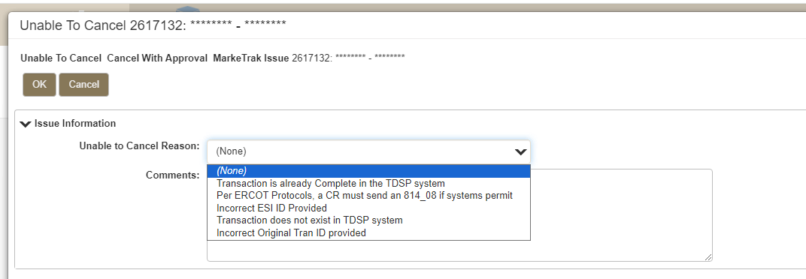
Marketrak SCR 817 Enhancement 2 – Develop a unique set of Unexecutable Reasons for Cancel With Approval and Switch Hold Removal subtypes.
Cancel With Approval:
Add Unable To Cancel Reason drop down field on the ‘Unable To Cancel’ transition for the Cancel With Approval subtype.
Unable To Cancel Reason field values:
Transaction is already Complete in the TDSP system
Per ERCOT Protocols, a CR must send an 814_08 if systems permit
Incorrect ESI ID Provided
Transaction does not exist in TDSP system
Incorrect Original Tran ID provided
NOTE: If an Unable to Cancel Reason is not selected, the User will be required to enter Comments.

Slide 10
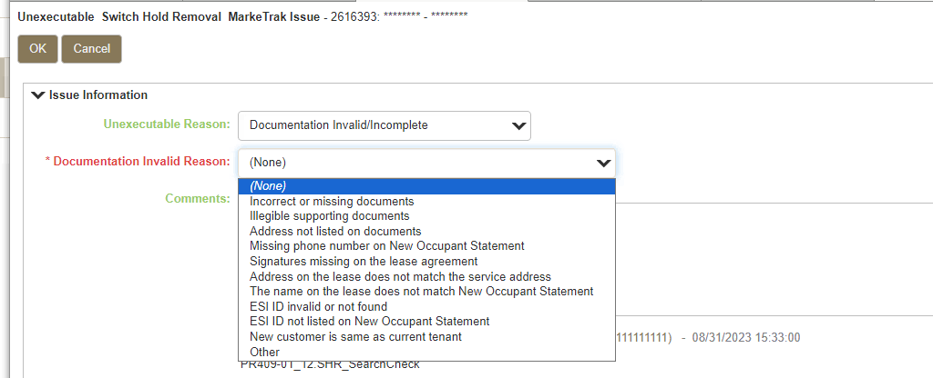
Marketrak SCR 817 Enhancement 2 – Develop a unique set of Unexecutable Reasons for Cancel With Approval and Switch Hold Removal subtypes cont.
Switch Hold Removal:
Modify the Unexecutable Reason field for Switch Hold Removal subtype.
When Documentation Invalid/Incomplete is selected from the Unexecutable Reason dropdown field on the Unexecutable transition, a secondary dropdown field ‘Documentation Invalid Reason’ displays with the following values:
Incorrect or missing documents
Illegible supporting documents
Address not listed on documents
Missing phone number on New Occupant Statement
Signatures missing on the lease agreement
Address on the lease does not match the service address
The name on the lease does not match New Occupant Statement
ESI ID invalid or not found
ESI ID not listed on New Occupant Statement
New customer is same as current tenant
Other
Comments Required

Slide 11
Marketrak SCR 817 Enhancements 3 & 4 – New Date validations on Inadvertent Gain, Inadvertent Loss, and Customer Rescission.
Inadvertent Gaining & Inadvertent Losing subtypes:
On the ‘Provide Regaining BGN02’ transition, the following validations will occur on the Proposed Regain Date:
Validate that the Proposed Regain Date is not less than Date of Loss + 1. Error message to display if True: “Regaining transaction cannot be less than Date of Loss + 1.”
Validate that the Proposed Regain Date is not greater than the MarkeTrak submit date + 10 days. Error message to display if True: “Proposed Regain Date is greater than 10 calendar days from submittal of MarkeTrak issue. Please Update with a valid Proposed Regain Date.”
Validate that the Proposed Regain Date is not greater than 150 days in the past. Error message to display if True: “Regain dates greater than 150 days in the past will be rejected by the TDSP.”
User has the ability to change the Proposed Regain Date or select Cancel to exit.
Customer Rescission:
On the ‘Submit’ transition for Customer Rescission issues, there is currently a validation that occurs to check that the effective date of the originating transaction is less than 25 calendar days in the past. The validation logic is being revised to 15 calendar days instead of 25.
The current error message for this validation is being updated to display “Error: This issue is unable to proceed because the effective date of the originating transaction at this premise was more than 15 calendar days in the past. Please enter a different ESIID or consult the Retail Market Guide to determine the proper course of action.”

Slide 12
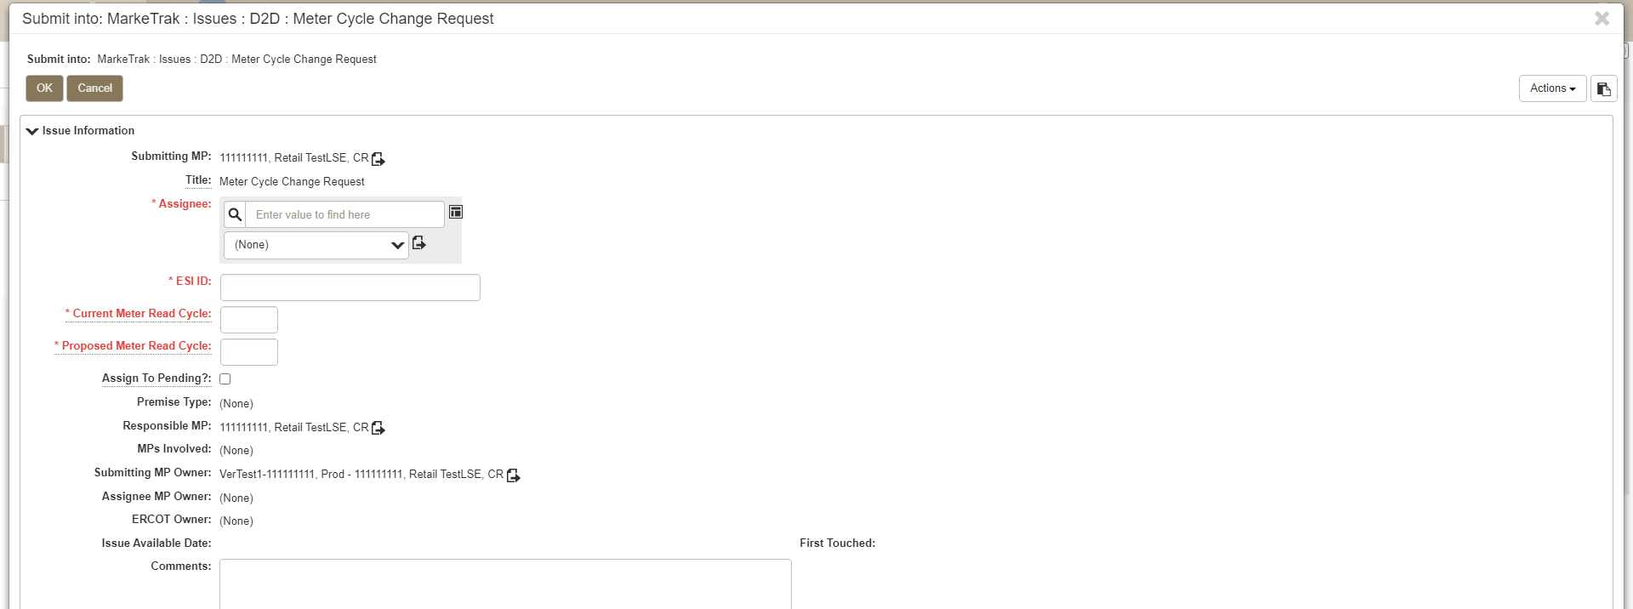
Marketrak SCR 817 Enhancement 5 – Creation of a new Meter Cycle Change Request subtype.
The Meter Cycle Change Request subtype was created for CRs to request a change to the Meter Read Cycle of an ESIID. Only one meter cycle change per Rep of Record for the customer is allowed at the discretion of the TDSP per their respective tariffs. This subtype can only be submitted by the current Rep of Record for the ESIID. MarkeTrak will validate that the Submitting MP is the current ROR. If the Submitting CR is not the current Rep of Record, an error message will display and the issue cannot be submitted.
The ‘Projects’ subtype is currently being used by CRs to request a change to the Meter Read Cycle. Market Participants will need to use the newly created ‘Meter Cycle Change Request’ subtype going forward to avoid the TDSP Unexecuting the issue for incorrect subtype.

Slide 13
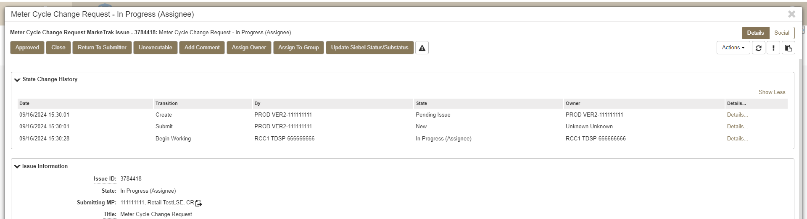
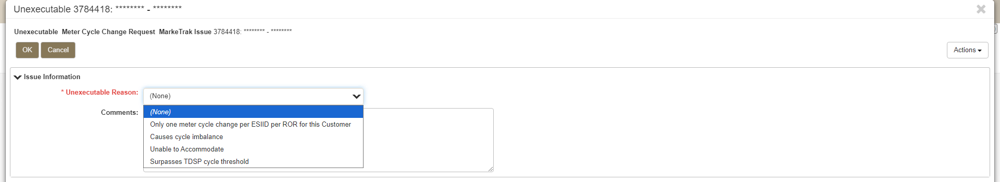
Marketrak SCR 817 Enhancement 5 – Creation of a new Meter Cycle Change Request subtype cont.
There are some transitions unique to the Meter Cycle Change Request subtype:
Approved: The Approved transition is available when the issue is In Progress and is used by the TDSP as a clear indicator that the Meter Cycle Change Request was approved.
Unexecutable Reasons: If the issue is transitioned ‘Unexecutable’ the User is required to select one of the following ‘Unexecutable Reasons’:
*Note: The selection of ‘Unable to Accommodate’ requires Comments

Slide 14
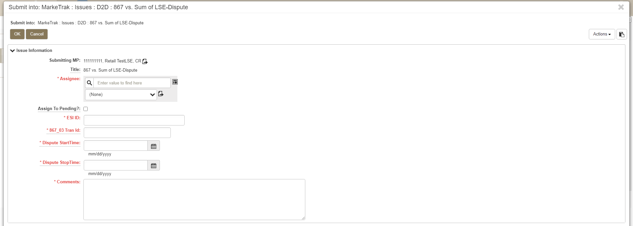
Marketrak SCR 817 Enhancement 6 – Creation of a new 867 vs. Sum of LSE – Dispute subtype.
This subtype is used by a CR to dispute a variance between the total usage reported on the 867_03 transaction and the sum of the AMS LSE interval data from the TDSP for the same time period. It should be noted that the standard accepted variance is within two times the meter multiplier.
This subtype can only be submitted by a CR and should be assigned to the TDSP. ERCOT system will validate that the Submitting CR is the Rep of Record for the Dispute Start Time and Dispute Stop Time provided on the issue.
The ‘Usage/Billing AMS - Dispute’ subtype is currently being used by CRs to dispute the variance between the 867_03 and the AMS LSE interval data. Market Participants will need to use the newly created ‘867 vs. Sum of LSE – Dispute’ subtype going forward to avoid the TDSP Unexecuting the issue for incorrect subtype.
Tran ID of the 867_03 in dispute
Start Time of the 867_03 in dispute
Stop Time of the 867_03 in dispute

Slide 15
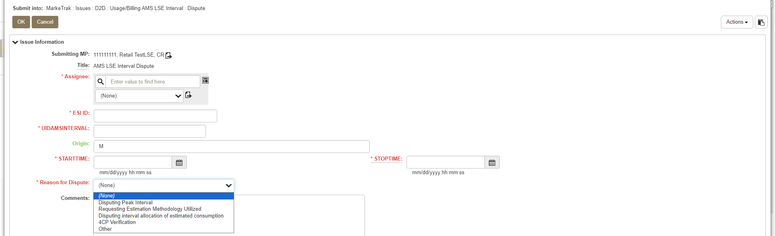
Marketrak SCR 817 Enhancement 7 – Redesign the AMS LSE-Dispute subtype.
A new field is being added to the Usage and Billing AMS LSE – Dispute subtype. The new dropdown field ‘Reason for Dispute’ is being added to the Submit form with the following values available to select:
Disputing Peak Interval
Requesting Estimation Methodology Utilized
Disputing interval allocation of estimated consumption
4CP Verification
Other (selecting Other requires the User to add comments)
Please note that the bulk insert template for the AMS LSE Interval - Dispute subtype has been updated to include the new Reason for Dispute field. If you have a saved version of the old template on your computer, you will need to replace it with the new version which will be available on the MarkeTrak Information Page at https://www.ercot.com/services/client_svcs/mktrk_info/index.html.

Slide 16
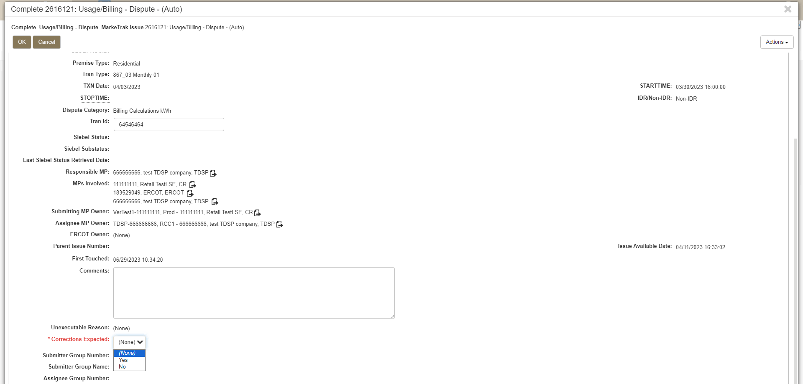
Marketrak SCR 817 Enhancement 8 – Add drop down field to Usage & Billing – Dispute subtype to clarify expected results.
A new ‘Corrections Expected’ drop down field is being added to the Usage & Billing – Dispute subtype when an issue is transitioned ‘Complete’ or ‘Unexecutable’ by the TDSP. This is a Yes/No selection to indicate if corrections will be made upon the TDSP review. This determination is made after the TDSP has completed their review to alert the CR if cancel/rebills can be expected.

Slide 17
Marketrak SCR 817 Enhancement 9 – Expand validations on the Submit transition for Missing Enrollment TXNs subtype.
When submitting a Missing Enrollment TXNs issue and 867_04 is selected from the Tran Type field, the following validations are performed on the ‘Submit’ transition:
Verify service order for Global ID provided is not in status of ‘Cancelled’ in ERCOT’s Registration System. If the service order is Cancelled, the following error message will display: “The service order for the Global ID provided has been cancelled in ERCOT Registration System. Please update the ESIID/Original Tran ID provided and click OK or click Cancel to exit”.
Verify the 867_04 has been received in ERCOT system for the Global ID provided. Error message to display if 867_04 is in the system: “The 867_04 transaction has already been sent. Please update the ESIID/Original Tran ID provided and click OK or click Cancel to exit”.
For the Global ID provided, perform a check to determine if the 814_04 and 814_05 transactions have been received. If TRUE, verify the Scheduled Meter Read Date is greater than 5 days of the submit date of the MarkeTrak issue. If TRUE, no action. If FALSE, warning message displays: “Please allow at least 5 days for the 867_04 to be sent by the TDSP”.
The Bulk Insert template for the Missing Enrollment TXNs subtype has been updated to add a column for the 867_04 date validation (SMRD check against the submit date). This validation is defaulted to ON which is an exception to most validations which are defaulted to OFF. Users wishing to turn this validation OFF in their bulk insert template would need to enter a ‘0’ in the validation field. Entering a ‘1’ or leaving the field blank will result in the validation occurring.
As noted above, the bulk insert template for the Missing Enrollment TXNs subtype has been revised. If you have a saved version of the old template on your computer, you will need to replace it with the new version which will be available on the MarkeTrak Information Page at https://www.ercot.com/services/client_svcs/mktrk_info/index.html.

Slide 18
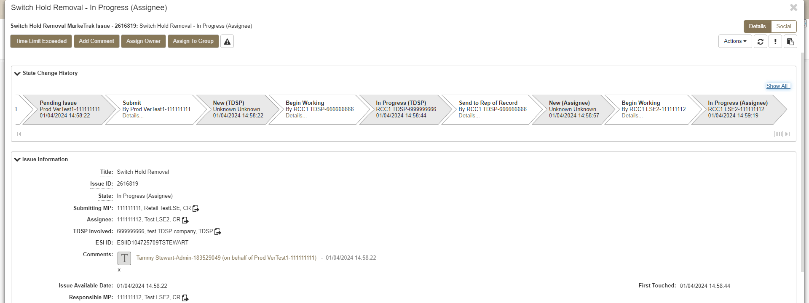
Marketrak SCR 817 Enhancement 10 – Modify Switch Hold Removal subtype to allow all TDSPs to execute Time Limit Exceeded transition.
Currently, the ‘Time Limit Exceeded’ transition is only available to the Submitting CR. With SCR 817, this transition will now be available to the TDSP when the issue is in a state of ‘New (Assignee)’ or ‘In Progress (Assignee)’ and the Responsible MP is the current Rep of Record (Assignee). If the Assignee does not transition the issue ‘Agree’ or ‘Disagree’ within the allotted one and a half business hours, both the Submitting CR and the TDSP now have the ability to transition the issue ‘Time Limit Exceeded’ to move the issue to the TDSP for the final review.
TDSP view

Slide 19
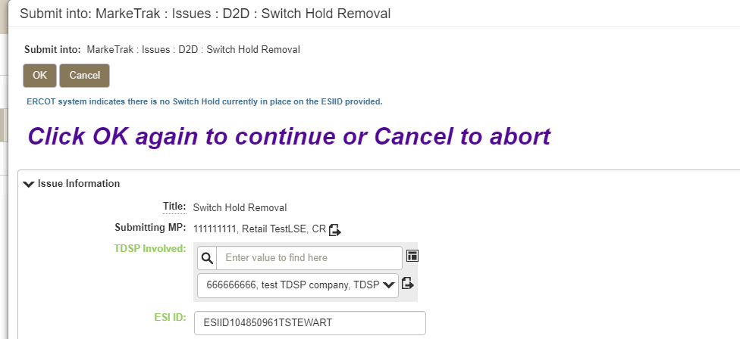
Marketrak SCR 817 Enhancement 11 – Create additional validations on the Submit transition for Switch Hold Removal subtype.
This enhancement adds the following validations to the Switch Hold Removal subtype on the Submit transition:
A check is performed to verify if a Switch Hold currently exists on the ESIID in the ERCOT Registration System. If there is no Switch Hold on the ESIID, a warning message will display to the User:
“ERCOT system indicates there is no Switch Hold currently in place on the ESIID provided. Click OK again to continue or Cancel to abort”

Slide 20
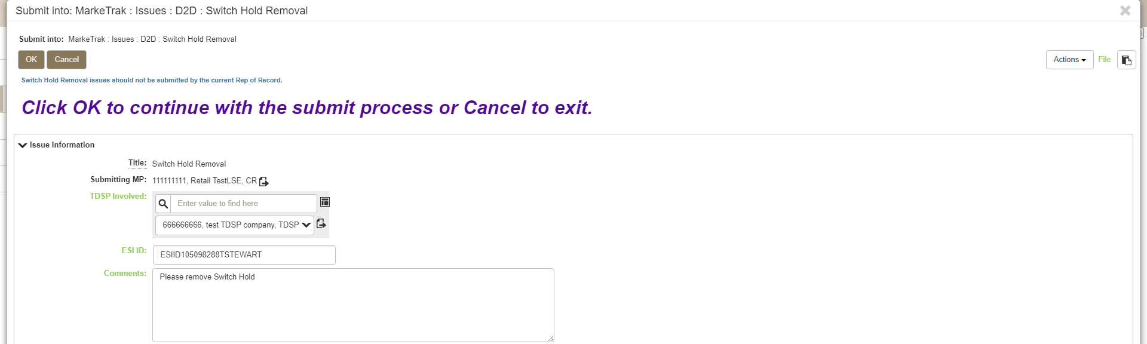
Marketrak SCR 817 Enhancement 11 – Create additional validations on the Submit transition for Switch Hold Removal subtype cont.
Check is performed to verify if the Submitting MP is the current Rep of Record in ERCOT’s Registration System. Warning message to display if TRUE:
“Switch Hold Removal issues should not be submitted by the current Rep of Record. Click OK to continue with the submit process or Cancel to exit.”

Slide 21
Marketrak SCR 817 Enhancement 12 – Modify Switch Hold Removal subtype for ERCOT to populate the current ROR.
With this requirement, the Assignee field is being added to the Switch Hold Removal issue upon the ‘Submit’ transition. This is currently a field that is manually populated by the TDSP upon the ‘Send To Rep of Record’ transition when the issue is in the state of ‘In Progress (TDSP)’. The new functionality will auto populate the Assignee field on the Submit transition with the current Rep of Record DUNS per the ERCOT Registration System.
If the ESIID provided is de-energized in the ERCOT Registration system and there is no current Rep of Record, ERCOT will transition the issue to the TDSP with a null value in the Assignee field.
We have also modified the ‘Send To Rep of Record’ transition when the issue is in the state of ‘In Progress (TDSP)’. Currently, the TDSPs manually enter the Rep of Record DUNS during this transition. Going forward, the Assignee field will still prompt as a required field; however, it will already be pre-populated by ERCOT. This value can be changed by the TDSP if needed.

Slide 22
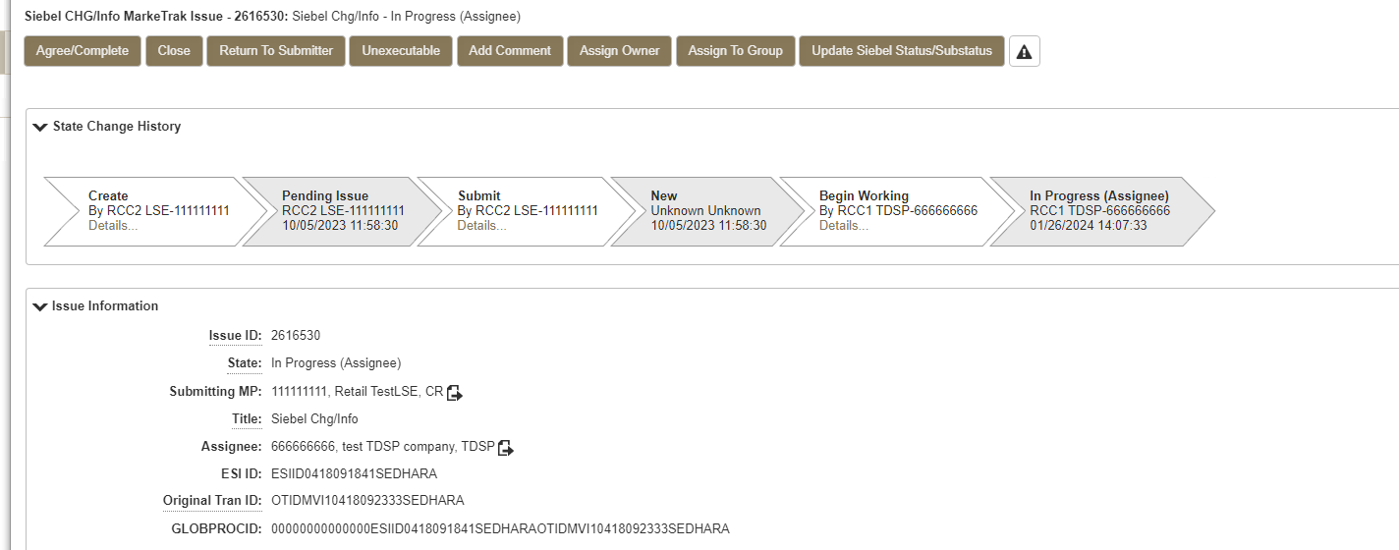
Marketrak SCR 817 Enhancement 13 – Change the name of the Complete transition to Agree/Complete on Siebel Chg/Info subtype.
State of ‘In Progress (Assignee)’
Update label on ‘Complete’ transition to ‘Agree/Complete’

Slide 23
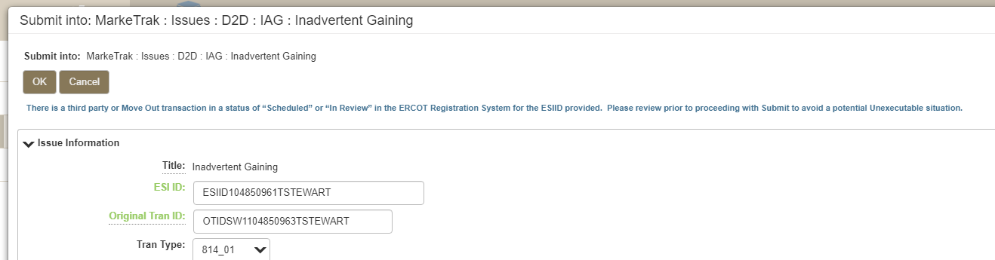
Marketrak SCR 817 Enhancement 14 – Add a warning message on the Submit transition for IAG/IAL/Cust Rescission subtypes for 3rd party txns in ‘Scheduled’ or ‘In Review’ status.
On the Submit transition for the Inadvertent Gaining, Inadvertent Losing, and Customer Rescission subtypes, a check will be performed to verify if a Third Party transaction for the ESIID provided is in the ERCOT Registration System with a service order status of “Scheduled” or “ In Review”. A check is also performed to verify if a Move Out by the Gaining CR is in a status of “Scheduled” or “In Review”.
A warning message will display if a Third Party or Move Out transaction exists with either status:
“There is a third party or Move Out transaction in a status of “Scheduled” or “In Review” in the ERCOT Registration System for the ESIID provided. Please review prior to proceeding with Submit to avoid a potential Unexecutable situation.”
Please note that the bulk insert templates for the Inadvertent Gaining, Inadvertent Losing, and Customer Rescission have been updated to include this new third party transaction validation. If you have saved versions of the old templates on your computer, you will need to replace them with the new versions which will be available on the MarkeTrak Information Page at https://www.ercot.com/services/client_svcs/mktrk_info/index.html.

Slide 24
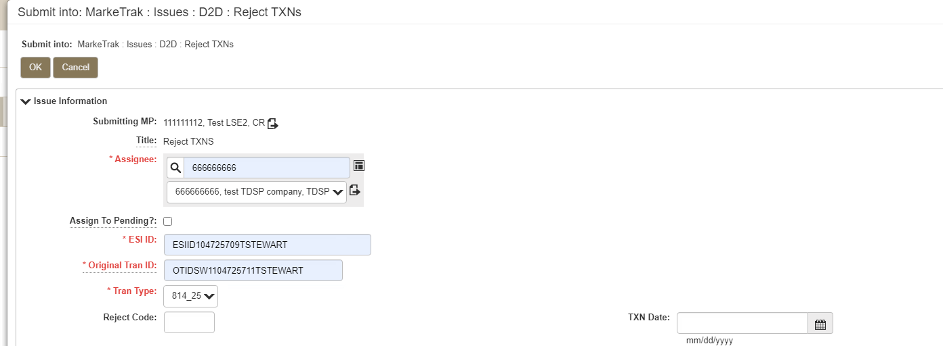
Marketrak SCR 817 Enhancement 15 – Revise the Reject TXNs subtype (ERCOT requirement to support TX Set 5.0).
With the implementation of TX Set 5.0, several new reject codes are being added to various transactions. Adding all of these new reject codes to the Reject Code dropdown field on the submit form for Reject TXNs subtype was not feasible. As part of SCR 817, the Reject Code field is changing from a dropdown field to a freeform field for the User to manually enter the appropriate reject code. The field is also changing from a required to an optional field.
It should be noted that, consistent with current functionality, entering ‘A13’ in the Reject Code field will require the Submitter to enter comments.
A76

Slide 25
SCR 817 API WSDL Updates
Add New Subtypes:
Requirement 5 – Creation of a New Meter Cycle Change Request subtype
Requirement 6 – Creation of a new 867 vs. Sum of LSE – Dispute subtype
Add New Required Elements:
Requirement 2 – Develop a unique set of Unexecutable Reasons for applicable subtypes
Requirement 7 – Redesign AMS LSE-Dispute subtype
Requirement 8 – Add a field to Billing-Dispute subtype to clarify expected results
Add New Validation Flags:
Requirement 9 – Expand validations on the Submit transition for Missing Enrollment TXNs subtype
Requirement 14 - Add a warning message on the Submit transition for Inadvertent Gain, Inadvertent Loss, Customer Rescission subtypes for third party transactions that are “Scheduled” or “In Review”
Add New Transition Labels and Field Formats:
Requirement 13 – Change the name of the Complete transition to Agree/Complete on Siebel Chg/Info subtype
Requirement 15 – Modify the Reject Code field on the Reject TXNs subtype
A draft WSDL with the SCR 817 changes is posted to the MarkeTrak Information page (https://www.ercot.com/services/client_svcs/mktrk_info/index.html).

Slide 26
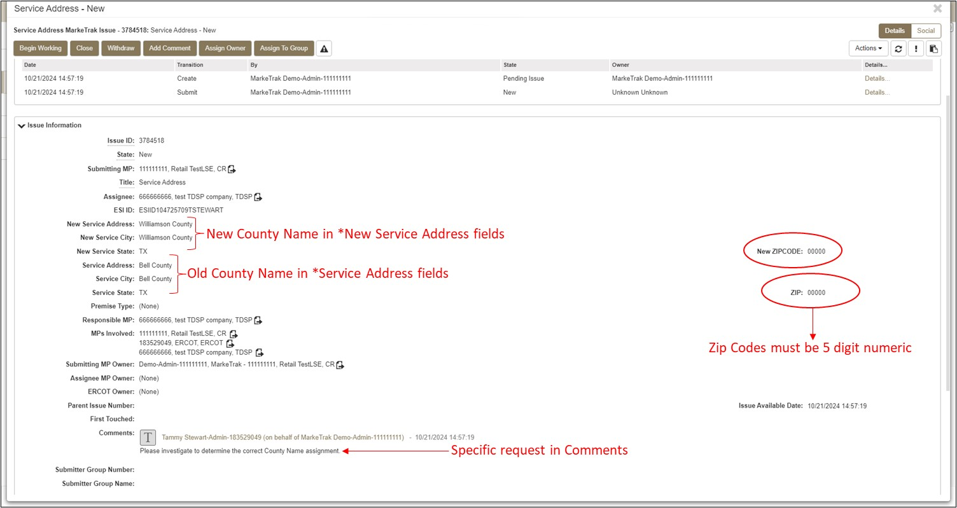
MarkeTrak Process Revision to support TX Set 5.0 Requirement – Add New Values For County.
With the implementation of TX Set 5.0, County Name will now be associated with an ESI ID. In the event the County for the ESI ID is not correct in ERCOT’s system, the Service Address subtype in MarkeTrak will be used by a CR to request that the TDSP send a correction for the County Name. The Service Address subtype does not currently include required fields for County Name. As an interim solution, CR’s should enter the New County Name in the New Service Address/New Service City fields. The current County Name should be entered in the Service Address/Service Address City fields. The Zip Code must be a 5-digit numeric number with a recommended value of ‘00000’. The comments field should contain a reference to the request to update the County Name for the ESI ID provided.

Slide 27
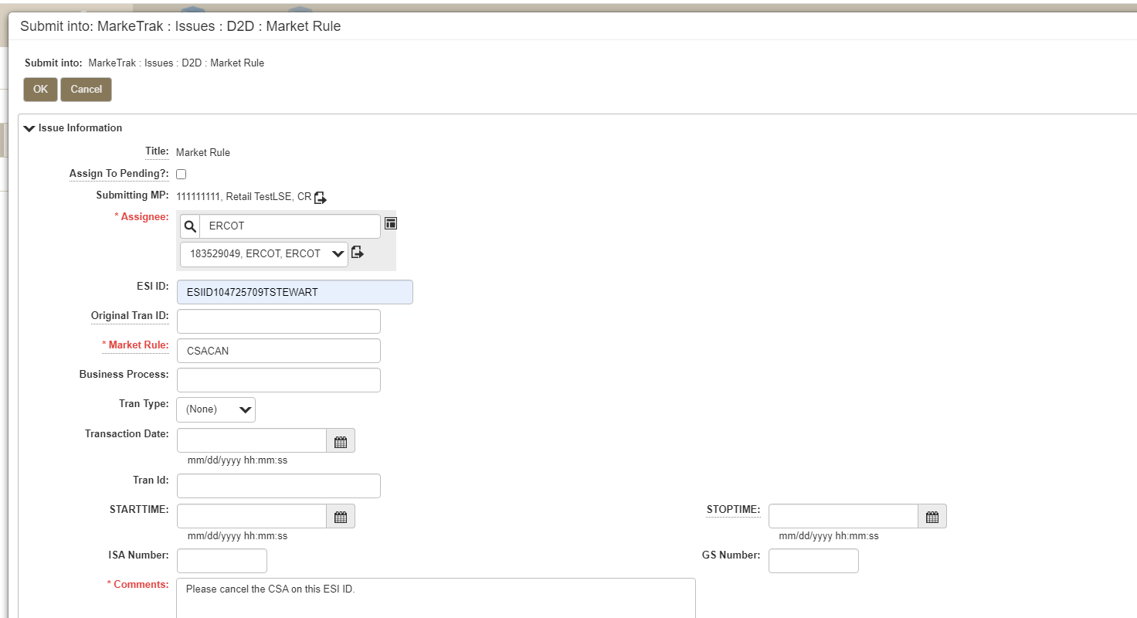
MarkeTrak Process Revision to support TX Set 5.0 Requirement – Removal of a pending CSA.
CR’s wishing to cancel a CSA where the CSA start date is in the future should create a MarkeTrak Day-to-Day Market Rule issue subtype, assigned to ERCOT, and enter “CSACAN” in the required Market Rule field.
ERCOT will cancel the pending CSA and select ‘Complete’ to indicate the requested action has been taken. The issue can then be closed by the Submitting CR or it will be auto closed by the system.
A slightly different process will be used to cancel a CSA on an ESI ID located in MOU territory. The CR will submit the Market Rule issue, assigned to ERCOT with the ‘CSACAN’ referenced in the Market Rule field. ERCOT will review and assign the issue to the MOU TDSP for approval. Upon the MOU TDSP approval, they will assign the issue back to ERCOT. ERCOT will cancel the pending CSA and select ‘Complete’ to indicate the requested action has been taken.

Slide 28
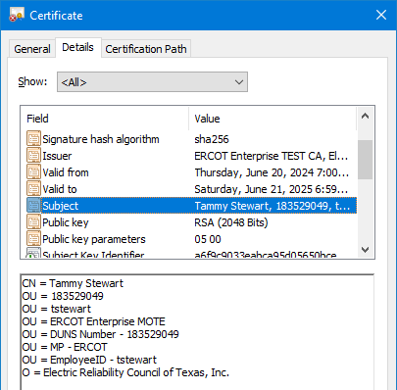
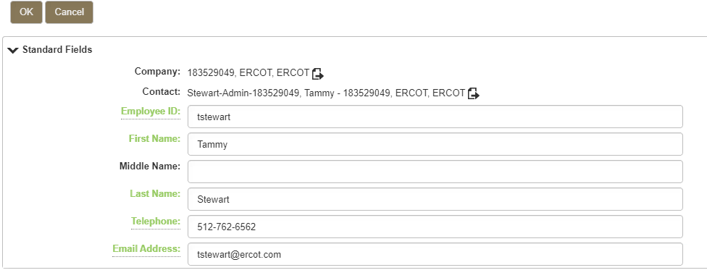
How To Access MarkeTrak in the Retail Market Test Environment (RMTE)
The MarkeTrak changes associated with SCR 817 are now available in the Retail Market Test Environment (RMTE). MarkeTrak users are strongly encouraged to log into the RMTE and view the changes to become familiar with the new functionality prior to Production Go-Live in November. The process to access the RMTE is as follows:
The URL for the MarkeTrak RMTE is https://testmis.ercot.com/marketrak/tmtrack/tmtrack.dll?
A current digital certificate for the MOTE environment is required. Users needing digital certificates should contact their USA. Once the digital certificate is issued, the user should install the dc on the machine used to access the MarkeTrak application.
Upon receiving your MOTE digital certificate, coordinate with your MP Admin to ensure you have a current User Profile in MarkeTrak. The Employee ID on the User Profile should match the Employee ID on the digital certificate. If these values do not match, authentication will fail.

Slide 29
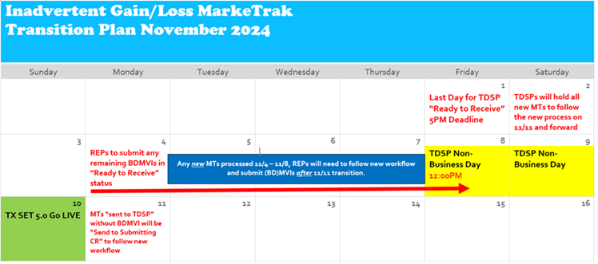
SCR 817 Implementation Transition Plan
The MarkeTrak changes associated with SCR 817 will be implemented in the Production environment the weekend of November 9-10 with Go-Live on November 11, 2024. A transition plan has been created to address Inadvertent issues that are in some form of ‘In Progress’ that will be impacted. The following is the transition plan that we will follow to address those ‘In Progress’ Inadvertent issues:
The TDSPs will stop transitioning all Inadvertent issues ‘Ready To Receive’ at 5:00 PM on Friday, November 1. After November 1, the TDSP’s will hold all new MarkeTrak Inadvertent Gain/Loss/Customer Resicission issues to follow the new workflows being implemented with this project.
Back dated MVI’s for Inadvertent issues that were transitioned ‘Ready To Receive’ on or prior to November 1 should be sent by noon on Friday, November 8.
On Monday, November 11, the TDSP’s will return any issues that were not transitioned ‘Ready To Receive’ back to the Submitting CR via the ‘Send To Submitting CR’ transition. Once the Submitting CR selects ‘Begin Working’ the issue will then follow the new workflow. Beginning Monday, November 11, all backdated MVI transactions associated with an Inadvertent Gain, Inadvertent Loss, or Customer Rescission are required to include the “IA” or “CR” code in the BGN07 segment. Failure to include these codes will result in the TDSP rejecting the regaining transaction.

Slide 30
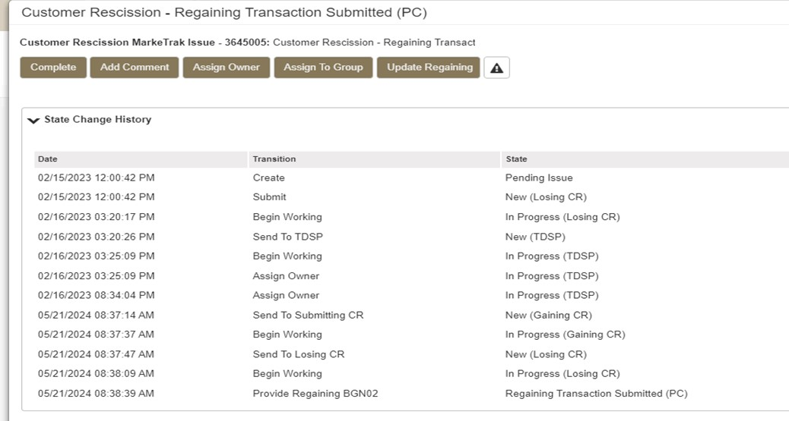
SCR 817 Implementation Transition Plan – Issues In Progress at Go-Live
Per the Transition Plan in the previous slide, the TDSPs will be ‘holding’ all Inadvertent Gaining, Inadvertent Losing, and Customer Rescission issues that are transitioned to them via the ‘Send To TDSP’ transition after 5:00 pm, November 1st. They will not be transitioning any issues ‘Ready To Receive’ after that date. On Monday, November 11th, the TDSPs will transition those issues ‘Send To Submitting CR’. This will return the issue back to the Submitting CR in a state of New (Gaining CR) and set the issue on the new workflow path. Below is an illustration of a Customer Rescission issue that was in progress prior to the new changes:
Customer Rescission – state of ‘In Progress (TDSP)’
Post Go-Live transitions:
TDSP – ‘Send To Submitting CR’
Gaining CR – ‘Begin Working’ / ‘Send To Losing CR’
Losing CR – ‘Begin Working’ / ‘Provide Regaining BGN02’

Slide 31
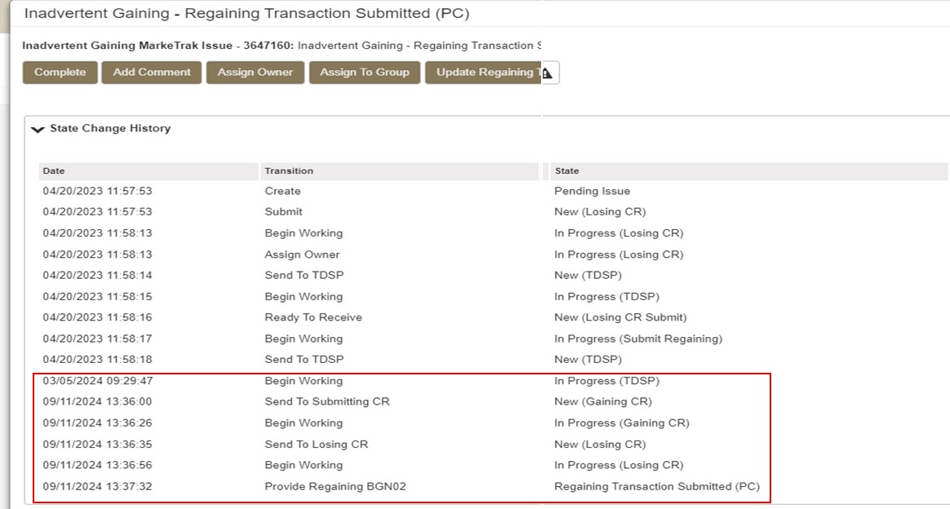
SCR 817 Implementation Transition Plan – Issues In Progress at Go-Live cont.
Inadvertent Gaining – state of ‘New (TDSP)’
Post Go-Live transitions:
TDSP – ‘Begin Working’/Send To Submitting CR’
Gaining CR – ‘Begin Working’ / ‘Send To Losing CR’
Losing CR – ‘Begin Working’ / ‘Provide Regaining BGN02’

Slide 32
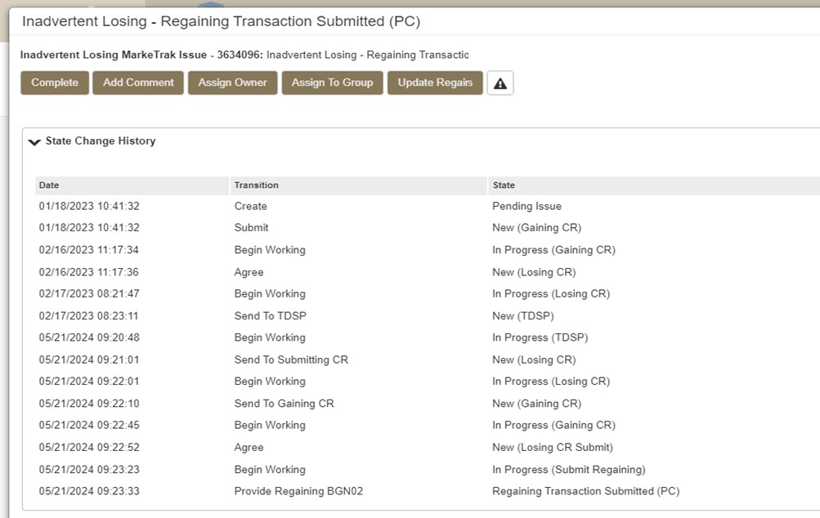
SCR 817 Implementation Transition Plan – Issues In Progress at Go-Live cont.
Inadvertent Losing – state of ‘New (TDSP)’
Post Go-Live transitions:
TDSP – ‘Begin Working’/Send To Submitting CR’
Losing CR – ‘Begin Working’ / ‘Send To Gaining CR’
Gaining CR – ‘Begin Working’ / ‘Agree’
Losing CR – ‘Begin Working’/’Provide Regaining BGN02’

Slide 33
SCR 817 Reference Material
Draft versions of documentation updates and API technical files have been posted to the MarkeTrak Information Page located at https://www.ercot.com/services/client_svcs/mktrk_info/index.html.
These include the following:
SCR817 DRAFT_MarkeTrakAPI_Technical Files
SCR817DRAFT_BulkInsertTemplates
SCR817DRAFT_States and Transitions Docs
SCR817DRAFT_User Guide Updates
The SCR 817 Business Requirements document is posted to the TDTMS main page located at https://www.ercot.com/committees/rms/tdtms.
SCR817 Business Requirements FINAL 073124
The MarkeTrak online tutorials have been updated and will be available the morning of November 11. The online modules can be accessed by logging into Cornerstone LMS at https://ercot.csod.com/login/render.aspx?id=defaultclp
Final versions of all other reference materials will be posted just prior to Go-Live in November.

Slide 34

MarkeTrak SCR 817 Training

