Slide 1

UFE 2005 ANALYSIS
Compiled by Load Profiling
ERCOT Energy Analysis & Aggregation

Slide 2
UFE Basics
UFE (unaccounted for energy) is computed as follows:
UFE = Generation – (Load + Losses)
Sources of UFE include:
■ Generation Measurement Errors
■ Load - Missing/Erroneous Usage Data
- Model Error
- Load Profile ID Assignment Error
■ Losses - Model Error
- Loss Code Assignment Error
Negative UFE indicates load/losses are overestimated

Slide 3
UFE Basics
UFE
Net Generation for Settlement Interval
GAP - - - - - - >
Losses:
Transmission & Distribution
Profiled Energy Usage
Non-Interval Data
Non-Metered Accounts
Net Generation
Compared to
Load Buildup
Interval Data
Energy Usage

Slide 4

DATA VERIFICATION IN THE SETTLEMENT PROCESS
UFE is computed for each 15-minute interval of a settlement run.
Initial Settlement
(posted on day 10 after the operating day)
Final Settlement
(posted on day 60 after the operating day)
True-up Settlement (posted 6 months after operating day)
Resettlement statement (posted as needed)
Final
Settlement
Initial
True-Up

Slide 5
Load Weighted Calculation of MCPE
Market Clearing Price for Energy (MCPE) is the highest price by Congestion Zone for a Settlement Interval for Balancing Energy deployed during the Settlement Interval.
In 2005 there were 5 congestion zones – E05, H05, N05, S05 and W05.
The load weighted MCPE is calculated for each 15 min. interval using the LCMZone cuts as follows:
  MCPE_LWTD = ((LCMZone_E05_Mwh * MCPEL_E05) + (LCMZone_H05_Mwh * MCPEL_H05) +
  (LCMZone_N05_Mwh * MCPEL_N05) + (LCMZone_S05_Mwh * MCPEL_S05) +
  (LCMZone_W05_Mwh * MCPEL_W05)) / (LCMZone_E05_Mwh + LCMZone_H05_Mwh +
  LCMZone_N05_Mwh + LCMZone_S05_Mwh + LCMZone_W05_Mwh)

Slide 6
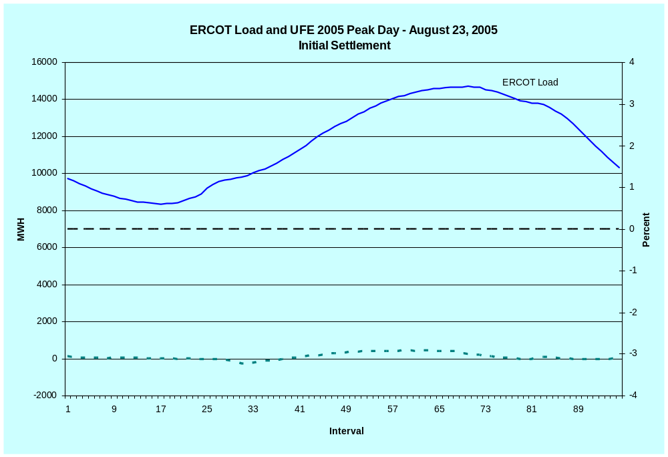
LOAD AND UFE – ERCOT PEAK 2005
Initial Settlement
SR01

Slide 7
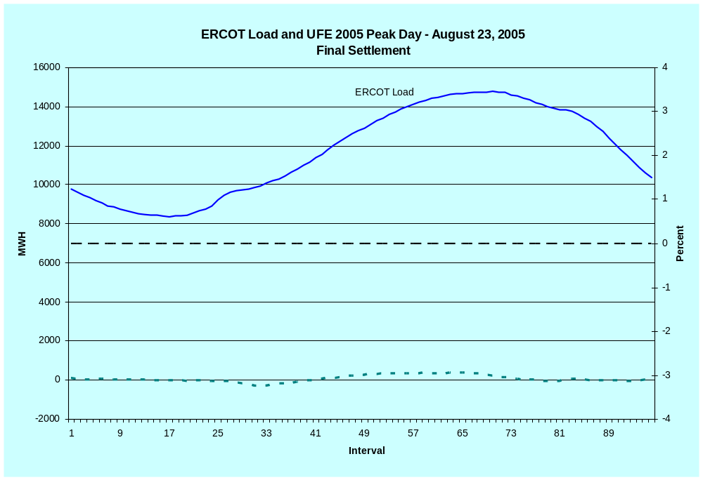
LOAD AND UFE – ERCOT PEAK 2005
Final Settlement
SR02

Slide 8
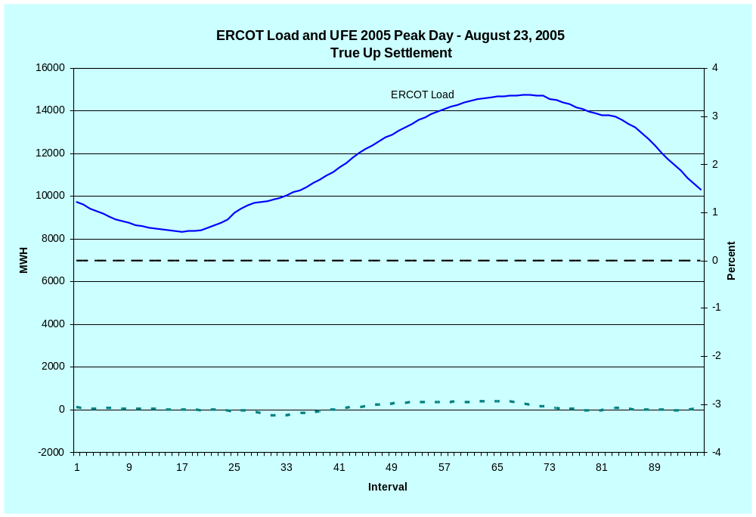
LOAD AND UFE – ERCOT PEAK 2005
True Up Settlement
SR03

Slide 9
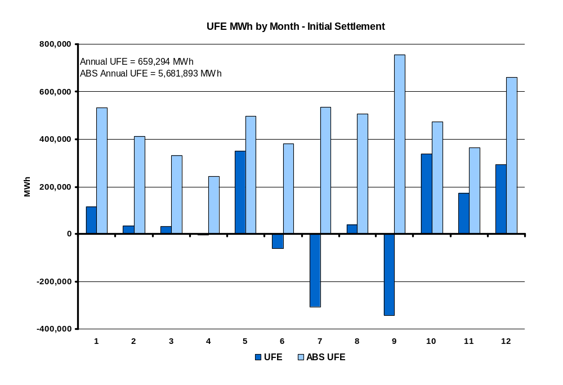
UFE MWh by Month in 2005
Initial Settlement
SR04
Notes:
This is NET UFE. + and – are canceling out. May and Oct (shoulder months) are the highest while April (another shoulder month) is lowest. Winter months are generally higher than summer months.

Slide 10
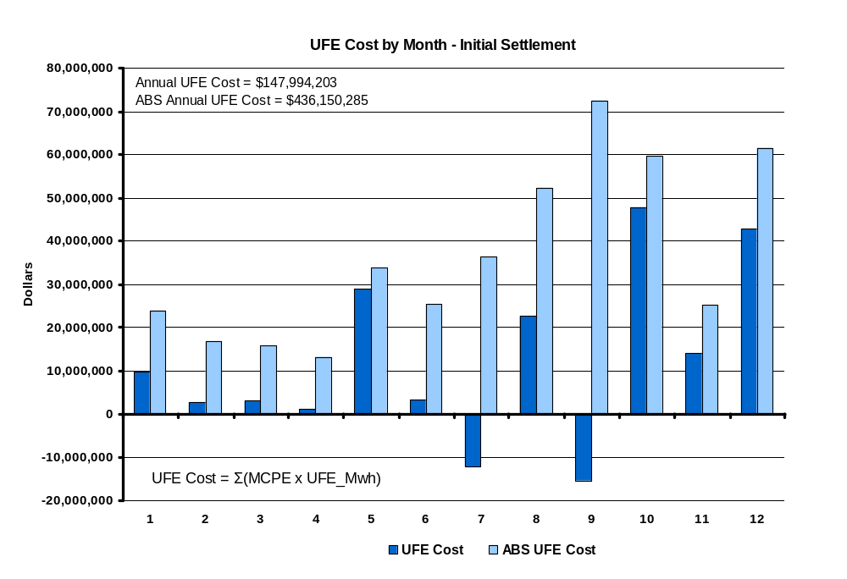
UFE Cost by Month in 2005
Initial Settlement
SR05

Slide 11
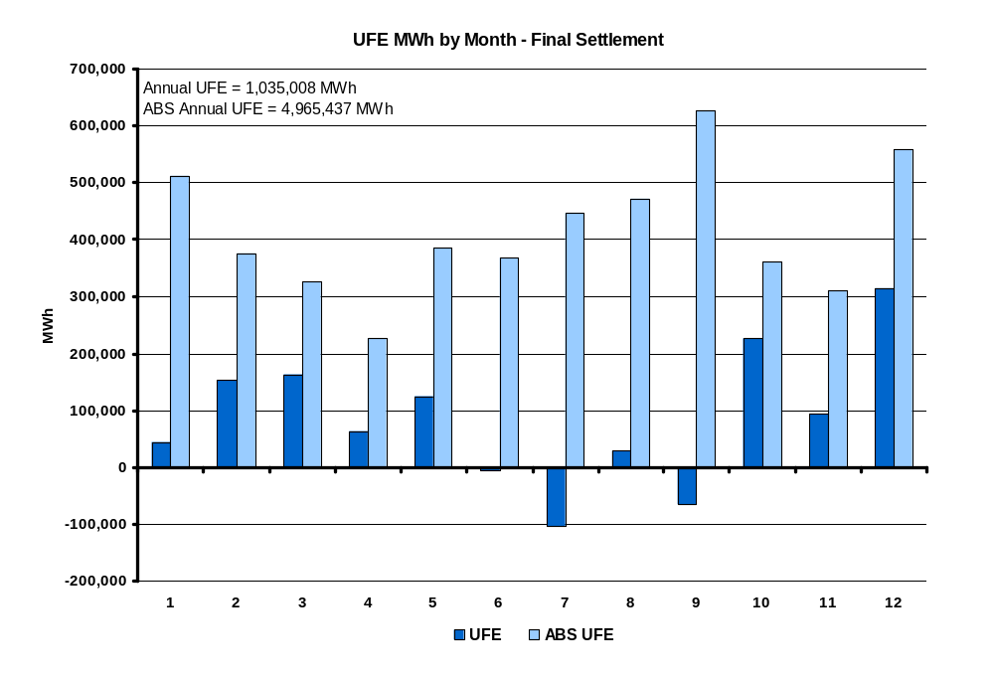
UFE MWh by Month in 2005
Final Settlement
SR06
Notes:
This is NET UFE. + and – are canceling out. May and Oct (shoulder months) are the highest while April (another shoulder month) is lowest. Winter months are generally higher than summer months.

Slide 12
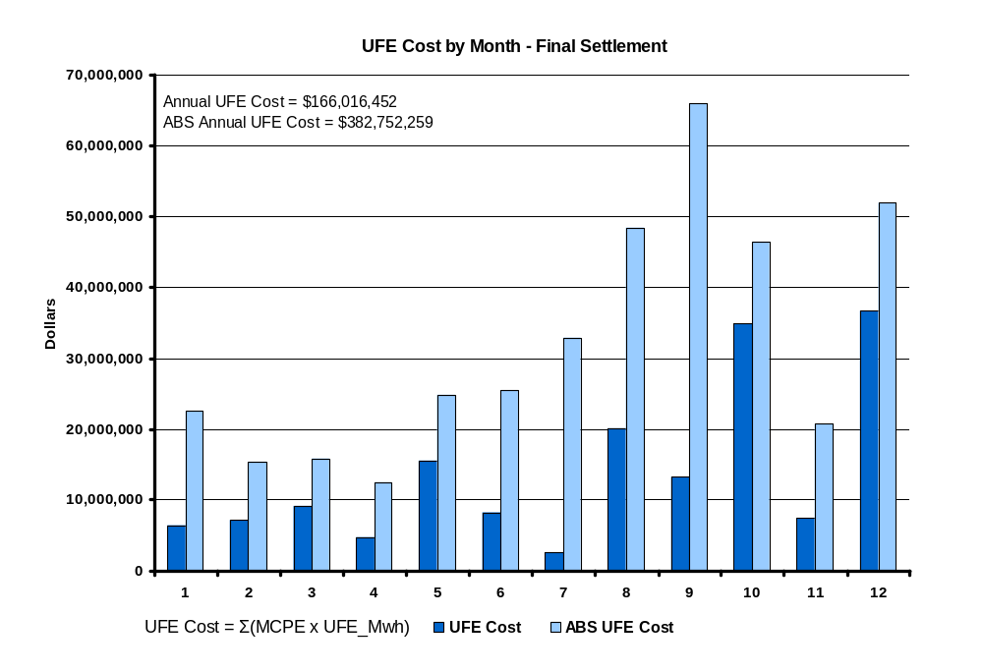
UFE Cost by Month in 2005
Final Settlement
SR07
Notes:
Annual total is 1,676,343 Mwh. Again, this is NET UFE.

Slide 13
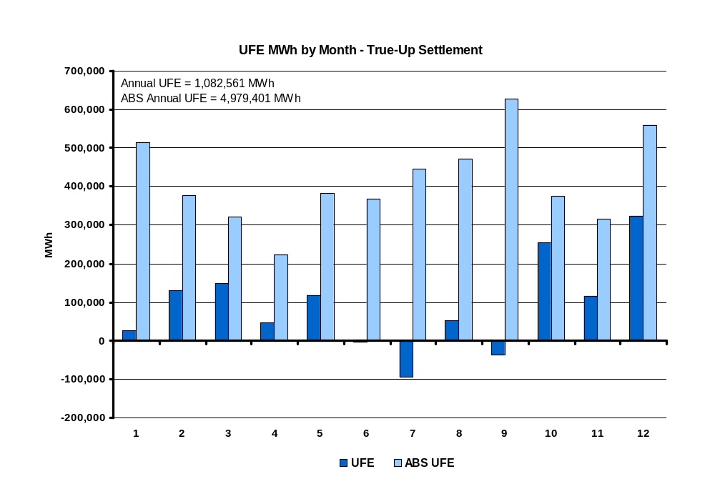
UFE MWh by Month in 2005
True-Up Settlement
SR08
Notes:
This is NET UFE. + and – are canceling out. May and Oct (shoulder months) are the highest while April (another shoulder month) is lowest. Winter months are generally higher than summer months.

Slide 14
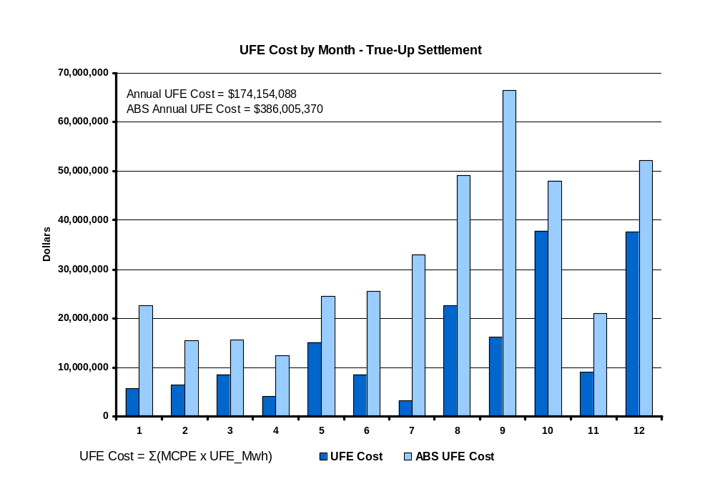
UFE Cost by Month in 2005
True-UP Settlement
SR09
Notes:
Annual total is 1,676,343 Mwh. Again, this is NET UFE.

Slide 15
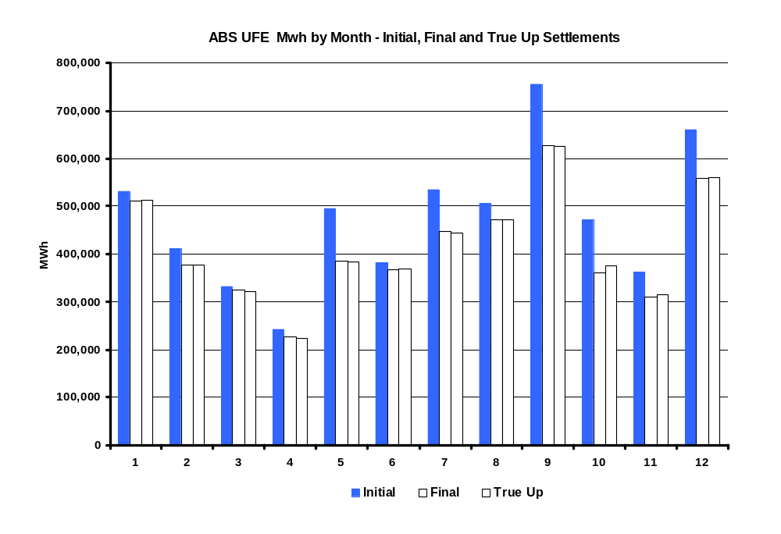
ABS UFE Mwh by Month in 2005
Initial, Final and True Up Settlements
SR09a
Notes:
Annual total is 1,676,343 Mwh. Again, this is NET UFE.

Slide 16
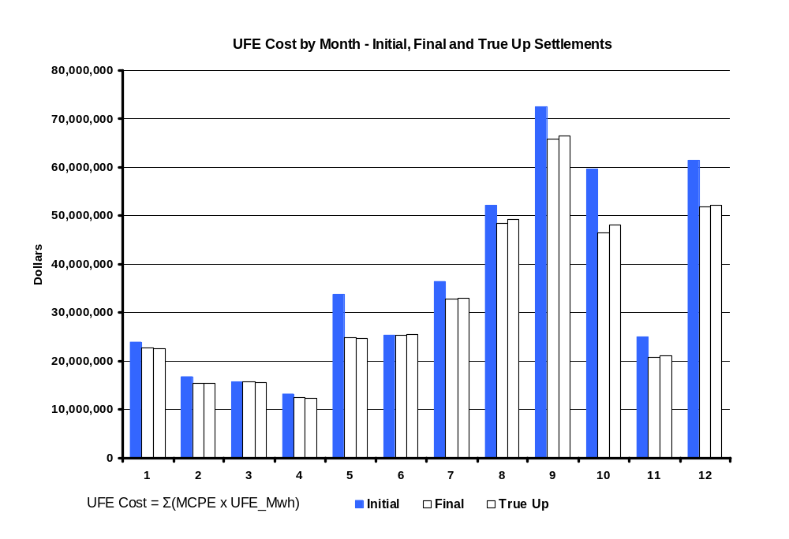
UFE Cost by Month in 2005
Initial, Final and True-UP Settlements
SR09b
Notes:
Annual total is 1,676,343 Mwh. Again, this is NET UFE.

Slide 17
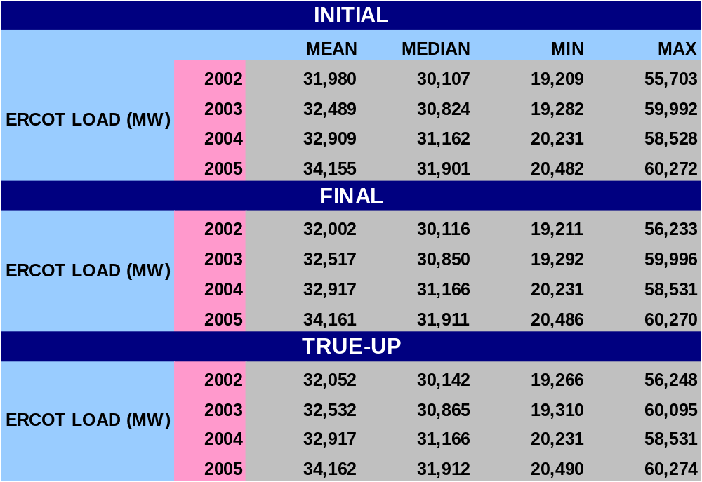
STATISTICAL SUMMARY - 2005
SR10

Slide 18
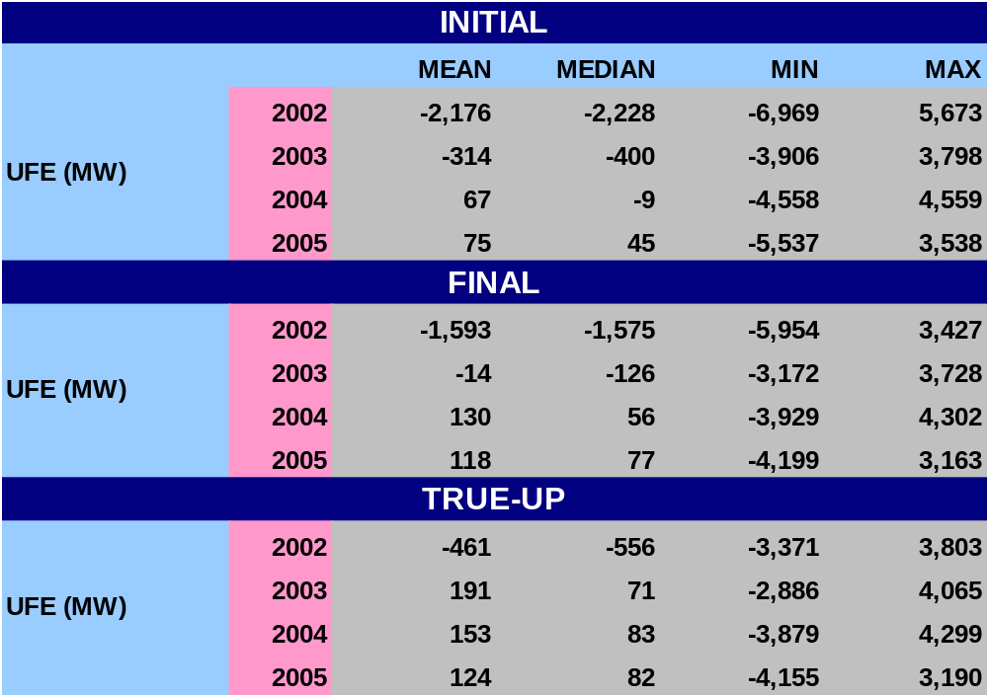
STATISTICAL SUMMARY - 2005
SR11a

Slide 19
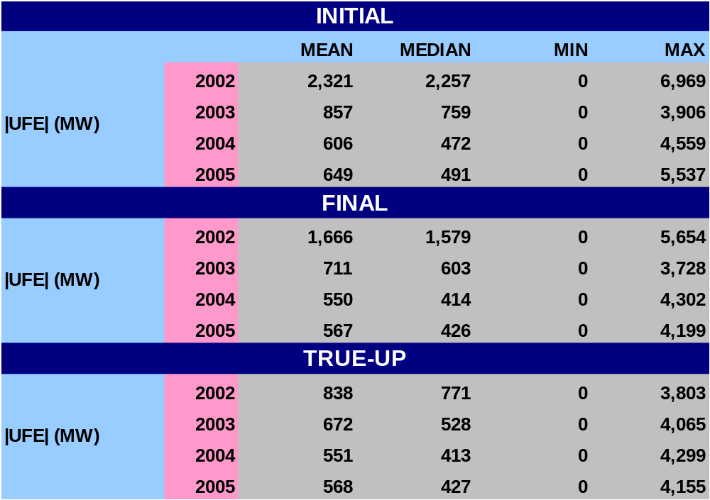
STATISTICAL SUMMARY - 2005
SR11b

Slide 20
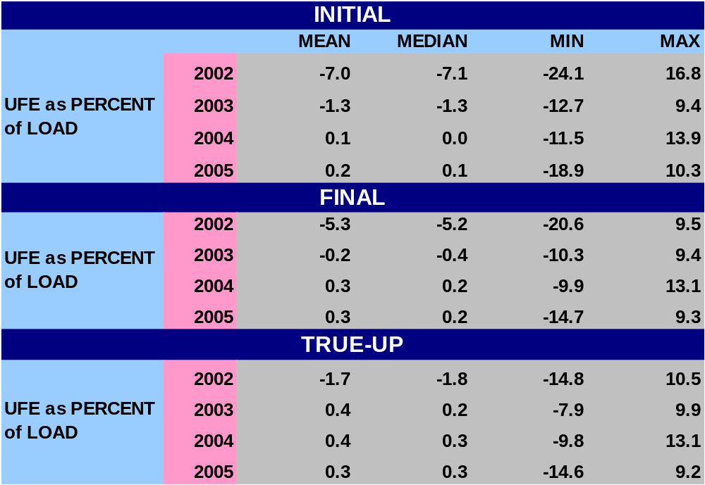
STATISTICAL SUMMARY - 2005
SR12a
Notes:
Last bullet – w/ regard to Mean and Median, UFE gets better with later settlements.

Slide 21
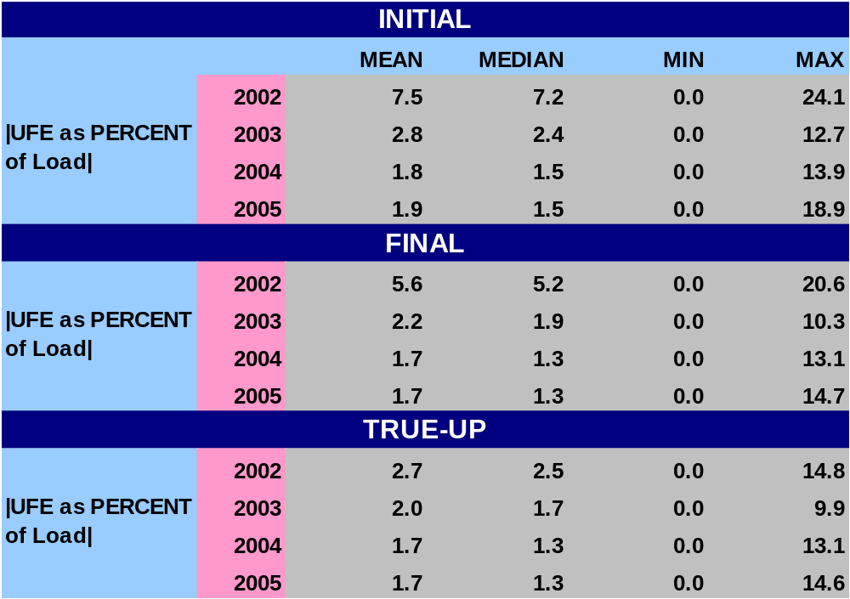
STATISTICAL SUMMARY - 2005
SR12b
Notes:
Last bullet – w/ regard to Mean and Median, UFE gets better with later settlements.

Slide 22
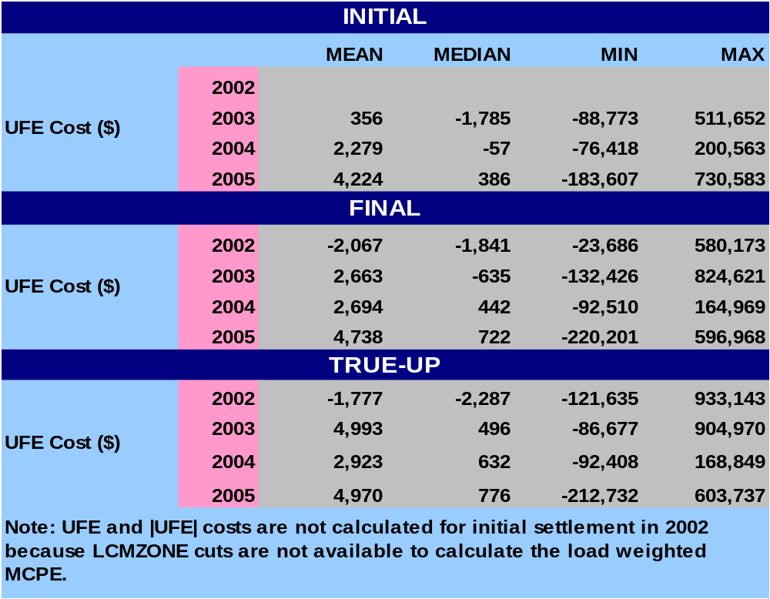
STATISTICAL SUMMARY - 2005
SR13a
Notes:
Last bullet – w/ regard to Mean and Median, UFE gets better with later settlements.

Slide 23
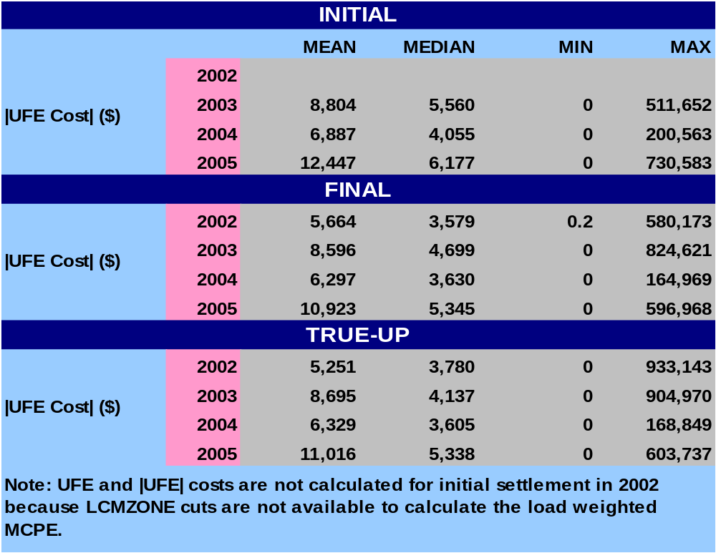
STATISTICAL SUMMARY - 2005
SR13b
Notes:
Last bullet – w/ regard to Mean and Median, UFE gets better with later settlements.

Slide 24
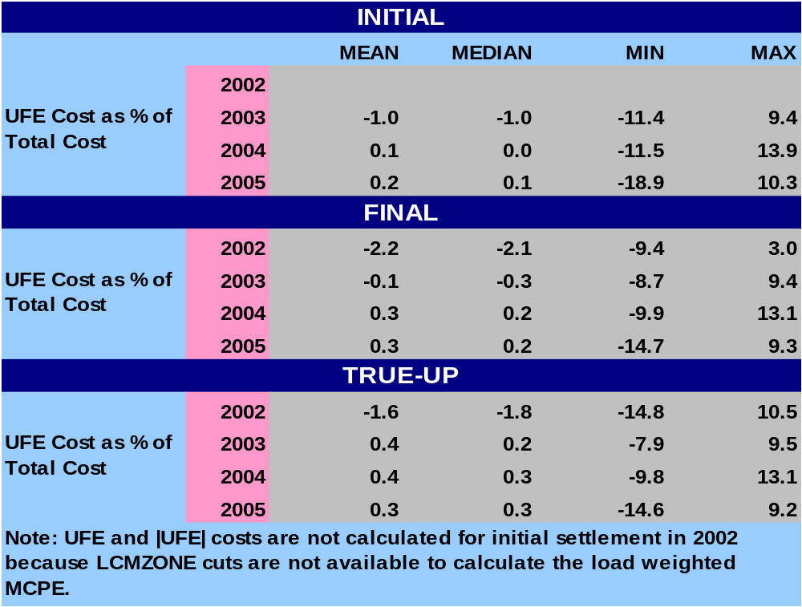
STATISTICAL SUMMARY - 2005
SR14a
Notes:
Last bullet – w/ regard to Mean and Median, UFE gets better with later settlements.

Slide 25
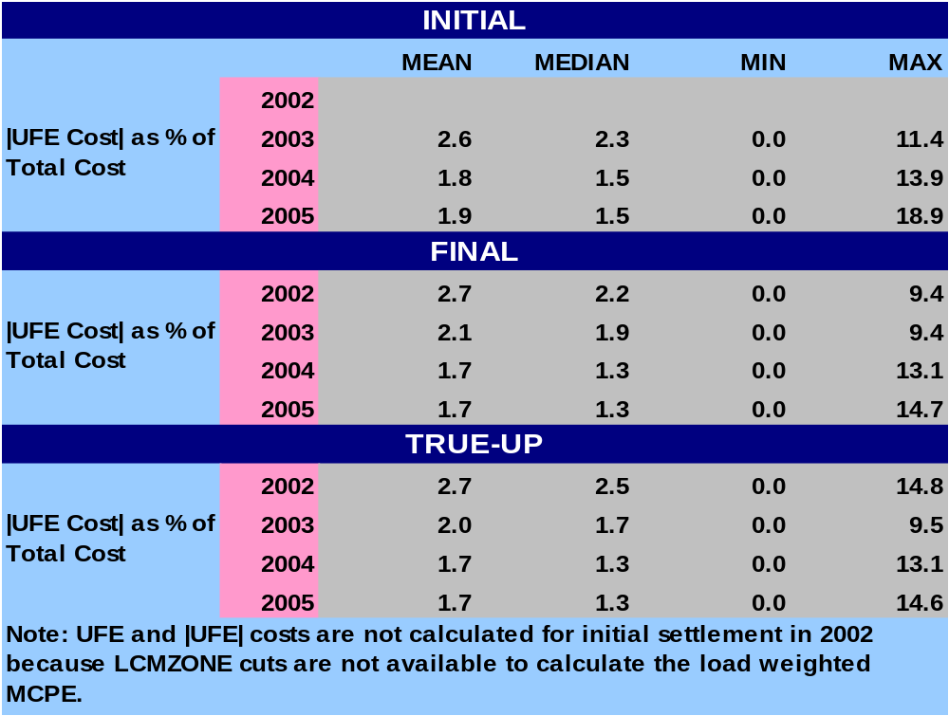
STATISTICAL SUMMARY - 2005
SR14b
Notes:
Last bullet – w/ regard to Mean and Median, UFE gets better with later settlements.

Slide 26
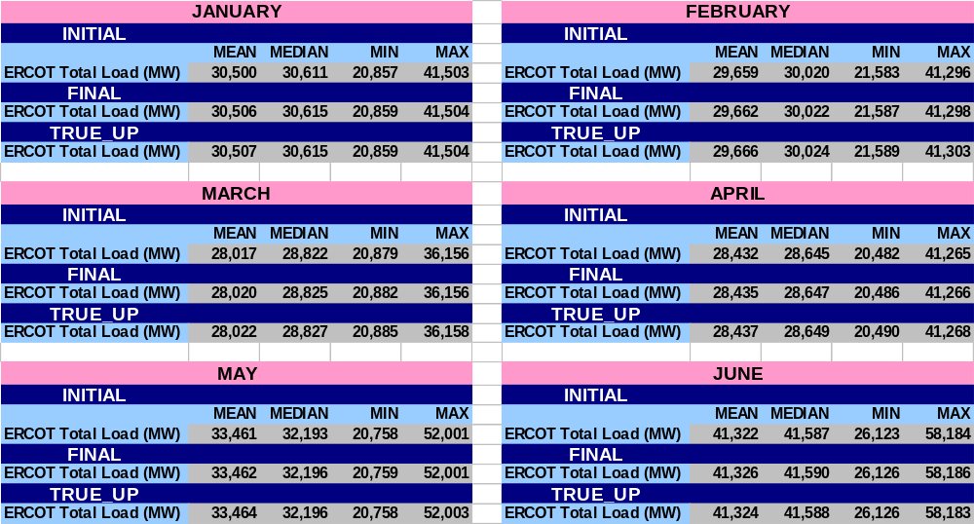
STATISTICAL SUMMARY – MONTHLY for 2005
SR15

Slide 27
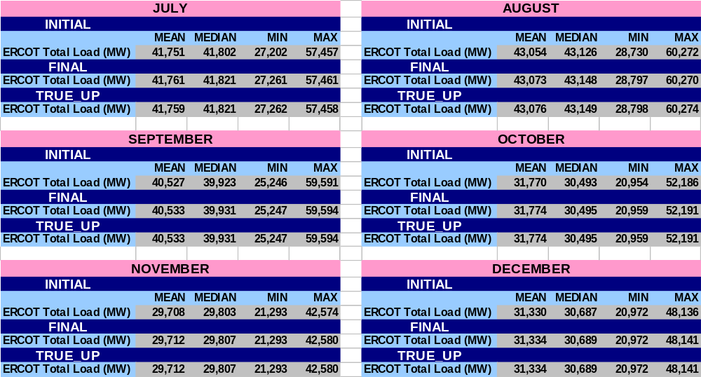
STATISTICAL SUMMARY – MONTHLY for 2005
SR16

Slide 28
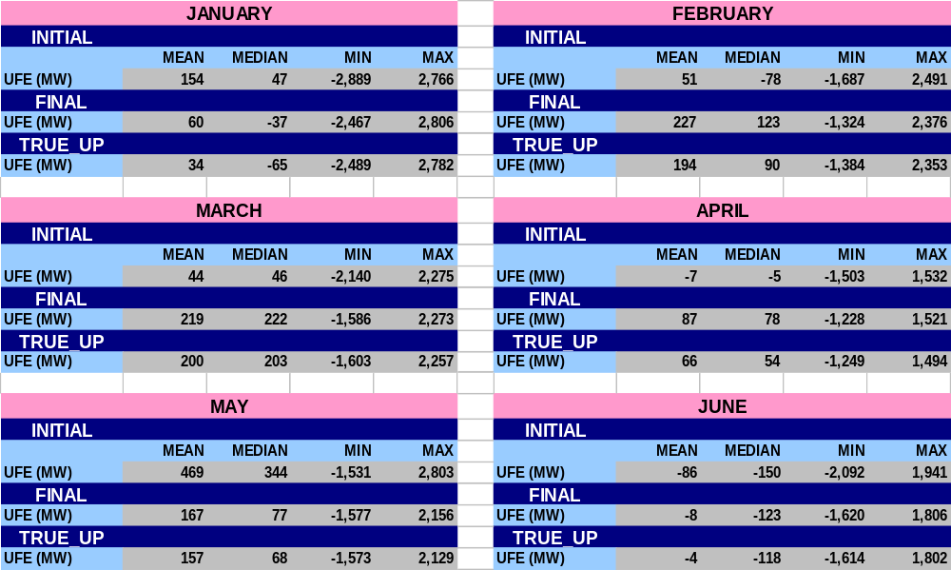
STATISTICAL SUMMARY – MONTHLY for 2005
SR17

Slide 29
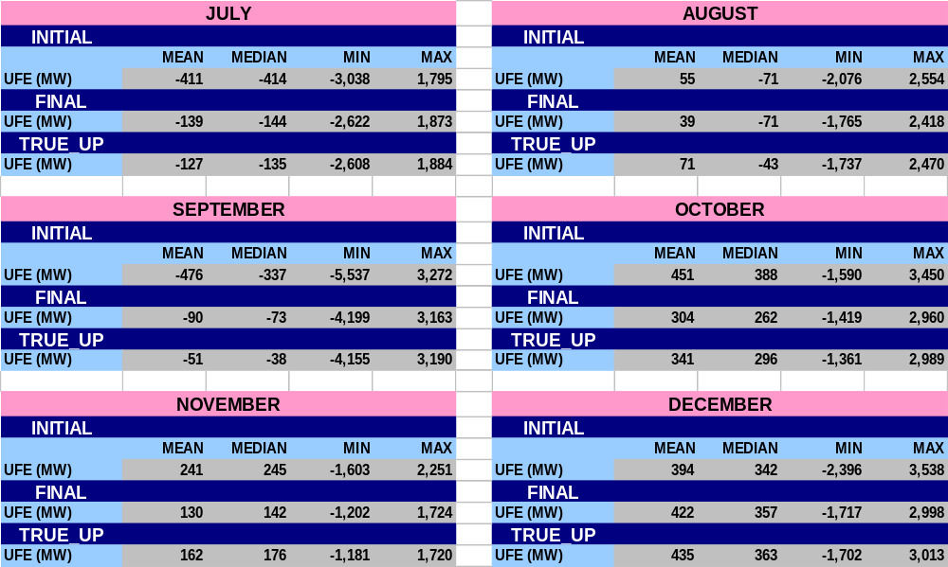
STATISTICAL SUMMARY – MONTHLY for 2005
SR18

Slide 30
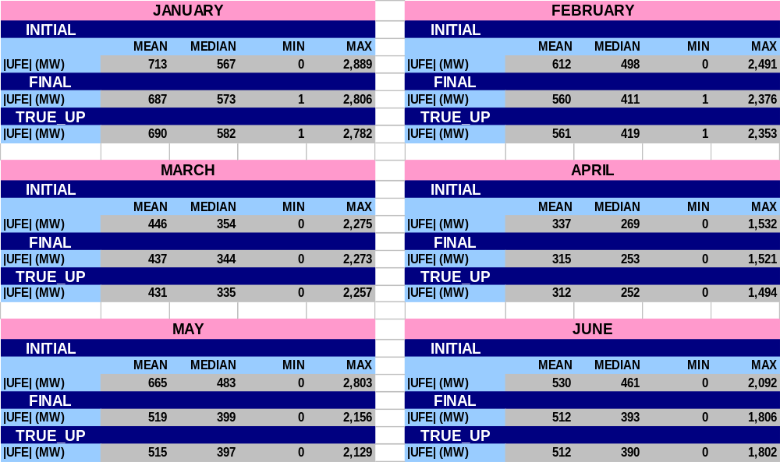
STATISTICAL SUMMARY – MONTHLY for 2005
SR19

Slide 31
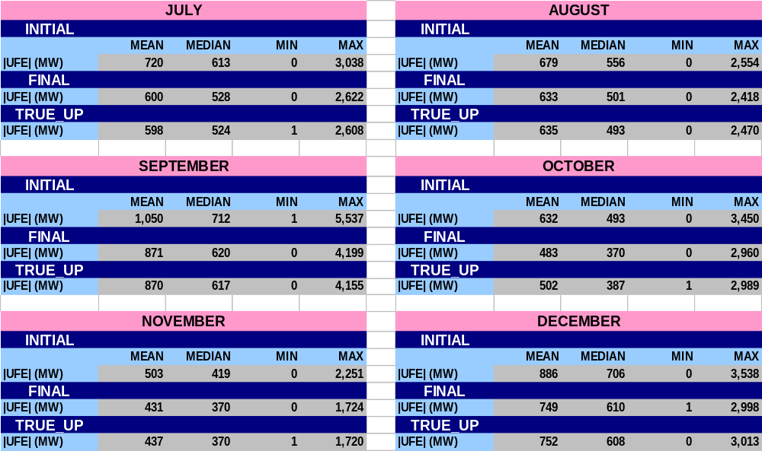
STATISTICAL SUMMARY – MONTHLY for 2005
SR20

Slide 32
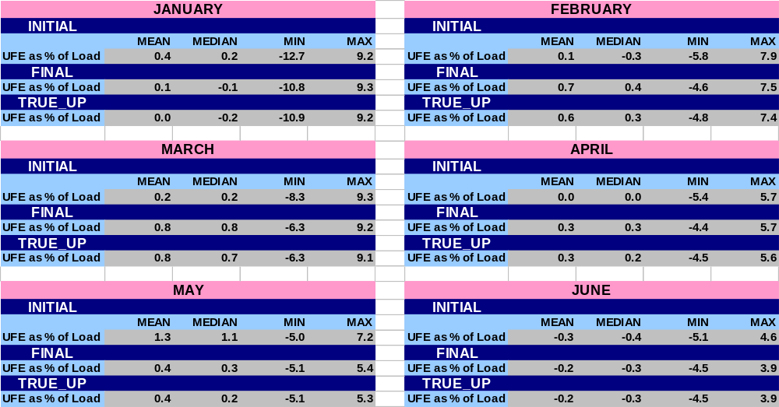
STATISTICAL SUMMARY – MONTHLY for 2005
SR21

Slide 33
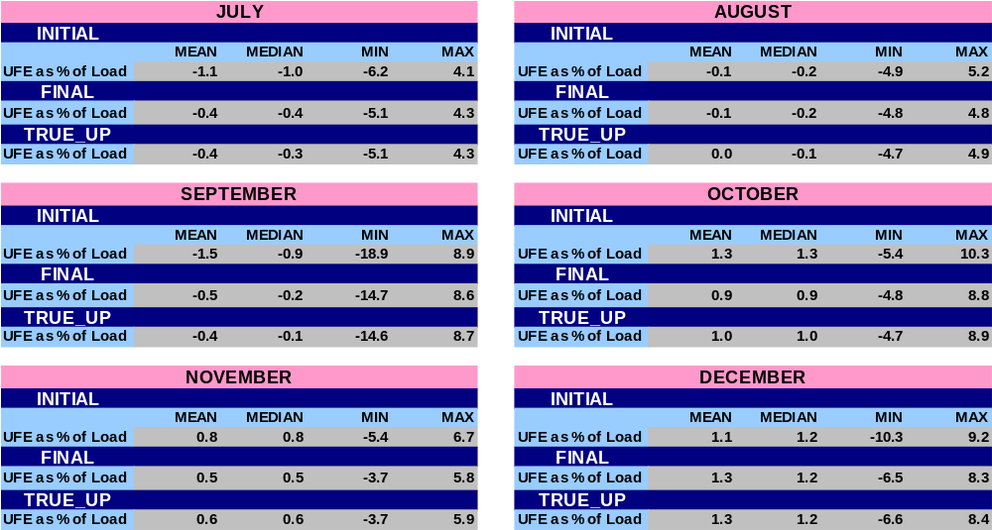
STATISTICAL SUMMARY – MONTHLY for 2005
SR22

Slide 34
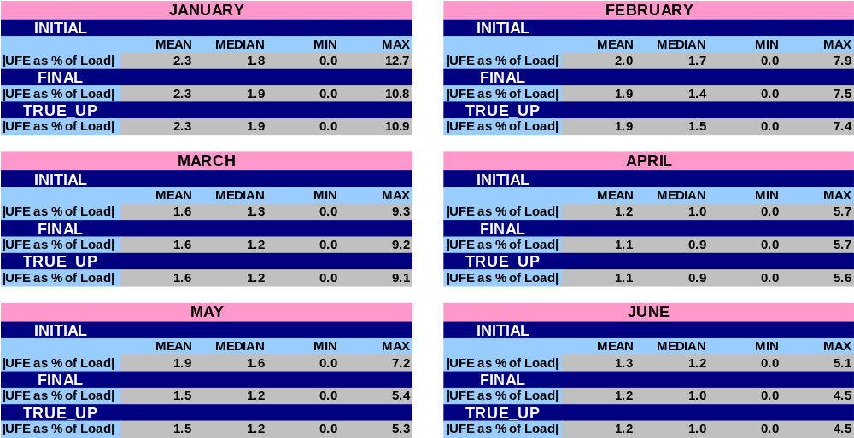
STATISTICAL SUMMARY – MONTHLY for 2005
SR23

Slide 35
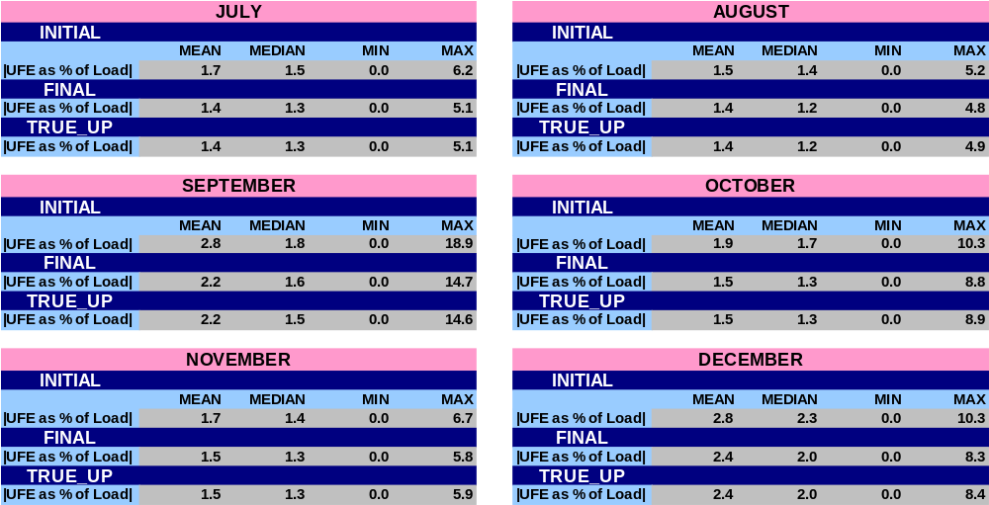
STATISTICAL SUMMARY – MONTHLY for 2005
SR24

Slide 36
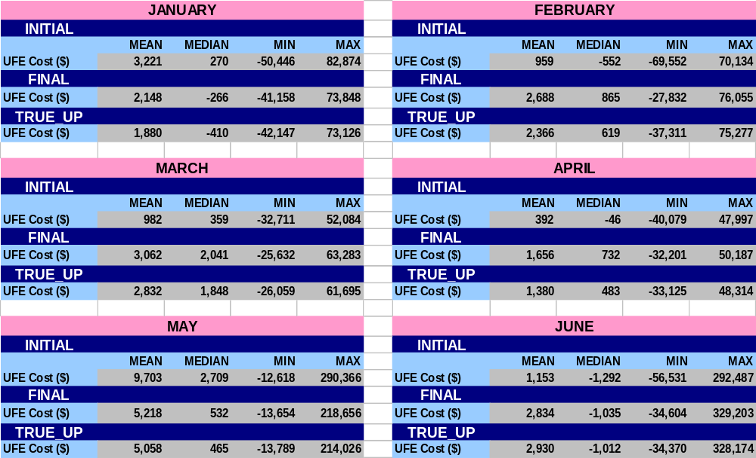
STATISTICAL SUMMARY – MONTHLY for 2005
SR25

Slide 37
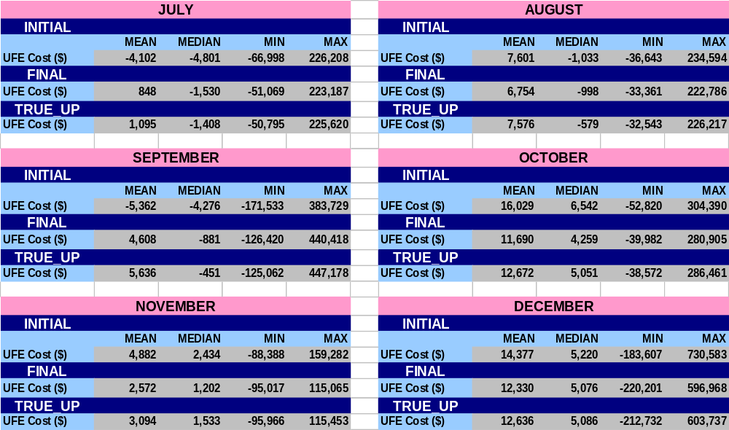
STATISTICAL SUMMARY – MONTHLY for 2005
SR26

Slide 38
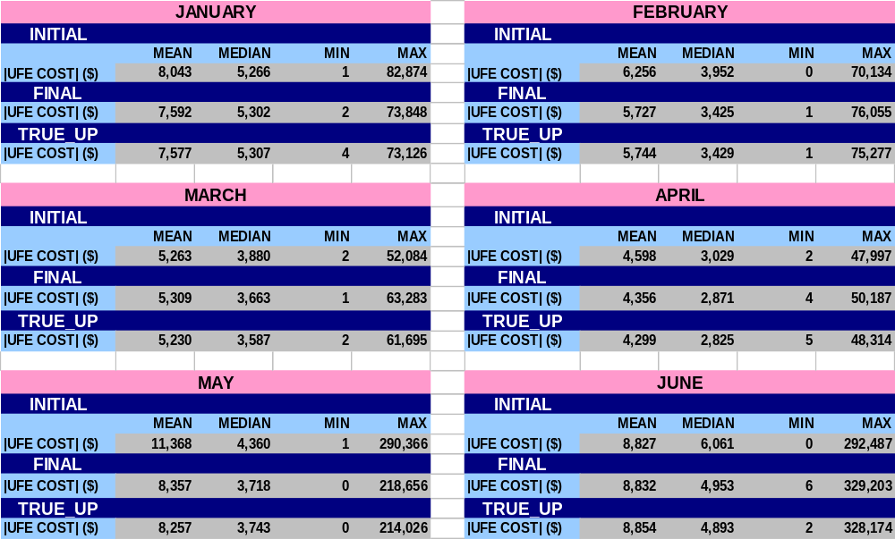
STATISTICAL SUMMARY – MONTHLY for 2005
SR27

Slide 39
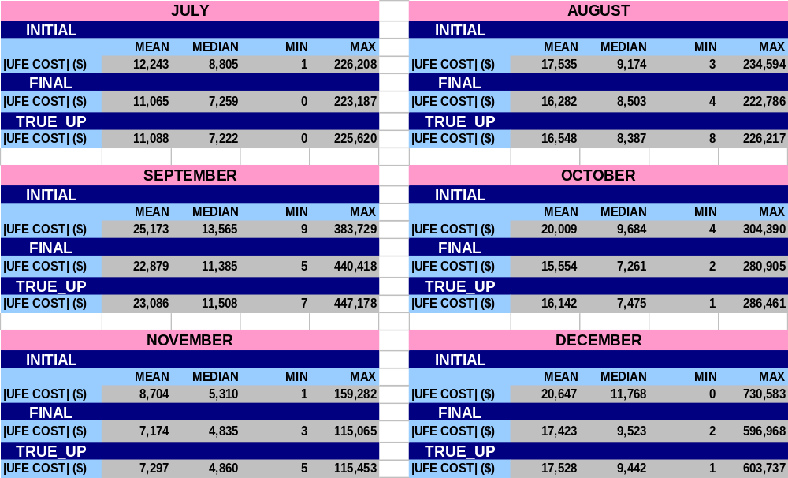
STATISTICAL SUMMARY – MONTHLY for 2005
SR28

Slide 40
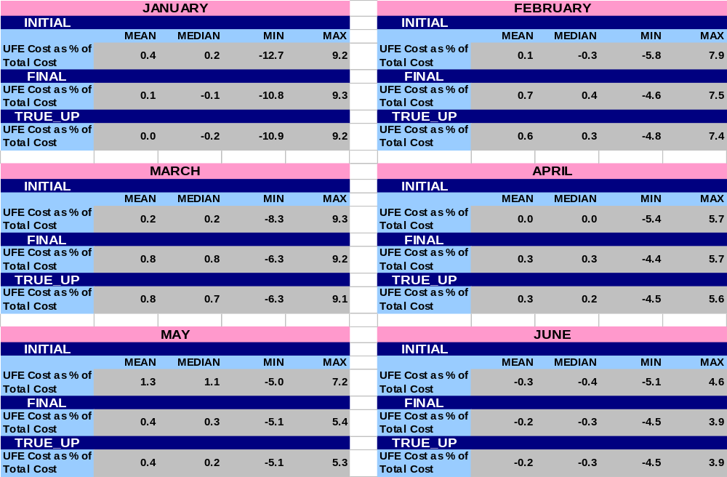
STATISTICAL SUMMARY – MONTHLY for 2005
SR29

Slide 41
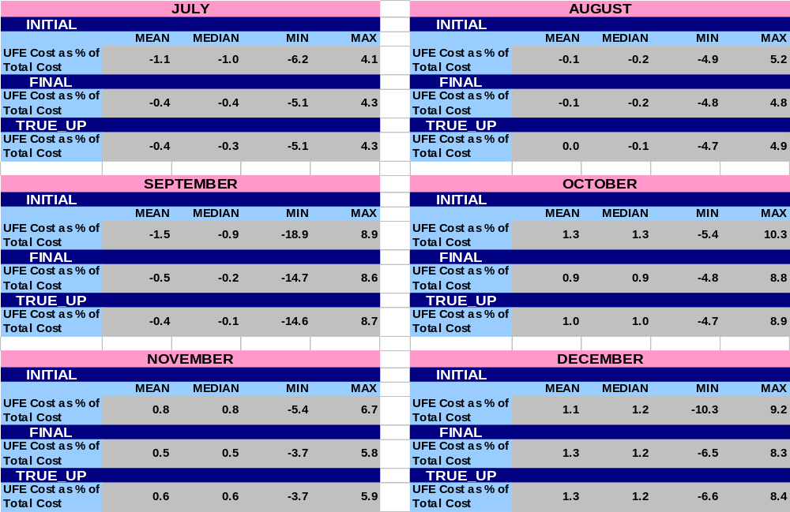
STATISTICAL SUMMARY – MONTHLY for 2005
SR30

Slide 42
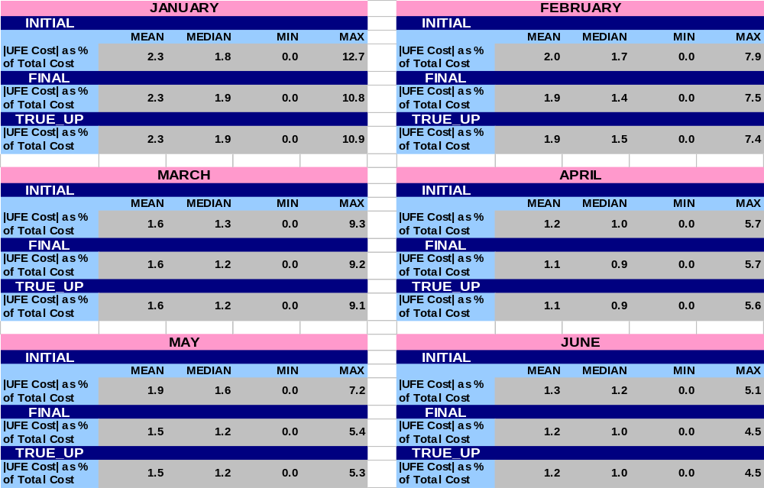
STATISTICAL SUMMARY – MONTHLY for 2005
SR31

Slide 43
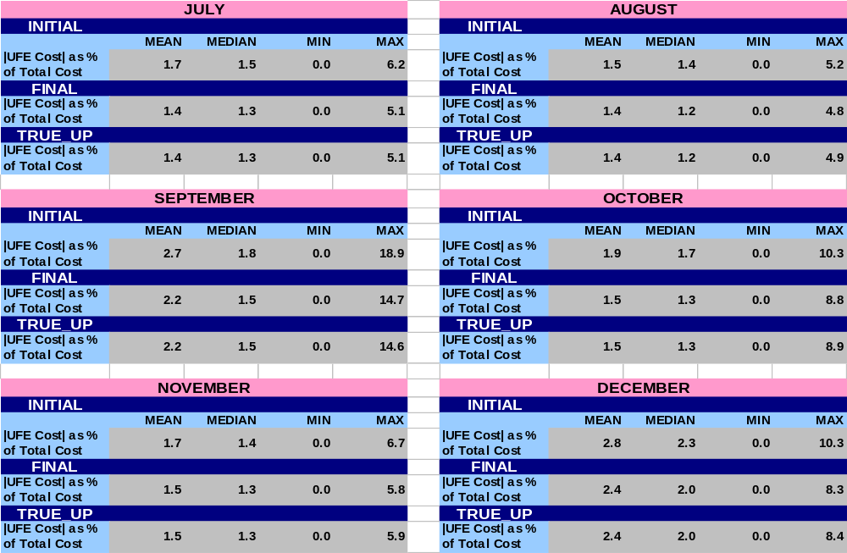
STATISTICAL SUMMARY – MONTHLY for 2005
SR32

Slide 44
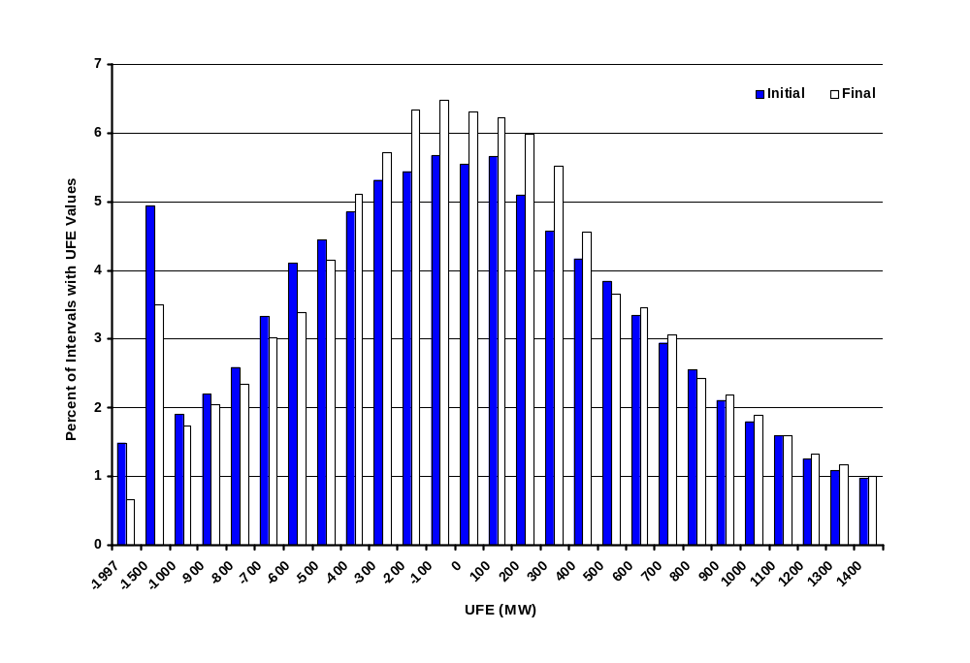
Percent Distribution of Total UFE (MW)
Initial to Final - 2005
UFD01
Notes:
UFE shifts in a positive direction from Initial to Final.

Slide 45
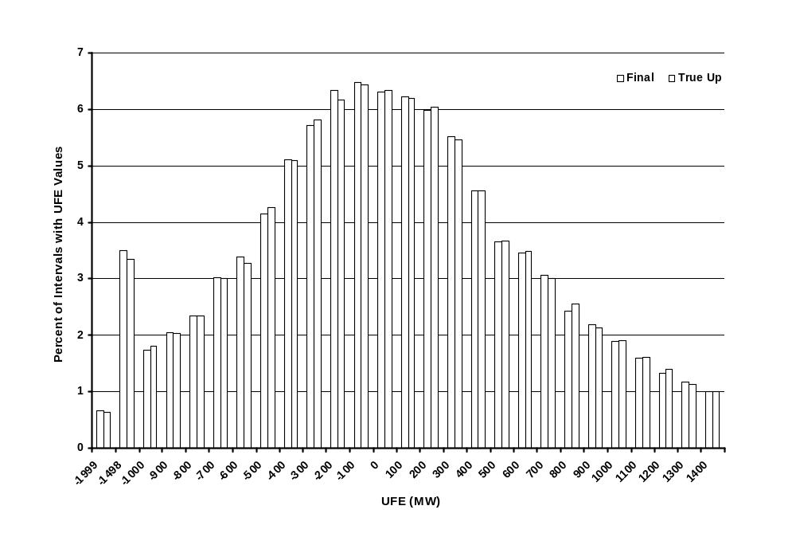
Percent Distribution of Total UFE (MW)
Final to True-Up - 2005
UFD02
Notes:
UFE shifts in a positive direction from Initial to Final.

Slide 46
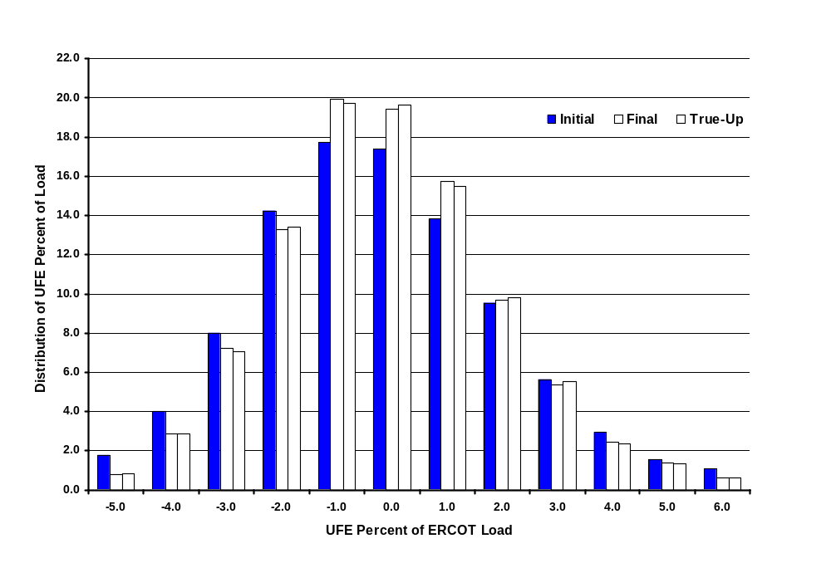
2005 Distribution of UFE Percent of ERCOT Load
UFD03
Notes:
The UFE percent moves in a positive direction from Initial to Final thru True-Up.

Slide 47
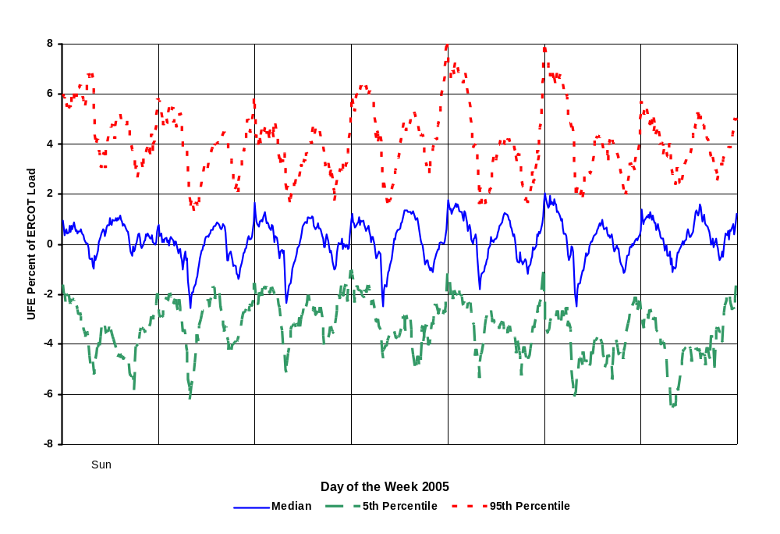
UFE Percent of ERCOT Load 2005
Initial Settlement
95% Confidence Interval
CIP01
Notes:
Indicative of systematic estimation problem. Full year – blend of seasons. Seasonal detail comes later.

Slide 48
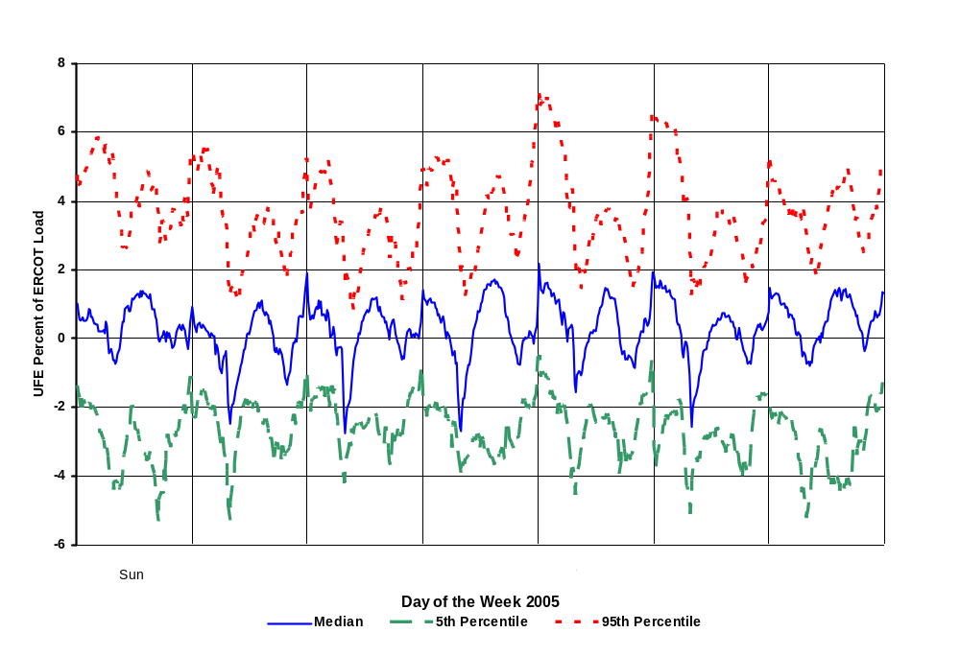
UFE Percent of ERCOT Load 2005
Final Settlement
95% Confidence Interval
CIP02

Slide 49
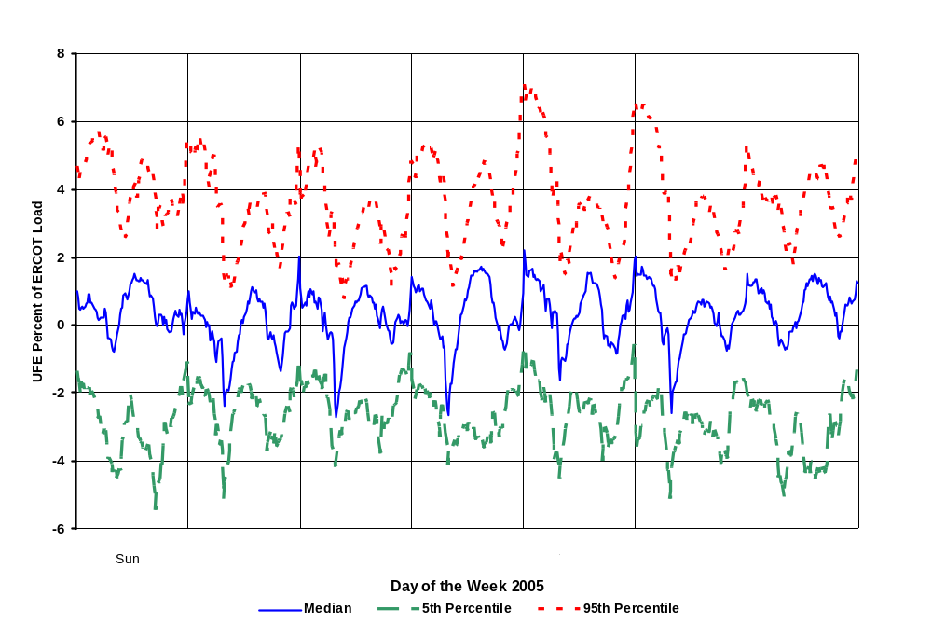
UFE Percent of ERCOT Load 2005
True-Up Settlement
95% Confidence Interval
CIP03

Slide 50
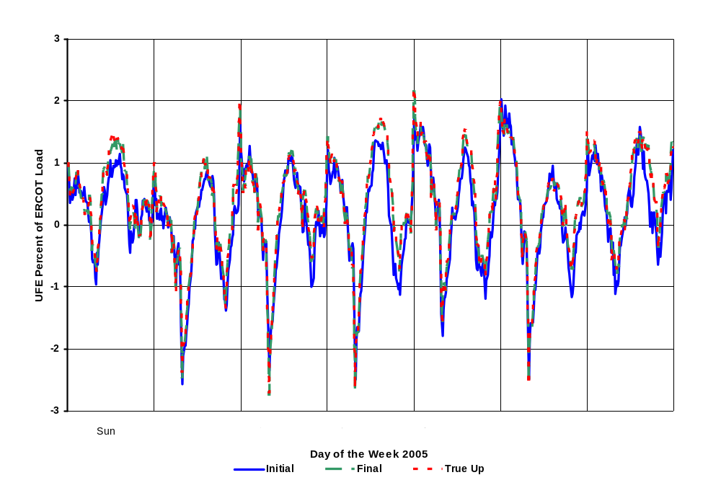
UFE Percent of ERCOT Load 2005
Comparison of Medians
With 95% Confidence Interval
CIP04

Slide 51
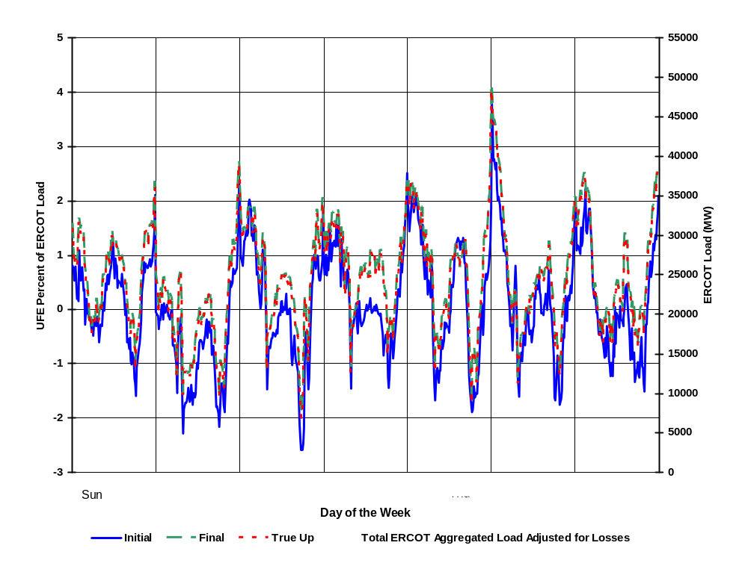
Seasonal Comparison - Spring 2005
UFE Percent of ERCOT Load and ERCOT Load
SEA01

Slide 52
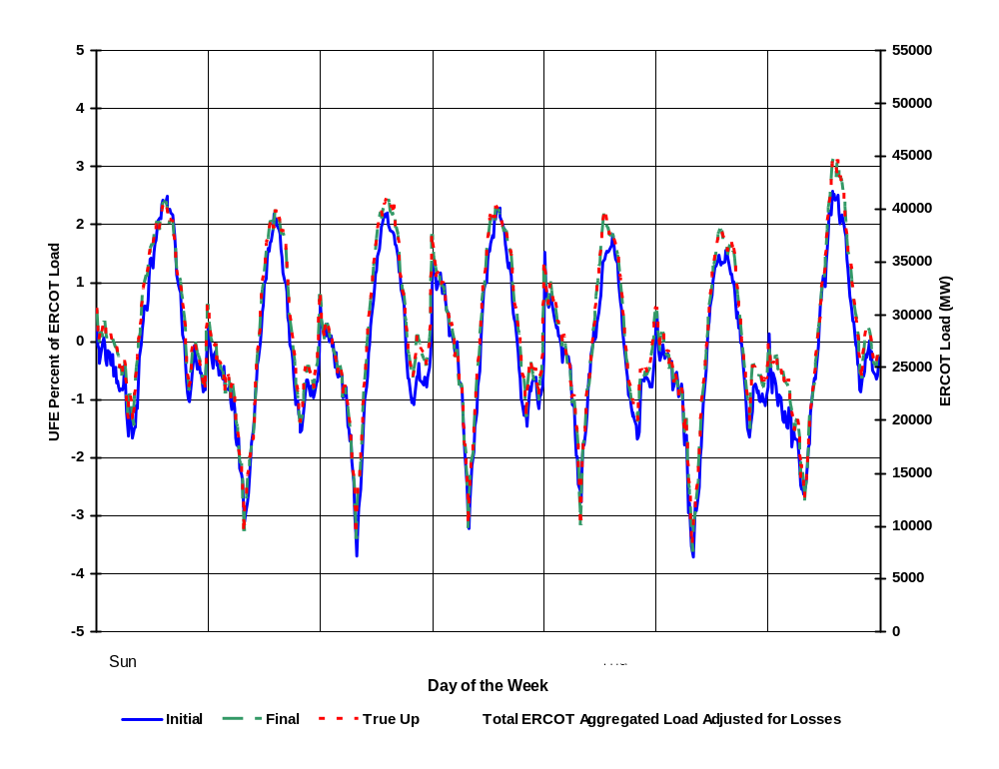
Seasonal Comparison - Summer 2005
UFE Percent of ERCOT Load and ERCOT Load
SEA02

Slide 53
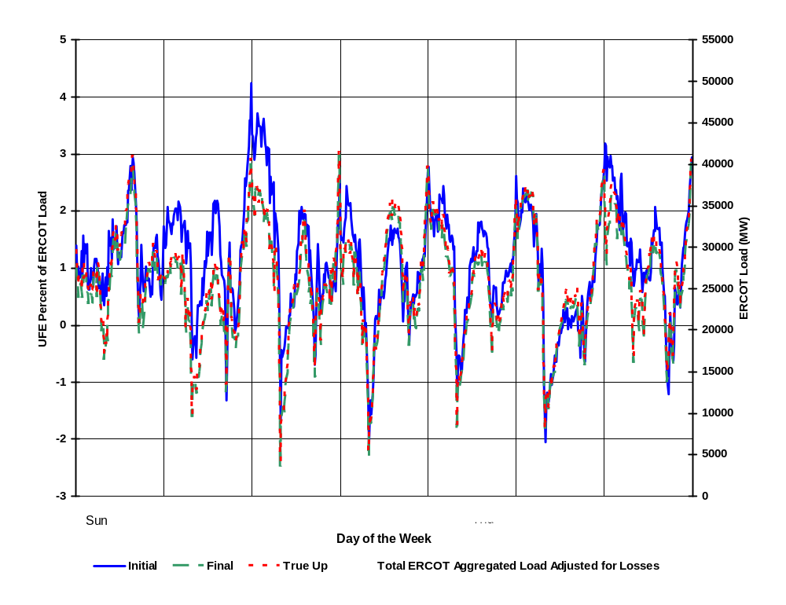
Seasonal Comparison - Fall 2005
UFE Percent of ERCOT Load and ERCOT Load
SEA03

Slide 54
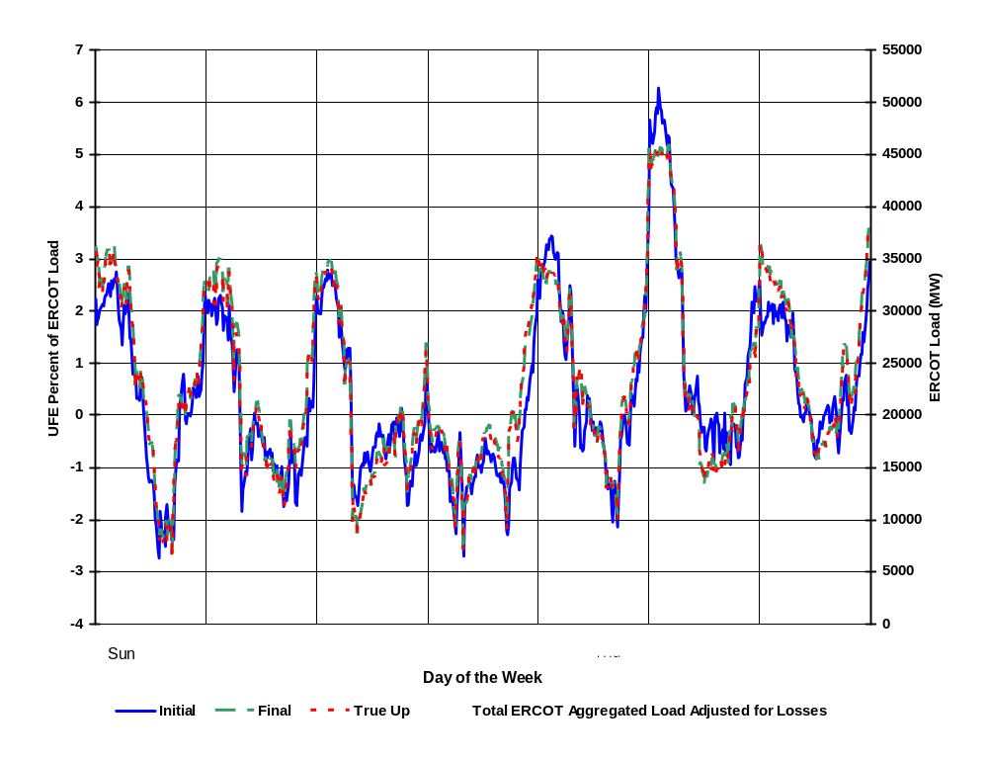
Seasonal Comparison - Winter 2005
UFE Percent of ERCOT Load and ERCOT Load
SEA04
Notes:
Looks like profiles are underestimating morning load, overestimating evening load.

Slide 55
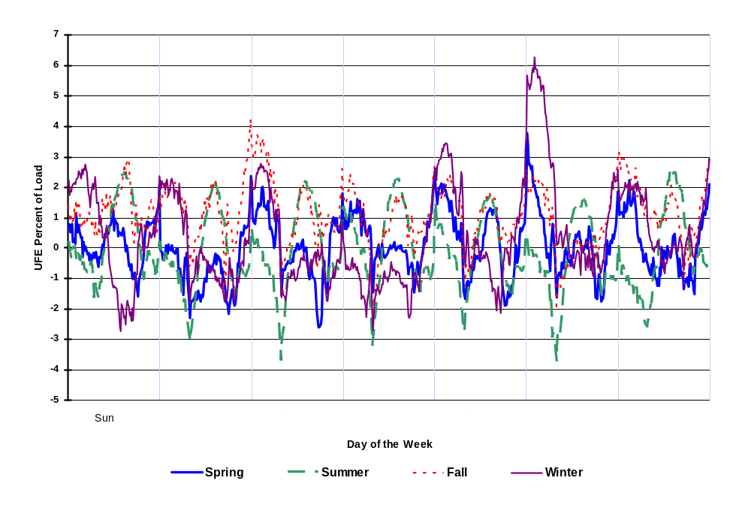
Seasonal Comparison of Medians – Initial Settlement
UFE Percent of ERCOT Load - 2005
SEA05
Notes:
Idea of seasonal differences by settlement.

Slide 56

Seasonal Comparison of Medians – Final Settlement
UFE Percent of ERCOT Load - 2005
SEA06

Slide 57

Seasonal Comparison of Medians – True Up
UFE Percent of ERCOT Load - 2005
SEA07

Slide 58

Percent UFE vs ERCOT Load
Initial Settlement - 2005
MPL01

Slide 59

Percent UFE vs ERCOT Load
Final Settlement - 2005
MPL02

Slide 60

Percent UFE vs ERCOT Load
True-Up Settlement – 2005
MPL03

Slide 61

Comparison of Median Percent UFE
Initial, Final and True-Up Settlements - 2005
MPL04
Notes:
True-up median ufe is worse than final ufe for ERCOT load > 34000 mw, similarly final is worse than initial for ERCOT load > 38000 mw

Slide 62

Load Weighted Average MCPE vs Load
Initial Settlement - 2005
MPL05
Notes:
Showing there is a significant relationship between UFE and load. If pure random errors, it would be bouncing around 0 – no upward trend. Gives indication of shift from overestimating to underestimating – around 40000 Mw. Shift moves to lower loads for subsequent settlements – point out on next 2 slides.

Slide 63

Load Weighted Average MCPE vs Load
Final Settlement - 2005
MPL06
Notes:
Showing there is a significant relationship between UFE and load. If pure random errors, it would be bouncing around 0 – no upward trend. Gives indication of shift from overestimating to underestimating – around 40000 Mw. Shift moves to lower loads for subsequent settlements – point out on next 2 slides.

Slide 64

Load Weighted Average MCPE vs Load
True Up Settlement - 2005
MPL07
Notes:
Showing there is a significant relationship between UFE and load. If pure random errors, it would be bouncing around 0 – no upward trend. Gives indication of shift from overestimating to underestimating – around 40000 Mw. Shift moves to lower loads for subsequent settlements – point out on next 2 slides.

Slide 65

Comparison of Median Load Weighted Average MCPE vs Load for Initial, Final and True-Up Settlements - 2005
MPL08

Slide 66

Load Weighted Average MCPE vs Percent UFE
Initial Settlement - 2005
MPL09

Slide 67

Load Weighted Average MCPE vs Percent UFE
Final Settlement - 2005
MPL10

Slide 68

Load Weighted Average MCPE vs Percent UFE
True-Up Settlement - 2005
MPL11

Slide 69

Comparison of Median Load Weighted Average MCPE vs Percent UFE for
Initial, Final and True-Up Settlements - 2005
MPL12

Slide 70

Sum of Dollars from Positive UFE across the Week 2005
UCT02

Slide 71

Sum of Dollars from Negative UFE across the Week 2005
UCT03

Slide 72

Sum of Dollars from Absolute Value of UFE across the Week 2005
UCT04

Slide 73

Sum of Dollars from Net UFE across the Week 2005
UCT05

Slide 74




SUM of UFE Dollars
Compare All Seasons in 2005
Positive and Negative UFE
UCT06

Slide 75

SUM of UFE Dollars – Spring 2005
Positive and Negative UFE
UCT07

Slide 76
SUM of UFE Dollars – Summer 2005
Positive and Negative UFE
UCT08

Slide 77

SUM of UFE Dollars – Fall 2005
Positive and Negative UFE
UCT09

Slide 78

SUM of UFE Dollars – Winter 2005
Positive and Negative UFE
UCT10

Slide 79




SUM of UFE Dollars
Compare All Seasons in 2005
Absolute Value and Net UFE
UCT11

Slide 80

SUM of UFE Dollars – Spring 2005
Absolute Value and Net UFE
UCT12

Slide 81

SUM of UFE Dollars – Summer 2005
Absolute Value and Net UFE
UCT13

Slide 82

SUM of UFE Dollars – Fall 2005
Absolute Value and Net UFE
UCT14

Slide 83

SUM of UFE Dollars – Winter 2005
Absolute Value and Net UFE
UCT15

Slide 84



Mean of UFE Dollars
Compare All Seasons in 2005
Positive and Negative UFE
65,000
Spring: March 1 - April 30
Mean (+UFE)
Mean (-UFE)
60,000
55,000
50,000
45,000
40,000
35,000
30,000
Dollars
25,000
20,000
15,000
10,000
5,000
0
-5,000
-10,000
-15,000
-20,000
-25,000
Sun
Mon
Tue
Wed
Thu
Fri
Sat
Day of the Week
UCT16

Slide 85

Mean of UFE Dollars – Spring 2005
Positive and Negative UFE
UCT17

Slide 86

Mean of UFE Dollars – Summer 2005
Positive and Negative UFE
UCT18

Slide 87

Mean of UFE Dollars – Fall 2005
Positive and Negative UFE
UCT19

Slide 88

Mean of UFE Dollars – Winter 2005
Positive and Negative UFE
UCT20

Slide 89




Mean of UFE Dollars
Compare All Seasons in 2005
Absolute Value and Net UFE
UCT21

Slide 90

Mean of UFE Dollars – Spring 2005
Absolute Value and Net UFE
UCT22

Slide 91

Mean of UFE Dollars – Summer 2005
Absolute Value and Net UFE
UCT23

Slide 92

Mean of UFE Dollars – Fall 2005
Absolute Value and Net UFE
UCT24

Slide 93

Mean of UFE Dollars – Winter 2005
Absolute Value and Net UFE
UCT25

Slide 94
Events that Influenced UFE in 2005
Annual validation 2004 was suspended for residential premises.
PRR’s implemented:
  PRR488 Weather Responsiveness Determination
  PRR514 Twelve Month Window for Non-IDR Scaling
  PRR536 lower IDR Mandatory Installation Threshold to 700 MW (or KVA)
  PRR544 12-Month Window for Scaling NIDR to IDR ESI IDs .

Slide 95
Next Steps
Improve Business Profile ID assignment process
Improve models using Round 2 load research data
Increase the number of IDR’s
Leverage AMI capability by increased use of TOU metering and more frequent meter reads
Evaluate Lagged Dynamic sampling techniques and their application to the ERCOT System
Continue to evaluate improvements to algorithms for missing IDR and NIDR data estimation
Continue to make improvements to loss estimations – updated TDSP loss studies.

