Slide 1

UFE 2006 ANALYSIS
Compiled by Load Profiling
ERCOT Energy Analysis & Aggregation

Slide 2
UFE Basics
UFE (unaccounted for energy) is computed as follows:
UFE = Generation – (Load + Losses)
Sources of UFE include:
■ Generation Measurement Errors
■ Load - Missing/Erroneous Usage Data
- Model Error
- Load Profile ID Assignment Error
■ Losses - Model Error
- Loss Code Assignment Error
Negative UFE indicates load/losses are overestimated

Slide 3
UFE Basics
UFE
Net Generation for Settlement Interval
GAP - - - - - - >
Losses:
Transmission & Distribution
Profiled Energy Usage
Non-Interval Data
Non-Metered Accounts
Net Generation
Compared to
Load Buildup
Interval Data
Energy Usage

Slide 4

DATA VERIFICATION IN THE SETTLEMENT PROCESS
UFE is computed for each 15-minute interval of a settlement run.
Initial Settlement
(posted on day 10 after the operating day)
Final Settlement
(posted on day 60 after the operating day)
True-up Settlement (posted 6 months after operating day)
Resettlement statement (posted as needed)
Final
Settlement
Initial
True-Up

Slide 5
Load Weighted Calculation of MCPE
Market Clearing Price for Energy (MCPE) is the highest price by Congestion Zone for a Settlement Interval for Balancing Energy deployed during the Settlement Interval.
In 2006 there were 5 congestion zones – E06, H06, N06, S06 and W06.
The load weighted MCPE is calculated for each 15 min. interval using the LCMZone cuts as follows:
  MCPE_LWTD = ((LCMZone_E06_Mwh * MCPEL_E06) + (LCMZone_H06_Mwh * MCPEL_H06) +
  (LCMZone_N06_Mwh * MCPEL_N06) + (LCMZone_S06_Mwh * MCPEL_S06) +
  (LCMZone_W06_Mwh * MCPEL_W06)) / (LCMZone_E06_Mwh + LCMZone_H06_Mwh +
  LCMZone_N06_Mwh + LCMZone_S06_Mwh + LCMZone_W06_Mwh)

Slide 6
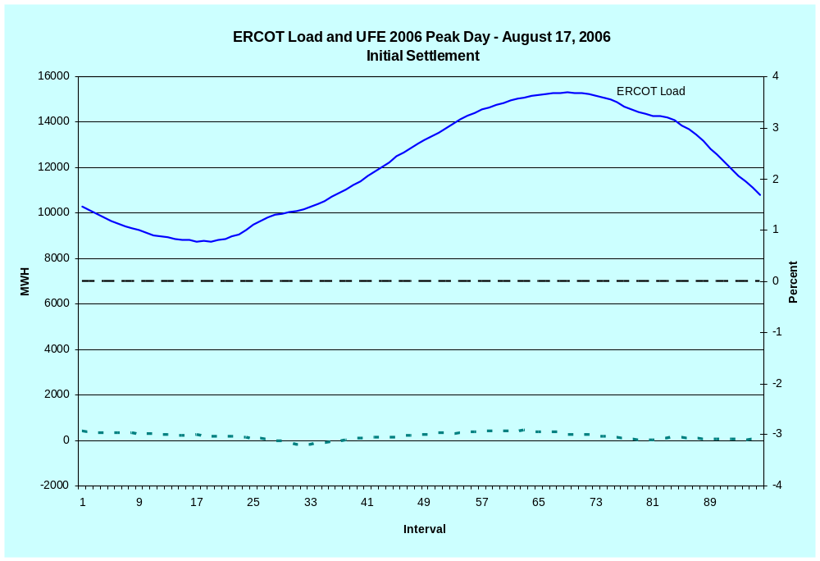
LOAD AND UFE – ERCOT PEAK 2006
Initial Settlement
SR01

Slide 7
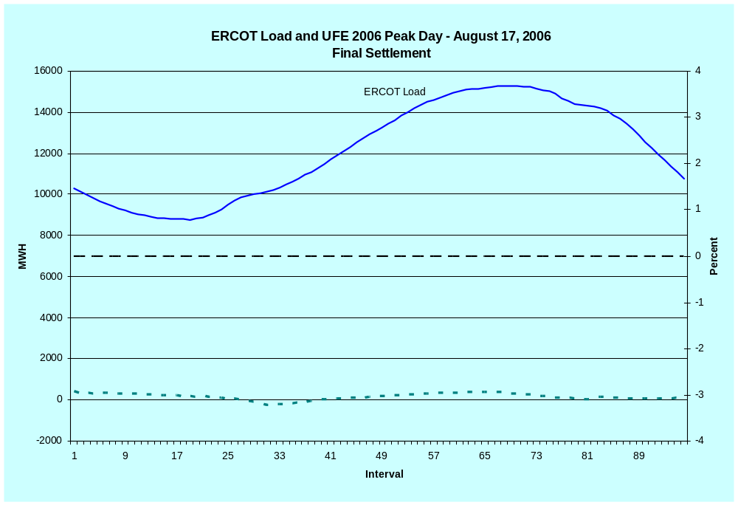
LOAD AND UFE – ERCOT PEAK 2006
Final Settlement
SR02

Slide 8
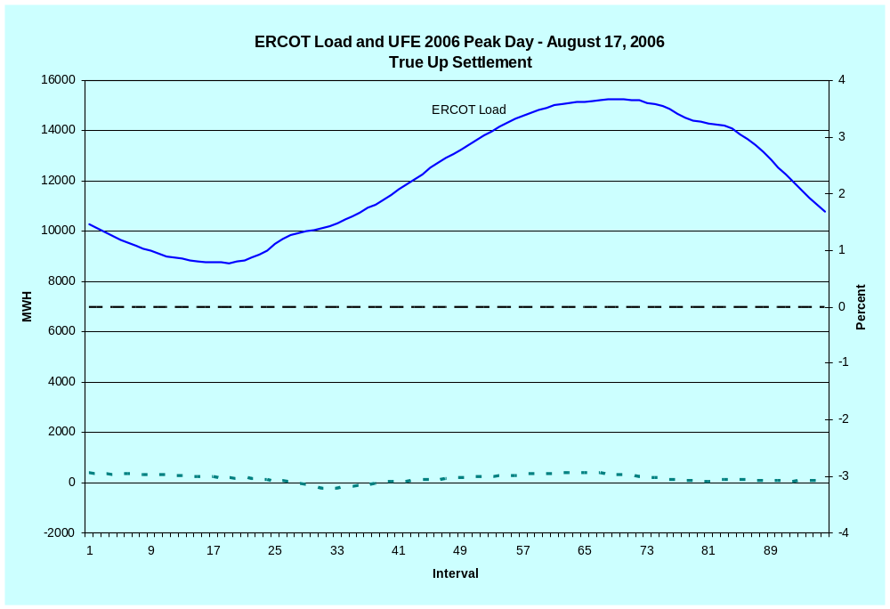
LOAD AND UFE – ERCOT PEAK 2006
True Up Settlement
SR03

Slide 9
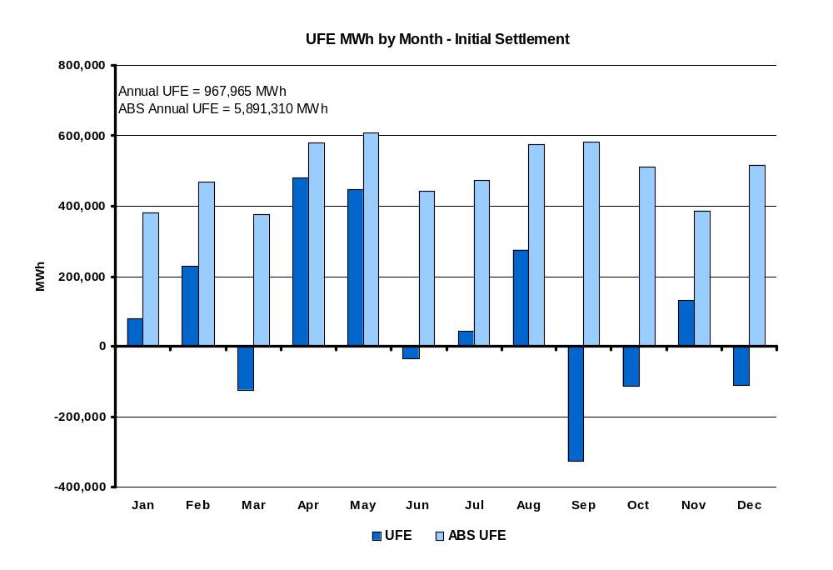
UFE MWh by Month in 2006
Initial Settlement
SR04
Notes:
This is NET UFE. + and – are canceling out. May and Oct (shoulder months) are the highest while April (another shoulder month) is lowest. Winter months are generally higher than summer months.

Slide 10
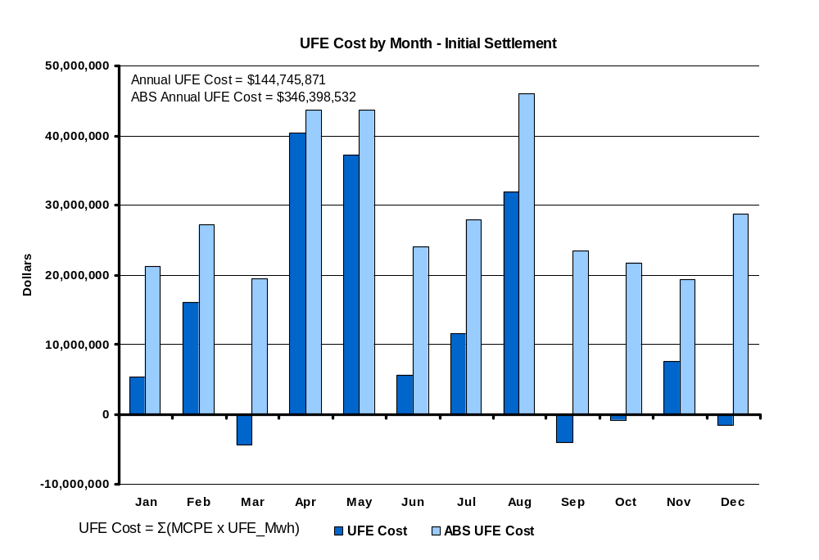
UFE Cost by Month in 2006
Initial Settlement
SR05

Slide 11
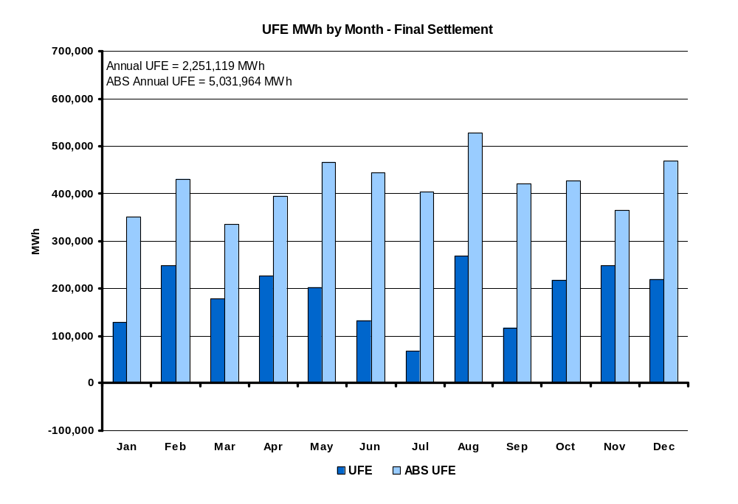
UFE MWh by Month in 2006
Final Settlement
SR06
Notes:
This is NET UFE. + and – are canceling out. May and Oct (shoulder months) are the highest while April (another shoulder month) is lowest. Winter months are generally higher than summer months.

Slide 12
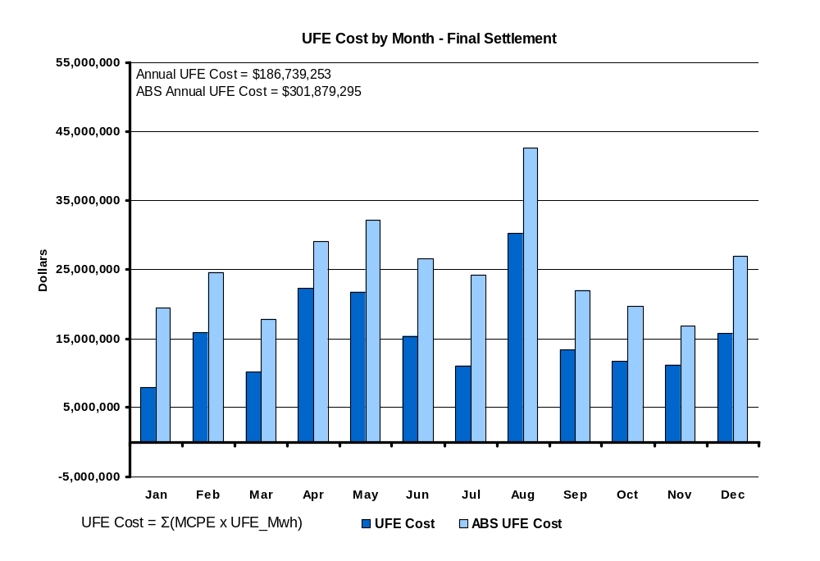
UFE Cost by Month in 2006
Final Settlement
SR07
Notes:
Annual total is 1,676,343 Mwh. Again, this is NET UFE.

Slide 13
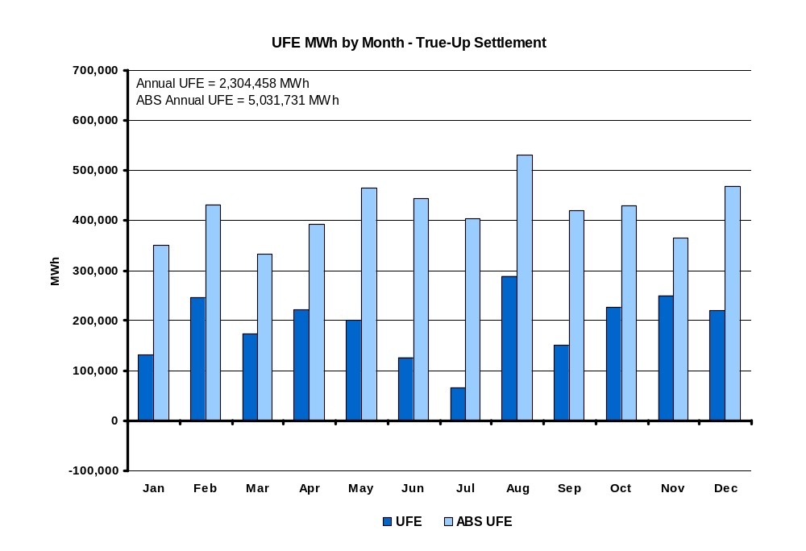
UFE MWh by Month in 2006
True-Up Settlement
SR08
Notes:
This is NET UFE. + and – are canceling out. May and Oct (shoulder months) are the highest while April (another shoulder month) is lowest. Winter months are generally higher than summer months.

Slide 14
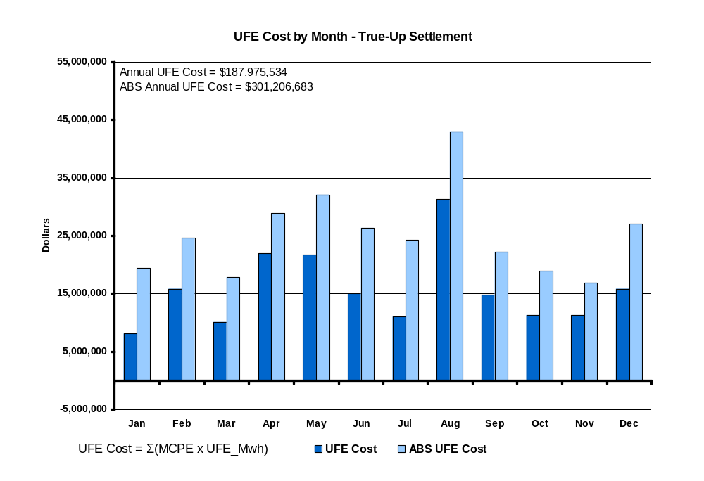
UFE Cost by Month in 2006
True-UP Settlement
SR09
Notes:
Annual total is 1,676,343 Mwh. Again, this is NET UFE.

Slide 15
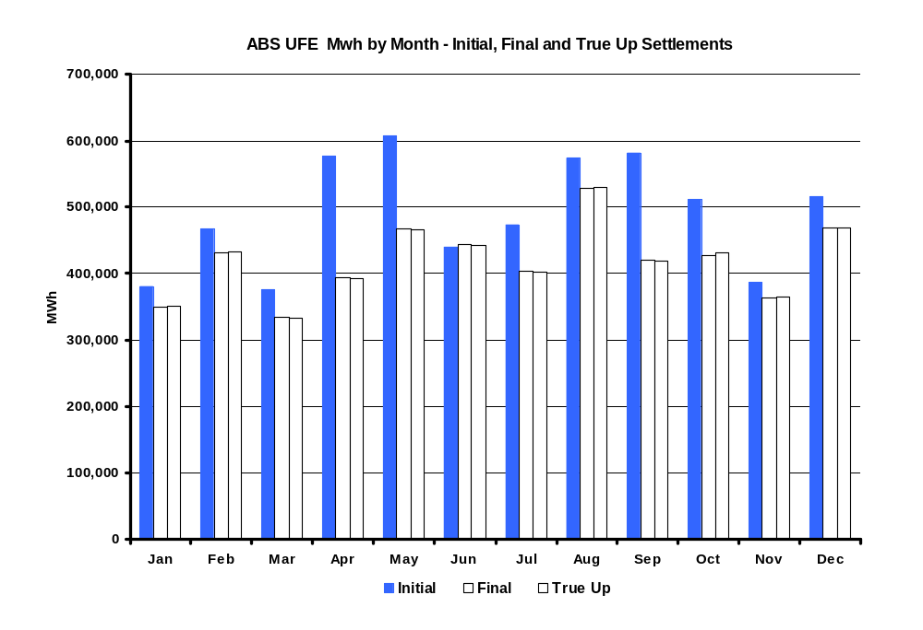
ABS UFE Mwh by Month in 2006
Initial, Final and True Up Settlements
SR09a
Notes:
Annual total is 1,676,343 Mwh. Again, this is NET UFE.

Slide 16
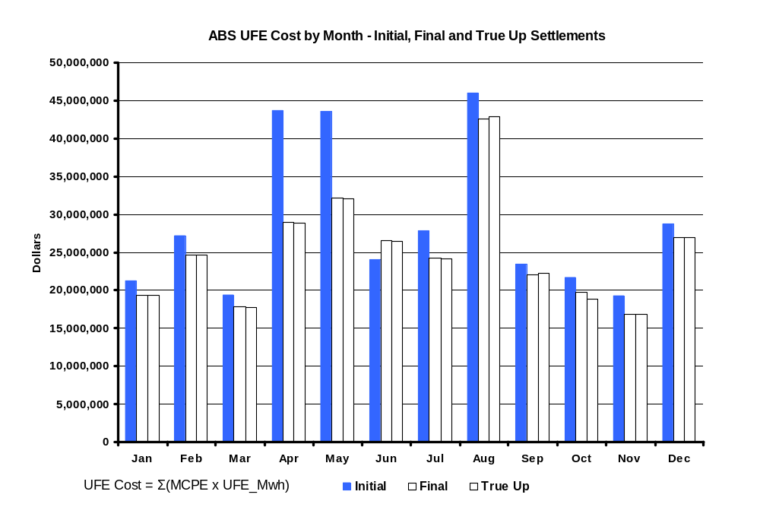
ABS UFE Cost by Month in 2006
Initial, Final and True-UP Settlements
SR09b
Notes:
Annual total is 1,676,343 Mwh. Again, this is NET UFE.

Slide 17
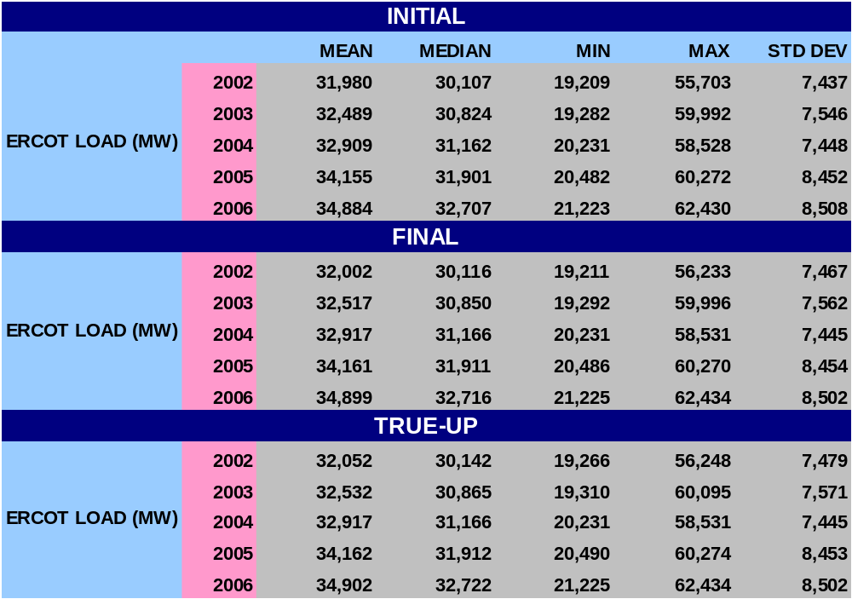
STATISTICAL SUMMARY - 2006
SR10

Slide 18
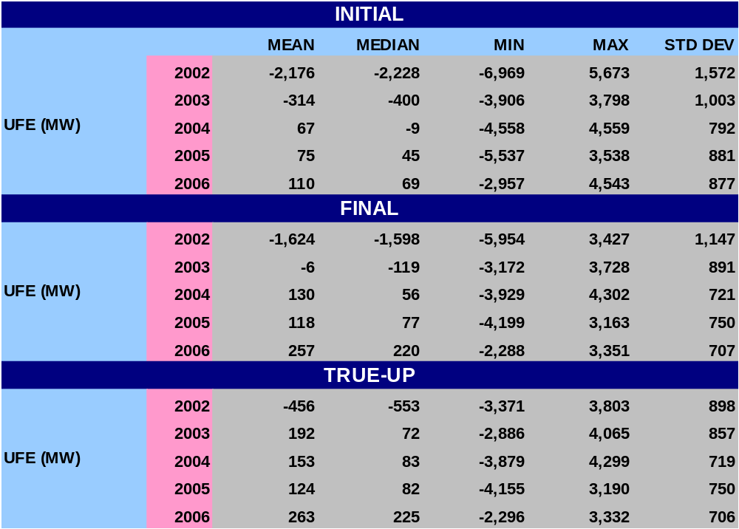
STATISTICAL SUMMARY - 2006
SR11a

Slide 19
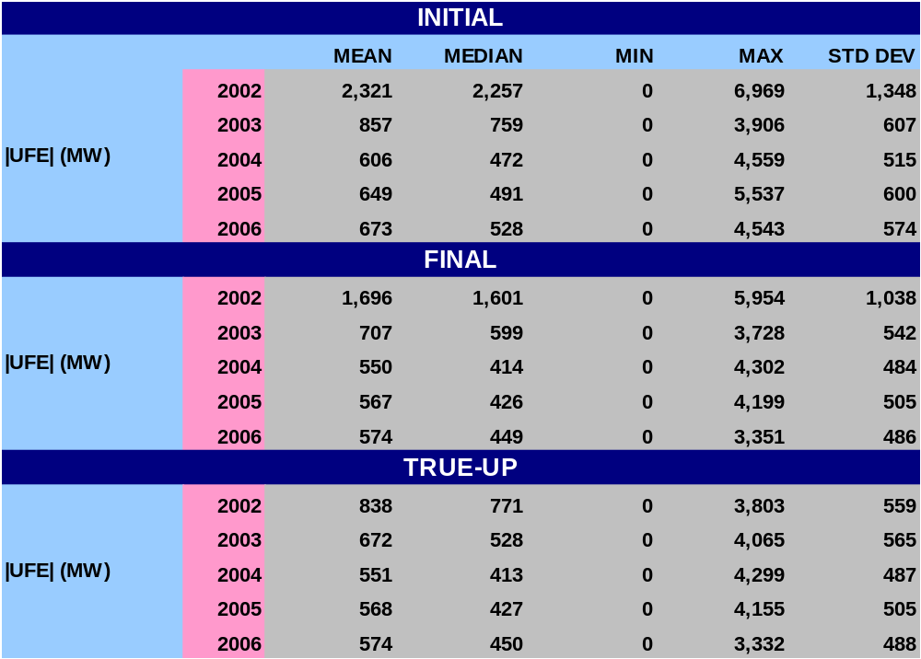
STATISTICAL SUMMARY - 2006
SR11b

Slide 20
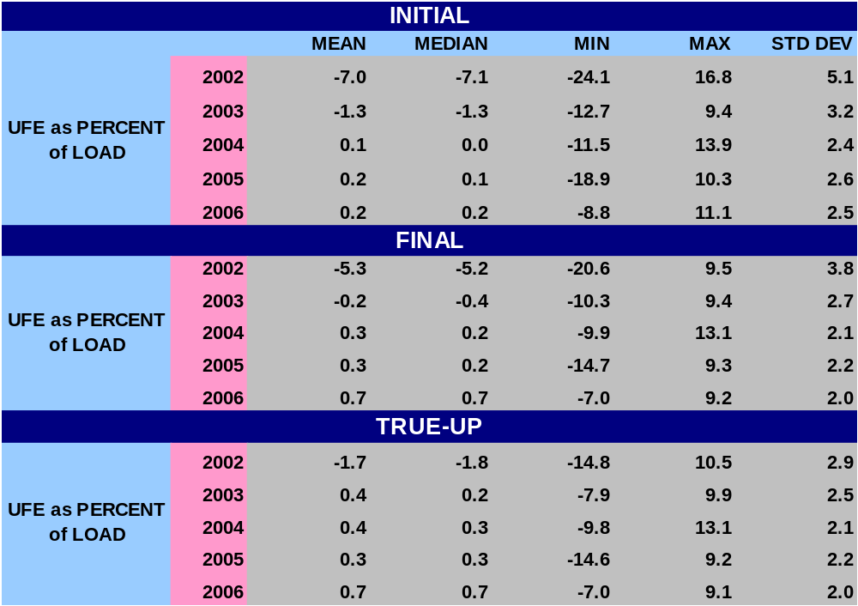
STATISTICAL SUMMARY - 2006
SR12a
Notes:
Last bullet – w/ regard to Mean and Median, UFE gets better with later settlements.

Slide 21
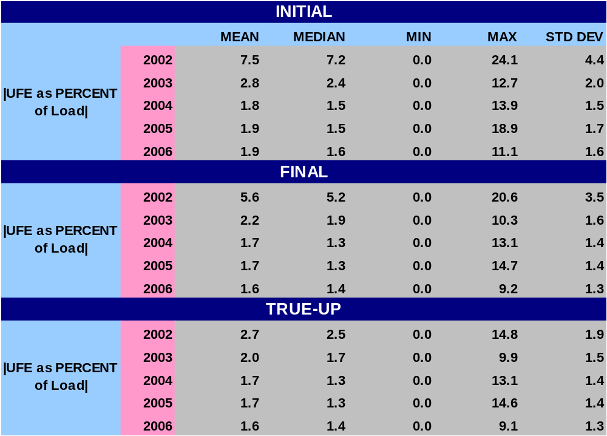
STATISTICAL SUMMARY - 2006
SR12b
Notes:
Last bullet – w/ regard to Mean and Median, UFE gets better with later settlements.

Slide 22
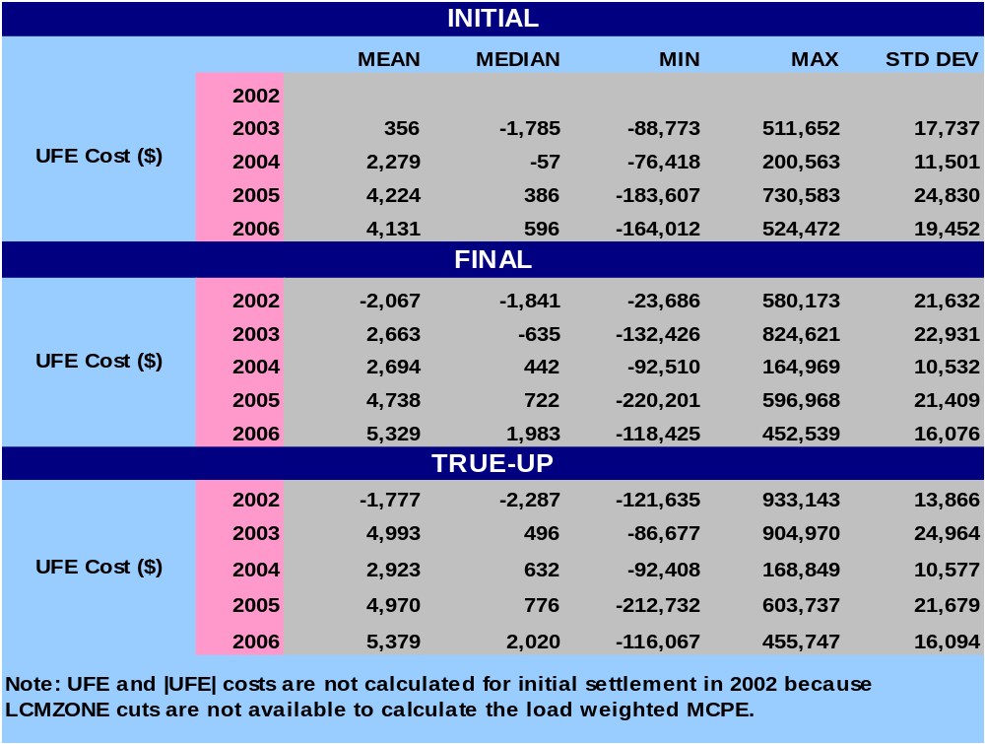
STATISTICAL SUMMARY - 2006
SR13a
Notes:
Last bullet – w/ regard to Mean and Median, UFE gets better with later settlements.

Slide 23
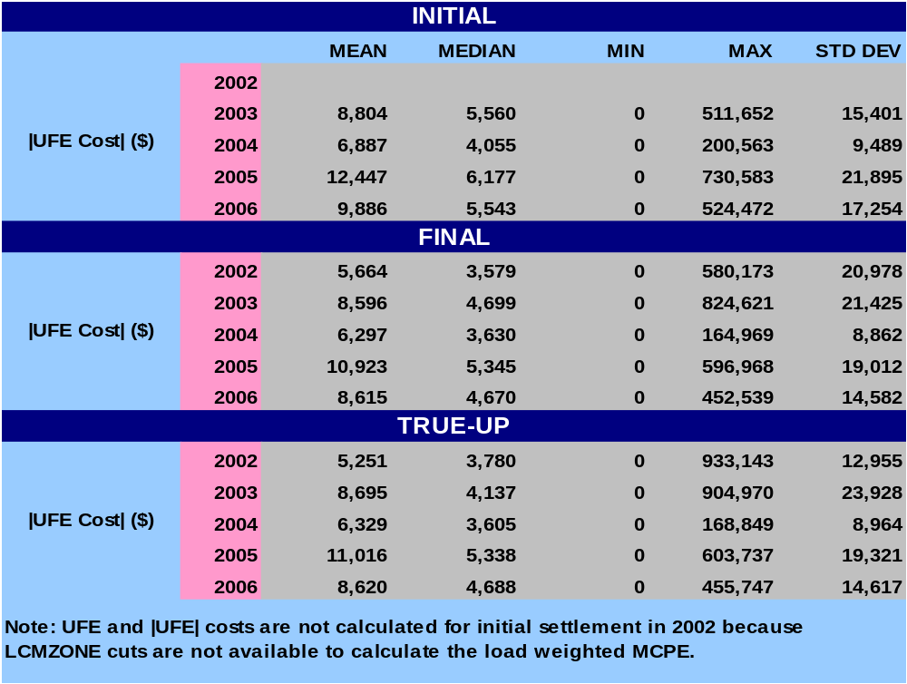
STATISTICAL SUMMARY - 2006
SR13b
Notes:
Last bullet – w/ regard to Mean and Median, UFE gets better with later settlements.

Slide 24
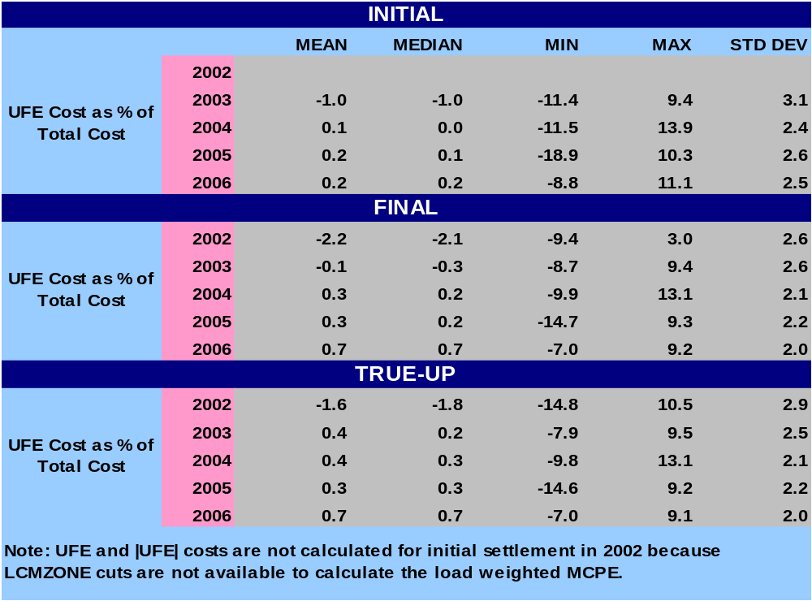
STATISTICAL SUMMARY - 2006
SR14a
Notes:
Last bullet – w/ regard to Mean and Median, UFE gets better with later settlements.

Slide 25
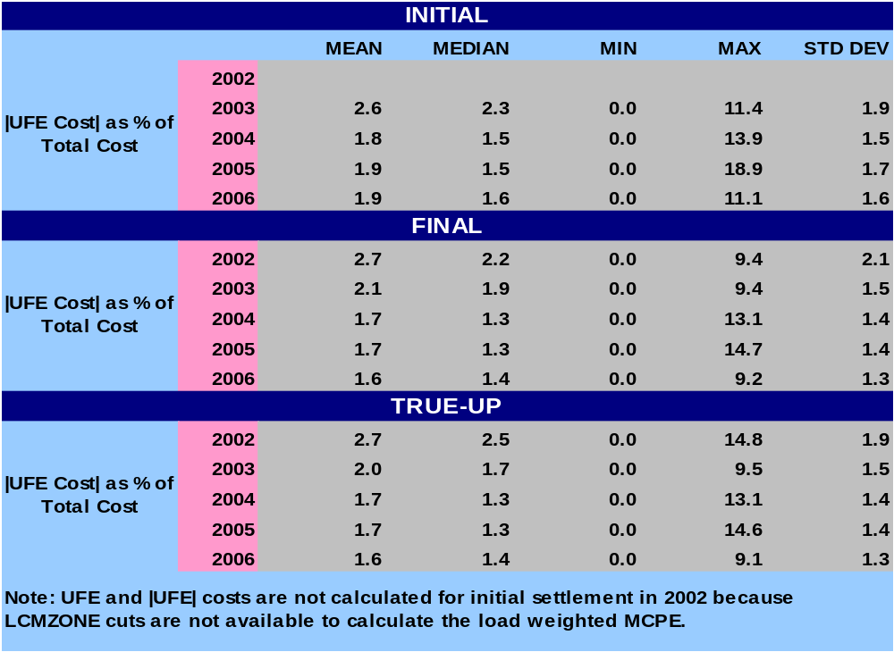
STATISTICAL SUMMARY - 2006
SR14b
Notes:
Last bullet – w/ regard to Mean and Median, UFE gets better with later settlements.

Slide 26
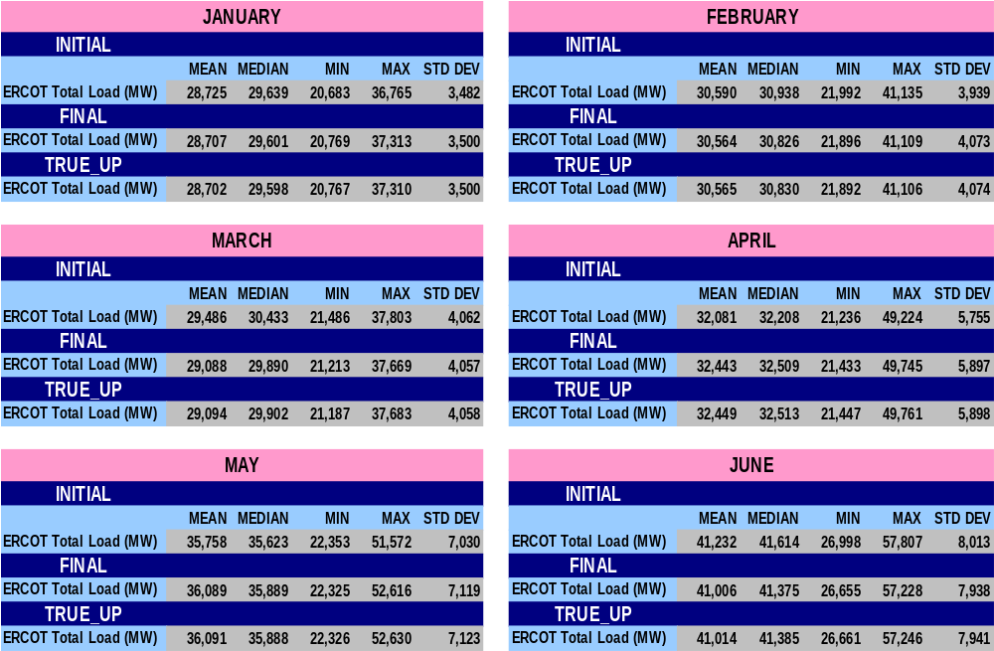
STATISTICAL SUMMARY – MONTHLY for 2006
SR15

Slide 27
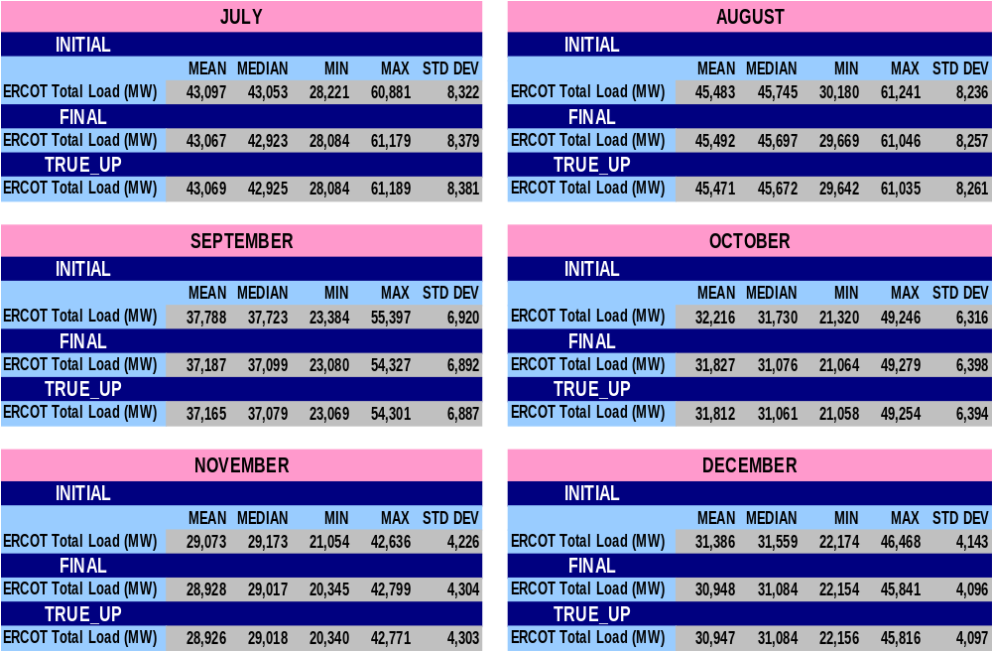
STATISTICAL SUMMARY – MONTHLY for 2006
SR16

Slide 28
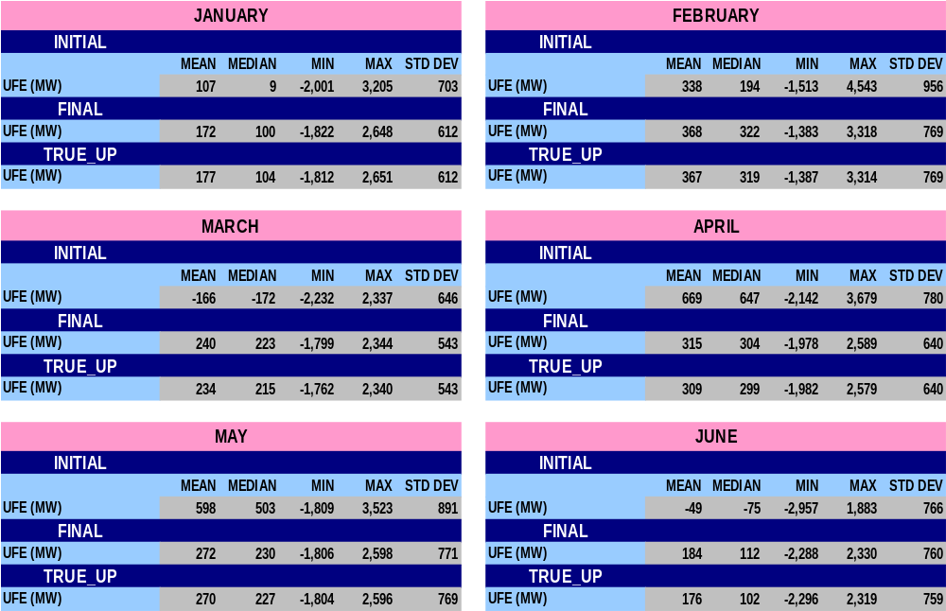
STATISTICAL SUMMARY – MONTHLY for 2006
SR17

Slide 29
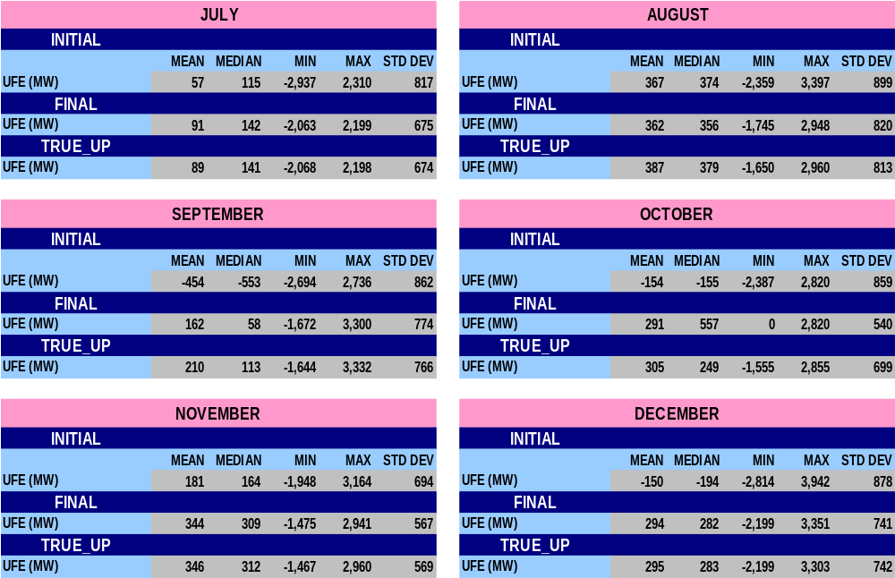
STATISTICAL SUMMARY – MONTHLY for 2006
SR18

Slide 30
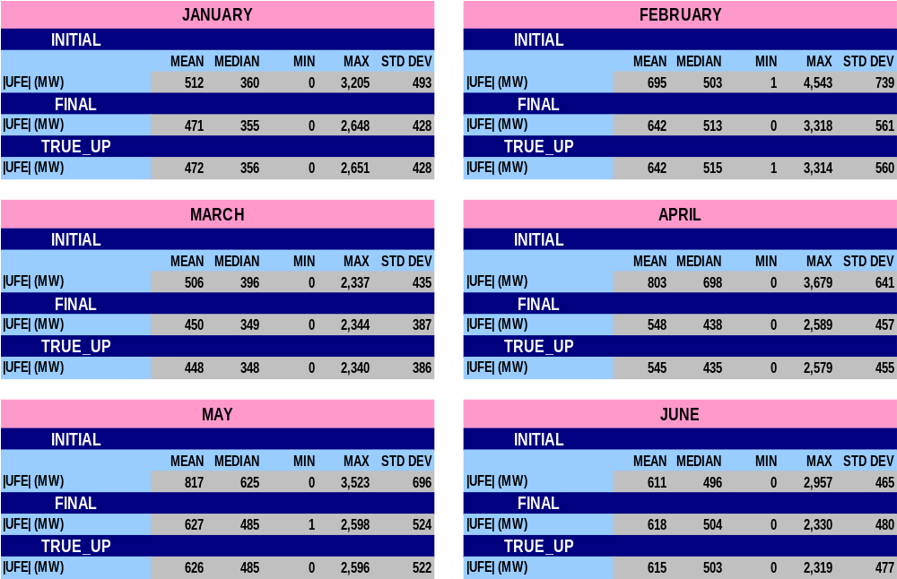
STATISTICAL SUMMARY – MONTHLY for 2006
SR19

Slide 31
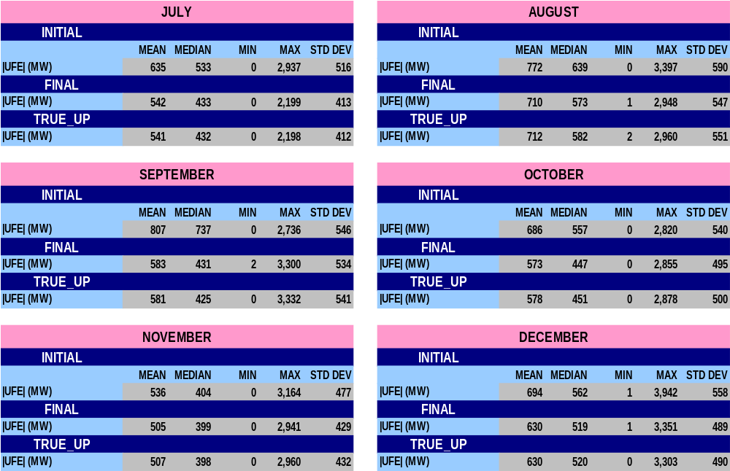
STATISTICAL SUMMARY – MONTHLY for 2006
SR20

Slide 32
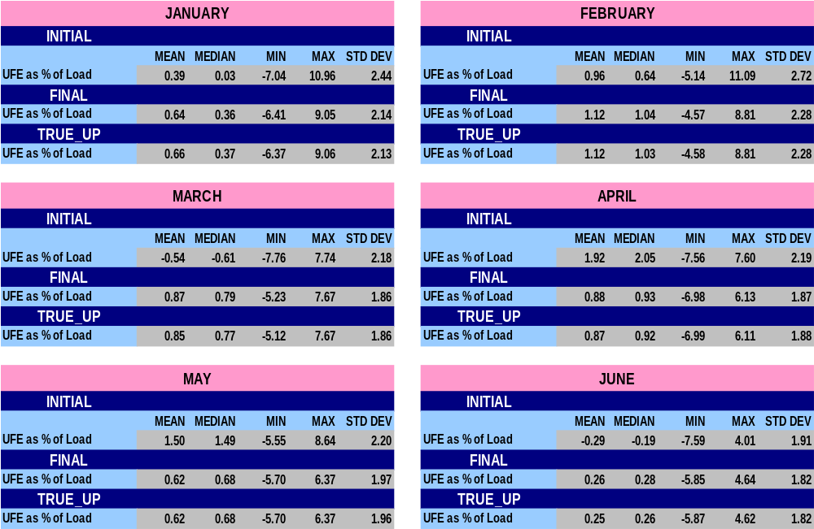
STATISTICAL SUMMARY – MONTHLY for 2006
SR21

Slide 33
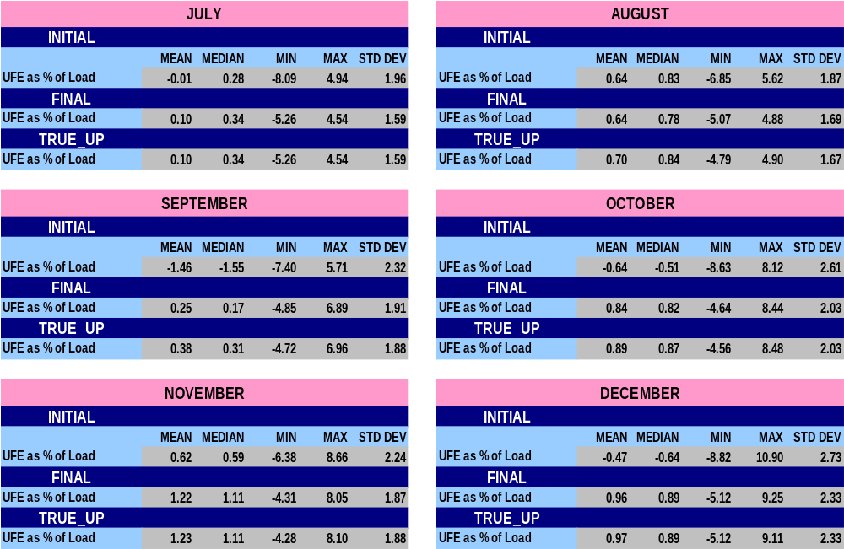
STATISTICAL SUMMARY – MONTHLY for 2006
SR22

Slide 34
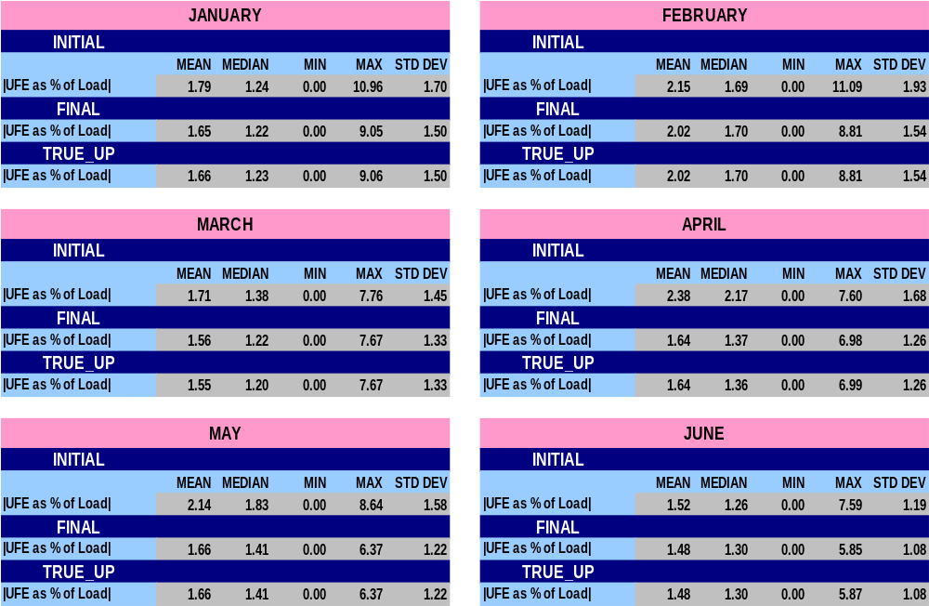
STATISTICAL SUMMARY – MONTHLY for 2006
SR23

Slide 35
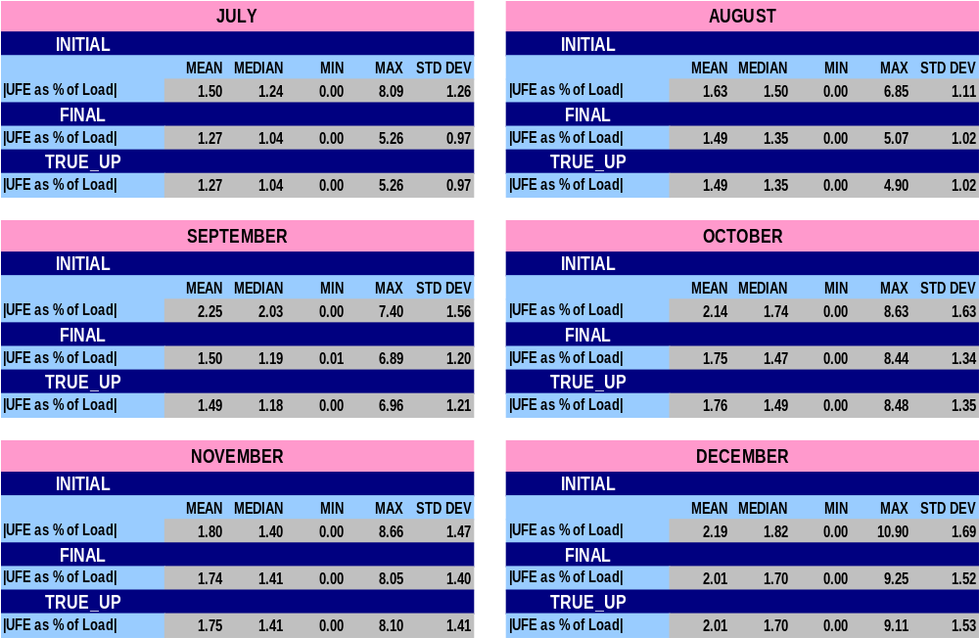
STATISTICAL SUMMARY – MONTHLY for 2006
SR24

Slide 36
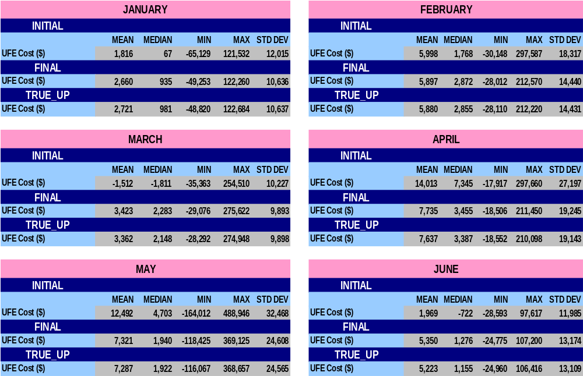
STATISTICAL SUMMARY – MONTHLY for 2006
SR25

Slide 37
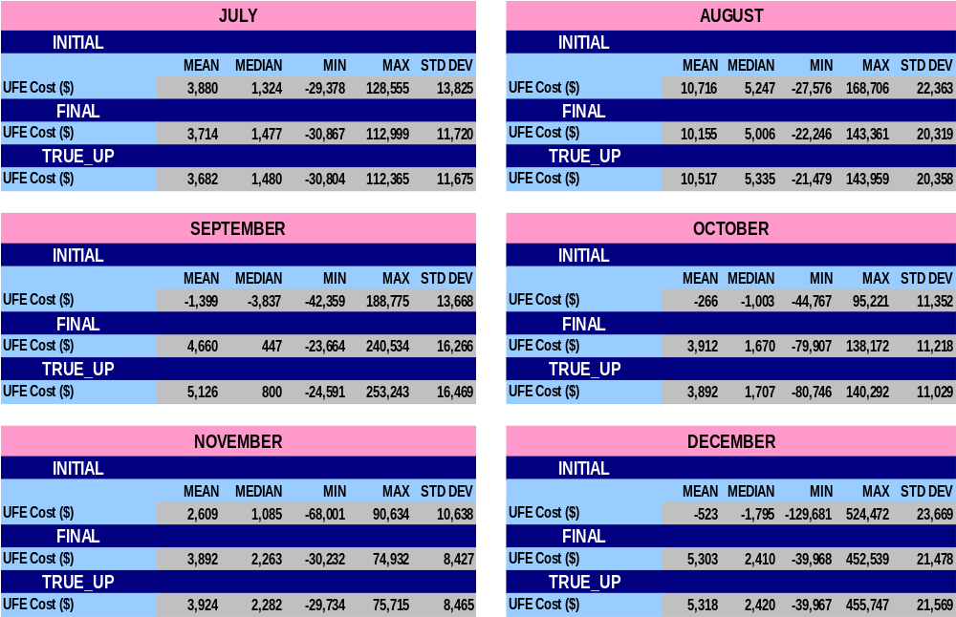
STATISTICAL SUMMARY – MONTHLY for 2006
SR26

Slide 38
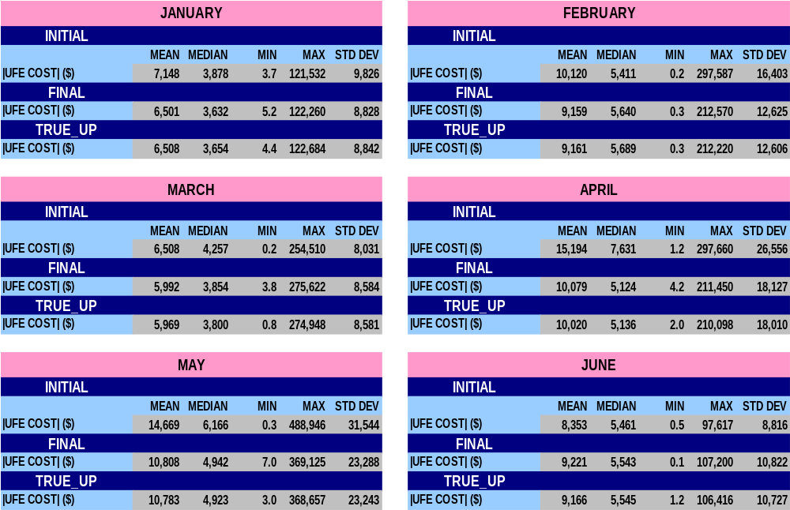
STATISTICAL SUMMARY – MONTHLY for 2006
SR27

Slide 39
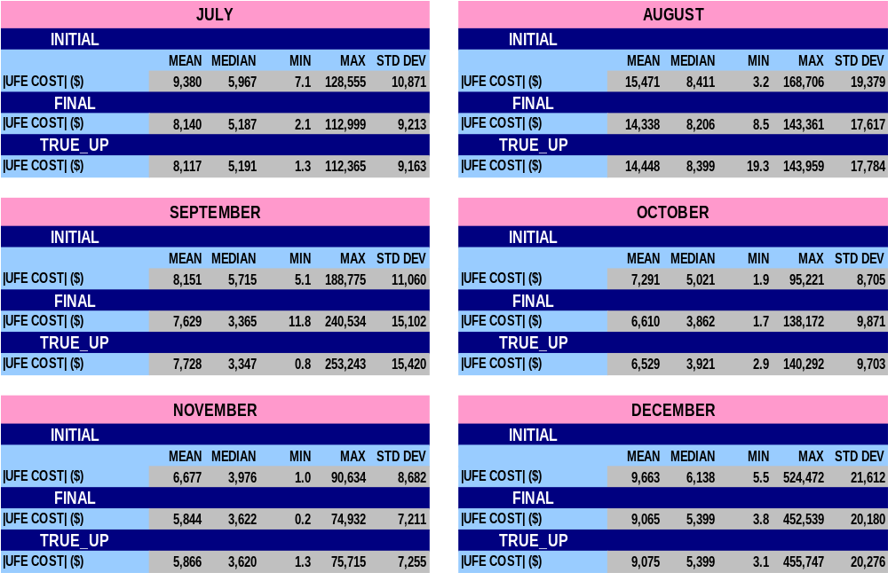
STATISTICAL SUMMARY – MONTHLY for 2006
SR28

Slide 40
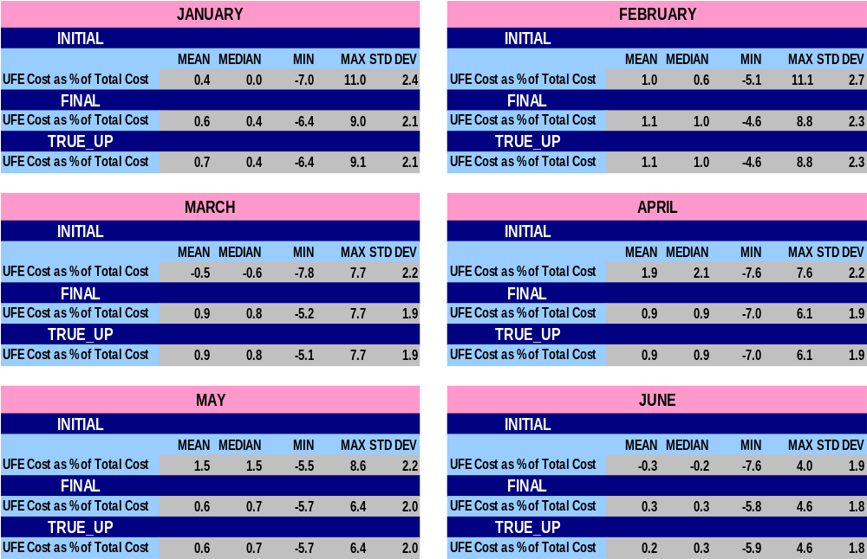
STATISTICAL SUMMARY – MONTHLY for 2006
SR29

Slide 41
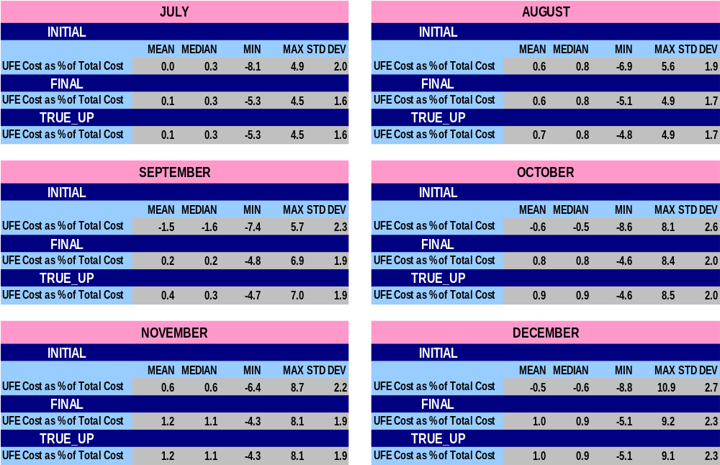
STATISTICAL SUMMARY – MONTHLY for 2006
SR30

Slide 42
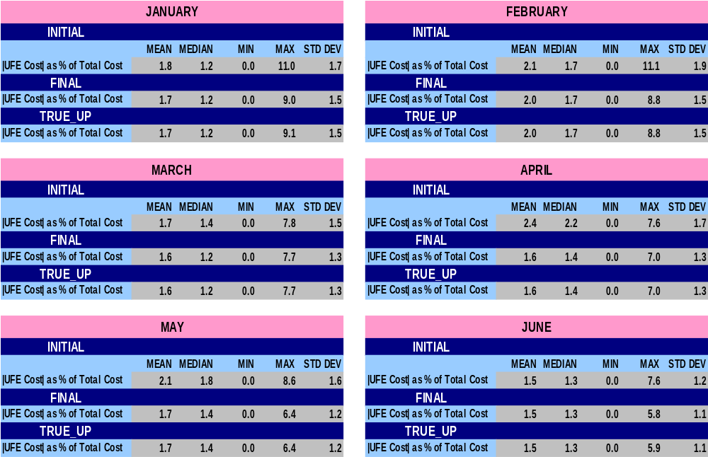
STATISTICAL SUMMARY – MONTHLY for 2006
SR31

Slide 43
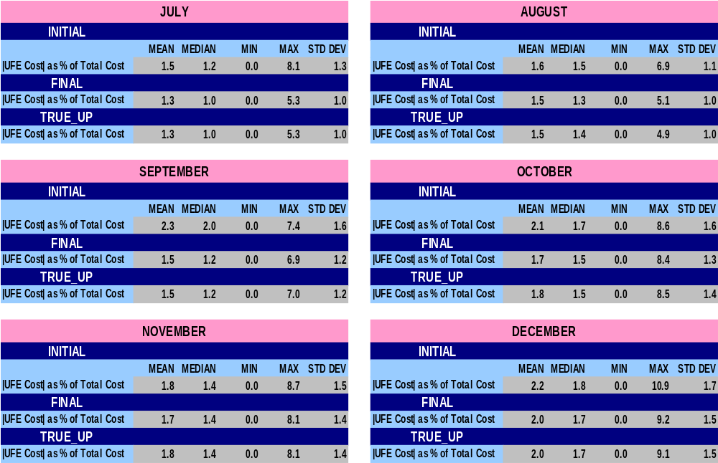
STATISTICAL SUMMARY – MONTHLY for 2006
SR32

Slide 44
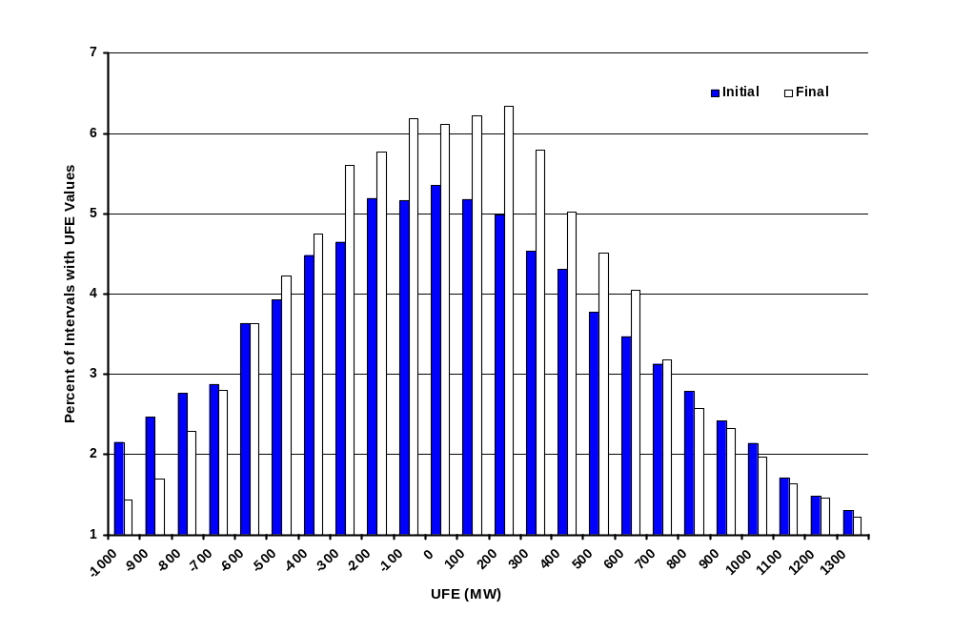
Percent of Intervals Distribution of UFE MW
Initial to Final - 2006
UFD01
Notes:
UFE shifts in a positive direction from Initial to Final.

Slide 45
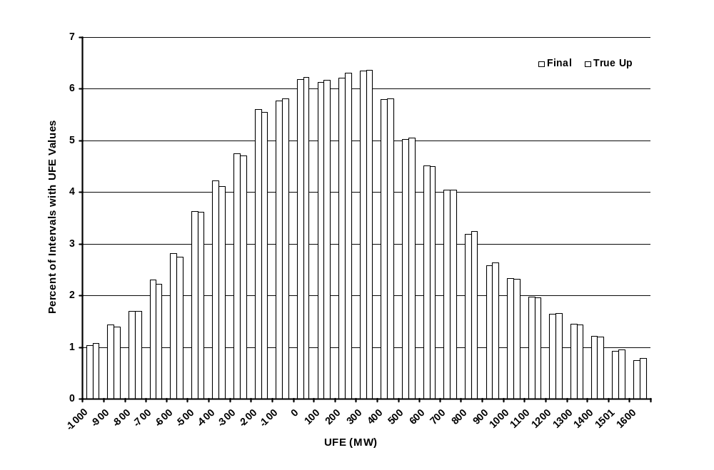
Percent of Intervals Distribution of UFE MW
Final to True Up - 2006
UFD02
Notes:
UFE shifts in a positive direction from Initial to Final.

Slide 46
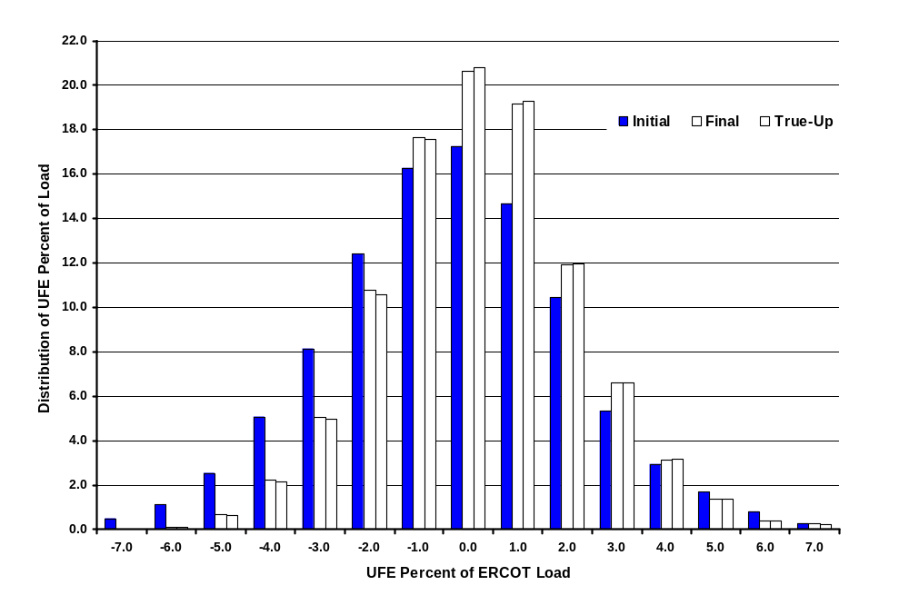
2006 Distribution of UFE Percent of ERCOT Load
UFD03
Notes:
The UFE percent moves in a positive direction from Initial to Final thru True-Up.

Slide 47
UFE Distribution
Initial

Slide 48
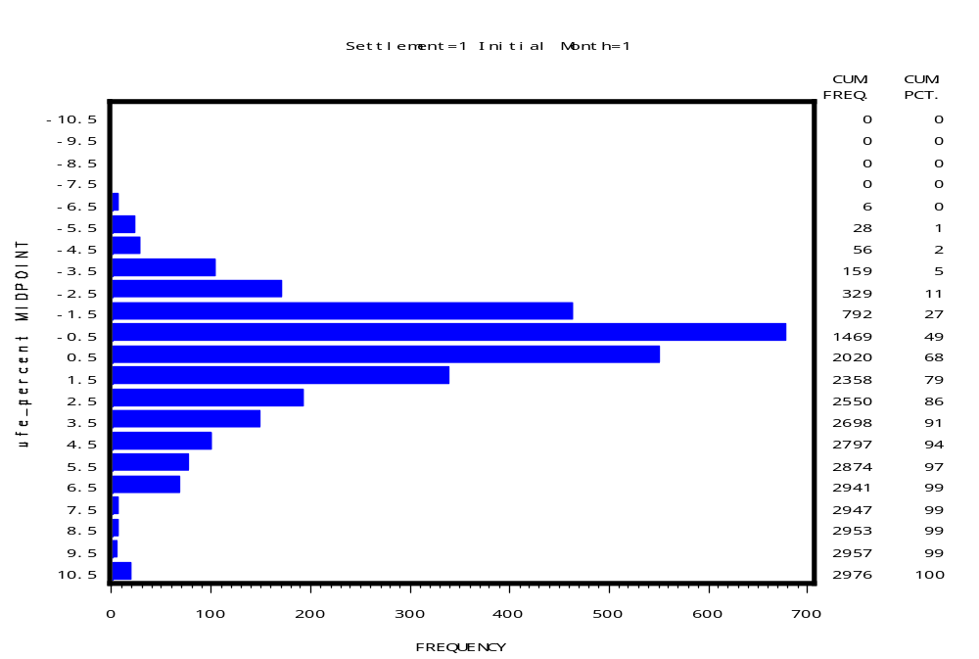
UFE Distribution 2006
Initial - January
UFD04

Slide 49
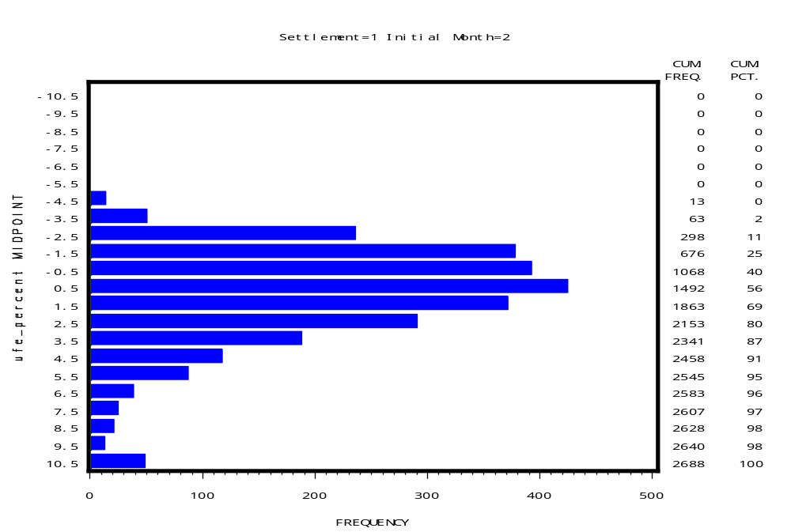
UFE Distribution 2006
Initial - February
UFD05

Slide 50
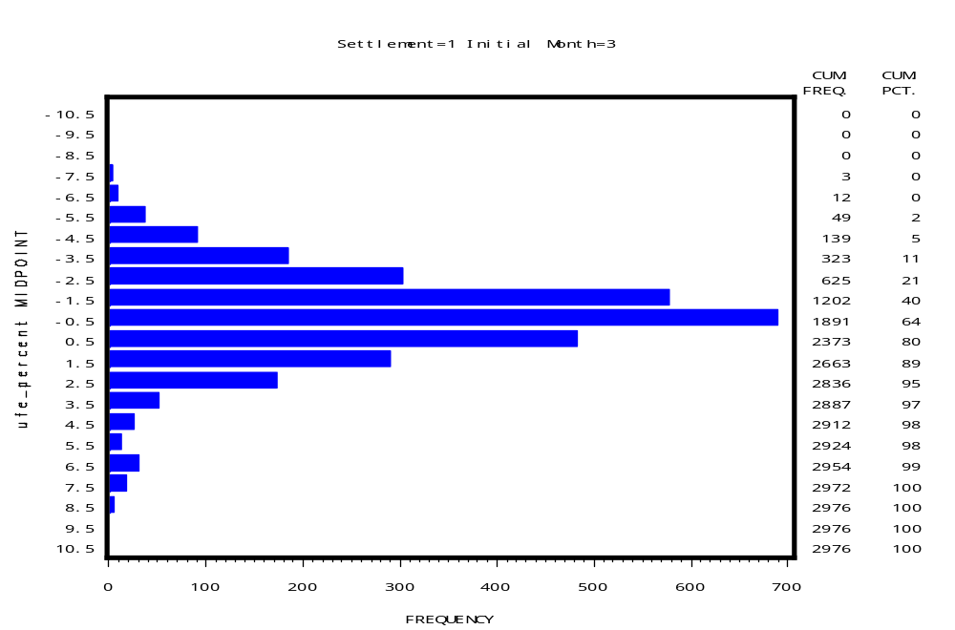
UFE Distribution 2006
Initial - March
UFD06

Slide 51
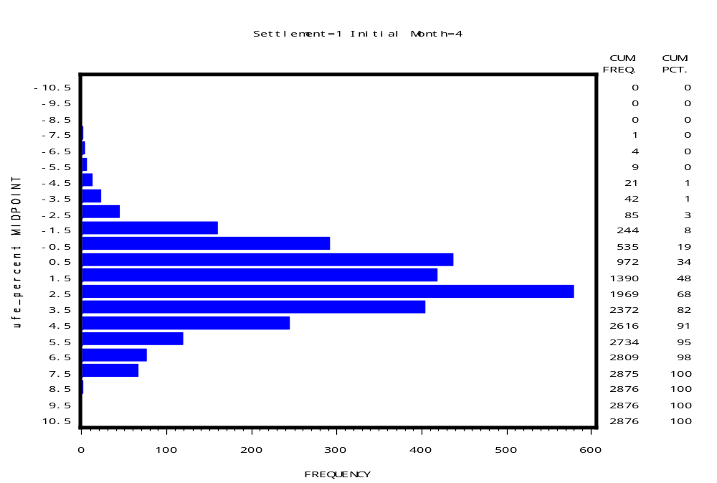
UFE Distribution 2006
Initial - April
UFD08

Slide 52
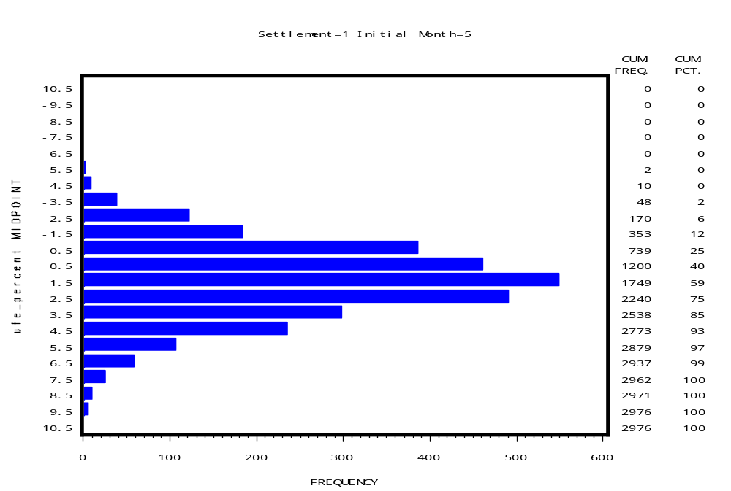
UFE Distribution 2006
Initial - May
UFD09

Slide 53
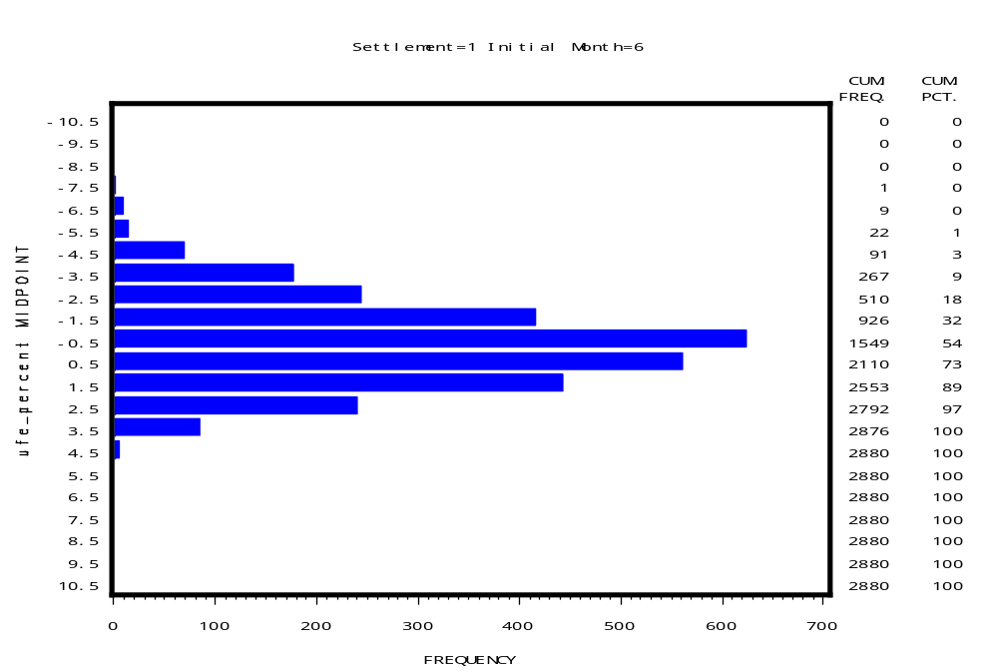
UFE Distribution 2006
Initial - June
UFD10

Slide 54
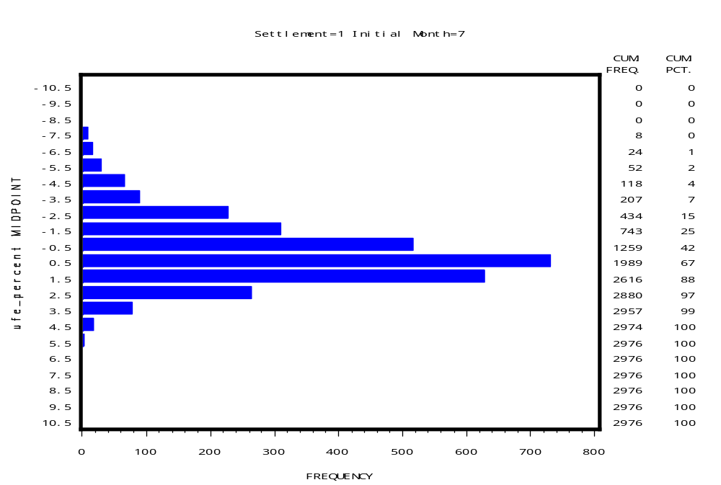
UFE Distribution 2006
Initial - July
UFD11

Slide 55
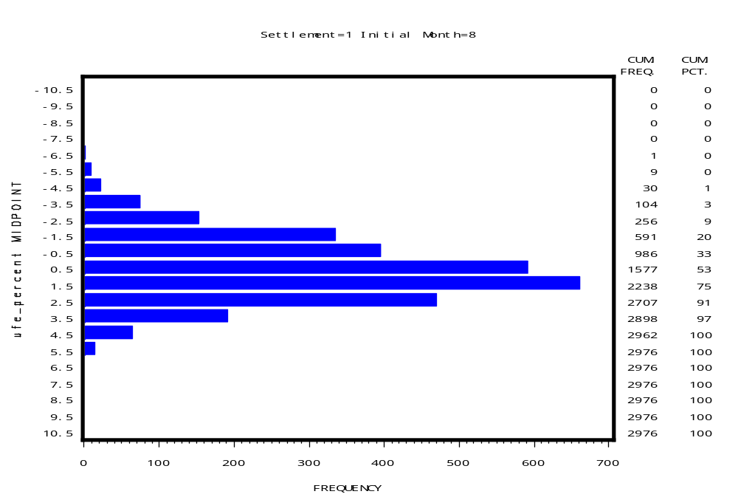
UFE Distribution 2006
Initial - August
UFD12

Slide 56
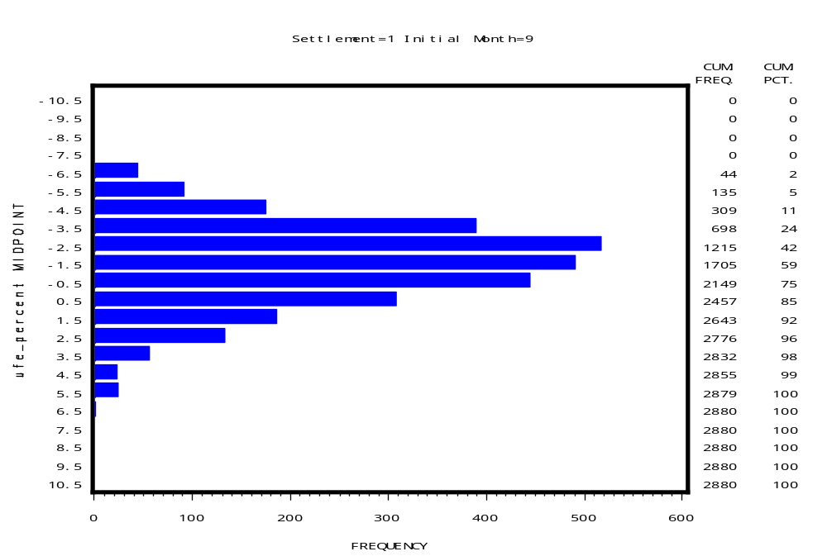
UFE Distribution 2006
Initial - September
UFD13

Slide 57

UFE Distribution 2006
Initial - October
UFD14

Slide 58

UFE Distribution 2006
Initial - November
UFD15

Slide 59

UFE Distribution 2006
Initial - December
UFD16

Slide 60
UFE Distribution
Final

Slide 61

UFE Distribution 2006
Final - January
UFD17

Slide 62

UFE Distribution 2006
Final - February
UFD18

Slide 63

UFE Distribution 2006
Final - March
UFD19

Slide 64

UFE Distribution 2006
Final - April
UFD20

Slide 65

UFE Distribution 2006
Final - May
UFD21

Slide 66

UFE Distribution 2006
Final - June
UFD22

Slide 67

UFE Distribution 2006
Final - July
UFD23

Slide 68

UFE Distribution 2006
Final - August
UFD24

Slide 69

UFE Distribution 2006
Final - September
UFD25

Slide 70

UFE Distribution 2006
Final - October
UFD26

Slide 71

UFE Distribution 2006
Final - November
UFD27

Slide 72

UFE Distribution 2006
Final - December
UFD28

Slide 73
UFE Distribution
True Up

Slide 74

UFE Distribution 2006
True Up - January
UFD29

Slide 75

UFE Distribution 2006
True Up - February
UFD30

Slide 76

UFE Distribution 2006
True Up - March
UFD31

Slide 77

UFE Distribution 2006
True Up - April
UFD32

Slide 78

UFE Distribution 2006
True Up - May
UFD33

Slide 79

UFE Distribution 2006
True Up - June
UFD34

Slide 80

UFE Distribution 2006
True Up - July
UFD35

Slide 81

UFE Distribution 2006
True Up - August
UFD36

Slide 82

UFE Distribution 2006
True Up - September
UFD37

Slide 83

UFE Distribution 2006
True Up - October
UFD38

Slide 84

UFE Distribution 2006
True Up - November
UFD39

Slide 85

UFE Distribution 2006
True Up - December
UFD40

Slide 86

UFE Percent of ERCOT Load 2006
Initial Settlement
95% Confidence Interval
CIP01
Notes:
Indicative of systematic estimation problem. Full year – blend of seasons. Seasonal detail comes later.

Slide 87

UFE Percent of ERCOT Load 2006
Final Settlement
95% Confidence Interval
CIP02

Slide 88

UFE Percent of ERCOT Load 2006
True-Up Settlement
95% Confidence Interval
CIP03

Slide 89

UFE Percent of ERCOT Load 2006
Comparison of Medians
With 95% Confidence Interval
CIP04

Slide 90

Seasonal Comparison - Spring 2006
UFE Percent of ERCOT Load and ERCOT Load
SEA01

Slide 91

Seasonal Comparison - Summer 2006
UFE Percent of ERCOT Load and ERCOT Load
SEA02

Slide 92

Seasonal Comparison - Fall 2006
UFE Percent of ERCOT Load and ERCOT Load
SEA03

Slide 93

Seasonal Comparison - Winter 2006
UFE Percent of ERCOT Load and ERCOT Load
SEA04
Notes:
Looks like profiles are underestimating morning load, overestimating evening load.

Slide 94

Seasonal Comparison of Medians – Initial Settlement
UFE Percent of ERCOT Load - 2006
SEA05
Notes:
Idea of seasonal differences by settlement.

Slide 95

Seasonal Comparison of Medians – Final Settlement
UFE Percent of ERCOT Load - 2006
SEA06

Slide 96

Seasonal Comparison of Medians – True Up
UFE Percent of ERCOT Load - 2006
SEA07

Slide 97

Percent UFE vs ERCOT Load
Initial Settlement - 2006
MPL01

Slide 98

Percent UFE vs ERCOT Load
Final Settlement - 2006
MPL02

Slide 99

Percent UFE vs ERCOT Load
True-Up Settlement – 2006
MPL03

Slide 100

Comparison of Median Percent UFE
Initial, Final and True-Up Settlements - 2006
MPL04
Notes:
True-up median ufe is worse than final ufe for ERCOT load > 34000 mw, similarly final is worse than initial for ERCOT load > 38000 mw

Slide 101

Load Weighted Average MCPE vs Load
Initial Settlement - 2006
MPL05
Notes:
Showing there is a significant relationship between UFE and load. If pure random errors, it would be bouncing around 0 – no upward trend. Gives indication of shift from overestimating to underestimating – around 40000 Mw. Shift moves to lower loads for subsequent settlements – point out on next 2 slides.

Slide 102

Load Weighted Average MCPE vs Load
Final Settlement - 2006
MPL06
Notes:
Showing there is a significant relationship between UFE and load. If pure random errors, it would be bouncing around 0 – no upward trend. Gives indication of shift from overestimating to underestimating – around 40000 Mw. Shift moves to lower loads for subsequent settlements – point out on next 2 slides.

Slide 103

Load Weighted Average MCPE vs Load
True Up Settlement - 2006
MPL07
Notes:
Showing there is a significant relationship between UFE and load. If pure random errors, it would be bouncing around 0 – no upward trend. Gives indication of shift from overestimating to underestimating – around 40000 Mw. Shift moves to lower loads for subsequent settlements – point out on next 2 slides.

Slide 104

Comparison of Median Load Weighted Average MCPE vs Load for Initial, Final and True-Up Settlements - 2006
MPL08

Slide 105

Load Weighted Average MCPE vs Percent UFE
Initial Settlement - 2006
MPL09

Slide 106

Load Weighted Average MCPE vs Percent UFE
Final Settlement - 2006
MPL10

Slide 107

Load Weighted Average MCPE vs Percent UFE
True-Up Settlement - 2006
MPL11

Slide 108

Comparison of Median Load Weighted Average MCPE vs Percent UFE for
Initial, Final and True-Up Settlements - 2006
MPL12

Slide 109

Sum of Dollars from Positive UFE across the Week 2006
UCT02

Slide 110

Sum of Dollars from Negative UFE across the Week 2006
UCT03

Slide 111

Sum of Dollars from Absolute Value of UFE across the Week 2006
UCT04

Slide 112

Sum of Dollars from Net UFE across the Week 2006
UCT05

Slide 113




SUM of UFE Dollars
Compare All Seasons in 2006
Positive and Negative UFE
UCT06

Slide 114

SUM of UFE Dollars – Spring 2006
Positive and Negative UFE
UCT07

Slide 115

SUM of UFE Dollars – Summer 2006
Positive and Negative UFE
UCT08

Slide 116

SUM of UFE Dollars – Fall 2006
Positive and Negative UFE
UCT09

Slide 117

SUM of UFE Dollars – Winter 2006
Positive and Negative UFE
UCT10

Slide 118




SUM of UFE Dollars
Compare All Seasons in 2006
Absolute Value and Net UFE
UCT11

Slide 119

SUM of UFE Dollars – Spring 2006
Absolute Value and Net UFE
UCT12

Slide 120

SUM of UFE Dollars – Summer 2006
Absolute Value and Net UFE
UCT13

Slide 121

SUM of UFE Dollars – Fall 2006
Absolute Value and Net UFE
UCT14

Slide 122

SUM of UFE Dollars – Winter 2006
Absolute Value and Net UFE
UCT15

Slide 123




Mean of UFE Dollars
Compare All Seasons in 2006
Positive and Negative UFE
UCT16

Slide 124

Mean of UFE Dollars – Spring 2006
Positive and Negative UFE
UCT17

Slide 125

Mean of UFE Dollars – Summer 2006
Positive and Negative UFE
UCT18

Slide 126

Mean of UFE Dollars – Fall 2006
Positive and Negative UFE
UCT19

Slide 127

Mean of UFE Dollars – Winter 2006
Positive and Negative UFE
UCT20

Slide 128




Mean of UFE Dollars
Compare All Seasons in 2006
Absolute Value and Net UFE
UCT21

Slide 129

Mean of UFE Dollars – Spring 2006
Absolute Value and Net UFE
UCT22

Slide 130

Mean of UFE Dollars – Summer 2006
Absolute Value and Net UFE
UCT23

Slide 131

Mean of UFE Dollars – Fall 2006
Absolute Value and Net UFE
UCT24

Slide 132

Mean of UFE Dollars – Winter 2006
Absolute Value and Net UFE
UCT25

Slide 133
Events that Influenced 2006 UFE
Annual validation 2005 was completed.
Initial settlement data aggregation moved from 14 days after the operating day to 8 days effective 1/17/2006.
IDR requirement threshold lowered from 1000 to 700 kW effective 10/1/2005. Completed in April 2006.

Slide 134
Next Steps
Improve Business Profile ID assignment process
Improve models using Round 2 load research data
Increase the number of IDR’s
Leverage AMI capability by increased use of TOU metering and more frequent meter reads
Evaluate Lagged Dynamic sampling techniques and their application to the ERCOT System
Continue to evaluate improvements to algorithms for missing IDR and NIDR data estimation
Continue to make improvements to loss estimations – updated TDSP loss studies.

