Slide 1

UFE 2009 ANALYSIS
Compiled by Load Forecasting & Analysis
for the PWG Meeting of
August 25, 2010

Slide 2
UFE Basics
UFE (unaccounted for energy) is computed as follows:
UFE = Generation – (Load + Losses)
Sources of UFE include:
■ Generation Measurement Errors
■ Load - Missing/Erroneous Usage Data
- Model Error
- Load Profile ID Assignment Error
- Theft
■ Losses - Model Error
- Loss Code Assignment Error
Negative UFE indicates load/losses are overestimated

Slide 3
UFE Basics
UFE
Net Generation for Settlement Interval
GAP - - - - - - >
Losses:
Transmission & Distribution
Profiled Energy Usage
Non-Interval Data
Non-Metered Accounts
Net Generation
Compared to
Load Buildup
Interval Data
Energy Usage

Slide 4

SETTLEMENT SCHEDULE
UFE is computed for each 15-minute interval of a settlement run.
Initial Settlement
(10 days after the trade day)
Final Settlement
(59 days after the trade day)
True-up and Resettlement (6 months to up to several years after the trade day)
The latest resettlement in each interval is used in the analysis for Initial, Final and True-Up.
Settlement
Initial
Final
True-Up
Resettlement
(if necessary)

Slide 5
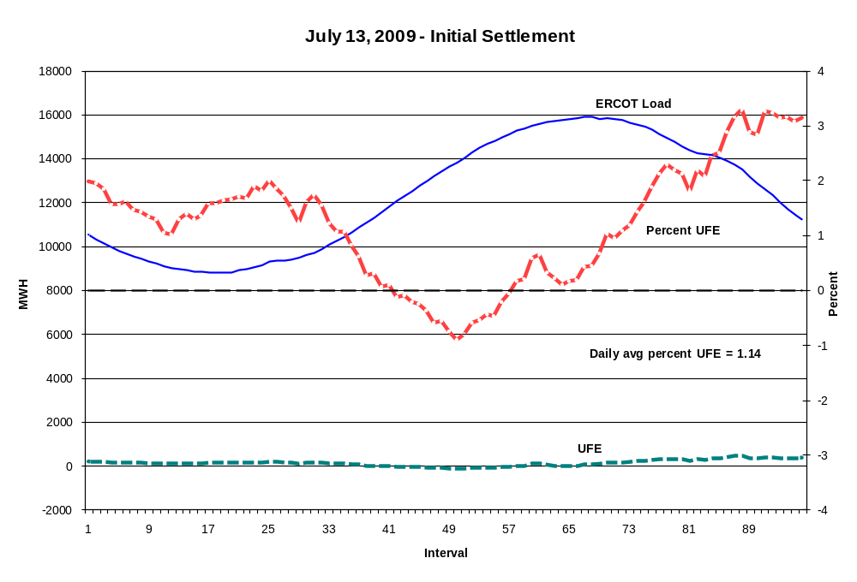
LOAD AND UFE – ERCOT PEAK Day 2009
Initial Settlement
SR01

Slide 6
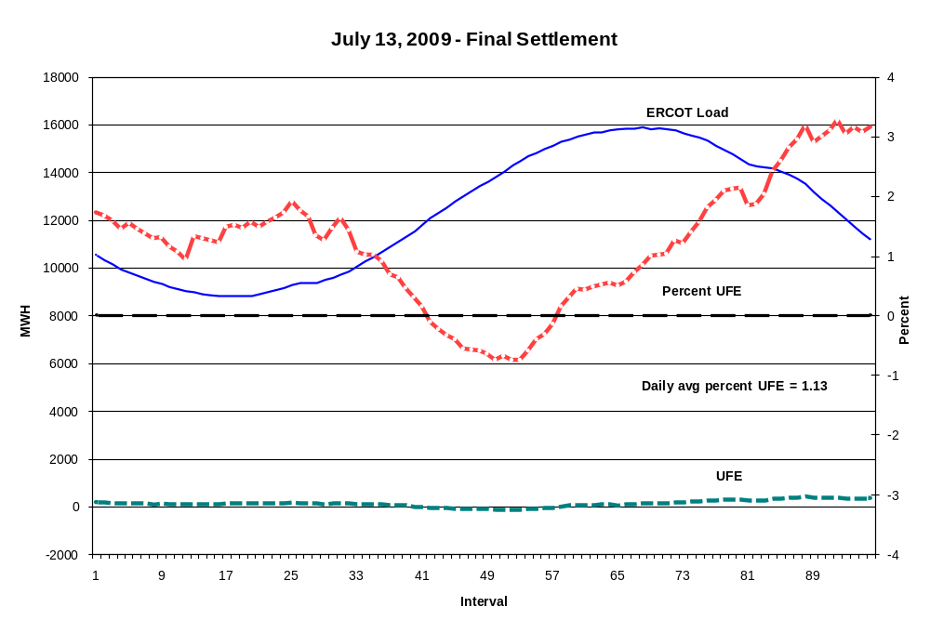
LOAD AND UFE – ERCOT PEAK Day 2009
Final Settlement
SR02

Slide 7
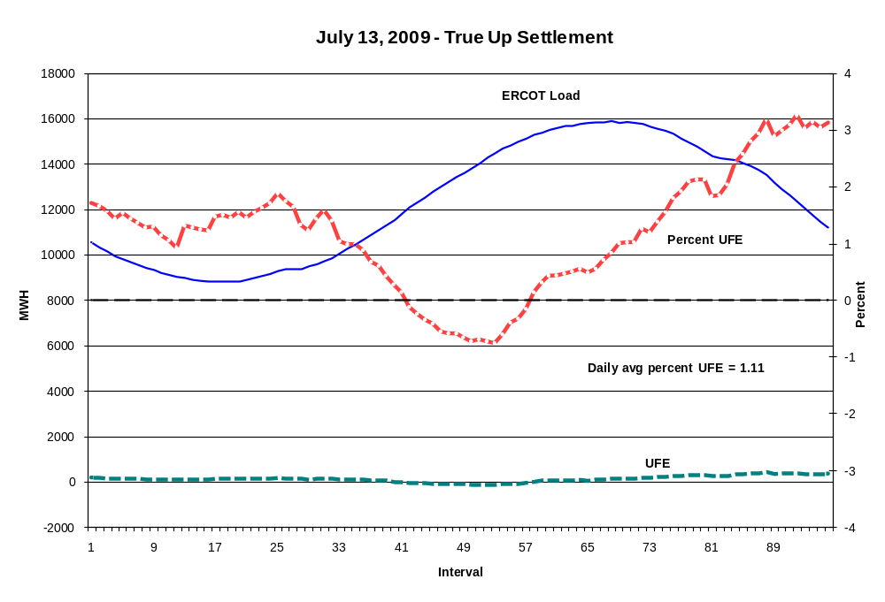
LOAD AND UFE – ERCOT PEAK Day 2009
True Up Settlement
SR03

Slide 8
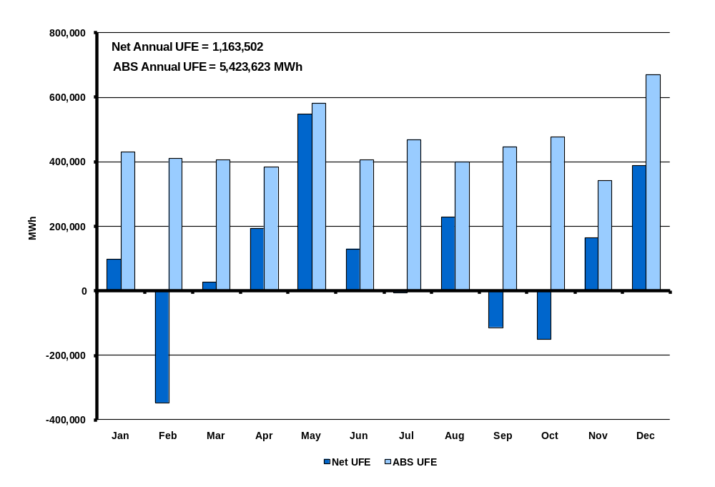
UFE MWh by Month in 2009
Initial Settlement
SR04
Notes:
This is NET UFE. + and – are canceling out. May and Oct (shoulder months) are the highest while April (another shoulder month) is lowest. Winter months are generally higher than summer months.

Slide 9
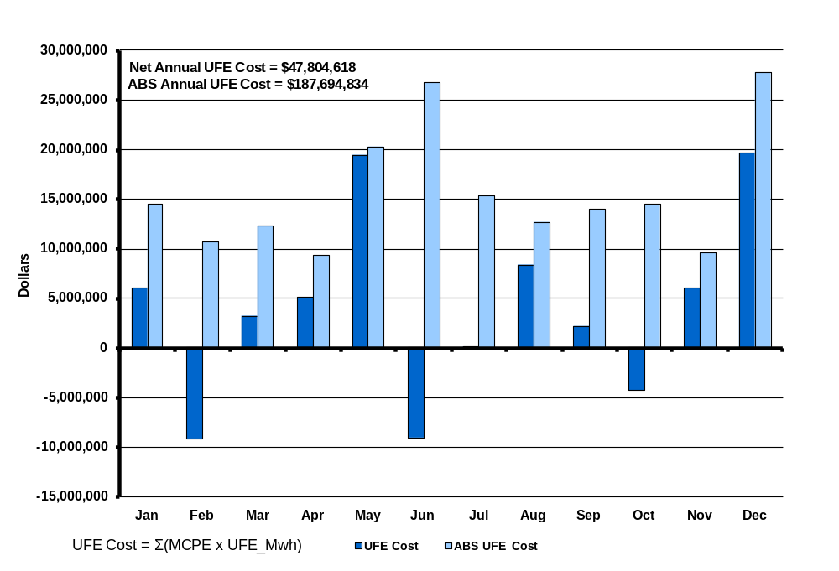
UFE Cost by Month in 2009
Initial Settlement
SR05

Slide 10
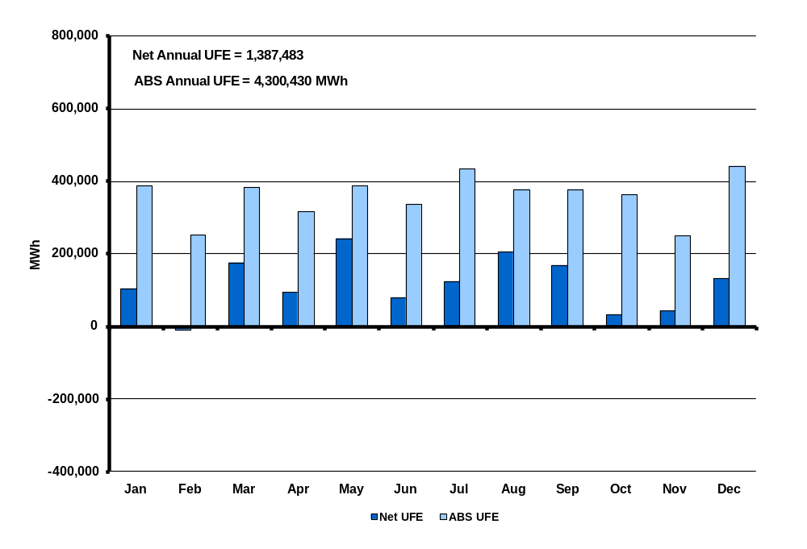
UFE MWh by Month in 2009
Final Settlement
SR06
Notes:
This is NET UFE. + and – are canceling out. May and Oct (shoulder months) are the highest while April (another shoulder month) is lowest. Winter months are generally higher than summer months.

Slide 11
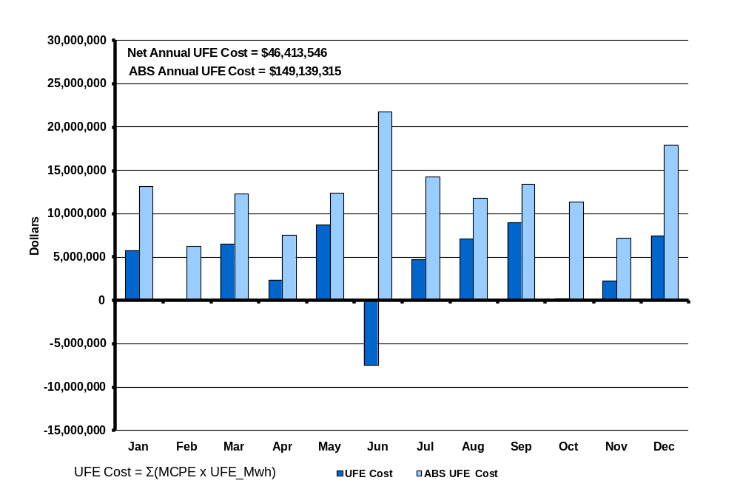
UFE Cost by Month in 2009
Final Settlement
SR07
Notes:
Annual total is 1,676,343 Mwh. Again, this is NET UFE.

Slide 12
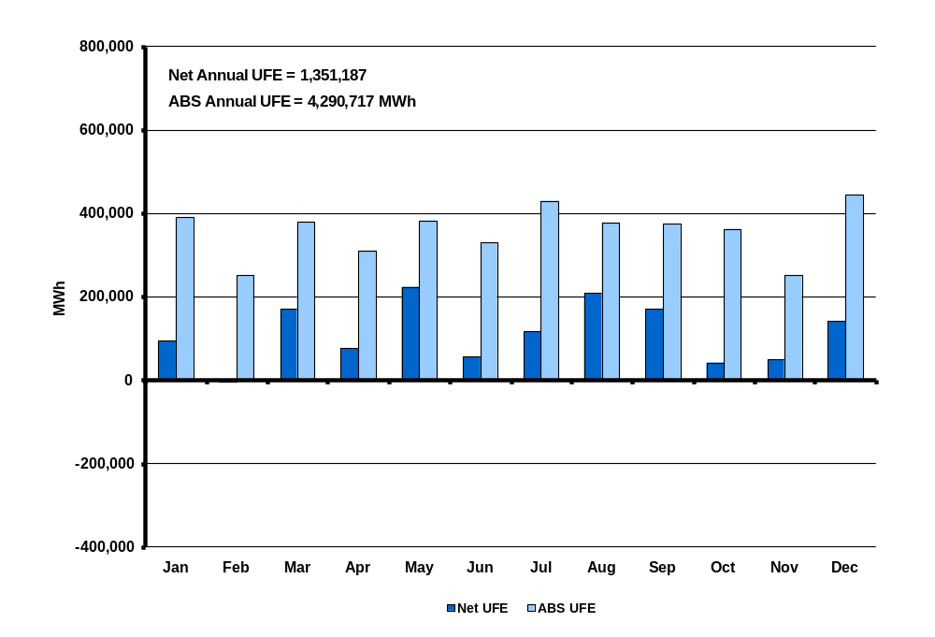
UFE MWh by Month in 2009
True-Up Settlement
SR09
Notes:
This is NET UFE. + and – are canceling out. May and Oct (shoulder months) are the highest while April (another shoulder month) is lowest. Winter months are generally higher than summer months.

Slide 13
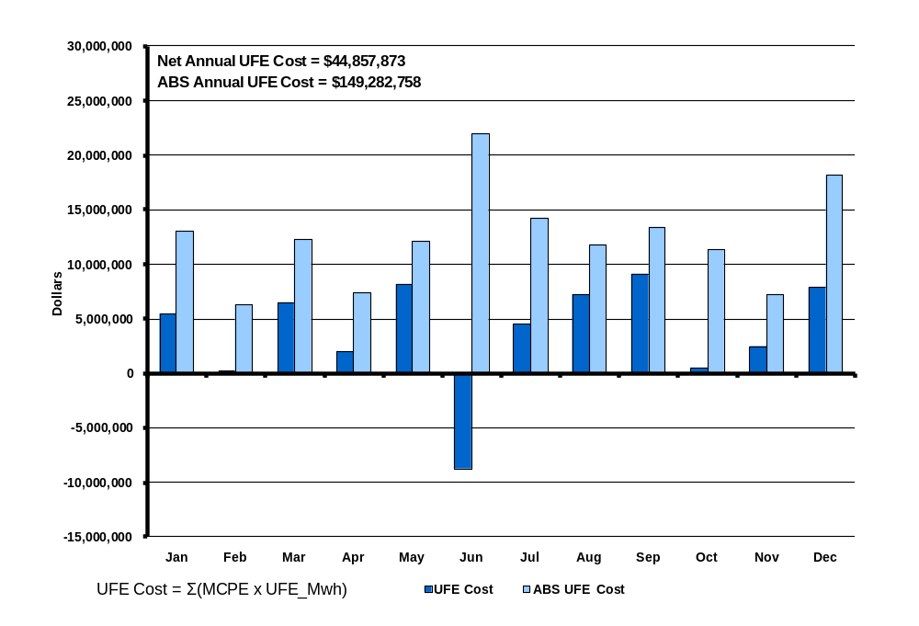
UFE Cost by Month in 2009
True-Up Settlement
SR09
Notes:
Annual total is 1,676,343 Mwh. Again, this is NET UFE.

Slide 14
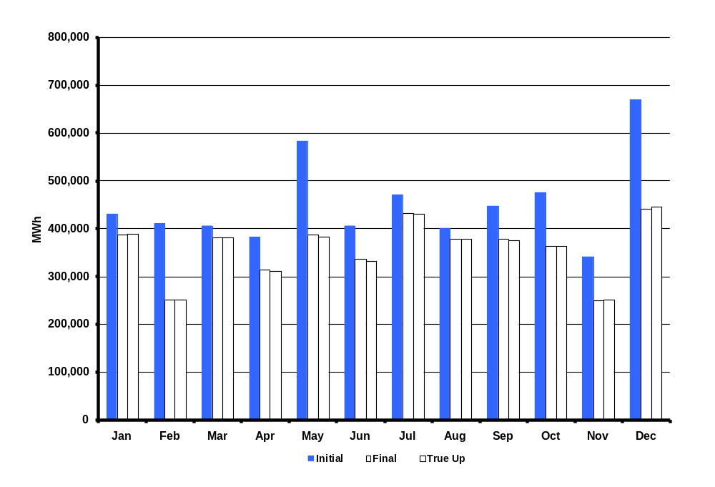
ABS UFE MWh by Month in 2009
Initial, Final and True Up Settlements
SR09a
Notes:
Annual total is 1,676,343 Mwh. Again, this is NET UFE.

Slide 15
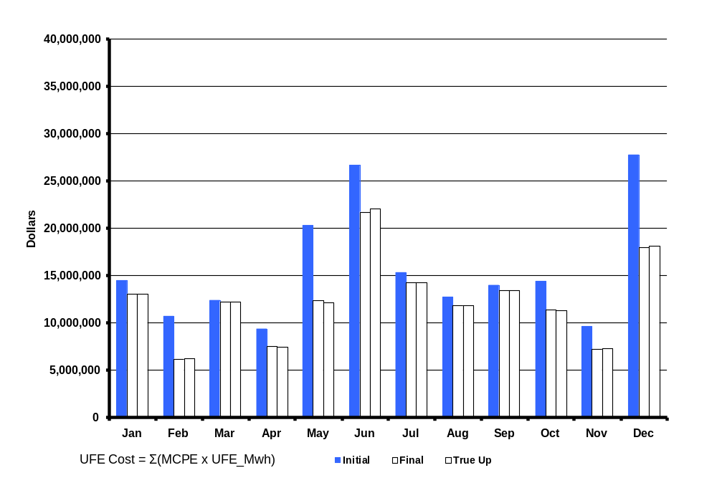
ABS UFE Cost by Month in 2009
Initial, Final and True-Up Settlements
SR09b
Notes:
Annual total is 1,676,343 Mwh. Again, this is NET UFE.

Slide 16
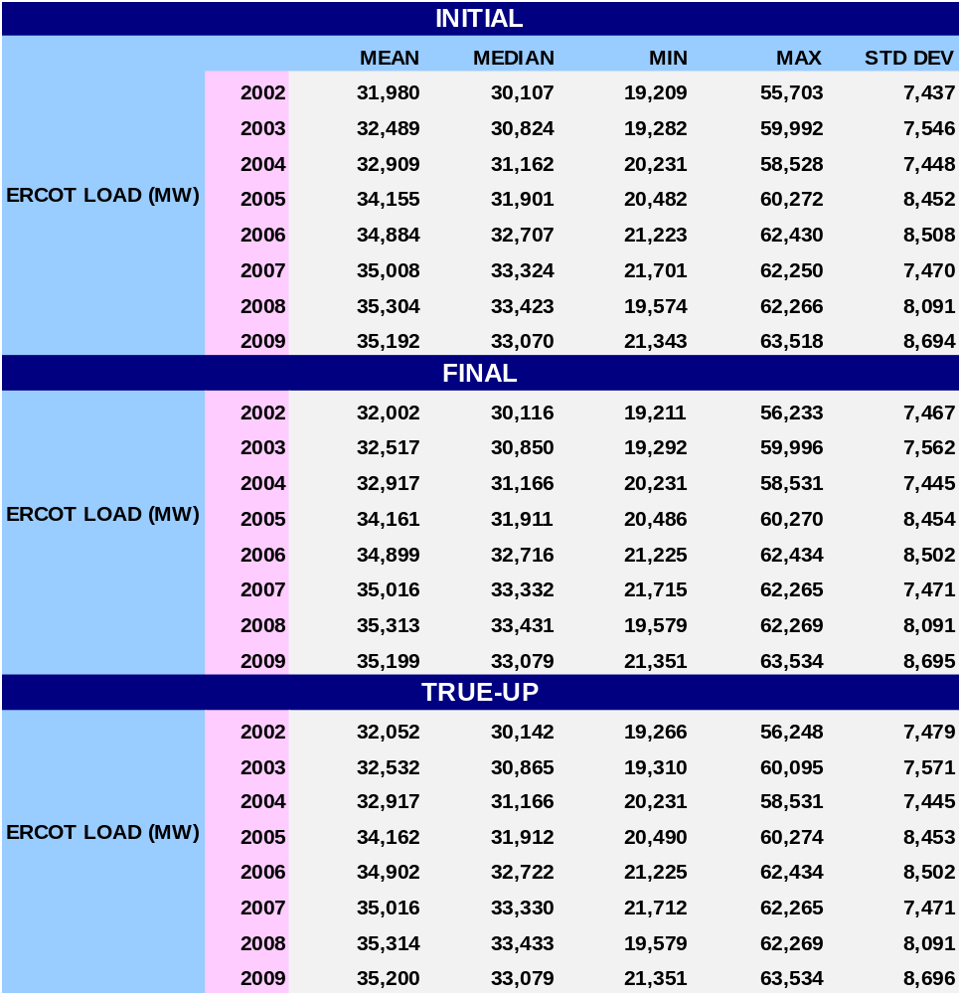
STATISTICAL SUMMARY - 2009
SR10

Slide 17
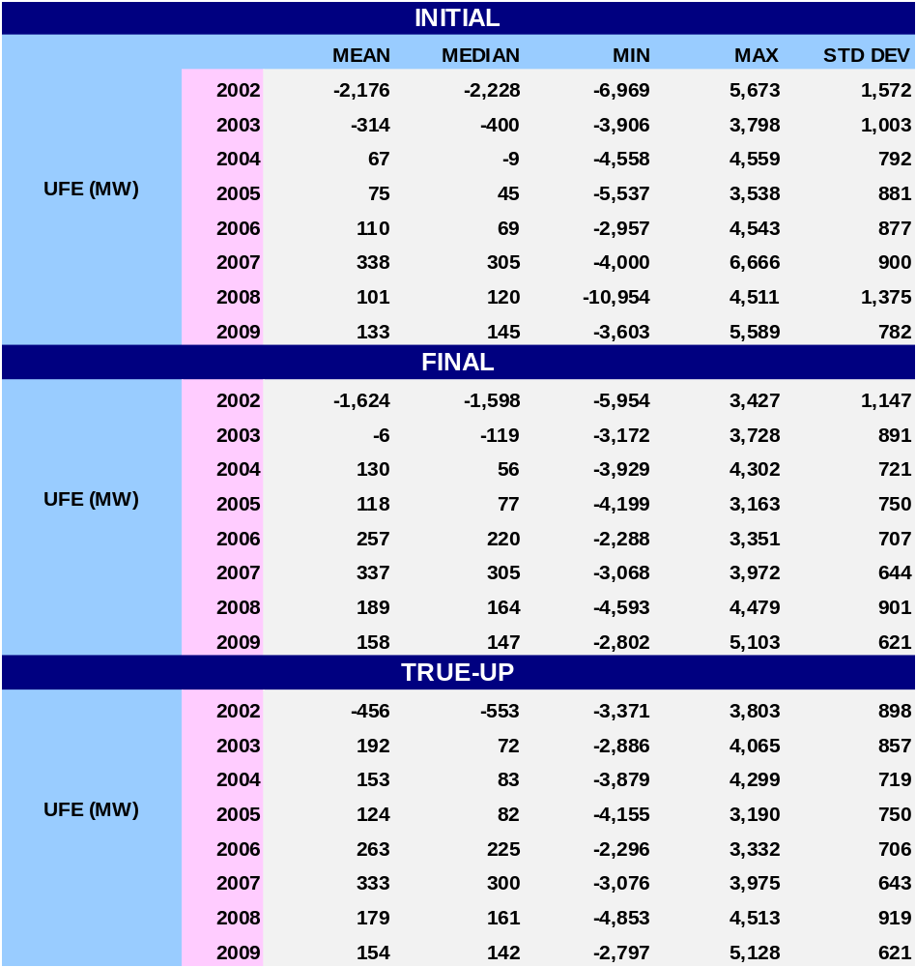
STATISTICAL SUMMARY - 2009
SR11a

Slide 18
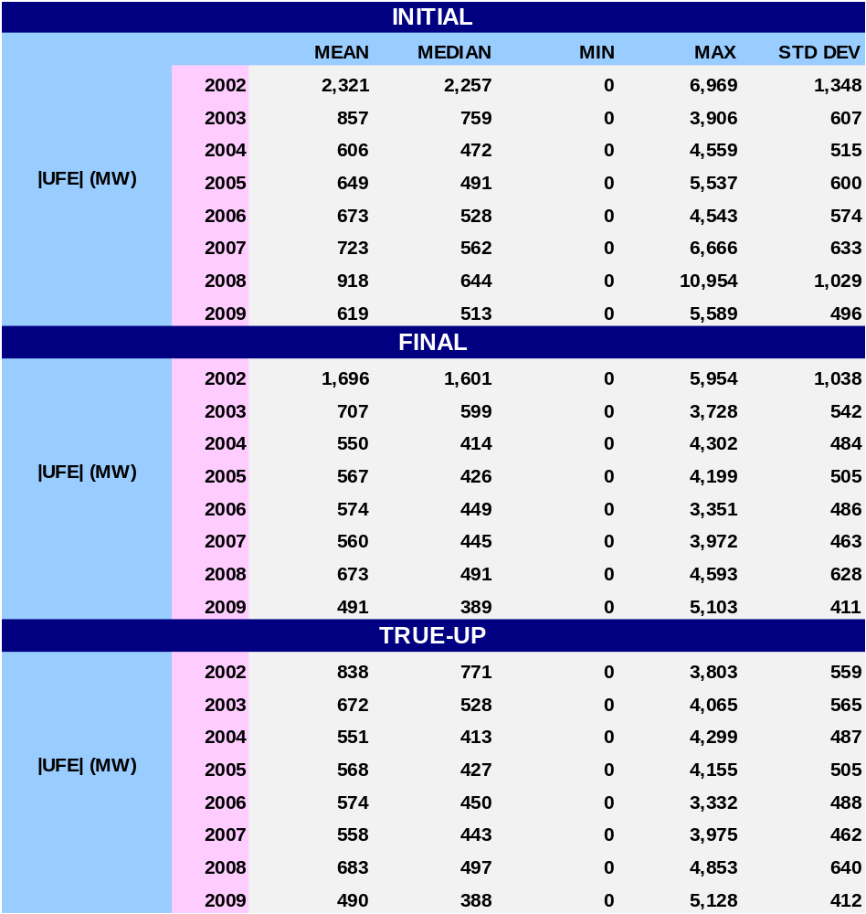
STATISTICAL SUMMARY - 2009
SR11b

Slide 19
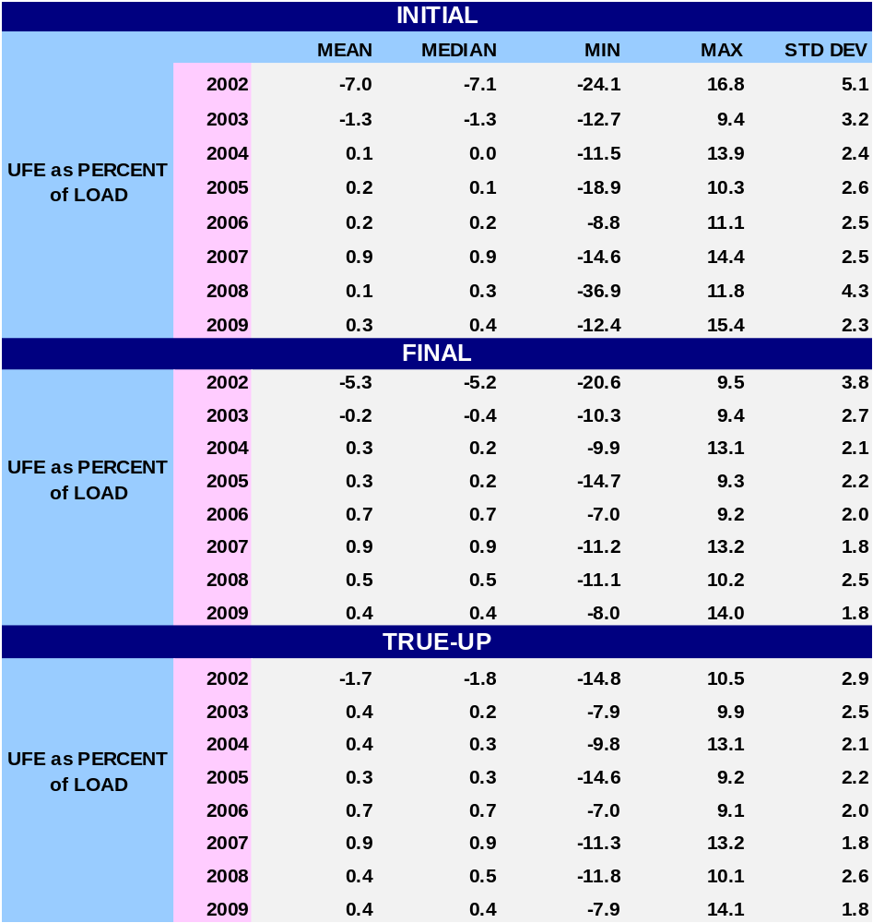
STATISTICAL SUMMARY - 2009
SR12a
Notes:
Last bullet – w/ regard to Mean and Median, UFE gets better with later settlements.

Slide 20
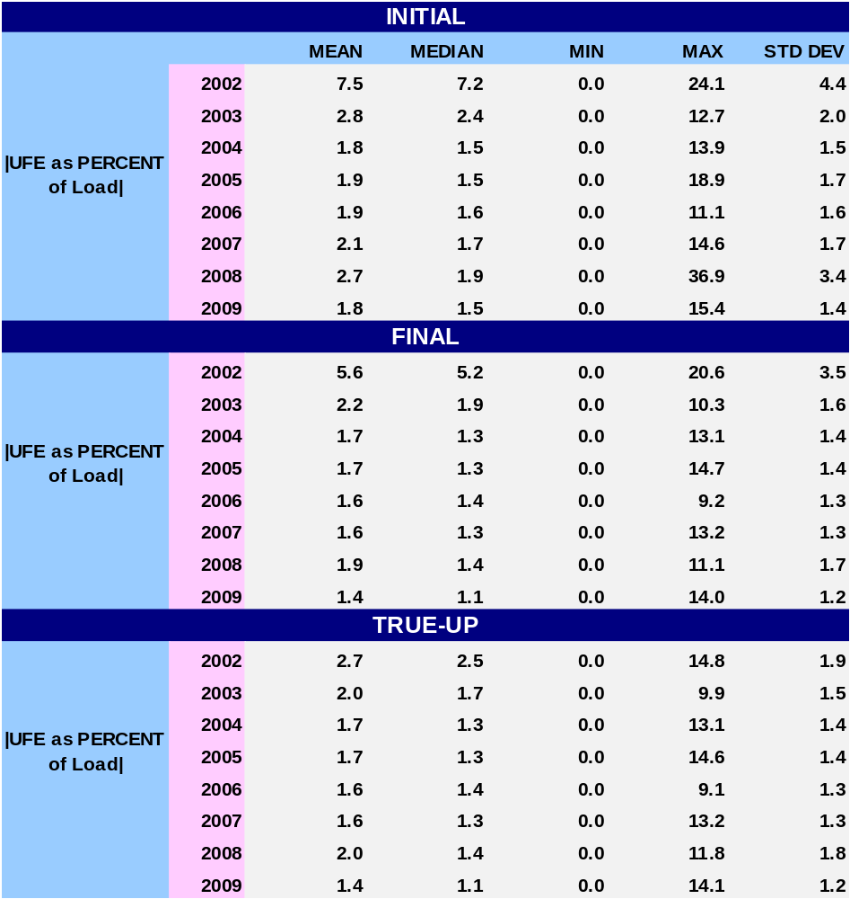
STATISTICAL SUMMARY - 2009
SR12b
Notes:
Last bullet – w/ regard to Mean and Median, UFE gets better with later settlements.

Slide 21
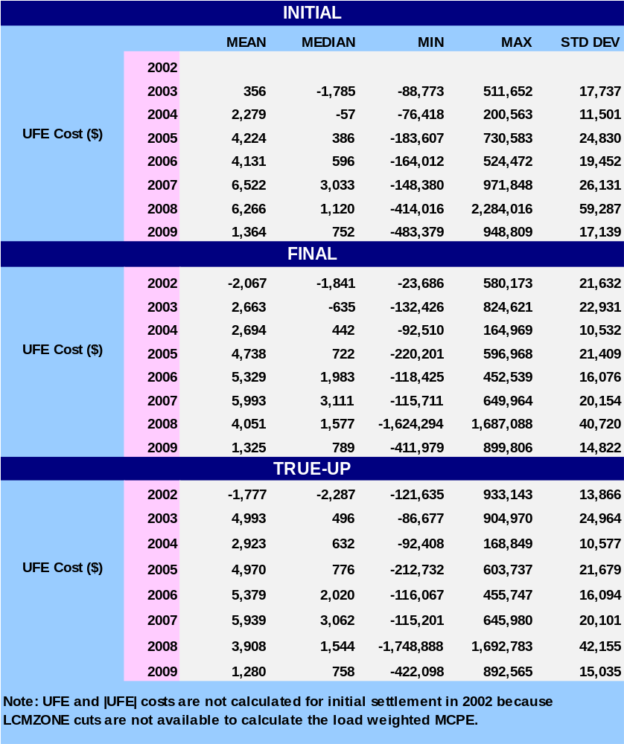
STATISTICAL SUMMARY - 2009
SR13a
Notes:
Last bullet – w/ regard to Mean and Median, UFE gets better with later settlements.

Slide 22
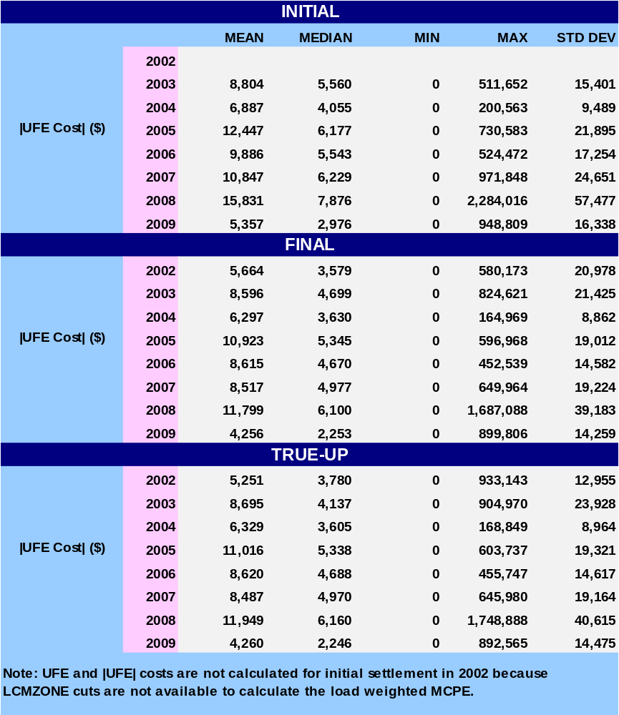
STATISTICAL SUMMARY - 2009
SR13b
Notes:
Last bullet – w/ regard to Mean and Median, UFE gets better with later settlements.

Slide 23
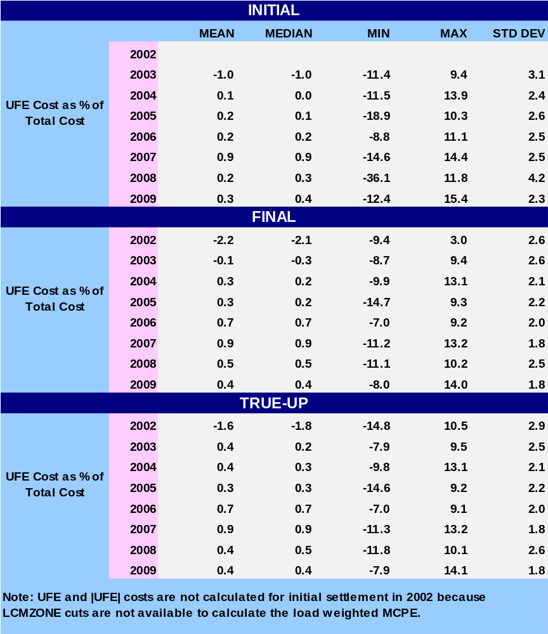
STATISTICAL SUMMARY - 2009
SR14a
Notes:
Last bullet – w/ regard to Mean and Median, UFE gets better with later settlements.

Slide 24
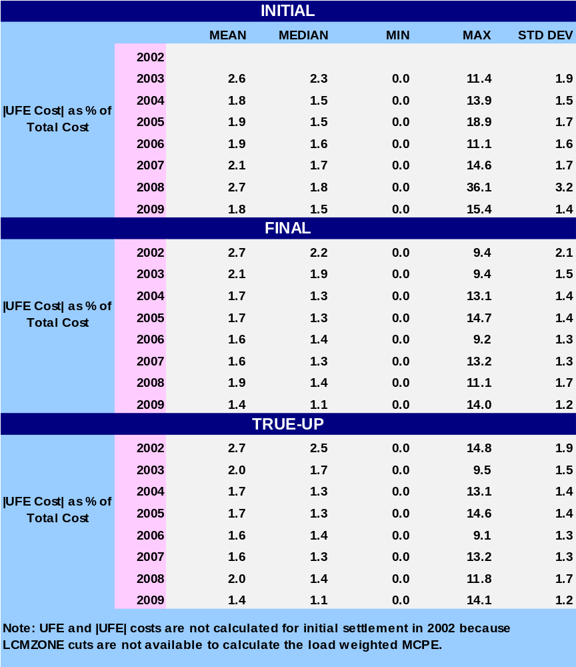
STATISTICAL SUMMARY - 2009
SR14b
Notes:
Last bullet – w/ regard to Mean and Median, UFE gets better with later settlements.

Slide 25
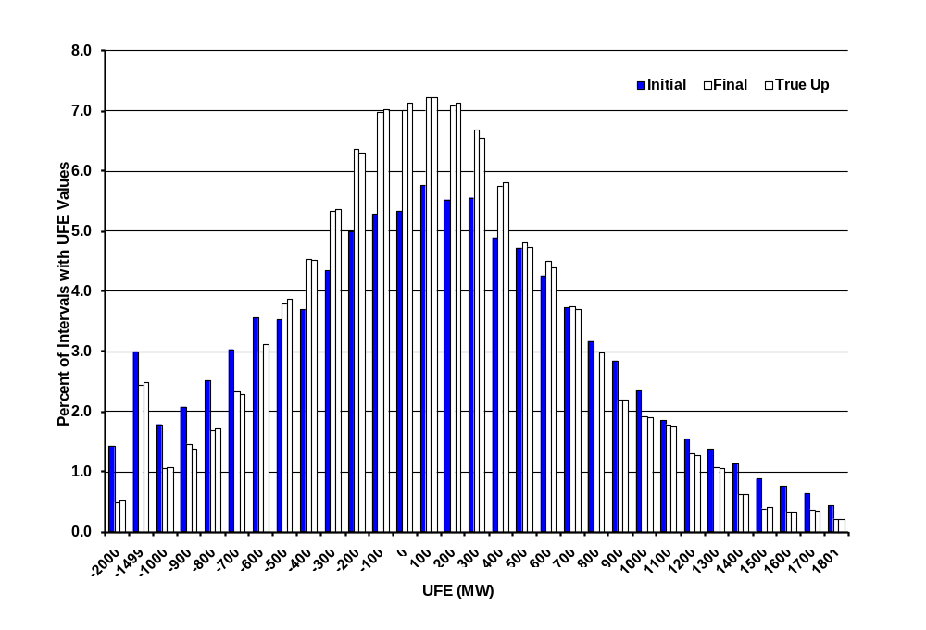
Distribution of UFE MW
Initial, Final, and True Up - 2009
UFD01
Notes:
UFE shifts in a positive direction from Initial to Final.

Slide 26
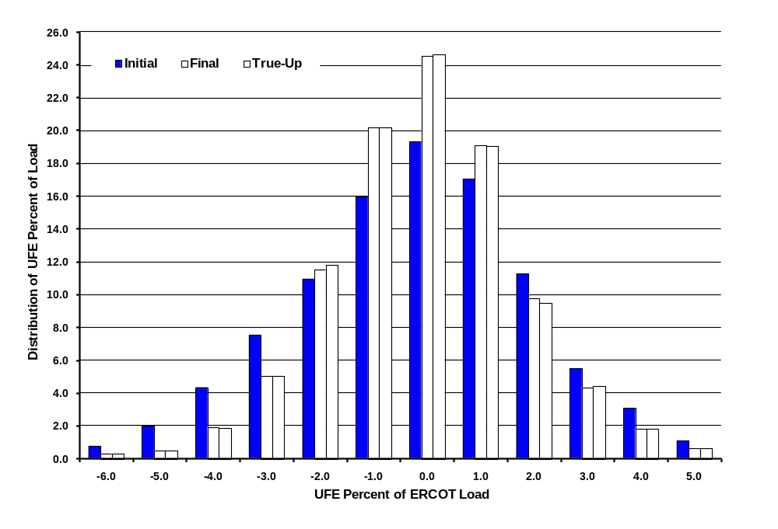
Distribution of UFE as Percent of Load - 2009
UFD03
Notes:
The UFE percent moves in a positive direction from Initial to Final thru True-Up.

Slide 27
COMPARISON OF 2007 TO 2009
To provide a frame of reference, some 2009 values are compared to 2007 values. The 2008 values were not used in these comparisons due to major impacts on UFE related to Hurricane Ike.

Slide 28
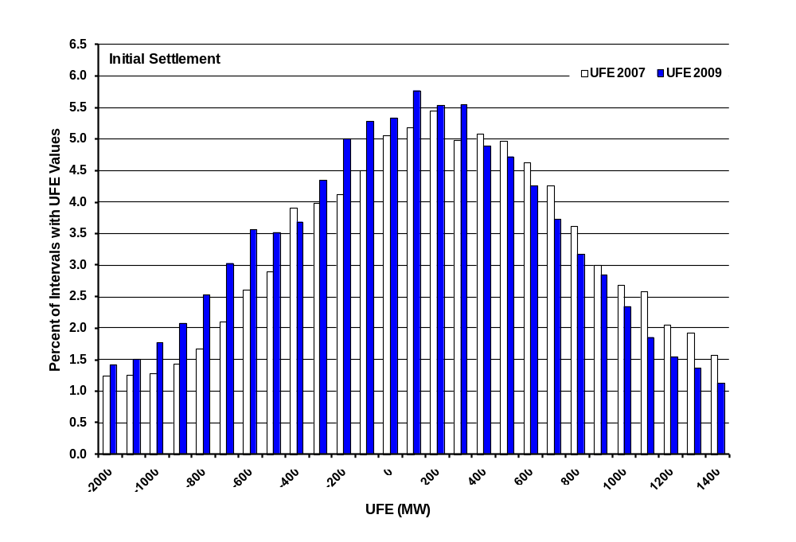
Distribution of UFE MW
2007 vs. 2009 - Initial Settlement
UFD04
Notes:
The UFE percent moves in a positive direction from Initial to Final thru True-Up.

Slide 29
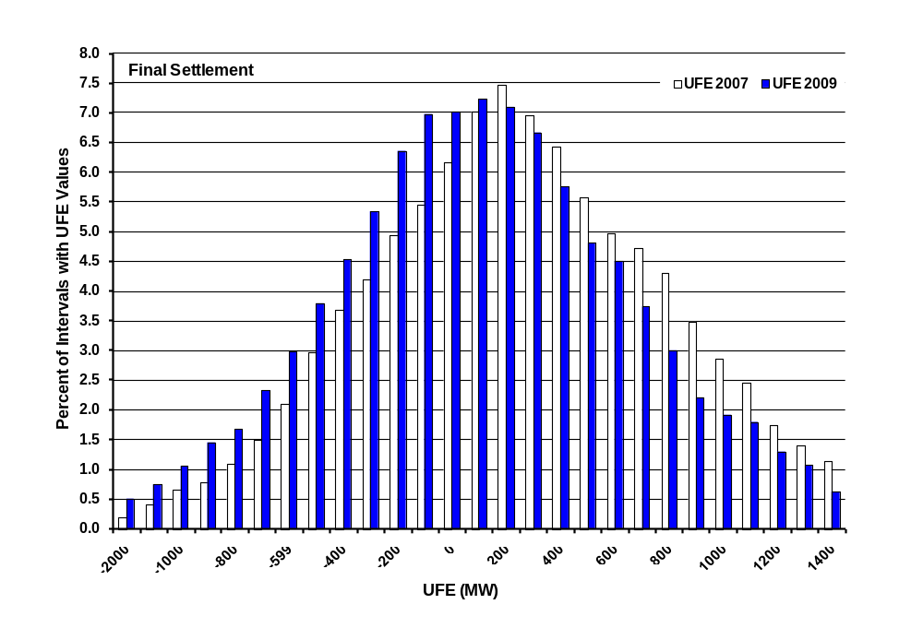
Distribution of UFE MW
2007 vs. 2009 - Final Settlement
UFD05
Notes:
The UFE percent moves in a positive direction from Initial to Final thru True-Up.

Slide 30
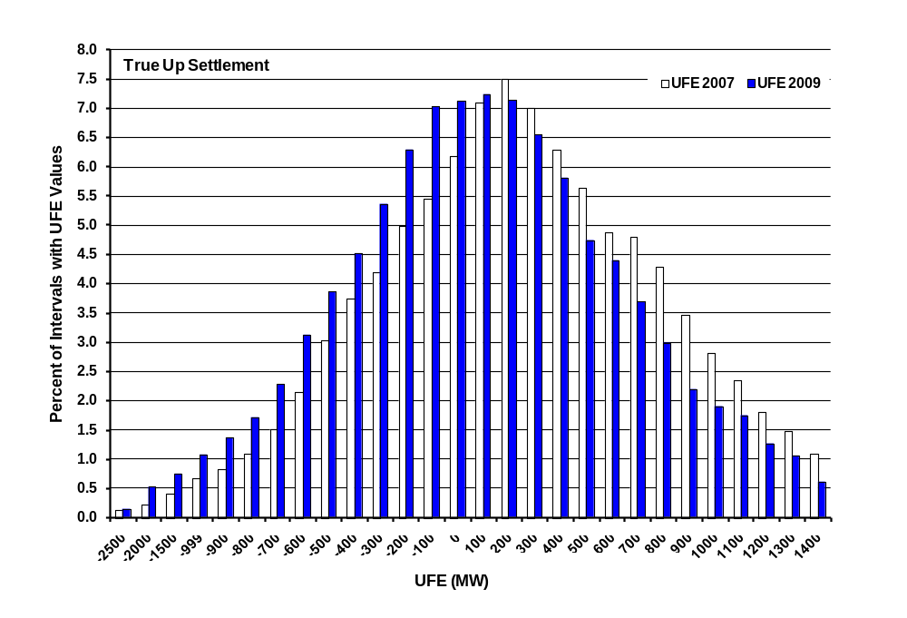
Distribution of UFE MW
2007 vs. 2009 – True Up Settlement
UFD06
Notes:
The UFE percent moves in a positive direction from Initial to Final thru True-Up.

Slide 31
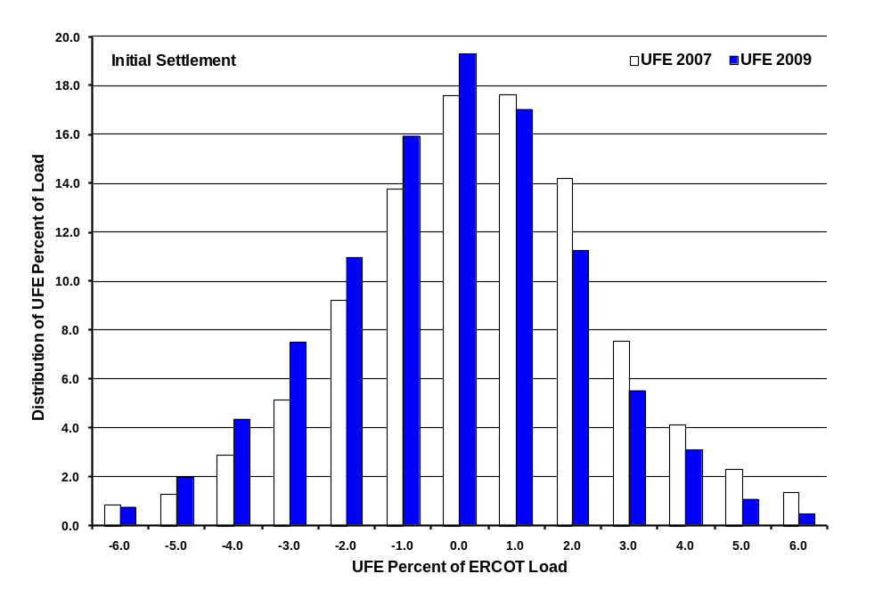
Distribution of UFE Percent of ERCOT Load
2007 vs 2009 – Initial Settlement
UFD07
Notes:
The UFE percent moves in a positive direction from Initial to Final thru True-Up.

Slide 32
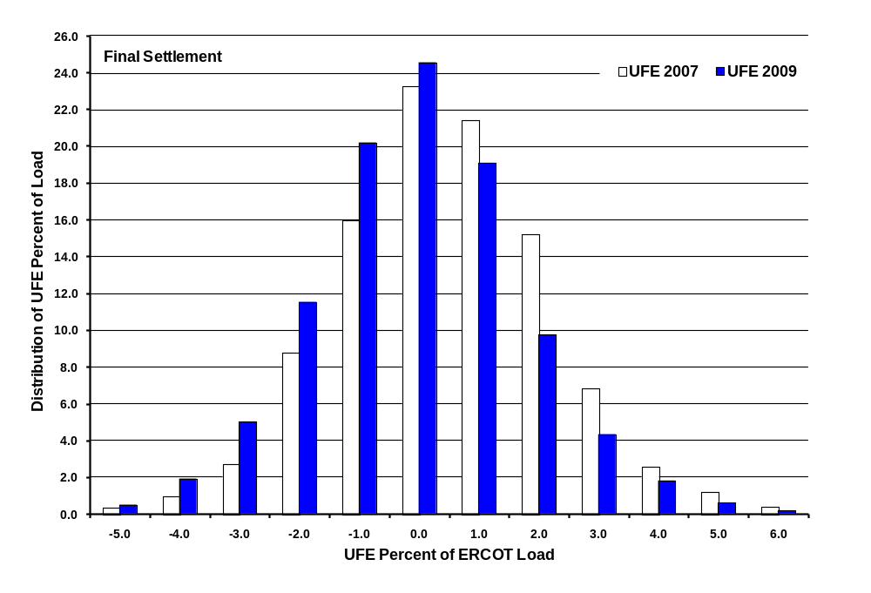
Distribution of UFE Percent of ERCOT Load
2007 vs 2009 – Final Settlement
UFD09
Notes:
The UFE percent moves in a positive direction from Initial to Final thru True-Up.

Slide 33
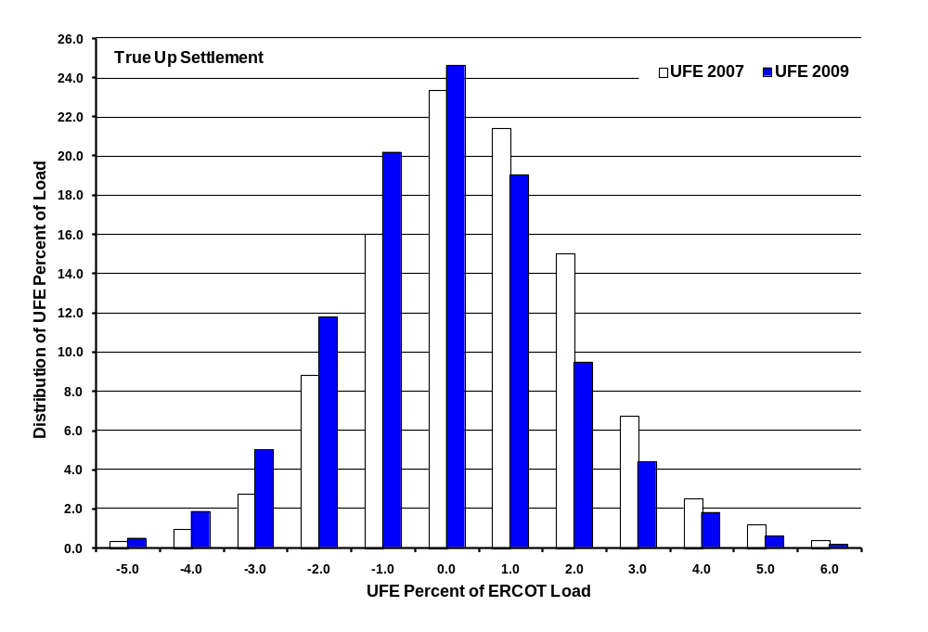
Distribution of UFE Percent of ERCOT Load
2007 vs 2009 – True Up Settlement
UFD09
Notes:
The UFE percent moves in a positive direction from Initial to Final thru True-Up.

Slide 34
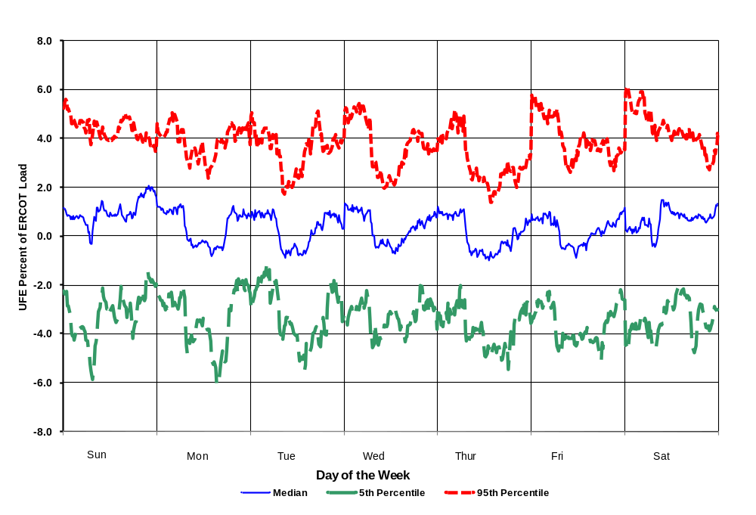
UFE Percent of ERCOT Load 2009
Initial Settlement plus
95% Confidence Intervals
CIP01
Notes:
Indicative of systematic estimation problem. Full year – blend of seasons. Seasonal detail comes later.

Slide 35
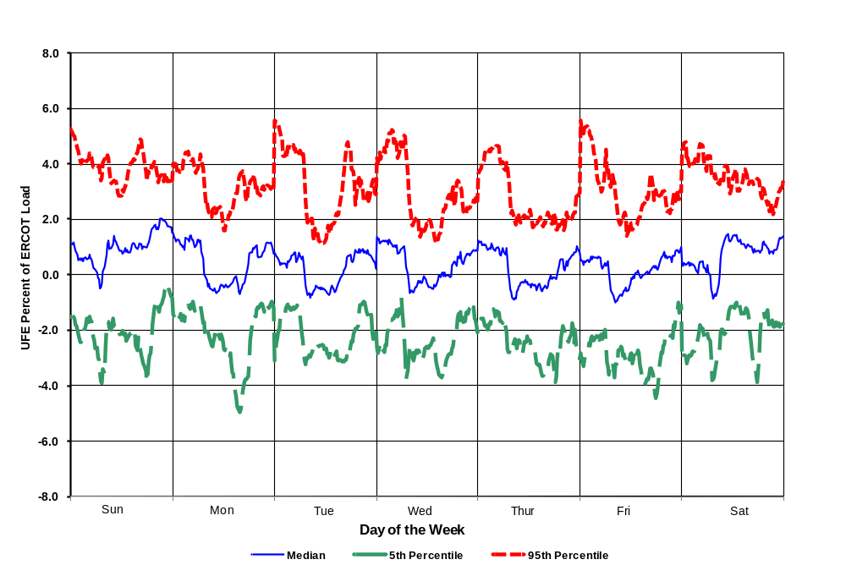
UFE Percent of ERCOT Load 2009
Final Settlement plus
95% Confidence Intervals
CIP02

Slide 36
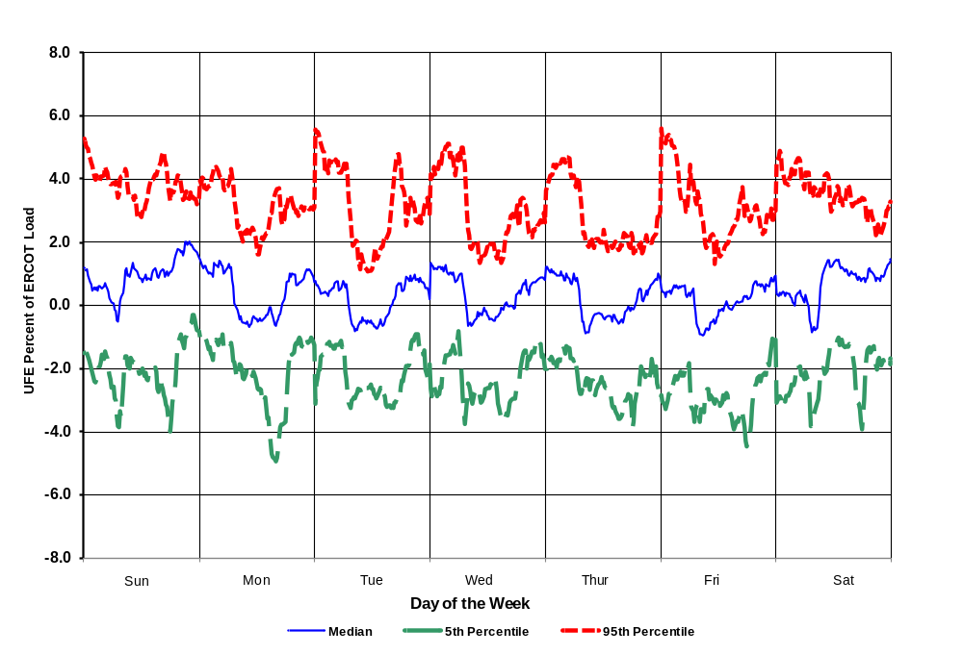
UFE Percent of ERCOT Load 2009
True-Up Settlement plus
95% Confidence Intervals
CIP03

Slide 37
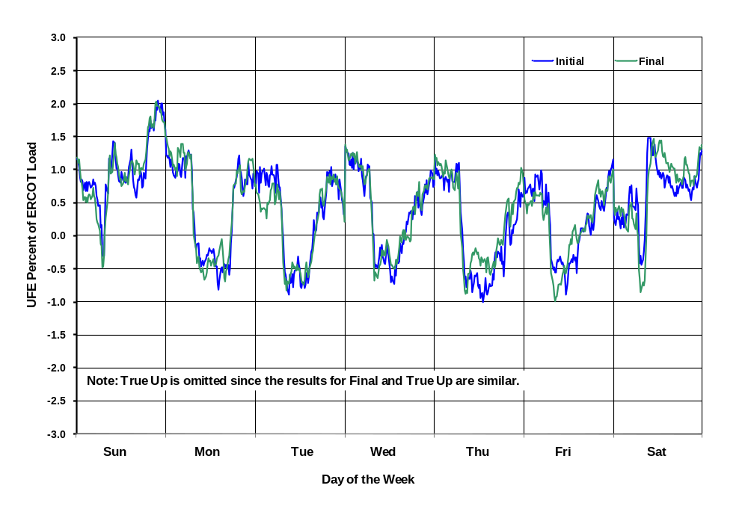
UFE Percent of ERCOT Load 2009
Comparison of Medians for Initial & Final
CIP04

Slide 38
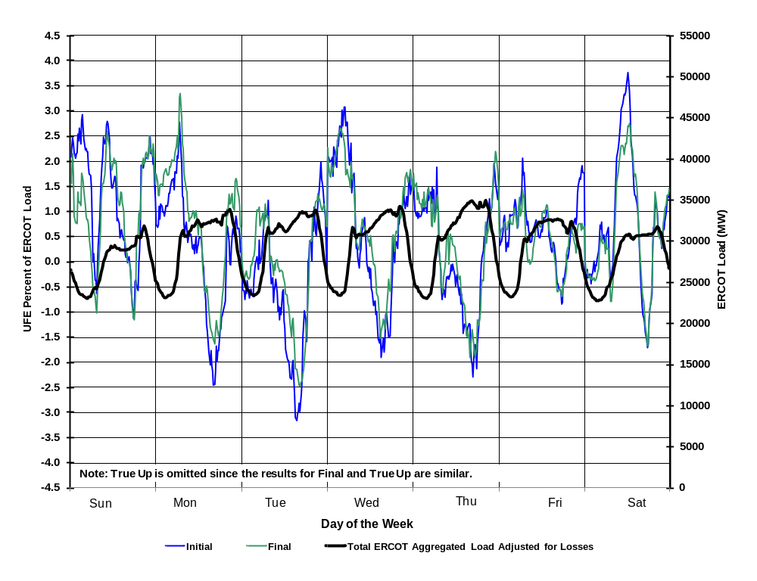
Seasonal Comparison - Spring 2009
UFE Percent of ERCOT Load and ERCOT Load
SEA01

Slide 39
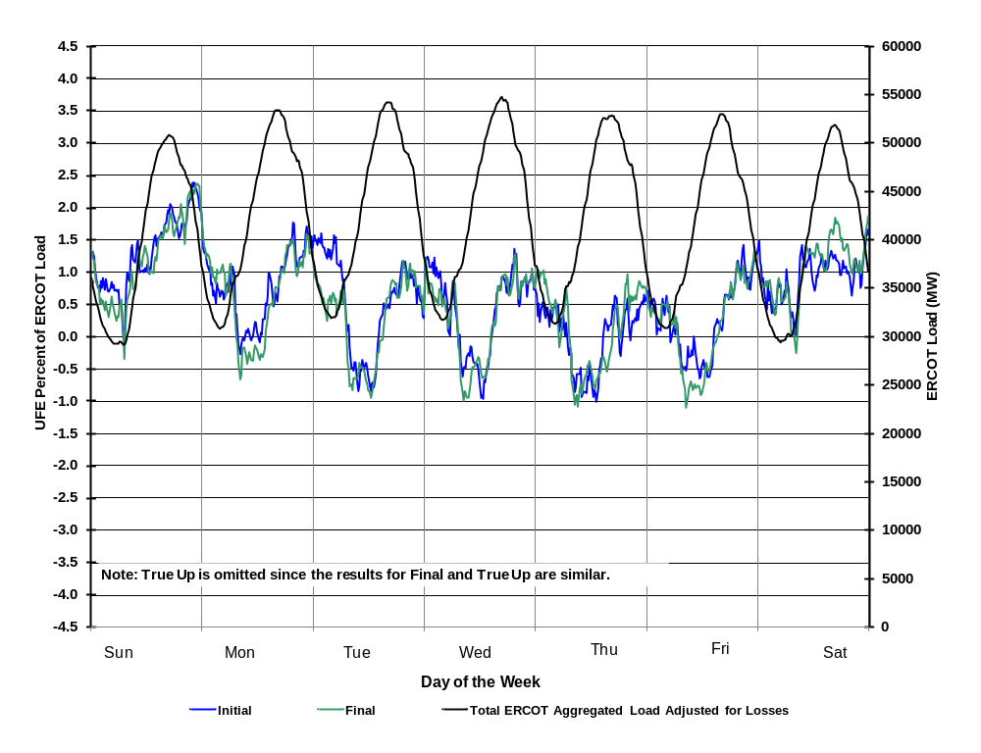
Seasonal Comparison - Summer 2009
UFE Percent of ERCOT Load and ERCOT Load
SEA02

Slide 40
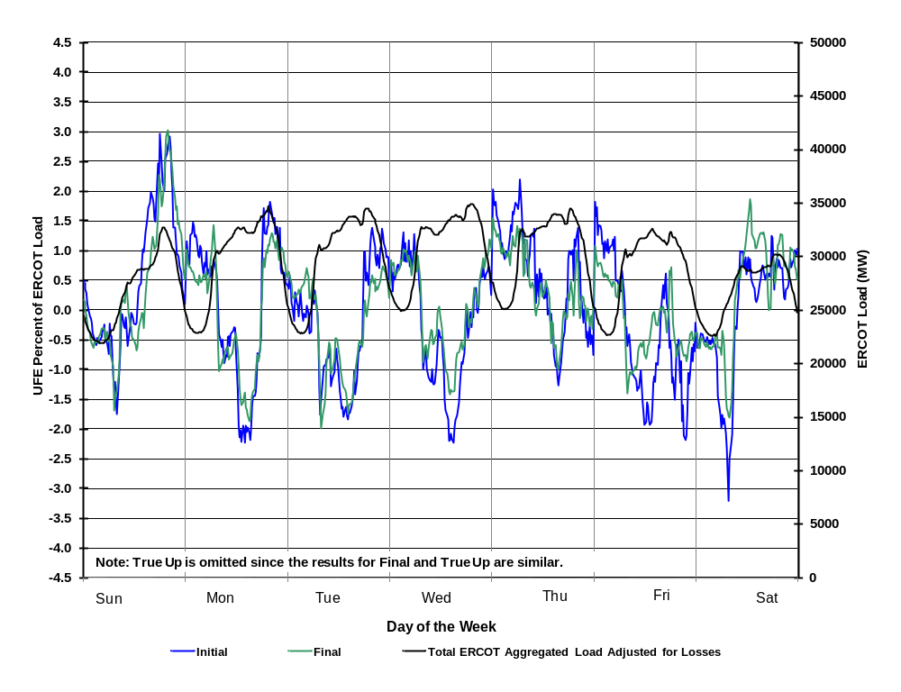
Seasonal Comparison - Fall 2009
UFE Percent of ERCOT Load and ERCOT Load
SEA03

Slide 41
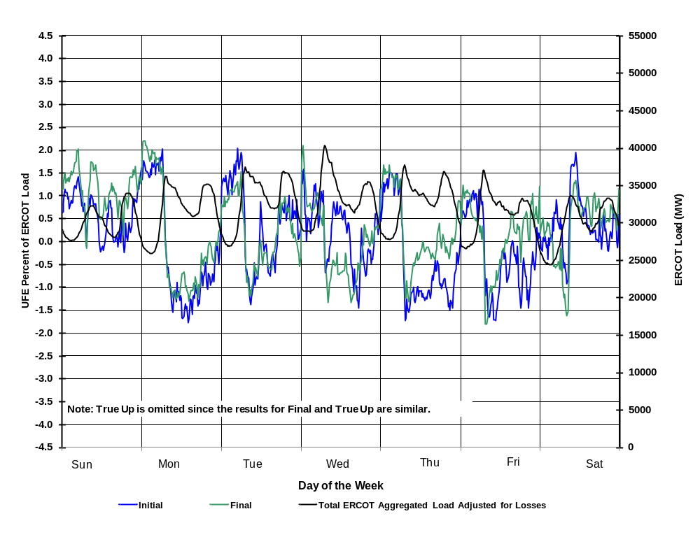
Seasonal Comparison - Winter 2009
UFE Percent of ERCOT Load and ERCOT Load
SEA04
Notes:
Looks like profiles are underestimating morning load, overestimating evening load.

Slide 42
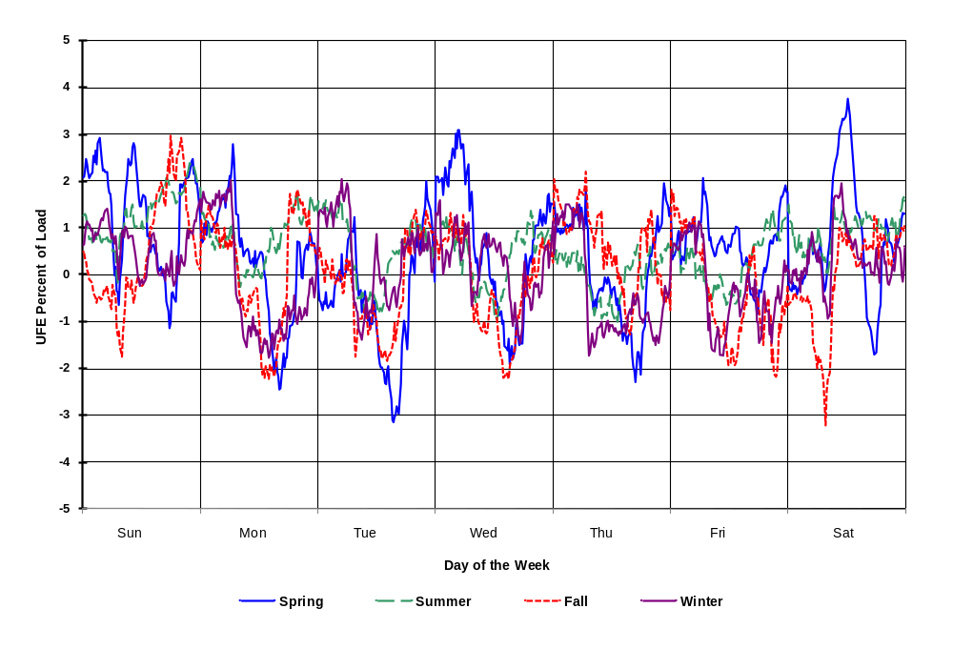
Seasonal Comparison of Medians – Initial Settlement
UFE Percent of ERCOT Load - 2009
SEA05
Notes:
Idea of seasonal differences by settlement.

Slide 43
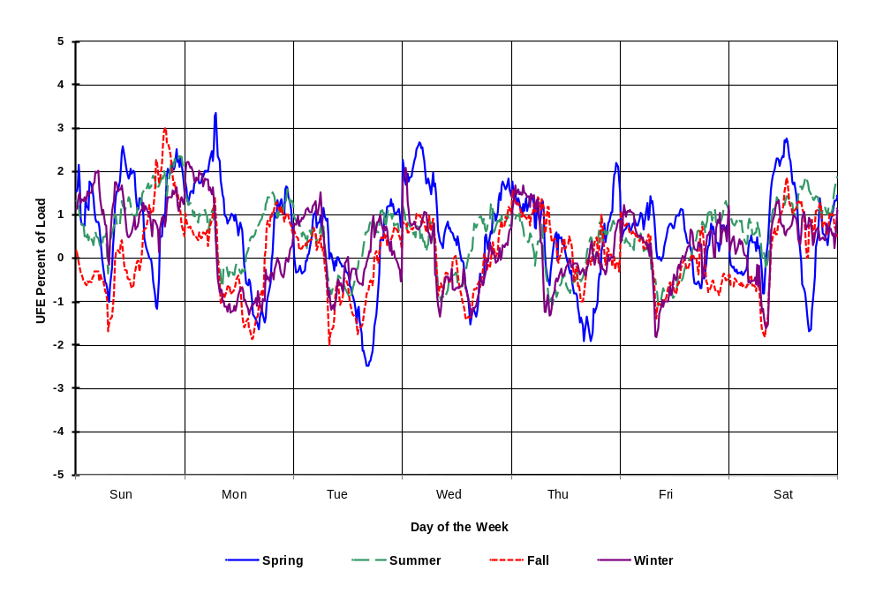
Seasonal Comparison of Medians – Final Settlement
UFE Percent of ERCOT Load - 2009
SEA06

Slide 44
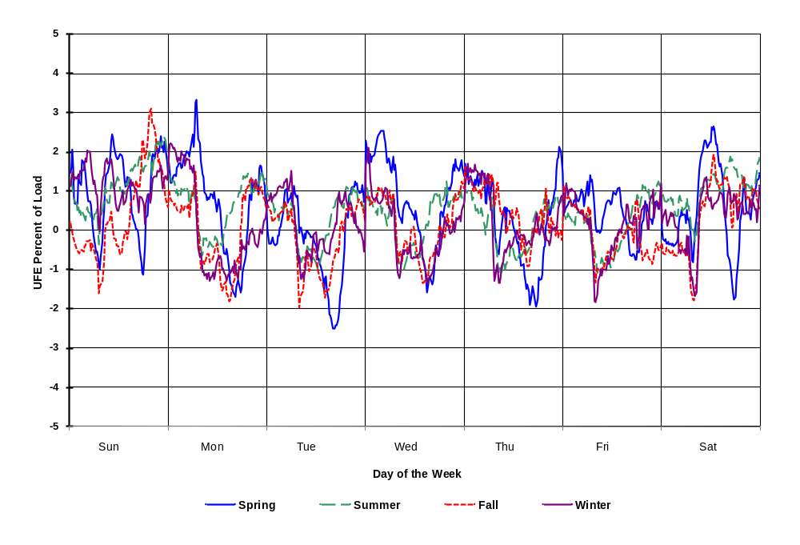
Seasonal Comparison of Medians – True Up
UFE Percent of ERCOT Load - 2009
SEA07

Slide 45
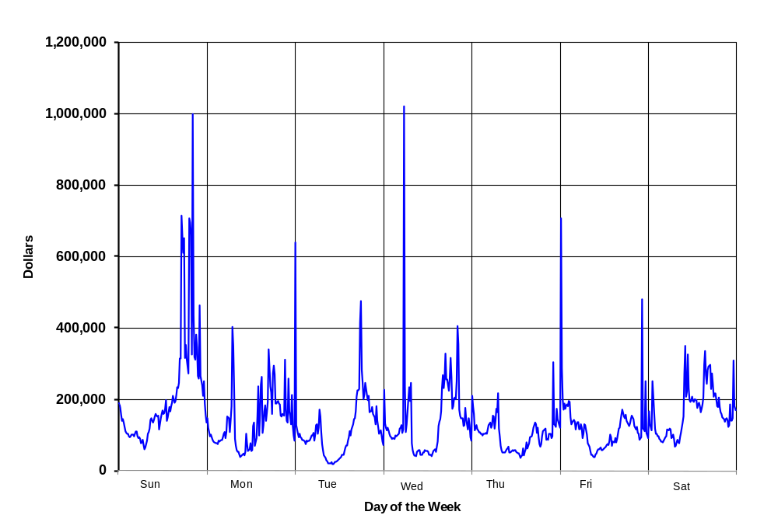
Sum of Dollars from Positive UFE across the Week in 2009
UCT02

Slide 46
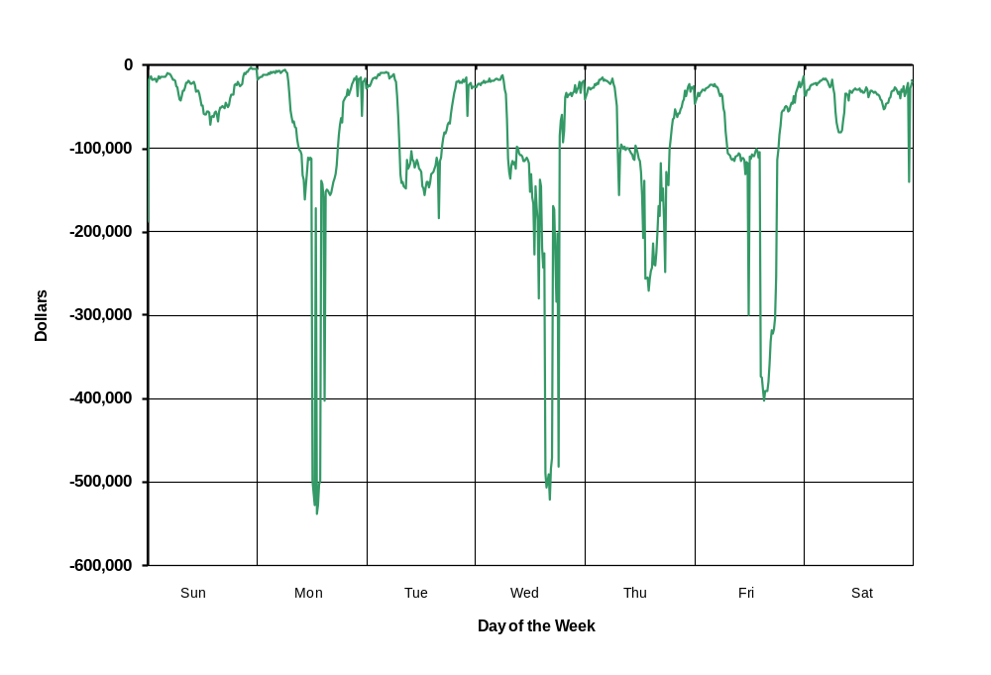
Sum of Dollars from Negative UFE across the Week in 2009
UCT03

Slide 47
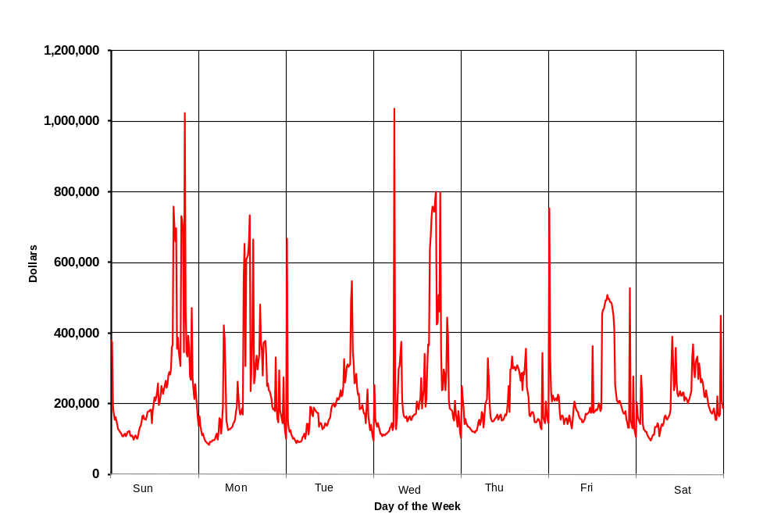
Sum of Dollars from Absolute Value of UFE across the Week in 2009
UCT04

Slide 48
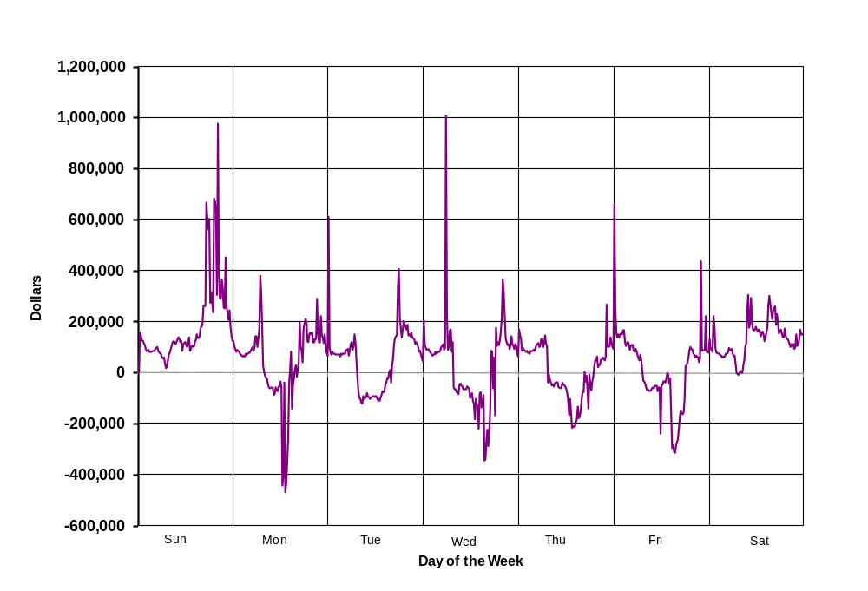
Sum of Dollars from Net UFE across the Week in 2009
UCT05

Slide 49
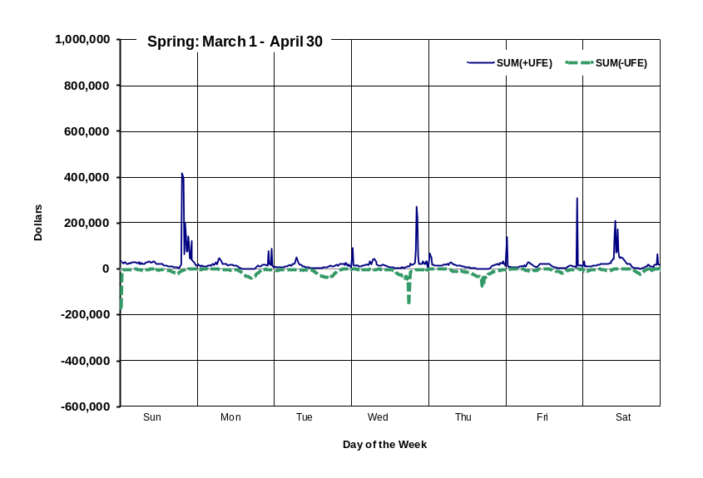
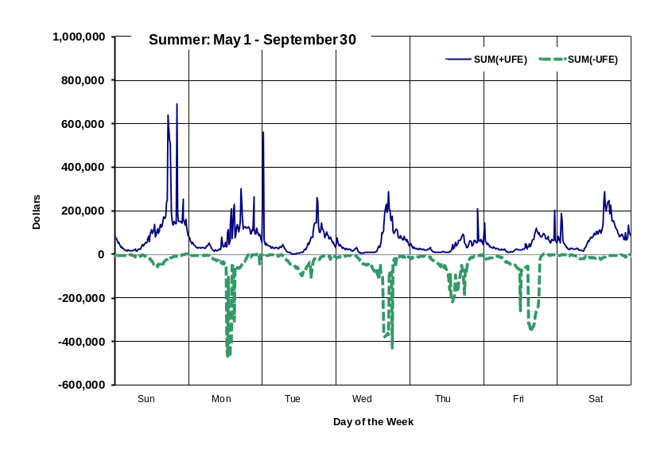
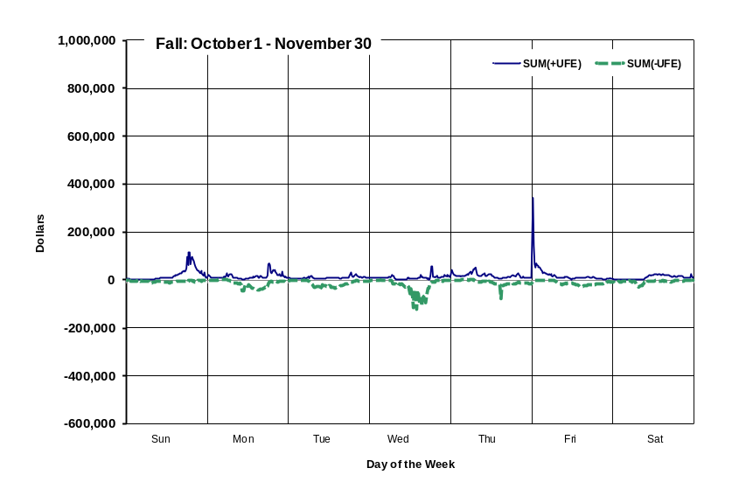
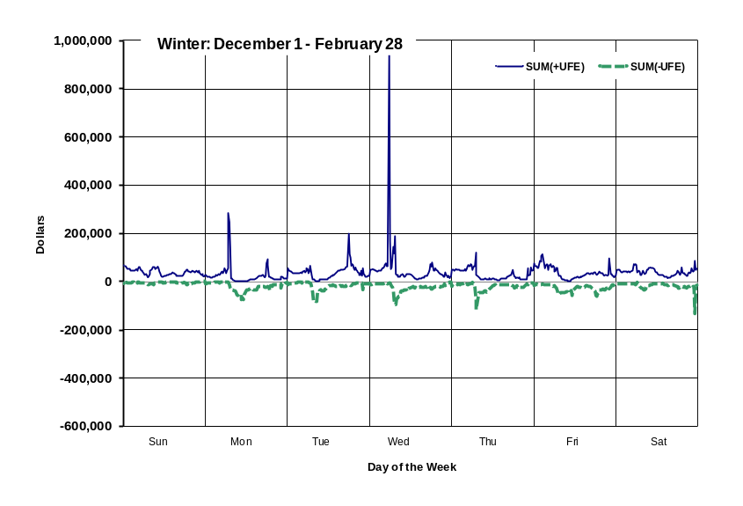
SUM of UFE Dollars
Compare All Seasons in 2009
Positive and Negative UFE
UCT06

Slide 50

SUM of UFE Dollars – Spring 2009
Positive and Negative UFE
UCT07

Slide 51

SUM of UFE Dollars – Summer 2009
Positive and Negative UFE
UCT08

Slide 52
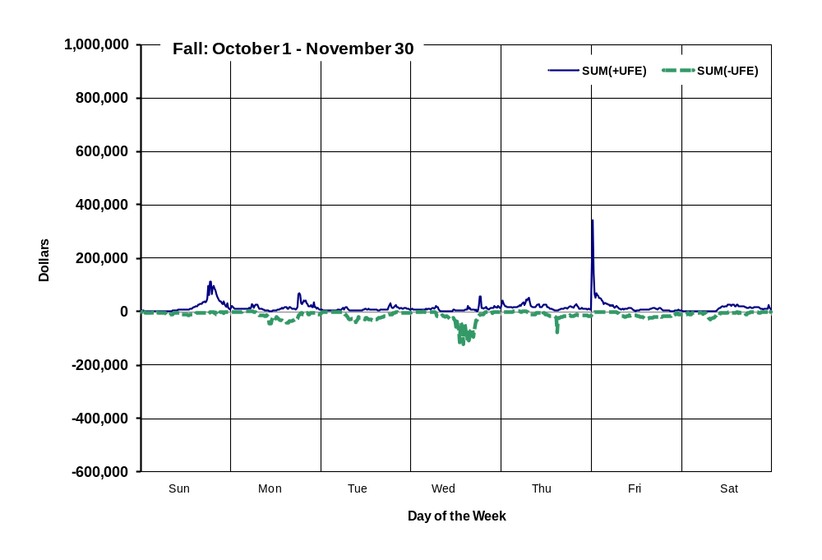
SUM of UFE Dollars – Fall 2009
Positive and Negative UFE
UCT09

Slide 53
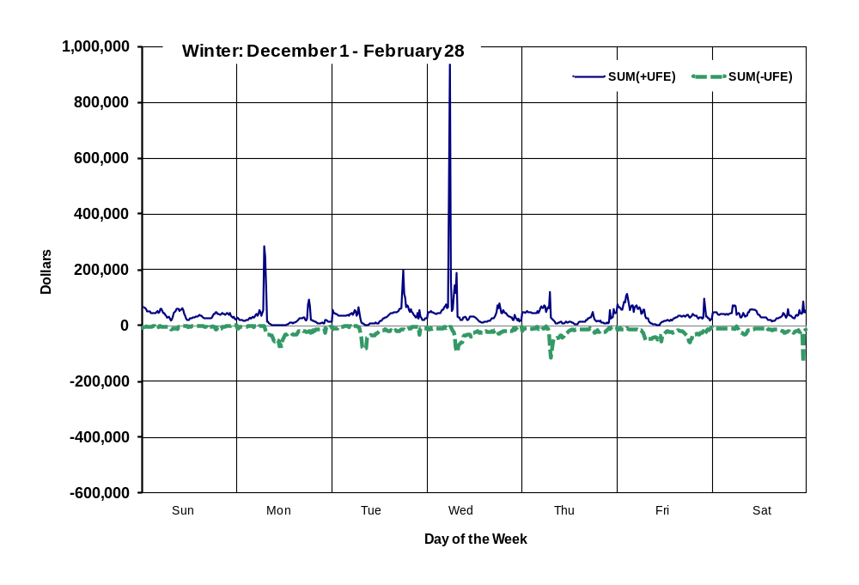
SUM of UFE Dollars – Winter 2009
Positive and Negative UFE
UCT10

Slide 54
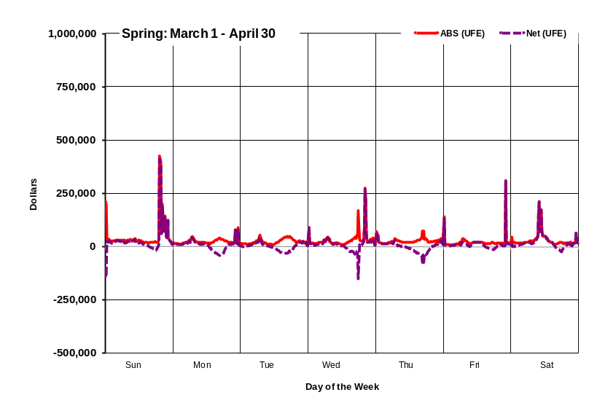



SUM of UFE Dollars
Compare All Seasons in 2009
Absolute Value and Net UFE
UCT11

Slide 55

SUM of UFE Dollars – Spring 2009
Absolute Value and Net UFE
UCT12

Slide 56

SUM of UFE Dollars – Summer 2009
Absolute Value and Net UFE
UCT13

Slide 57

SUM of UFE Dollars – Fall 2009
Absolute Value and Net UFE
UCT14

Slide 58

SUM of UFE Dollars – Winter 2009
Absolute Value and Net UFE
UCT15

Slide 59




Mean of UFE Dollars
Compare All Seasons in 2009
Positive and Negative UFE
UCT16

Slide 60

Mean of UFE Dollars – Spring 2009
Positive and Negative UFE
UCT17

Slide 61

Mean of UFE Dollars – Summer 2009
Positive and Negative UFE
UCT18

Slide 62

Mean of UFE Dollars – Fall 2009
Positive and Negative UFE
UCT19

Slide 63

Mean of UFE Dollars – Winter 2009
Positive and Negative UFE
UCT20

Slide 64




Mean of UFE Dollars
Compare All Seasons in 2009
Absolute Value and Net UFE
UCT21

Slide 65

Mean of UFE Dollars – Spring 2009
Absolute Value and Net UFE
UCT22

Slide 66

Mean of UFE Dollars – Summer 2009
Absolute Value and Net UFE
UCT23

Slide 67

Mean of UFE Dollars – Fall 2009
Absolute Value and Net UFE
UCT24

Slide 68

Mean of UFE Dollars – Winter 2009
Absolute Value and Net UFE
UCT25

Slide 69
UFE 2009 Analysis Observations
2009 values were compared to 2007 values. The 2008 values were not used due to Hurricane Ike related impacts on UFE.
No extreme weather events occurred in 2009.
Advanced meters were first used in settlements beginning late 2009.
Mean and median UFE (MW) and UFE as Percent of Load declined from 2007 values.
Mean and median UFE Cost ($) and UFE Cost as Percent of Total Cost declined from 2007 values.
Standard deviation values are trending lower.

