Slide 1


UFE 2002 ANALYSIS

Slide 2
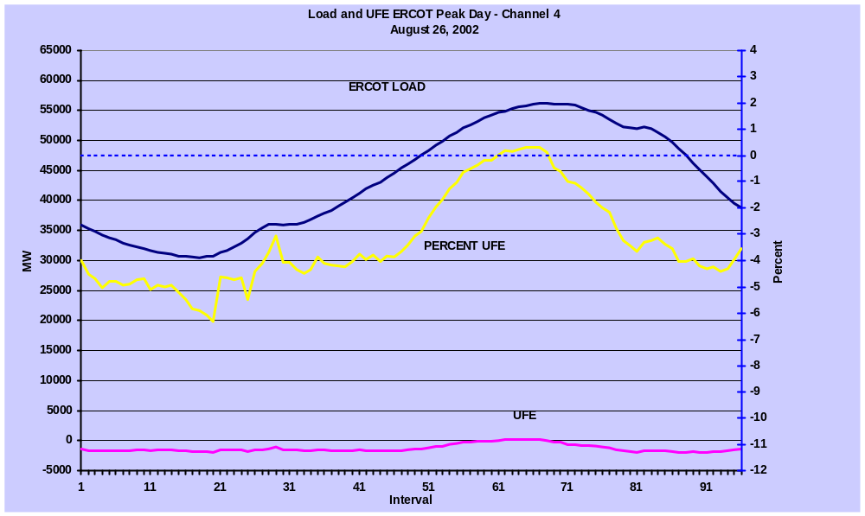

LOAD AND UFE – ERCOT PEAK 2002
This is a graphic depiction of load and UFE on the ERCOT Peak Day for 2002.

Slide 3
DETERMINING FACTORS
UFE (unaccounted for energy) is computed as follows:
UFE = Generation – (Load + Losses)
Sources of UFE include:
■ Generation Measurement Errors
■ Load – Missing/Erroneous Usage Data
– Model Error
■ Losses
– Model Error
Negative UFE generally indicates load/loss overestimated

Slide 4
DATA VERIFICATION
UFE is computed for each each interval at the time of a settlement and assigned a channel number.
Channel 1 – initial
(17 days after the trade day)
Channel 4 – final
(59 days after the trade day)
Channels 5 - 9 – true-up and resettlements all assigned to channel 9 for this analysis (6 months – up to 1 year after)
CHANNEL 4
Settlement
CHANNEL 1
CHANNEL 9

Slide 5
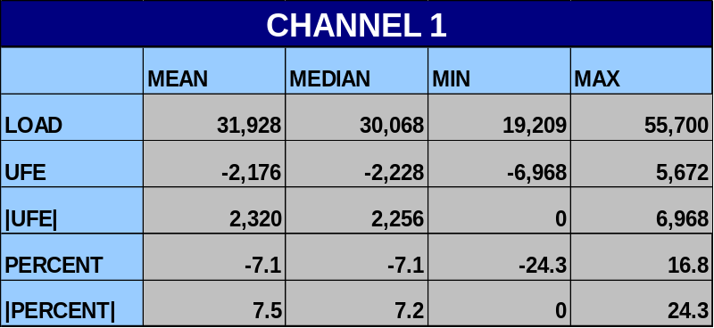
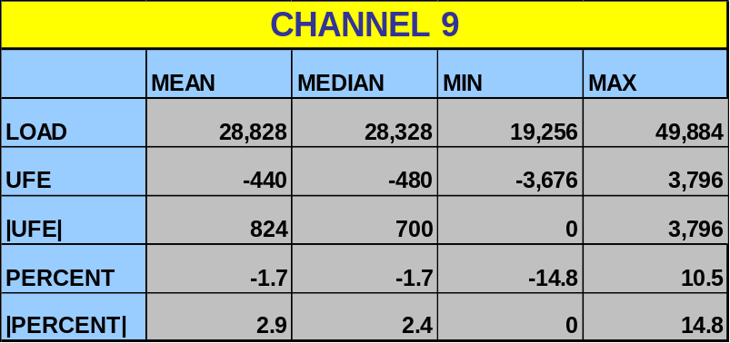
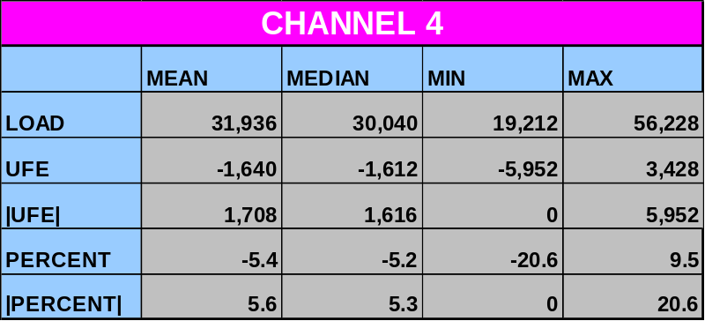
STATISTICAL RESULTS
UFE has a significant negative bias.
Mean and Median UFE values are similar … the distributions are not skewed.
As Channel increases from 1 to 9 UFE gets closer to 0.
Thus, usage data loading improves UFE.

Slide 6
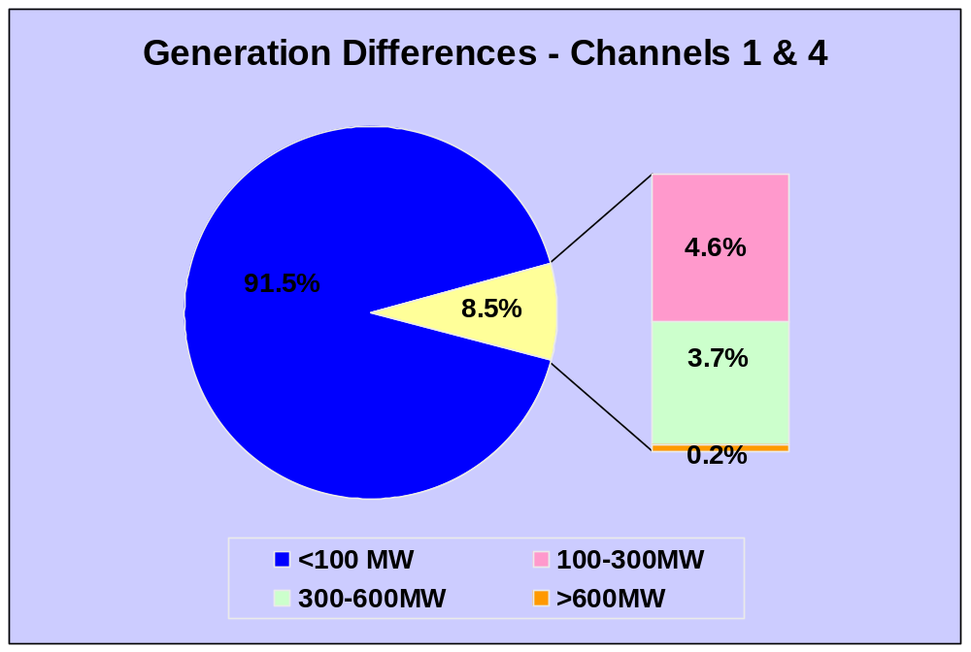
GENERATION DIFFERENCES BETWEEN CHANNELS 1 & 4
Only 8.5% of the intervals had channel 1 to channel 4 differences greater than 100MW.
Differences greater than 300 MW occurred for only 3.9% of the intervals.

Slide 7
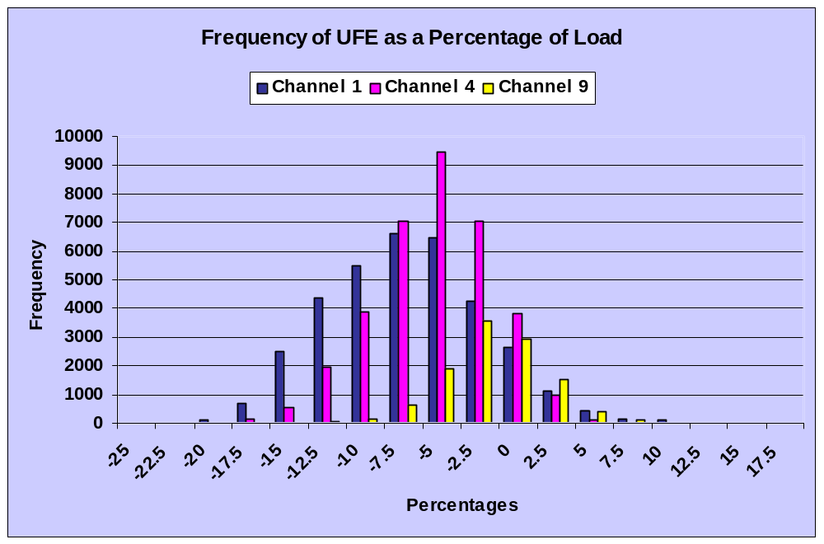
Distribution of UFE Percent
The distribution of UFE percentages is negatively biased for all channels.
Channel 4 has a tighter distribution and is closer to 0 than channel 1.
Similarly, channel 9 is better than channel 4.

Slide 8
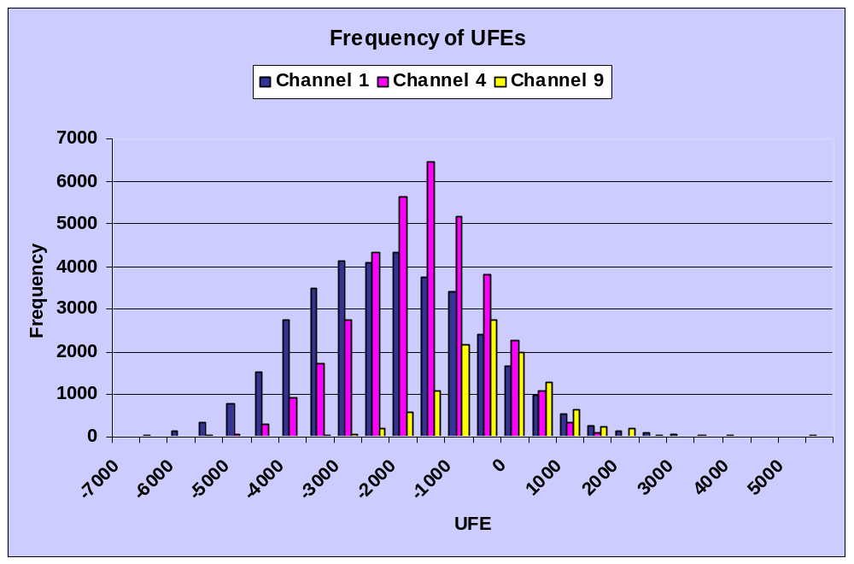
Distribution of UFE MW
The distribution of MW shows a similar pattern.

Slide 9
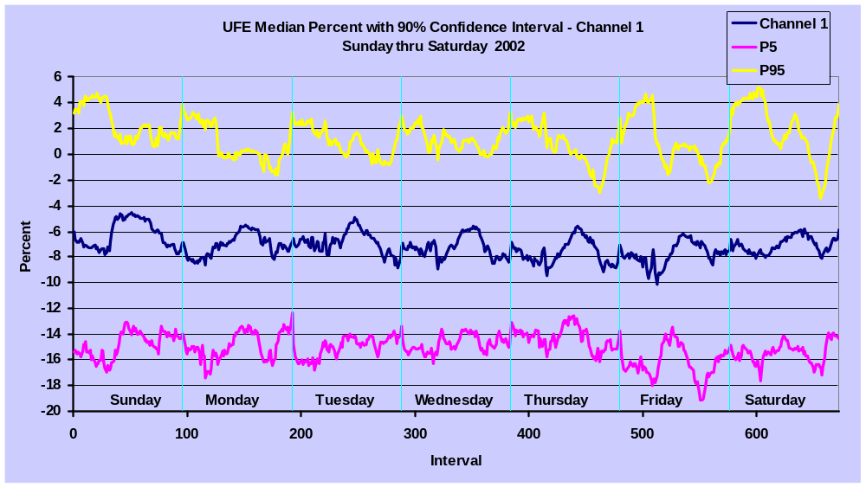
UFE CONFIDENCE INTERVAL
CHANNEL 1
The percentile graphs show that UFE varies over a wide range for the year and is predominantly negative.

Slide 10
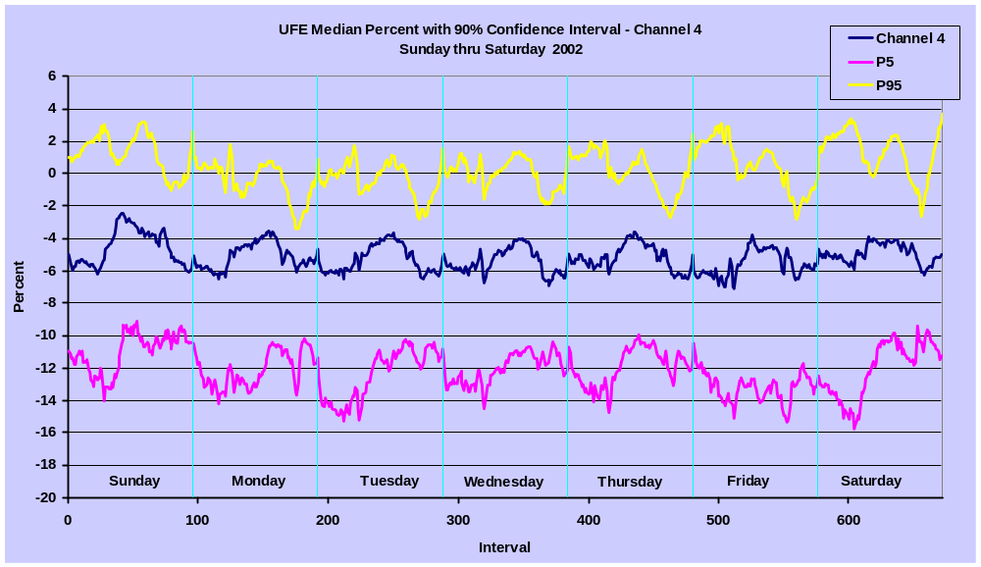
UFE CONFIDENCE INTERVAL
CHANNEL 4
The percentile graphs for Channel 4 are closer to the median but still show a wide variability in UFE and negative bias.

Slide 11
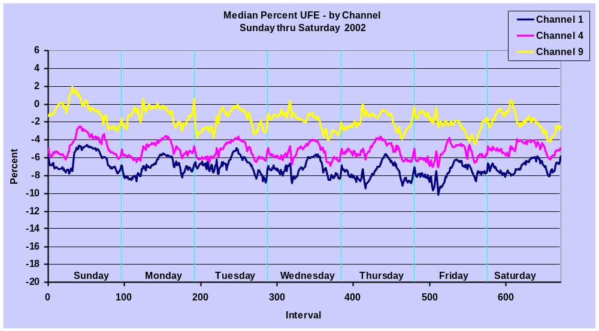
ANNUAL MEDIAN UFEs by CHANNEL
The median UFE value improves as the Channel increases across all days of the week. For all Channels there is evidence of a cyclical component of UFE across day-types.
UFE is generally better during the middle of the day than during morning and evening hours.

Slide 12
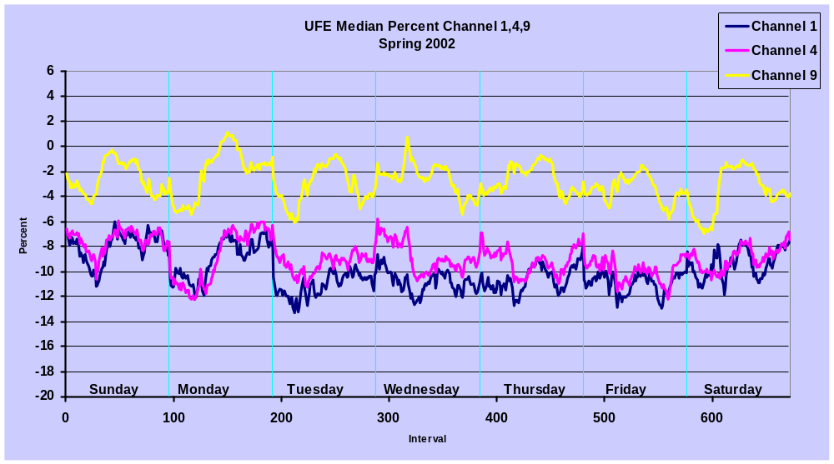
SPRING COMPARISON - CHANNELS 1, 4, 9
UFE for Channels 1 and 4 are similar while Channel 9 shows significant improvement. All are negatively biased and somewhat cyclical.
Data loading issues affected initial and final settlements during the beginning of 2002.

Slide 13
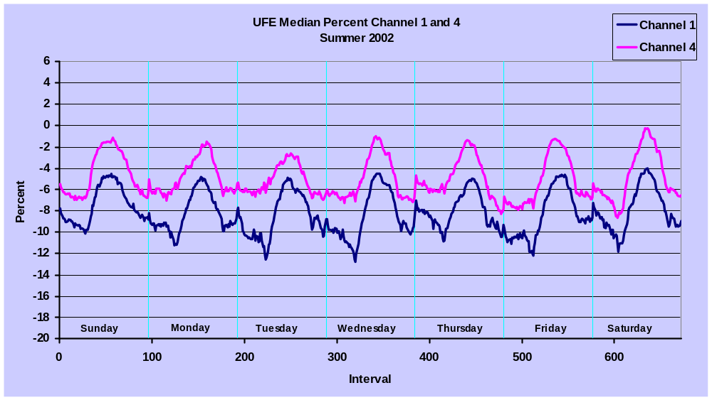
SUMMER COMPARISON - CHANNELS 1 & 4
Channel 4 shows significant improvement over Channel 1 … Channel 9 is missing because true-up settlements have been suspended.
The UFE pattern is very cyclical by time of day and similar across day-types. On-peak UFE is significantly better than off-peak.

Slide 14
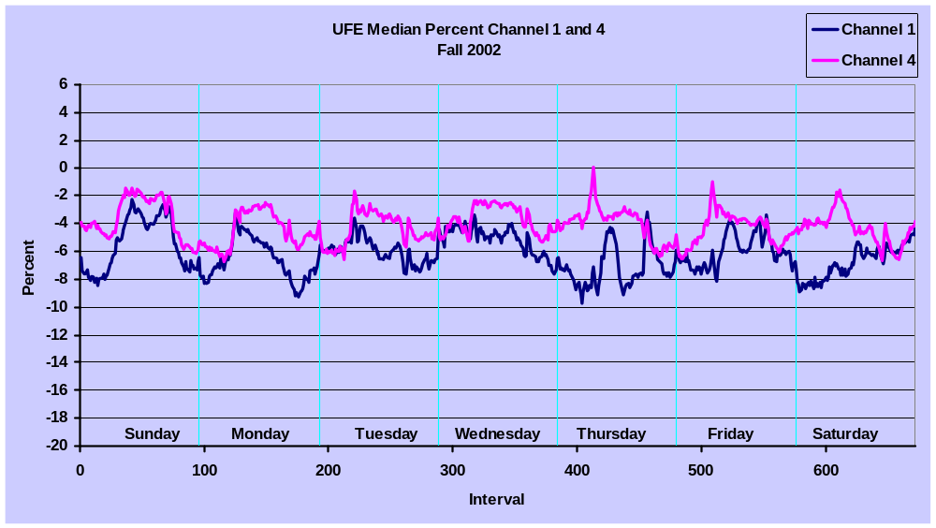
FALL COMPARISON - CHANNELS 1 & 4
Channel 4 shows some improvement over Channel 1 … Channel 9 is missing because true-up settlements have been suspended.
The UFE pattern is somewhat cyclical by time of day and similar across day-types. On-peak UFE is better than off-peak.

Slide 15
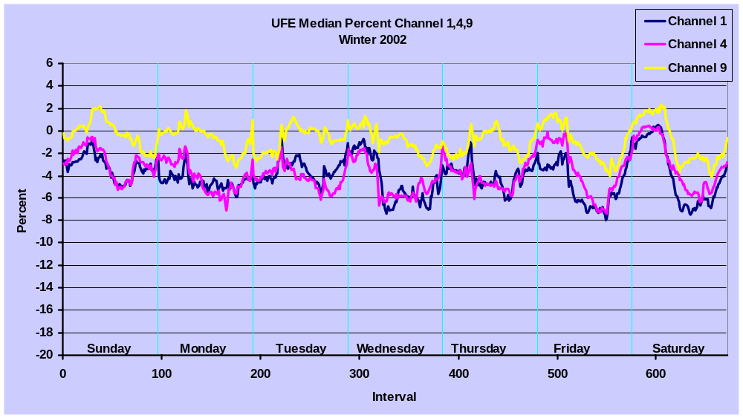
WINTER COMPARISON - CHANNELS 1,4,9
UFE for Channels 1 and 4 are similar while Channel 9 shows significant improvement. All are negatively biased and somewhat cyclical.
Data loading issues affected initial and final settlements during January and February of 2002.

Slide 16
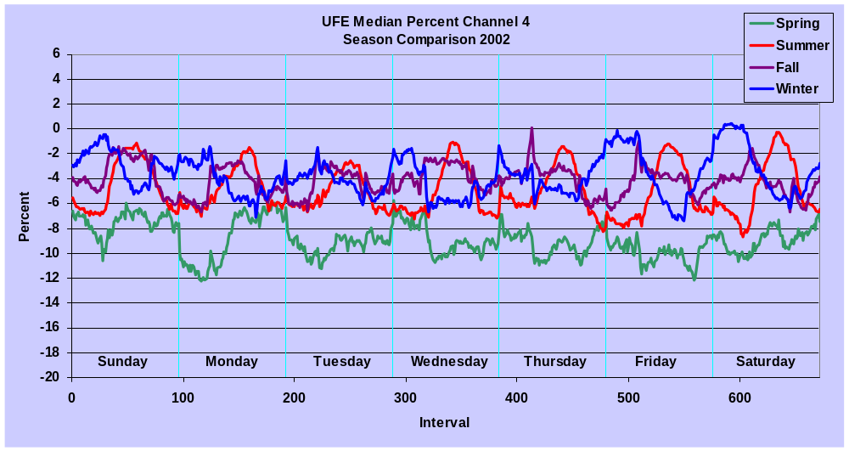
SEASONAL UFE COMPARISONS
Spring UFE pattern is worse than the other seasons as a result of data loading issues.
UFE for the other seasons is similar in magnitude.
Winter UFE cycle is different than the other seasons and is better than spring in spite of the data loading issues.

Slide 17
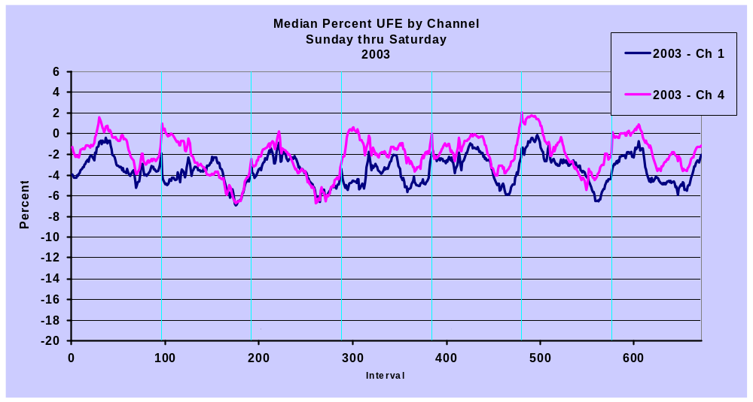
2003 Median UFE by Channel
UFE improves slightly between Channel 1 and Channel 4.
UFE levels are improved from Channel 1 and Channel 4 in 2002.

Slide 18
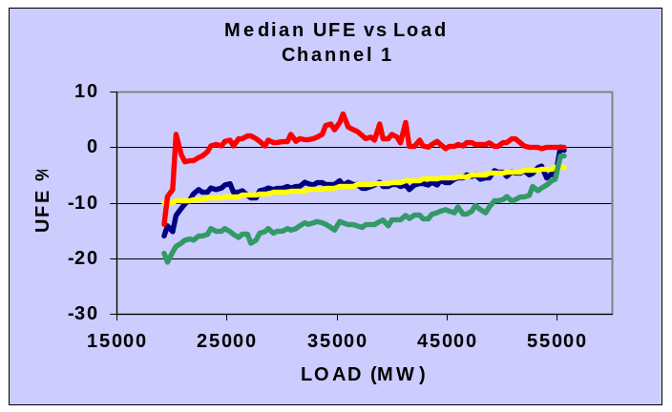
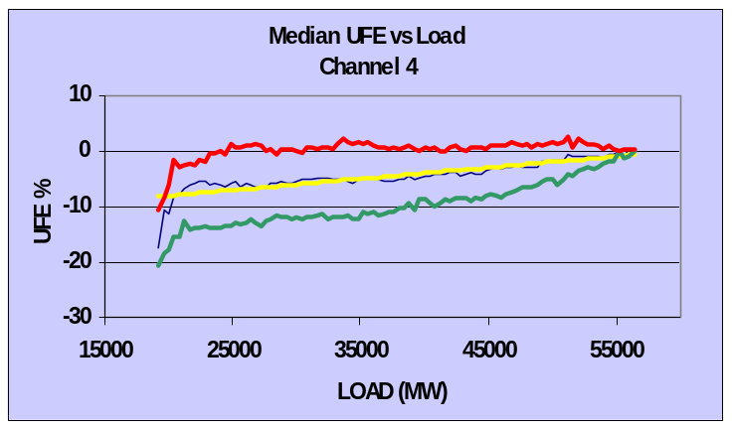
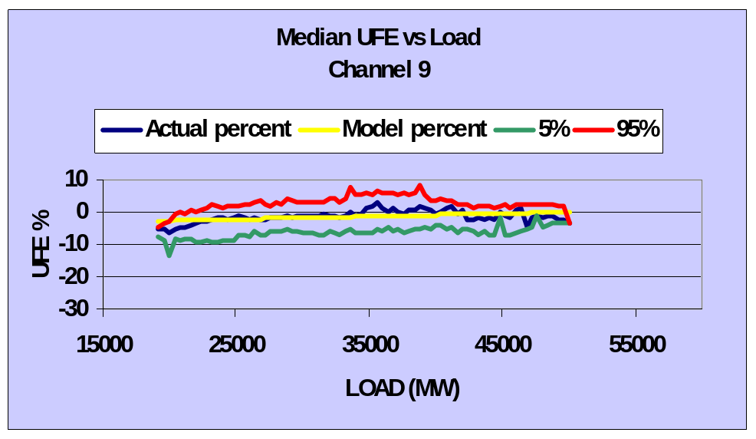
MEDIAN UFE GRAPHS vs Load
There is variance in UFE as it relates to load as shown by the percentile plots.
The relationship between UFE and Load is significant. As load increases, median UFE gets closer to zero.

Slide 19
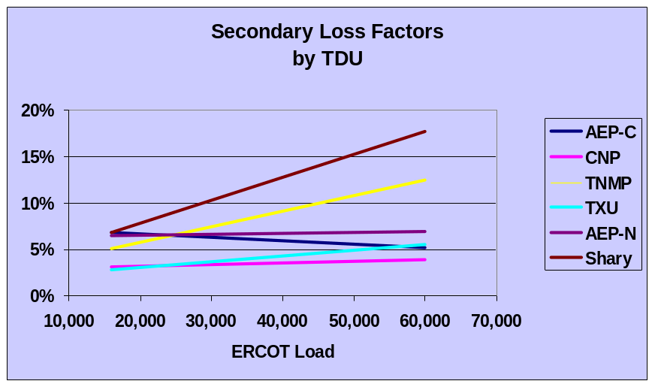
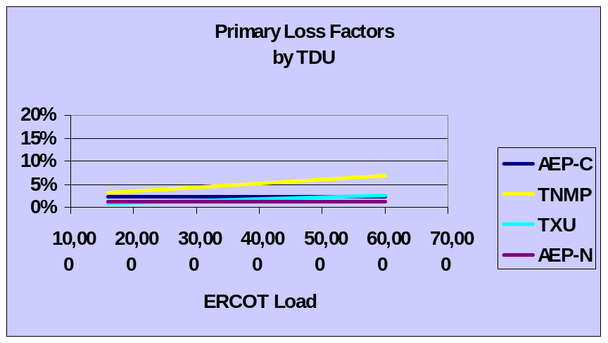
LOSS FACTORS BY TDU
The Secondary Loss Factors vary significantly across TDUs.
Primary Loss Factors also vary but, not as much.
CNP and Sharyland do not distinguish between primary and secondary loss factors.
UFE = Generation – (Load + Losses)
Overestimation of losses would lead to negative UFE.
Loss factors could be validated with substation metering.

Slide 20
Conclusions
Generation Measurement Errors are not a significant contributor to UFE.
Settlements based on more complete usage data result in improvements in UFE.
UFE has a strong negative bias, it appears that loads and/or losses are generally overestimated.
The patterns of UFE change across seasons but are similar across day-types within season.
There is a systematic component of UFE related to load which may be attributable to model performance at low load levels.
Modeled estimates of losses are also systematically related to load. UFE may also be affected by inaccurate estimation of losses.

Slide 21


RECOMMENDATIONS
Improve usage data loading accuracy/timeliness (SCR 727)
Update load research samples (PUCT Project 25516 & ERCOT PR-30014)
  Load Profiling Models
  Evaluate lagged-dynamic samples
Evaluate algorithms for missing IDR data estimation (ERCOT PR-30130)
Evaluate TDSP loss factors with substation load data (ERCOT PR-30022)
  Evaluate the need for additional substation metering
  Compare data aggregated to substation level with substation metering
Explore alternative methods for UFE allocation (ERCOT PR-30022)
  UFE Zones
  By Substation
  Weather
Re-convene UFE Group

