Slide 1


UFE 2003 ANALYSIS
Compiled by the Load Profiling Group
ERCOT Energy Analysis & Aggregation
June 1, 2005

Slide 2
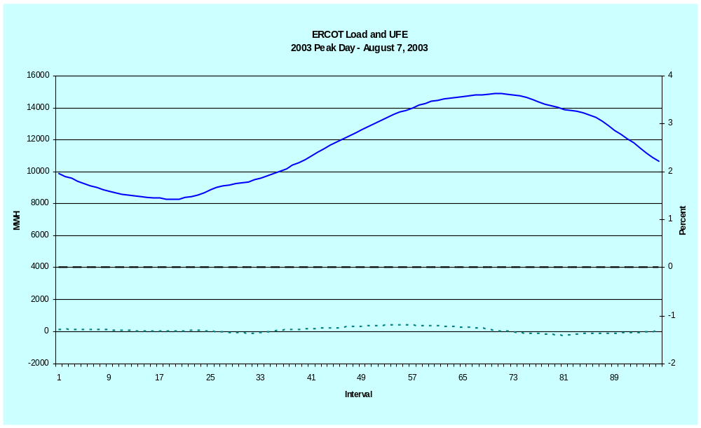

LOAD AND UFE – ERCOT PEAK 2003
Based on True-up Settlement
This is a graph of load and UFE on the Peak Day in 2003.

Slide 3
UFE Basics
UFE (unaccounted for energy) is computed as follows:
UFE = Generation – (Load + Losses)
Sources of UFE include:
■ Generation Measurement Errors
■ Load - Missing/Erroneous Usage Data
- Model Error
- Load Profile ID Assignment Error
■ Losses - Model Error
- Loss Code Assignment Error
Negative UFE indicates load/losses are overestimated

Slide 4
UFE Basics
UFE
Net Generation for Settlement Interval
GAP - - - - - - >
Losses:
Transmission & Distribution
Profiled Energy Usage
Non-Interval Data
Non-Metered Accounts
Net Generation
Compared to
Load Buildup
Interval Data
Energy Usage

Slide 5
DATA VERIFICATION IN THE SETTLEMENT PROCESS
UFE is computed for each 15-minute interval of a settlement run.
Initial Settlement
(17 days after the trade day)
Final Settlement
(59 days after the trade day)
True-up and Resettlement (6 months to up to several years after the trade day.)
The latest resettlement in each interval is used in the analysis for Initial, Final and True-Up.
Final
Settlement
Initial
True-Up

Slide 6
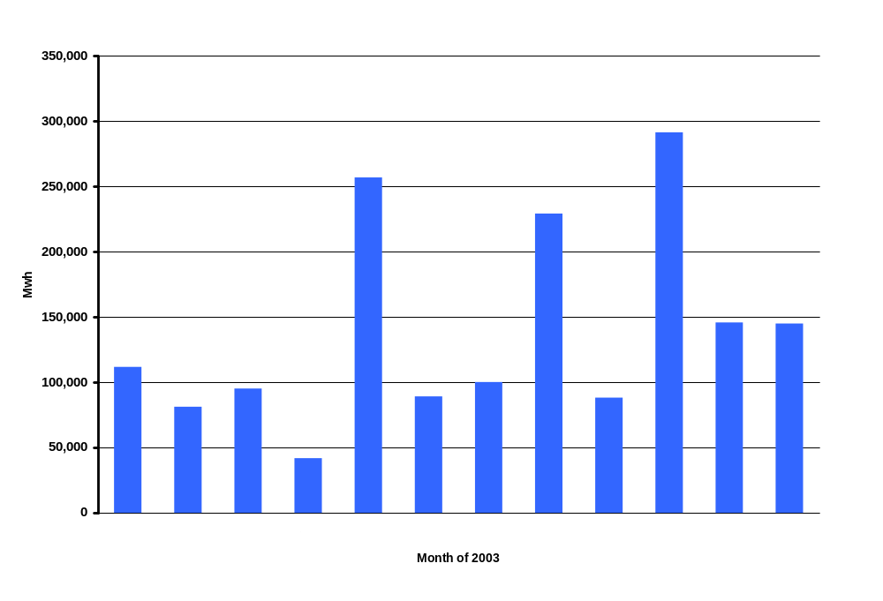
UFE Mwh by Month
SR01
Notes:
This is NET UFE. + and – are canceling out. May and Oct (shoulder months) are the highest while April (another shoulder month) is lowest. Winter months are generally higher than summer months.

Slide 7
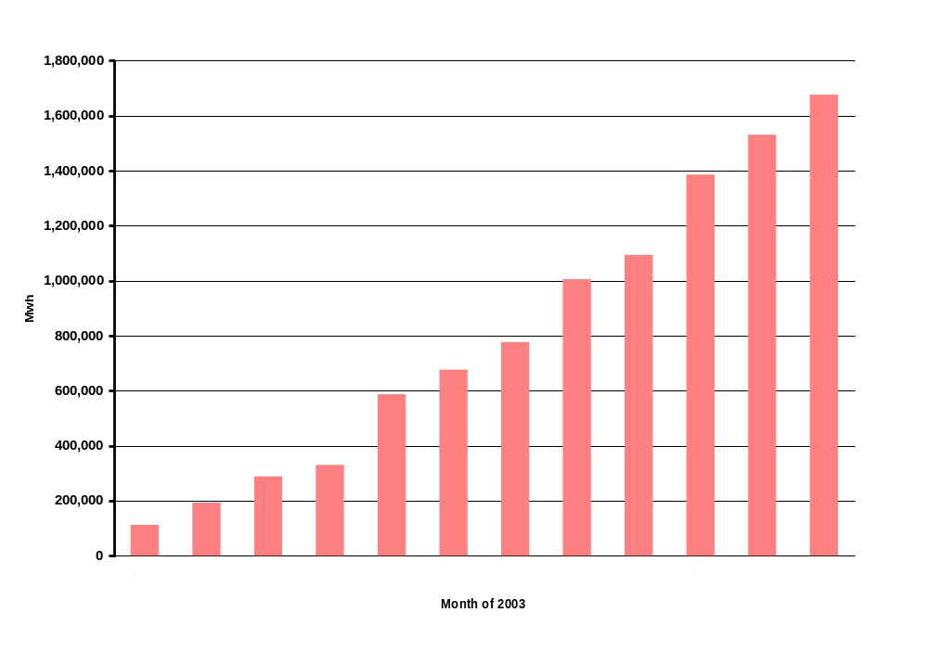
Cumulative UFE Mwh by Month
SR02
Notes:
Annual total is 1,676,343 Mwh. Again, this is NET UFE.

Slide 8
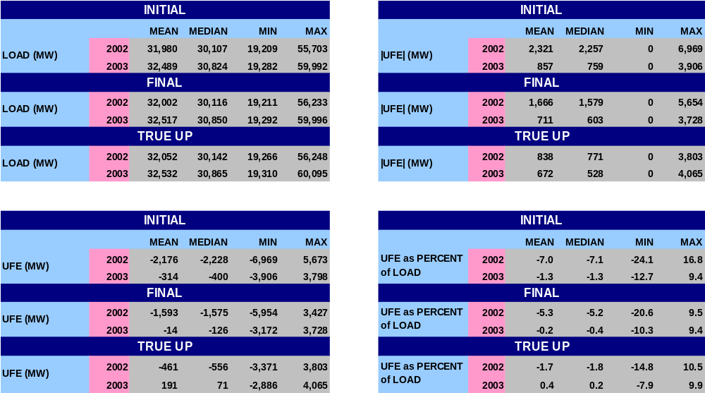
STATISTICAL RESULTS
SR03

Slide 9
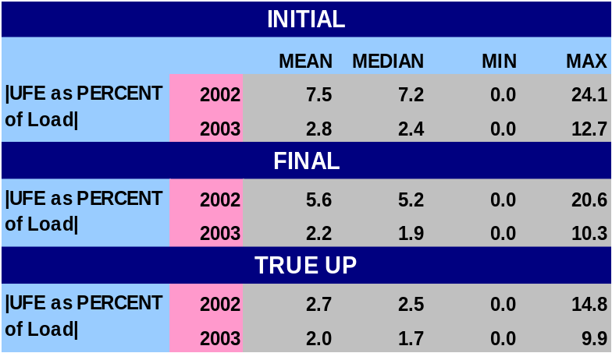
STATISTICAL RESULTS CONTINUED
2002 UFE has a negative bias across all settlements.
2003 UFE has a negative bias for Initial and final Settlement, positive bias for True-up.
2003 UFE for True-up has a mean of 0.5% and a median of 0.2% as compared to -1.6% and -1.8% respectively for 2002.
Mean and Median UFE values are similar indicating the UFE distributions are not skewed.
From Initial to Final thru True-Up settlements, UFE gets closer to 0 indicating more complete usage data improves UFE.
SR04
Notes:
Last bullet – w/ regard to Mean and Median, UFE gets better with later settlements.

Slide 10
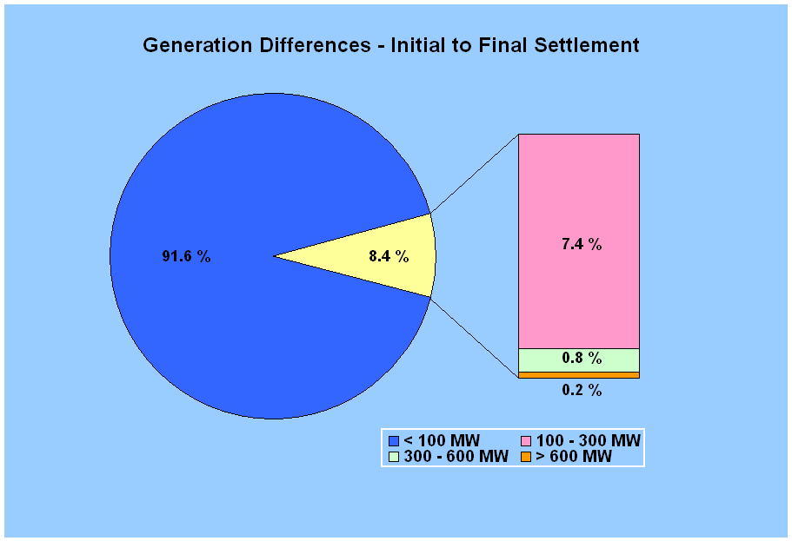
Generation Differences Between Initial and Final Settlements
8.4% of the intervals had Initial to Final differences greater than 100 MW
Differences greater than 300 MW occurred for 1.0 % of the intervals
GDF01
Notes:
Point – generation metering is not a big contributor to UFE. Explain what graph is showing – for 91.6% of the intervals, the generation changes less than 100 Mw from Initial to Final Settlement. Number exactly zero (I to F) = 3079 Intervals; (F to T) = 3023; (I to T) = 196.

Slide 11
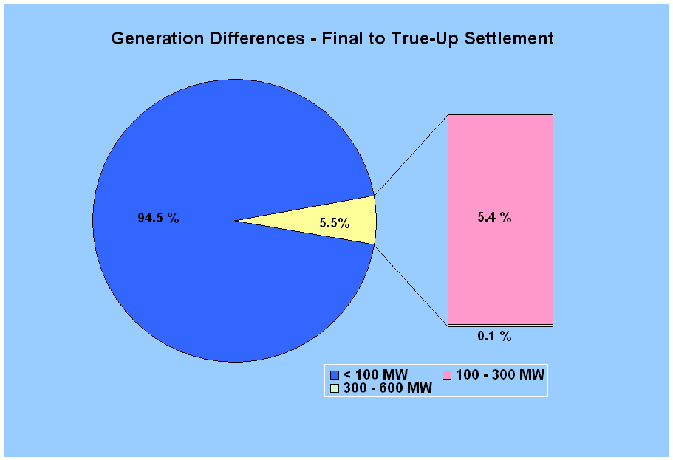
Generation Differences Between Final and True-Up Settlements
5.5% of the intervals had Final to True-Up differences greater than 100 MW
Differences greater than 300 MW occurred for 0.1 % of the intervals
GDF02

Slide 12
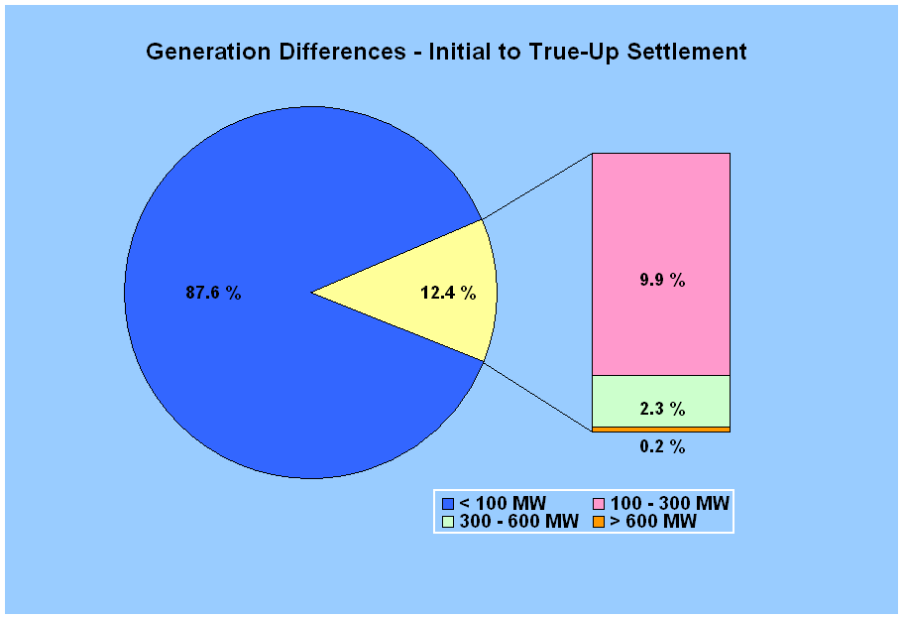
Generation Differences Between Initial and True-Up Settlements
12.4% of the intervals had Initial to True-Up differences greater than 100 MW
Differences greater than 300 MW occurred for 2.5 % of the intervals
GDF03

Slide 13
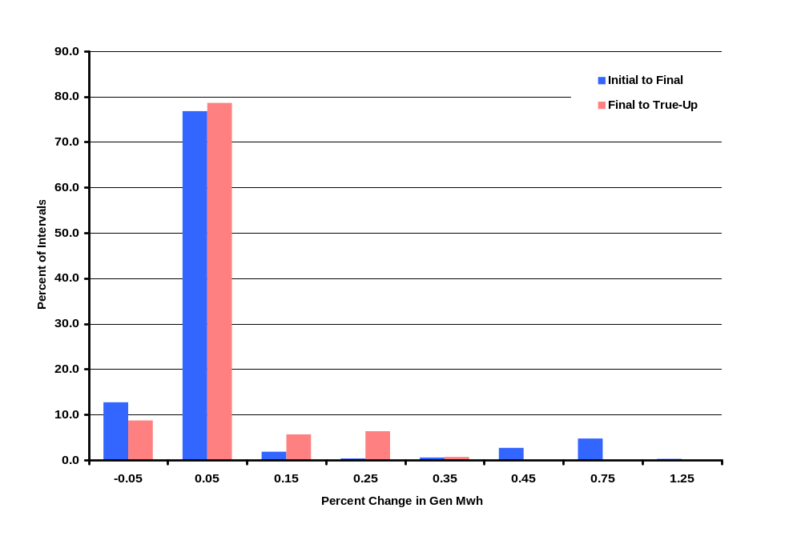
Change in Generation between Settlements
GDF04

Slide 14
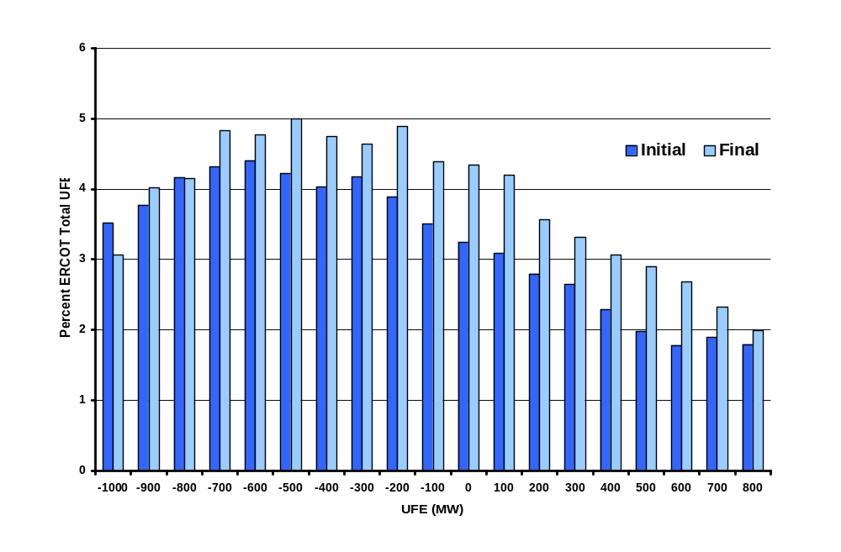
2003 Percent Distribution of UFE MW – Initial to Final
UFE shifts in a positive direction from Initial to Final.
UFD01

Slide 15
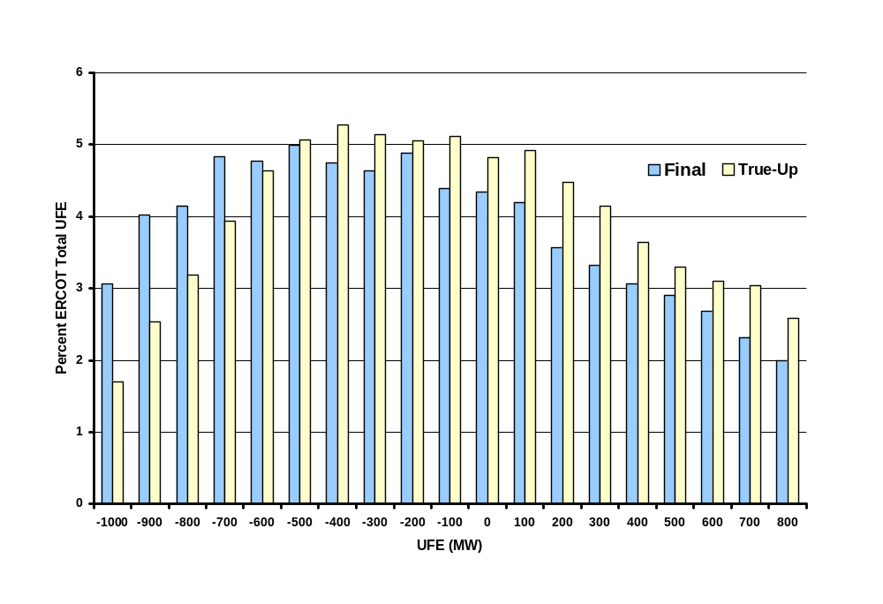
2003 Percent Distribution of UFE MW - Final to True-Up
UFE continues to move in a positive direction from Final to True-Up.
UFD02

Slide 16
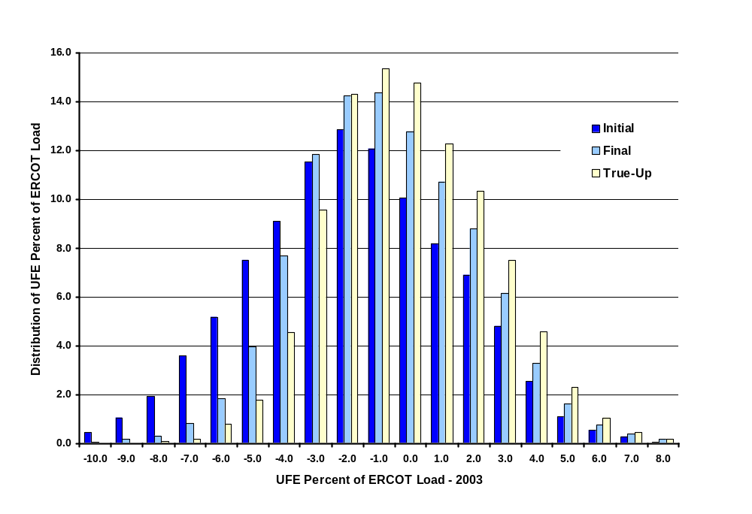
2003 Distribution of UFE Percent of ERCOT Load
The UFE percent moves in a positive direction from Initial to Final thru True-Up.
UFD03

Slide 17
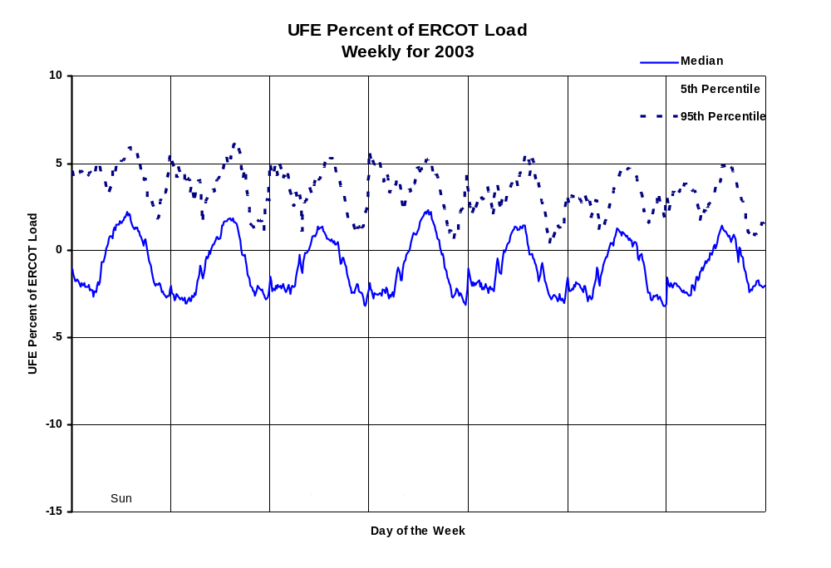
Statistical Studies by Week – Initial Settlement
95% Confidence Interval
CIP01
Notes:
Indicative of systematic estimation problem. Full year – blend of seasons. Seasonal detail comes later.

Slide 18
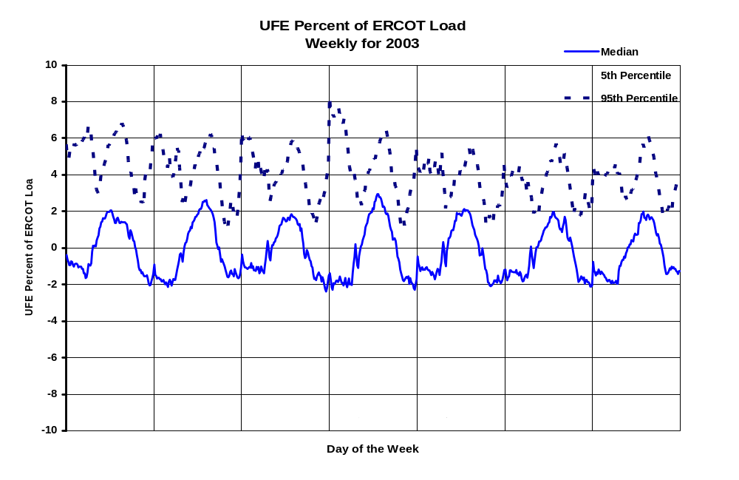
Statistical Studies by Week – Final Settlement
95% Confidence Interval
CIP02

Slide 19
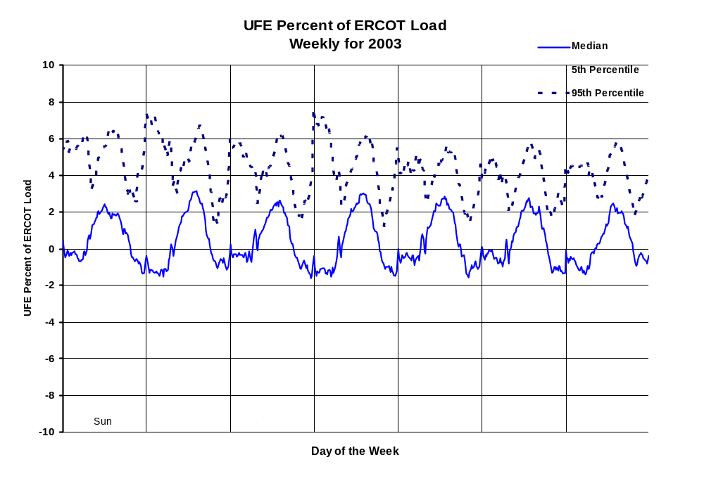
Statistical Studies by Week – True-Up Settlement
95% Confidence Interval
CIP03

Slide 20
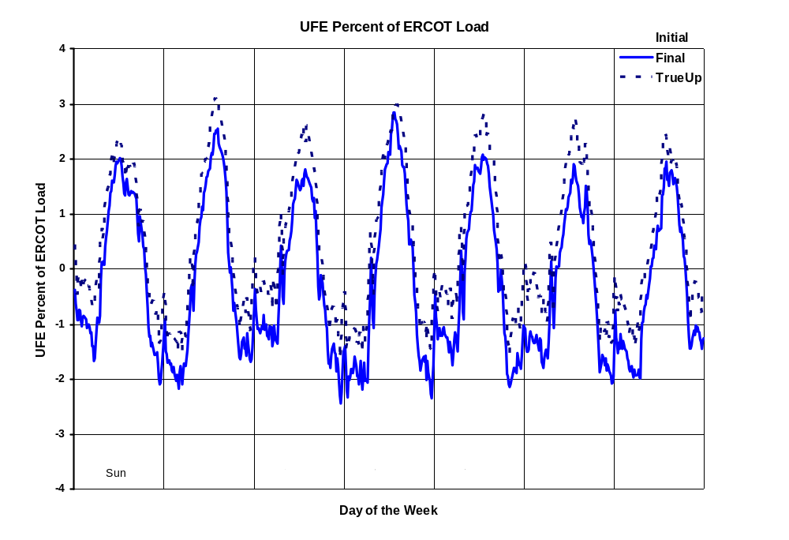
Statistical Studies by Week – Median Comparison
95% Confidence Interval
CIP04

Slide 21
Statistical Studies by Week
General Observations
The UFE Percent of ERCOT Load graphs indicate UFE as a percent of load varies over a wide range between the Median, the 5th Percentile and 95th Percentile.
The difference between the Median, the 5th Percentile and 95th Percentile decreases from Initial to Final through True-Up settlements.
For all settlements there is a well-defined cyclical component across all days of the week. UFE is negative during the off-peak hours and positive during on-peak hours.
Median values move in a positive direction from Initial to Final through True-Up settlements across all days of the week indicating settlements based on more complete usage data result in a reduction in the over-estimation of load.
CIP05

Slide 22
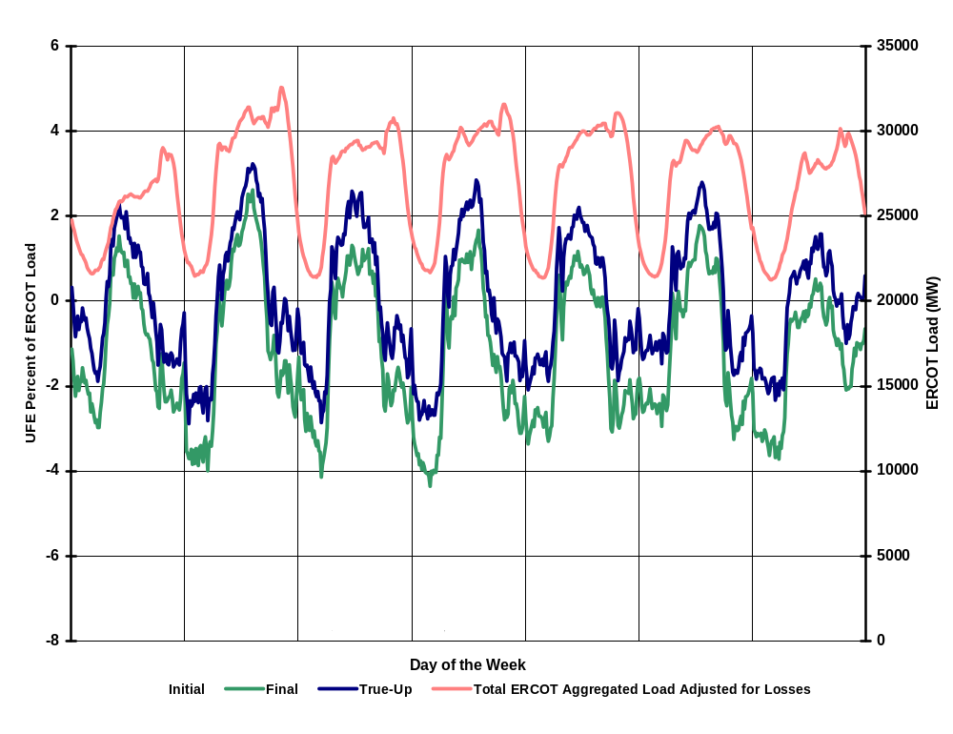
Seasonal Comparison - Spring 2003
UFE Percent of ERCOT Load and ERCOT Load
SEA01

Slide 23
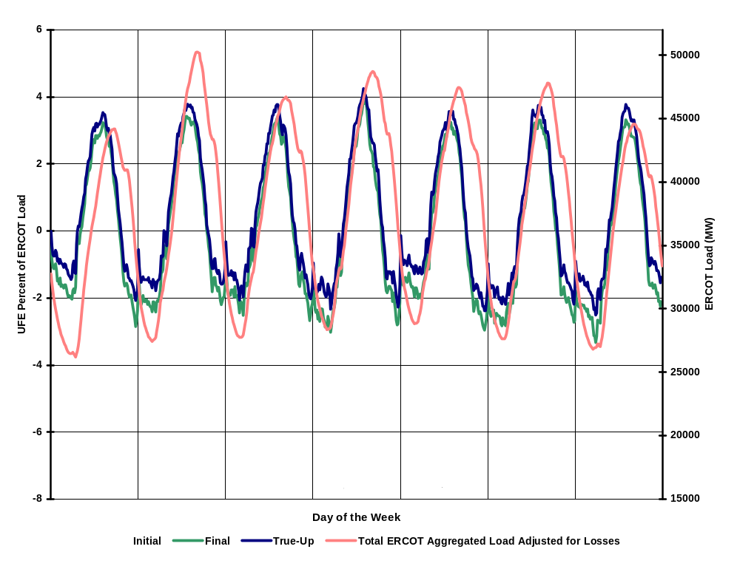
Seasonal Comparison - Summer 2003
UFE Percent of ERCOT Load and ERCOT Load
SEA02

Slide 24
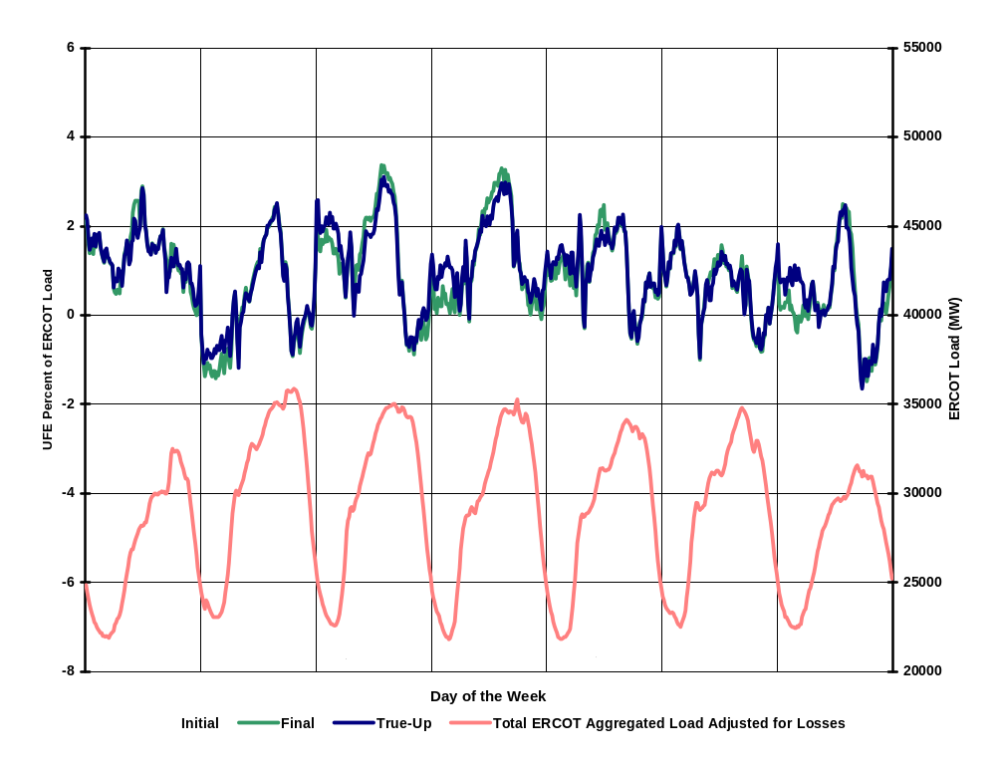
Seasonal Comparison - Fall 2003
UFE Percent of ERCOT Load and ERCOT Load
SEA03

Slide 25
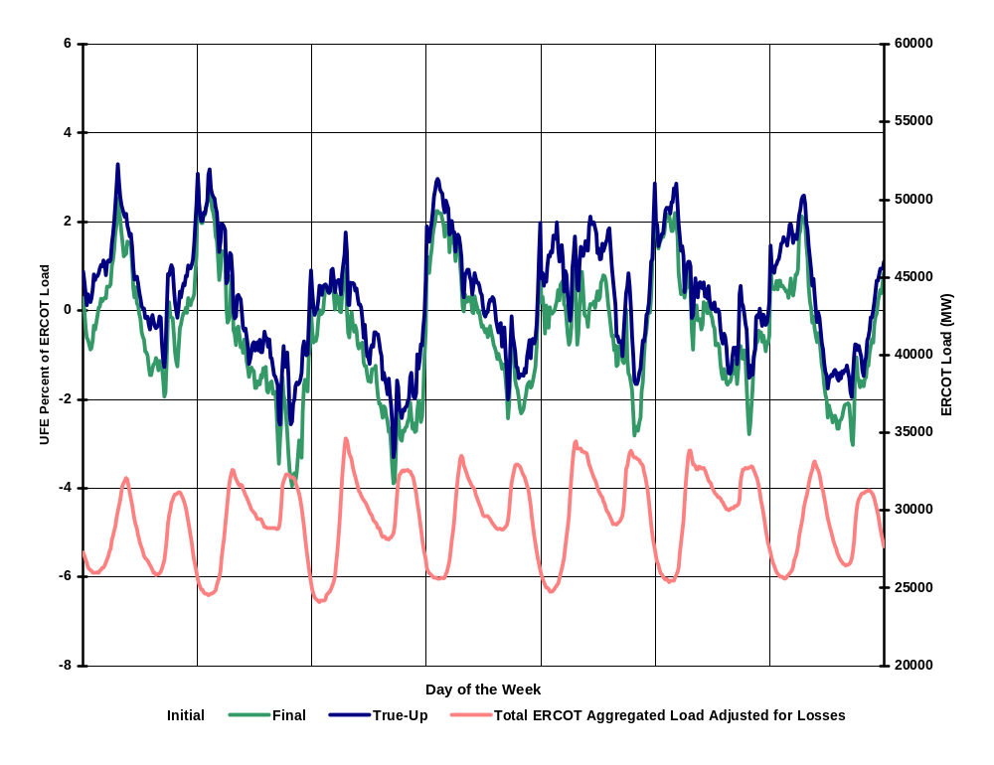
Seasonal Comparison - Winter 2003
UFE Percent of ERCOT Load and ERCOT Load
SEA04
Notes:
Looks like profiles are underestimating morning load, overestimating evening load.

Slide 26
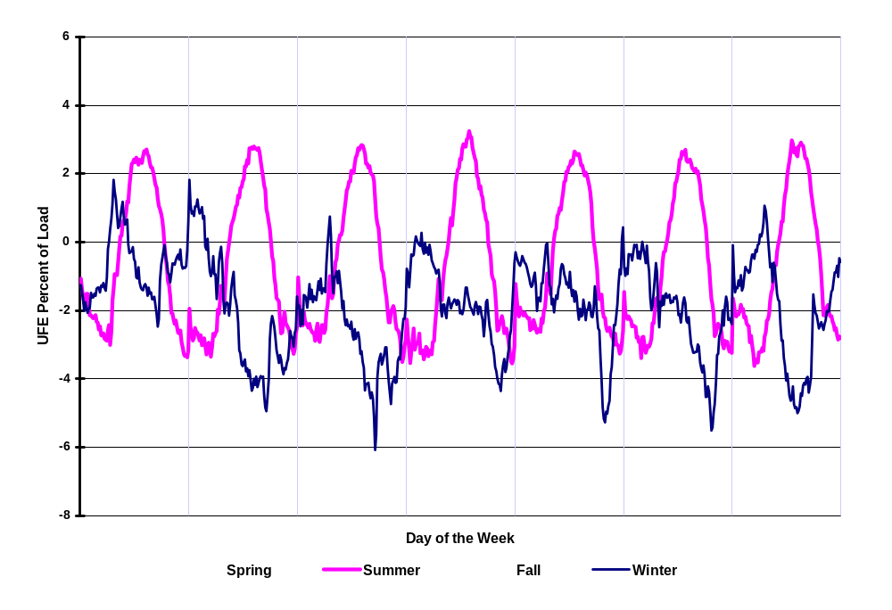
Seasonal Comparison of Medians – Initial Settlement
UFE Percent of ERCOT Load
SEA05
Notes:
Idea of seasonal differences by settlement.

Slide 27
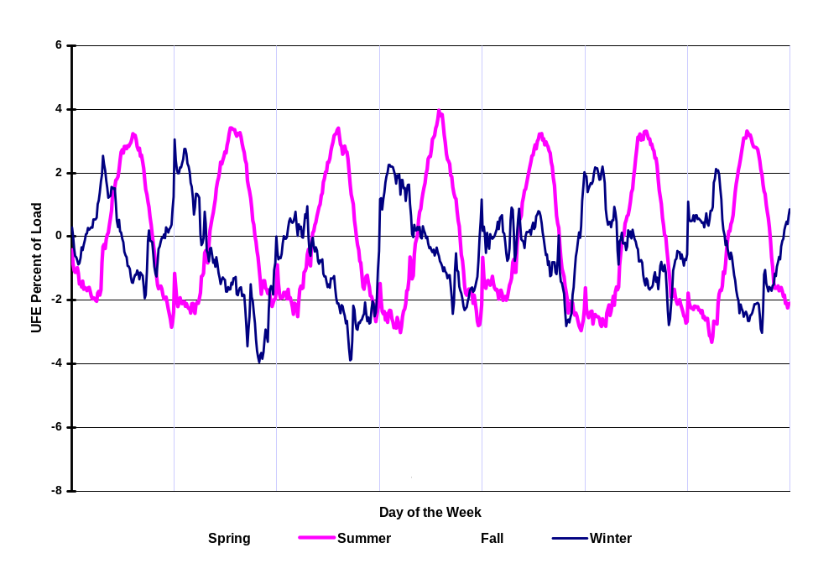
Seasonal Comparison of Medians – Final Settlement
UFE Percent of ERCOT Load
SEA06

Slide 28
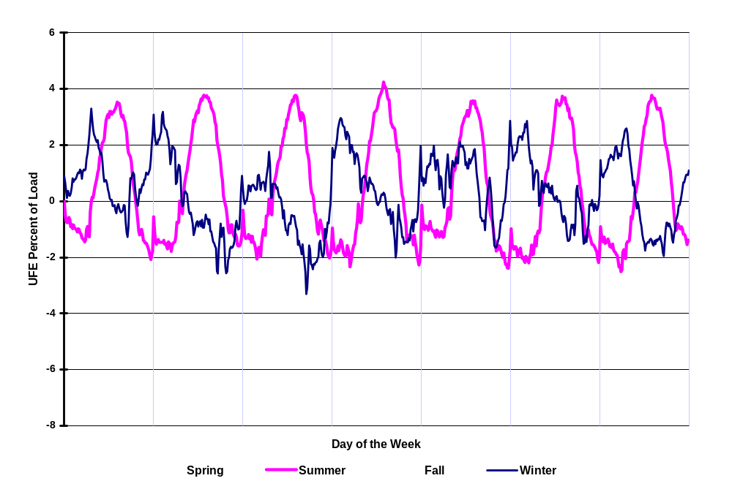
Seasonal Comparison of Medians – True-Up Settlement
UFE Percent of ERCOT Load
SEA07

Slide 29
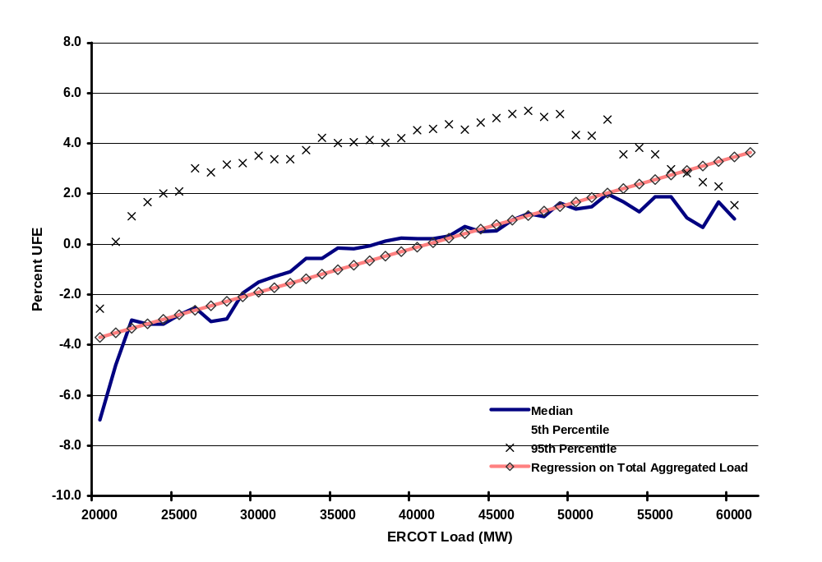
Percent UFE vs ERCOT Load
Initial Settlement
MPL01
Notes:
Showing there is a significant relationship between UFE and load. If pure random errors, it would be bouncing around 0 – no upward trend. Gives indication of shift from overestimating to underestimating – around 40000 Mw. Shift moves to lower loads for subsequent settlements – point out on next 2 slides.

Slide 30
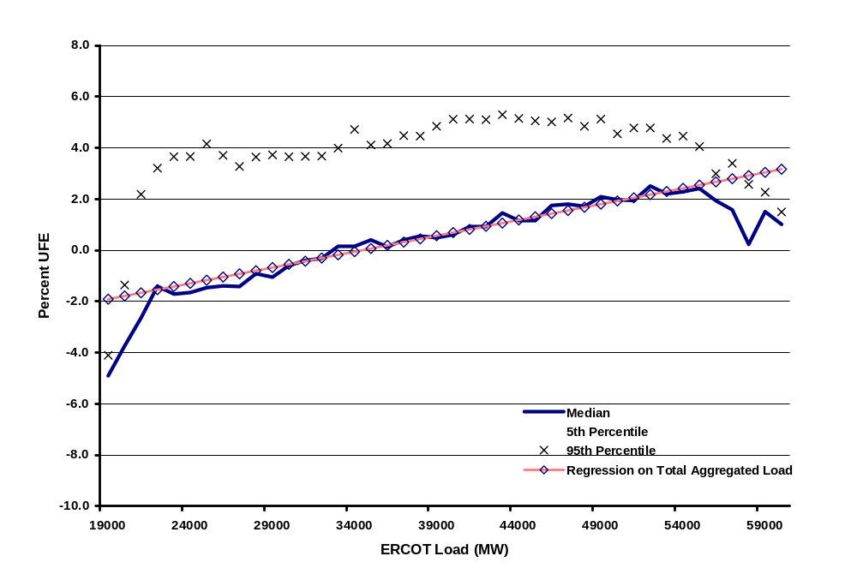
Percent UFE vs ERCOT Load
Final Settlement
MPL02
Notes:
Slope gets flatter for Final and True-Up. Variance gets smaller.

Slide 31
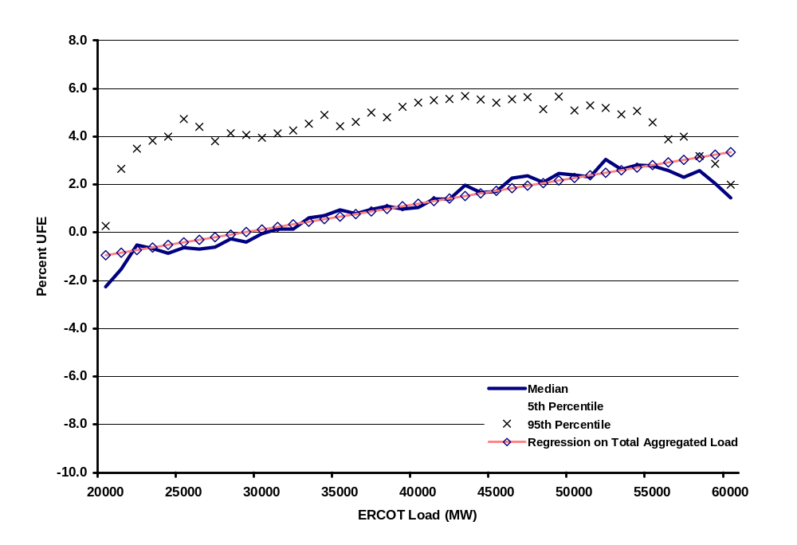
Percent UFE vs ERCOT Load
True-Up Settlement
MPL03

Slide 32
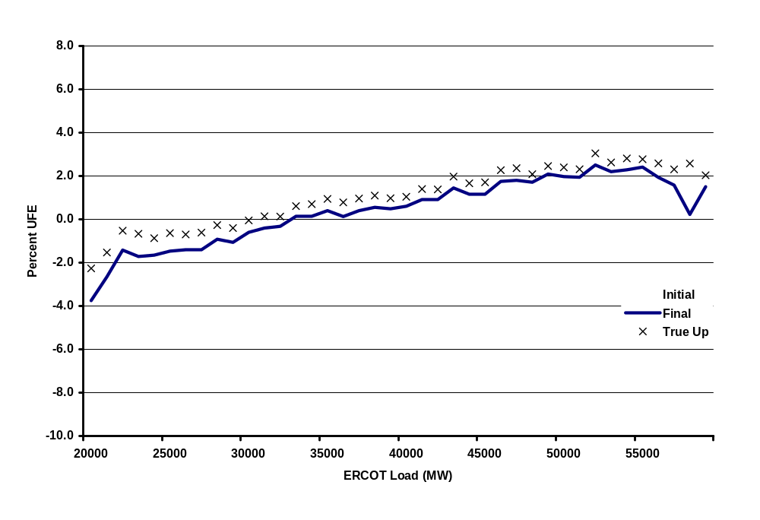
Comparison of Median Percent UFE
Initial, Final and True-Up Up Settlements
MPL04
Notes:
True-up median ufe is worse than final ufe for ERCOT load > 34000 mw, similarly final is worse than initial for ERCOT load > 38000 mw

Slide 33
General Observations
Percent UFE vs ERCOT Load
UFE = Generation – (Load + Losses)
There is a statistically significant relationship between load and UFE.
There is wide variability between the median, 5th and 95th percentiles of percent UFE for initial and final settlements. Variability decreases dramatically for the true up settlements.
As load increases, median UFE for all settlements moves in a positive direction indicating (Load + Losses) are over estimated at low load intervals and are progressively more under estimated as load increases.
UFE shifts in a positive direction from initial to final thru true-Up settlements indicating settlements based on more complete usage data result in a reduction in the over-estimation of load.
UFE is closest to zero between 30,000 to 40,000 MW. UFE for Initial settlement becomes worse than UFE for Final settlement at approximately 38,000 MW of ERCOT load. Similarly, UFE for Final settlement becomes worse than UFE for True-Up at approximately 34,000 MW of ERCOT load.
MPL05

Slide 34
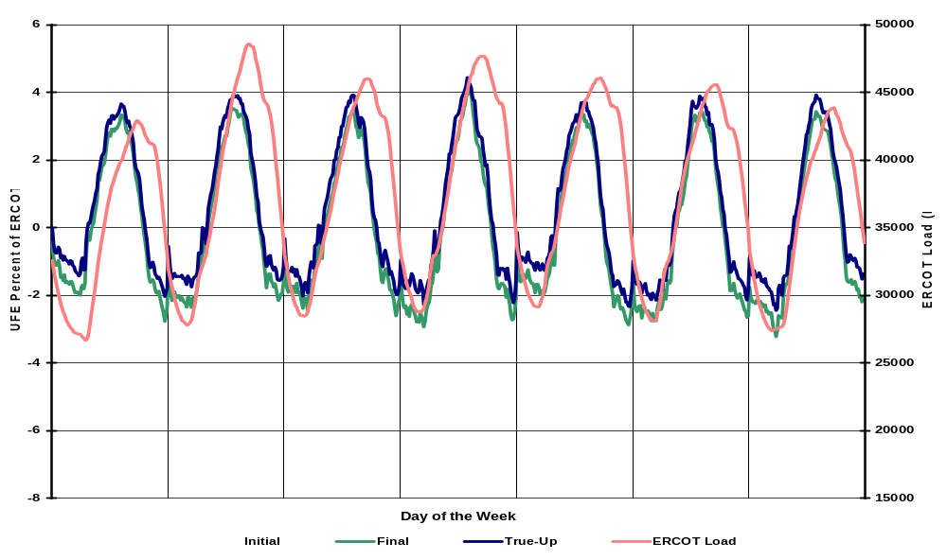

General Observations Continued
Percent UFE versus ERCOT Load
There is a well-defined cyclical component across all days of the week however the UFE cycles are out of phase with the load cycles as illustrated in the graph below.
MPL06

Slide 35
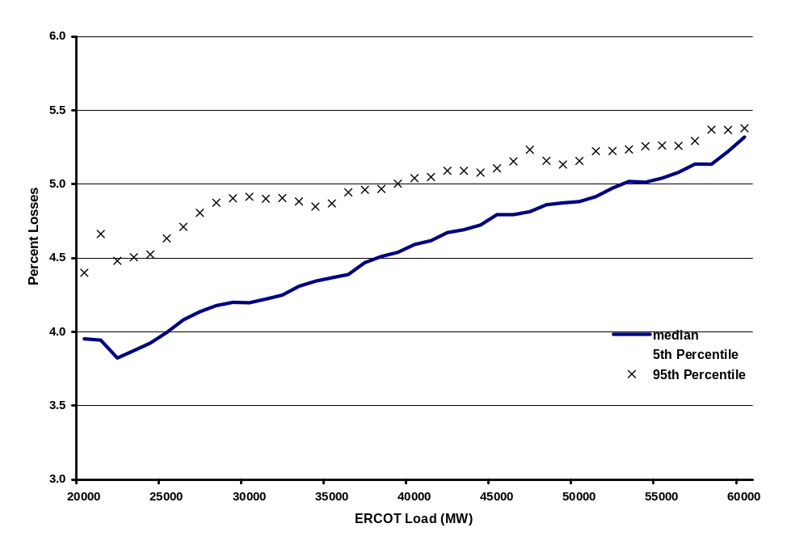
Percent Transmission Plus Distribution Losses versus Total ERCOT Load
MPL07
Notes:
Aggregation of all loss estimations.

Slide 36
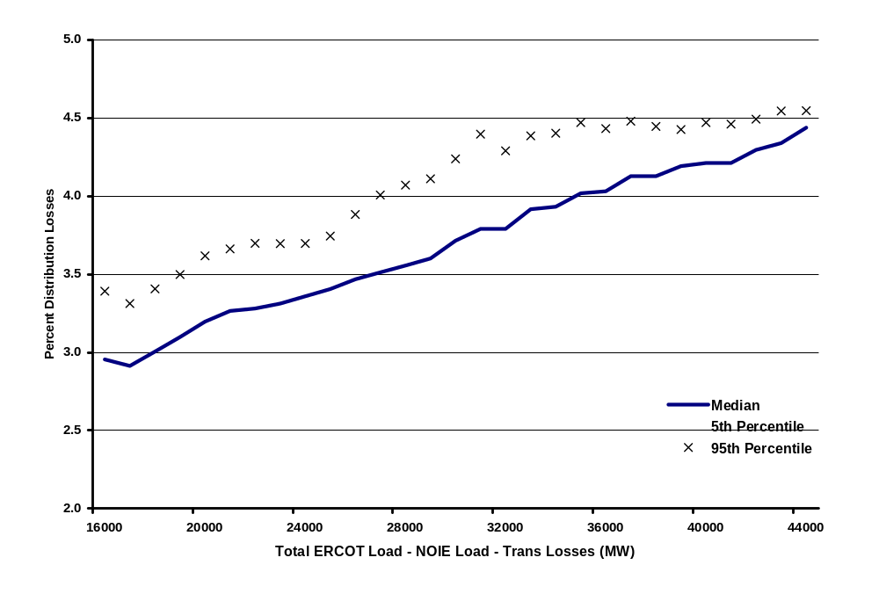
Percent Distribution Losses versus
Total ERCOT Load – NOIE Load – Transmission Losses
MPL08
Notes:
Aggregation of TDSP distribution loss estimations.

Slide 37
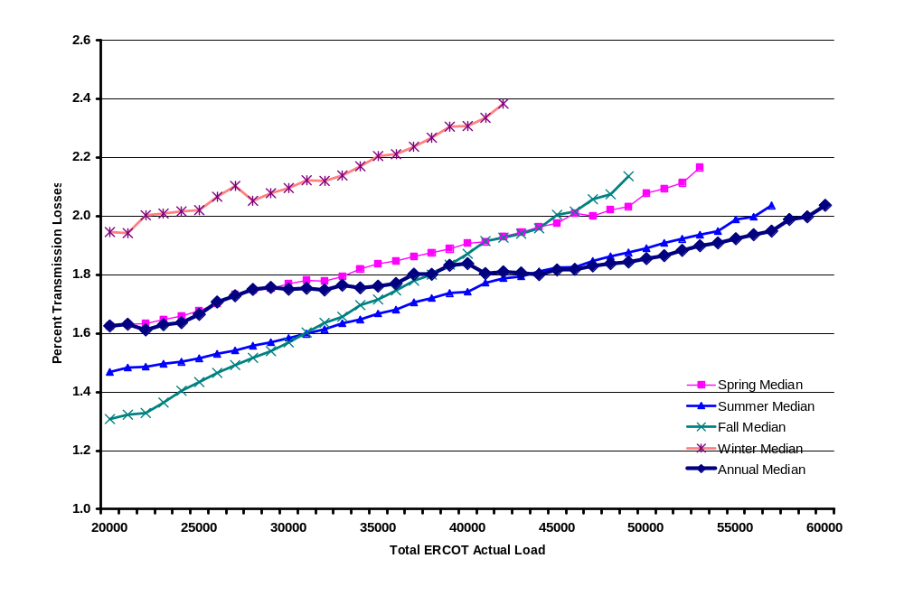
Percent Transmission Losses versus
Total ERCOT Actual Load
MPL09
Notes:
Transmission losses are calculated on Initial settlement ONLY.

Slide 38
UFE Cost Analysis by Congestion Management Zone
UFE costs are calculated by multiplying the UFE (MWH) times the Market Clearing Price for Load (MCPEL)($/MWH) for each 15-minute interval in 2003.
MCPEL is a function of Congestion Zone. MCPEL is the same across all Congestion Zones if there is no congestion.
The means of dollars indicate relative magnitude. The sums of dollars indicate where dollars are going.
The CM Zones for 2003 are: Houston, North, South and West
UFE cost values per interval are calculated for:
  positive and negative UFE
  the absolute value of UFE
  the net value of UFE.
Median UFE cost studies include:
  Seasonal as defined in the Profile Assignment Decision Tree
    Spring: March 1 – April 30
    Summer: May 1 – September 30
    Fall: October 1 – November 30
    Winter: December 1 – February 28
  Monthly
  Hour of the week.
UCT01

Slide 39
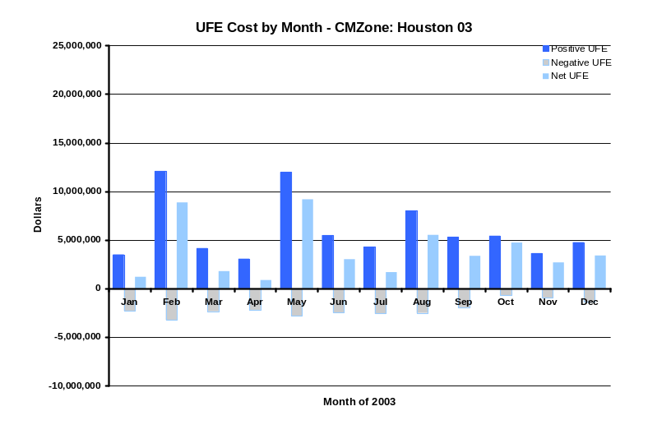
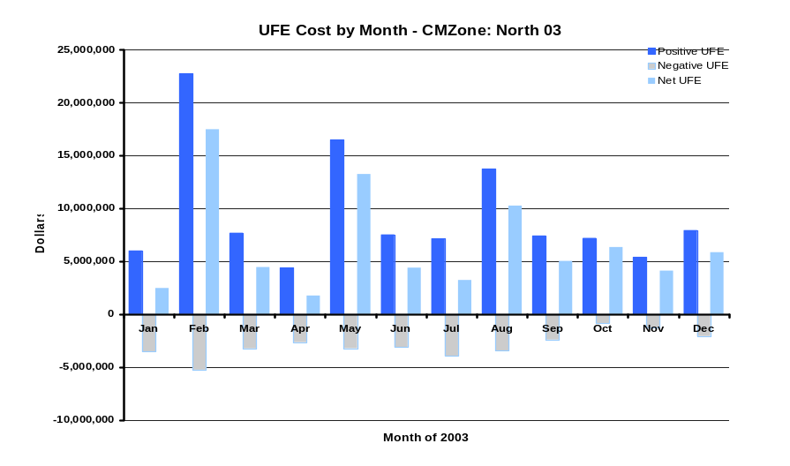
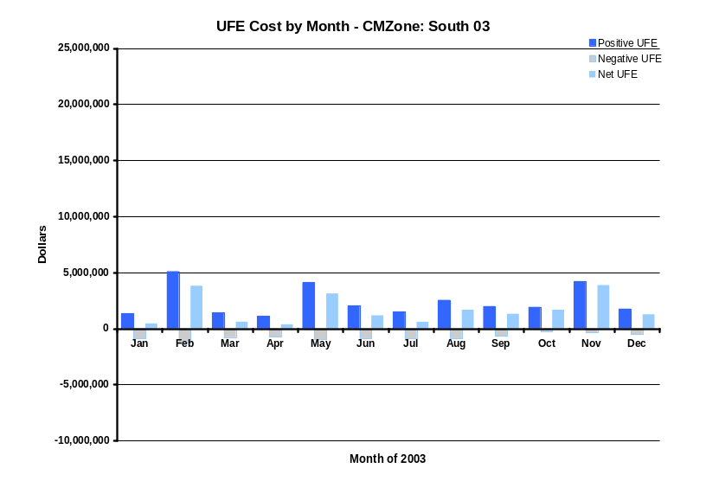
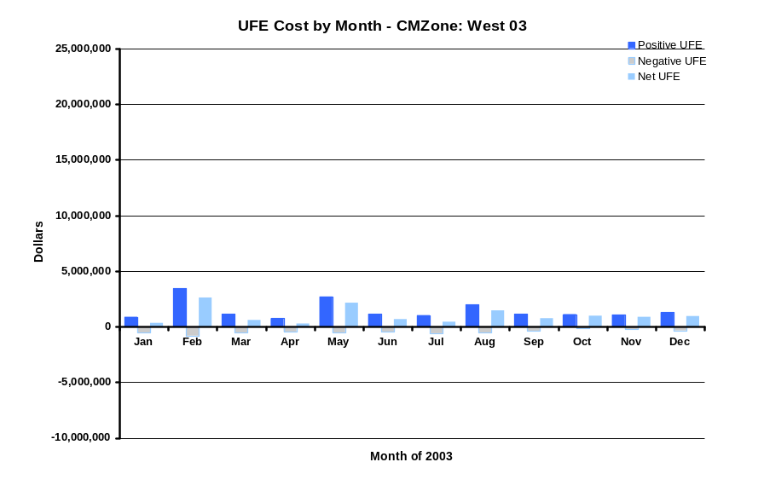
UFE Cost by Month and CMZone
UCT02

Slide 40
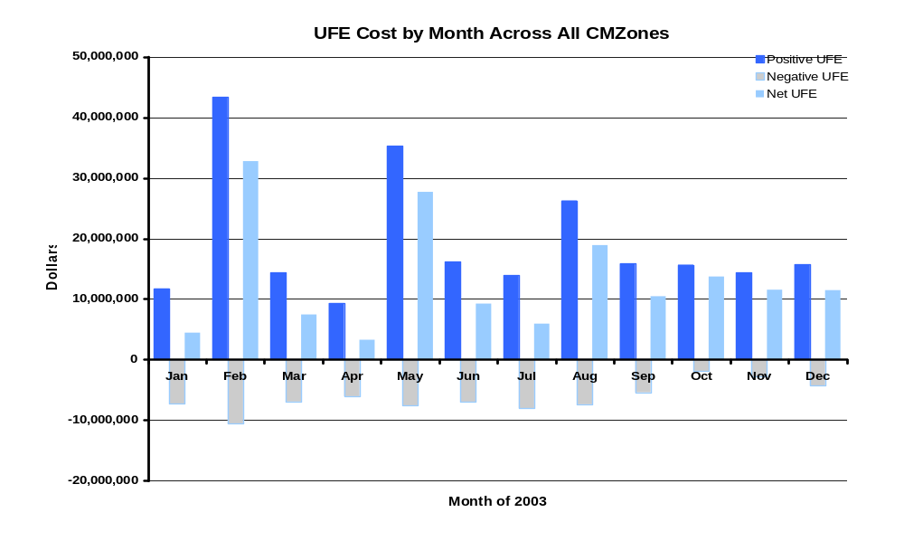
UFE Cost by Month across all CMZones
UCT03

Slide 41
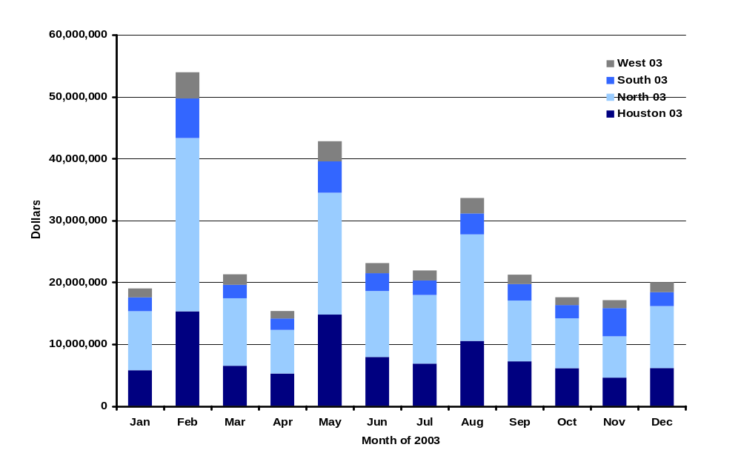
Absolute Value
UFE Cost by Month and CMZone
UCT04

Slide 42
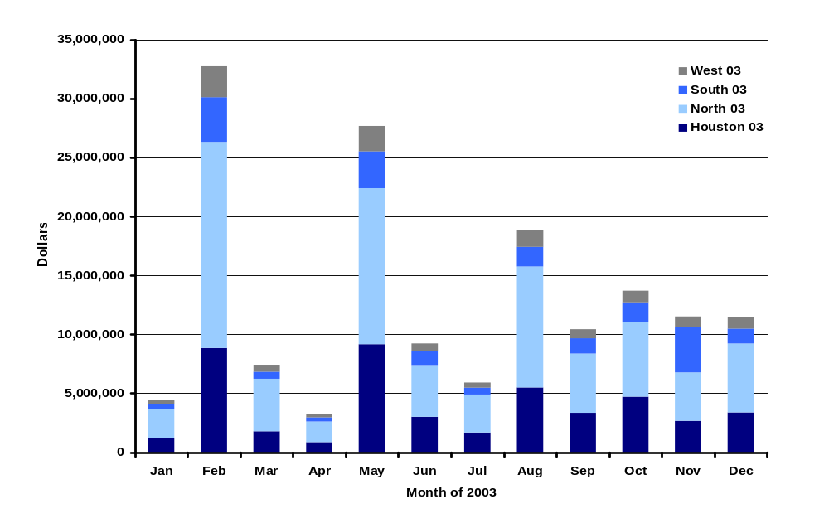
Net UFE Cost by Month and CMZone
UCT05

Slide 43
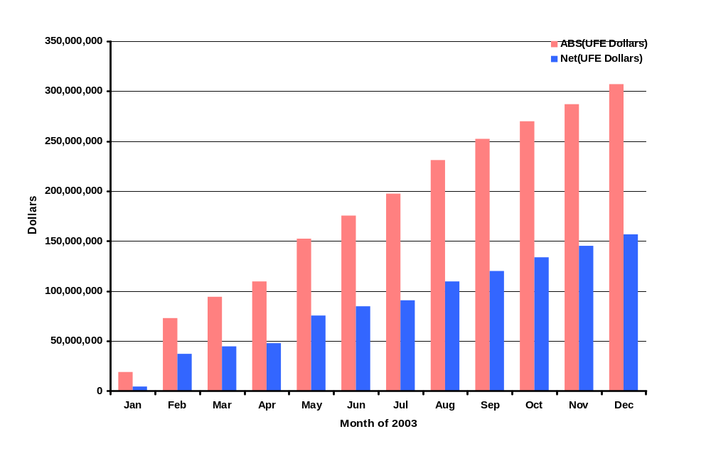
ERCOT Total Cumulative UFE Cost across the Year
UCT06

Slide 44
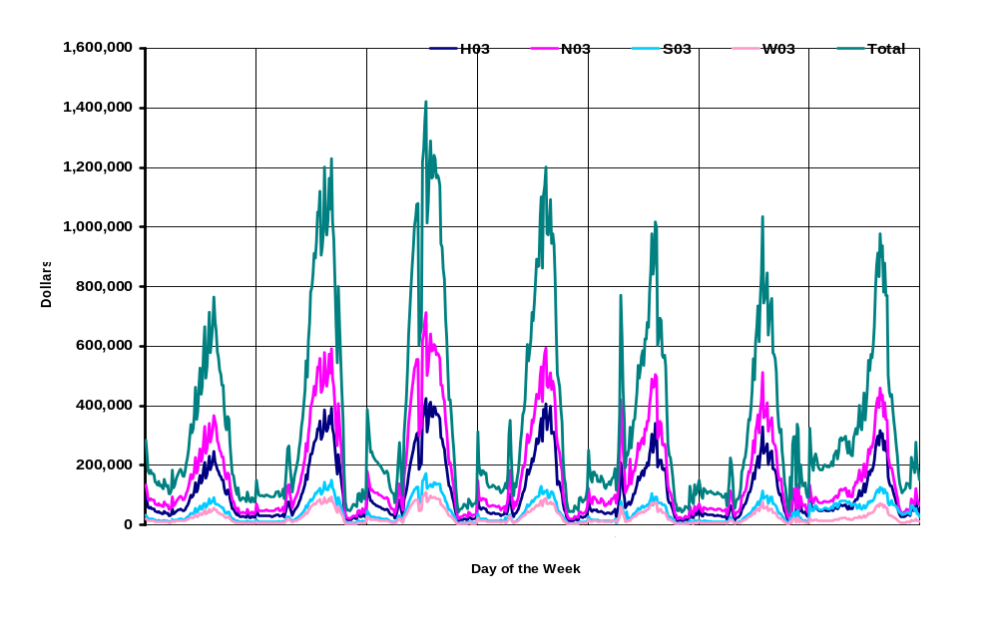
Sum of Dollars from Positive UFE
UCT07

Slide 45
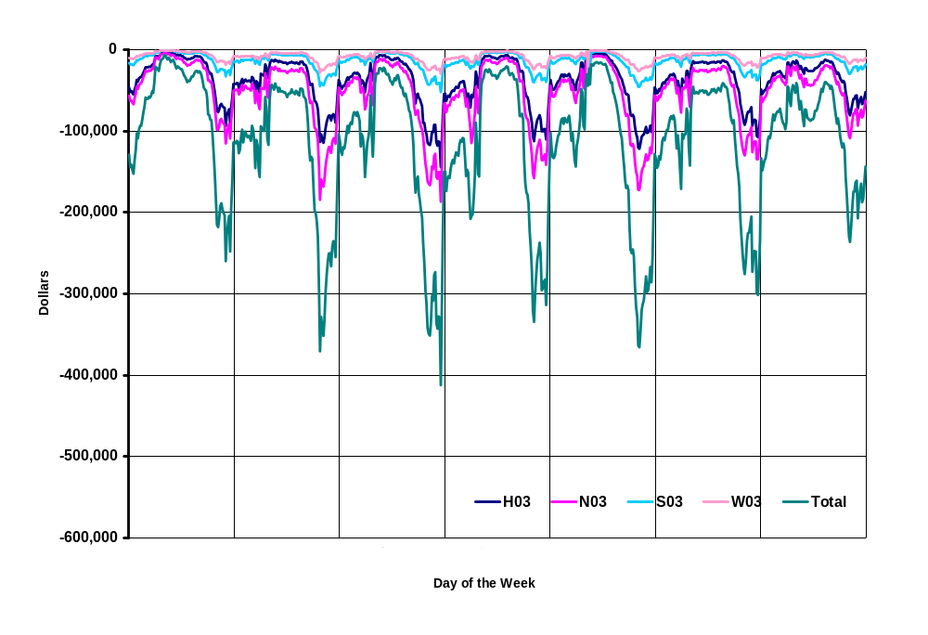
Sum of Dollars from Negative UFE
UCT08

Slide 46
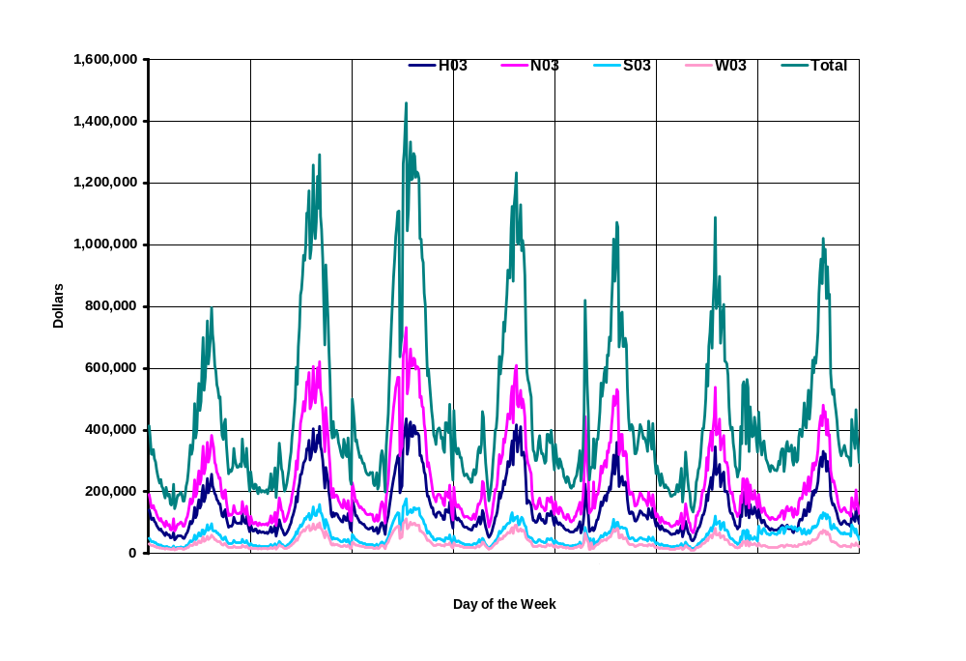
Sum of Dollars from Absolute Value of UFE
UCT09

Slide 47
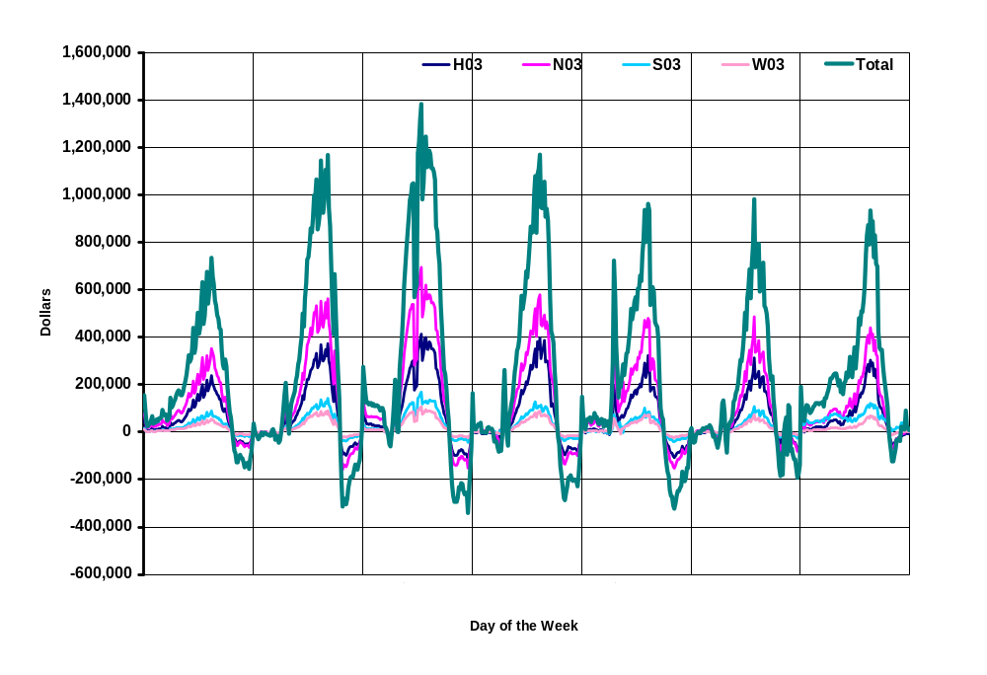
Sum of Dollars from Net UFE
UCT10

Slide 48
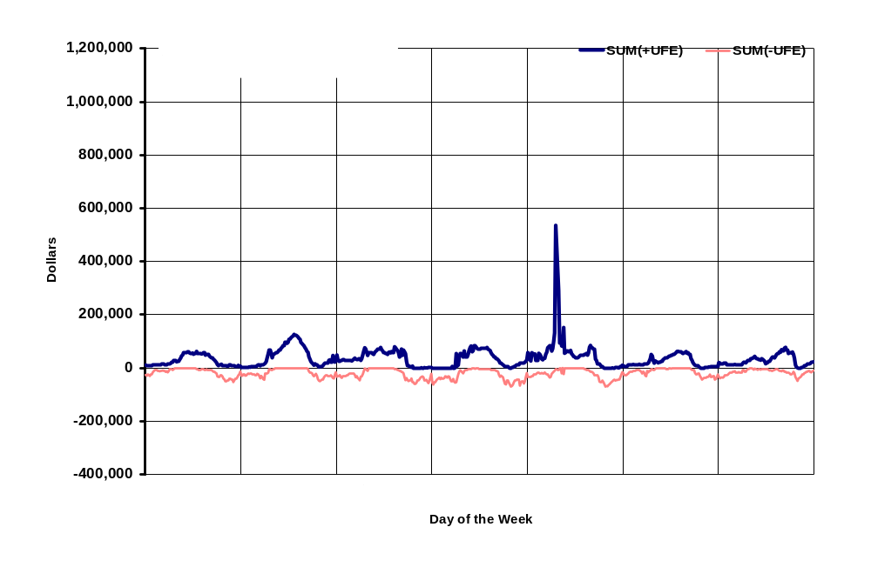
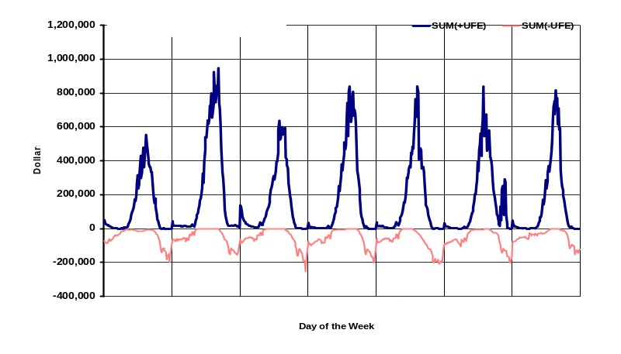
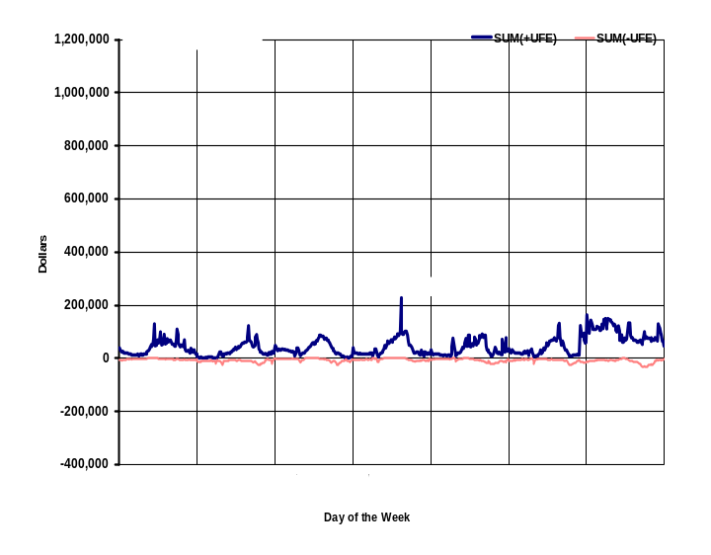
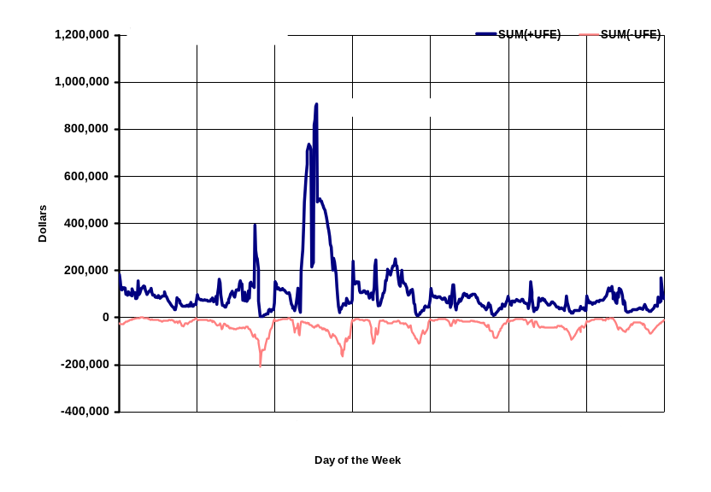
SUM of UFE Dollars – All Seasons
Positive and Negative UFE
UCT11

Slide 49
SUM of UFE Dollars – Spring
Positive and Negative UFE
UCT12

Slide 50
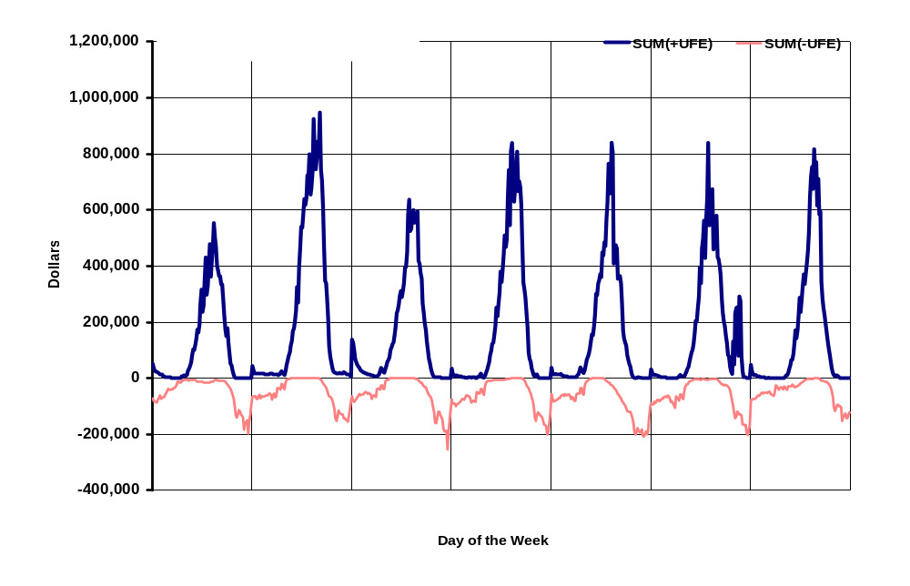
SUM of UFE Dollars – Summer
Positive and Negative UFE
UCT13

Slide 51
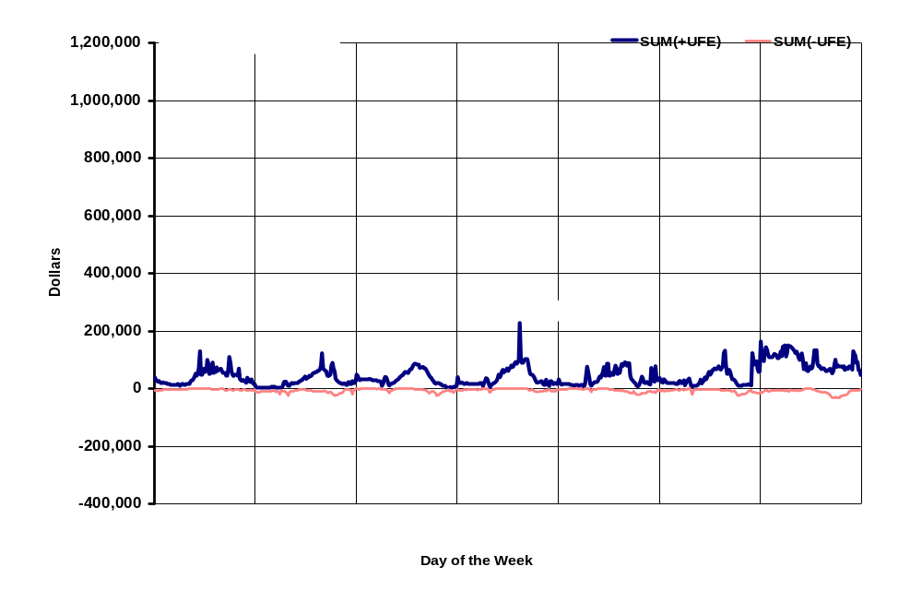
SUM of UFE Dollars – Fall
Positive and Negative UFE
UCT14

Slide 52
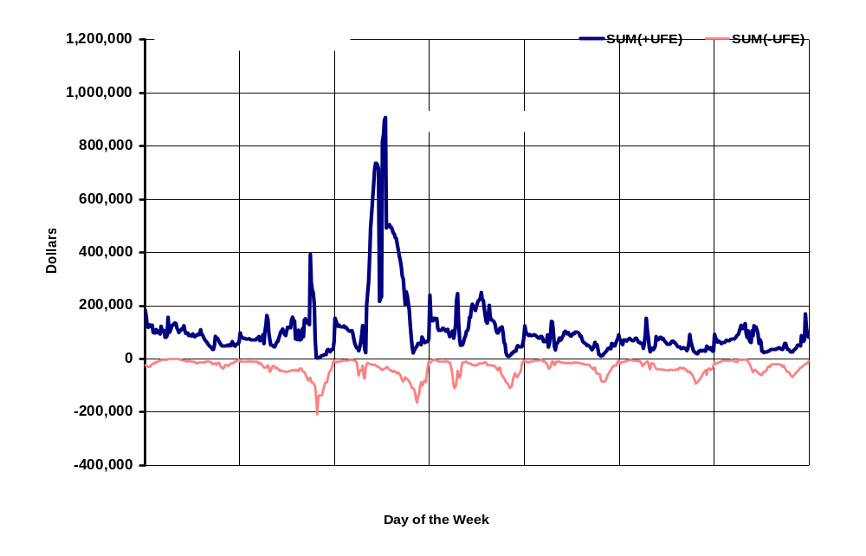
SUM of UFE Dollars – Winter
Positive and Negative UFE
UCT15

Slide 53




SUM of UFE Dollars – All Seasons
Absolute Value and Net UFE
UCT16

Slide 54

SUM of UFE Dollars – Spring
Absolute Value and Net UFE
UCT17

Slide 55

SUM of UFE Dollars – Summer
Absolute Value and Net UFE
UCT18

Slide 56

SUM of UFE Dollars – Fall
Absolute Value and Net UFE
UCT19

Slide 57

SUM of UFE Dollars – Winter
Absolute Value and Net UFE
UCT20

Slide 58




Mean of UFE Dollars – All Seasons
Positive and Negative UFE
UCT21
Notes:
Means – indicate magnitude
Sums – where are the $

Slide 59

Mean of UFE Dollars – Spring
Positive and Negative UFE
UCT22

Slide 60

Mean of UFE Dollars – Summer
Positive and Negative UFE
UCT23

Slide 61

Mean of UFE Dollars – Fall
Positive and Negative UFE
UCT24

Slide 62

Mean of UFE Dollars – Winter
Positive and Negative UFE
UCT25

Slide 63




Mean of UFE Dollars – All Seasons
Absolute Value and Net UFE
UCT26

Slide 64

Mean of UFE Dollars – Spring
Absolute Value and Net UFE
UCT27

Slide 65

Mean of UFE Dollars – Summer
Absolute Value and Net UFE
UCT28

Slide 66

Mean of UFE Dollars – Fall
Absolute Value and Net UFE
UCT29

Slide 67

Mean of UFE Dollars – Winter
Absolute Value and Net UFE
UCT30

Slide 68
RESULTS and CONCLUSIONS
The total dollars for the absolute value of UFE in 2003 amounted to $307 million. The net UFE amounted to $157 million.
During 2003, there was a strong daily cyclical component to median UFE (related to load).
Median UFE tends to be negative during the off-peak intervals and positive during on-peak intervals. This pattern is similar for all days of the week.
Median UFE tends to be negative during low load intervals and moves in a positive direction as load increases.
Median UFE values move in a positive direction from initial to final thru true-up indicating settlements based on more complete usage data result in a reduction in the over-estimation of load.
There is less variance in UFE for true-up settlements when compared to initial and final settlements.
The pattern of median UFE is significantly different across seasons.

Slide 69
RECOMMENDATIONS
Continue with Load Research Project (PUCT Project 25516)
Improve Profile ID assignment process
Continue to improve usage data loading accuracy and timeliness
Increase the number of IDR’s
Evaluate Lagged Dynamic sampling techniques and their application to the ERCOT System
Continue to evaluate improvements to algorithms for missing IDR and NIDR data estimation
Continue to make improvements to loss estimations
Explore alternative methods for UFE allocation
  UFE Zones
  By Substation Assignment
  By Weather Zone

