Slide 1
Load Balancing
Understanding GreedyLB and RefineLB strategies

Slide 2

GreedyLB
Algorithm 1: The GreedyLB Algorithm
begin
Data:
Vt (the set of chare objects), Vp (the set of processors),
Gp (the background load of processors) // due to non-migratable objects, etc.
Result: Map : Vt −→ Vp (An object mapping)
// build heap of size equal to the number of objects ; ObjectHeap objHeap(|Vt|); Vt −→ objHeap ; // insert each element of Vt in objHeap MinHeap cpuHeap(P); //Initially processors are empty with only background load;
Gp −→ cpuHeap;
for i ← 1 to nmigobj do
o= objHeap.deleteMax(); donor ←− cpuHeap.deleteMin(); Assign c to donor and record it in Map;
donor.load += c.load // add object load of c to the donor;
cpuHeap.insert(donor) ;
end

Slide 3
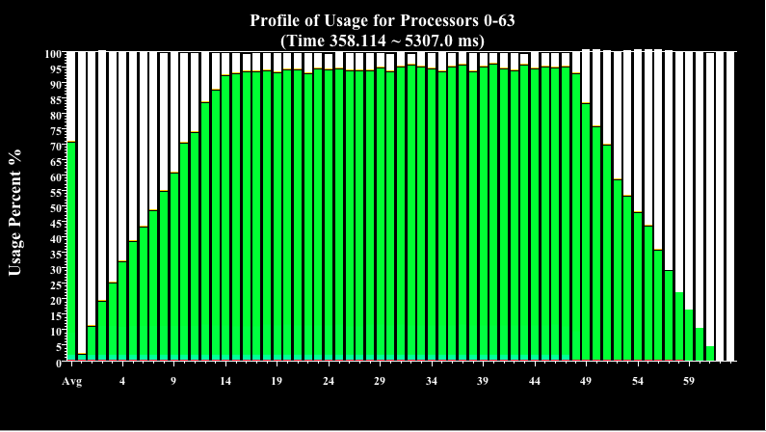
GreedyLB Utilization before LB

Slide 4
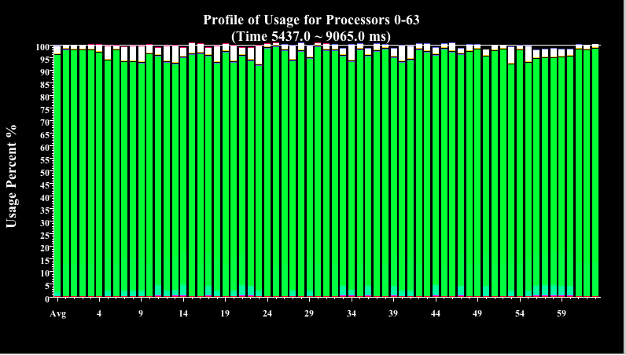
GreedyLB Utililzation after LB

Slide 5
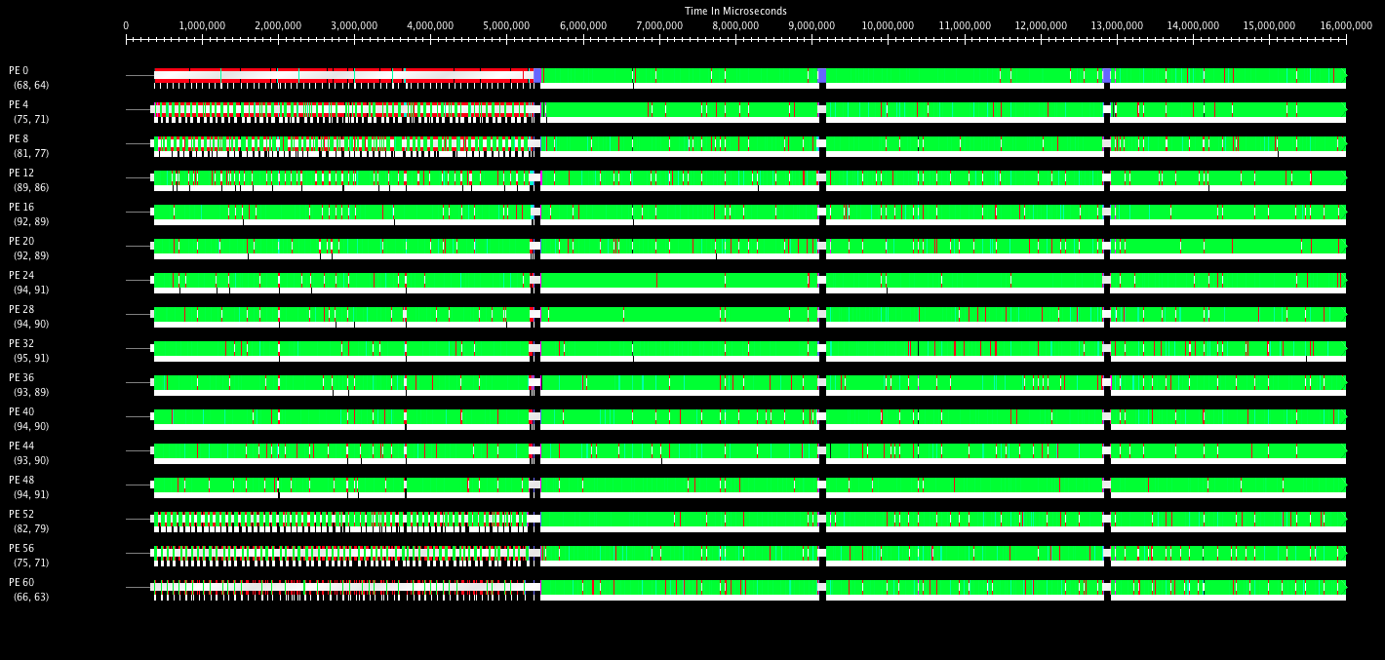
GreedyLB
Before LB – 85ms/step
After LB – 60 ms/step

Slide 6
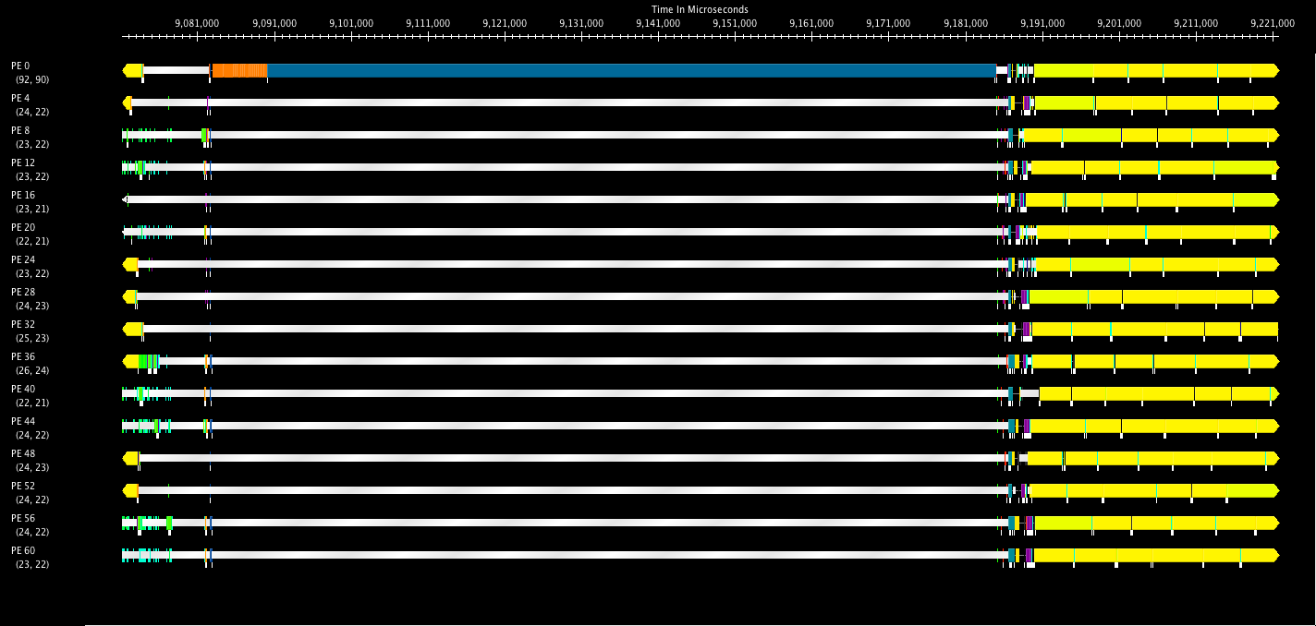
GreedyLB
Object Migration time
Statistics collection
Strategy decision time
LB took 100 msec
Timeline of 140ms

Slide 7
Costs of Balancing Load
Costs
Statistics collection
Decision making
Object Migration
In our example, the migration cost was small because the objects were relatively tiny
In real apps, each object may occupy (say) 5-10% of processor memory
Can we trade off some quality of load balancing for a reduction in load balancing time?

Slide 8
RefineLB
begin
Data:
Vt (the set of objects), Vp (the set of processors),
Result: P : Vt −→ Vp (An object mapping)
// build heap; ProcessorHeap heavyProcs(Vp); Set *lightProcs;
While (!done)
donor ← heavyProcessors->deleteMax()
While (ligthProcs)
obj, lightProc ← BestObjFromDonor(donor)
if (obj.load + lightProc.load > avg_load)
continue;
if (obj_obtained)
break;
deAssign(obj, donor)
assign(obj, lightProc)
end

Slide 9
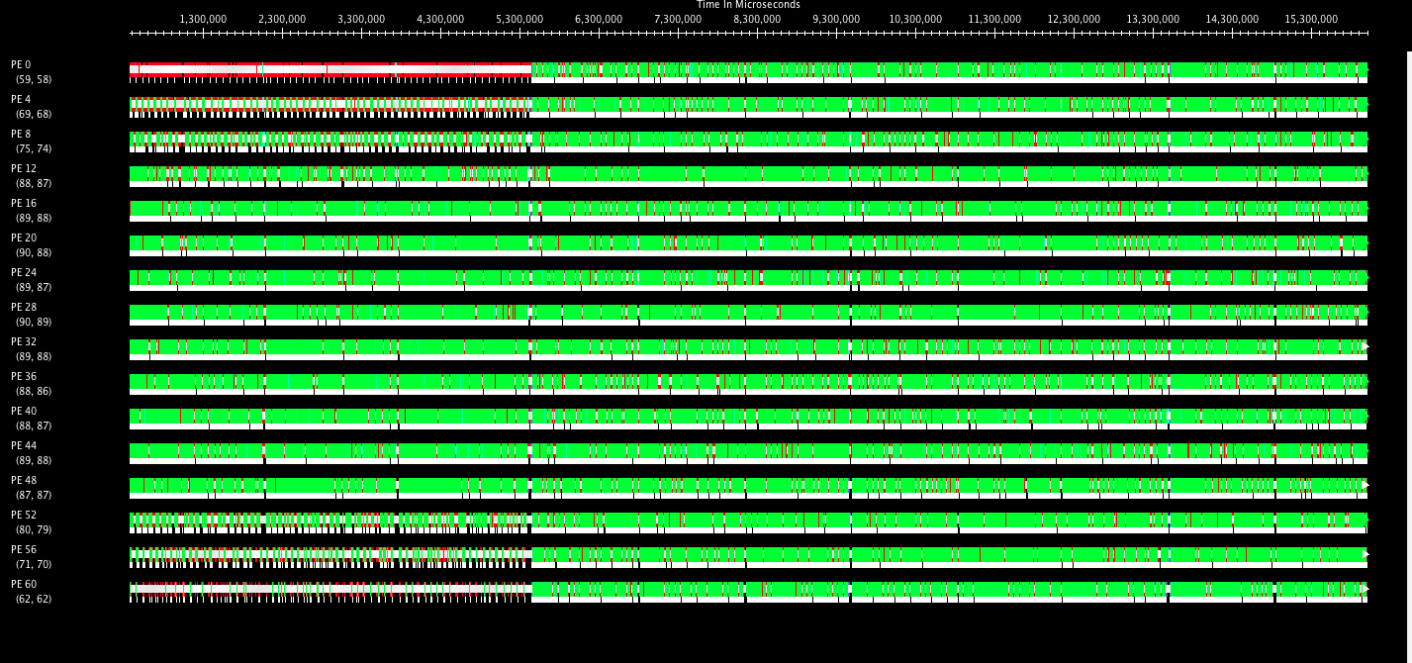
RefineLB
Before LB – 85ms/step
After LB – 67ms/step

Slide 10
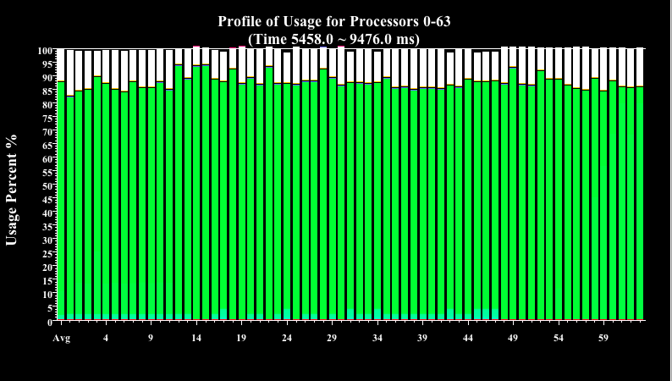
RefineLB Utilization after LB

Slide 11
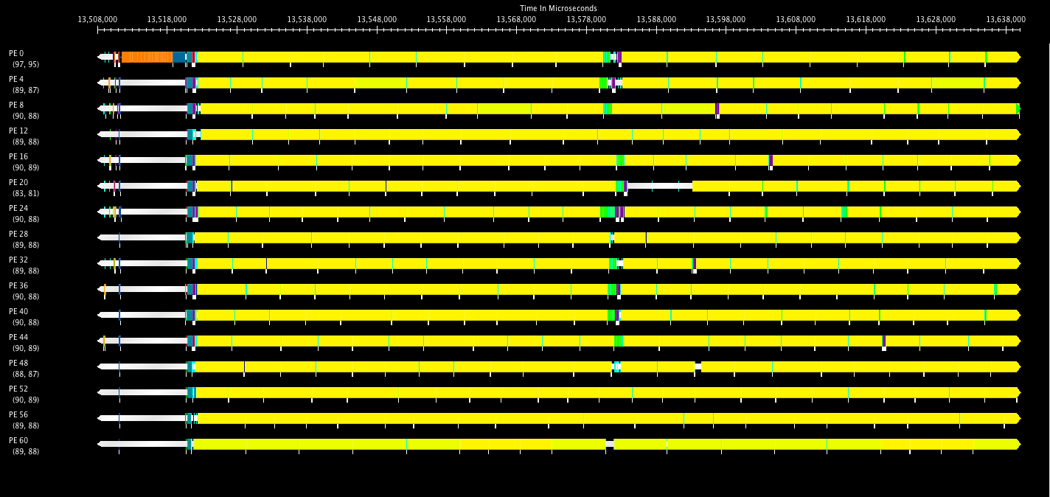
RefineLB at Load Balancing
Time taken for LB 0.01 sec
Timeline of 140ms

Slide 12
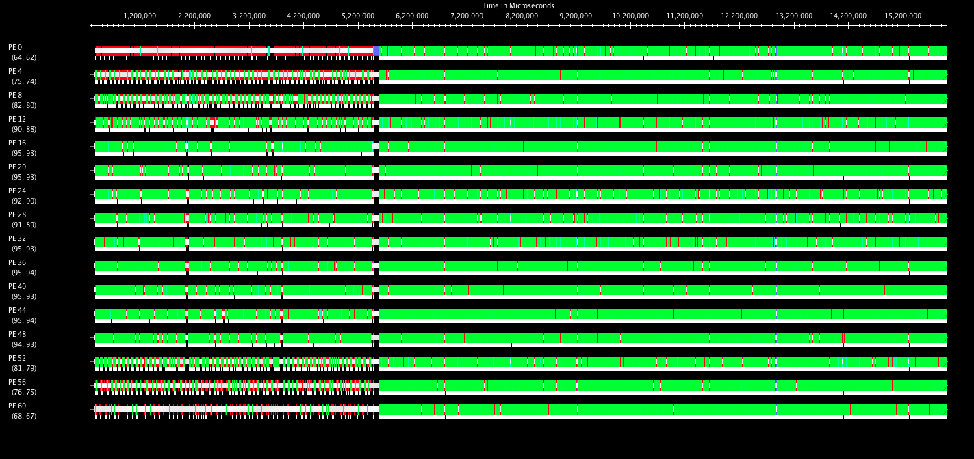
GreedyLB followed by RefineLB
Before LB – 85ms/step
After LB – 60ms/step

Slide 13
RefineSwap
Sometime Refine “gets stuck”
Esp. when the number of chares per PE is small
Any object from the heaviest loaded processor is too heavy to add to the lightest loaded processor
It becomes overloaded
Solution: swap objects rather than donate them

Slide 14
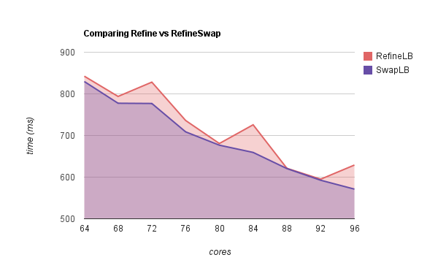
RefineSwap

Slide 15
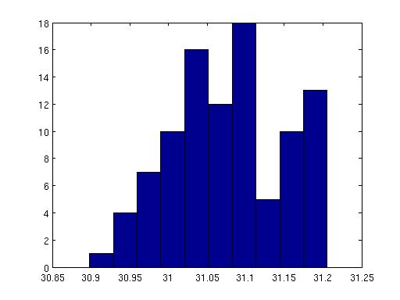
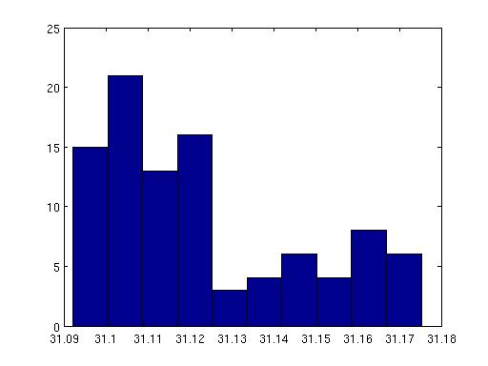
Histogram of load on PEs
RefineLB
RefineSwapLB

Slide 16
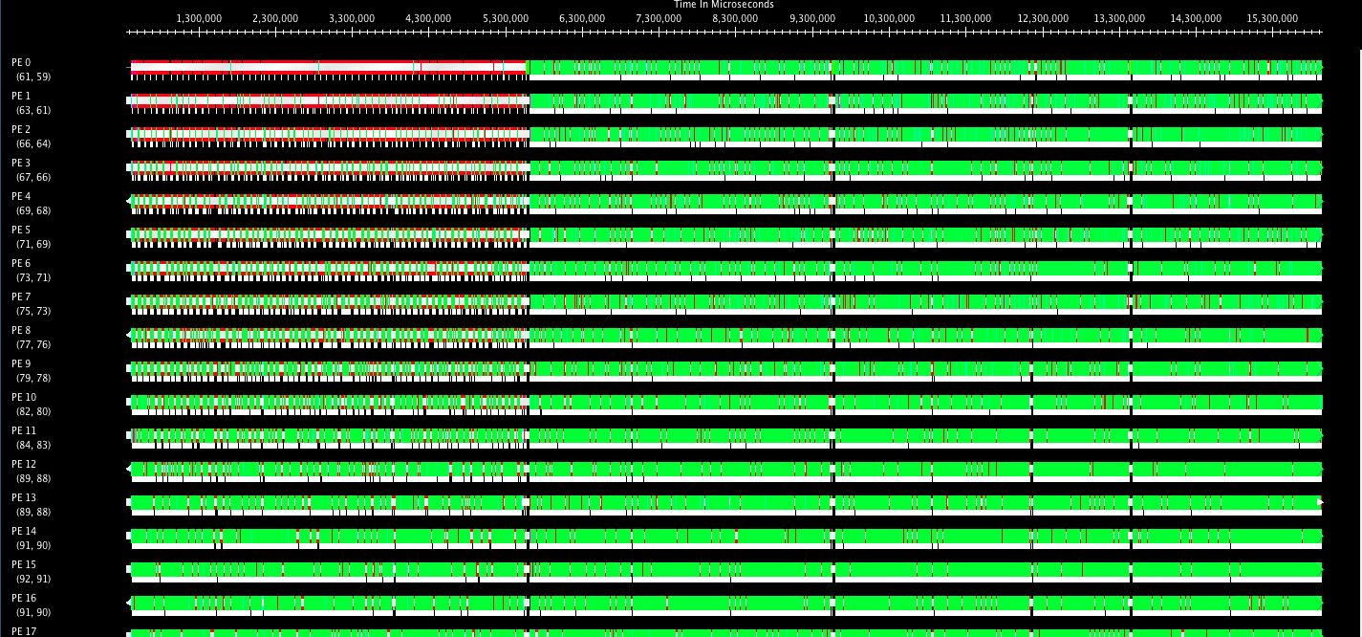
RefineSwapLB
Before LB – 85ms/step
After LB – 62ms/step

Slide 17
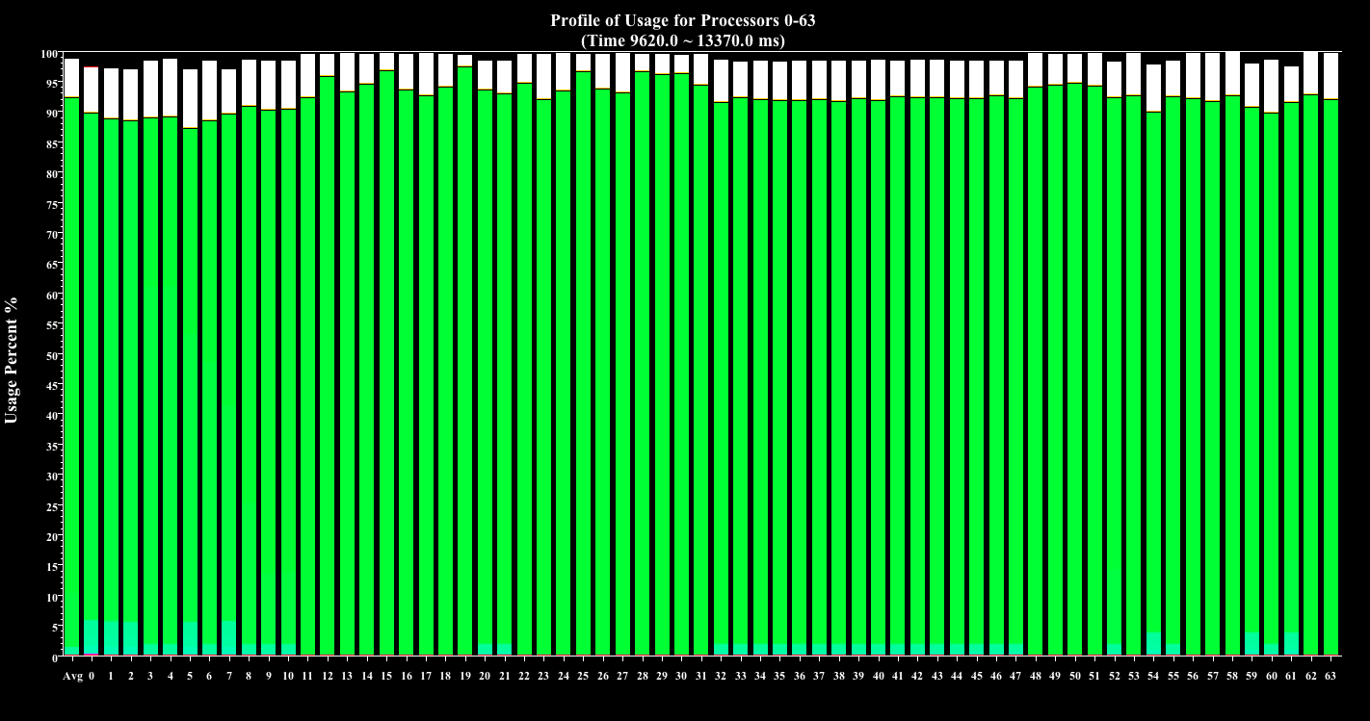
RefineSwapLB

Slide 18
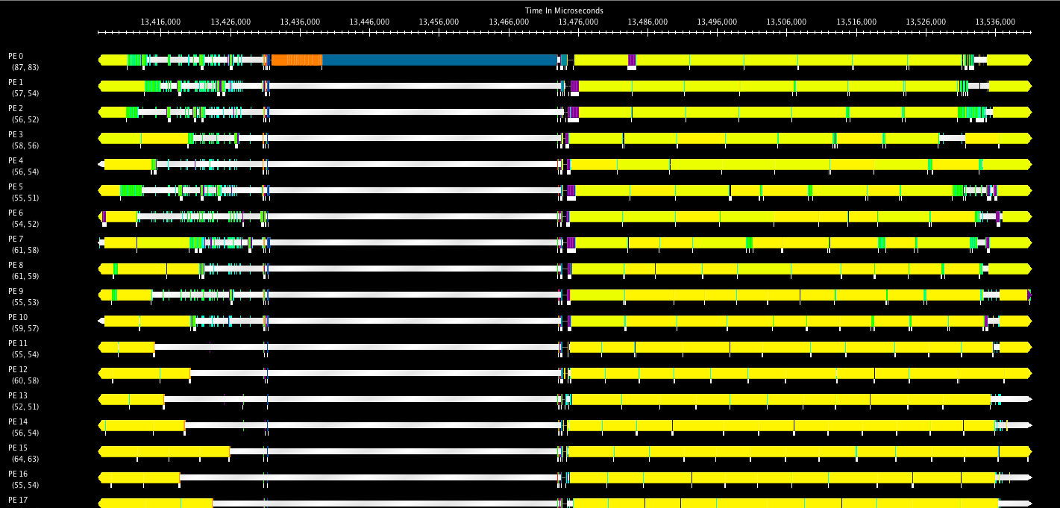
RefineSwapLB
Time taken for LB 0.03 sec

Slide 19
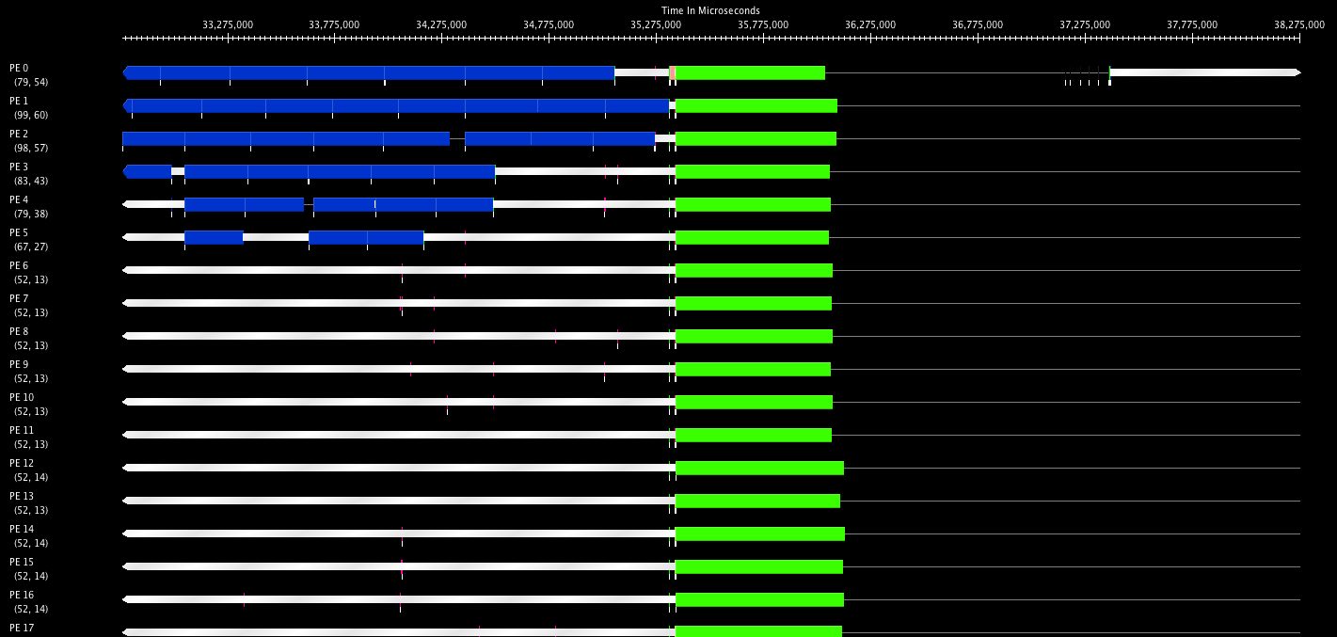
NPB : BT-MZ with GreedyLB
Timeline of 5.5 sec
Strategy time – 0.021sec
Migration time – 2.3sec (1015 migrations)

Slide 20
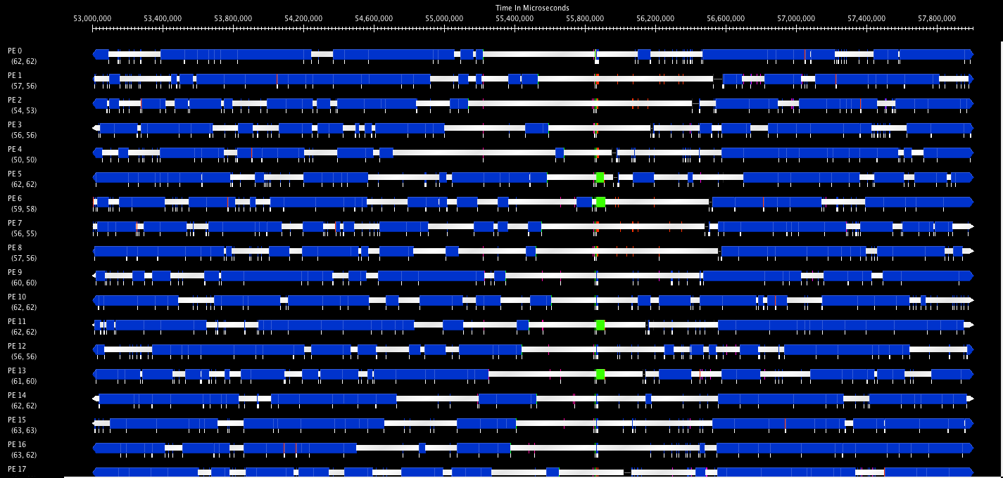
NPB : BT-MZ with RefineLB
Timeline of 5 sec
Strategy time – 0.0005sec
Migration time – 0.013sec (13 migrations)

Slide 21
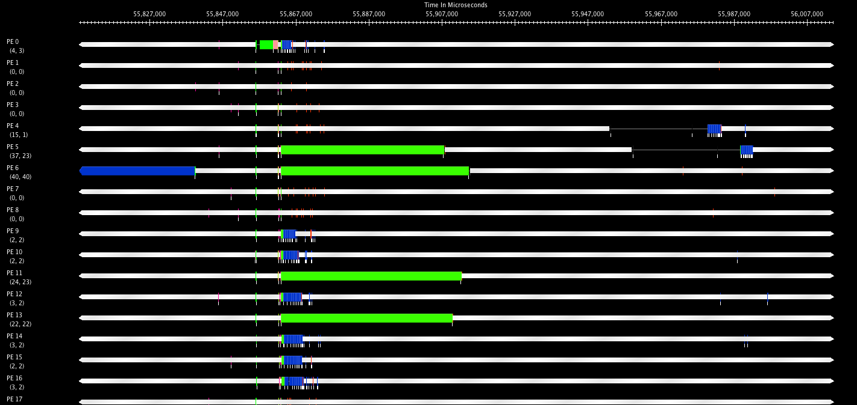
BT-MZ RefineLB Closeup
Timeline of 200 ms
Strategy time – 0.0005sec
Migration time – 0.013sec (13 migrations)

