Slide 1
Mitigating Impact of Heterogeneity Across Power Constrained Nodes
Sandeep Dasgupta, Karthik Gooli, Dhawal Seth
Notes:
<number>

Slide 2
Motivation and Problem Statement
Goal is to build high performance systems under strict power budget constraints
Running systems at TDP (Thermal Design Power) is wasteful
Running on multiple nodes at lower power cap vs Running on less number of nodes at higher power cap
Intel’s RAPL (Running Average Power Limit) toolkit is used to constrain power of compute nodes to lower power caps
Notes:
<number>

Slide 3
Motivation and Problem Statement (contd)
Under lower power caps different nodes yield different application performance under the same work load
This performance imbalance needs to be minimized
OUR WORK
Study the load imbalance at various power caps
Design and implement a dynamic load balancer which is heterogeneity/power aware to reduce the heterogeneity
Notes:
<number>

Slide 4
Test Bed and Applications Used
60-node Dell PoweEdge R620 cluster
Each node is Intel Xeon E5-2620 Sandy-bridge server with 6 physical cores @ 2GHz, 2-way SMT with 16 GB of DRAM
Package power can be capped in the range of 23-95W
(package power: chip that hosts processing cores, caches and memory controller)
Jacobi-2d: 5-point stencil memory-bound application
frame size:(36000 *36000) chare size: (60*60)
LeanMD: Computationally intensive molecular dynamics simulation application
Notes:
<number>

Slide 5

Heterogeneity Metric
Average Idle time:
max(t) : maximum execution time by a processor
P : Number of Processors
t : Execution time by a processor
Maximum Idle time
max(t) : maximum execution time by a processor
Min(t) : minimum execution time by a processor
Max Idle Time
Notes:
<number>

Slide 6
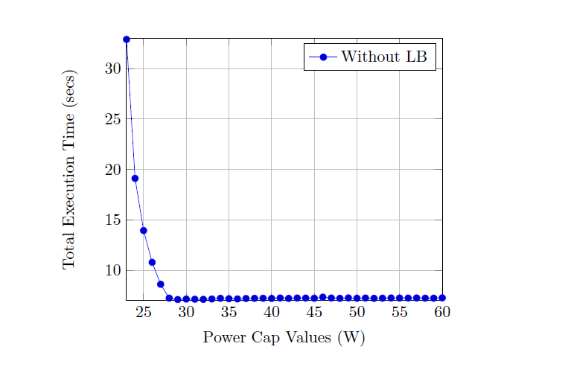
Power vs Total Execution Time (for Jacobi Application)
Execution time remains more/less the same until 32W
Exponential increase of Execution time at power caps 27-23W
Notes:
<number>

Slide 7
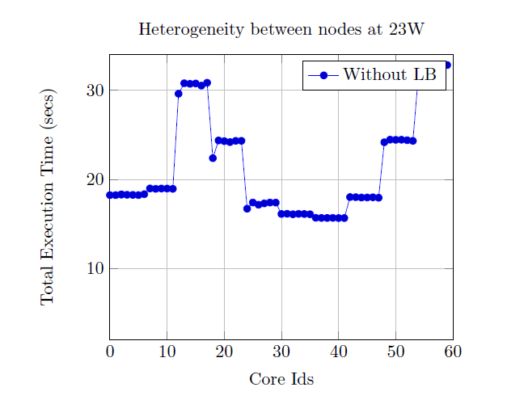
Heterogeneity Comparison
Intra-node execution time of PEs is constant
Inter-node execution time of PEs vary
Conclusion:
Heterogeneity is applicable only across the nodes
Heterogeneity is non-existent within a node
Notes:
<number>

Slide 8
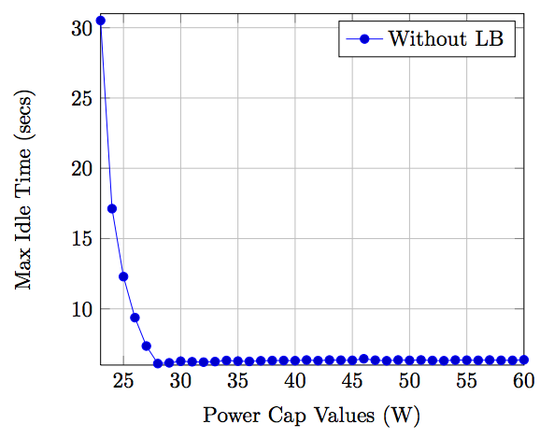
Max Idle Time Variation
There is huge variation between max execution times and min execution times at lower power caps
There is a high idle time range which suggests improvements can be obtained

Slide 9
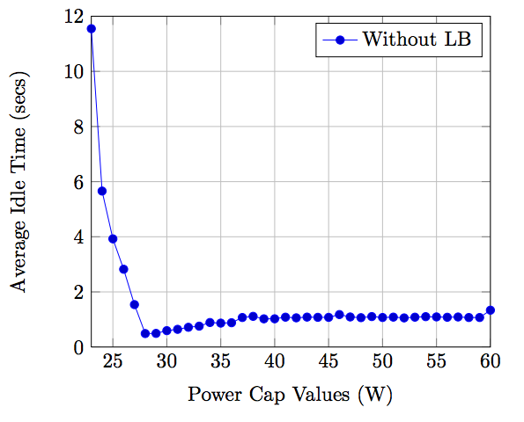
Average Idle time Variation
There is a significant increase in average Idle times at lower power caps
There is a significant chance for Improvement to reduce the average idle time

Slide 10
Refine LB
P1
Heavy PEs
Object
Avg PEs Object Time
If Object.load + P2.load < Avg PEs ObjectTime
P2
Light PEs
Notes:
Aims at converging to the average ex time
Calculates common average of total load
Set of PEs with execution time < avg time
Max heap of PEs with ex time > avg time
Keep Assigning Chares from Pop(MaxHeap) -> Set[x]

Slide 11
Greedy LB
Assumption: Obj Time(New PE) = Obj Time(Old PE)
MinHeap (PEs)
MaxHeap Objects
P1
Obj
P2
P3
P4
P5

Slide 12
Power Aware LB
w1x1 = w2x2 = … = wnxn
x1 + x2 + … + xn = X (Total number of Chares)
X1
X2
X3
X4
Time
Time

Slide 13
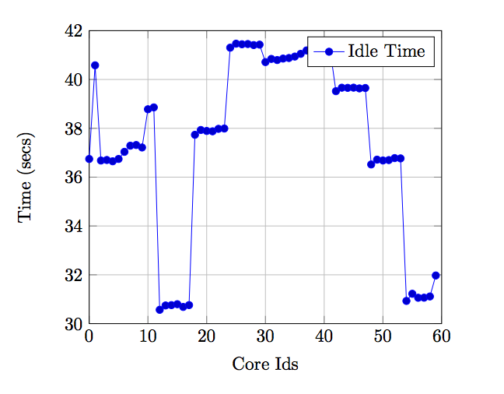
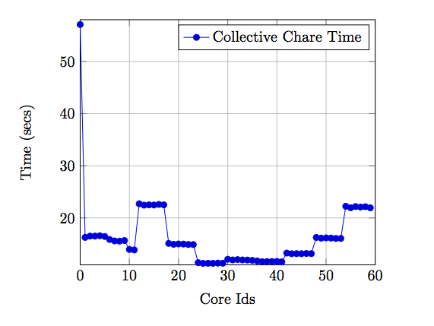
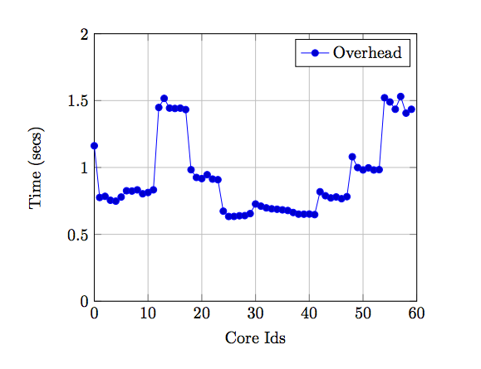
Percentage Change Idle Time = 0.35
Percentage Change bg Time = 1.41
Percentage Change Collective Chare time = 4.09

Slide 14
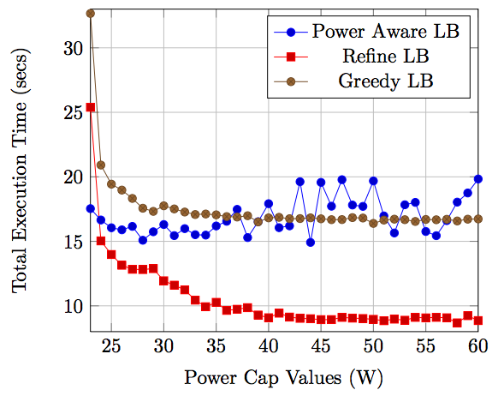
Load Balancer Performances
RefineLB uses incremental approach for load balancing
Greedy & Power Aware LB reshuffles completely

Slide 15
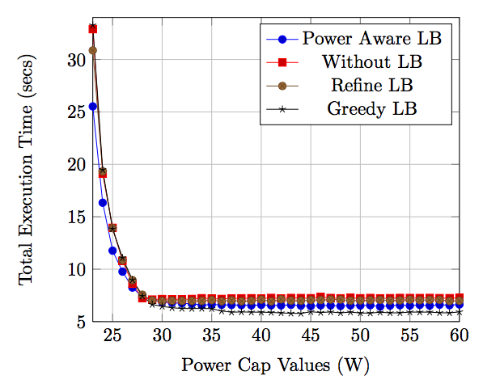
Performance Analysis
Power | WithoutLB | RefineLB | GreedyLB
27 | 1.04 | 1.08 | 1.08
26 | 1.10 | 1.11 | 1.13
25 | 1.18 | 1.18 | 1.17
24 | 1.16 | 1.18 | 1.19
23 | 1.28 | 1.20 | 1.30

Slide 16
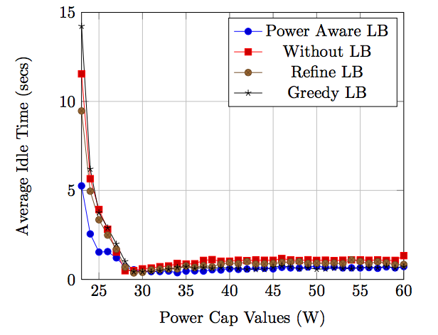
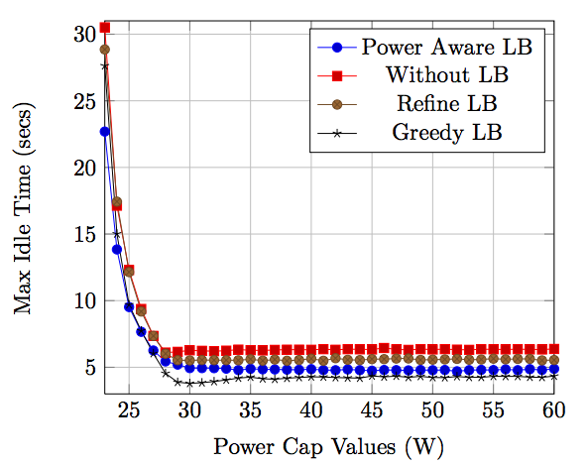
 | % AVG IDLE TIME REDUCTION |  | % MAX IDLE TIME REDUCTION
Power | WOLB | RLB | GLB |  | WOLB | RLB | GLB
27 | 21.16748102 | 28.7831285 | 39.05618147 |  | 14.8772971 | 14.85078958 | -3.76590009
26 | 44.58251887 | 37.21624656 | 46.11884641 |  | 18.27452998 | 16.5714934 | 1.005868444
25 | 60.86781115 | 54.16576351 | 59.05319516 |  | 22.55774121 | 21.61329299 | 1.782739272
24 | 54.81861203 | 48.43511273 | 58.77602275 |  | 19.17622293 | 20.58643506 | 7.796186289
23 | 54.4883819 | 44.46868137 | 63.05822859 |  | 25.63775594 | 21.36046695 | 17.8754218

Slide 17
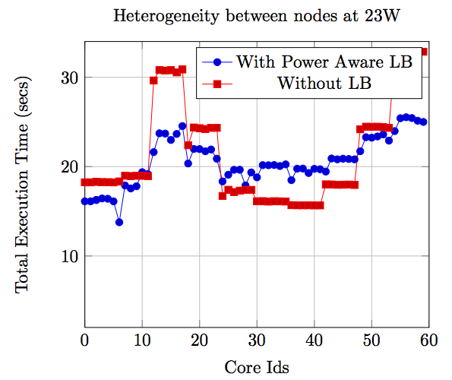
Execution Time Distribution
Execution times are averaged out with power aware LB
Scope for Improvement still left
Prior profiling of core or hard coding can help further ☺

Slide 18
Conclusion and Future Work
Heterogeneity is prominent in lower power regions
Developed Power Aware LB with
Frequency aware dynamic object allocation
Reduced Average Idle Time
Reduced Heterogeneity at lower power caps
Develop Power Aware LB for compute-intensive and loads
Eg. LeanMD
Relation between Heterogeneity and Surrounding Temperature

Slide 19
THANK YOU !

Slide 20
References
[1] Intel, Intel-64 and IA-32 Architectures Software Developers Manual , Volume 3A and 3B: System Programming Guide, 2011..
[2] Osman Sarood, PhD Thesis 2013, Optimizing Performance Under Thermal and Power Constraints for HPC Data Centers.
[3] Intel, Intel Power Governor. http://software.intel.com/en-us/articles/intel-power-governor.
[4] R. K. BRUNNER AND L. V. KAL´E, Handling applicationinduced load imbalance using parallel objects, in Parallel and Distributed Computing for Symbolic and Irregular Applications, World Scientific Publishing, 2000, pp. 167–181.
[5] L. KALE, The Chare Kernel parallel programming language and system, in Proceedings of the International Conference on Parallel Processing, vol. II, Aug. 1990, pp. 17–25.
[6] L. V. KALE, A. BHATELE, E. J. BOHM, AND J. C. PHILLIPS, NAnoscale Molecular Dynamics (NAMD), in Encyclopedia of Parallel Computing (to appear), D. Padua, ed., Springer Verlag, 2011.
[7] L. V. KALE AND S. KRISHNAN, Charm++: A portable concurrent object oriented system based on c++, in Proceedings of the Eighth Annual Conference on Object-oriented Programming Systems, Languages, and Applications, OOPSLA ’93, New York, NY, USA, 1993, ACM, pp. 91–108.
[8] V. MEHTA, LeanMD: A Charm++ framework for high performance molecular dynamics simulation on large parallel machines, Master’s thesis, University of Illinois at Urbana-Champaign, 2004.
[9] O. SAROOD, A. LANGER, L. V. KALE, B. ROUNTREE, AND B. DE SUPINSKI, Optimizing power allocation to cpu and memory subsystems in overprovisioned hpc systems, in Proceedings of IEEE Cluster 2013, Indianapolis, IN, USA,September 2013.
[10] G. ZHENG, E. MENESES, A. BHATELE, AND L. V. KALE, Hierarchical load balancing for charm++ applications on large supercomputers, in Proceedings of the 2010 39th International Conference on Parallel Processing Workshops, ICPPW ’10, Washington, DC, USA, 2010, IEEE Computer Society, pp. 436–444.

