Slide 1
GDFA PROJ - 2
Sandeep Dasgupta
Y9111031

Slide 2
Some Concepts
Bit vector framework
Independence of data flow information of different entities.
f_{n}(X) = (X − Kill_{n}) ∪ Gen_{n}
Non Separable Framewok
Data flow value of a given entity may depend on the data flow value of same entity or data flow value of some other entity.
Gen_{n}(x) = ConstGen_{n} U DepGen_{n} (x)
Kill_{n}(x) = ConstKill_{n} U DepKill_{n} (x)
f_{n}(X) = (X − Kill_{n}(x)) ∪ Gen_{n}(x)

Slide 3
ENTRY
ENTRY
ENTRY
‘B’ not live
‘A’, ‘B’ faint
B = 2;
A = 3;
B = 2;
B = 2;
‘A’ faint, ‘B’ not
‘B’ live, ‘A’ not
A = 3;
A = B + 1;
Transitive Effect
‘B’ not live
‘A’ faint, ‘B’ not
A = B +1;
‘A’ not live
‘A’ , ‘B’ faint
EXIT
EXIT
EXIT
Live Variable Analysis : Before Dead Code Elimination
Live Variable Analysis : After Dead Code Elimination
Faint Variable Analysis --
Non-Separable framework
Notes:
<number>

Slide 4
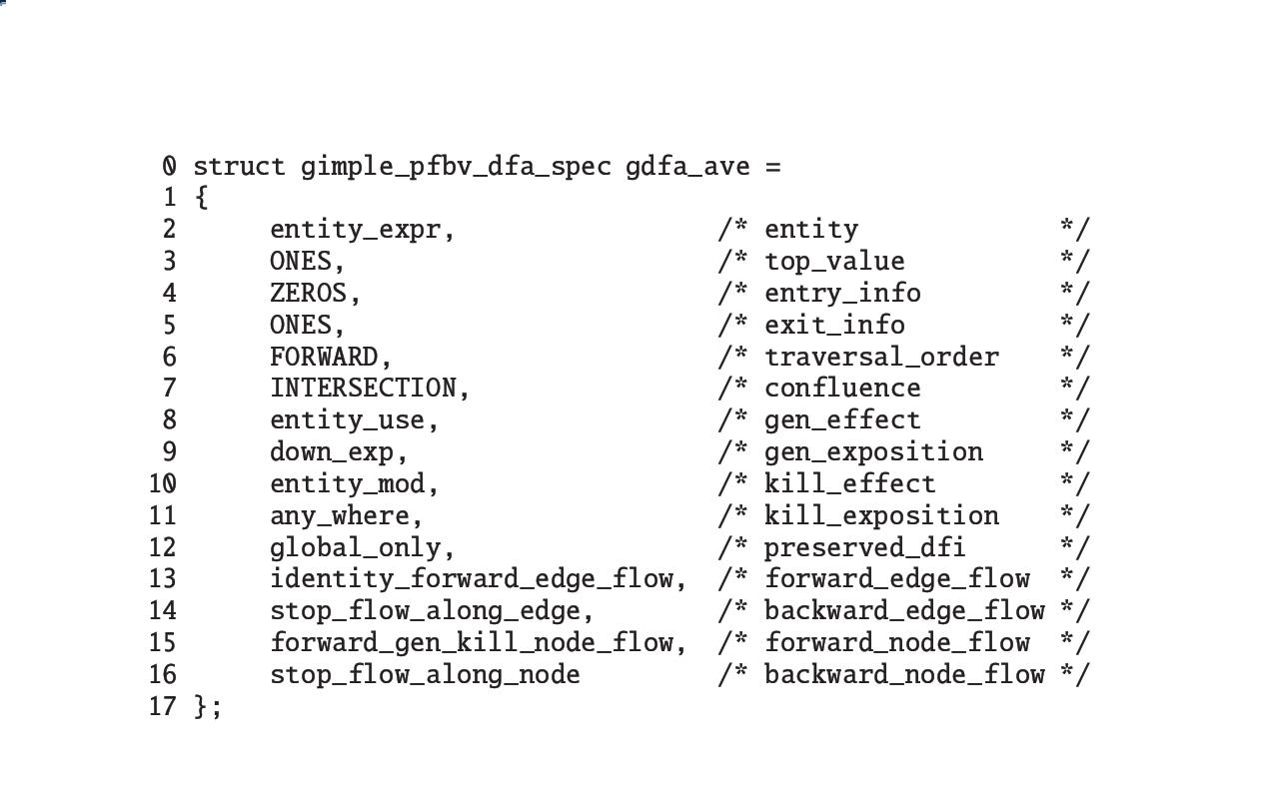

Status of gdfa in GCC
Intraprocedural bit vector data flow analysis.
Gdfa uses generic data flow equations which makes it possible to execute a wide variety of specifications without having to know the name of a particular analysis being performed.

Slide 5
Goal
Extend gdfa to the dataflow frameworks where flow information can be represented using bit vector but the frameworks are non-separable.
Output should be in
Textual format – print GIMPLE code lines showing impact chains.
Graphical format – show the entire control flow graph with basic block/gimple statements in the impact chain highlighted.

Slide 6
An Approach
Gen_{n}(x) = ConstGen_{n} U DepGen_{n} (x)
Kill_{n}(x) = ConstKill_{n} U DepKill_{n} (x)
f_{n}(X) = (X − Kill_{n}(x)) ∪ Gen_{n}(x)
To treat a statement as an independent basic block.
To debug one particular analysis(live variable analysis) to know the nitty gritty of the code.
The dependent part of Gen Kill need to be implemented in gdfa.
The specification structure need to be updated. We propose introduction of four more fields in the existing structure.

Slide 7
Expectations
The existing bit vector analysis should work fine with the new framework (passing void in the DepGen, DepKill form).
Implementation of faint variable analysis, possibly uninitialised variable analysis successfully.

