Slide 1


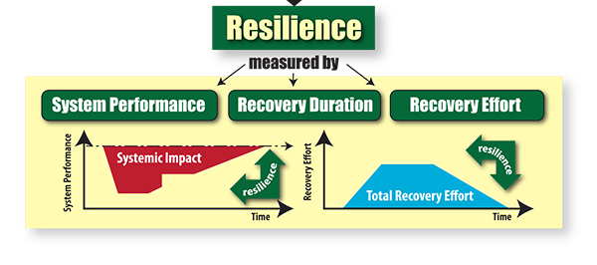
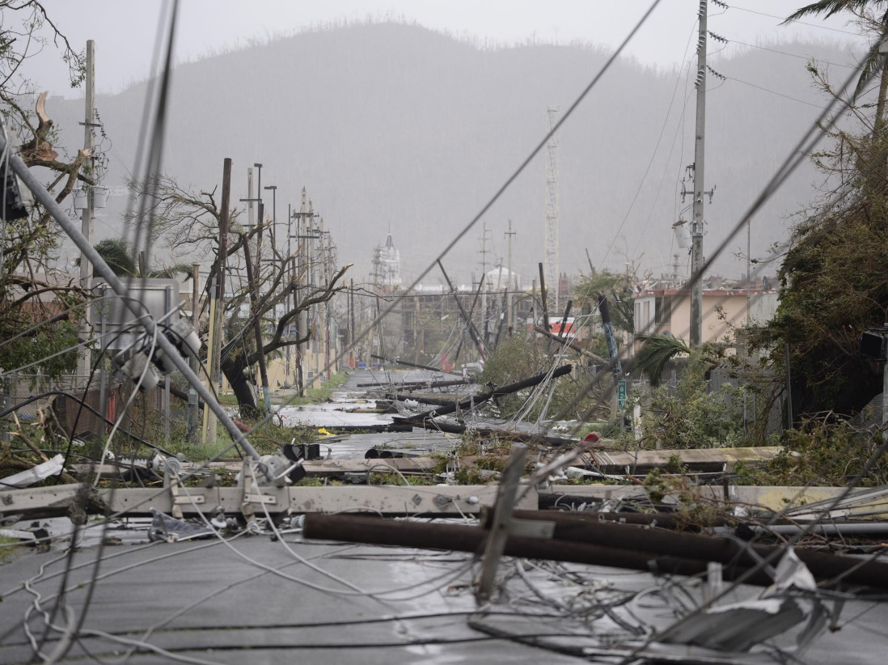



optimal post-disaster restoration of power
Networks in Puerto rico
Alireza Inanlouganji, Agami Reddy, Giulia Pedrielli
School of Computing, Informatics and Decision Systems Engineering
Background & Objectives
Disasters such as hurricanes cause huge losses in terms of both physical assets and lives and a significant portion of the adversarial effects is due to failure in infrastructure systems such as power and water networks. In this research, we study the issue of optimal recovery of power networks with a case study in Puerto Rico using mathematical optimization models.
Challenges in this research are as follows:
The water network and its interdependence with power network should be modeled.
Joint restoration of coupled water-power network should be considered
Societal impacts of natural disasters in communities should be considered.
Summary & Future Research
Approach
Optimal restoration sequence can lead to huge savings in outage cost penalties. Thus, it is important to find the optimal restoration order using mathematical models.
While for Puerto Rico case study, the inclusion of human factor did not change the rank of solutions, in general this is not the case.
Higher resolution network in western Puerto Rico changed the dispatch values and the impact of failures. More detailed analysis using this higher resolution network topology seems promising.
Extending methodology to model water network and its interconnection to power and joint restoration of coupled water-power network is another interesting direction for future research. This is specially as joint restoration of coupled power-water networks is not studied enough.
Considering uncertainty in failures and the implication of this uncertainty is another promising extension. This specially true as in reality, the propagation of natural hazard and as a result the damages it causes to the network is
Finally, analyzing the network and proposing topological changes to the network in order to increase its resiliency against disasters would an interesting direction for future research.
Network flow models to mimic behavior of power networks after disaster
$$\sum_{\left\{k ∈F_{i}^{+}\right\}}{{f_{\left\{ki\right\}}^{t}+p}_{i}^{t}}− s_{i}^{t}− \sum_{\left\{l ∈F_{i}^{−}\right\}}{f_{\left\{il\right\}}^{t}}= 0$$
$$f_{ij}^{t}≤f_{ij}^{max}{ w}_{i}^{t}$$
$$s_{i}^{t}≤d_{i}^{t}{ w}_{i}^{t}$$
$$p_{i}^{t}≤p_{i}^{max}{ w}_{i}^{t}$$
Failed Transformers | Supplied Power (MW) | Unmet Load (MW) | Figure of Merit
T09 | 2,368 | 61 | 97.49%
T13 | 2,283 | 146 | 93.99%
T05 | 1,882 | 547 | 77.48%
T05, T09, T13 | 1,438 | 991 | 59.20%
G03
G04
G01
G01
G01
G01
T07
G02
T03
T04
T05
G01
T02
G01
T06
G01
T08
G01
G01
Sequence | Outage Cost (k$)
T05, T09, T13 | 53,694
T05, T13, T09 | 50,293
T09, T05, T13 | 81,805
T09,T13, T05 | 97,835
T13, T05, T09 | 66,323
T13, T09, T05 | 85,755
T01
G01
T10
G01
G01
T13
T09
G01
G01
G06
G05
G08
T12
T11
G07
References
[1] PR Power Grid Model, Gustavo Cuello-Polo, Efraín O’Neill-Carrillo, Electrical and Computer Engineering Department, University of Puerto Rico-Mayagüez.
[2] DHS's Homeland Infrastructure Foundation-Level data portal. https://hifld geoplatform.opendata.arcgis.com/datasets/electric-power-transmission-lines?geometry= 68.682%2C17.734%2C-63.45%2C18.647
[3] Government of Puerto Rico's http://www.gis.pr.gov/descargaGeodatos/Infraestructuras/Pages/Electricidad.aspx
[4] Data published by the Puerto Rico Electric Power Authority in compliance with the Energy Transformation and Relief Act of Puerto Rico. http://energia.pr.gov/wp-content/uploads/2015/09/Estadisticas.pdf
Sequence | Outage Cost (k$)
T05, T09, T13 | 93,674
T05, T13, T09 | 87,347
T09, T05, T13 | 143,453
T09,T13, T05 | 172,760
T13, T05, T09 | 116,654
T13, T09, T05 | 152,287
resilientinfrastructure.org
tcarval3@asu.edu
Eric21.org

