Slide 1

Intrusion Detection System (IDS) Network Traffic
A Data-Driven Analysis of an Industrial Control System (ICS)

Slide 2
Overview
IDS/ICS Breakdown
Protocol Use
Data Flow
Targeted IP Addresses
Malicious Traffic - Time on Network
Malicious Connection States
Amount of Data Transferred
Implications and Recommendations
Sources

Slide 3
What is an IDS
Intrusion Detection System (IDS)
Monitors network traffic
Information is typically sent to a Security Information and Event Management System (SIEM)
If capable of responding to a detected intrusion, IDS is called an Intrusion Prevention System (IPS)
Network intrusion detection systems (NIDS): Analyzes incoming network traffic
Host-based intrusion detection systems (HIDS): Monitors important operating system files
Industrial Control System (ICS) – Control processes for industrial systems such as manufacturing, product handling, production, and distribution
Electrical, mechanical, hydraulic, pneumatic, etc
Often uses UDP
Older, less reliable protocol, but faster than TCP
Notes:
https://www.barracuda.com/support/glossary/intrusion-detection-system#:~:text=An%20intrusion%20detection%20system%20(IDS,information%20and%20event%20management%20system
https://csrc.nist.gov/glossary/term/industrial_control_system#:~:text=Industrial%20control%20systems%20include%20supervisory,controllers%20to%20control%20localized%20processes
Supervisory Control and Data Acquisition (SCADA)
Distributed control systems (DCS)
Programmable logic controllers (PLC)

Slide 4
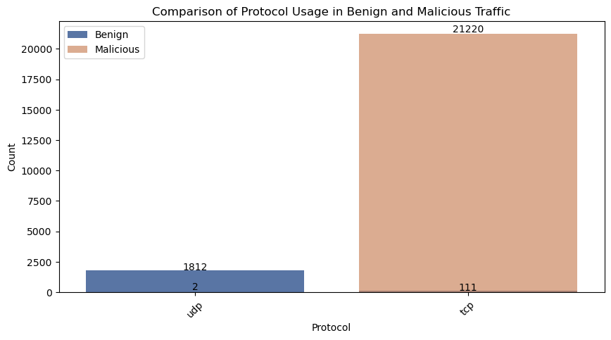
All Traffic – Protocol Use
This network traffic typically uses UDP, while the malicious traffic almost always comes over TCP.

Slide 5
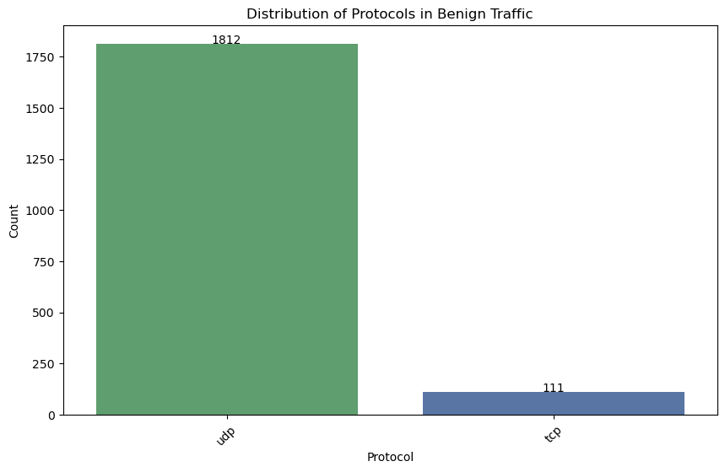
Benign Traffic - Protocol

Slide 6
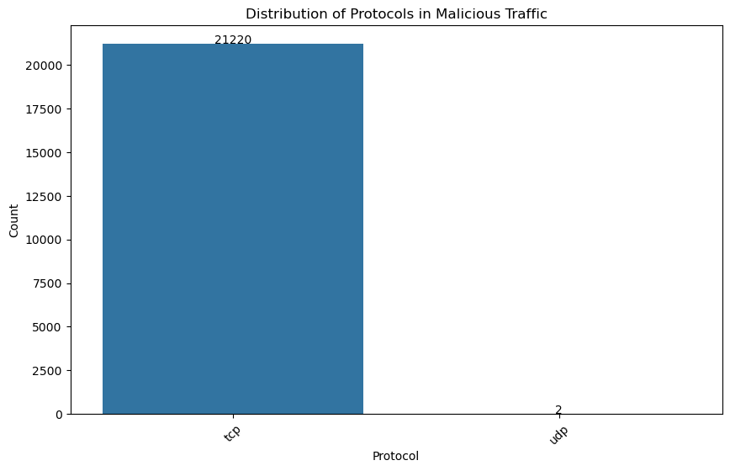
Malicious Traffic Protocol

Slide 7
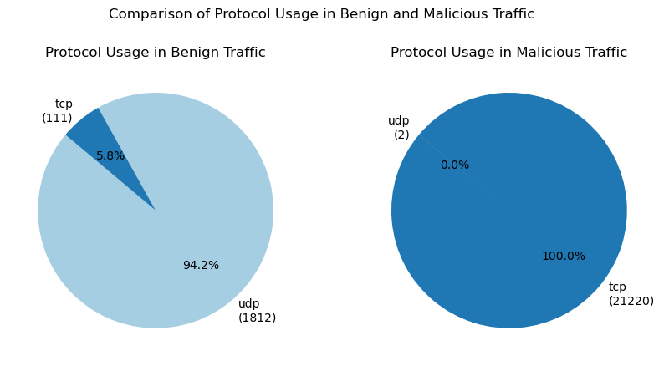
All Traffic – Protocol Use
May be wise to limit, if not eliminate, TCP traffic for targeted ICS devices.

Slide 8
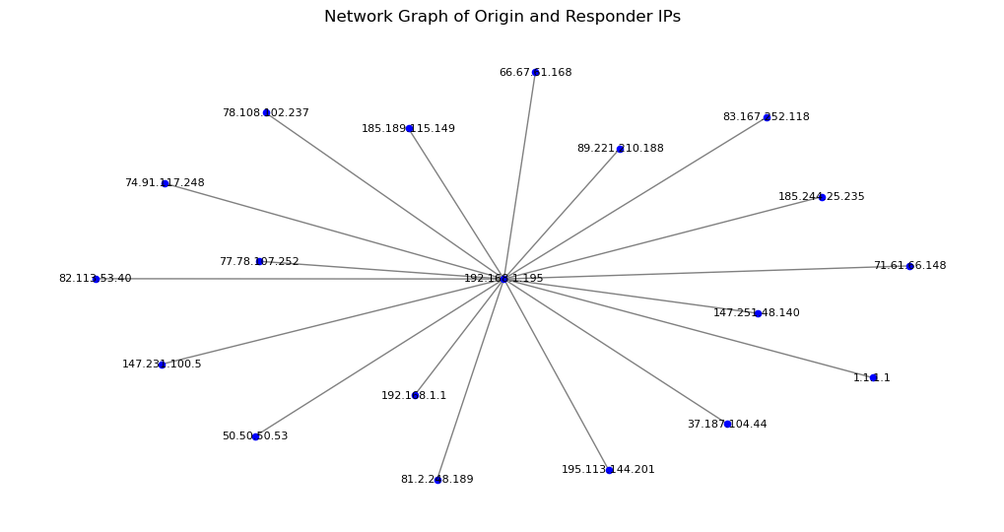
Data Flow

Slide 9
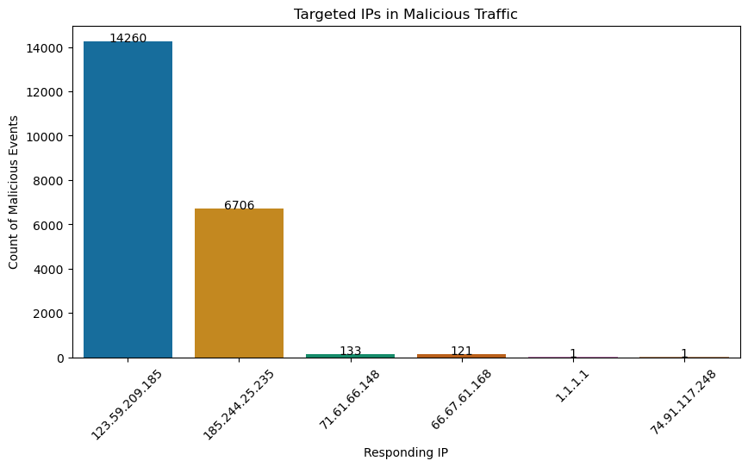
Targeted IP Addresses

Slide 10
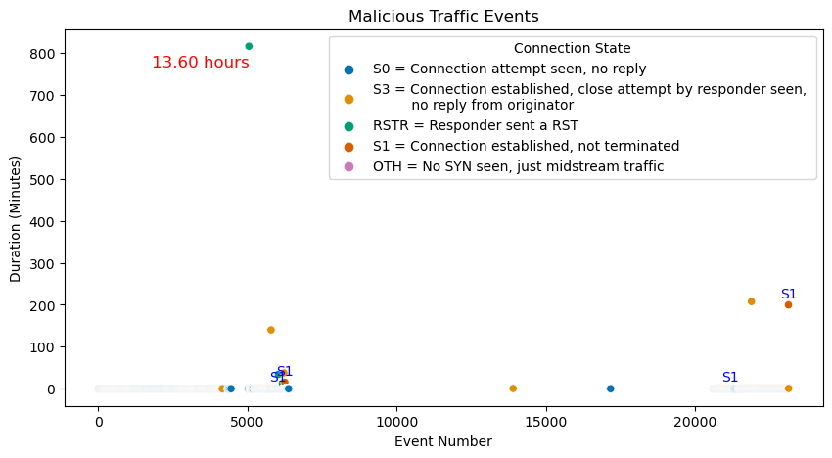
Time on Network per Event

Slide 11
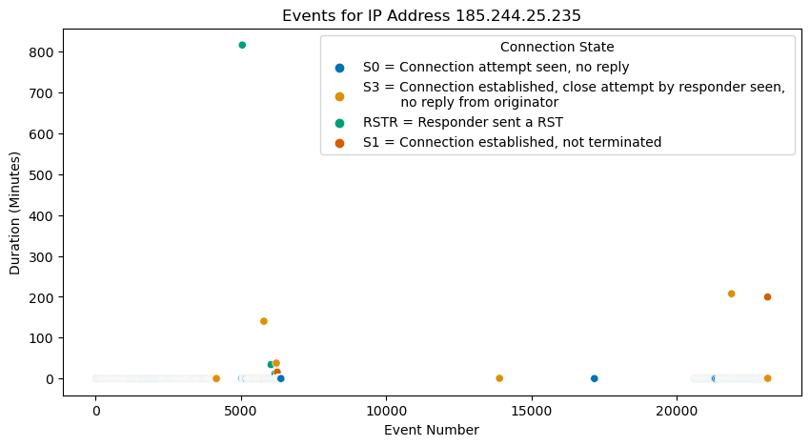
IP of 13 Hour Event

Slide 12
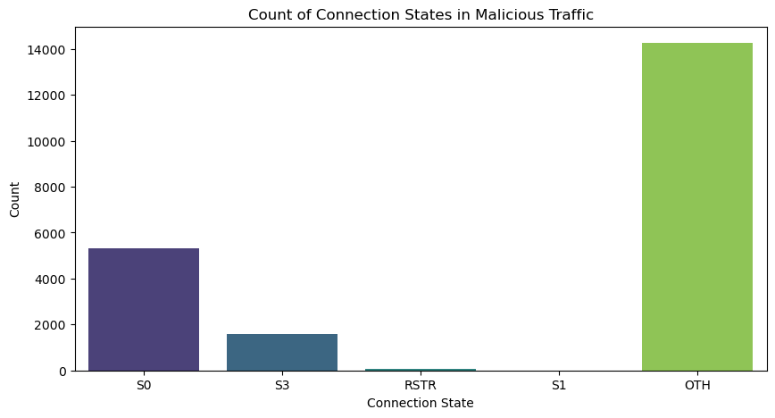
Connection States

Slide 13
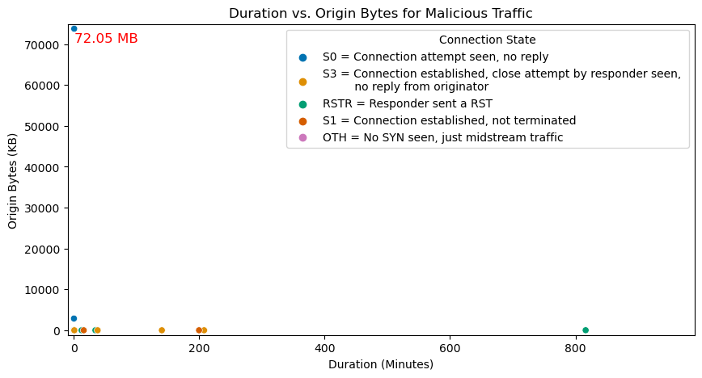
Amount of Data from Origin
The 72.05 MB event is targeting IP 74.91.117.248 and is the only time this IP is seen in the IDS data.

Slide 14
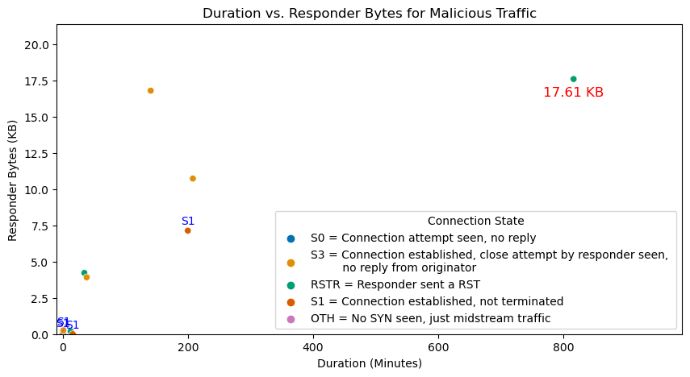
Data Sent

Slide 15
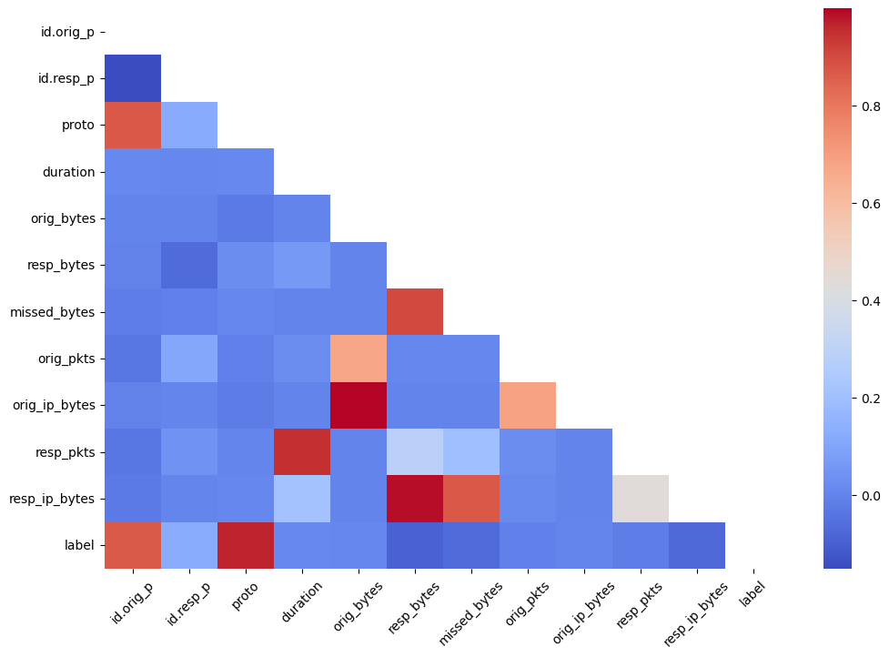
IDS Network Traffic

Slide 16
Recommendations
Your IDS sucks

