Slide 1

Intrusion Detection System (IDS) Network Traffic
A Data-Driven Analysis of Cybersecurity Measures

Slide 2
Overview
The Data and the Goal
IDS/ICS Breakdown
Protocol Use
Data Flow
Targeted IP Addresses
Malicious Traffic - Time on Network
Malicious Connection States
Amount of Data Transferred
Implications and Recommendations
Sources

Slide 3
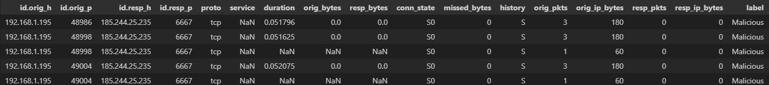
The Data and Goal
Data and Methodology
Includes captures of both malicious and benign traffic on IoT devices
Retrieved from Kaggle: https://www.kaggle.com/datasets/wittigenz/hydras
Contains more than 23,000 rows, without duplicates
Will need to convert binary string values into integer values “1” and “0”
For example: Malicious will equal 1 and benign will equal 0
Columns with non-binary string values may be dropped for certain stages of analysis
Research Objective
Will assist in assessing the effectiveness of this IDS on IoT devices
Will be directly applicable to similar data ingest

Slide 4
What is an IDS
Intrusion Detection System (IDS)
Monitors network traffic
Information is typically sent to a Security Information and Event Management System (SIEM)
If capable of responding to a detected intrusion, IDS is called an Intrusion Prevention System (IPS)
Network intrusion detection systems (NIDS): Analyzes incoming network traffic
Host-based intrusion detection systems (HIDS): Monitors important operating system files
Internet of Things (IoT) – Software and other technologies that connect and exchange data with other devices and systems over the internet or other communications networks.
Smart Appliances (Security camera, lights, thermostats, etc)
Wearable Devices
Healthcare
Notes:
https://www.barracuda.com/support/glossary/intrusion-detection-system#:~:text=An%20intrusion%20detection%20system%20(IDS,information%20and%20event%20management%20system
https://csrc.nist.gov/glossary/term/industrial_control_system#:~:text=Industrial%20control%20systems%20include%20supervisory,controllers%20to%20control%20localized%20processes
Supervisory Control and Data Acquisition (SCADA)
Distributed control systems (DCS)
Programmable logic controllers (PLC)

Slide 5
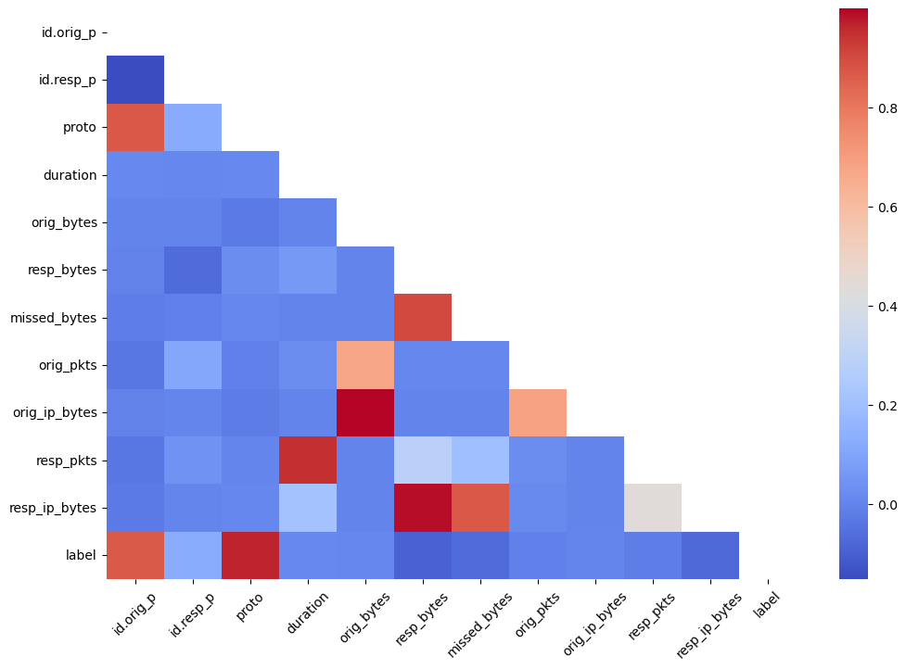
IDS Network Traffic

Slide 6
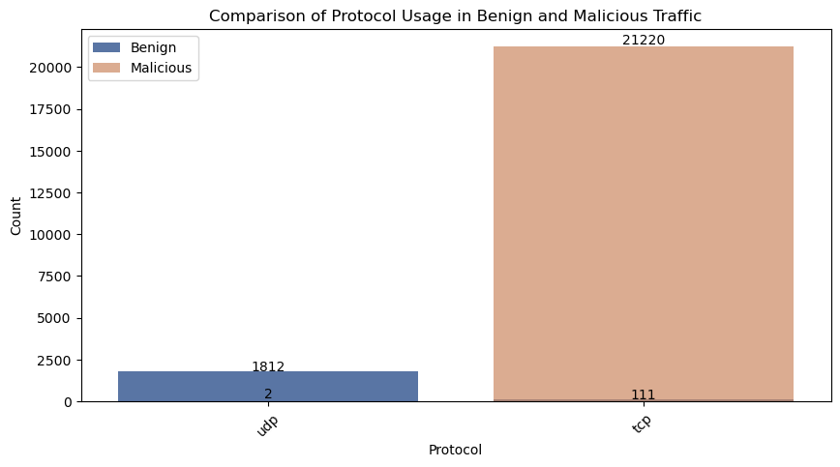
All Traffic – Protocol Use
This network traffic typically uses UDP, while the malicious traffic almost always comes over TCP.

Slide 7
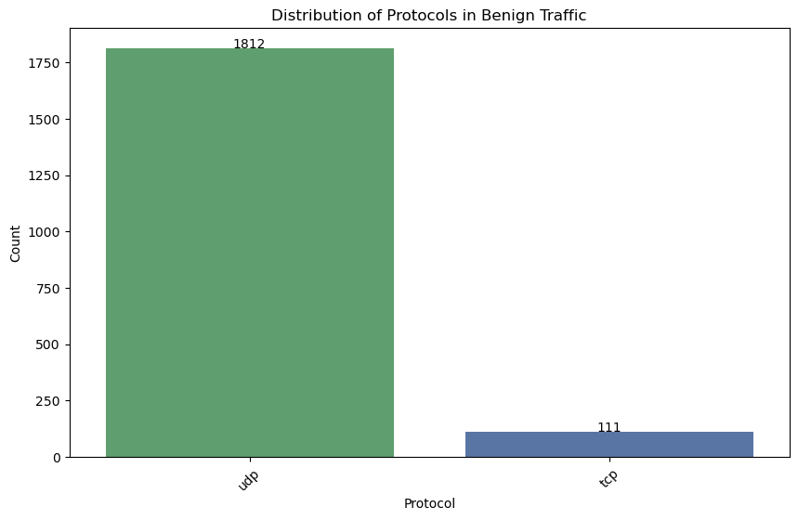
Benign Traffic - Protocol

Slide 8
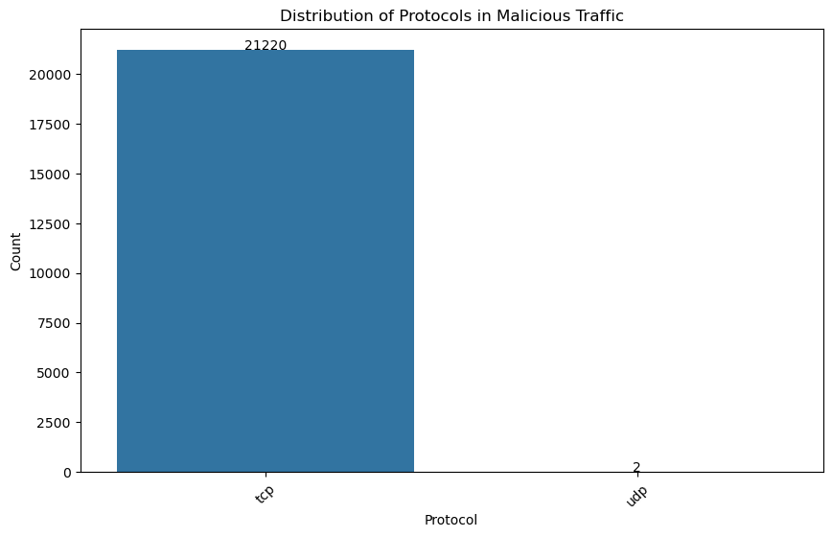
Malicious Traffic Protocol

Slide 9
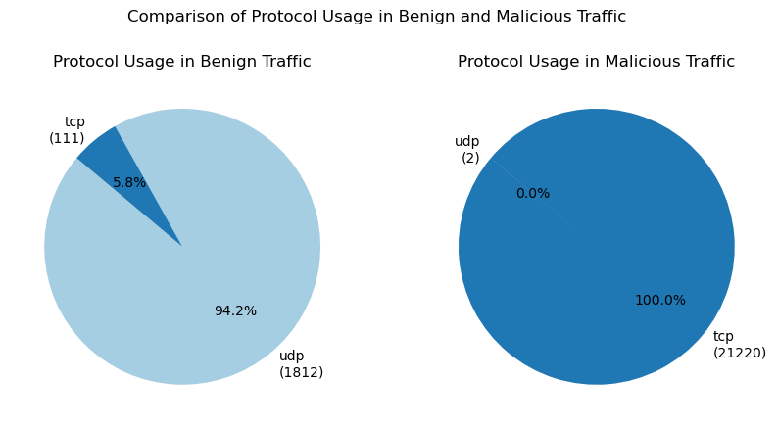
All Traffic – Protocol Use
May be wise to limit, if not eliminate, TCP traffic for targeted IoT devices.

Slide 10
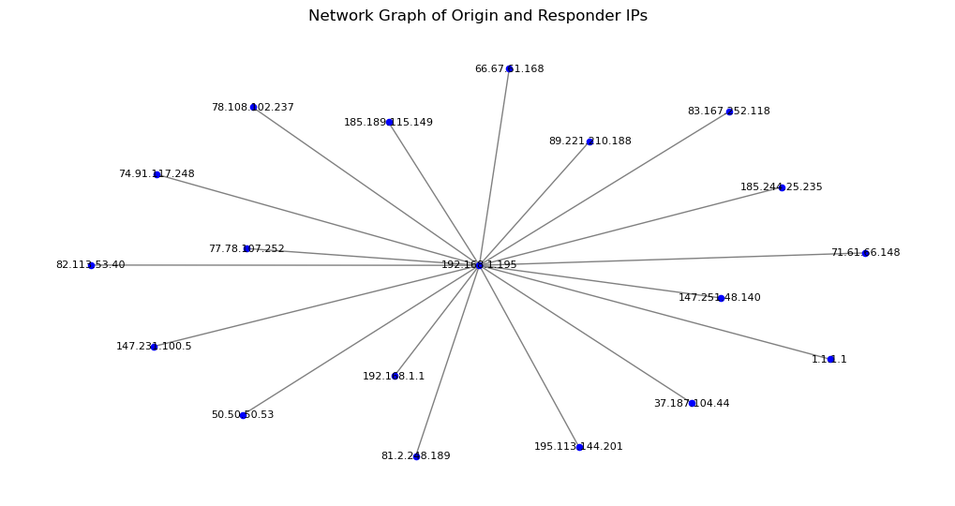
Data Flow

Slide 11
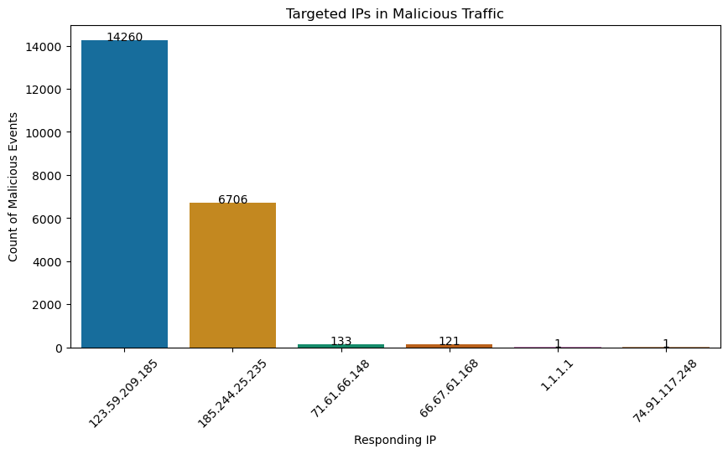
Targeted IP Addresses

Slide 12
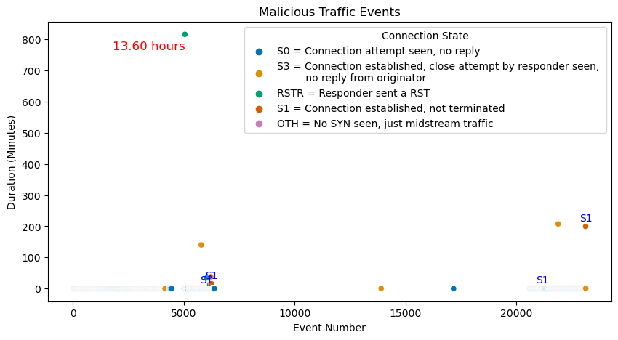
Time on Network per Event

Slide 13
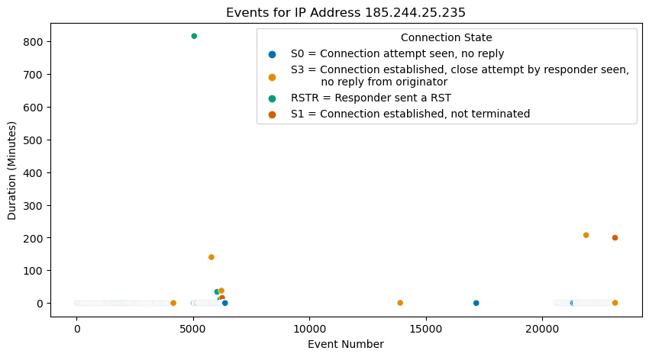
IP of 13 Hour Event

Slide 14
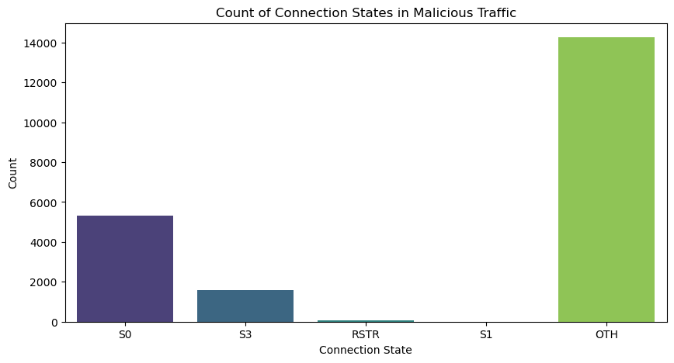
Connection States

Slide 15
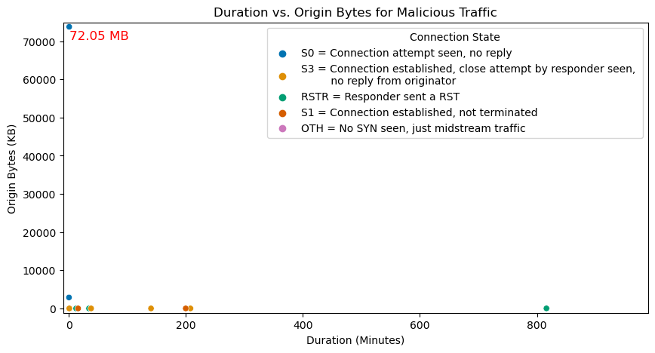
Amount of Data from Origin
The 72.05 MB event is targeting IP 74.91.117.248 and is the only time this IP is seen in the IDS data.

Slide 16
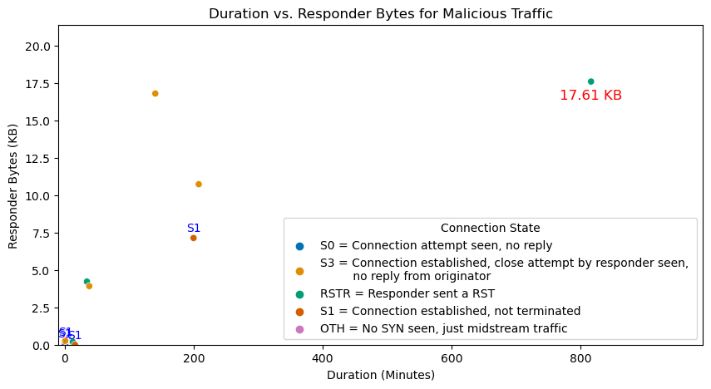
Data Sent

Slide 17
Recommendations
IDS Sensors
Deploy both internally (at subnet boundaries) and externally (at the perimeter)
Monitor network segments at key points within the network
Critical servers or subnet boundaries
Logging
Correlate alerts with internal logs (firewall logs) that contain original IP address information
Integrate IDS with a Security Information and Event Management (SIEM) system
Will aggregate and correlate data from multiple sources
Configure NAT devices to log detailed translation information
Include internal-to-external IP mappings
Can be used to trace back the internal source of traffic
Future Analysis
The above recommendations will offer a more in-depth opportunity for future analysis
The original dataset shows how necessary it is to configure your IDS
Analysis on a properly configured dataset may prove invaluable

Slide 18
Sources and Contact Information
https://docs.zeek.org/en/current/scripts/base/protocols/conn/main.zeek.html
ipinfo.io
https://www.barracuda.com/support/glossary/intrusion-detection-system#:~:text=An%20intrusion%20detection%20system%20(IDS,information%20and%20event%20management%20system
https://csrc.nist.gov/glossary/term/industrial_control_system#:~:text=Industrial%20control%20systems%20include%20supervisory,controllers%20to%20control%20localized%20processes
Libraries:
Pandas
Numpy
Matplotlib
seaborn
sklearn network
Ipinfo
Github Repository: https://github.com/sdave777/Internet-of-Things_IDS_Data
Contact:
david.scott.98@spaceforce.mil
SPC4 Scott, David
Cyber Intelligence Analyst, USSF 71 ISRS Detachment 6

