Slide 1

Network Analysis and Cybersecurity Prioritization
A Data-Driven Analysis of Network Monitoring Logs

Slide 2
Overview
The Data and the Goal
IDS/ICS Breakdown
Protocol Use
Data Flow
Targeted IP Addresses
Malicious Traffic - Time on Network
Malicious Connection States
Amount of Data Transferred
Implications and Recommendations
Sources

Slide 3
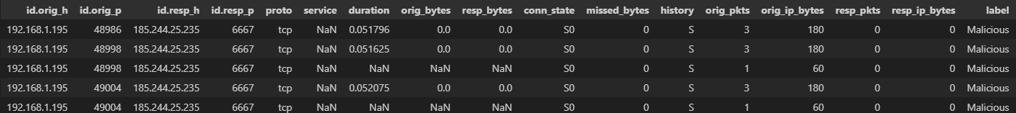
The Data and Goal
Data and Methodology
Includes captures of both malicious and benign traffic on IoT devices
Retrieved from Kaggle: https://www.kaggle.com/datasets/wittigenz/hydras
Contains more than 23,000 rows, without duplicates
Research Objective
To predict most likely malicious activity and test the efficacy of recommended mitigations
Will be directly applicable to similar data ingest

Slide 4
What is an IDS
Intrusion Detection System (IDS)
Monitors network traffic
Information is typically sent to a Security Information and Event Management System (SIEM)
If capable of responding to a detected intrusion, IDS is called an Intrusion Prevention System (IPS)
Network intrusion detection systems (NIDS): Analyzes incoming network traffic
Host-based intrusion detection systems (HIDS): Monitors important operating system files
Notes:
https://www.barracuda.com/support/glossary/intrusion-detection-system#:~:text=An%20intrusion%20detection%20system%20(IDS,information%20and%20event%20management%20system
https://csrc.nist.gov/glossary/term/industrial_control_system#:~:text=Industrial%20control%20systems%20include%20supervisory,controllers%20to%20control%20localized%20processes
Supervisory Control and Data Acquisition (SCADA)
Distributed control systems (DCS)
Programmable logic controllers (PLC)

Slide 5
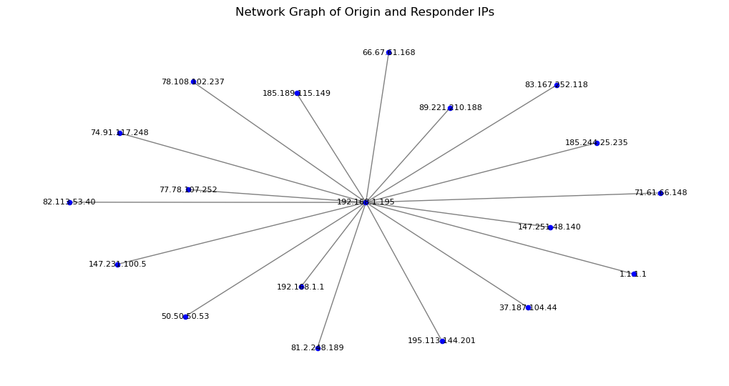
Data Flow

Slide 6
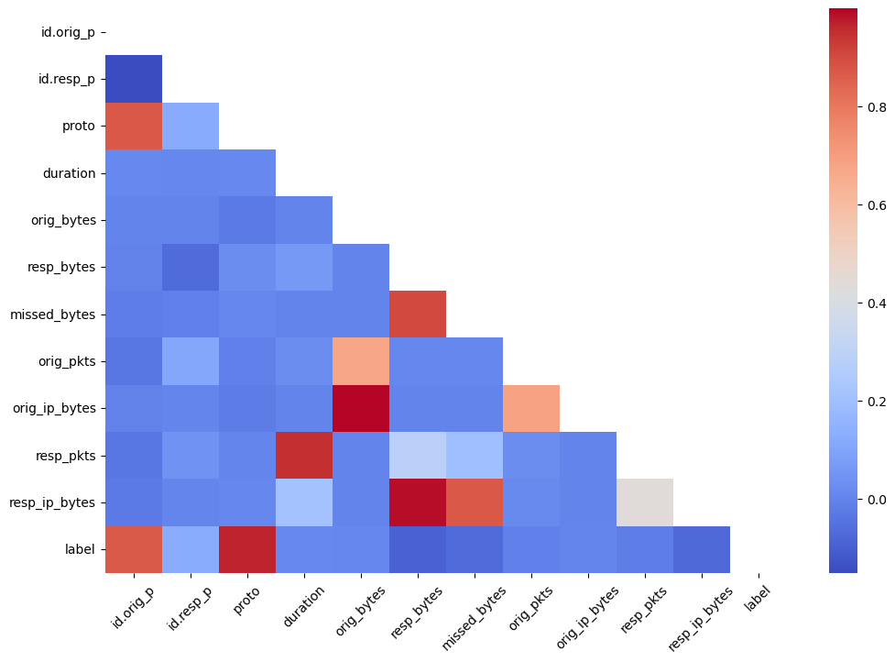
IDS Network Traffic

Slide 7
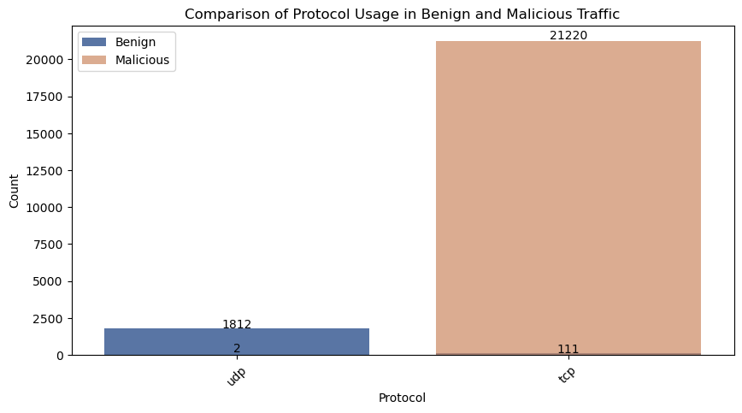
All Traffic – Protocol Use
Benign traffic for this network typically uses UDP, while the malicious traffic almost always comes over TCP.

Slide 8
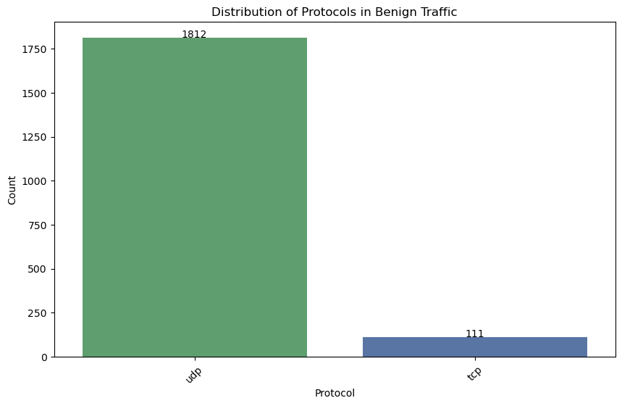
Benign Traffic - Protocol

Slide 9
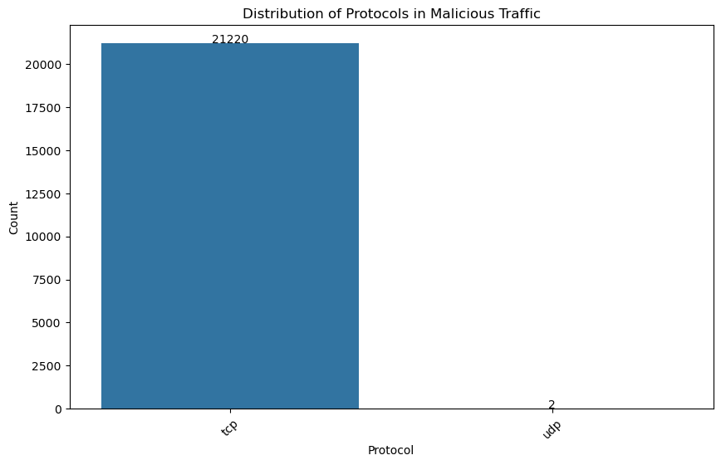
Malicious Traffic Protocol

Slide 10
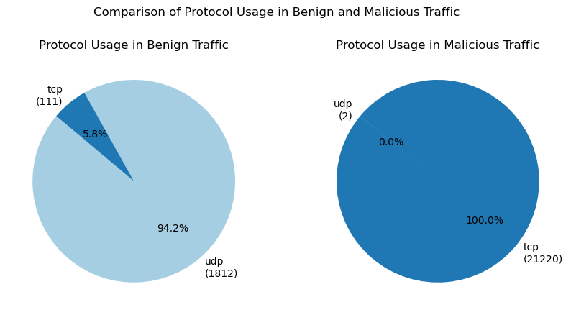
All Traffic – Protocol Use
May be wise to limit, if not eliminate, TCP traffic.

Slide 11
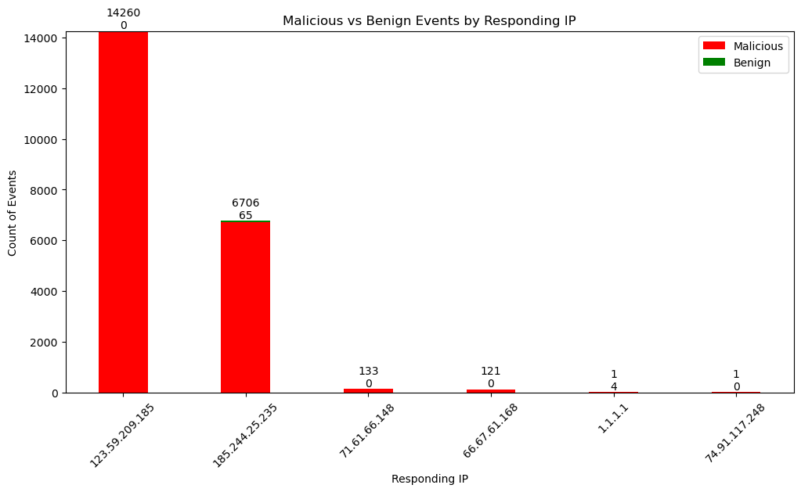
Targeted IP Addresses

Slide 12
Tools and Proof of Concept
Prediction of malicious activity for IP addresses:
Will include all the data from the dataset
Duration of connection
Protocol used
Amount of data transferred
Ports that were accessed
Potential IP addresses for prediction:
185.244.25.235
123.59.209.185
1.1.1.1
147.231.100.5
https://network-analysis-and-dco-prioritization.onrender.com/docs#/

Slide 13
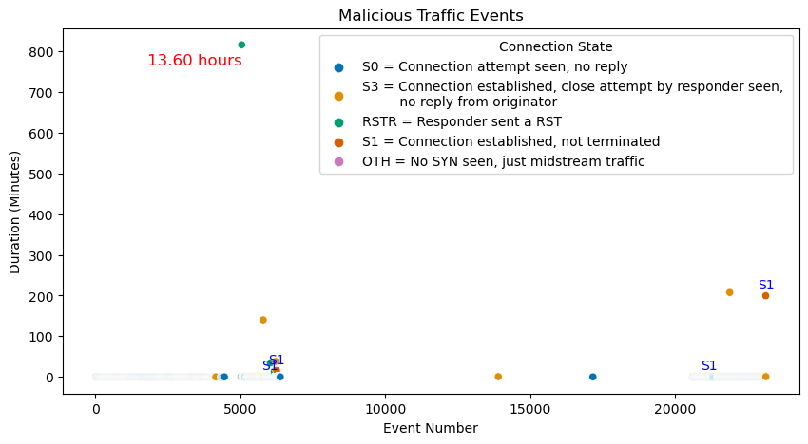
Time on Network per Event

Slide 14
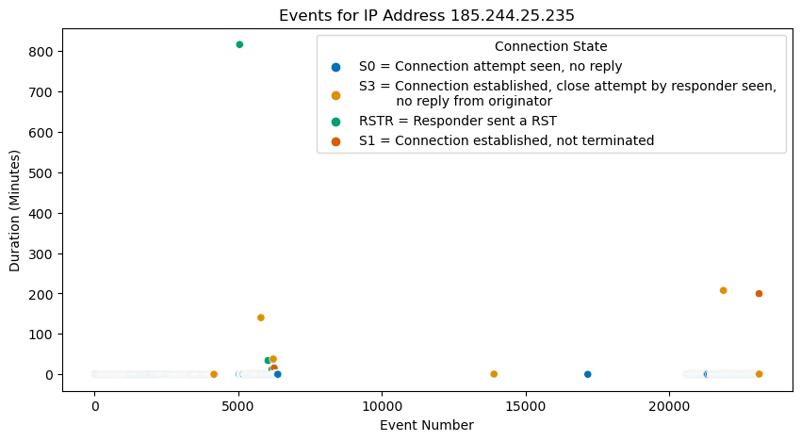
IP of 13 Hour Event

Slide 15
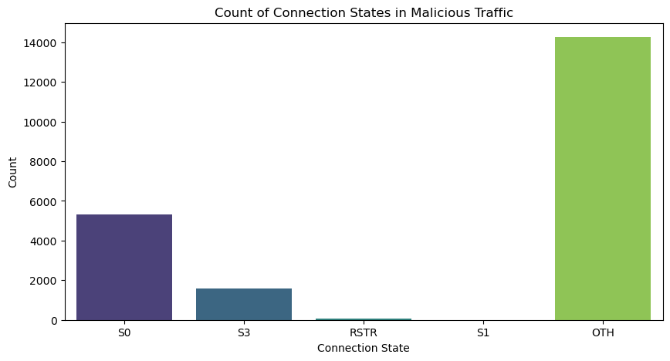
Connection States

Slide 16
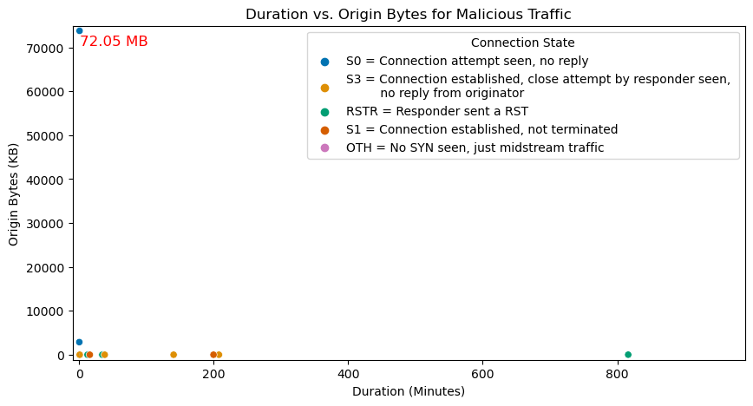
Amount of Data from Origin
The 72.05 MB event is targeting IP 74.91.117.248 and is the only time this IP is seen in the IDS data.

Slide 17
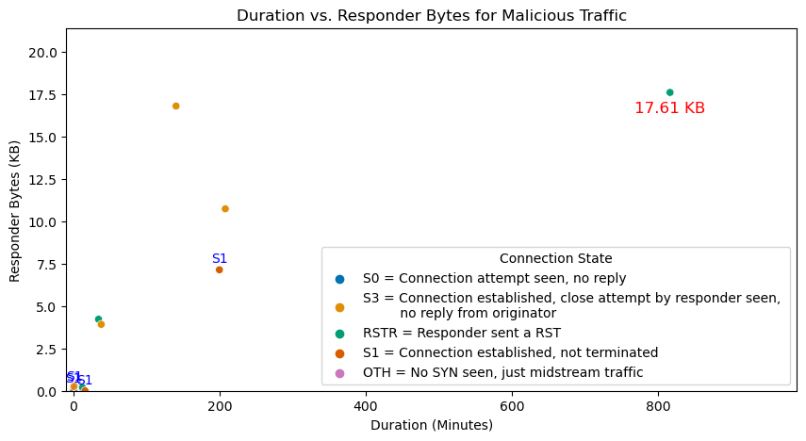
Data Sent

Slide 18
Recommendations
Limit traffic to UDP
More extensive logging
Correlate alerts with internal logs (firewall logs) that contain original IP address information
Integrate IDS with a Security Information and Event Management (SIEM) system
Will aggregate and correlate data from multiple sources
Configure NAT devices to log detailed translation information
Include internal-to-external IP mappings
Can be used to trace back the internal source of traffic
Future Analysis
The above recommendations will offer a more in-depth opportunity for future analysis
The original dataset shows how necessary it is to configure your IDS
Analysis on a properly configured dataset may prove invaluable

Slide 19
Sources and Contact Information
https://docs.zeek.org/en/current/scripts/base/protocols/conn/main.zeek.html
ipinfo.io
https://www.barracuda.com/support/glossary/intrusion-detection-system#:~:text=An%20intrusion%20detection%20system%20(IDS,information%20and%20event%20management%20system
https://csrc.nist.gov/glossary/term/industrial_control_system#:~:text=Industrial%20control%20systems%20include%20supervisory,controllers%20to%20control%20localized%20processes
Libraries: Pandas
Numpy
Matplotlib
seaborn
sklearn networkx
Ipinfo
https://network-analysis-and-dco-prioritization.onrender.com/docs#/
https://github.com/sdave777/Network-Analysis-and-DCO-Prioritization
Contact:
david.scott.98@spaceforce.mil
SPC4 Scott, David
Cyber Intelligence Analyst, USSF 71 ISRS Detachment 6

