Slide 1

April 2014, CoH
(Seize the Day) Ian introduction and gives his farewell
Sahil color guards / leads pledge of allegiance
Ian introduces new SPL / ASPL (song - "Bad to the Bone")
Cole and Tate enter from side door, through the scouts getting high fives, etc.
Cole / Tate - thank yous, looking forward to a fun year
Introduce new scouts who bridged from Webelos ( song - "Happy" )
Scouts will enter one at a time when Tate calls their name, high fives with other scouts, 3 second dance
Cole asks parents to come up for recognition of Scout rank
Mr. Gomatam, Mike Klein, Scott Davidson shake hands
Tenderfoot Rank Awards
Cole reads short description
Cole asks scouts and parents to come up
Second Class Rank Awards
Tate reads short description
Tate asks scouts and parents to come up
Tate introduce Mr. / Mrs. Jancis (JAN-SISS) for Friends of Scouting
Star Rank Awards
Cole reads short description
Cole asks scouts and parents to come up
Life Class Rank Awards
Tate reads short description
Tate asks scouts and parents to come up
Parent Skit –
Parents = Mr. Lucas, Mr. Oh, Mr. Barghava, Mr. Yu (Cole / Tate)
Scott – explain to audience
Introduce Patrol Leaders
Come up front – Mr. Klein to distribute patches
Scoutmaster Minute (from Mr. Klein)
Adult Bulletins
Tate - Closing (Scout Oath / Law)
Cole - Color Guards dismissed
Cole – Pick up t-shirts from your Patrol leader, get some dessert

Slide 2
April 2014, CoH (2)
Ranks:
Scout:
Siddarth
Manan
Aditya
Samuel
Jacob
Eshaan
Alex Marston
Andrew
Parin
Sachin
Puneet
Samrudh
Alex Zhang (may be late)
Shaan (not attending )
Tenderfoot :
Boaz
Caleb
2nd Class :
Joshua
Prabhat
Star :
Naman
Ryan
Life :
Alec
Amit
Patrol Leaders:
Thundersharks – John Johnston
Inception – Ben Murphy
Daggers – Nick Klein
Tomahawks - Amit
To earn the Tenderfoot rank, a scout must pitch a tent and help w/ the cooking on a campout, learn and teach the how to tie a sqaure knot and test himself physically and then after a month of practice, show improvement, along w/ some other requirements. Will our new Tenderfoot scouts, Boaz and Caleb, please come forward.
To earn the Second Class rank, a scout must demonstrate the use of a compass, continue to participate in campouts, and demonstrate proficiency in firebuilding, along w/ some other requirements. . Will our new Second Class scouts, Joshua and Prabhat, please come forward.
To earn the Star Class rank, a first class scout must be active in the troop, earn 6 merit badges (including 4 from the Eagle list), take part in a service project and provide troop leadership. Will our new Star scouts, Naman and Ryan, please come forward.
To earn the Life Class rank, a Star scout must be active in the troop, earn 5 more merit badges (including 3 more from the Eagle list), take part in a service project and provide troop leadership. Will our new Life scouts, Alec and Amit, please come forward.

Slide 3
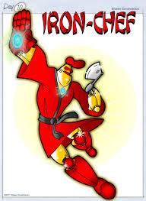
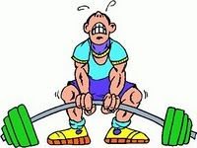
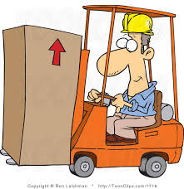
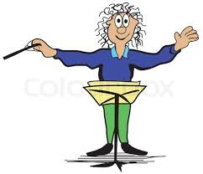
April 2014, CoH (3)
To adults: You are being asked to compete in a silent acting contest where the audience will try to guess your occupation and then vote who did the best acting job. Mr. Davidson is explaining the contest to the audience right now.
Please select an occupation out of the hat and take a minute to decide how you’re going to act it out. The single prop of a chair must be incorporated into at least part of act.
Olympic Power Lifter
Iron Chef
Fork Lift Operator
Orchestra Conductor

Slide 4
todo
To Do :
Load song for Ian intro ( Av7F – Seize the Day)
Get short descriptions of the Ranks
Make list of occupations for Adult skit
Print last page of committee meeting minutes for troop positions
Make Lemonade
To Bring :
Sunglasses
Hat
Connector for computer (music – ipod play list ? )
Adult Skit Occupations
Speaker
Mixer, Long chord mic
Extension cord
Power strip
Lemonade
CoH Notes / Clipboards

