Slide 1
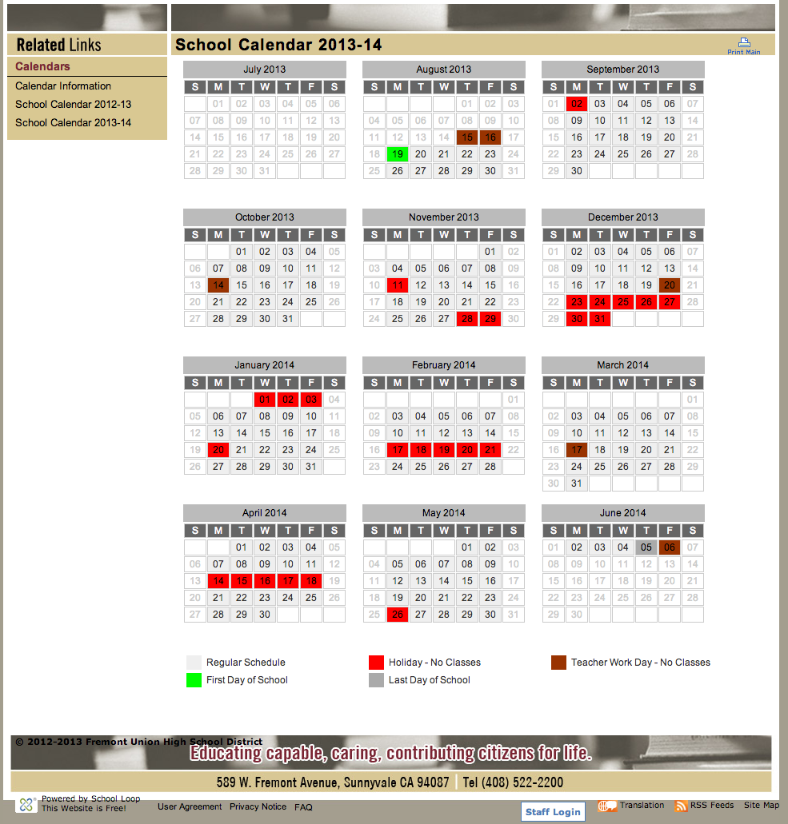

Slide 2
Itzik Camping / hiking ideas
3 or more nights and or moderate to advanced Backpacking
1. Sonol to Del Val
2. skyline to sea
3. Emigrant Wilderness
4. DeathValley
5. John Muir trail
6. Mt Whitney
7. Lost coast
8. Trinity Alps
9. Desolation wilderness
Pushpak’s List
Sam MacDonald County park
Portola State Park
Mount Madonna County Park
Uvas Canyon County Park
Joseph Grant County Park
Henry Coe State Park
Big Basin State Park
Carmel Highlands
Lake Del Valle
Point Reyes National Seashore
Mount Tam State Park
Fort Ross SHP
Sacramento River Raft
Indoor Rock Climbing/Rocknasium
Chesebrough Council Camp
Pinnacles Natl Monument
Death Valley Natl Park
Possibilities (New):
Alcatraz Island
High adventure (Historical):
Ely/Northern Tier (Minnesota)
Philmont Scout Ranch (New Mexico)
Channel Islands
Florida Sea Base
Itzik Camping / hiking ideas
Day trips and prep hikes
1. Long ridge open space reserve - Santa Cruz mountain
2. Mission peak
3. Fremont Older
4. Pescadero Creek park
One night camping
1.portola Redwoods
2.big Basin
3. Castle Rock
4. Henry Coe
5. mt Tam
6. Mt Madona
Bay Area Two nights and or easy to Moderate Backpacking
1. Lake Del Val
2. Henry Coe
3. Ft Ross
4. Pt Reyes
5. Big Sur
6. pinnacles
7. Mendocino county
Getaway Top 10 N CA Hiking Treks:
Point Reyes
Lost Coast
Lake Del Valle
Yosemite
Big Sur
Redwood National Forest
Lassen Volcanic National Park
Pinnacles
Mt Shasta
10. My Whitney

