Slide 1
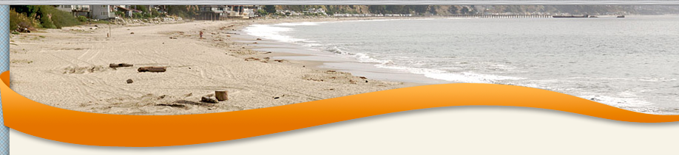

Troop 457 Beach Campout
When: Sat, October 19 – Sun, October 20
Where: New Brighton Beach, CA
Who: Webelos Scouts from Pack 457 and a parent
Details:
Webelos scouts / parents must contact Scott Davidson by Sunday, Oct 6th to reserve a spot
Carpooling is required b/c of limiting parking, so please indicate if you’re willing to drive (and have a large capacity vehicle)
Scouts will arrive @ Deanza Park (parking lot near baseball fields) @ 12:15 and leave promptly at 12:45 pm on Saturday
Scouts will return home by approximately 1:00 pm (check out @ noon)
Parents will coordinate w/ other troop parents for their meals; scouts will be assigned to patrols and eat/sleep with them.
Contacts:
Scott Davidson, Committee Chair, scott@scott-davidson.com
Allen Zhang, Adult Trek Leader, allenazhang@yahoo.com

