Slide 1



Enhancing Memory Bandwidth and Energy Efficiency in GPU
Microarchitecture through High Bandwidth Memory (HBM) and Data
Locality Optimizations
EECE7352: Computer Architecture
Suchibrata Das

Slide 2
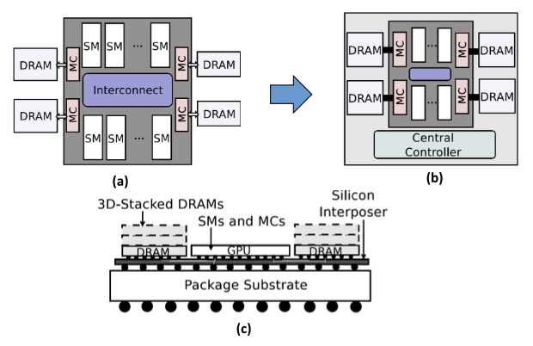

Introduction : Challenges and goals in GPU architecture
The rise of AI, High Performance Computing (HPC), and real-time analytics is reshaping computing demands.
Despite their parallel processing capabilities, GPUs face critical bottlenecks in memory bandwidth, energy efficiency, and control flow divergence..
Addressing these bottlenecks is key to scaling GPU architectures for future workloads.
Goal: Optimize GPU scalability and performance for future workloads.
Figure 1 - Architecture of HBM-enabled GPU. (a) Conventional GPU with off- chip GDDRs DRAM. (b) HBM-enabled GPU (top view). (c) HBM-enabled GPU (side view)
Fig 2. The exponential growth of data-intensive workloads drives GPU innovation and scalability

Slide 3
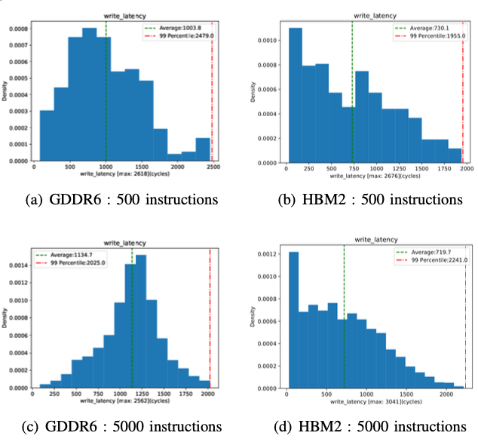
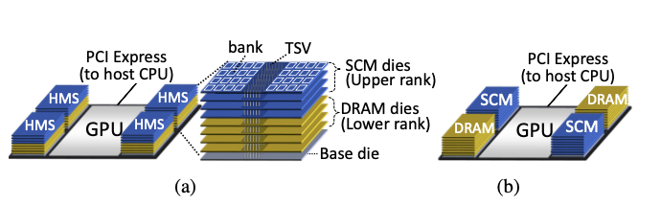
Memory Hierarchy Optimization: Tackling Bandwidth
Bottlenecks
One of the biggest challenges in GPU scalability lies in optimizing memory bandwidth and hierarchy.
High Bandwidth Memory (HBM): Revolutionizes GPU performance with 3D stacking and TSV technology.
Double-Buffering Pipelines: Overlap computation and memory transfers to reduce latency and improve throughput (e.g., 1.63× speedup in AlexNet training).
Locality-Aware Hierarchies:
Adaptive caching minimizes memory traffic.
Improves bandwidth utilization and reduces energy consumption.
Performance Insights:
HBM3E achieves up to 1.2 TB/s bandwidth, reducing training times for AI models like GPT-4.
Maintains stability in high-throughput tasks like BFS traversal.
While memory hierarchy optimizations address bandwidth, energy efficiency remains a crucial challenge
Fig 3. Evaluation of GDDR6 and HBM across different number of write instructions
Fig 4. Design space of a GPU with SCM and DRAM cache with (a) 3D- stacked DRAM and SCM and (b) separate DRAM and SCM stacks.

Slide 4
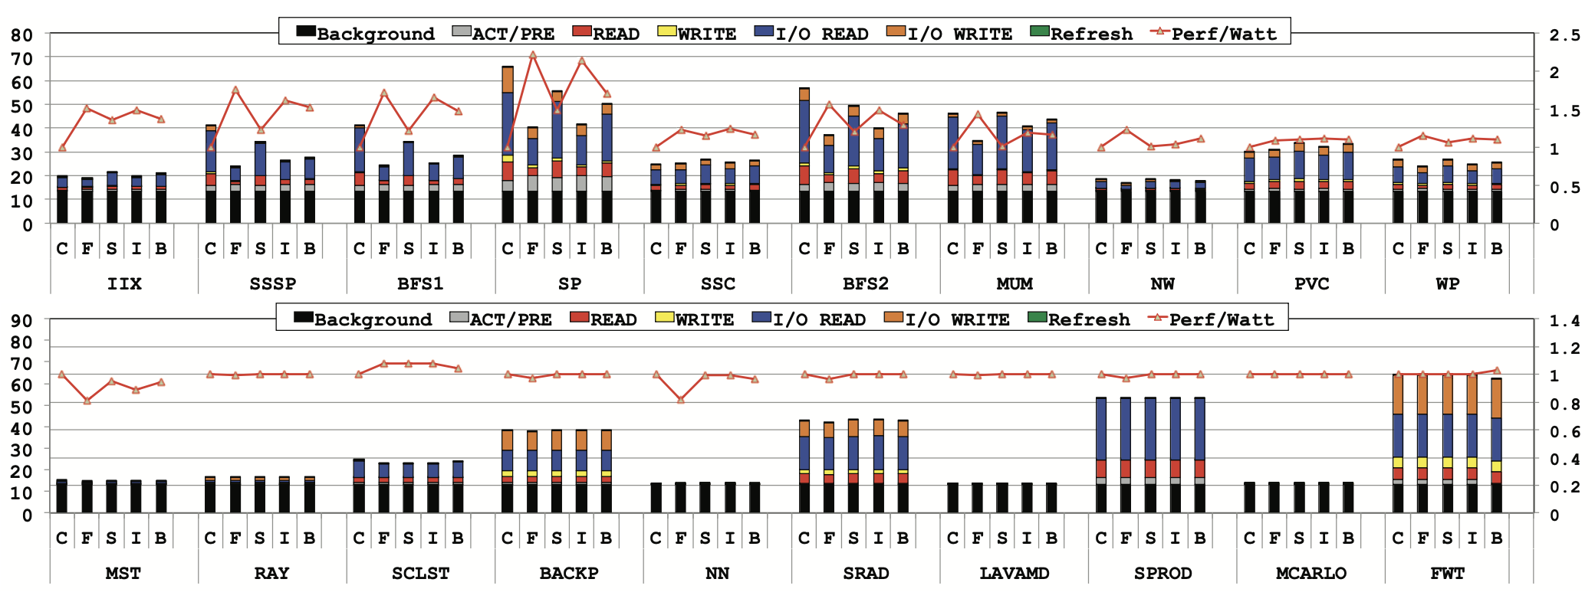
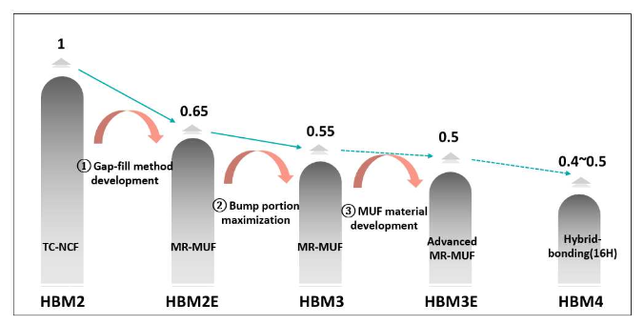
Energy Efficiency: Scaling GPUs for Data-Intensive Applications
Challenge: As GPU parallelism increases, power consumption becomes a bottleneck in scalability.
Locality-Aware Memory Hierarchies:
Reduces redundant memory traffic and optimizes cache usage.
Energy consumption reduced by up to 40% using spatial and temporal data locality optimizations.
Dynamic Resource Allocation:
Real-time adjustment of GPU resources minimizes idle power while maintaining throughput.
Achieves up to 2.9× energy efficiency improvements in variable workloads.
Thermal Management Innovations:
Advanced techniques like micro-channel cooling, MR-MUF, and graphene-coated interposers ensure efficient heat dissipation.
Enables safe scaling of memory stacks such as HBM3E.
With energy efficiency addressed, we turn to innovations enhancing control flow and resource utilization in GPUs.
Fig 5. A breakdown of DRAM power (Watt, left axis) and the corresponding Perf/Watt (normalized to CG-only, right axis).
Fig 6. Thermal resistance according to MR-MUF process improvement

Slide 5
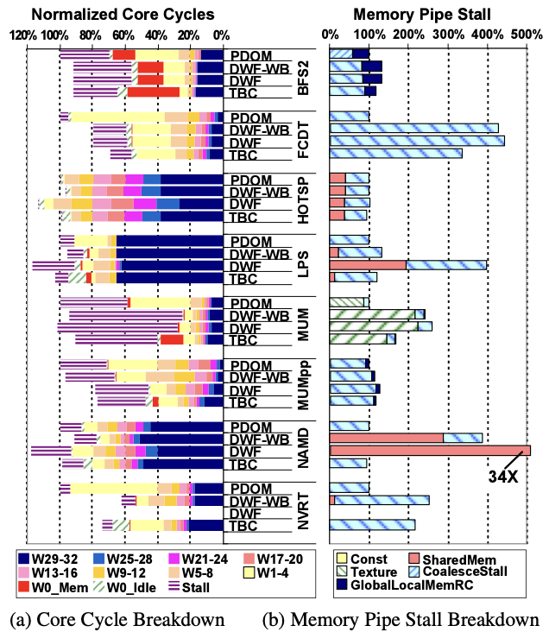
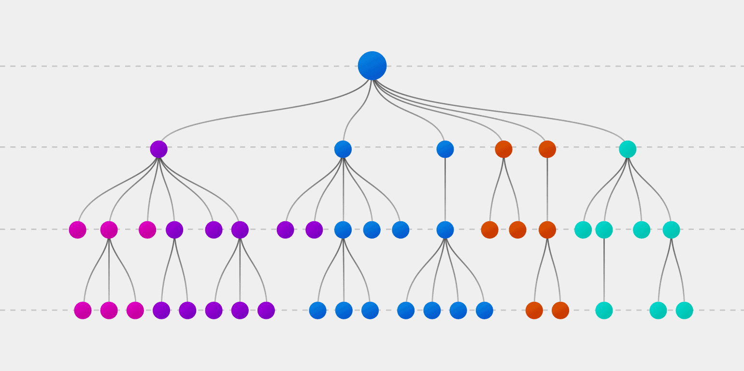
SIMT for Diverse GPU Workloads
Key Challenge: Control flow divergence in SIMT (Single Instruction, Multiple Threads) reduces warp efficiency and resource utilization.
Techniques to Address Divergence:
Thread Block Compaction (TBC):
Dynamically groups threads with similar execution paths.
Achieves up to 22% higher IPC and reduces instruction stalls by 30%.
Dynamic Warp Formation (DWF):
Reassigns threads during execution to new warps.
Particularly effective in nested control flows but introduces slight scheduling overhead.
Hybrid Techniques:
Combine TBC and DWF with warp prioritization for balanced fairness and efficiency.
Performance Gains:
Up to 36% reduction in clock cycles for BFS traversal workloads.
Hybrid traversal achieves 2.5× speedup over thread-centric approaches.
Fig 7. Detail performance data of TBC and DWF relative to baseline (PDOM) for the DIVG benchmark set
Fig 8. Dynamic thread grouping optimizes warp utilization, reducing idle cycles and enhancing throughput in divergent workloads.

Slide 6
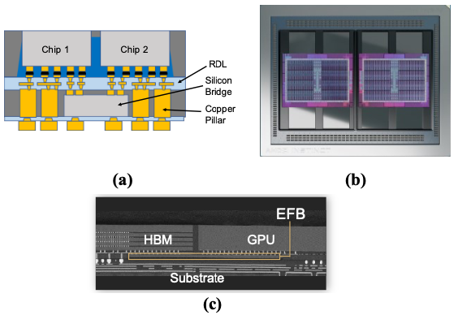
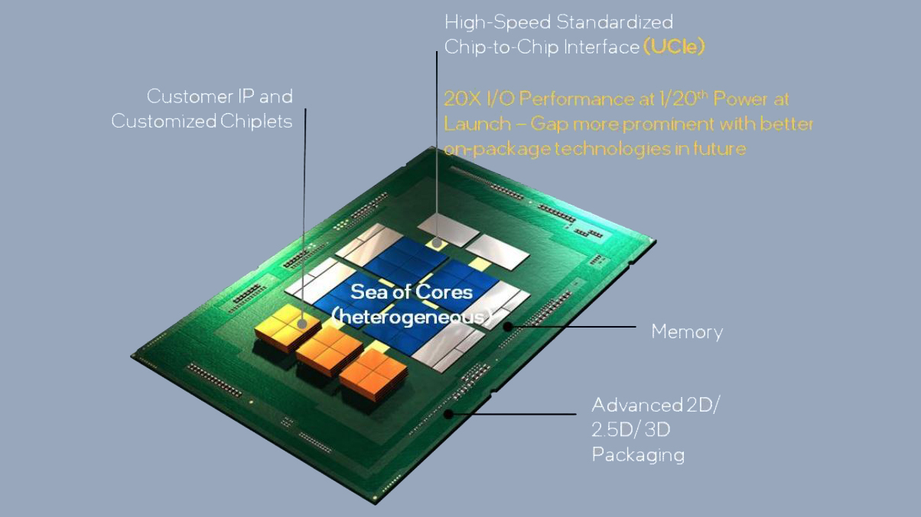
HBM and Chiplet Synergy: Revolutionizing GPU Efficiency
Key Challenges and Innovations
Logic-Based HBM Integration:
Embedding logic layers within HBM minimizes latency and energy costs.
Enhances bandwidth utilization and localized data processing efficiency.
Chiplet-Based Architectures:
Modular designs allow customizable GPU configurations.
Optimized for edge computing and AI inference.
Performance and Energy Efficiency Gains
Energy Efficiency:
HBM3E reduces energy consumption by up to 30% compared to its predecessors.
Proximity of logic layers cuts energy costs by 50% in AI inference workloads.
Performance Gains:
Over 1.2 TB/s bandwidth with HBM3 Gen2 accelerates AI models like GPT-4.
Combined HBM and chiplets deliver up to 40% faster data access.
Fig 9. a) Cross-section schematic of two chips connected via a silicon bridge, (b) using silicon bridges to connect eightmemory modules to two processor dies, and (c) a cross-sectional view of one of the bridge assemblies.
Fig 10. UCIE-enabled GPU architecture with modular chiplets, heterogeneous cores, and advanced memory integration
Notes:
The role of defects and doping in 2D graphene sheets and 1D nanoribbons, Humberto Terrones, Ruitao Lv, Mauricio Terrones, and Mildred S Dresselhaus, 2012.
Jiang, K., Ji, J., Gong, W. et al. Mechanical cleavage of non-van der Waals structures towards two-dimensional crystals. Nat. Synth 2, 58–66 (2023)

Slide 7
Bridging Current and Future GPU Advancements
Challenges Resolved:
Optimized memory bandwidth with HBM and hybrid memory systems.
Improved energy efficiency via locality-aware hierarchies and thermal management.
Enhanced SIMT resource utilization through divergence reduction techniques.
Gaps and Opportunities:
Hybrid Memory Integration:
Seamless layering of HBM with non-volatile memory for scalability and energy savings.
Real-Time Thermal Solutions:
AI-driven management to dynamically mitigate thermal hotspots.
Next-Gen Modular Designs:
UCIE-enabled chiplet architectures to revolutionize data locality and energy usage.
Transition to Future Directions:
Leveraging breakthroughs to tackle AI, HPC, and edge workloads.
Building GPUs tailored for real-time, data-intensive applications.
Notes:
Nanotomy-based production of transferable and dispersible graphene nanostructures of controlled shape and size, Nihar Mohanty, David Moore, Zhiping Xu, T.S. Sreeprasad, Ashvin Nagaraja ,Alfredo Alexander Rodriguez & Vikas Berry, 2012.
Longitudinal unzipping of carbon nanotubes to form graphene nanoribbons, Dmitry V. Kosynkin, Amanda L. Higginbotham, Alexander Sinitskii, Jay R. Lomeda, Ayrat Dimiev, B. Katherine Price & James M. Tour, 2009.

Slide 8
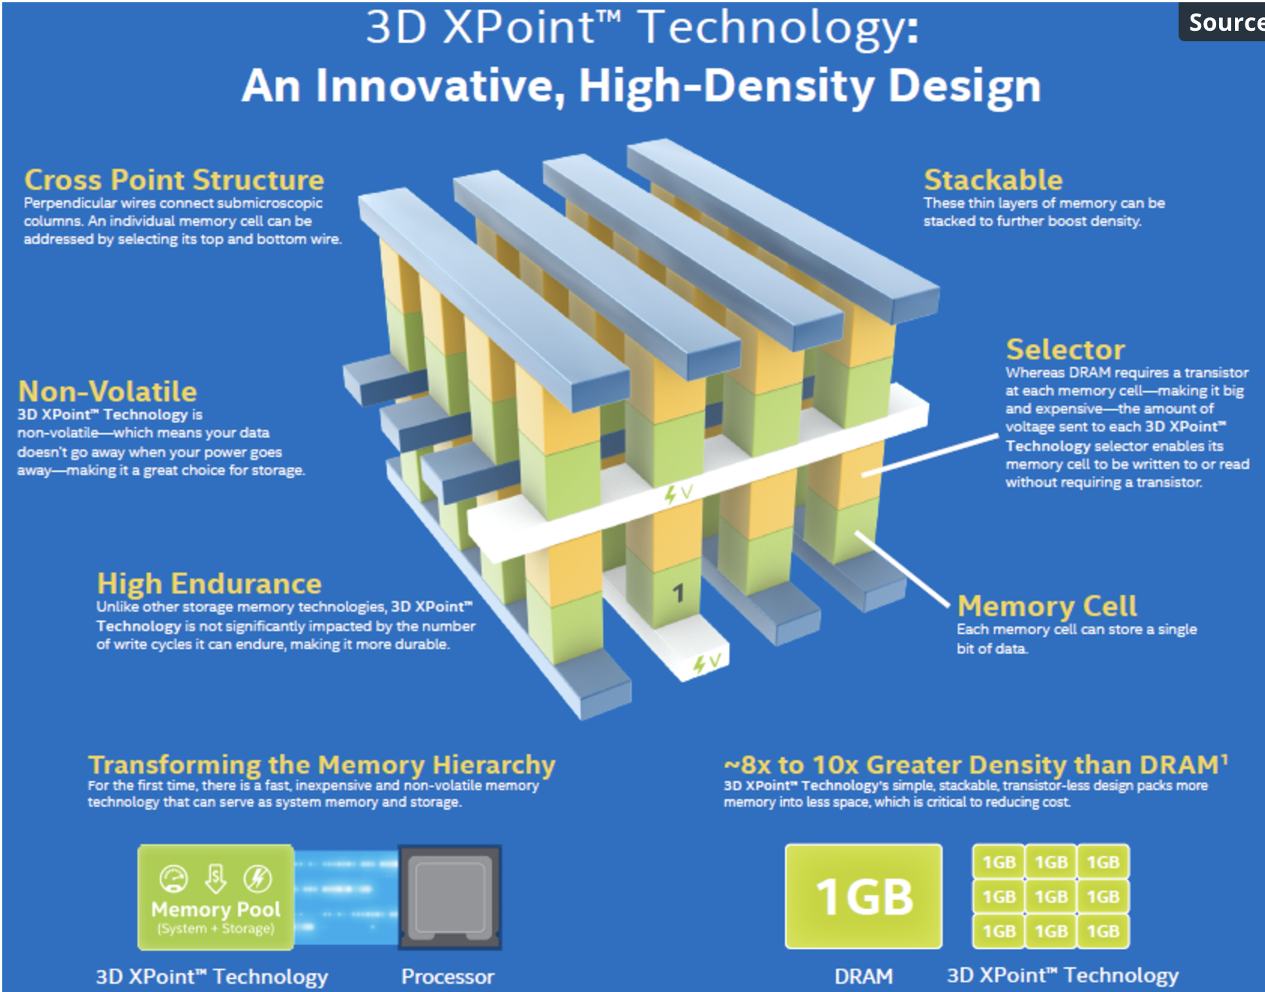
Bridging Current and Future GPU Advancements
Key Innovations Driving GPU Advancements:
Hybrid Memory Systems (HMS):
Combines High Bandwidth Memory (HBM) with non-volatile storage (e.g., NVRAM, 3D XPoint).
Balances performance and capacity with dynamic data placement.
Advanced Thermal Management:
Techniques like micro-channel cooling, MR-MUF, and graphene-coated interposers.
Improves thermal efficiency, enabling safe scaling of HBM stacks.
SIMT Efficiency Enhancements:
Dynamic Warp Formation (DWF) and Thread Block Compaction (TBC).
Achieves up to 22% higher IPC and 36% lower latency in divergent workloads.
Chiplet-Based Architectures:
Modular designs for tailored GPU configurations.
Optimized for edge computing, AI inference, and diverse workloads.
AI-Driven Scheduling:
Predictive schedulers dynamically allocate GPU resources.
Reduces idle cycles and improves throughput for complex workloads.
Fig 11. Overview of 3D XPoint Technology - Non-volatile memory enhancing GPU scalability and energy efficiency
8
Notes:
The zigzag-edge ribbons are always metallic, while the armchair-edge GNR can
be semiconductor such that the corresponding bandgap energy decreases by increasing
the ribbon index (width) as shown
3p and 3p + 1 are semiconductors, whereas 3p+2 is metallic (small Eg)
The band gap can be opened by quantum confinement of GNR in one dimension but it degrades the linearity of subbands near Dirac points.

Slide 9
Conclusion: Empowering Next-Generation GPUs
Key Takeaways:
Memory Bandwidth Revolution: High Bandwidth Memory (HBM) and hybrid memory systems address bottlenecks in performance and capacity.
Energy and Efficiency Gains: Advanced cooling techniques and logic-layer integration reduce energy consumption while improving scalability.
Optimized Processing: Techniques like Thread Block Compaction (TBC), Dynamic Warp Formation (DWF), and UCIE-driven modular designs ensure adaptability across diverse workloads.
Future Horizons:
Seamless hybrid memory integration to balance performance, cost, and energy efficiency.
AI-powered workload management and real-time thermal optimization to enhance scalability.
Modular architectures like UCIE-enabled GPUs to unlock unprecedented versatility for AI, HPC, and edge computing.
Vision Forward:
GPUs will continue to evolve as a cornerstone of modern computing, empowering breakthroughs in AI, real-time analytics, and next-gen workloads.
9
Notes:
The zigzag-edge ribbons are always metallic, while the armchair-edge GNR can
be semiconductor such that the corresponding bandgap energy decreases by increasing
the ribbon index (width) as shown
3p and 3p + 1 are semiconductors, whereas 3p+2 is metallic (small Eg)
The band gap can be openedby quantum confinement of GNR in one dimension but it degrades the linearity of subbands near Dirac points.

