Slide 1
Opinion Mining ON traveler REVIEWS and ranking hotels
CSE-4250: PROJECT AND THESIS-II
Presented By
Rafeedul Bar Chowdhury 11.02.04.088
Mahmud Hossain 11.02.04.082
Soumik Das Bibon 11.02.04.003
Zahidul Haque 11.02.04.086

Slide 2
Supervisors
MIR TAFSEER NAYEEM
Lecturer Department of Computer Science & Engineering Ahsanullah University Of Science & Technology
SUJAN SARKER
Lecturer Department of Computer Science & Engineering Ahsanullah University Of Science & Technology

Slide 3
Outline
Introduction
Opinion
Opinion Mining
Literature Review
Tasks of Opinion Mining
Research Challenges
Proposed Framework
Conclusion
Limitations
Future Work
Working Procedure
Weight Assignment
Final Calculation
[6]
[7]
Domain of our Research
Problem Domain
Performance Evaluation
Achievement of our Research
Tools used
Comparison of Ranks
Comparison of Scores
Accuracy
Summary

Slide 4
Introduction

Slide 5
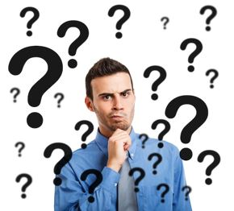
What is Opinion?
Opinions are thoughts influencing decision making.
Which schools should I apply to?
Which professor to work for?
Whom should I vote for?
Which hotel should I book?

Slide 6


Whom shall I ask for opinions?
Pre Web
Friends and relatives
Acquaintances
Post Web
Blogs (google blogs, livejournal)
E-commerce sites (amazon, ebay)
Review sites (CNET, PC Magazine)
Discussion forums (forums.craigslist.org, forums.macrumors.com)

Slide 7

Have enough opinions!
Now that I have got enough opinions, I can take decisions…
Is it really enough?

Slide 8
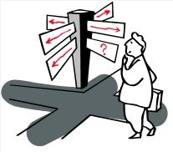
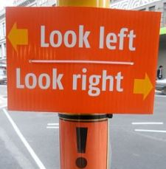
…Having opinions is not enough
Searching for reviews is quite difficult
Searching for opinions is not as convenient as
general web search
Huge amounts of information available on one topic
Difficult and quite impossible to analyze
each and every review separately
Expression of reviews are different in many ways
“overall, this hotel is my first choice at Cox’s Bazar…”
“the facilities are good but the service isn’t so…”
“best in Cox’s Bazar by quality and value”
“…disappointing”

Slide 9
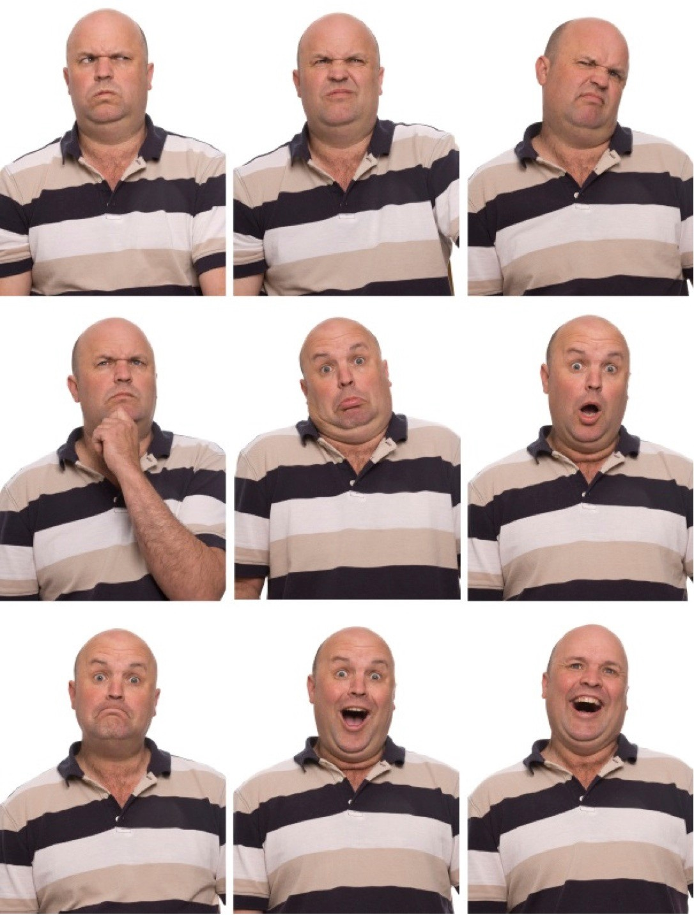

What is Opinion Mining?
Computational study of opinions, sentiments and emotions expressed in text.
Detects the contextual polarity of text
(positive or, neutral or, negative)
Derives the opinion, or the attitude of
an opinion holder.

Slide 10
Tasks of Opinion Mining
Opinion mining is a complex task that is why it is divided into sub classes.
Subjectivity Classification
Opinion Classification
Optional Tasks

Slide 11
Subjectivity Classification
Raw data contains opinionated and non-opinionated texts, punctuations etc.
In this classification opinionated text is separated from the raw document.
For Example: A review is such that,
“we arrived at the long beach hotel yesterday, me and my brother planned this short trip to Cox’s Bazar. This hotel is near to the beach so the view from the balcony is amazing.”

Slide 12
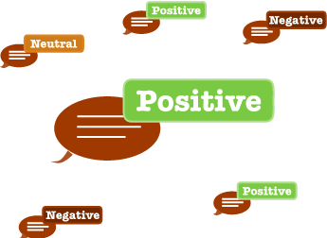
Opinion Classification
From the opinionated text using this classification we get polarity of the text.
It can be binary classification (positive or negative)
It can be multiclass classification (extremely negative, negative, neutral, positive, extremely positive)

Slide 13
Optional Tasks
There are various optional tasks. Such as,
Opinion Holder Extraction
e.g. getting the ranks of the contributor
Feature Extraction
e.g. extracting a specific feature like room service, food court etc.

Slide 14
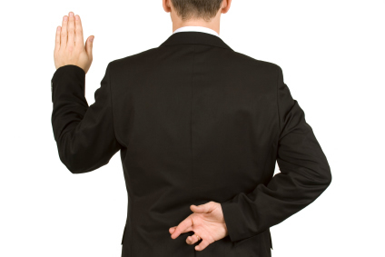
Research Challenges
Integrity of the reviews can not be ensured

Slide 15
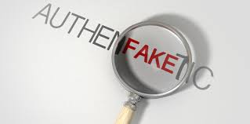
Research Challenges(Cont.)
Due to competition among the hotels high possibility of false reviews

Slide 16
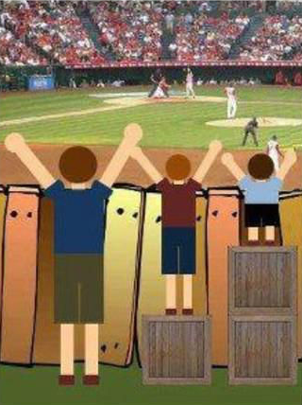
Research Challenges(Cont.)
Amount of reviews highly varies which sometimes results in inaccurate ratings of hotels

Slide 17
Literature Review

Slide 18
Mining and Summarizing Customer Reviews [6]
Minqing Hu and Bing Liu , “Mining and Summarizing Customer Reviews”
Main objective of this work:
(1) Mining product features commented by the customer (2) Identifying opinion sentences in each review and deciding polarity (3) Summarizing the results.

Slide 19

Drawbacks
In this paper the authors didn’t summarize the reviews by selecting a subset of reviews.
Summarization didn’t take any original sentences from the reviews. So it cannot idealize the main points as the classic text summarization does

Slide 20
Reviews, Reputation, and Revenue: The Case of Yelp.com [7]
Michael Luca, “Reviews, Reputation and Revenue: The Case of Yelp.com”
In this research paper, the author proposed,
(1) a one-star increase in Yelp rating leads to a 5-9 percent increase in revenue,
(2) this criteria only applies to single independent restaurants
(3) Chain restaurants plays neutral role even if yelp rating increases

Slide 21

Drawbacks
Chain restaurant revenue increment cannot be extracted from this research
Data set was small for this work because extracting data from Yelp.com is prohibited from using web crawler (i.e. tools for scraping data from web)

Slide 22
Domain of Our Research

Slide 23

Problem Domain
Mining traveler experiences/reviews expressed on services provided by hotels in Bangladesh

Slide 24
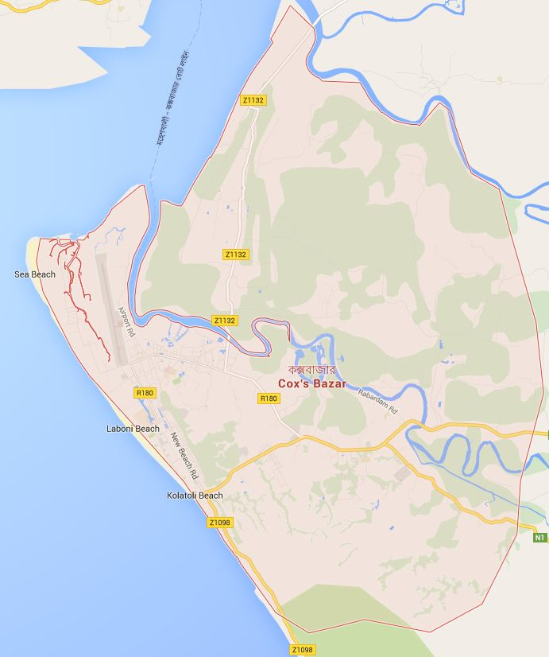

Problem Domain (Cont.)
We are mining reviews from the travelling guide, “TripAdvisor”
www.tripadvisor.com
We are starting our work from the district that attracts tourists the most which is Cox’s Bazar
Primarily we are mining reviews of travelers visiting various hotels in this tourist gathering area

Slide 25
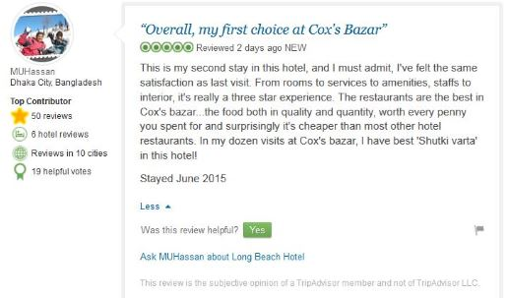
Problem Domain (Cont.)
1
3
4
5
2

Slide 26
Problem Domain (Cont.)
Name and residence of the reviewing traveler e.g. MUHassan, Dhaka City, Bangladesh
Information about the profile of the reviewer on “TripAdvisor” site e.g. Top Contributor, 50 Reviews, 19 helpful votes etc.
Rating provided by the reviewer and the time of the review e.g. 5 out of 5 stars, Reviewed 12,June,2015 etc.
The review of the traveler in a large opinioned paragraph
Voting panel for other users to vote a review if it is helpful or not!

Slide 27
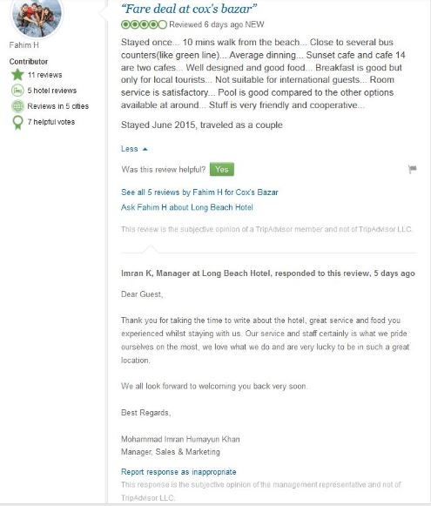
Problem Domain (Cont.)
1
2

Slide 28
Problem Domain (Cont.)
All the reviews provided by a certain reviewer on the site
Feedback given by a hotel manager upon reviewing of a traveler

Slide 29
Proposed Framework

Slide 30
Working Procedure
We followed the below mentioned steps to achieve our goal
1. SentiWordNet based score retrieval
2. Score retrieval using Naïve Bayes method
3. Weight assignment to individual opinion holder
4. Final calculation of two approaches

Slide 31
Score Retrieval
SentiWordNet:
SentiWordNet is a lexical resource for opinion mining.
It assigns each synsets of WordNet with three sentiment score.
(Positive, negative and objective)

Slide 32
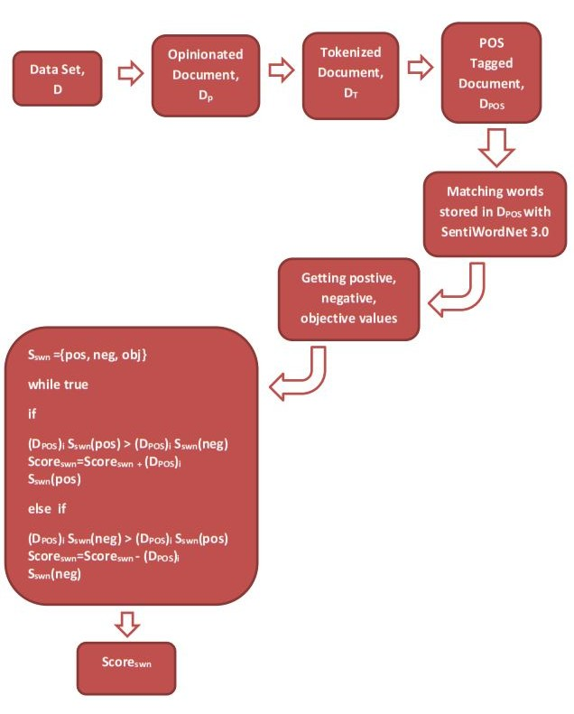
Score Retrieval (Cont.)

Slide 33

Score Retrieval (Cont.)
Naïve Bayes Method:
Naïve Bayes is a Supervised learning approach which gives probabilistic result of unlabeled data based on trained labeled data set.
Where,
P(c) = Probability of Unlabeled data(c)
P(d) = Probability of Labeled data(d)

Slide 34
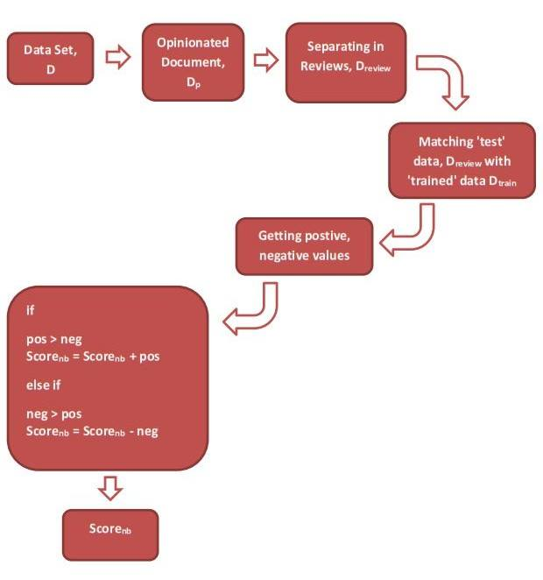
Score Retrieval (Cont.)

Slide 35
Weight Assignment
Why weight assignment is necessary?
Opinion prioritizing is a must in order to distinguish mature and professional reviewers opinion from an amateur reviewers opinion.
A professionals point of view and interest will definitely make a difference in case of ranking a hotel.
There will always be some integrity/accuracy issues when it comes to opinions as someone stating a feature as satisfactory while other will state otherwise ( Whose opinion to choose? )

Slide 36

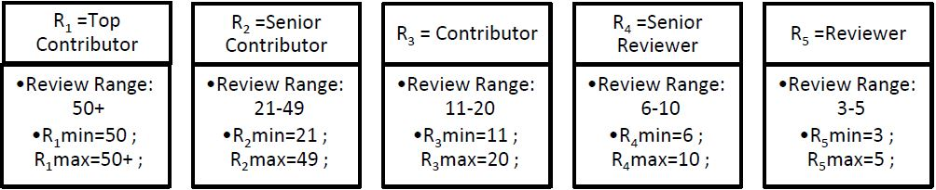
Weight Assignment (Cont.)
In TripAdvisor, there is already a priority rating system available for the reviewers!

Slide 37

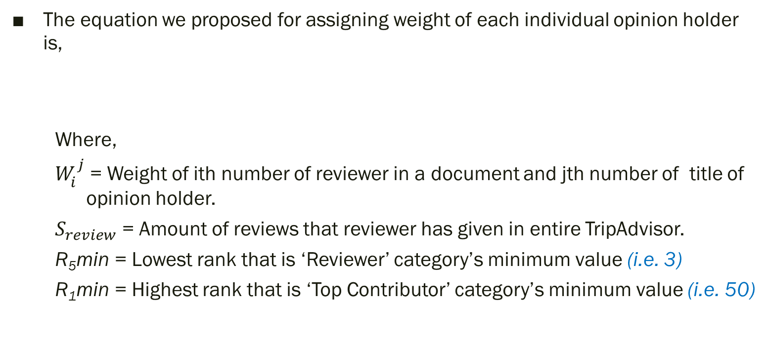
Weight Assignment (Cont.)
The equation we proposed for assigning weight of each individual opinion holder is,
Where,
$W_{i}^{j}$ = Weight of ith number of reviewer in a document and jth number of title of opinion holder.
$S_{review}$ = Amount of reviews that reviewer has given in entire TripAdvisor.
R₅min = Lowest rank that is ‘Reviewer’ category’s minimum value (i.e. 3)
R₁min = Highest rank that is ‘Top Contributor’ category’s minimum value (i.e. 50)

Slide 38
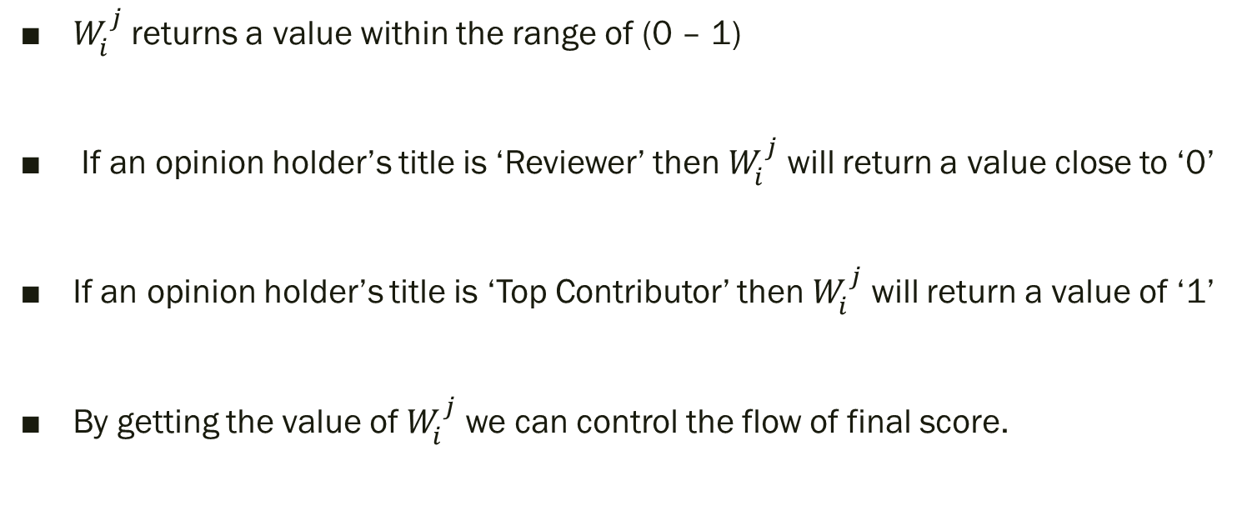
Weight Assignment (Cont.)
$W_{i}^{j}$ returns a value within the range of (0 – 1)
If an opinion holder’s title is ‘Reviewer’ then $W_{i}^{j}$ will return a value close to ‘0’
If an opinion holder’s title is ‘Top Contributor’ then $W_{i}^{j}$ will return a value of ‘1’
By getting the value of $W_{i}^{j}$ we can control the flow of final score.

Slide 39


Final Calculation
For SentiWordNet approach, final score of a hotel is,
Where,
${Score}_{swn}$ = Score of each opinionated review by using SentiWordNet.
$W_{i}^{j}$ = Weight of that opinion holder.

Slide 40


Final Calculation (Cont.)
For Naïve Bayes approach, final score of a hotel is-
Where,
${Score}_{nb}$= Score of each opinionated review by using Naïve Bayes.
$W_{i}^{j}$ = Weight of that opinion holder.

Slide 41
Achievement of Our Research
We have implemented the dictionary based approach using SentiWordNet and supervised machine learning approach using Naïve Bayes method
Based on the output results of this two methods we ranked the hotels
Compared our ranking with the original ranking done by TripAdvisor
We yielded considerable amount of accurate results comparing to the original

Slide 42
Performance Evaluation

Slide 43
Tools Used
The language we used for parsing data, -python(2.7.8)
We used python shell as IDLE (Integrated Development and Learning Environment)
NLTK (Natural language Tool Kit)
We used a library for extracting data from HTML and XML files, -beautifulsoup (vers. 4.3.2)
We used a library for training and testing data sets -Textblob (vers. 0.11.0)
SentiWordNet(3.0)

Slide 44
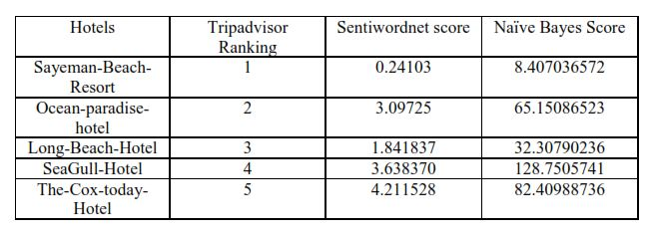
Comparison of Scores
In here we compared the output results we got from the approaches used

Slide 45
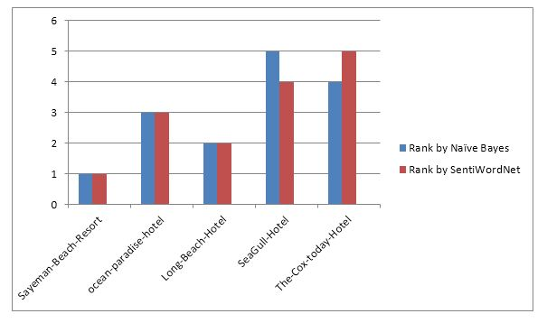
Comparison of Ranks
Comparison of ranking depending on the score of Naïve Bayes and SentiWordNet

Slide 46
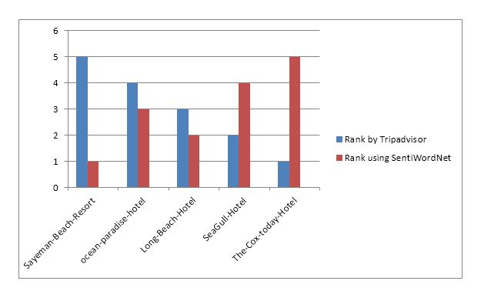
Comparison of Ranks (Cont.)
Comparison of ranking of TripAdvisor and score of SentiWordNet

Slide 47
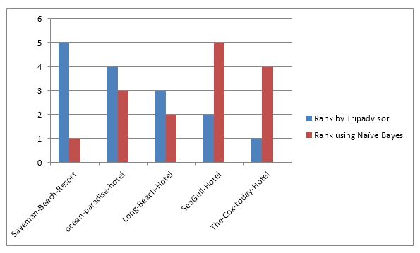
Comparison of Ranks (Cont.)
Comparison of ranking of TripAdvisor and score of Naïve Bayes

Slide 48
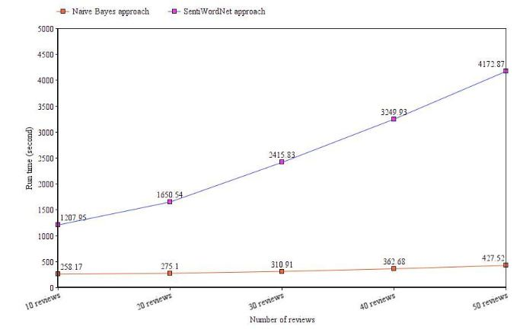
Comparison of Run Time Performance
Comparison of time needed to run each of the approaches we used

Slide 49
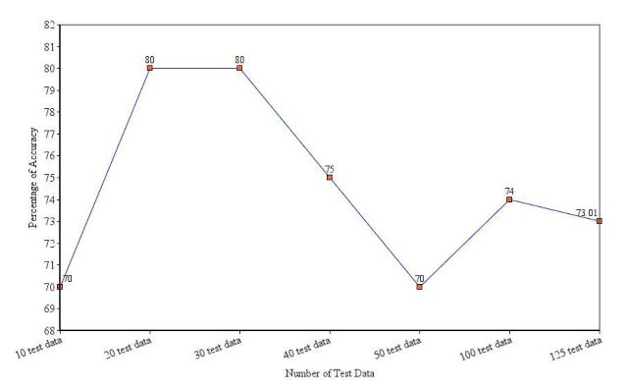
Accuracy
Accuracy can vary depending on test data set while using Naïve Bayes approach

Slide 50
Conclusion

Slide 51
Summary
We used the methods which are dictionary based SentiWordNet and supervised machine learning method Naïve Bayes
Successfully implementing these two methods we collected scores
Based on the scores we established a ranking system of our own which prioritizes user opinions
Compared our output with the original ranking done by TripAdvisor
Our ranking proves to be better than that of the original with higher accuracy

Slide 52
Limitations
Our context of research is hotel reviews. We could not ensure the integrity of the reviews we used for our purpose.
Due to the competition among the hotels to become the best there is a possibility of finding false reviews.
Monotonous type of reviews given in large quantity can affect the polarity of the desired result
We had to take equal amount of reviews from each hotels otherwise uneven amount of reviews would have resulted in inaccurate ratings
We have chosen Naïve Bayes classifier as our machine learning method. We could have gotten more accurate result if we used other machine learning approaches such as Support Vector Machine (SVM) or Maximum Entropy (ME).

Slide 53
Future Work
We have ranked hotels based on user opinions in this research of ours. In future we want rank hotels based on individual features of particular hotels.
We want to implement other approaches to yield better accuracy in future.
The system of user contribution has changed in TripAdvisor since our research. We want to take on the new system to research further.

Slide 54
References
[1]B.Liu Sentiment Analysis and Subjectivity. Handbook of Natural Language Processing, Second edition, 2010
[2]https://en.wikipedia.org/wiki/Sentiment_analysis
[3]J. Wiebe, T. Wilson and C. Cardie. Annotating expressions of opinions and emotions in language. Language Resources and Evaluation, 1(2), 2005.
[4]J. Wiebe, T. Wilson, R. Bruce, M. Bell, and M. Martin, “Learning subjective language,” Computational Linguistics, vol. 30, pp. 277–308, September 2004.
[5]Pang, B and Lee L. Opinion mining and sentiment analysis. Foundations and Trends in Information Retrieval 2008,(1-2),1–135

Slide 55
References (Cont.)
[6] Minqing Hu and Bing Liu, “Mining and Summarizing Customer Reviews”
[7] Michael Luca, Reviews, “Reputation and Revenue: The Case of Yelp.com”
[8]E. Riloff, S. Patwardhan, and J. Wiebe, “Feature subsumption for opinion analysis,” Proceedingsof the Conference on Empirical Methods in Natural Language Processing (EMNLP), 2006.
[9]J. Wiebe, “Learning subjective adjectives from corpora,” Proceedings of AAAI, 2000.
[10]Teeja Mary Sebastian, Akshi Kumar, Sentiment Analysis: A Perspective on its Past, Present and Future, 2012
[11]Pang B. and Lee L. Seeing stars: Exploiting class relationships for sentiment categorization with respect to rating scales, Proceedings of the Association for Computational Linguistics (ACL),2005:115–124

Slide 56
References (Cont.)
[12]Choi, Y., Cardie, C., Riloff, E., and Patwardhan, S., Identifying sources of opinions with conditional random fields and extraction patterns. Proceedings of the Human Language Technology Conference and the Conference on Empirical Methods in Natural Language Processing (HLT/EMNLP), 2005.
[13]Bethard, S., Yu, H., Thornton, A., Hatzivassiloglou, V., and Jurafsky, D., Automatic extraction of opinion propositions and their holders. Proceedings of the AAAI Spring Symposium on Exploring Attitude and Affect in Text, 2004.
[14]Yi, J., Nasukawa, T., Niblack, W., & Bunescu, R., Sentiment analyzer: extracting sentiments about a given topic using natural language processing techniques. Proceedings of the 3rd IEEE international conference on data mining (ICDM 2003):427–434
[15]Hu, M. and Liu, B. Mining opinion features in customer reviews. In Proceedings of AAAI, 2004:755–760.

Slide 57
References (Cont.)
[16]Popescu A-M. andEtzioni O., Extracting product features and opinions from reviews, Proceedings of the Human Language Technology Conference and the Conference on Empirical Methods in Natural Language Processing (HLT/EMNLP),2005
[17]Dave K., Lawrence S, and Pennock D.M. Mining the peanut gallery: Opinion extraction and semantic classification of product reviews. In Proceedings of the 12th international conference on World Wide Web(WWW), 2003, pp.:519–528
[18]Turney P. Thumbs up or thumbs down? Semantic orientation applied to unsupervised classification of reviews. In Proceedings of the Association for Computational Linguistics (ACL), 2005: 417–424
[19]Yu H. and Hatzivassiloglou V., Towardsanswering opinion questions: Separating factsfrom opinions and identifying the polarity ofopinion sentences.In Proceedings of the Conference on Empirical Methods in Natural Language Processing (EMNLP), 2003.

Slide 58
References (Cont.)
[20]Liu, B., Hu, M.,& Cheng, J. Opinion observer: Analyzing and comparing opinions on the web. In Proceedings of the 14th international world wide web conference (WWW-2005). ACM Press: 10–14.
[21]Wilson T., Wiebe J., and Hoffmann P.,Recognizing contextual polarity in phrase-level sentiment analysis. In Proceedings of the Human Language Technology Conference and the Conference on Empirical Methods in NaturalLanguage Processing (HLT/EMNLP) 2005:347–354
[22]Esuli, A., &Sebastiani, F. Determining the semantic orientation of terms through gloss classification.In Proceedings of CIKM-05, the ACM SIGIR conference on information and knowledge management, Bremen, DE, 2005.
[23]Aue, A. and Gamon, M., Customizing sentiment classifiers to new domains: A case study. Proceedings of Recent Advances in Natural Language Processing (RANLP),2005.

Slide 59
References (Cont.)
[24]Hatzivassiloglou, V. and McKeown, K., Predicting the semantic orientation of adjectives. In Proceedings of the Joint ACL/EACL Conference,2004: 174–181
[25]Kim, S. and Hovy, E., Determining the sentiment of opinions.In Proceedings of the International Conference on Computational Linguistics (COLING) ,2004
[26] Melville, P., Gryc, W., and Lawrence, R.D. Sentiment analysis of blogs by combining lexical knowledge with text classification. In Proceedings of the 15th ACM SIGKDD international conference on Knowledge discovery and data mining.2009: 1275-1284.
[27] Annett, M. and Kondrak, G. A comparison of sentiment analysis techniques: Polarizing movie blogs. Advances in Artificial Intelligence,2008, 5032:25–35
[28] Heerschop, B., Hogenboom, A., and Frasincar, F. Sentiment lexicon creation from lexical resources, Springer, In 14th International Conference on Business Information Systems (BIS 2011), volume 87 of Lecture Notes in Business Information Processing: 185–196.

Slide 60
References (Cont.)
[29] Julia Kreutzer & Neele Witte, Semantic Analysis, Opinion Mining Using SentiWordNet
[30] Baccianella, Stefano, Andrea Esuli, and Fabrizio Sebastiani. "SentiWordNet 3.0: An Enhanced Lexical Resource for Sentiment Analysis and Opinion Mining." LREC. Vol. 10. 2010.
[31] Alexander Pak, Patrick Paroubek, Twitter as a Corpus for Sentiment Analysis and Opinion Mining

Slide 61


Slide 62


