Slide 1
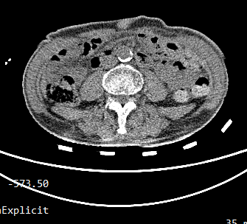
Split
Model: Chan-Vese
Pics: 125

Slide 2
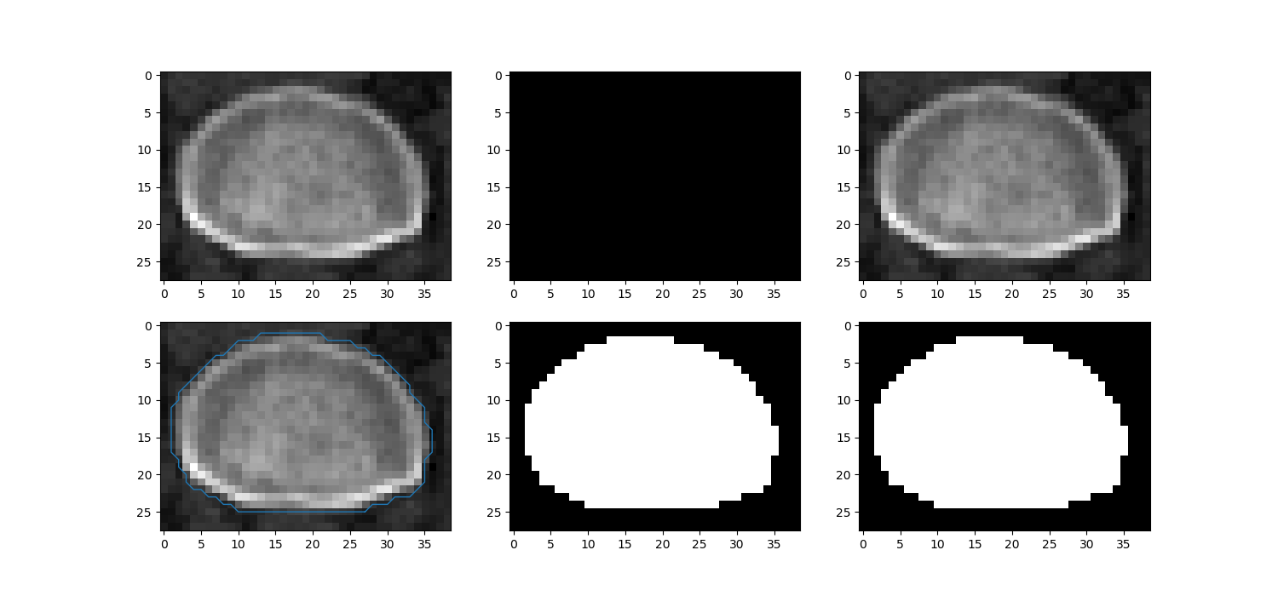
Good pics

Slide 3
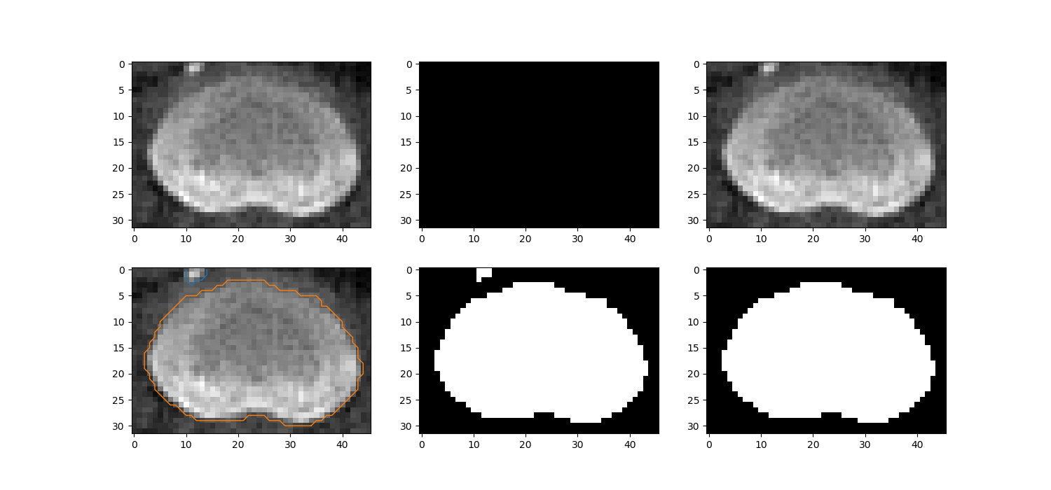
Good pics

Slide 4
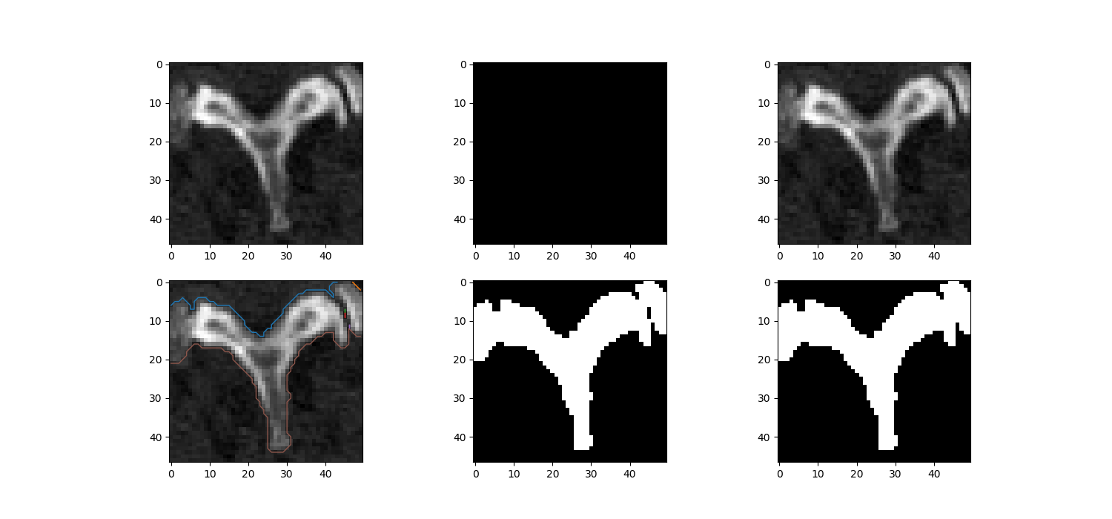
Good pics

Slide 5
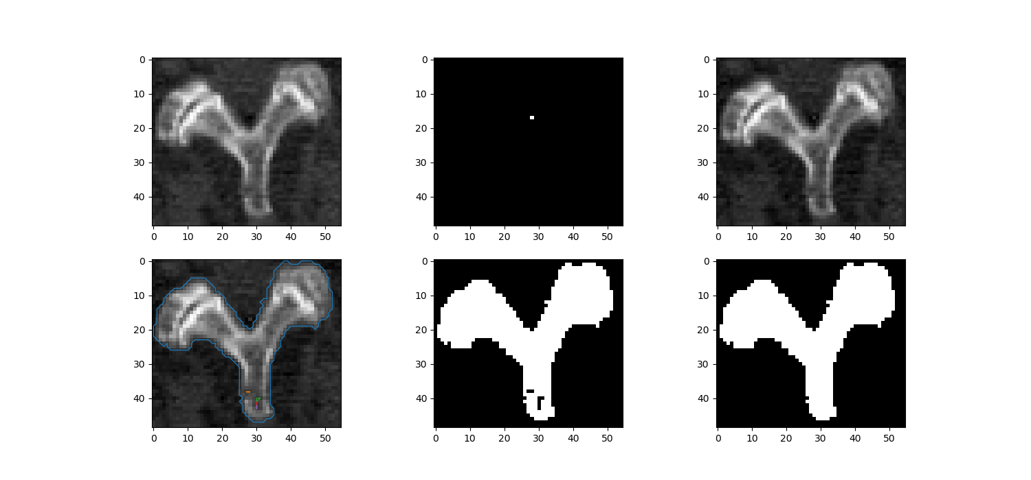
Good pics

Slide 6
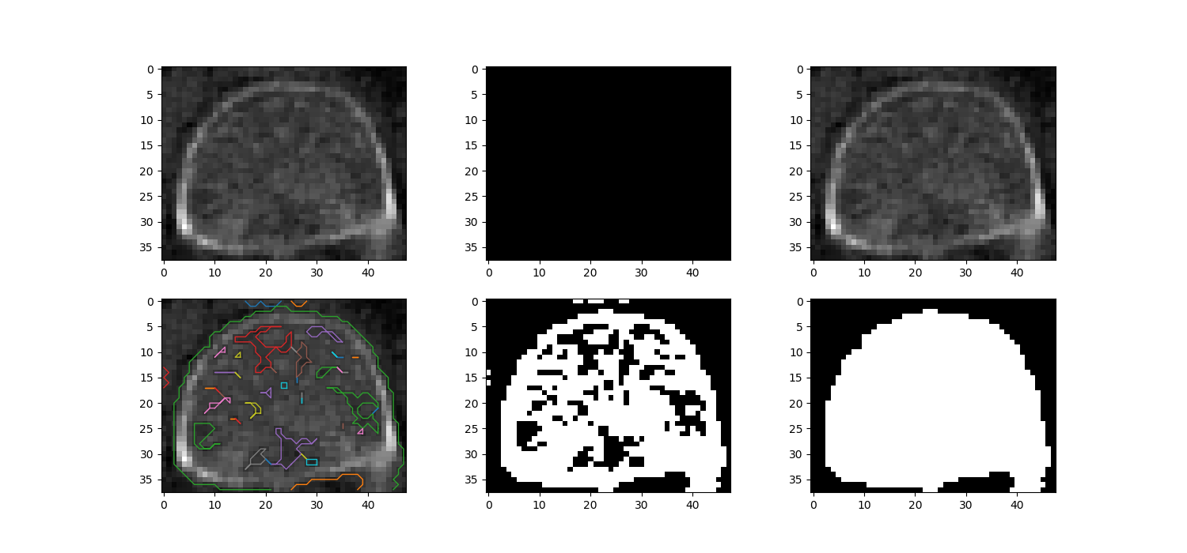
Bad pics

Slide 7
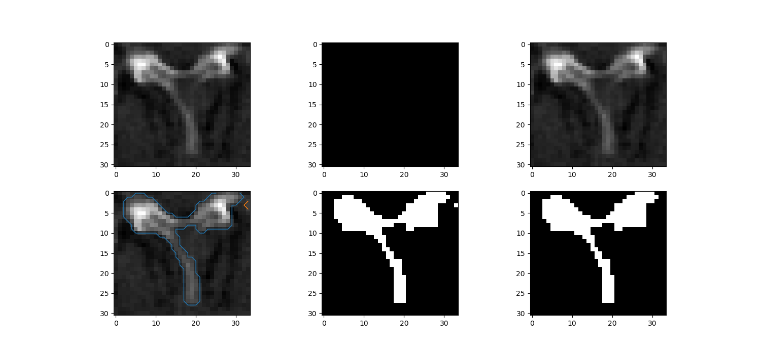
Bad pics

Slide 8
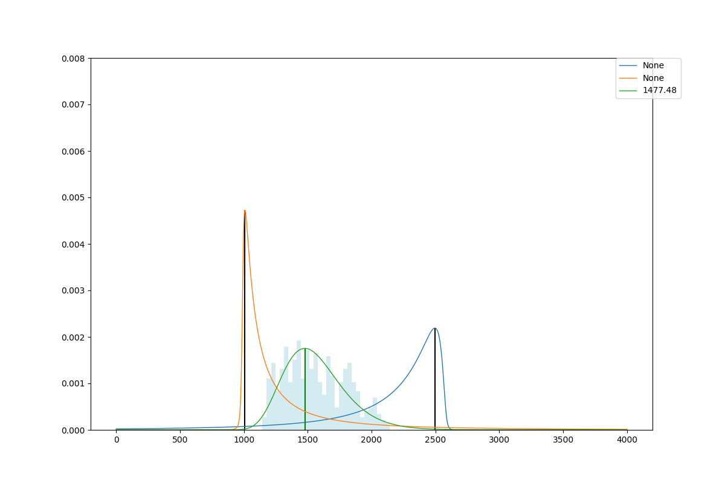
Correlation
Johnsonsu distribution
Age～Extremum of brightness frequency

Slide 9
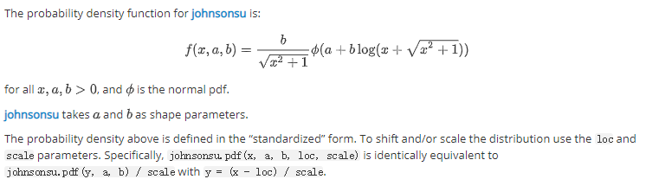
Correlation
Age～a, b, loc, scale

Slide 10
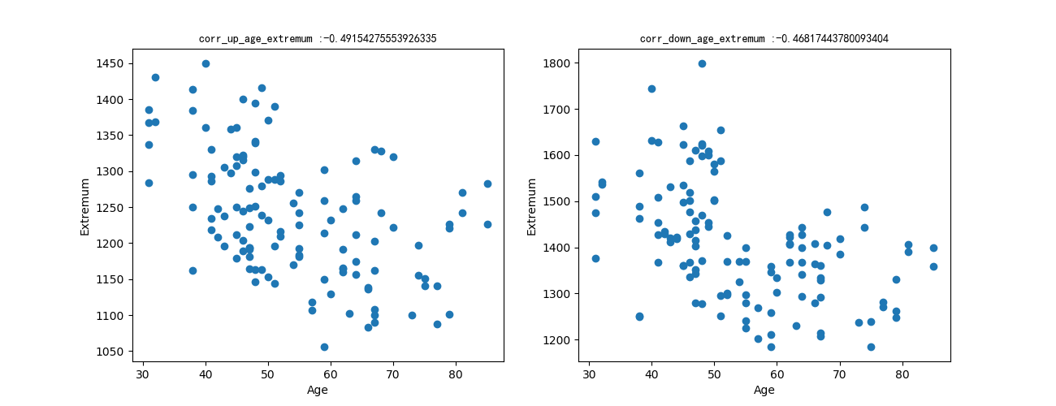
Age～Extremum
-0.492
-0.468

Slide 11
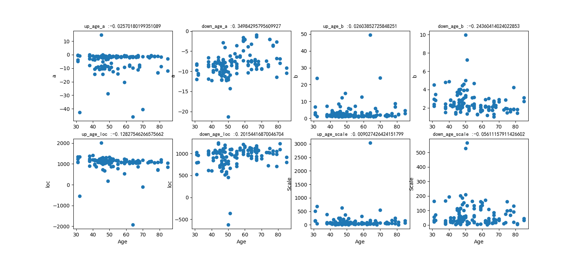
Age～a, b, loc, scale

Slide 12
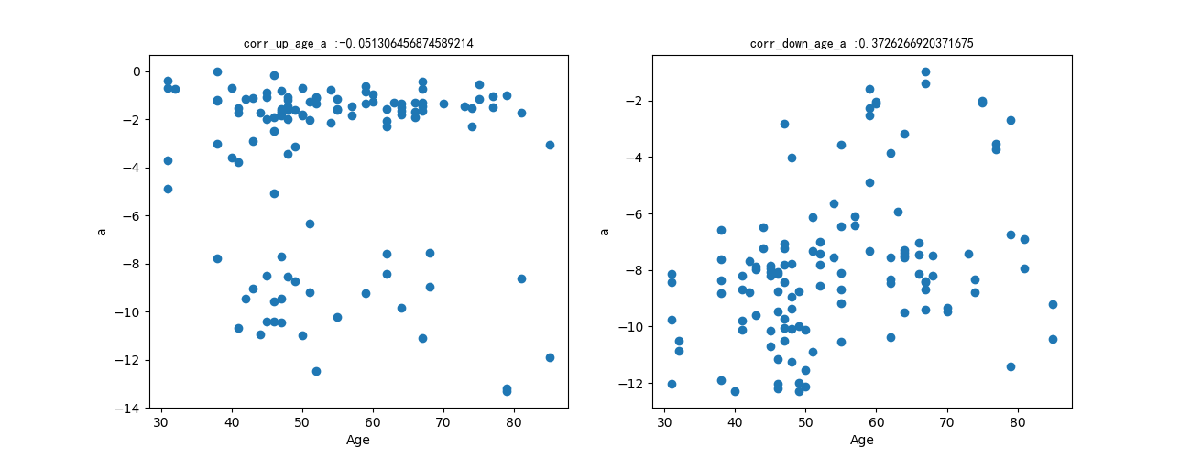
Age～a
-0.051
-0.372

Slide 13
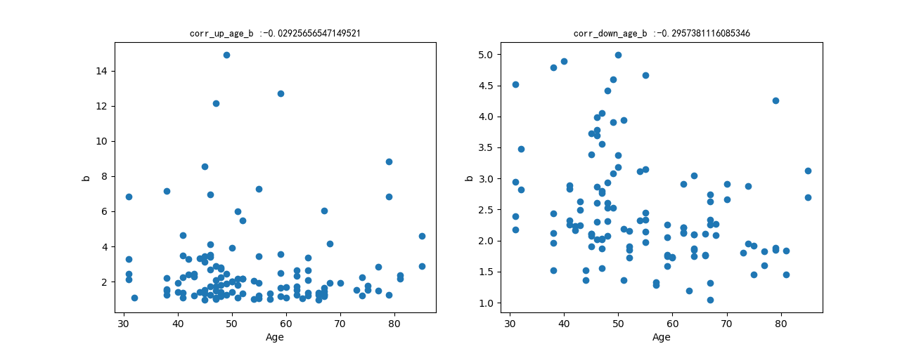
Age～b
-0.029
-0.296

Slide 14
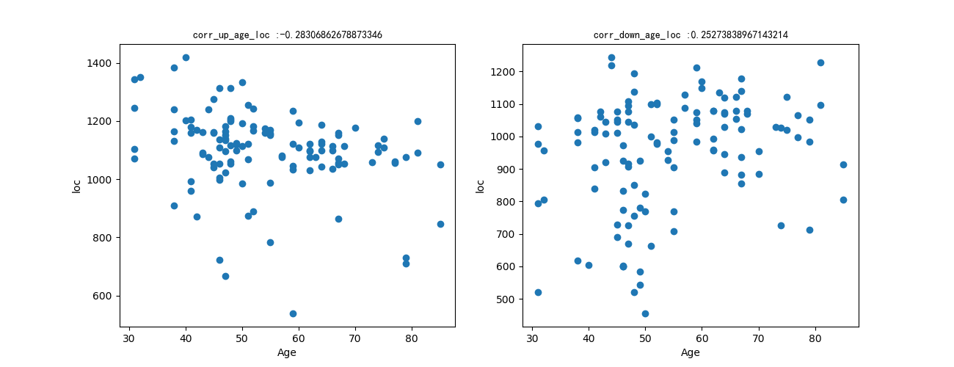
Age～loc
-0.283
-0.253

Slide 15
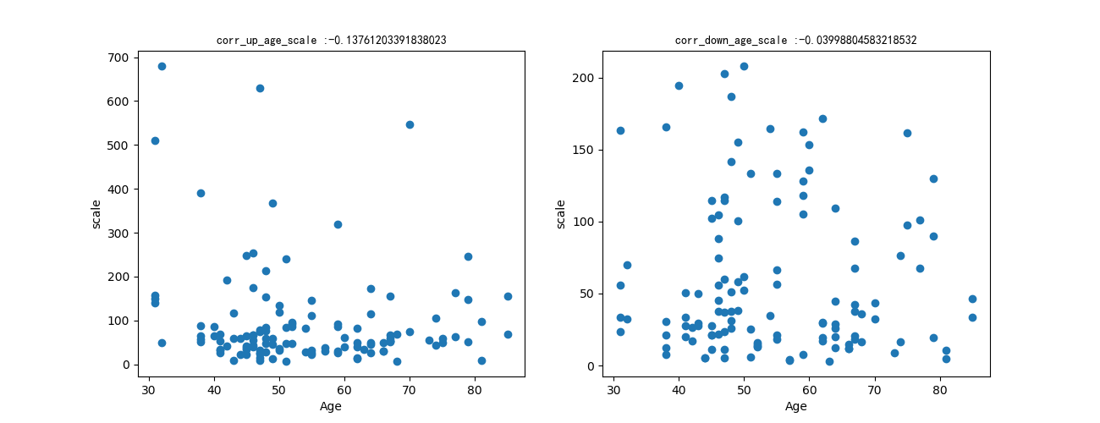
Age～scale
-0.138
-0.040

Slide 16
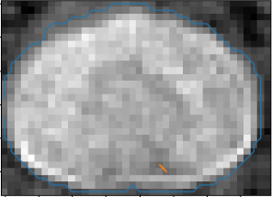
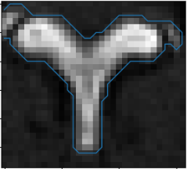
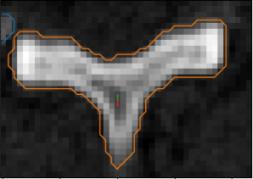
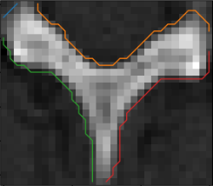
Outlier

