Slide 1
Title slide

Slide 2
Chapter slide

Slide 3
The team
Present the team

Slide 4
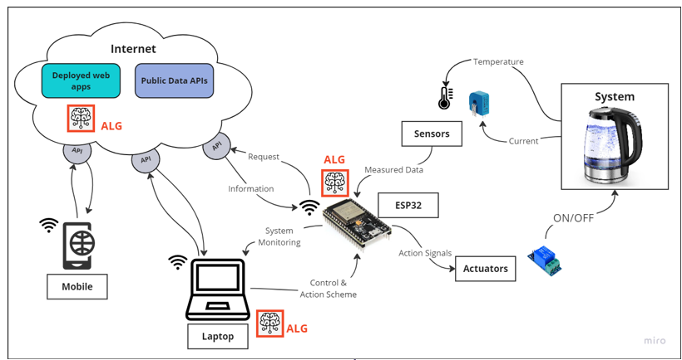
Project description and workflow
(i.e. the problem you are addressing, overview of the project, basic functioning of the load + your idea to monitor/improve/goal of your solution, an information and data flow diagram of your prototype to show an overview of the sensors implemented ecc)
Example of the diagram (miro or draw.io are both nice to make this diagram. Google draw or powerpoint are also fine)

Slide 5
Building the prototype: hardware
Datasheet and description of the chosen load.
(show me you understand how the hardware works, which sensors you chose, ESP32 connections...)

Slide 6
Building the prototype: software
(show me you understand the software architecture. No need to show code but block diagrams are appreciated. I.e. how do you control the load? What variables are you monitoring? Granularity? How are you storing and processing data? You know your project better than I do, show me what you did.
Important: upload your code on a GitHub repository

Slide 7
Results
(present the benefits/savings/findings ecc...)

Slide 8
Personal insights
I'm curious to know your experience working on this project.
What went surprisingly well?
What did you struggle with?
What went wrong (i.e. sensors unexpectedly breaking/ESP32 not working)? At the end of the day even bad results or a strategy not working are still proven results and a tested strategy.

Slide 9
Conclusions
Final takeaways/metrics/next steps. How would you improve the prototype if you had more time/funds to work on it?

Slide 10
End slide

