Slide 1


The Riemann Zeta Function: Zeros, the Critical Line, and Computational Exploration
Computational visualization, prime structure, and experimental mathematics
Samuel Castillo
www.PredictiveInsightsAI.com
Software Engineer Sunday 5th April, 2026

Slide 2



Roadmap
1
Introduction
2
Computation
3
Conclusion
<number>/20

Slide 3
Introduction
From Euler to Riemann
Euler’s resolution of the Basel problem revealed that the zeta function already encodes remarkable arithmetic structure at special values such as
_{π}2
ζ(2) = .
6
Riemann’s later insight extended this perspective dramatically: after analytic continuation, the non-trivial zeros of the zeta function govern the fine-scale distribution of prime numbers.
<number>/20

Slide 4
The Riemann Zeta Function
The Riemann zeta function occupies a central place in analytic number theory.
For ℜ(s) > 1, it is defined by the convergent series
∞
Σ
1
_{n}s
ζ(s) =
.
n=1
Euler showed that this function also admits the product expansion
ζ(s) = ^{Y} 1 − p^{−s −1} ,
p
which connects analysis directly to the prime numbers.
<number>/20

Slide 5
Central Thesis
Big idea
The zeros of ζ(s) are not merely analytic curiosities. They are structural features that govern the oscillatory behavior of prime counting.
This viewpoint culminates in the Riemann Hypothesis, which asserts that every non-trivial zero lies on the critical line
ℜ(s) = ¹ .
2
<number>/20

Slide 6
Prime Number Distribution
This broader perspective also situates related phenomena in prime number theory.
Mersenne primes: numbers of the form 2^{p} − 1, where p must be prime for 2^{p} − 1 to have any chance of being prime.
Twin primes: pairs of primes differing by 2, such as (29, 31).
The Twin Prime Conjecture asserts that infinitely many such pairs exist.
<number>/20

Slide 7
Where the Zeros Live
The non-trivial zeros of the Riemann zeta function lie in the critical strip
0 < ℜ(s) < 1.
Extensive numerical evidence suggests that these zeros lie on the critical line
1
ℜ(s) = ,
2
as asserted by the Riemann Hypothesis.
Visualization techniques provide useful geometric intuition for the analytic structure of ζ(s) in the complex plane.
<number>/20

Slide 8
Visualization Modes
Phase Plots: hue tracks arg(ζ(s)) while brightness tracks |ζ(s)|; zeros appear as phase singularities.
Contour Plots: the curves ℜ(ζ(s)) = 0 and ℑ(ζ(s)) = 0 intersect exactly at zeros.
Three-Dimensional Surfaces: the graph of |ζ(s)| creates a landscape whose minima align with non-trivial zeros.
<number>/20

Slide 9
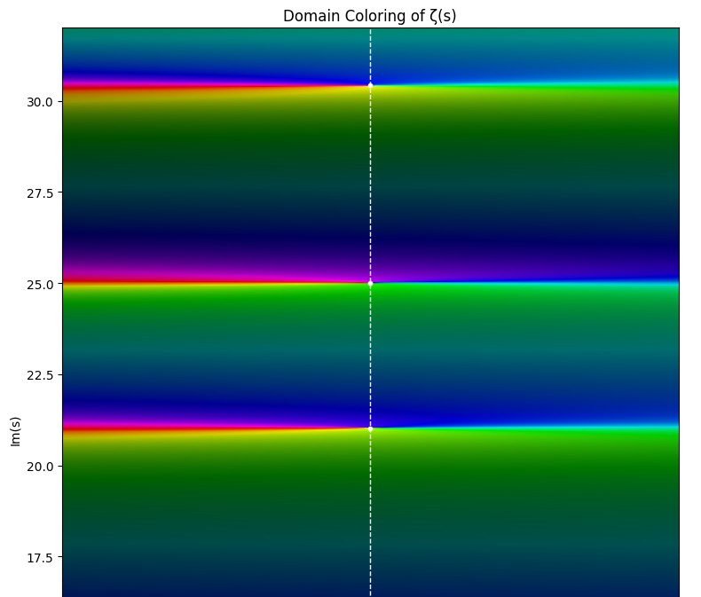
Phase Graph
<number>/20

Slide 10
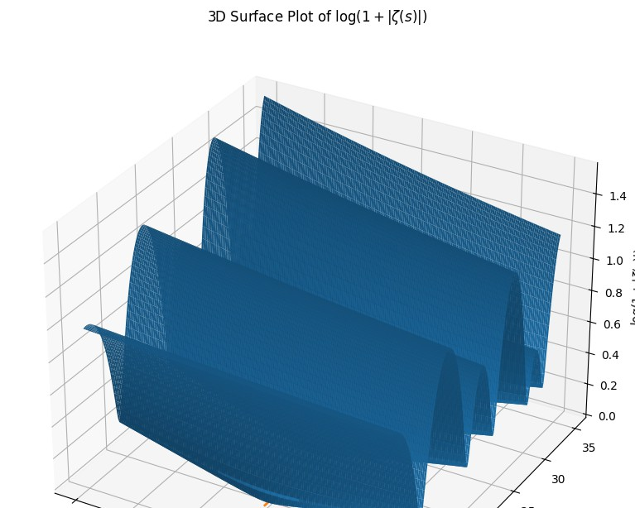
Surface Plot
<number>/20

Slide 11
Takeaway
These visual representations reinforce the interpretation of the zeros as structural features governing the behavior of ζ(s), and by extension, the distribution of prime numbers through the explicit formula.
<number>/20

Slide 12
Computational Consequences
Computational Evidence: extensive computations have verified enormous numbers of non-trivial zeros on the critical line.
Prime Counting: the zeros appear explicitly in formulas such as
π(x) = Li(x) − ^{Σ} Li(x^{ρ}) + lower-order terms.
ρ
Error Bounds: RH implies the near-optimal error term
π(x) = Li(x) + O x^{1/2} log x .
<number>/20

Slide 13
The Big Formula
A central bridge between the zeros of ζ(s) and the distribution of primes is the explicit formula
Σ
x
ρ
1
ψ(x) = x −
−2
— log(2π) − log(1 − x ),
ρ 2
ρ
where ψ(x) is the Chebyshev function and the sum runs over non-trivial zeros ρ of ζ(s).
This formula shows that the zeros contribute oscillatory corrections to the main term x.
<number>/20

Slide 14
Prime Analytics
Numerical contour analysis: visualize level sets of ℜ(ζ(s)) and
ℑ(ζ(s)), approximate zeros, and study local spacing.
Automated theorem search: machine-assisted systems can explore large proof spaces and intermediate lemmas.
Large-scale verification: distributed computation continues to test zero locations to increasing heights.
<number>/20

Slide 15
Classical vs Modern Ciphers
The contrast between classical and modern cryptography highlights why prime numbers matter outside pure mathematics.
Classical example
A Caesar cipher shifts each letter by a fixed number of positions. A slightly more complex variant uses a keyword substitution alphabet such as
KEYWORDABCFGHIJLMNPQSTUVXZ.
These systems are weak because they leak repeated letters, frequency patterns, and key-space structure.
<number>/20

Slide 16
Key Space Size
Cipher Comparison
System
Attack Method
Time to Break
Caesar Cipher | 25 keys | Brute force | Instant (< 1 ms)
Keyword Substitution DES (56-bit) | Large theoretical space ₂56 | Frequency analysis Exhaustive search | Seconds–minutes Hours–days
RSA-512 | Large composite modulus | Integer factorization | Hours–months
RSA-2048 | Very large composite modulus | Integer factorization | Infeasible classically
<number>/20

Slide 17
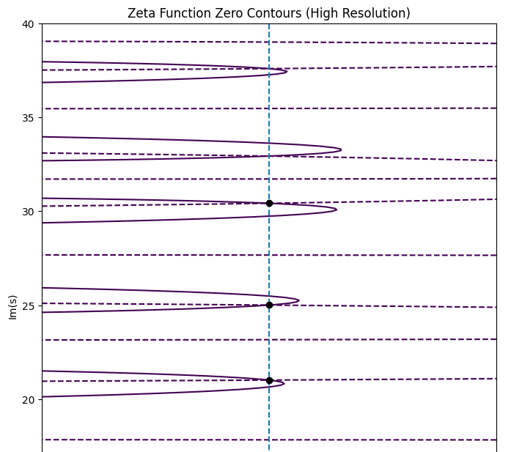
Contour Plot
<number>/20

Slide 18
Conclusion
The Riemann Hypothesis links complex analysis with the fine structure of prime distribution.
Euler opened one door into the zeta function through special values.
Riemann opened another through the zeros, which govern oscillatory structure in the primes.
<number>/20

Slide 19
Why the Visuals Matter
The contour plot makes the geometry concrete:
intersections of ℜ(ζ(s)) = 0 and ℑ(ζ(s)) = 0 reveal non-trivial zeros;
the explicit formula ties those zeros directly to prime irregularity;
computation and visualization create a practical way to explore deep analytic structure.
<number>/20

Slide 20
Future Work
Future work will extend the computational side of this project in four main directions:
high-precision numerical approximation of ζ(s) along the critical line;
richer visualization, including domain coloring and surface plots;
experiments with truncated explicit formulas for ψ(x) and π(x);
exploratory AI-based analysis of zero spacing, clustering, and prime-related data.
<number>/20

