Slide 1
The Riemann Zeta Function: Zeros, the Critical Line, and Computational Exploration
Samuel Castillo April 4, 2026
Abstract
Euler’s resolution of the Basel problem revealed that the zeta function already encodes remarkable arithmetic structure at special values such as
_{π}2
ζ(2) = .
6
Riemann’s later insight extended this perspective dramatically: after analytic continuation, the non-trivial zeros of the zeta function govern the fine-scale distribution of prime numbers. This paper presents a structured overview of the Riemann zeta function, the critical line, and the Riemann Hypothesis, with special emphasis on computational visualization and reproducible numerical experiments. In particular, contour plots of ℜ(ζ(s)) and ℑ(ζ(s)) are used to visu- alize the geometric structure of the zeros in the critical strip. The paper also discusses the explicit formula, prime density, and the role of modern computational and AI-assisted methods in experimental work related to the zeta function.
1 Introduction
The Riemann zeta function occupies a central place in analytic number theory. For ℜ(s) > 1, it is defined by the convergent series
∞
ζ(s) =
Σ
1
_{n}s
.
n=1
Euler showed that this function also admits the product expansion
Y
−s
−1
ζ(s) = 1 − p ,
p
where the product runs over all prime numbers. This identity establishes a deep connection between analysis and arithmetic: the zeta function is not only an infinite series, but also a compact encoding of the prime numbers.
The central thesis of this paper is that the zeros of ζ(s) are not merely analytic curiosities. Rather, they are structural features that govern the oscillatory behavior of prime counting. This viewpoint culminates in the Riemann Hypothesis, which asserts that every non-trivial zero lies on
the critical line ℜ(s) = ¹ .
2

Slide 2
2 From Euler’s Basel Problem to Prime Number Theory
Euler’s solution to the Basel problem showed that
∞
Σ
2
1 π
_{n2} = ,
n=1
6
or equivalently,
_{π}2
ζ(2) = .
6
This result was already surprising: a purely arithmetic series evaluates to an expression involving
π. It suggested that the zeta function contains far deeper structure than might first appear.
Riemann later extended ζ(s) to the complex plane (except for a simple pole at s = 1) and connected its zeros to the distribution of prime numbers. In modern language, the Prime Number Theorem states that
π(x) ∼
x
,
log x
where π(x) denotes the number of primes less than or equal to x. The zeros of ζ(s) govern the deviations from this leading approximation.
This broader perspective also situates related phenomena in prime number theory. Mersenne primes, numbers of the form 2^{p} − 1, are of special interest because p must be prime for 2^{p} − 1 to have any chance of being prime, though this condition is not sufficient. Twin primes are pairs of primes differing by 2, such as (29, 31), and the Twin Prime Conjecture asserts that infinitely many such pairs exist.
3 Visualizing Zeta Function Zeros
The non-trivial zeros of the Riemann zeta function lie in the critical strip
0 < ℜ(s) < 1.
Extensive numerical evidence suggests that these zeros lie on the critical line
1
ℜ(s) = ,
2
as asserted by the Riemann Hypothesis.
Visualization techniques provide useful geometric intuition for the analytic structure of ζ(s) in the complex plane.
Phase Plots: Domain coloring techniques visualize the complex function ζ(s) by assigning to each point s = σ + it a color determined by arg(ζ(s)), while the magnitude |ζ(s)| is encoded through brightness or intensity. Zeros appear as phase singularities, where the argument becomes undefined and the full spectrum of colors converges.
Contour Plots: The level curves defined by ℜ(ζ(s)) = 0 and ℑ(ζ(s)) = 0 can be plotted in the complex plane. Their intersections occur precisely at points where both the real and imaginary parts vanish, and therefore correspond exactly to the zeros of ζ(s), providing a geometric method for locating them.

Slide 3
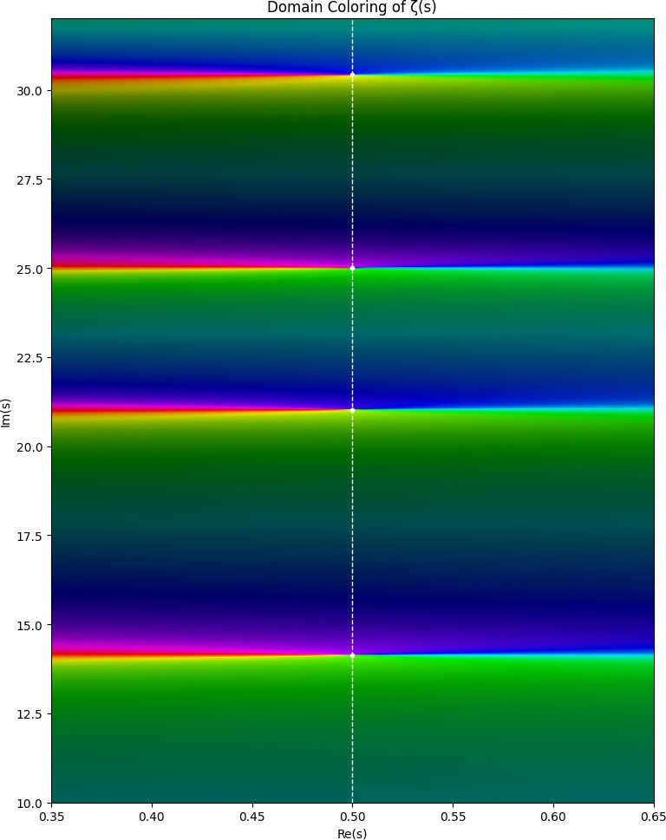
Three-Dimensional Surfaces: Representing |ζ(s)| as a surface over the complex plane produces a landscape in which zeros appear as pronounced minima, approaching zero. Such visualizations emphasize the oscillatory structure of ζ(s) and its heightened sensitivity near
the critical line ℜ(s) = ¹ .
2
Figure 1: Domain coloring visualization of the Riemann zeta function ζ(s) in the critical strip. Hue represents arg(ζ(s)), while brightness encodes the magnitude |ζ(s)|. Non-trivial zeros appear
as phase singularities where the color spectrum converges. The critical line ℜ(s) = ¹ is shown as a
2
dashed line.
These visual representations reinforce the interpretation of the zeros as structural features governing the behavior of ζ(s), and by extension, the distribution of prime numbers through the explicit formula.

Slide 4
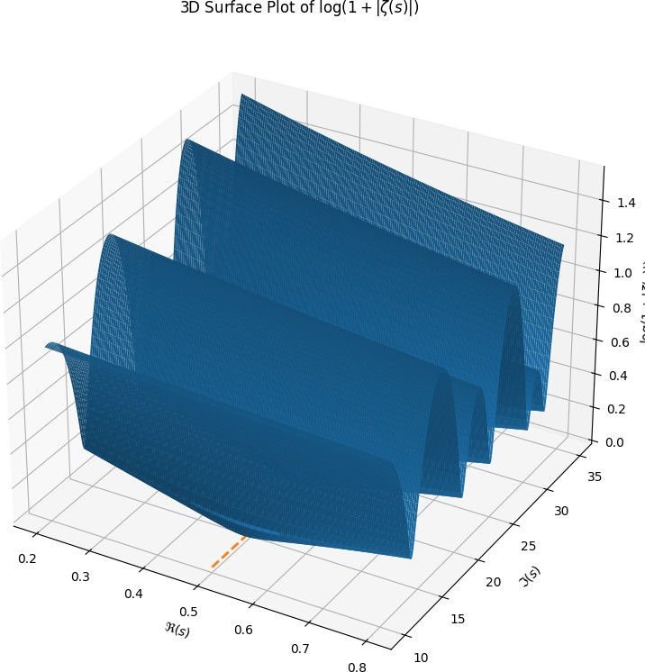
Figure 2: Three-dimensional surface plot of log(1 + |ζ(s)|) in a portion of the critical strip. The minima in the surface correspond to locations where |ζ(s)| approaches zero, highlighting the non-
trivial zeros of the Riemann zeta function. The dashed line indicates the critical line ℜ(s) = ¹ .
2
A Numerical Contour Plot in the Critical Strip
To illustrate this geometric structure, we generated a contour plot of ℜ(ζ(s)) and ℑ(ζ(s)) in the critical strip using Python and high-precision numerical evaluation.
Figure 3 provides a numerical and geometric illustration of the non-trivial zeros. The alignment of contour intersections along the critical line does not prove the Riemann Hypothesis, but it does provide a striking empirical picture of the structure predicted by the conjecture.
The Critical Line and the Riemann Hypothesis
The Riemann zeta function satisfies the functional equation
s s−1
πs
2
ζ(s) = 2 π sin
Γ(1 − s)ζ(1 − s),

Slide 5
which relates values at s and 1 − s and extends the function to the complex plane, apart from the pole at s = 1.
The non-trivial zeros lie in the critical strip 0 < ℜ(s) < 1. The Riemann Hypothesis asserts that all such zeros lie on the critical line
1
ℜ(s) = .
2
Key Consequences
Computational Evidence: Extensive numerical computations have verified that enormous numbers of non-trivial zeros lie on the critical line, providing strong evidence in support of the hypothesis.
Prime Counting: The zeros of ζ(s) appear explicitly in formulas governing the distribution of primes. For example,
Σ
ρ
π(x) = Li(x) − Li(x ) + lower-order terms,
ρ
where the sum runs over the non-trivial zeros ρ.
Error Bounds: The Riemann Hypothesis implies optimal-order bounds on the error term in the Prime Number Theorem, namely
π(x) = Li(x) + O x^{1/2} log x .
6 Prime Density and the Explicit Formula
A central bridge between the zeros of ζ(s) and the distribution of primes is the explicit formula
ψ(x) = x −
Σ
x
ρ
1
−2
— log(2π) − log(1 − x ),
ρ
ρ 2
where ψ(x) is the Chebyshev function and the sum runs over non-trivial zeros ρ of ζ(s).
This formula shows that the zeros contribute oscillatory corrections to the main term x. In this sense, the prime numbers are not distributed randomly: their irregularities are encoded by the zero set of the zeta function.
Related asymptotic relationships include
1
P (n prime) ≈ ,
ln n
and
∫
x
dt x
ln t ln x
Li(x) =
2
~ .
7 Computational and AI-Assisted Approaches
Recent computational work suggests that modern symbolic, numerical, and machine-assisted meth- ods may play an increasingly important role in the exploration of the zeta function.

Slide 6
Numerical contour analysis: High-precision contour and grid-based methods make it possible to visualize level sets of ℜ(ζ(s)) and ℑ(ζ(s)), approximate zeros, and study local spacing behavior.
Automated theorem search: Machine-assisted reasoning systems can explore large proof spaces and may eventually help identify useful intermediate lemmas, structural patterns, or conjectural pathways relevant to analytic number theory.
Large-scale verification: Distributed computational methods continue to test zero loca- tions to increasing heights, providing empirical support for the conjectural picture.
These methods do not constitute a proof of the Riemann Hypothesis, but they do expand the range of mathematically meaningful experiments that can be performed.
8 Cryptographic Motivation
The contrast between classical and modern cryptography highlights why prime numbers matter outside pure mathematics.
Before modern public-key cryptography, encryption methods often relied on simple substitution schemes. A classical example is the Caesar cipher, used in ancient Rome, which shifts each letter by a fixed number of positions. A somewhat more complex variant is a keyword substitution alphabet, for example
KEYWORDABCFGHIJLMNPQSTUVXZ.
Such systems are weak because they leak structure: repeated letters, frequency patterns, and small key spaces make them vulnerable to brute force or frequency analysis.
Comparison of Cryptographic Strength
System | Key Space Size | Attack Method | Time to Break
Caesar Cipher | 25 keys | Brute force | Instant (< 1 ms)
Keyword Substitution | large theoretical space | Frequency analysis | Seconds–minutes
DES (56-bit) | ₂56 | Exhaustive search | Hours–days
RSA-512 | large composite modulus | Integer factorization | Hours–months (cluster)
RSA-2048 | very large composite modulus | Integer factorization | Infeasible classically
Modern systems such as RSA rely on the practical difficulty of factoring large integers. This does not mean the Riemann Hypothesis directly proves or breaks RSA, but it places the study of primes and their structure in a broader computational context.
Conclusion
The Riemann Hypothesis remains one of the most consequential open problems in mathematics, linking complex analysis with the fine structure of prime number distribution. Euler’s work on the Basel problem opened one door into the zeta function through special values, while Riemann’s work revealed a second and far deeper door: the zeros of ζ(s) govern the oscillatory structure of the primes.

Slide 7
The contour plot in Figure 3 helps make this idea concrete. It visually displays the intersections of ℜ(ζ(s)) = 0 and ℑ(ζ(s)) = 0, illustrating the geometric organization of the non-trivial zeros near the critical line. Together with the explicit formula, this supports the central theme of the paper: the zeros of the zeta function are deeply tied to the distribution of prime numbers.
Computational experiments, visualization, and AI-assisted approaches do not yet yield a proof, but they do create new ways to explore, organize, and test mathematical structure. In that sense, the study of the Riemann zeta function continues to serve not only as a central problem in pure mathematics, but also as a testing ground for new paradigms in computation and mathematical discovery.
Future Work
Future work will extend the computational side of this project in four main directions:
high-precision numerical approximation of ζ(s) along the critical line;
improved visualization, including domain coloring and surface plots;
computational experiments using truncated explicit formulas for ψ(x) and π(x);
exploratory AI-based analysis of zero spacing, clustering, and prime-related data.
A Reproducibility: Python Code for the Contour Plot
The following Python code was used to generate the contour plot shown in Figure 3.
import numpy as np
import matplotlib.pyplot as plt import mpmath as mp
mp.dps = 25
re_vals = np.linspace(0.0, 0.99, 200)
im_vals = np.linspace(0.1, 40.0, 300)
Re, Im = np.meshgrid(re_vals, im_vals)
Z_real = np.zeros_like(Re, dtype=float) Z_imag = np.zeros_like(Im, dtype=float)
for i in range(Re.shape[0]):
for j in range(Re.shape[1]):
s = mp.mpc(float(Re[i, j]), float(Im[i, j])) try:
z = mp.zeta(s)
Z_real[i, j] = float(mp.re(z)) Z_imag[i, j] = float(mp.im(z))
except ValueError:
Z_real[i, j] = np.nan Z_imag[i, j] = np.nan
plt.figure(figsize=(8, 10))

Slide 8
plt.contour(Re, Im, Z_real, levels=[0], colors=’red’) plt.contour(Re, Im, Z_imag, levels=[0], colors=’green’)
plt.axvline(0.5, color=’blue’, linestyle=’--’, label=r’$\Re(s)=\frac{1}{2}$’) zeros_im = [14.134725, 21.022040, 25.010858, 30.424876]
for t in zeros_im:
plt.plot(0.5, t, ’bo’, markersize=4)
plt.title(r"Contour Plot of $\zeta(s)$: $\Re(\zeta)=0$ (red), $\Im(\zeta)=0$ (green)") plt.xlabel(r"$\Re(s)$")
plt.ylabel(r"$\Im(s)$") plt.grid(True, alpha=0.3) plt.legend()
plt.savefig("rzt.png", dpi=300, bbox_inches="tight")
plt.show()
Reproducibility: Python Code for Zeta Visualizations
This appendix provides reproducible Python code for two numerical visualizations of the Riemann zeta function in the critical strip: a domain-coloring phase plot and a three-dimensional surface plot of |ζ(s)|.
  Python Code for the Phase Plot
import numpy as np
import matplotlib.pyplot as plt import mpmath as mp
from matplotlib.colors import hsv_to_rgb
mp.dps = 30
# Zoom near the critical line
re_vals = np.linspace(0.35, 0.65, 500)
im_vals = np.linspace(10.0, 32.0, 700)
Re, Im = np.meshgrid(re_vals, im_vals)
phase = np.zeros_like(Re, dtype=float) magnitude = np.zeros_like(Re, dtype=float)
for i in range(Re.shape[0]):
for j in range(Re.shape[1]):
s = mp.mpc(float(Re[i, j]), float(Im[i, j])) try:
z = mp.zeta(s)
phase[i, j] = float(mp.arg(z)) magnitude[i, j] = float(abs(z))
except ValueError:
phase[i, j] = 0.0

Slide 9
magnitude[i, j] = np.nan
# Map phase to hue
phase_norm = (phase + np.pi) / (2 * np.pi)
# Make zeros dark and larger values brighter value = 1.0 / (1.0 + magnitude)
saturation = np.ones_like(value)
# HSV image
hsv = np.zeros((Re.shape[0], Re.shape[1], 3), dtype=float) hsv[..., 0] = phase_norm
hsv[..., 1] = saturation
hsv[..., 2] = value
rgb = hsv_to_rgb(hsv)
plt.figure(figsize=(8, 10)) plt.imshow(
rgb,
extent=[re_vals.min(), re_vals.max(), im_vals.min(), im_vals.max()], origin="lower",
aspect="auto"
)
plt.axvline(0.5, color="white", linestyle="--", linewidth=1) # Optional: mark first few known zeros
zeros_im = [14.134725, 21.022040, 25.010858, 30.424876]
for t in zeros_im:
plt.plot(0.5, t, ’wo’, markersize=3)
plt.title("Domain Coloring of zeta(s)") plt.xlabel("Re(s)")
plt.ylabel("Im(s)") plt.tight_layout()
plt.savefig("zeta_phase_corrected.png", dpi=300, bbox_inches="tight")
plt.show()
A.2 Python Code for the Three-Dimensional Surface Plot
import numpy as np
import matplotlib.pyplot as plt import mpmath as mp
from mpl_toolkits.mplot3d import Axes3D # noqa: F401
mp.dps = 30
# Region in the complex plane re_vals = np.linspace(0.2, 0.8, 160)
im_vals = np.linspace(10.0, 35.0, 220)
Re, Im = np.meshgrid(re_vals, im_vals)

Slide 10
Z_abs = np.zeros_like(Re, dtype=float)
# Compute |zeta(s)| on the grid for i in range(Re.shape[0]):
for j in range(Re.shape[1]):
s = mp.mpc(float(Re[i, j]), float(Im[i, j])) try:
z = mp.zeta(s)
Z_abs[i, j] = float(abs(z)) except ValueError:
Z_abs[i, j] = np.nan
# Log scaling improves visibility Z_plot = np.log1p(Z_abs)
fig = plt.figure(figsize=(10, 8))
ax = fig.add_subplot(111, projection=’3d’)
surf = ax.plot_surface( Re, Im, Z_plot, rstride=1, cstride=1, linewidth=0, antialiased=True
)
# Mark critical line on base plane critical_x = np.full_like(im_vals, 0.5) critical_y = im_vals
critical_z = np.full_like(im_vals, np.nanmin(Z_plot)) ax.plot(critical_x, critical_y, critical_z, linestyle=’--’, linewidth=2)
ax.set_title(r"3D Surface Plot of log(1 + |zeta(s)|)") ax.set_xlabel(r"Re(s)")
ax.set_ylabel(r"Im(s)") ax.set_zlabel(r"log(1 + |zeta(s)|)")
plt.tight_layout()
plt.savefig("zeta_surface.png", dpi=300, bbox_inches="tight") plt.show()

Slide 11
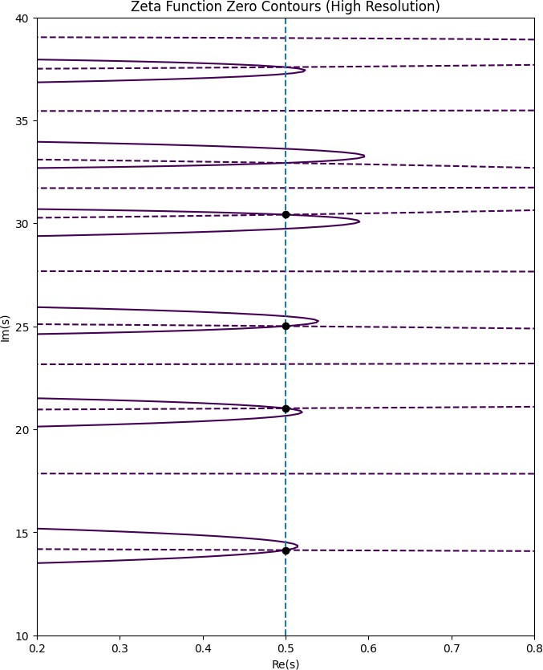
Figure 3: Contour plot of the Riemann zeta function ζ(s) in the critical strip. The red curves represent ℜ(ζ(s)) = 0 and the green curves represent ℑ(ζ(s)) = 0. Their intersections correspond
to non-trivial zeros of ζ(s), which are observed to align along the critical line ℜ(s) = ¹ .
2

