Slide 1
Continuous-Valued Variables: Dichotomize with Care
12 Mar 2024
Notes:
“Ending Dichotomania: Stop Throwing Away Information” (2021 talk)
“Please don’t dichotomize predictor variables” (2022 talk)

Slide 2
Problem Statement
Current common data analysis approaches based on dichotomization of continuous-valued variables typically cause loss of precision and power and other statistical problems that reduce the value of the data. Using the original continuous-scaled data for analysis can avoid such losses and thus increase the probability of successful biomarker discovery, development, and use.

Slide 3
Dichotomization
What is it?
Problems caused by it
Alternatives to it (REMOVED REAL DATA EXAMPLES FROM THIS VERSION)

Slide 4
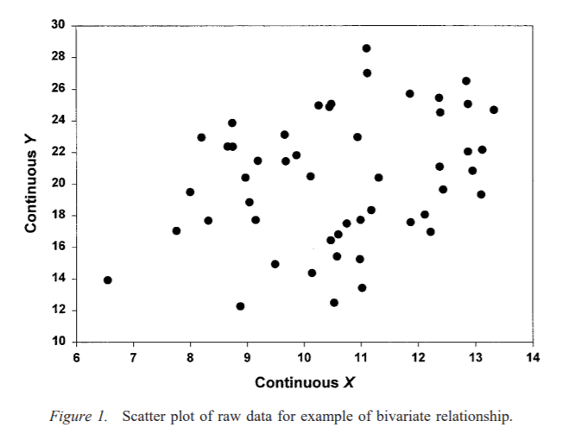
What Does it Mean to Dichotomize?
Figures copied from:
MacCallum, R. C., Zhang, S., Preacher, K. J., & Rucker, D. D. (2002). On the practice of dichotomization of quantitative variables. Psychological Methods, 7(1), 19–40. https://doi.org/10.1037/1082-989X.7.1.19
“… dichotomization is rarely defensible and often will yield misleading results”

Slide 5
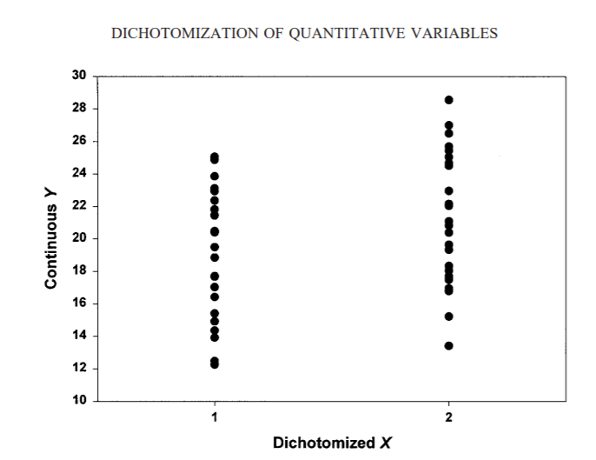
What Does it Mean to Dichotomize?
Figures copied from:
MacCallum, R. C., Zhang, S., Preacher, K. J., & Rucker, D. D. (2002). On the practice of dichotomization of quantitative variables. Psychological Methods, 7(1), 19–40. https://doi.org/10.1037/1082-989X.7.1.19
“… dichotomization is rarely defensible and often will yield misleading results”
Notes:
2 points close together near threshold moved to be very different from each other
2 points far apart but on the same side of threshold moved to be the same
Both these features can greatly distort signals in the data!

Slide 6
Effect of dichotomization may depend on role of variable in analysis
RESPONSE = PREDICTORS + COVARIATES
g{E(s(Y) | X, Z)} = f(X) + h(Z)
Dichotomize response variable: s = Ind(Y > a)
Dichotomize predictor of interest: f = Ind(X > b)
Dichotomize covariate: h = Ind(Z > c)
Dichotomization is but one special case of variable transformation for function approximation

Slide 7
Effect of dichotomization may depend on role of variable in analysis
RESPONSE = PREDICTORS + COVARIATES
g{E(s(Y) | X, Z)} = f(X) + h(Z)
Dichotomize response variable: s = Ind(Y > a)
Dichotomize predictor of interest: f = Ind(X > b)
Dichotomize covariate: h = Ind(Z > c)
Dichotomization is but one special case of variable transformation for function approximation

Slide 8
Dichotomization
What is it?
Problems caused by it
Alternatives to it

Slide 9
Some problems with dichotomizing
Loss of power and precision: requires larger, slower, more expensive studies
May increase false positive rates; not necessarily conservative!
Destroys information about non-linear associations
Makes measures of association (e.g., HR, OR) depend on study design (e.g., inclusion criteria); may not generalize well

Slide 10
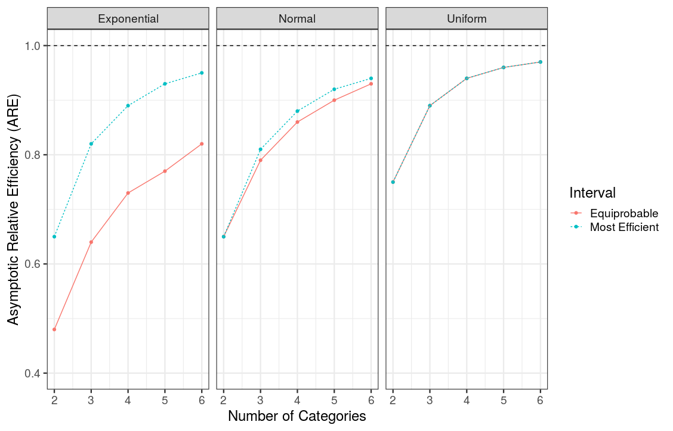
Categorizing a continuous predictor is inefficient (wastes info)
ARE:= {Correlation (X*, X)}² where X* is categorized version of continuous predictor, X
  Models are less efficient when categorizing continuous predictor
  If you must categorize (Why?), the more categories the better
  3 levels is much better than 2
  Equiprobable intervals are NOT necessarily optimal
Dichotomizing predictor is equivalent to losing 1/3 of data
Figure based on table from:
Lagakos, S. W. "Effects of mismodelling and mismeasuring explanatory variables on tests of their association with a response variable." Statistics in medicine 7.1‐2 (1988): 257-274.

Slide 11
Why we often use tertiles for illustration (e.g., K-M plots)
Andrew Gelman and David K. Park. Splitting a Predictor at the Upper Quarter or Third and the Lower Quarter or Third. The American Statistician, November 2008, Vol. 62, No. 4.
  “… approximate the regression of y on x by a simple comparison of the average value of y when x is high, compared to the average value of y when x is low.”
  “In common practice, variables are discretized into two categories … we can do better by discretizing x into three values and throwing away the middle category…”
  “By discretizing x into three categories, we claw back about half the efﬁciency lost by the commonly used strategy of dichotomizing the predictor.”
  [We recommend] “that the high and low categories each be set to contain 1/4 to 1/3 of the data, which results in comparisons with approximately 80%–90% of the efﬁciency of linear regression if the predictor x follows a uniform or normal distribution.”
  “A loss of 10%–20% of efﬁciency is not minor, and so we do not recommend that the comparisons replace regressions but rather that they be considered as useful supplementary summaries, especially for the goal of communicating to a general audience.”
Notes:
This result is a key part of the rationale for our recommendation to e.g., show K-M curves for biomarker tertiles instead of dichotomizing at the median!

Slide 12


Slide 14
One Direction: full picture → simplified picture

Slide 15
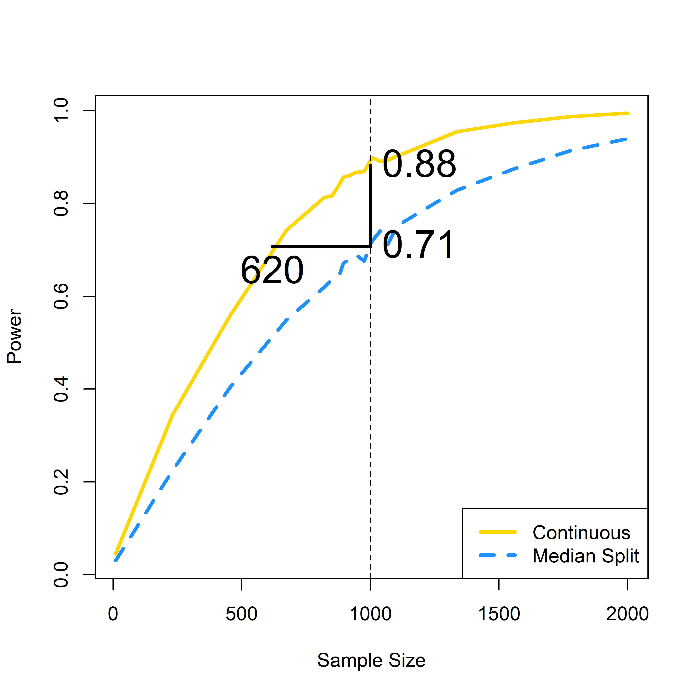
Simulation example: dichotomizing causes loss of power to detect a true effect
Power to detect a strong effect (beta=2.5) in a continuous covariate at nominal alpha level 0.05
  At N=1000, continuous analysis has power 0.88
  If you dichotomize that case, power drops to 0.71
  If you are okay with this power, you could have done the same study with N=620 patients. (380 extra patients were put at risk)

Slide 16
Simulation example: dichotomizing causes loss of power to detect a true effect
Power to detect a strong effect (beta=2.5) in a continuous covariate at nominal alpha level 0.05
  At N=1000, continuous analysis has power 0.88
  If you dichotomize that case, power drops to 0.71
  If you are okay with this power, you could have done the same study with N=620 patients. (380 extra patients were put at risk)
Benefits of using continuous variables on original scale:
  Get more statistical power, or…
  Can run smaller, faster, more cost-effective experiments

Slide 17
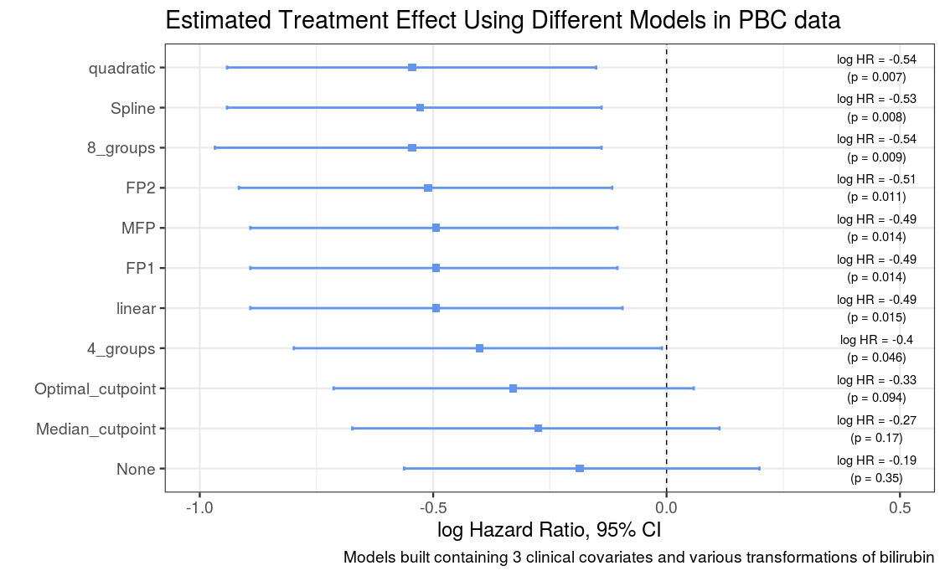
Categorization causes failure to adjust for imbalance in prognostic factor (residual confounding bias, Type 1 or 2 error rate inflation)
None:= No adjustment for bilirubin
n_groups:= Number of categories bilirubin is split into
FPn:= Fractional Polynomial of nth degree for bilirubin
MFP:= Multivariable Fractional Polynomial for bilirubin
Optimal_cutpoint:= Single cutpoint for bilirubin determined based on outcome
Based on Table 1 in Royston, Patrick, Douglas G. Altman, and Willi Sauerbrei. "Dichotomizing continuous predictors in multiple regression: a bad idea." Statistics in medicine 25.1 (2006): 127-141.

Slide 18
Recent Thoughts from FDA regarding Covariate Adjustment
Adjusting for Covariates in Randomized Clinical Trials for Drugs and Biological Products
Guidance for Industry (May 2023)
“Even when the linear regression model is misspecified and does not accurately capture the relationships between the outcome, covariates, and treatment, covariate adjustment through a linear model is a valid method for estimating and performing inference for the average treatment effect (Lin, 2013). However, the power of hypothesis tests and precision of estimates generally improves if the model more closely approximates the true relationships among the outcome, covariates, and treatment.”
Dichotomizing a covariate limits the modeled relationship to be a step function, rarely a good approximation
Dichotomizing may also lead to bias and Type 1 errors in some situations; not just about power!

Slide 19
Some problems with dichotomizing
Loss of power and precision: requires larger, slower, more expensive studies
May increase false positive rates; not necessarily conservative!
Destroys information about non-linear associations
Makes measures of association (e.g., HR, OR) depend on study design (e.g., inclusion criteria); may not generalize well

Slide 20
Type I Error Inflation when Categorizing Continuous Confounder
Type I error rate for a test of effect of X on logit(p), for different transformations of Z, vs. correlation between X and Z
2-level
2-level
continuous
continuous
Figure copied from:
Austin, Peter C., and Lawrence J. Brunner. "Inflation of the type I error rate when a continuous confounding variable is categorized in logistic regression analyses." Statistics in medicine 23.7 (2004): 1159-1178.

Slide 21
Some problems with dichotomizing
Loss of power and precision: requires larger, slower, more expensive studies
May increase false positive rates; not necessarily conservative!
Destroys information about non-linear associations
Makes measures of association (e.g., HR, OR) depend on study design (e.g., inclusion criteria); may not generalize well

Slide 22
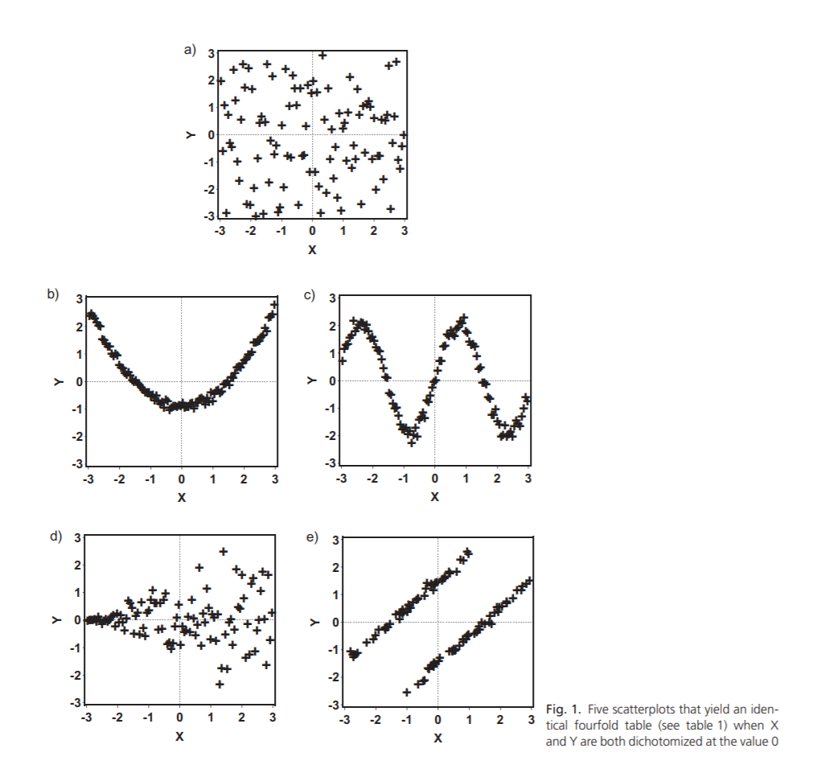
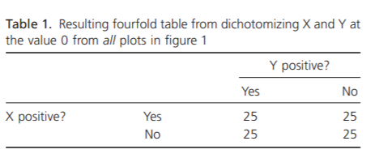
Different Relationships on Continuous Scale Can Yield Identical Relationship After Dichotomization -> Loss of Information
Table and Figure copied from:
Kuss, Oliver. "The danger of dichotomizing continuous variables: A visualization." Teaching Statistics 35.2 (2013): 78-79.

Slide 23
Different Relationships on Continuous Scale Can Yield Identical Relationship After Dichotomization -> Loss of Information
Table and Figure copied from:
Kuss, Oliver. "The danger of dichotomizing continuous variables: A visualization." Teaching Statistics 35.2 (2013): 78-79.

Slide 24
Some problems with dichotomizing
Loss of power and precision: requires larger, slower, more expensive studies
May increase false positive rates; not necessarily conservative!
Destroys information about non-linear associations
Makes measures of association (e.g., HR, OR) depend on study design (e.g., inclusion criteria); may not generalize well

Slide 25
Measures of association (e.g., HR, OR) for a dichotomized explanatory variable depend on the study design, do not generalize well
Inspired by Max Rohde (2022) Sensitivity of odds-ratios calculated on dichotomized variables to inclusion criteria: A short simulation example showing why dichotomization of continuous variables can lead to wrong conclusions. https://maximilianrohde.com/posts/odds-ratio-dichotomize/

Slide 26
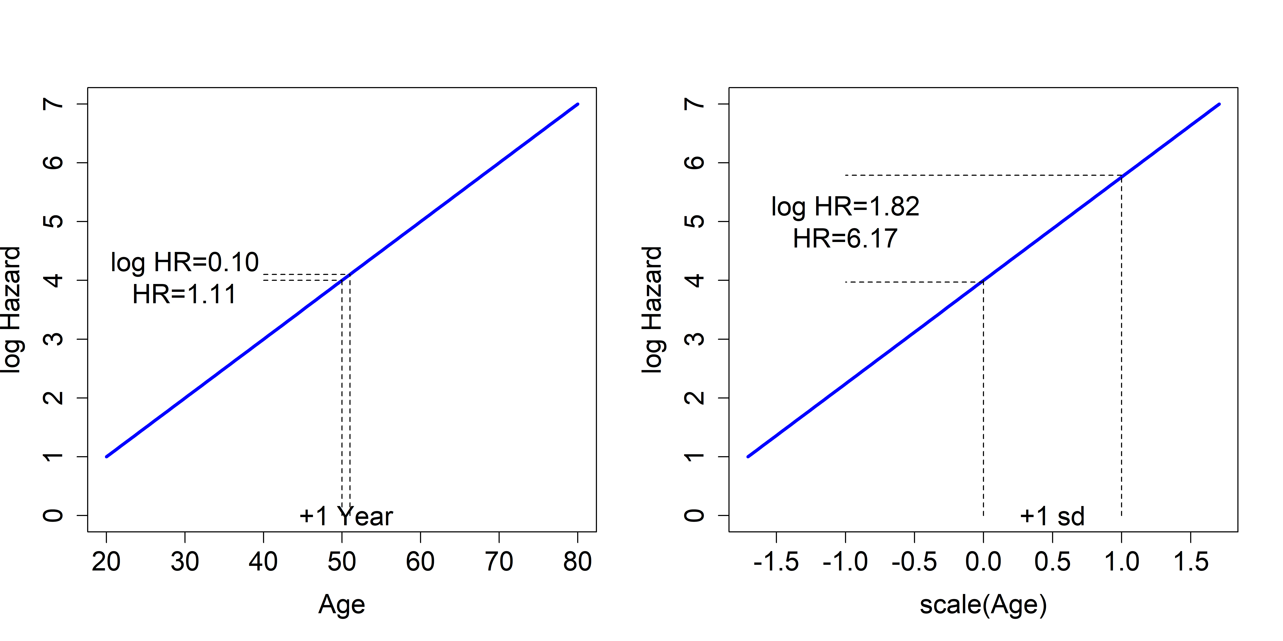
What is a hazard ratio anyway?
The hazard ratio is the ratio of two hazards:
To calculate it, you need to pick two points to compare
To interpret it, you need to know what those two points are
Re-scaling to 1 unit = 1 SD (or IQR) makes HRs for different variables comparable
Default? Usually on a +1 unit scale

Slide 27
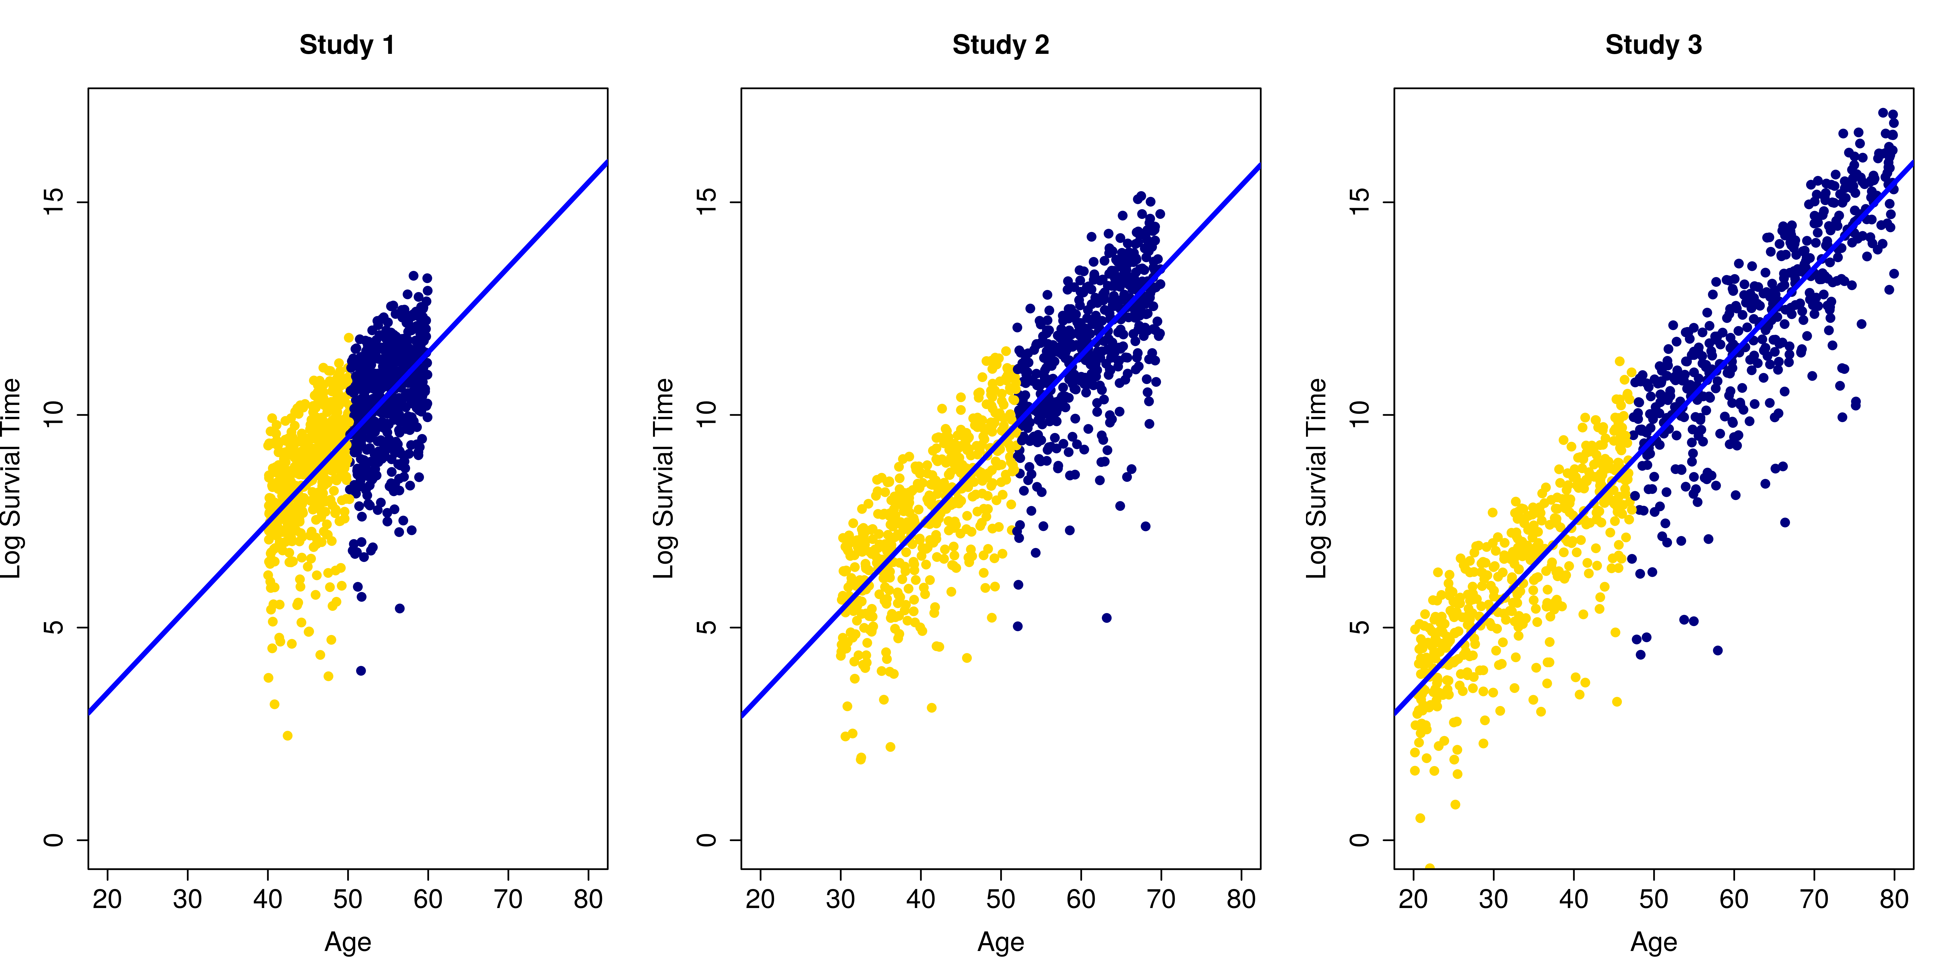
Consider 3 studies with different inclusion criteria (age ranges) but the same true continuous relationship
Log(Survival Time)
Log(Survival Time)
Log(Survival Time)
Age
Age
Age

Slide 28
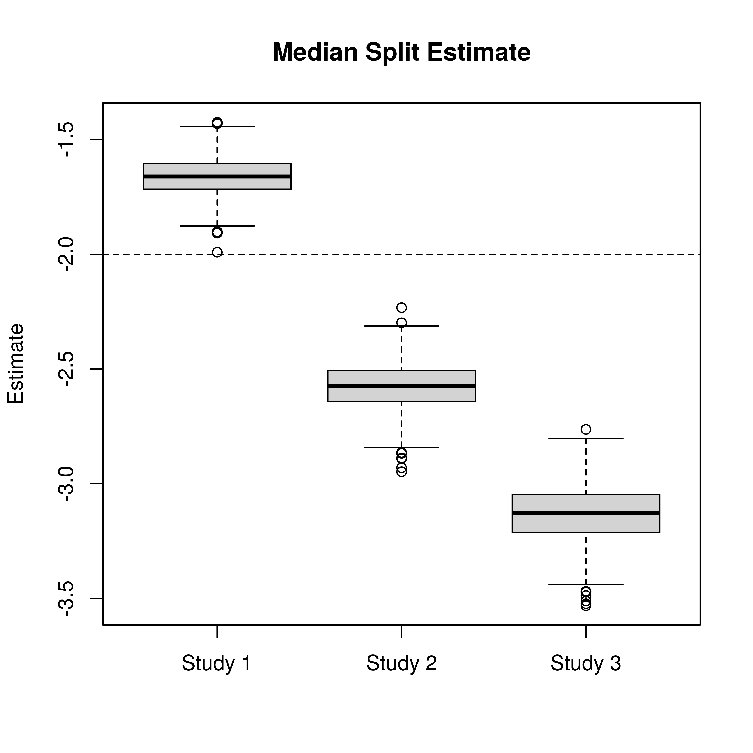
Regression coefficient estimates after dichotomization vary with inclusion criteria and are biased.
(From 1000 simulated data sets)
True value
Log(HR) Estimate

Slide 29
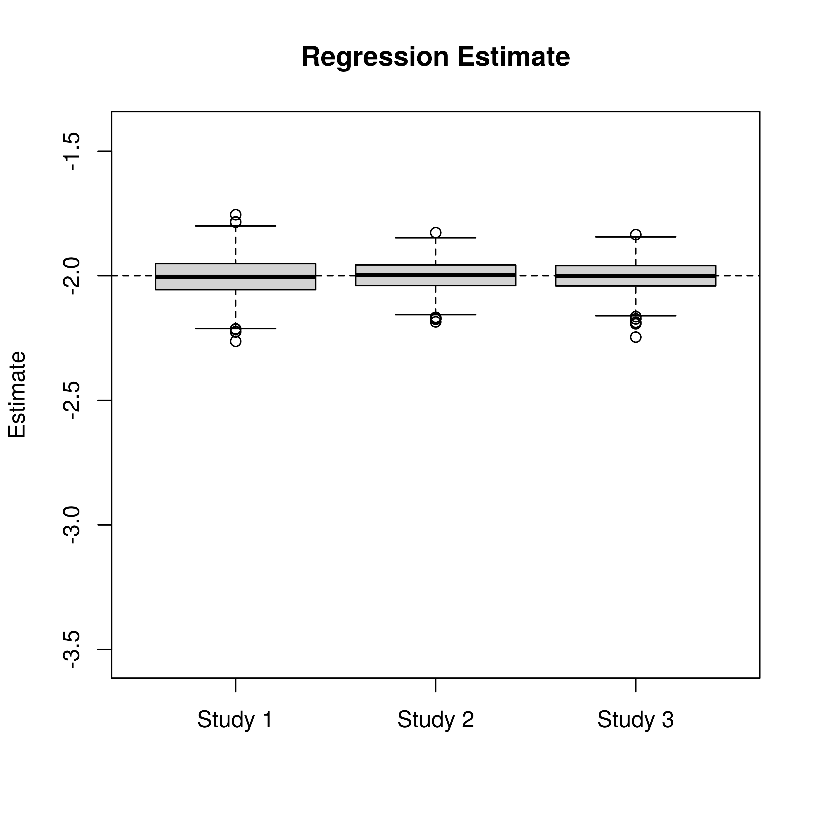
Regression coefficient estimates from continuous-scale analysis do not vary with inclusion criteria and are unbiased.
(From 1000 simulated data sets)
True value
Log(HR) Estimate
Log(HR) Estimate
(HR scaled to 1 unit = 10 years)

Slide 30
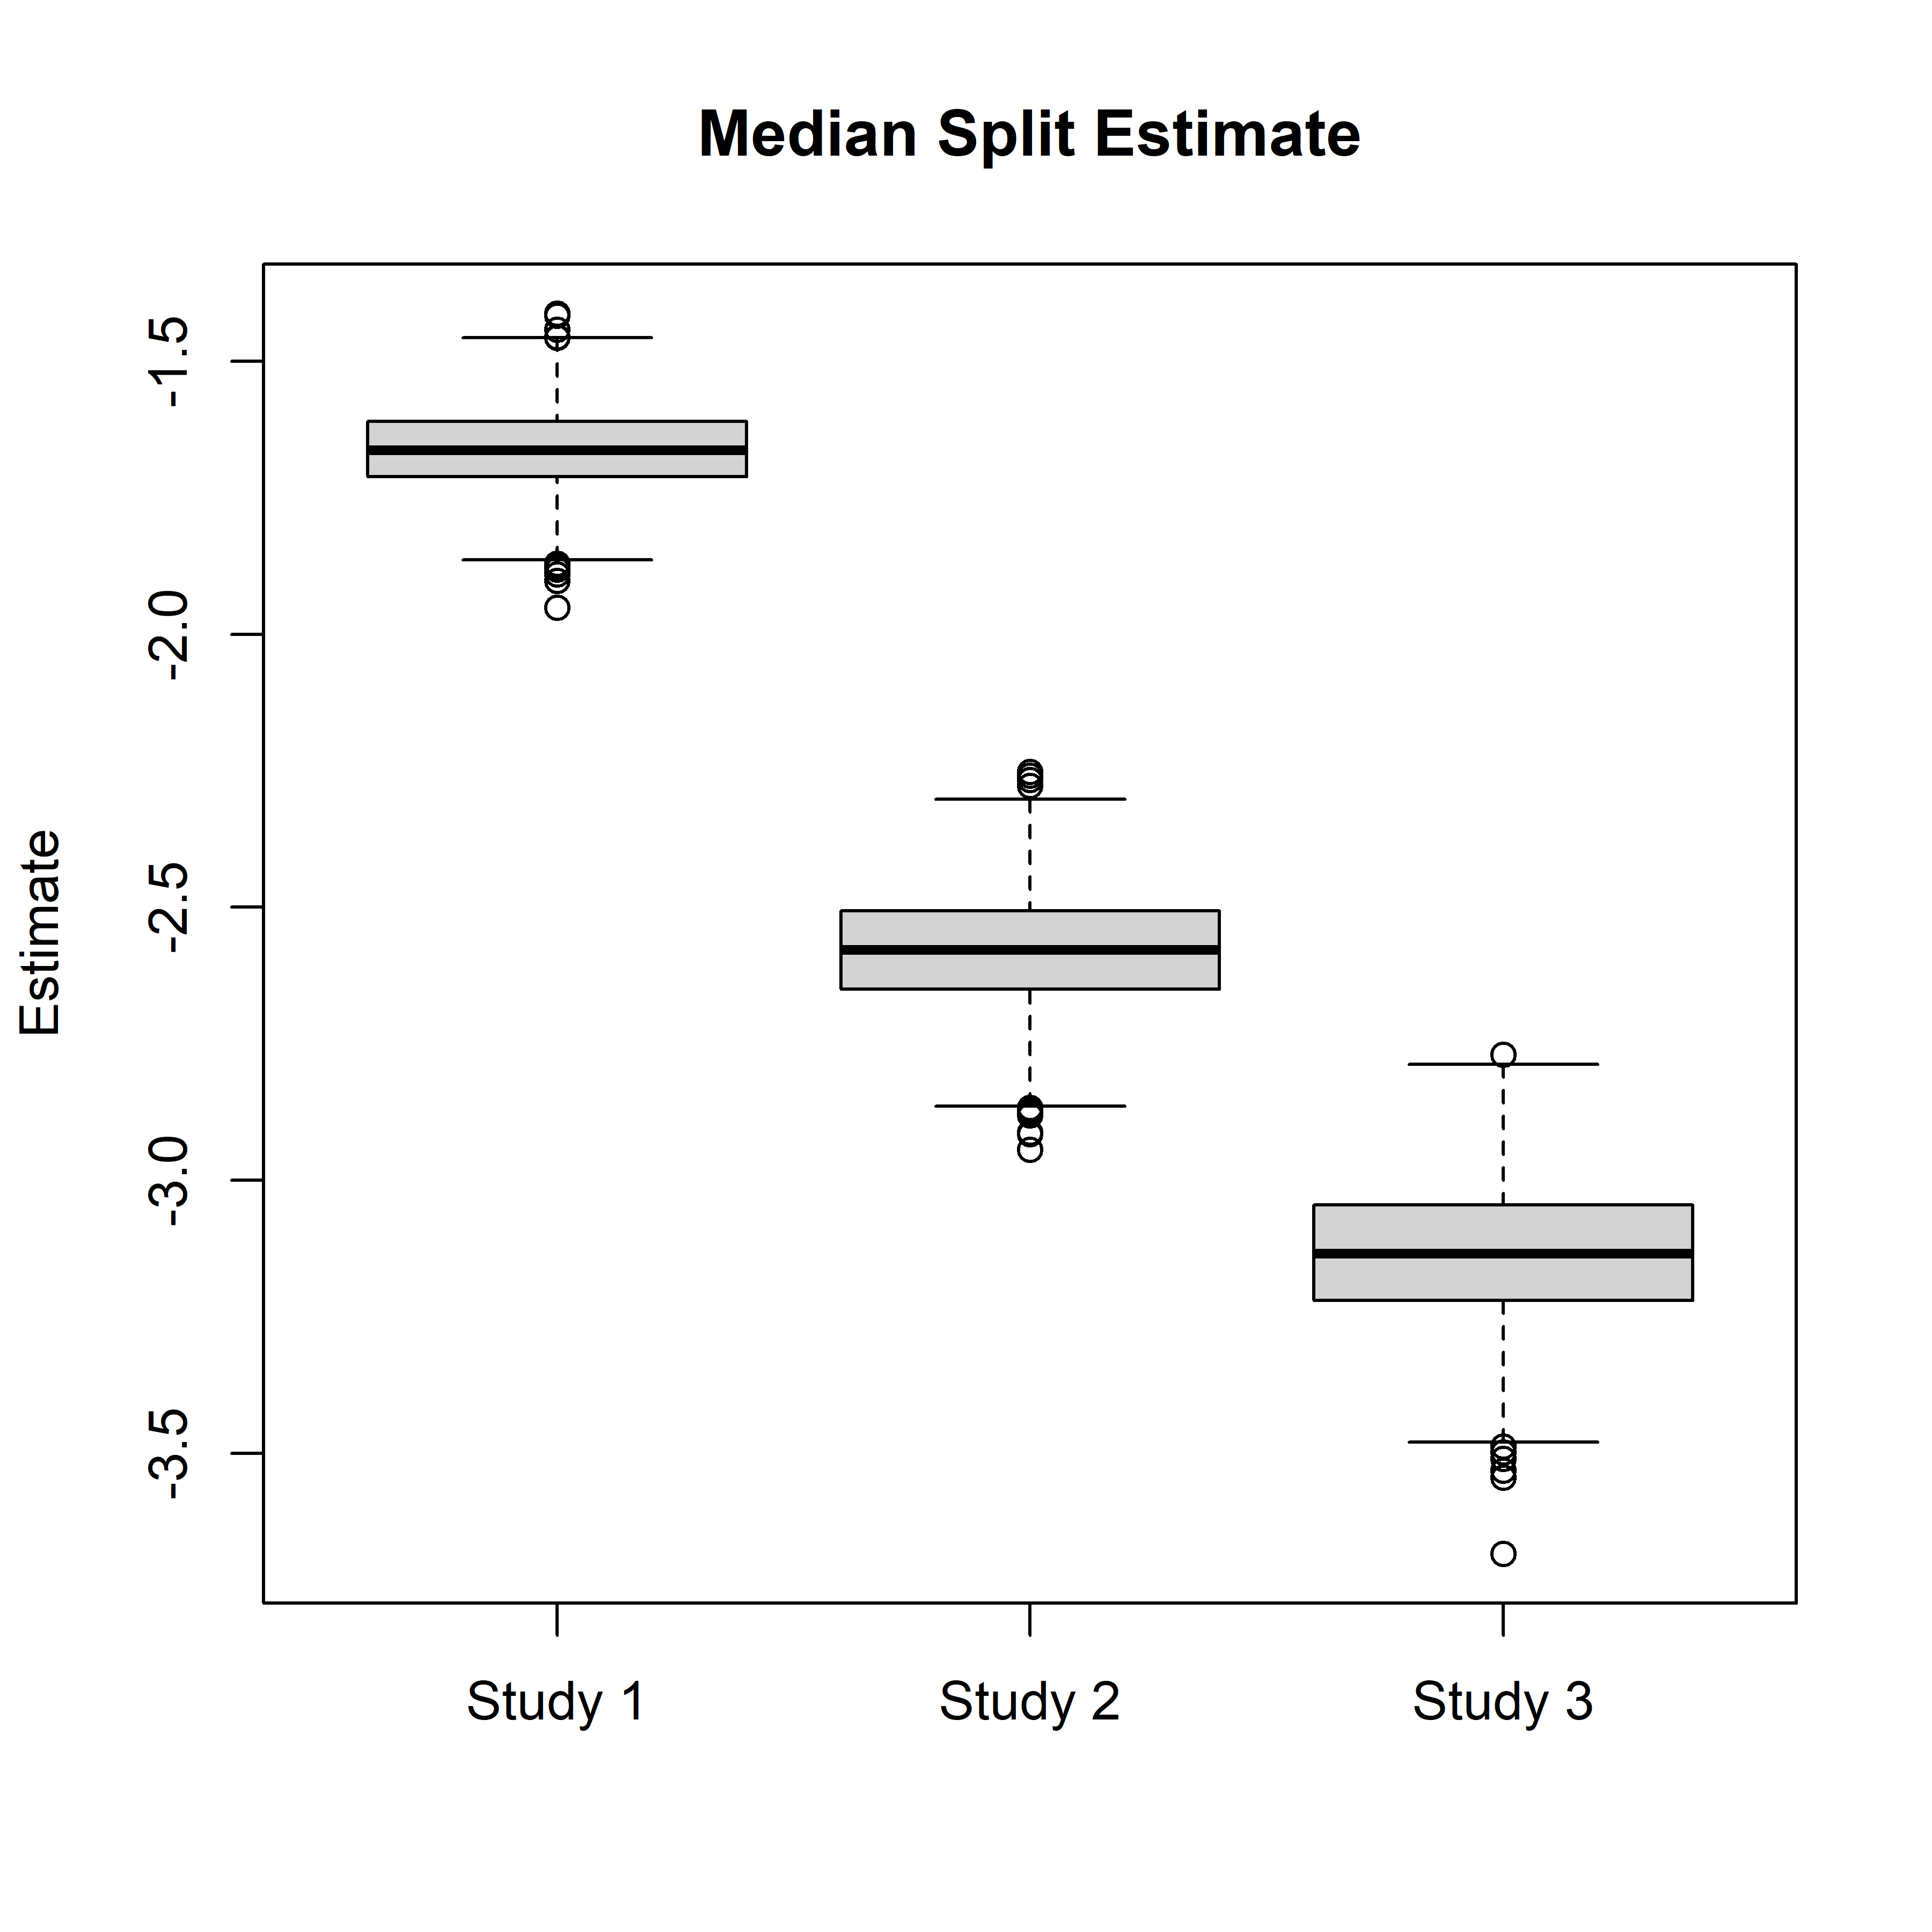
Dichotomizing picks the two comparison points for us
(this is bad, we can’t control the interpretation).
(Mean age)_{high} – (mean age)_{low}
Age 55 – Age 45 = 10 years
Scale | Median Split log(HR) (median of 1000 reps) | True log(HR)
10 years | -1.7 | -2.0
20 years | -2.6 | -4.0
30 years | -3.1 | -6.0
Log(HR) Estimate
Age 60 – Age 40 = 20 years
Age 65 – Age 35 = 30 years
So, the median split yields a HR estimate that can’t control its scale and is biased towards no effect.

Slide 31
Some problems with dichotomizing
Loss of power and precision: requires larger, slower, more expensive studies
May increase false positive rates; not necessarily conservative!
Destroys information about non-linear associations
Makes measures of association (e.g., HR, OR) depend on study design (e.g., inclusion criteria); may not generalize well

Slide 32
Large body of literature going back at least 66 years!
Cox, David R. "Note on grouping." Journal of the American Statistical Association 52.280 (1957): 543-547.
Maxwell SE, Delaney HD. Bivariate median-splits and spurious statistical significance. Psychological Bulletin 1993; 113:181–190.
Buettner, Petra, Claus Garbe, and Irene Guggenmoos-Holzmann. "Problems in defining cutoff points of continuous prognostic factors: Example of tumor thickness in primary cutaneous melanoma." Journal of clinical epidemiology 50.11 (1997): 1201-1210.
Altman, Douglas G. "Suboptimal analysis using ‘optimal’ cutpoints." British journal of cancer 78.4 (1998): 556.
MacCallum RC, Zhang S, Preacher KJ, Rucker DD. On the practice of dichotomization of quantitative variables. Psychological Methods (2002); 7:19 – 40.
Senn, Stephen. "Dichotomania: an obsessive compulsive disorder that is badly affecting the quality of analysis of pharmaceutical trials." Proceedings of the International Statistical Institute, 55th Session, Sydney (2005).
Altman, Douglas G., and Patrick Royston. "The cost of dichotomising continuous variables." Bmj 332.7549 (2006): 1080.
Royston, Patrick, Douglas G. Altman, and Willi Sauerbrei. "Dichotomizing continuous predictors in multiple regression: a bad idea." Statistics in medicine 25.1 (2006): 127-141.
Fedorov, Valerii, Frank Mannino, and Rongmei Zhang. "Consequences of dichotomization." Pharmaceutical Statistics: The Journal of Applied Statistics in the Pharmaceutical Industry 8.1 (2009): 50-61.
Giannoni, Alberto, et al. "Do optimal prognostic thresholds in continuous physiological variables really exist? Analysis of origin of apparent thresholds, with systematic review for peak oxygen consumption, ejection fraction and BNP." PLoS One 9.1 (2014): e81699.
Many, many more…..

Slide 33
Some non-statisticians recognize the problem too
  “It is easier to think in black and white than in shades of gray. Doctors - and I am as guilty of this as any other - too easily offer dichotomies… We do not do a good job of communicating the magnitude of harms and benefits, or how confident we are in them… the moment you try to move away from presenting simplified pictures… you have to start using numbers to express yourself. Statistics, even simple ones, do not come easily to most of us. Nevertheless, there is no excuse for doctors not doing their best to use them in as helpful a manner as possible.”
  Druin Burch, MD (Natural History 2009)

Slide 34
Why is dichotomania (the “bad idea” and “obsessive compulsive disorder”) still common?
That is: “Why have researchers continued to ignore methodologists’ advice not to dichotomize their measures?” Maxwell and Delaney (1993)
Our guess:
  Many researchers are unaware of the problems it likely causes
  Many researchers are unaware of available alternatives

Slide 35
Dichotomization
What is it?
Problems caused by it
Alternatives to it

Slide 36
Regulatory agencies are beginning to request continuous-scaled analyses of biomarkers: the Keytruda CPS example
Oct 2023 EPAR (European Public Assessment Report) for “Extension of indication [for Keytruda] to include in combination with chemotherapy the first-line treatment of locally advanced unresectable or metastatic HER2-negative gastric or gastrooesophageal junction adenocarcinoma in adults based on study KEYNOTE-859”
EMA requested, and sponsor reported, results of modeling association between PD-L1 CPS score on continuous scale and efficacy outcomes, OS and PFS (but several defects in this analysis)
Cartoon Figure
Log-hazard rate
Sqrt(CPS)
Notes:
(These particular analyses leave much room for improvement but at least go beyond over-simplified categorization…)
Some limitations of reported analysis:
What hypothesis test did they use? Wald? Score? LR?
Some models include CPS = 0; some do not. Makes comparisons difficult.
Scaled the HR estimates to represent a 1-unit change in CPS on the sqrt scale. That is hard to interpret.
They do not justify the sqrt transform
They assume a straight-line, let alone monotonic, relation between log-hazard and sqrt(CPS), but fail to mention this strong assumption. We know the results for TPS and CPS can be very sensitive to this assumption.
They assume continuity between CPS = 0 and CPS > 0 but fail to mention this. We know the results for TPS and CPS can be very sensitive to this assumption.
They modeled each arm separately. This makes it impossible to properly assess the critical question of whether the association between OS and CPS differs between the arms, or equivalently, whether the treatment effects varies with CPS.
The way they report just two separate analyses, one per arm, encourages an incorrect inference approach of comparing two p-values. Having one small p-value and one not very small p-value does NOT tell us much about the strength of evidence behind an assertion that the association between OS and CPS differs between the arms! Should we believe this or not? Sure would be nice to have some guidance…

Slide 37
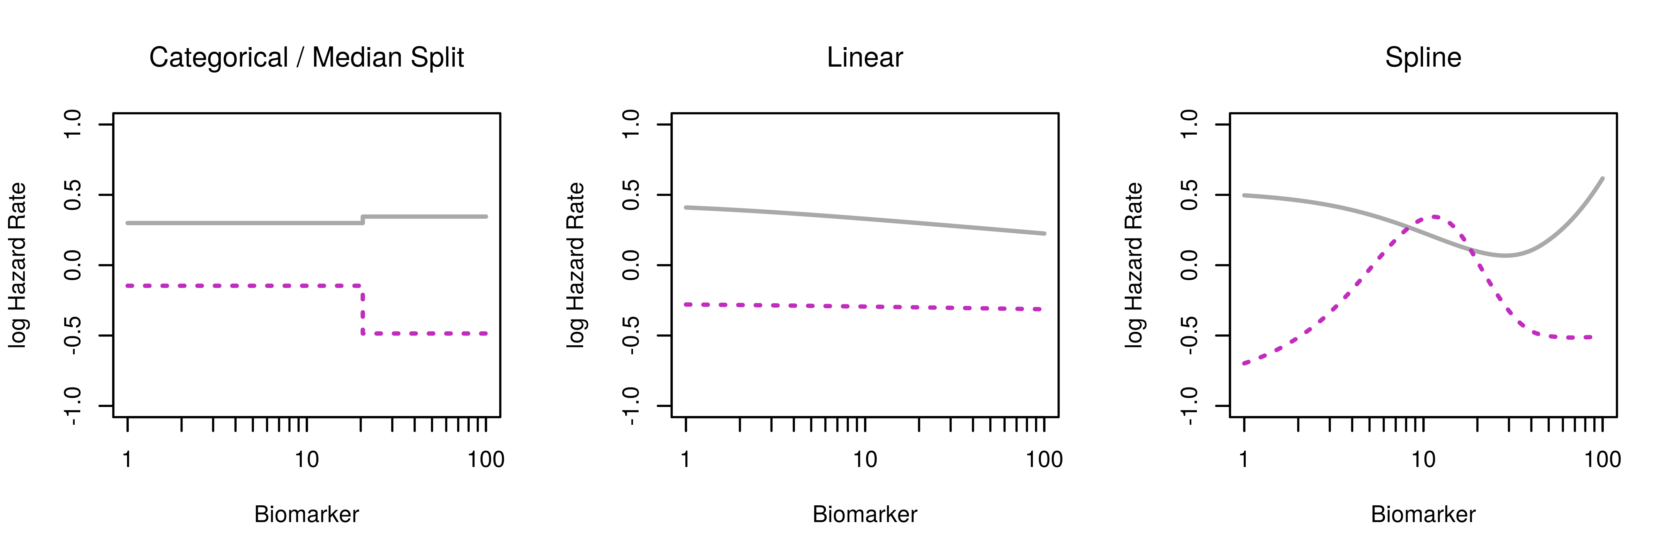
Model with biomarker on continuous scale is more powerful, less biased, more flexible, more informative
3 Cox PH models fit to a single dataset (log-biomarker, treatment arm, and survival)
“Categorical” model split the biomarker at the median; all others used biomarker on its log-transformed continuous scale

Slide 38
Model with biomarker on continuous scale is more powerful, less biased, more flexible, more informative
3 Cox PH models fit to a single dataset (log-biomarker, treatment arm, and survival)
“Categorical” model split the biomarker at the median; all others used biomarker on its log-transformed continuous scale

Slide 39
Model with biomarker on continuous scale is more powerful, less biased, more flexible, more informative
3 Cox PH models fit to a single dataset (log-biomarker, treatment arm, and survival)
“Categorical” model split the biomarker at the median; all others used biomarker on its log-transformed continuous scale

Slide 40
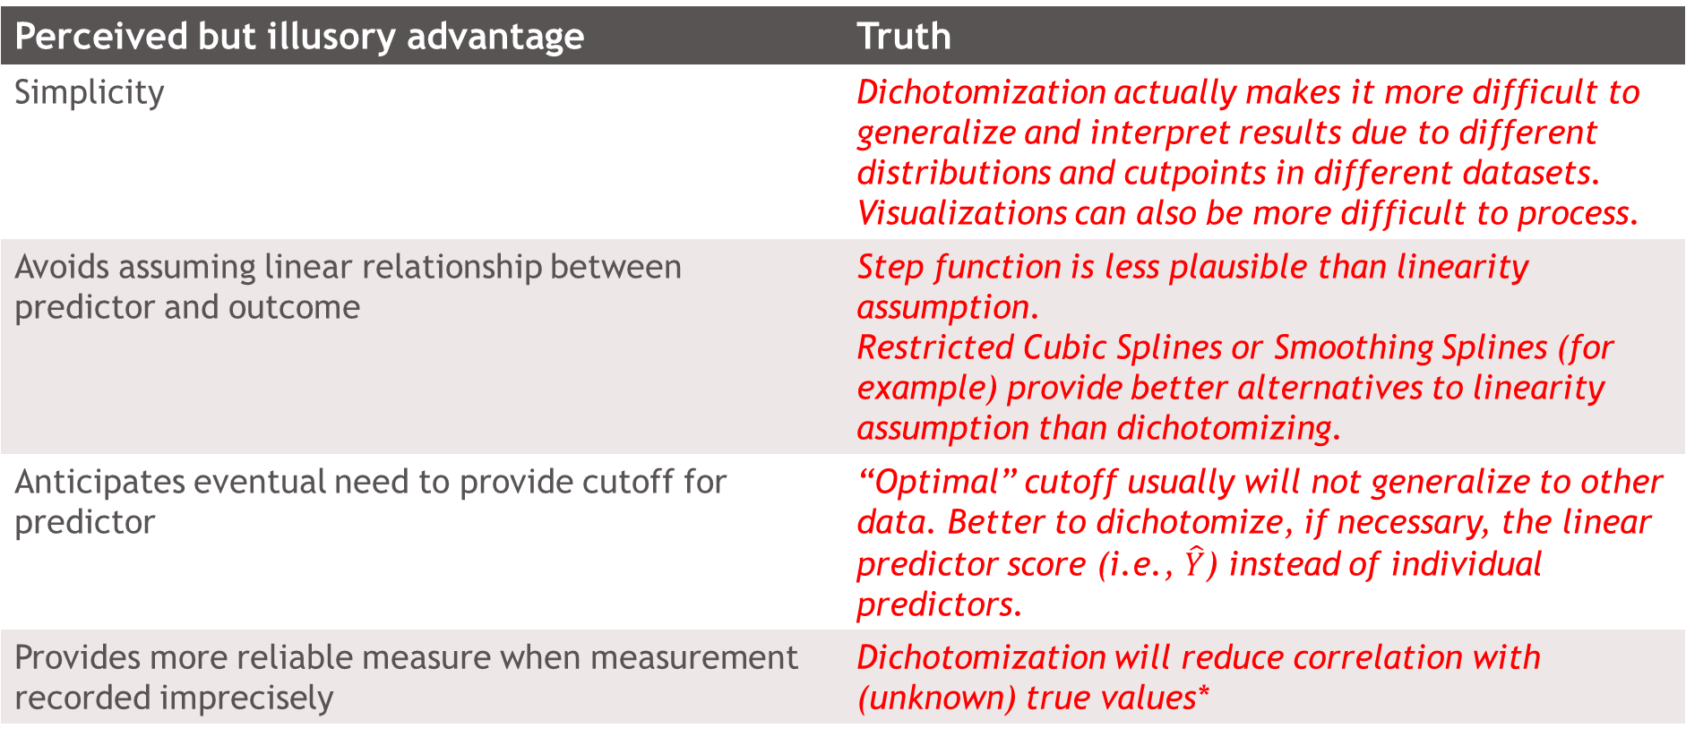
Perceived advantages of dichotomizing
Perceived but illusory advantage | Truth
Simplicity | Dichotomization actually makes it more difficult to generalize and interpret results due to different distributions and cutpoints in different datasets. Visualizations can also be more difficult to process.
Avoids assuming linear relationship between predictor and outcome | Step function is less plausible than linearity assumption. Restricted Cubic Splines or Smoothing Splines (for example) provide better alternatives to linearity assumption than dichotomizing.
Anticipates eventual need to provide cutoff for predictor | “Optimal” cutoff usually will not generalize to other data. Better to dichotomize, if necessary, the linear predictor score (i.e., $\hat{Y}$) instead of individual predictors.
Provides more reliable measure when measurement recorded imprecisely | Dichotomization will reduce correlation with (unknown) true values*
* MacCallum RC, Zhang S, Preacher KJ, Rucker DD. On the practice of dichotomization of quantitative variables. Psychological Methods 2002; 7:19 – 40.

Slide 41
Analyze continuous variables as continuous variables
Avoid major problems in analysis and interpretation caused by dichotomization. With continuous-scaled analyses:
  Better power and precision; can run smaller, faster, more cost-effective experiments
  Avoid inflated false positive rates, increase chances of correct conclusions
  Retain information about and estimate non-linear associations
  Estimate measures of association that generalize better to other studies
Methods for continuous-scaled analyses are readily available

Slide 42
BACKUPS

Slide 43
Impact of dichotomizing more than one explanatory variable
Royston, Patrick, Douglas G. Altman, and Willi Sauerbrei (2006):
“…The effect of dichotomization of two X variables will depend on the correlation coefficients between them and the response (Y) and cannot easily be predicted.”
Can lead to a spurious relation between an X variable and Y [1, 6]. It is especially likely to occur when the partial correlation between one X variable and Y is close to zero.
Can lead to spuriously significant interactions between X variables [1].
“…regression models with two or more dichotomized continuous explanatory variables could be seriously misleading, both in respect of which variables are significant in the model, and perhaps also with respect to the overall predictive ability. If some of the cutpoints were selected using a data-dependent method, problems would worsen.”
(1) Maxwell SE, Delaney HD. Bivariate median-splits and spurious statistical significance. Psychological Bulletin 1993; 113:181–190.
(6) MacCallum RC, Zhang S, Preacher KJ, Rucker DD. On the practice of dichotomization of quantitative variables. Psychological Methods 2002; 7:19–40.

Slide 44
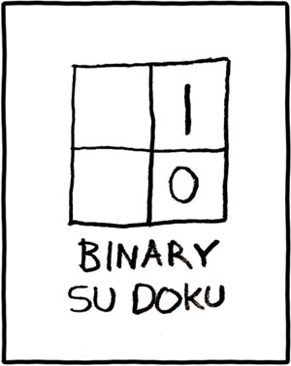
Dichotomizing does Simplify Life
http://xkcd.com/74/
Notes:
Now, I admit, dichotomizing does simplify life.

Slide 45
But Simplicity is Over-rated
The pure and simple truth is rarely pure and never simple.
Oscar Wilde
All truth is simple... is that not doubly a lie?
Friedrich Nietzsche
For every complex problem there is an answer that is clear, simple, and wrong.
H. L. Mencken
Make everything as simple as possible, but not simpler.
Albert Einstein?
Seek simplicity, and distrust it.
Alfred North Whitehead

Slide 46
Maxwell and Delaney asked, “Why have researchers continued to ignore methodologists’ advice not to dichotomize their measures?”
30 years ago, in 1993!
13 years later, Royston, Patrick, Douglas G. Altman, and Willi Sauerbrei (2006)
  “It is well recognized in the methodological literature that dichotomization of continuous variables introduces major problems in the analysis and interpretation of models… Nevertheless, dichotomization of continuous variables is widespread in clinical research. Problems include loss of information, reduction in power, uncertainty in defining the cutpoint, arriving at a biologically implausible step function as the estimate of a dose–response function, and the impossibility of detecting a non-monotonic dose–response relation.
  “Uncertainty in how to select a ‘sensible’ cutpoint to group a continuous variable into two classes has led researchers to use either the median or an ‘optimal’ cutpoint. The latter approach gives a highly inflated type 1 error probability, together with biased parameter estimates and variances that are too small... In general, the situation seems hardly to have improved since the advice in 1993 of Maxwell and Delaney to avoid dichotomization...

