Slide 1


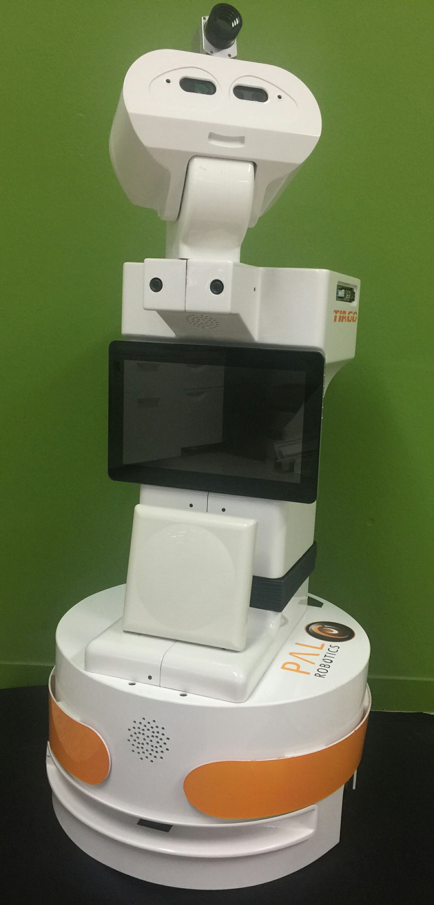

Servers on Amazon
numb.viagenie.ca
Backend
Frontend
STUN/TURN
STUN/TURN
r-c.4
r-c.4
r-c.4
r-c.2
r-c.3
r-c.2
r-c.3
c.1
c.2
r.1
c.3
Robots
Clients
r-c.1

Slide 2
r-c.1
numb.viagenie.ca
Robots
STUN/TURN
r-c.4
Clients
r-c.3
r-c.3
r-c.4
Servers on Amazon
r-c.4
r-c.2
STUN/TURN
c.3
r-c.2
c.2
r.1
Backend
Frontend
c.1

Slide 3
Newspapers Sites
Robots
rss2json.com API
2
1
3
4
2
3

Slide 4


Alice
Bob
Call Message
Accept Message
RTC Offer
RTC Answer
RTC ICE Candidates
Connection established
Video/Audio data changed
Stop Message
Connection closed

Slide 5
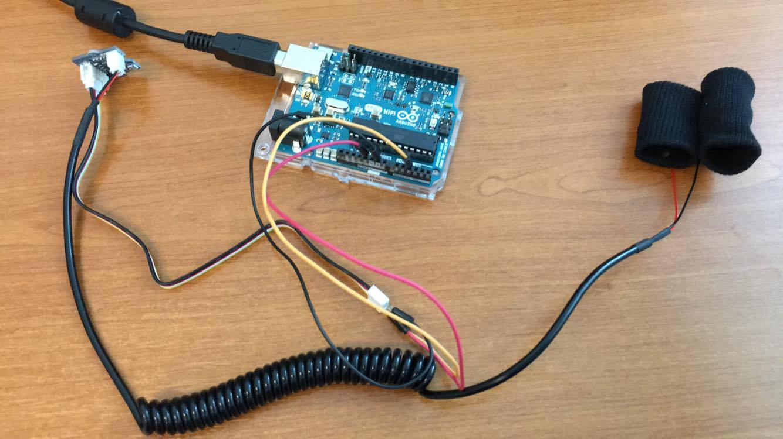
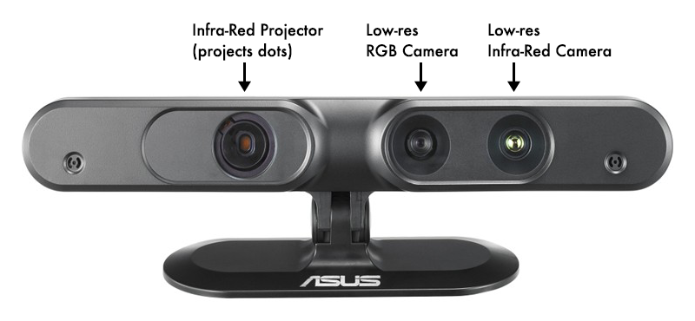
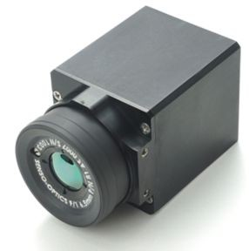
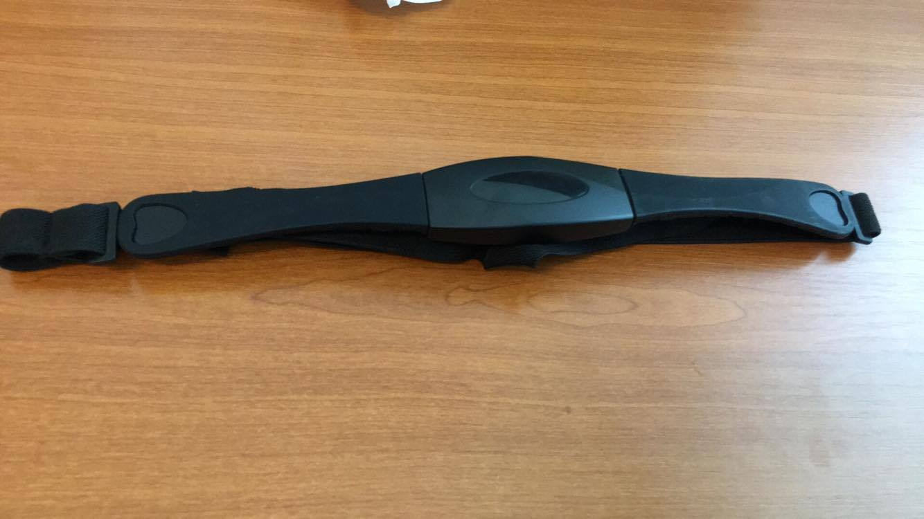
Galvanic Skin Response Sensor
RGB camera
Tiago
Participant
Variable distance (0-200cm)
Heart rate sensor
Thermal camera

