Slide 1
HPC Software Verification in Action: A Case Study with Tensor Transposition
Erdal Mutlu, Ajay Panyala, Sriram Krishnamoorthy
Post Doctoral Research Associate
erdal.mutlu@pnnl.gov
Notes:
About the Image: PNNL Aerial Photo
Aerial photo of the Pacific Northwest National Laboratory campus from the west.
https://www.flickr.com/photos/pnnl/42712951642/in/album-72157670058514908/

Slide 2
Correctness in HPC
Verification challenges in HPC
hard to specify scientific applications
different sources of non-determinism
concurrency
approximation
randomness
floating point arithmetic
Where to start?
functional equivalence checking
optimized implementation vs simple trusted implementation
model checking techniques
symbolic execution

Slide 3
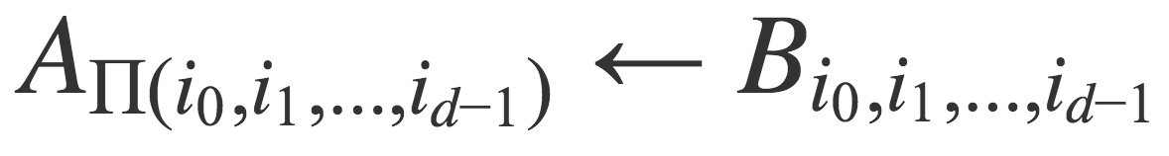
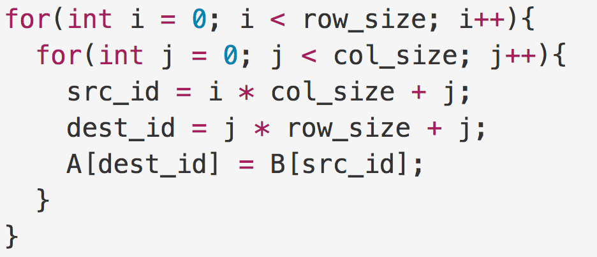
Tensor Algebra
Tensor Operations
majority of machine learning (ML) application
scientific applications: quantum chemistry
Tensor Transposition
E.g. 2-D Matrix transposition : A(j, i) = B(i, j)

Slide 4
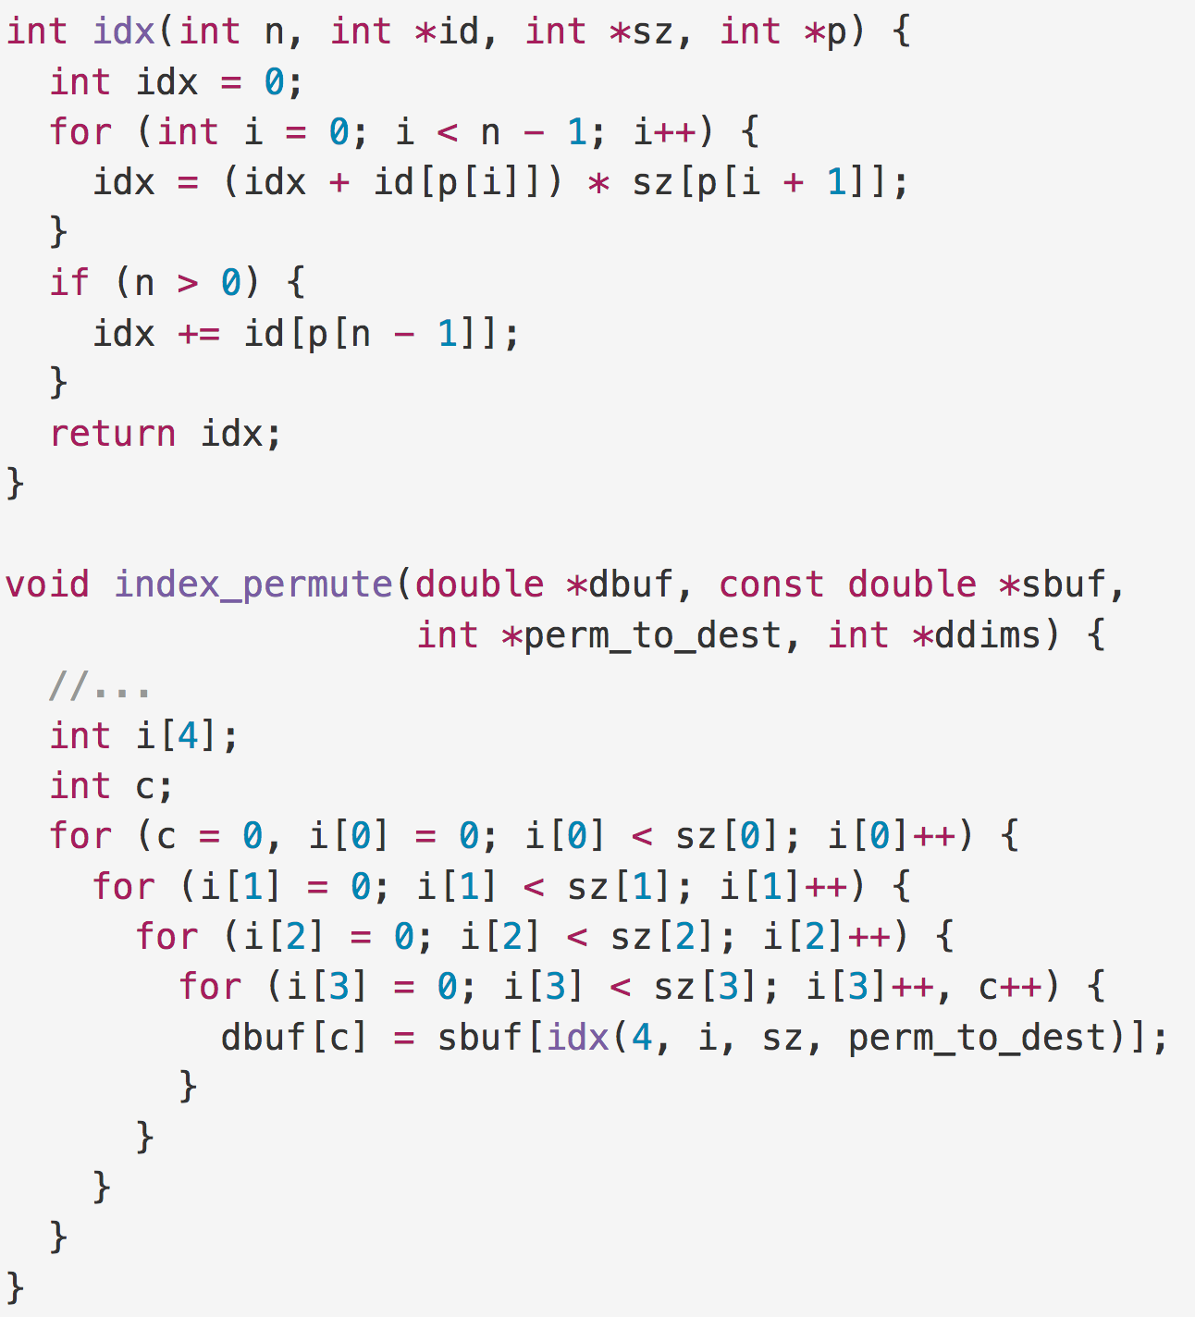
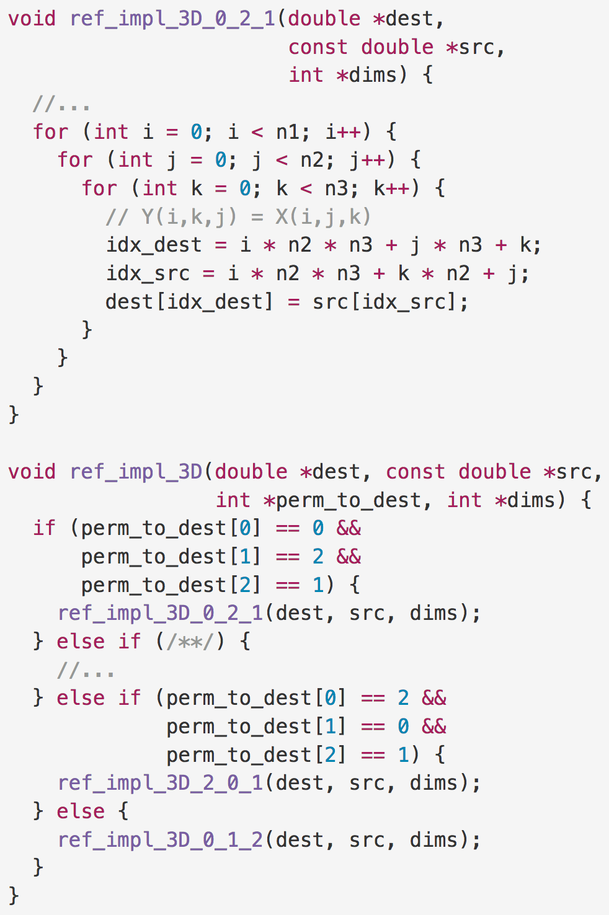
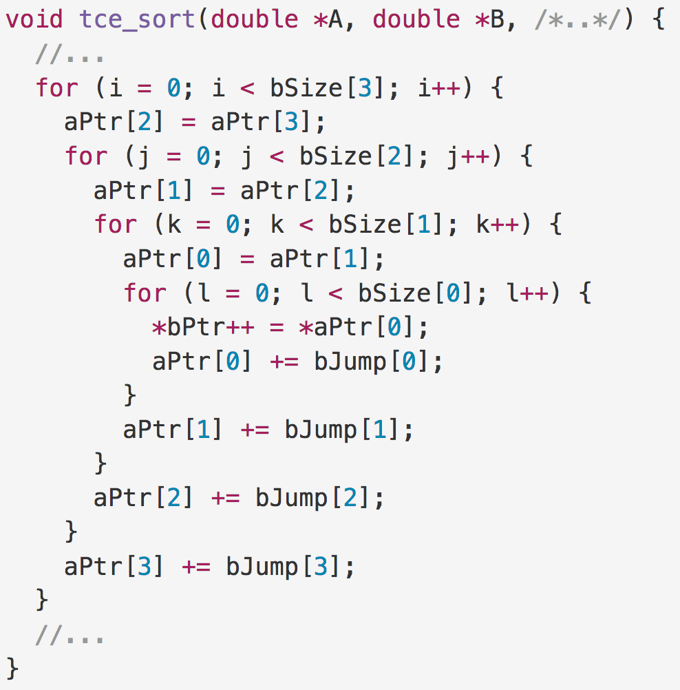
Tensor Transpose Implementations
NWChem implementation
specialized implementations for 2-D and 4-D tensors
optimized for production use
uses heavy pointer arithmetic
TAMM implementation
generalized C++ implementation
supports reduction
Reference implementation
specialized for each permutation

Slide 5
Equivalence Checking Tools
CIVL: the concurrency intermediate verification language
symbolic execution-based model checking
supports many HPC-relevant parallel programming models
OpenMP, pthreads, CUDA
checks different properties
race freedom, deadlock freedom, assertion violation
CodeThorn
trace-based equality checking technique
re-write updates into a normalized form
compare resulting traces

Slide 6
Research Questions
Can current equivalence checking tools be used in production code?
How scalable are these tools’ performance?
Where these tools fall short?

Slide 7
Experimental Setup
Compared 2, 3 and 4 dimensional tensor transpose implementations
NWChem
TAMM
Reference
CIVL setup
Bounded input size
$assume(1 <= N <= BOUND) ;
Fixed input size
$input N = X;
CodeThorn setup
Fixed input size

Slide 8
Research Questions
Can current equivalence checking tools be used in production code?
Worked for us (with some code modification) ☺
Valuable input during development
How scalable are these tools?
Where these tools fall short?

Slide 9
Research Questions
Can current equivalence checking tools be used in production code?
Worked for us (with some code modification) ☺
Valuable input during development
How scalable are these tools?
Works relatively well in small size inputs
Using different modes helps
Where these tools fall short?

Slide 10
Results – CIVL
Functional equality checking for NWChem against reference implementation
3D - NWChem vs Ref
4D - NWChem vs Ref
Volume = # of Permutations * Loop Volume

Slide 11
Results – CodeThorn
Functional equality checking with CodeThorn

Slide 12
Research Questions
Can current equivalence checking tools be used in production code?
Worked for us (with some code modification) ☺
Valuable input during development
How scalable are these tools?
Works relatively well in small size inputs
Using different modes helps
Where these tools fall short?
Supporting programming languages (C++)
Problems with pointer arithmetic

Slide 13
Conclusion
Emerging heterogeneous architectures in HPC:
complex optimized versions of the same algorithm
hard to write specify/verify
floating point arithmetic
Functional equivalence checking
both, CIVL and CodeThorn, can be used in production codes
symbolic evaluation based
works relatively well for small input size
some caveats:
subset of C programming language is supported
false positives (case with pointer arithmetic)

Slide 15
False Positive – CIVL

Slide 16
Results – CIVL
Other metrics reported by CIVL
# of States – Execution Time
Volume – # of SMT Solver Calls

