Slide 1
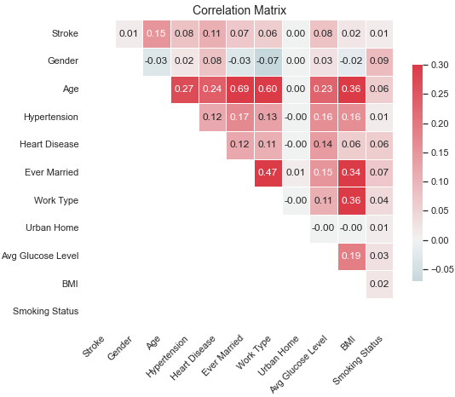
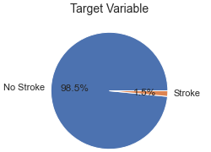
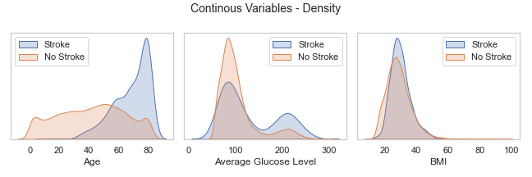
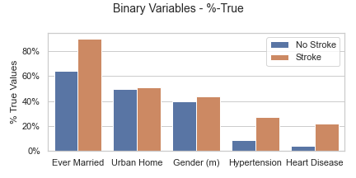
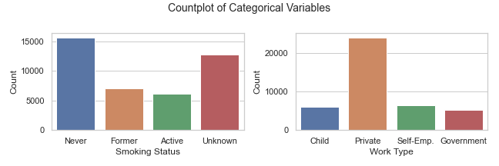
Comparing Decision Tree and K-Nearest Neighbor for Cerebral Stroke Prediction by Stefan Diener
1) Description and Motivation of the Problem
In 2020, England recorded cerebrovascular diseases are the third leading cause of death [1]. A cerebral stroke is a subtype of these diseases in which the blood supply to part of the brain is interrupted, depriving brain tissue of oxygen and nutrients and causing the death of brain cells within minutes. Therefore, predicting whether a person will have a cerebral stroke can be of great importance to public health, as it can help ensure adequate preparation and quick action in an emergency. The goal of this project is to train and compare the ability of a Decision Tree and a K-Nearest Neighbor classifier to predict whether a person will suffer a stroke.
2) Initial analysis of the data set including basic statistics
The medical data set on cerebral strokes is supplement to Lui, Fan and Wu (2019) was published on data.mendeley.com.
It contains 43’000 observations of potential patients, one target variable and 11 features on the patients’ physiology.
The data is characterized by imbalance in the target variable, and missing values primarily in the ‘Smoking Status’ feature.
Missing Values: BMI: 3.3%, Smoking Status 30.6%
738 cases of stroke.
In addition to the binary stroke variable, it contains five binary, three continuous, two categorical features
Variable | Min | Mean | Max | SD
Stroke | 0 | 0.02 | 1 | 0.12
Gender | 0 | 0.40 | 1 | 0.49
Hypertension | 0 | 0.09 | 1 | 0.28
Heart Disease | 0 | 0.04 | 1 | 0.20
Ever Married | 0 | 0.64 | 1 | 0.48
Urban Home | 0 | 0.50 | 1 | 0.50
Age | 0 | 41 | 82 | 22.48
Avg Glucose | 55.00 | 103.67 | 291.05 | 42.28
BMI | 10.10 | 28.62 | 97.60 | 7.77

