Slide 1
E₁
E₂
E₃
h₁
h₂
h₃
* W_{xh}
* W_{xh}
* W_{xh}
X₁
X₂
X₃

Slide 2
통계적 방법
<수식 1> AR 모델
<수식 2> MA 모델

Slide 4
h_{t-1}
h_{t}
h_{t+1}
Memory cell lline
c_{t-2}
LSTM
_{cell}
LSTM
_{cell}
LSTM
_{cell}
c_{t+1}
h_{t-2}
h_{t+1}
X_{t-1}
X_{t}
X_{t+1}

Slide 5



Forget Gate
Update Gate
Output Gate
C_{t-1}
*
+
C_{t}
$\tilde{C}$_{t}
G_{f}
*
$$\tan{h}$$
$$\tan{h}$$
*
G_{u}
G_{o}
σ
σ
σ
b_{f}
+
b_{i}
+
b_{i}
+
b_{i}
+
W_{f}
W_{i}
W_{i}
W_{i}
h_{t}
h_{t-1}
X_{t}

Slide 6
Encoder
LSTM
LSTM
LSTM
LSTM
I
study
math
hard
Context
Decoder
나는
수학을
열심히
공부한다
<eos>
LSTM
LSTM
LSTM
LSTM
LSTM
<sos>
나는
수학을
열심히
공부한다

Slide 7
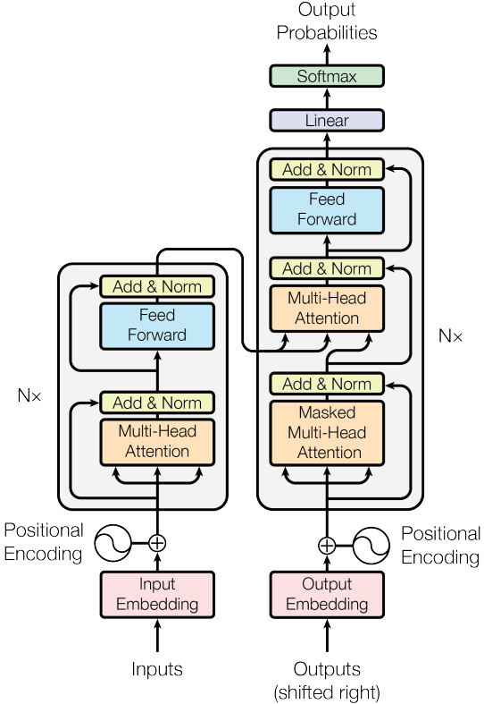

Slide 8
