Slide 1
Remove Boxes
LC# 546: Given several boxes with different colors represented by different positive numbers. You may experience several rounds to remove boxes until there is no box left. Each time you can choose some continuous boxes with the same color (composed of k boxes, k >= 1), remove them and get k*k points. Find the maximum points you can get.
Test cases:
Boxes contains only 2 different colors, then remove all the less-frequent color boxes until all that is left is the more frequent color box. Then remove all of the remaining boxes in one move.
[1,2,1,2,2,1,2,1,1] # total = 0 there are four 2 and five 1, so remove all 2 first
[1,1,1,1,1] # total = 6
[] # total = 31
-----------------------------------------------
It is always beneficial to remove all boxes with a count of 1 first. If there is only one box of a certain color, all it is doing is blocking more common colors from forming larger groups.
[1,2,3,4,3,1,2,5] # points = 0
[1,2,3,3,1,2] # points = 2
---------------------------------------------

Slide 2
Subproblem case 1:
Input = [1,3,2,2,2,3,4,3,1]
Steps:
Remove 1 -> points += 1*1 input = [3,2,2,2,3,4,3,1]
Remove 3 -> points += 1*1 input = [2,2,2,3,4,3,1]
Remove 2 -> points += 3*3 input = [3,4,3,1]
Remove 3 -> points += 1*1 input = [4, 3, 1]
Remove 4 -> points += 1*1 input = [3,1]
Remove 3 -> points += 1*1 input = [1]
Remove 1 -> points += 1*1 input = NULL
Total points = 13

Slide 3
Subproblem case 2:
Input = [1,3,2,2,2,3,4,3,1]
Steps:
Remove 2 -> points += 3*3 input = [1,3,3,4,3,1]
Remove 4 -> points += 1*1 input = [1,3,3,3,1]
Remove 3 -> points += 3*3 input = [1,1]
Remove 1 -> points += 2*2 input = NULL
Total points = 23

Slide 4
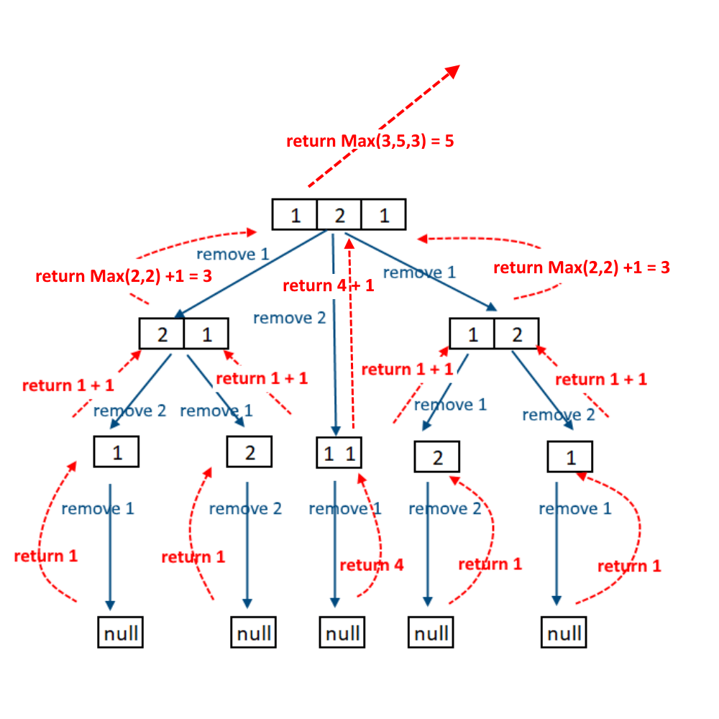
Recursion tree

Slide 5
Top-Down
Boxes = [1,1,2,3,1,1,5,6]
Case 1: Count (k) all the same colored boxes which are already grouped together
Here the starting box is of color 1
The count for color 1 is 2 (k = 2)
Remove initial boxes of color 1, hence remaining Boxes = [2,3,1,1,5,6]
Ans1 = (2*2) + dfs(remaining Boxes)
Case 2: Bring same colored boxes together
Find other boxes of same color as the start index, here the starting box color is 1
Now split in two groups:
Boxes before the starting box of color 1 form group 1 - [2,3]
Boxes which start with the starting box of color 1 form group 2 - [1,1,5,6]
Ans2 = dfs(group1, 0) + dfs(group2, k)
Ans = max(Ans1, Ans2)

Slide 6
Bottom up:
Boxes = [1,2,1]
Dp[3][3][3] =
{
{1, , }, {2, , }, {5, , },
{ , , }, {1, 4, }, {2, 5, },
{ , , }, { , , }, {1, 4, 9},
}
Case1: Dp[i][j][k] = (k*k) + Dp[i+1][j][0];
Case2: Dp[i][j][k]= max(Dp[i][j][k], Dp[i+1][m-1][0] + Dp[m][j][k+1]); where m is the index whose color is same as that of the starting box color and is not grouped with the starting color boxes

Slide 7
Strange printer:
LC#664: There is a strange printer with the following two special requirements:
The printer can only print a sequence of the same character each time.
At each turn, the printer can print new characters starting from and ending at any places, and will cover the original existing characters.
Given a string consists of lower English letters only, your job is to count the minimum number of turns the printer needed in order to print it.
Test cases:
Input: "aabbcc"; Output: 3 (operation 1: print "aa", operation 2: print "bb", operation 3: print "cc")
Input: "aabbccaa"; Output: 3 (Operation 1: print "aaaaaaaa", operation 2: replace "aa" with "bb" in index 2 and 3, operation 3: replace "aa" with "cc" in index 4 and 5)

Slide 8
Subproblem
S = "ABA"
Case 1:
Print "A" - remaining "BA" - 1 turn
Print "B" - remaining "A" - 1 turn
Print "A" - remaining NULL - 1 turn
Total = 3 turns
Dfs("ABA") = 1 + Dfs("BA");
Case 2:
Print "AAA" - remaining NULL - 1 turn
Print "B" - remaining "AAA"("AA") - 1 turn
Total = 2 turns
Dfs(ABA) = Dfs("AAA") + Dfs("B")

Slide 9
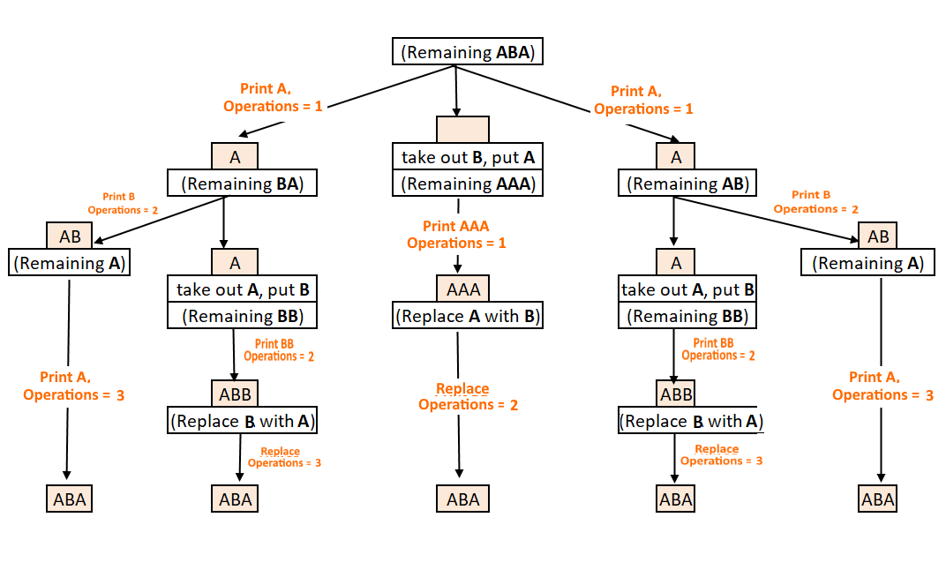
Recursion tree

Slide 10
Top-Down
S = "AABFACD"
Case 1: Count (k) all the same letters which are already grouped together at the start
Remove the initial grouped letters, hence remaining S = "BFACD"
Ans1 = 1 + dfs(remaining string)
Case 2: Bring same letters together, which are apart from each other
Now split in two groups:
Letters before the starting letter, here is "A" form group 1 - "BF"
Letters which start with the starting letter, which is "A" here to form group 2 - "ACD"
Ans2 = dfs(group1) + dfs(group2)
Ans = min(Ans1, Ans2)

Slide 11
Bottom up
S = "abcad"
Dp[i][j] =
{ {1, 2, 3, 3, 4},
{0, 1, 2, 3, 4}, {0, 0, 1, 2, 3},
{0, 0, 0, 1, 2},
{0, 0, 0, 0, 1}
}
Case 1: Dp[i][j] = 1 + Dp[i+1][j]; Case 2: Dp[i][j] = min(res, Dp[i+1][m-1] + Dp[m][j]); where m is the index of the letter needs to be adjacent to the starting letter of the string.

Slide 12
Burst Balloons
LC#312: Given n balloons, indexed from 0 to n-1. Each balloon is painted with a number on it represented by array nums. You are asked to burst all the balloons. If the you burst balloon i you will get nums[left]*nums[i]*nums[right] coins. Here left and right are adjacent indices of i. After the burst, the left and right then becomes adjacent.
Find the maximum coins you can collect by bursting the balloons wisely.
Test Case:
Input: [3,1,5,8] Output: 167 Explanation: nums = [3,1,5,8]-->[3,5,8]-->[3,8]-->[8]-->[] coins = 3*1*5 + 3*5*8 + 1*3*8 + 1*8*1 = 167

Slide 13
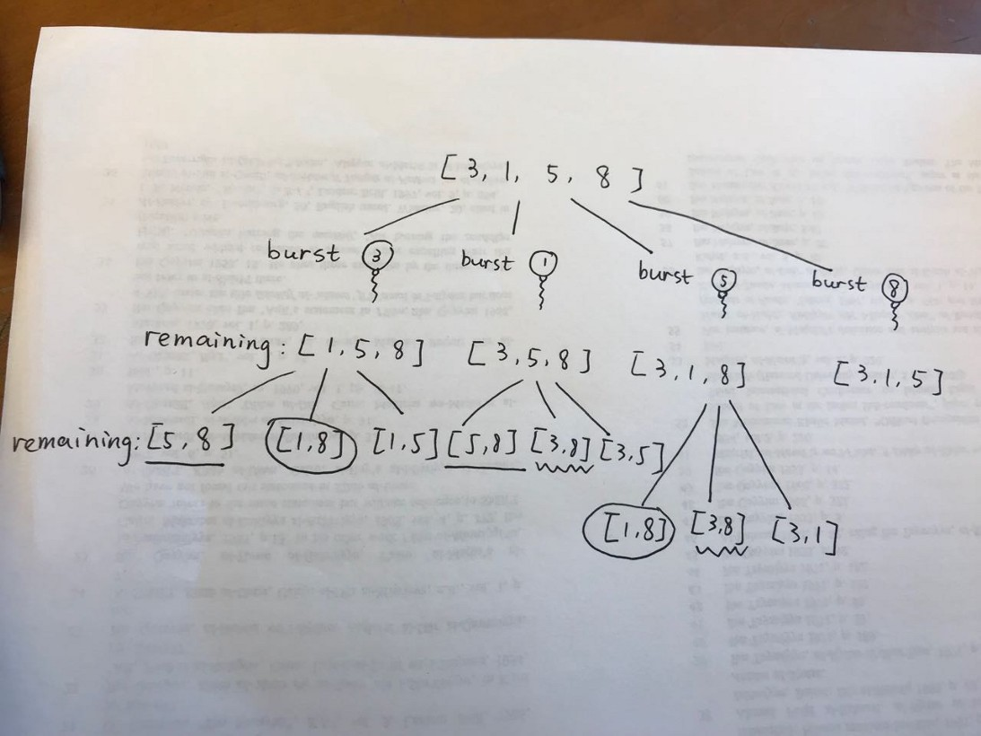
Recursion tree

Slide 14
Top down
input = [3,1,5,8]
add 1 to both ends
input = [1,3,1,5,8,1]
{//memo
{-1, -1, 3, 30, 159, 167},
{-1, -1, -1, 15, 135, 159},
{-1, -1, -1, -1, 40, 48},
{-1, -1, -1, -1, -1, 40},
{-1, -1, -1, -1, -1, -1},
{-1, -1, -1, -1, -1, -1}
}
[3,1,5,8] --> [3,5,8] --> [3,8] --> [8] --> []
coins =
3*1*5 + 3*5*8 + 1*3*8 + 1*8*1 = 167

Slide 15
Bottom up
input = [3,1,5,8]
add 1 to both ends
input = [1,3,1,5,8,1]
Dp[i][j] =
{
{0, 0, 3, 30, 159, 167},
{0, 0, 0, 15, 135, 159},
{0, 0, 0, 0, 40, 48},
{0, 0, 0, 0, 0, 40},
{0, 0, 0, 0, 0, 0},
{0, 0, 0, 0, 0, 0}
}

Slide 16
Bottom up...
len = 2
1) i = 0 j = 2 m = 1 -> 1*3*1 + dp[0][1] + dp[1][2] = 3
2) i = 1 j = 3 m = 2 -> 3*1*5 + dp[1][2] + dp[2][3] = 15
3) i = 2 j = 4 m = 3 -> 1*5*8 + dp[2][3] + dp[3][4] = 40
4) i = 3 j = 5 m = 4 -> 5*8*1 + dp[3][4] + dp[4][5] = 40
len = 3
1) i = 0 j = 3
m = 1 -> 1*3*5 + dp[0][1] + dp[1][3] = 15 + 0 + 15 = 30
m = 2 -> 1*1*5 + dp[0][2] + dp[2][3] = 5 + 3 + 0 = 5
2) i = 1 j = 4
m = 2 -> 3*1*8 + dp[1][2] + dp[2][4] = 24 + 0 + 40 = 64
m = 3 -> 3*5*8 + dp[1][3] + dp[3][4] = 120 + 15 + 0 = 135
3) i = 2 j = 5
m = 3 -> 1*5*1 + dp[2][3] + dp[3][5] = 5 + 0 + 40 = 45
m = 4 -> 1*8*1 + dp[2][4] + dp[4][5] = 8 + 40 + 0 = 48
len = 4
1) i = 0 j = 4
m = 1 -> 1*3*8 + dp[0][1] + dp[1][4] = 24 + 0 + 135 = 159
m = 2 -> 1*1*8 + dp[0][2] + dp[2][4] = 8 + 3 + 40 = 51
m = 3 -> 1*5*8 + dp[0][3] + dp[3][4] = 40 + 30 + 0 = 70
2) i = 1 j = 5
m = 2 -> 3*1*1 + dp[1][2] + dp[2][5] = 3 + 0 + 48 = 51
m = 3 -> 3*5*1 + dp[1][3] + dp[3][5] = 15 + 15 + 40 = 70
m = 4 -> 3*8*1 + dp[1][4] + dp[4][5] = 24 + 135 + 0 = 159
len = 5
1) i = 0 j = 5
m = 1 -> 1*3*1 + dp[0][1] + dp[1][5] = 3 + 0 + 159 = 162
m = 2 -> 1*1*1 + dp[0][2] + dp[2][5] = 1 + 3 + 48 = 52
m = 3 -> 1*5*1 + dp[0][3] + dp[3][5] = 5 + 30 + 40 = 75
m = 4 -> 1*8*1 + dp[0][4] + dp[4][5] = 8 + 159 + 0 = 167

