Slide 1
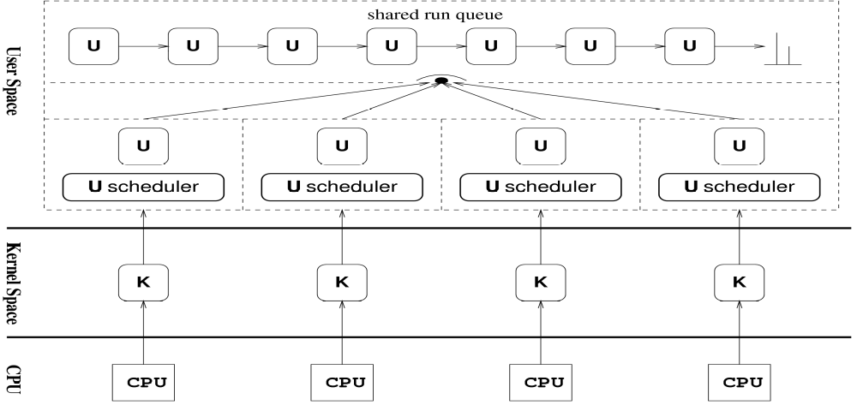
Fast User-Level Inter-thread Communication and Synchronisation
Author: Li Lin Supervisor: Dr Keivn Vella
University of Malta
Abstract
SMASH
This project's objective is to design and implement several user-level inter-thread communication constructs for SMASH. Since communication and synchronization among threads in a process is heavily used in most multi-threading programs,the efficiency of inter-thread communications affects the efficiency of the whole program. Traditionally, those communication and synchronization constructs were built with locks, but this lock-based approach has some problems such as potential deadlock starvation and priority inversion. In order to solve these problems, lock-free algorithms were invented. Recently there is a lot of interest in lock-free algorithms in the research community. In this project, all the inter-thread communication constructs considered have two implementations: the
lock-based implementation and the lock-free implementation.
A user-level thread system on top of pthreads developed by Kurt.
Runs on both uniprocessor machine and SMPs.
Very fast context switch
Architecture of SMASH
Inter-thread communication though the kernel
Involve system calls.
May block the kernel thread.
Expensive.
Inter-thread communication in user space
No vertical switches
Only blocks user-level threads
Does not involve the kernel
Implemented constructs
Lock-based VS Lock-free
Mutex
Semaphore
Message queue
The CSP communication channel
Spin locks
Lock-free algorithm
Easy to design
May have high memory contention
May have live lock
May have priority inversion
Hard to design
Low memory contention in general
Free of dead/live lock
No priority inversion
Results
Several benchmarks were conducted on a machine with an Intel Core2 Duo CPU, 4Mb L2 cache and 2Gb memory. The operating system was Debian unstable.
The following graph shows the performances of the same concurrent program when using pthread mutex and our user-level mutex.
Acknowledgements
In this project, several user-level inter-thread communication constructs are developed for SMASH, and some improvements has been shown. Additionally, lock-free algorithms are exploited. Although due to the hardware limit, the advantage of these lock-free implementations can not be shown, we still believe that lock-free algorithms will perform better than lock-based ones when a SMP system is under high contention.

