Slide 1
Melbourne House Prices
Median sale house prices for the period of January 2020 to April 2020 based on suburbs
Team members: Sean Dee, Dhanya Maheswaran, Oriola Orekoya and Laurie Walker
Notes:
Oriola

Slide 2
Motivation & Summary
Hypothesis
The recent COVID-19 pandemic have heavily influenced on the decline of median house sale prices in Melbourne suburbs for the period between January 2020 to April 2020.
Objective
To extract and clean data from the Domain.com.au API website and provide statistical analysis on the Melbourne housing market. The study includes: Top 10 Best and Worst performing suburbs, Demographic analysis, and differences in the change by house sale prices and sales volumes.
Notes:
Oriola

Slide 3

Data Obtaining Process - API
Used the Domain API to create a dataset
Involved interacting with many different APIs on the domain portal
First had to get a Suburb ID or reference for each Suburb in Melbourne
Used pandas and looping through a csv to obtain the median prices and number sold and demographic data
Notes:
Dhanya

Slide 4
Challenges faced obtaining Data
The Domain API was not very user friendly which led to multiple issues:
The Domain API documentation was hard to understand
Only 500 calls were allowed per day
Some of the demographic data was ordered differently for each call, and therefore IF statements had to be used
Notes:
Dhanya

Slide 5
Data Cleanup and Analysis
Consolidated the occupation data and migrant data into two categories
Cleaned data to eliminate rows with missing data and observations, reducing the number of suburbs in our sample to 245.
Converted variables to percentage
Notes:
Dhanya

Slide 6
Question 1
How were house prices affected by Coronavirus?
Hypothesis: We predict that the median house price will decrease as a result of the pandemic, thus the median price will be lower in April 2020 as compared to January 2020
Notes:
Sean

Slide 7
Evidence and Visualisation
Has ongoing COVID-19 pandemic had an effect on the Melbourne housing market? Measure of quarterly house sale results and sale volume.
The total number of suburbs extracted from Domain API was 314. After data cleaning, the final figure was reduced down to 248.
Sufficient drop in both the median sale prices and the number of properties sold for the period of January 2020 to April 2020
 | Jan 2020 Median | April 2020 Median | Jan 2020 Number Sold | April 2020 Number Sold
Total | $260,711,000.00 | $251,540,000.00 | 11000.00 | 9669.00
Average | $1,055,510.12 | $1,022,520.33 | 44.53 | 39.15
Change % |  | -3.52% |  | -12.08%
Notes:
Sean

Slide 8
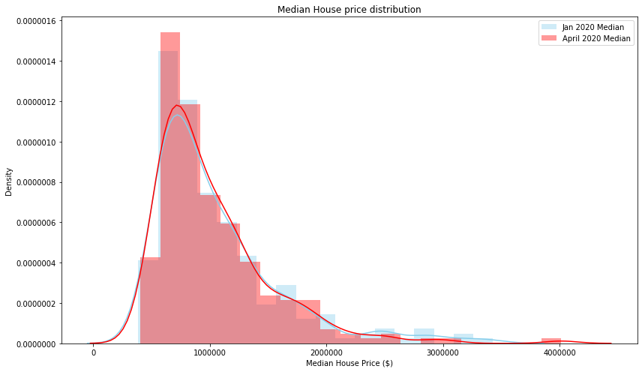
Data
Jan Mean: 1,053,910.20
Jan Std Dev: 544,232.43
Jan Skewness: 1.804948
Jan Kurtosis: 3.764503
Apr Mean: 1,024,061.22
Apr Std Dev: 496,957.68
Apr Skewness: 2.036627
Apr Kurtosis: 6.538400
Notes:
Laurie - A slight change in suburban median house prices brought about a contraction in higher price suburbs

Slide 9
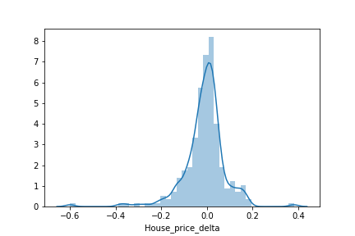
Data
House price delta Mean: -0.010737
House price delta Std Dev: 0.093196
House price delta Skewness: -1.389991
House price delta Kurtosis: 8.792317
Notes:
Laurie- House price delta (the % change in median house prices per suburb between January and April) is at least somewhat normally distributed, which allows us to perform hypothesis testing. Based on this normal distribution, we were able to do a hypothesis test to see whether the Mean House price delta is statistically significant and different to 0. After testing, we determined it was statistically significant at the 90% confidence level.

Slide 10
Question 2
What postcodes would have the highest and lowest median price drop in suburbs and what are the differences in the demographic characteristics of the people in these postcodes?
Hypothesis, we predict that:
Highest drop in prices occurs in postcodes with higher proportion of young people, migrants and people in lower-skilled jobs
These people also tend to live in dense areas and more likely to rent and the value of rentals has decreased as a result of the crisis
Notes:
Oriola

Slide 11
Which areas have been most affected?
Compare top 10 most affected and least affected postcodes/suburbs.
St Kilda had the most significant change in average decrease in median house prices and volume of sale. The suburb’s price range is broad, plus the volume of sale is not adequate enough to determine accuracy in our results.
Most Affected | Least Affected
St Kilda | Lower Plenty
Malvern | Carrum
Armadale | Fitzroy North
Albert Park | Toorak
Strathmore | Melton West
Fitzroy | Ascot Vale
Clayton | Williamstown
Warrandyte | Sandringham
Healesville | Altona
Chelsea | Eaglemont
St Kilda | January | April
Price | $3,100,000 | $1,239,000
Volume | 25 | 12
Notes:
Oriola

Slide 12
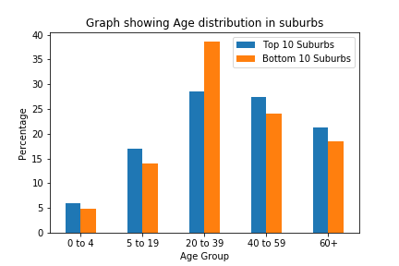
Suburb Demographics
High proportion (almost 40%) of people between 20-39 in the suburbs where median house price has declined the most
This supports the hypothesis
Notes:
Dhanya

Slide 13
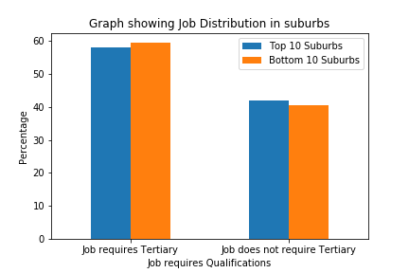
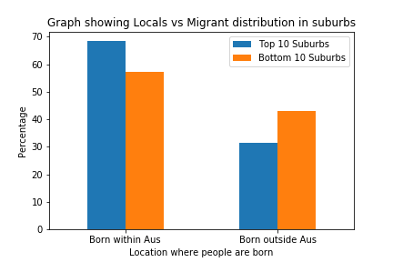
Suburb Demographics
No real difference when looking at Tertiary Qualifications
Suburbs that have the highest fall in median house price have a higher proportion of migrants
Notes:
Dhanya

Slide 14
Question 3
Question: Is there a clear correlation between certain demographic characteristics and change in prices in Melbourne suburbs across all of Melbourne? (not just top 10 and bottom 10 suburbs)
Hypothesis:
Across Melbourne, it is likely that suburbs containing young families have a positive correlation with price
With a low proportion of people in jobs that require tertiary qualifications and with a higher proportion of migrants will have a negative correlation with changes in house prices.
Notes:
Laurie

Slide 15
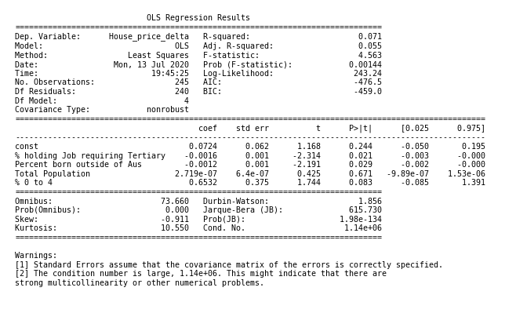
To test whether there is a relationship between demographic factors and changes in median house prices, we performed an OLS linear regression using statsmodel module
Notes:
Laurie

Slide 16
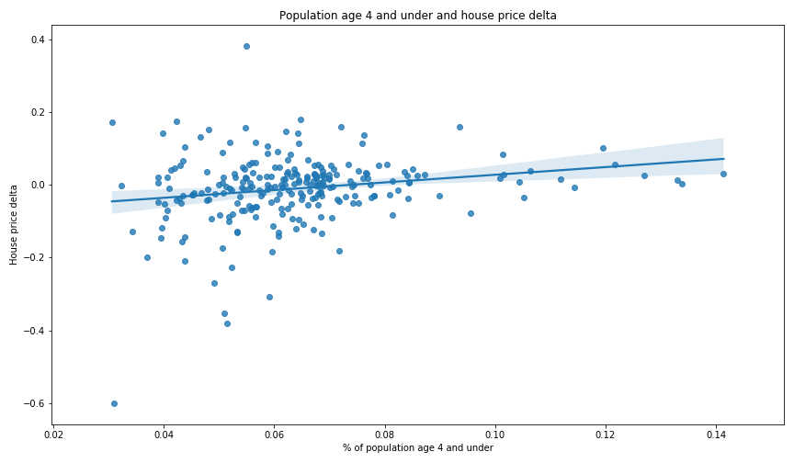
Scatterplots
Based on linear regression model, there is a slight positive relationship between the percentage of suburban population aged 4 and under and the change in median house prices.
Notes:
Laurie- This may point to young families moving into suburbs. These areas tend to be less densely populated and also may be where there are more long-term homes and thus less affected.

Slide 17
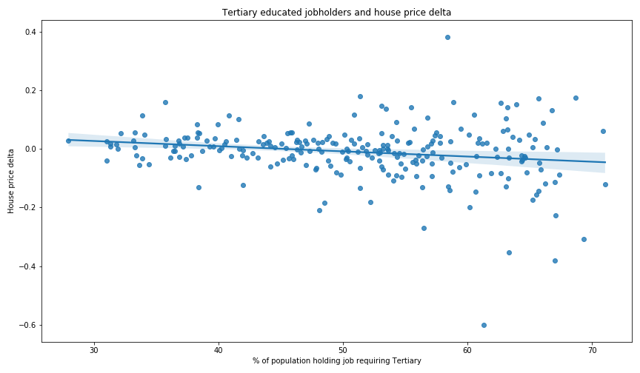
Scatterplots
We observed a slight negative relationship between the percentage of suburban population holding a job requiring tertiary education and median house price changes, contrary to what we initially expected.
Notes:
Laurie- This is somewhat contrary to what we expected- initially believed that suburbs with less tertiary educated job holders would suffer a greater economic impact which would affect house prices. Need further research to determine why this does not appear to be the case. However, it supports prior results that there was not much difference in the proportion of people holding jobs requiring tertiary qualifications in top performing and bottom performing suburbs.

Slide 18
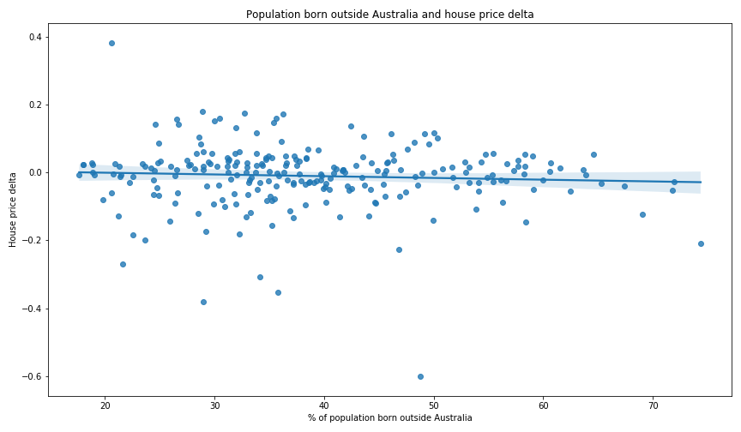
Scatterplots
There was a very slight negative relationship between the percentage of suburban population born overseas and the change in median house prices.
Notes:
Laurie- We did expect a negative correlation between the proportion of the population born overseas and a negative change in house prices, based on the impact that Covid has had migration, international student demand and also foreign citizens on temporary working visas.

Slide 19
Overall Implications of Findings
Trend of house prices will continue to decrease due to economic uncertainty with the ongoing COVID-19 pandemic.
High percentage of demographic age group between 20-39 lived in suburbs where median house prices has declined the most. Back by evidence in the current job crisis and unemployment rate. Younger families are experience more difficulties in job securities and loan repayments.
-
-
Notes:
Sean

Slide 20
Limitations and difficulties
Number of houses is affected by seasonality - why we didn’t include it in the analysis
Limited data, only takes into account what was sold
Missing data from suburbs where no houses were sold are excluded from the analysis
Restricted timeline (only in the periods of January 2020 to April 2020)
Notes:
Sean

Slide 21
Q&A

