Slide 1
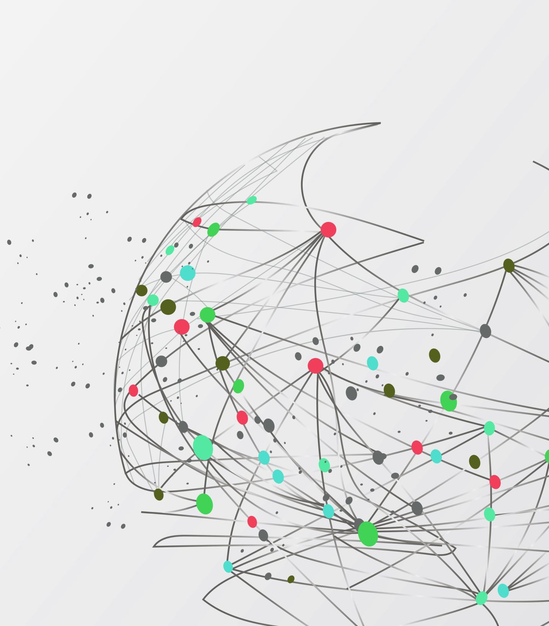
Telecom Customer Churn Analysis
Blake Tindol, Yesul Song, Sean Deery
IST-718 Big Data Analytics

Slide 2
Agenda
Customer Churn in Telecom
Problem Background
Data
Exploratory Analysis
Demographic Data
Customer Relationship Data
Models
Logistic Regression
Random Forest
Support Vector Machine

Slide 3
Customer Churn in Telecom
Subscription Based Business:
Monthly,
1-year,
2-year contracts
Revenue and long-term growth
Data
Telecom Customer Churn Prediction dataset from Kaggle
Telecom Company in California
Customer Data Q2 2022
Population by zip code
https://www.kaggle.com/datasets/shilongzhuang/telecom-customer-churn-by-maven-analytics/data

Slide 4

Exploratory Data Analysis
Distributions
Correlations with Churn

Slide 5
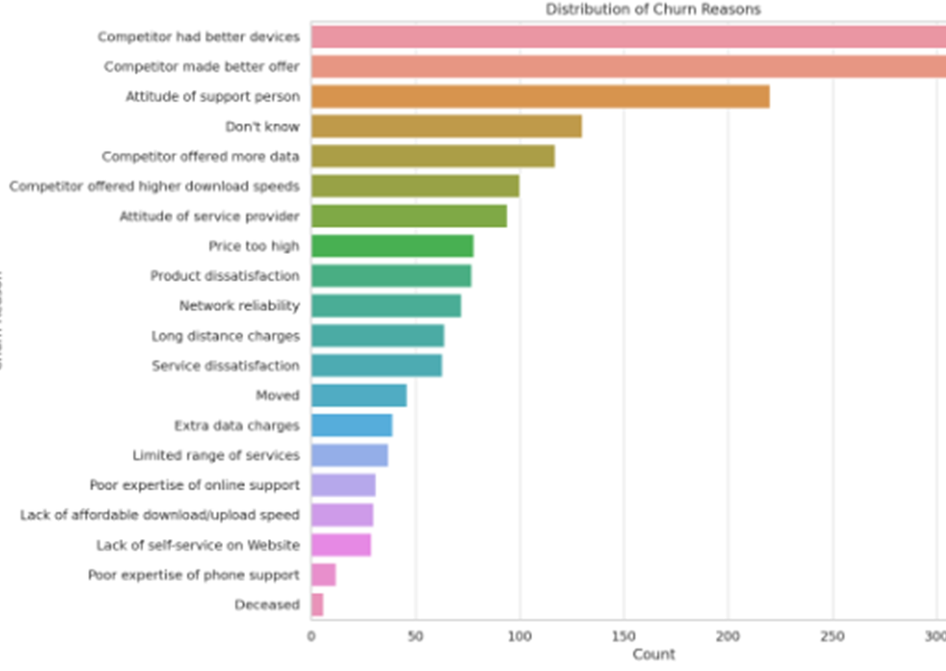
Churn Reason
Top 3
Competitor has better devices
Competitor made better offer
Attitude of support person

Slide 6
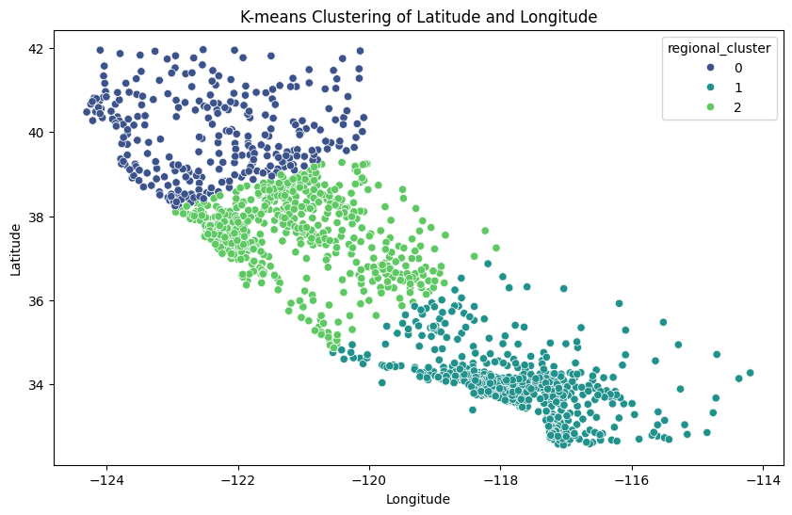
Location
K-Means Clustering with 3 clusters
Northern CA
Central CA
Southern CA

Slide 7

Predictive Models
Logistic Regression
Random Forest Classifier
Support Vector Machine

Slide 8
Models Test Accuracy
Logistic Regression
Unbalanced Data: 83.7%
Down-sampled Data: 78.1%
Up-sampled Data: 78.9%
Random Forest
Unbalanced Data: 84.6%
Down-sampled Data: 79.2%
Up-sampled Data: 81.5%
Support Vector Machine
Unbalanced Data: 84.6%
Down-sampled Data: 77.1%
Up-sampled Data: 76.3%

Slide 9
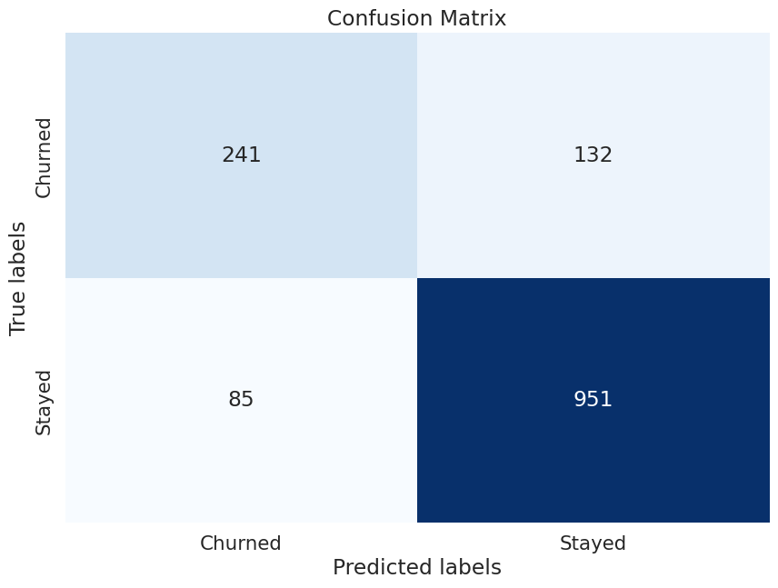
Best Model
Support Vector Machine: 84.6% Test Accuracy
Unbalanced Data

Slide 10

Final Thoughts
Best model was achieved with Support Vector Machine
241 of the 373 churned customers in the test set were predicted as churned
Recommendations:
Pricing Strategy Reevaluation
Enhancing Customer Engagement
Geographical and Demographic Targeting
Service Improvement

