Slide 1
HR Employee Attrition
Nathaniel Bowen, Elizabeth Curinga, Sean Deery, Mackenzie Houser, Binosh Padman

Slide 2
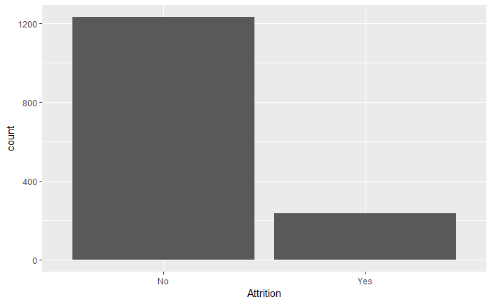
Attrition
Data Set
1470 rows
35 columns
Impact of Attrition
Performance
Reputation
What type of attrition?

Slide 3
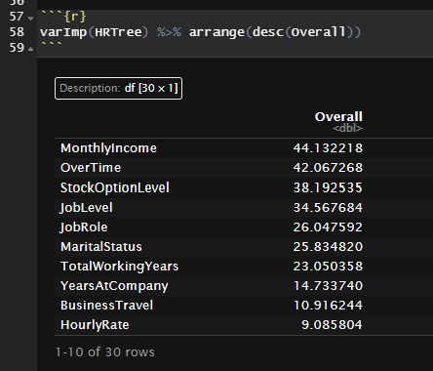
Significant Variables Pt 1
What R determined as the most important variables in the dataset
Monthly Income
Over Time
Stock Option Level
Job Level
Job Role
Marital Status
Total Working Years
Years at Company
Business Travel
Hourly Rate

Slide 4
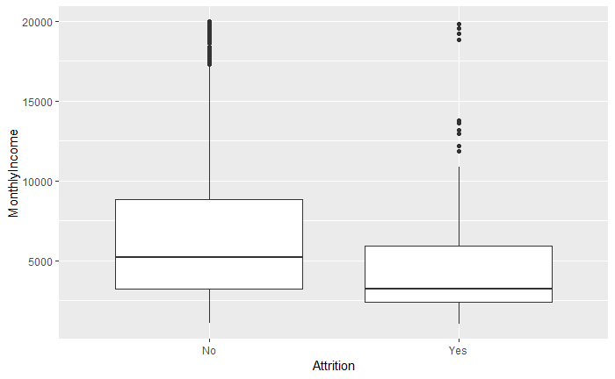
Significant Variables Pt 2 - Monthly Income

Slide 5
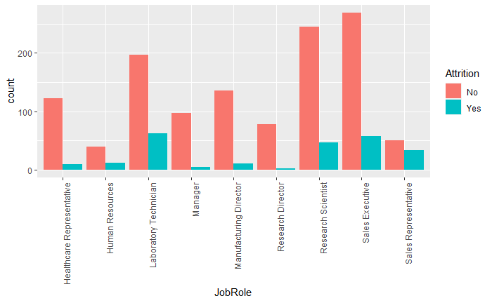
Significant Variables Pt 3 - Job Role

Slide 6
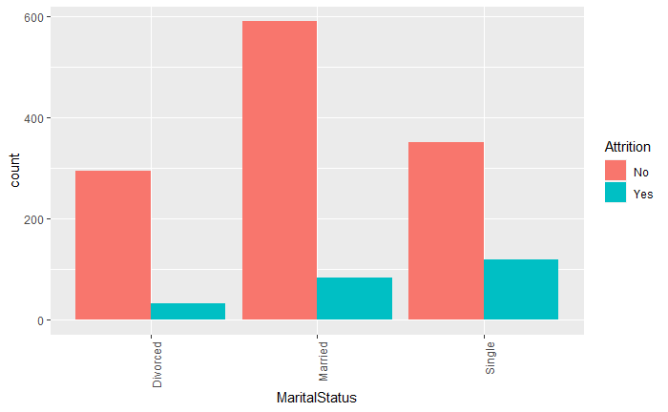
Significant Variables Pt 4 - Marital Status

Slide 7
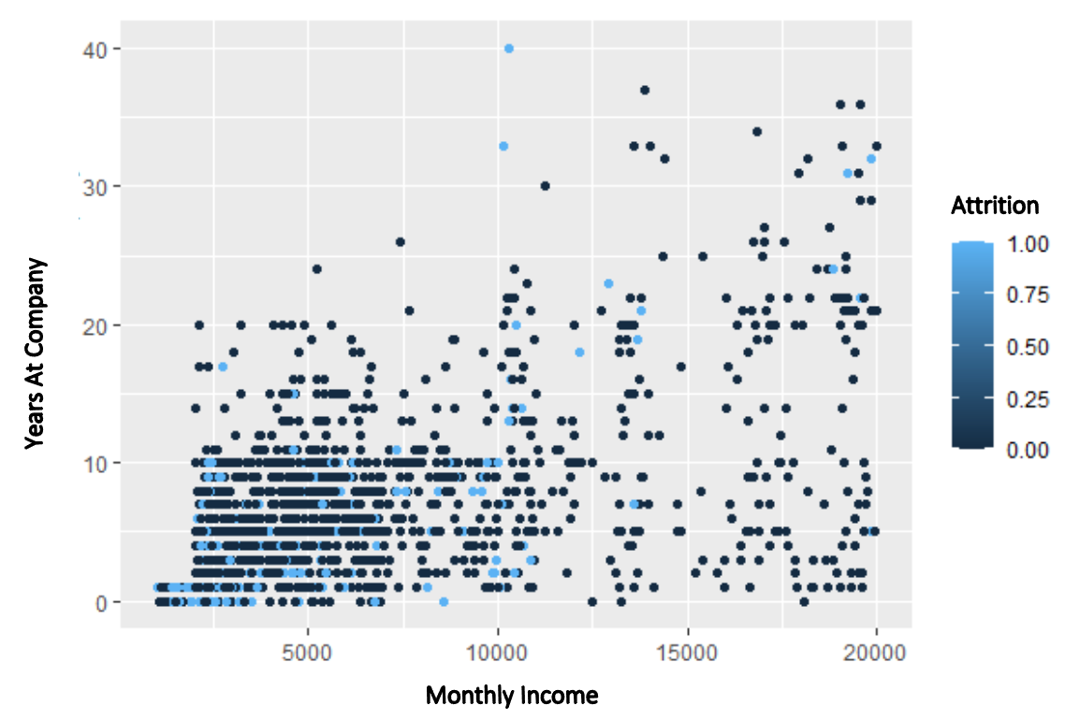
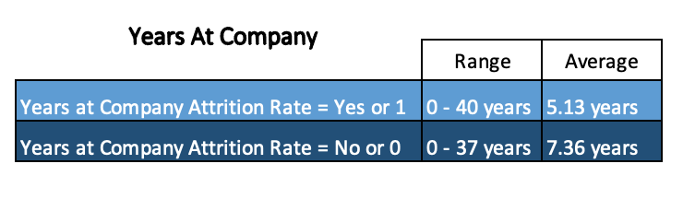
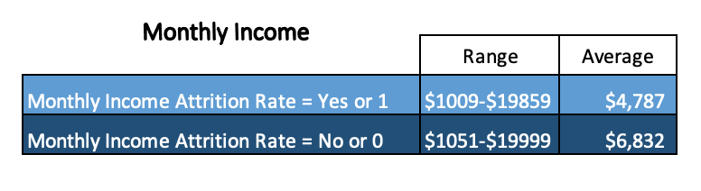
How does pay and time worked at the company affect attrition?

Slide 8
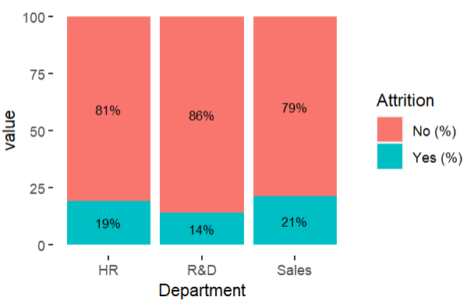
What are the differences in attrition between departments?
Dept | Emp | Attrition Rate
HR | 63 | 19.05%
R&D | 961 | 13.84%
Sales | 446 | 20.63%

Slide 9
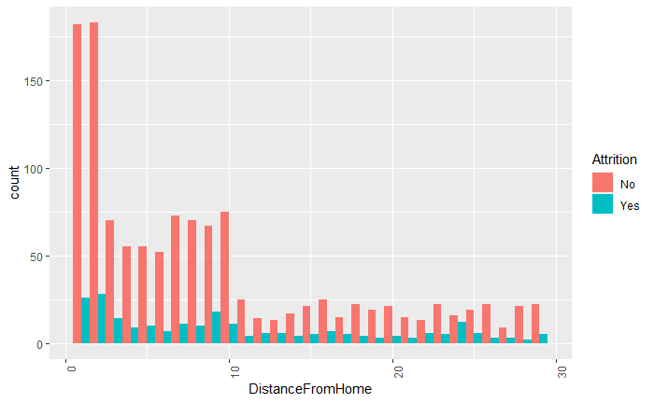
How does distance from home affect attrition?
Attrition | Average Distance From Home
Yes | 10.6
No | 8.9

Slide 10
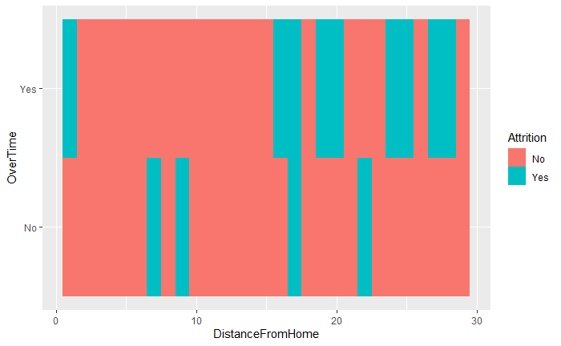
How does distance from home affect attrition?

Slide 11
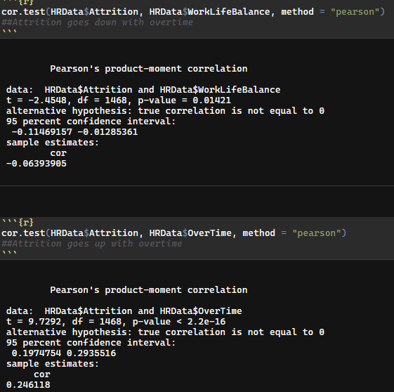
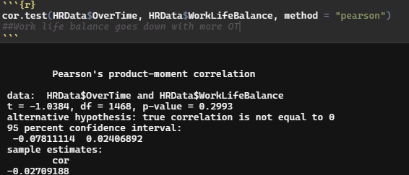
Is overtime and work life balance correlated and how do they affect attrition?

Slide 12
Recommendations
Focus on the Sales department - they have the highest attrition rate
Offer work from home options for those employees who live further from the office
Be cognizant of your employees who work overtime, they are more likely to leave
Paying employees well will keep them longer.

Slide 13
Limitations
Inconsistent collection of data
Given values but not units of measurement for certain variables
Data collected for a variable multiple times in different ways
Determining what kind of attrition was happening
People quitting is something a company would want to avoid
Retirement is a healthy type of attrition that we would want to encourage
People who were fired also counts towards attrition
Unaware of current employee benefits

Slide 14
Works Cited
BasuMallick, Chiradeep. “What Is Employee Attrition? Definition, Attrition Rate, Factors, and Reduction Best Practices.” Spiceworks, 11 Mar. 2021, https://www.spiceworks.com/hr/engagement-retention/articles/what-is-attrition-complete-guide/.
Chauhan, Aman. “Employee Analysis: Attrition Report.” Kaggle, 12 Sept. 2022, https://www.kaggle.com/datasets/whenamancodes/hr-employee-attrition?select=HR%2BEmployee%2BAttrition.csv.
NetSuite.com. “Why Employees Quit & How to Keep Them.” Oracle NetSuite, https://www.netsuite.com/portal/resource/articles/human-resources/employee-turnover-statistics.shtml#:~:text=What%20is%20a%20good%20employee,is%20known%20as%20involuntary%20turnover.

