Slide 1
Thermistor Reader Proposal
By Sam Deghuee

Slide 2
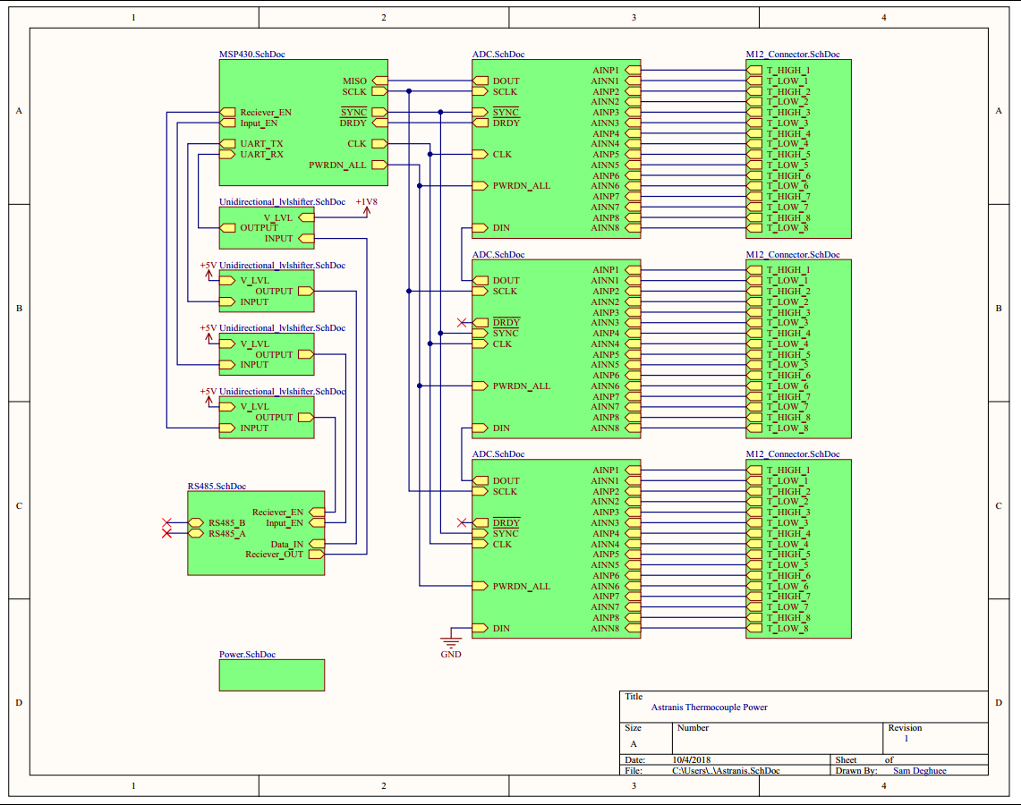
Thermistor Board:
Logic and Sense
MSP430FR5969-SP (MCU)
ADS1278-SP (ADC)
Communication
DS16F95 (RS-485)
MPSA18G (NPN)
Power
TPS709 (LDO)
LT3437IFE (Buck)

Slide 3
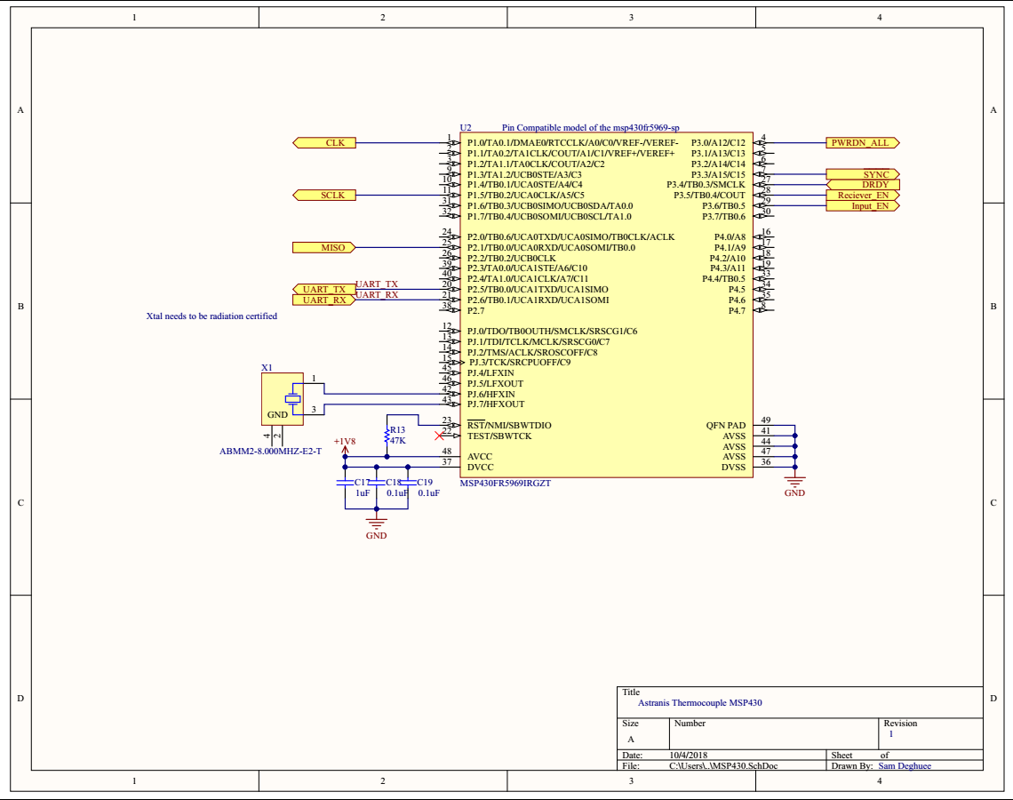
MSP430 Schematic
Space rated
Ultra low power MCU
SPI peripheral for ADCs
UART peripheral for RS-485
Operating at +1.8V to reduce risk of SEL and power draw
External OSC for 8Mhz operation

Slide 4
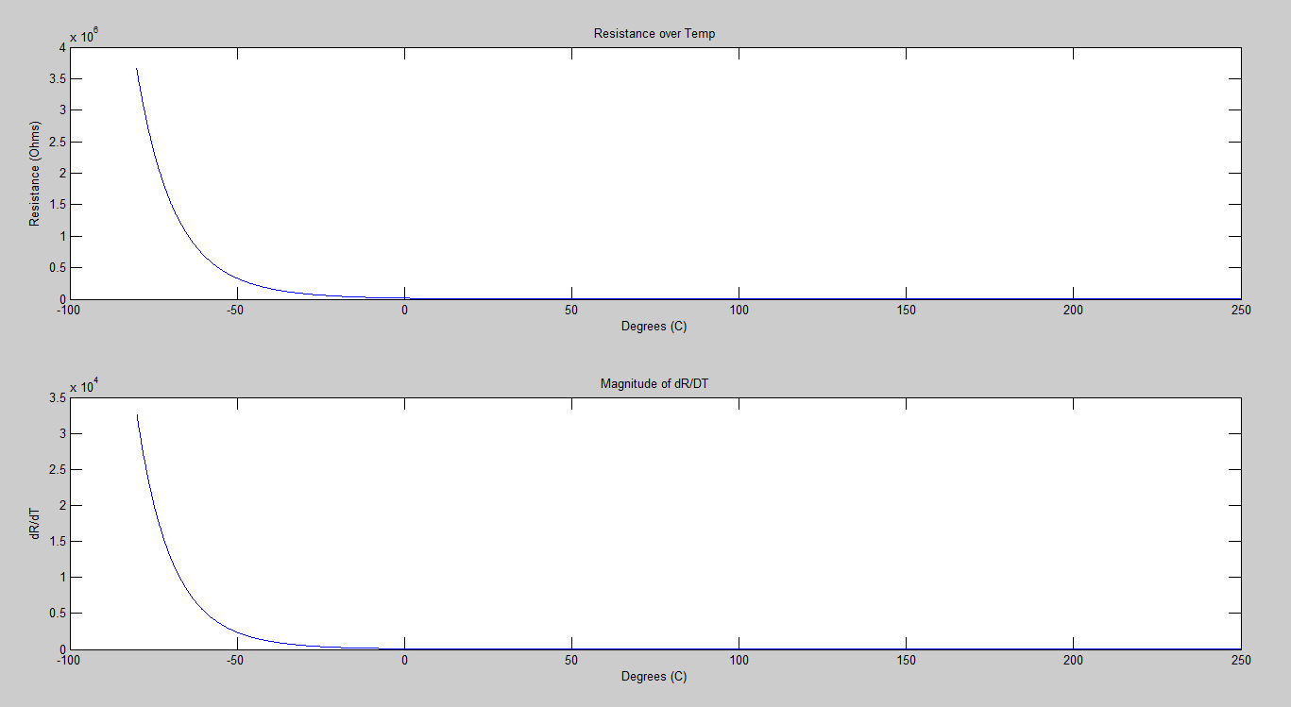
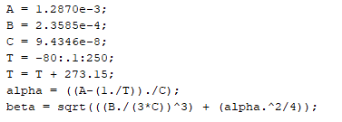
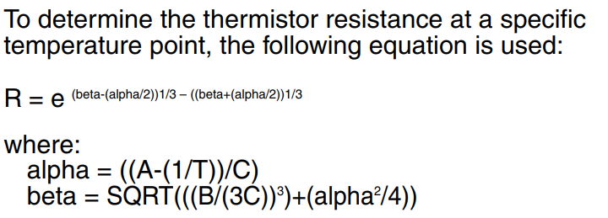
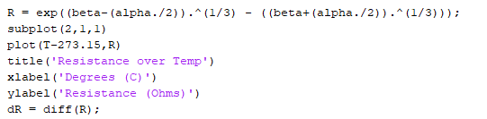
Component Selection: ADC
Full range of thermistors (-80°C : 250°C)
MATLAB calculations of full range and derivative show worse case scenario
The high end temperature has the smallest dR/dT and so is the hardest to maintain the precision of +/-0.7°C
Used the R_{min} = 14.0201 Ohms and R_{min2} = 14.1719 for rest of power and ADC resolution calculations.
MATLAB Code to generate plots
Equations from TH-22 datasheet

Slide 5
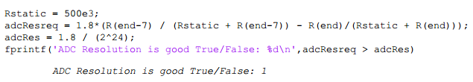
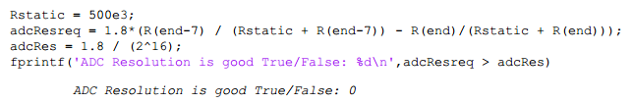
Component Selection: ADC
Using R_{min} and R_{min2} with a necessary reading of 0.7°C an ADC could be chosen
16bit was not a high enough resolution but 24bit is
A 500K Ohm resistor was chosen as the resistive divide to minimize power loss while maintaining accuracy
MATLAB Code Output of valid resolution
MATLAB Code Output of a low resolution

Slide 6
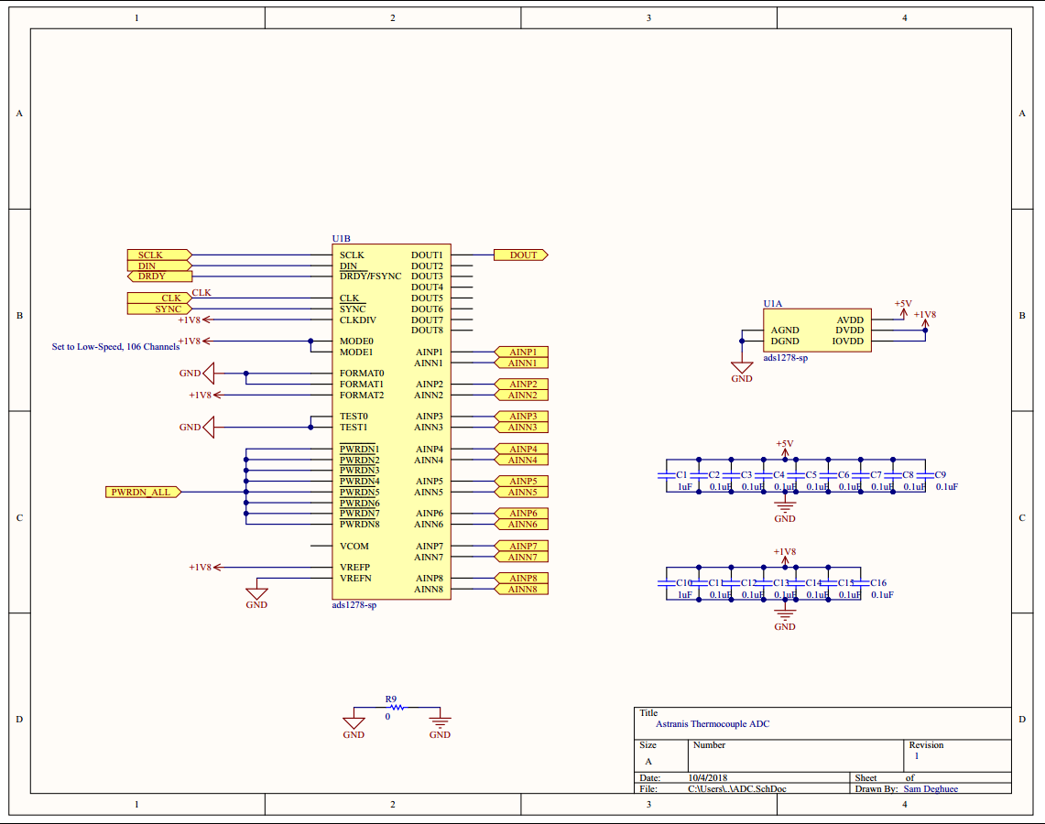
Component Selection: ADC
The ADS1278-sp was chosen for its space rating, high resolution and ability to turn off channels to save power.
Configured for low speed
Utilizes a daisy chained SPI interface
Routing Note:
The ADC utilizes the analog ground to minimize noise caused by the digital electronics, and therefore should use a separate ground plane connected by a 0 Ohm resistor close to the ADCs

Slide 7
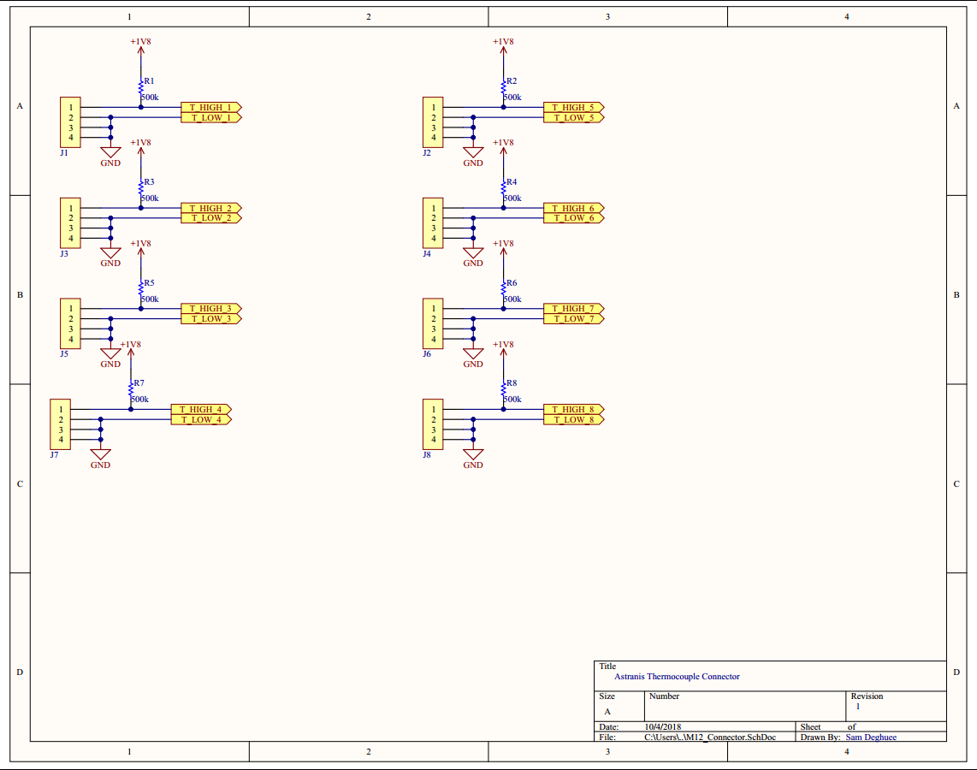
Connector Setup:
8 Thermistors per ADC
Pins 1 and 2 are the thermistor from the datasheet.
If dual filament thermistors are not used, the unused inputs should be grounded for noise reduction.
A divide with 500K Ohm allows for low power
If 24 thermistors is not desirable, 4 extra can be used as redundant channels or disabled for further power savings.
Routing Notes:
The negative input of the ADC should not be a part of the ground plane, but should be routed as a trace

Slide 8
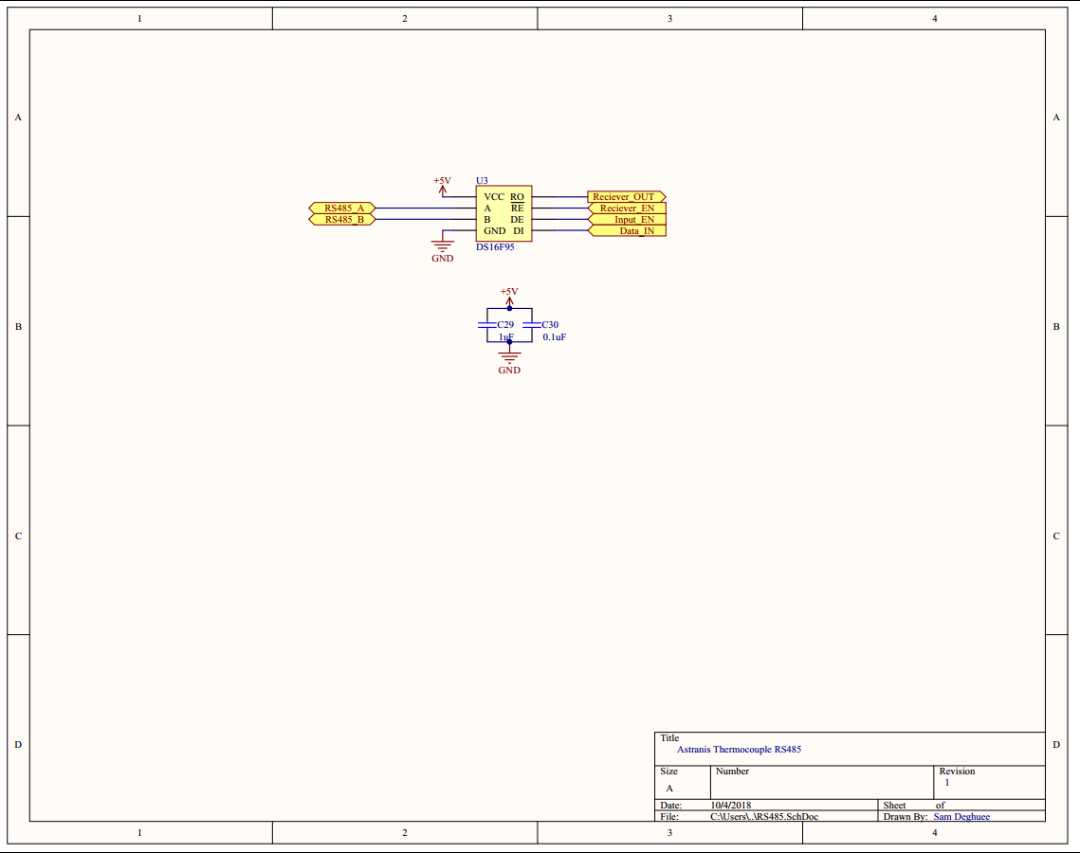
Component Selection: RS-485
The DS16F95ML-SP was chosen for its robustness and compatibility with the RS-485 and RS-422A standard.
Space Rated
Since the chip operates at +5V a level shifter design was needed to interface with the +1.8V logic level interfaces.

Slide 9
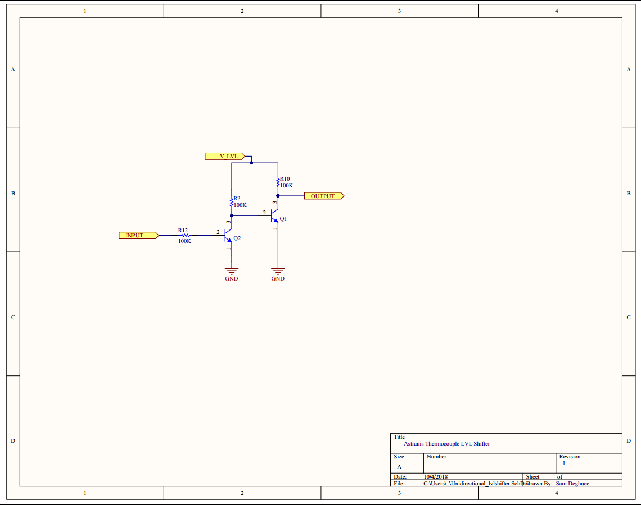
Level-Shifter Schematic
Basic one direction level translator
BJT design chosen to prevent latching from radiation effects.
SPICE simulation done to verify performance and current draw.
Final design would require more complete simulation to verify rise and fall times based on baud rate.

Slide 10
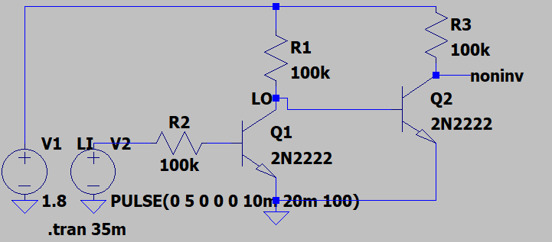
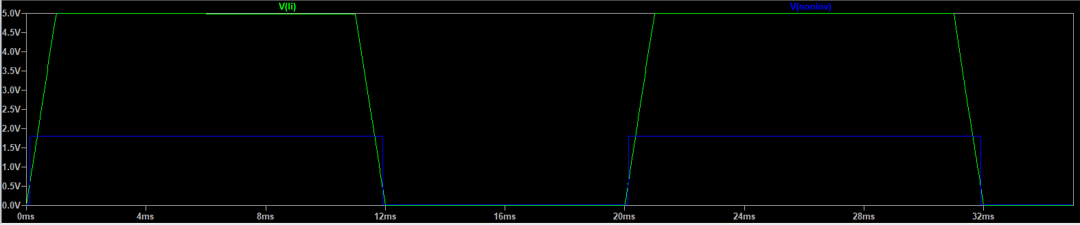
Level-Shifter Simulation
Validates basic circuit operation
With more time / resources a more accurate model of chosen NPN BJTs could be used with a better representation of UART to validate real performance
LTspice Schematic capture
Simulation Results

Slide 11
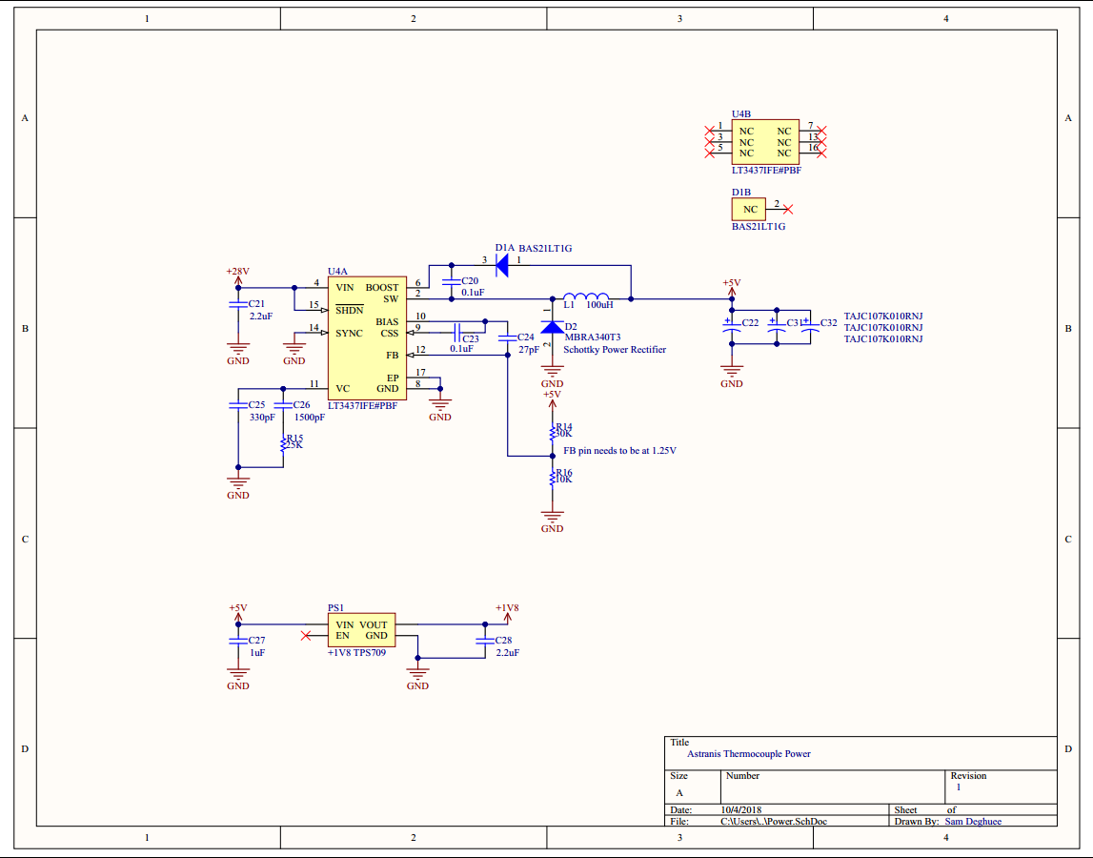
Power Schematic
Tight power constraints influenced a buck converter design.
The LT3437IFE was chosen for its radiation immunity as shown from an AIAA/USU Conference on Small Satellites article which rad tested this chip and found minimal impact.
TPS709 (LDO) was chosen for converting to lower voltages for noise reduction
Careful consideration to reduce ripple into the ADC would need to be taken.
Buck can accept up to 60V and has a drop out of 6V

Slide 12
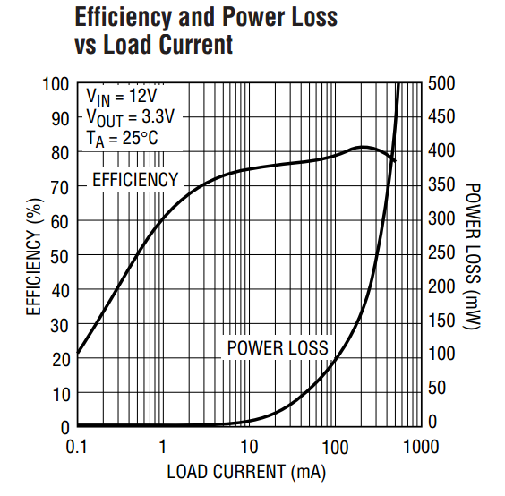
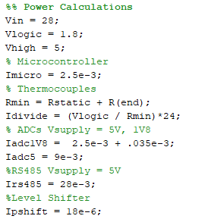
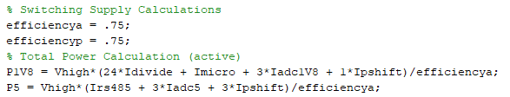
Power Calculations
Two central assumptions were used:
Efficiency*Power into a buck = Power out.
Current into LDO = Current out of LDO.
Ability to turn off ADC channels for “passive” mode.
Efficiency of 75% was used for buck as a conservative estimate.
Data from MATLAB code summarized below:
Power Consumption(active) 1V8: 0.08 Watts
Power Consumption(active) 5: 0.37 Watts
Power Consumption(active) Total: 0.45 Watts
Power Consumption(passive) 1V8: 0.08 Watts
Power Consumption(passive) 5: 0.19 Watts
Power Consumption(passive) Total: 0.27 Watts
Since TH-22 probes have a response time of a few seconds, the steady state power draw could be minimized by utilizing the passive mode.
Efficiency of Buck Switching Regulator

Slide 13
Backups

Slide 14
References
[1] Doug Sinclair, Jonathan Dyer. 2013. “Radiation Effects and COTS parts in SmallSats,” Proceedings of the AIAA/USU Conference on Small Satellites, Technical Session IV: Down The Middle, 69. http://digitalcommons.usu.edu/smallsat/2013/all2013/69/.

Slide 15
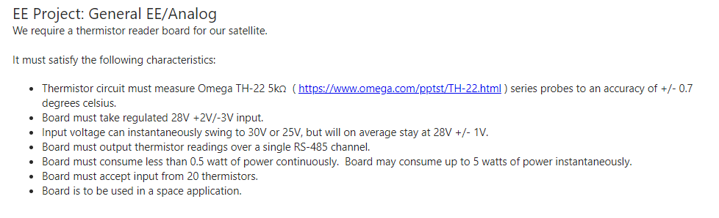
Backups Design Requirements

Slide 16
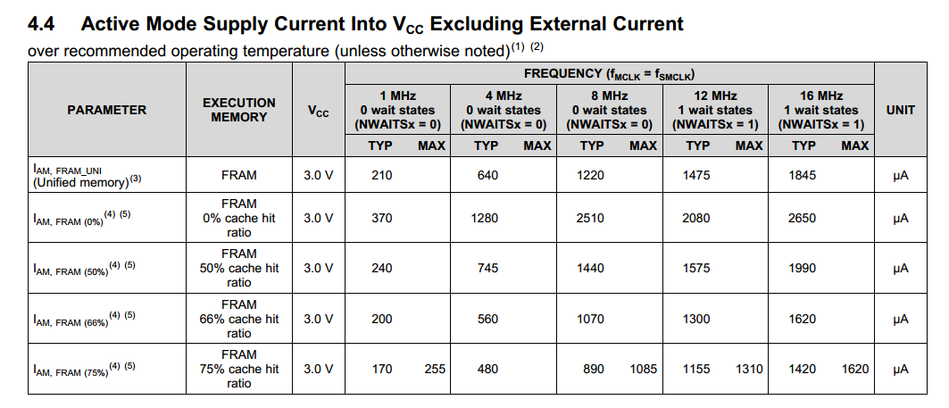
Backups MSP power draw

Slide 17
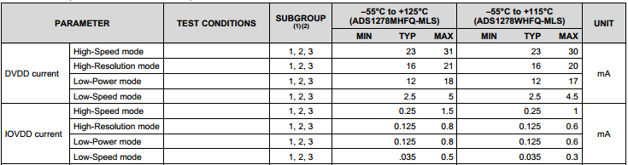

Backups ADC power draw

Slide 18
Backups ADC power draw

