Slide 1
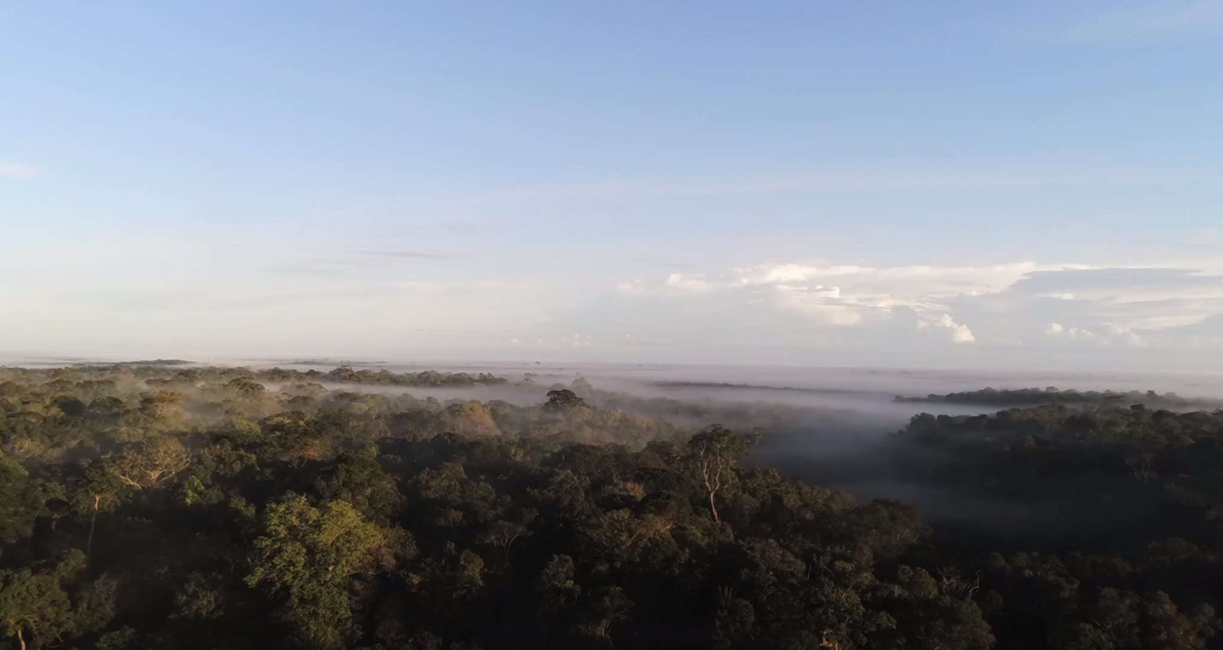
Running FATES
FATES tutorial @ UGent

Slide 2

Introduction to FATES
Introduction
Set up a default model run with CLM-FATES
Set up a site level run using inventory data
Explore the model yourself
All material can be accessed through Github:
https://github.com/sdeherto/CLM-FATES4UGent
Tutorial is build from the combination of practicals of land climate dynamics course (VUB) and sessions followed in FATES tutorial in the summer of 2024 at the Lawrence Berkeley National Laboratory (https://github.com/NGEET/fates-tutorial/)
Notes:
add in examples of past uses cases with FATES

Slide 3
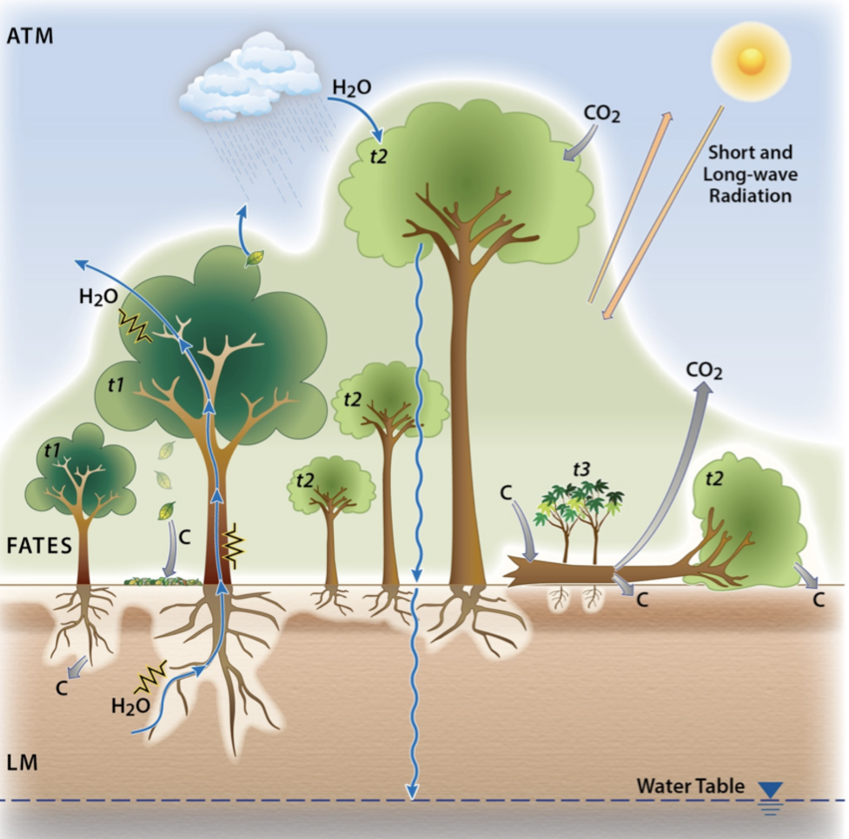
Functionally Assembled Terrestrial Ecosystem Simulator
Process based model
Integrates plant demography with ecophysiology and biogeophysical and biogeochemical processes
Sub-daily to multi-century dynamics
Processes from individual to regional scale

Slide 4
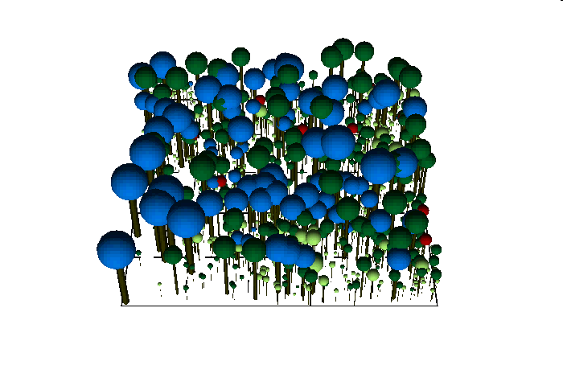
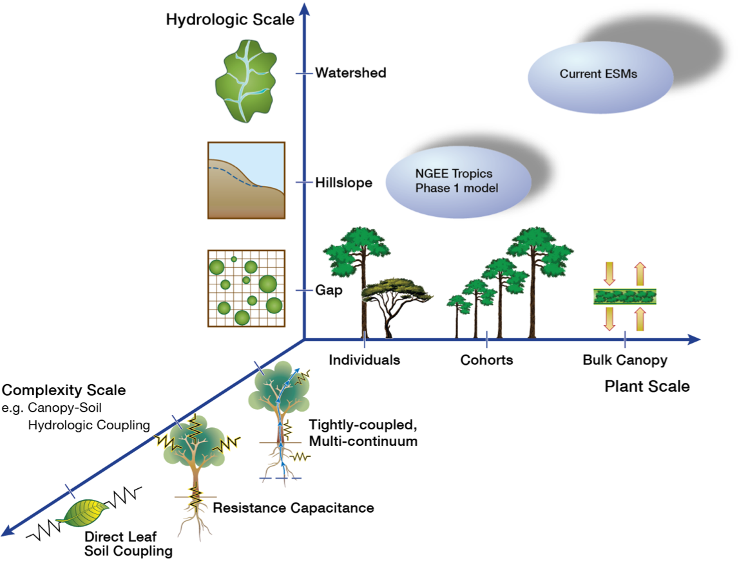
The cohort model approach
Big Leaf Model
Cohort model
Stochastic Individual Model

Slide 5
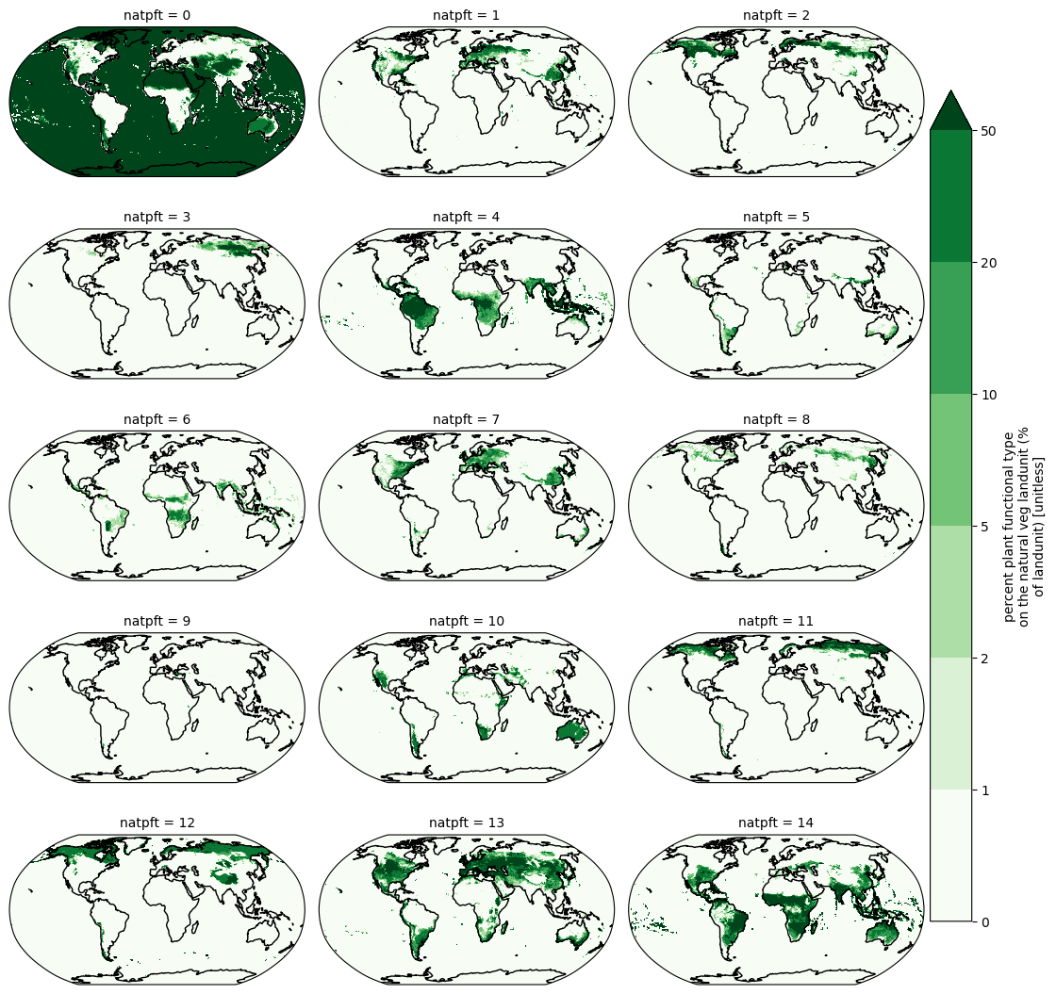
Plant Functional Types
Groups of similar species
Broad categories distinguishable from space (evergreen/deciduous, broadleaf/needleleaf)
broadleaf_evergreen_tropical_tree
needleleaf_evergreen_extratrop_tree
needleleaf_colddecid_extratrop_tree
broadleaf_evergreen_extratrop_tree
broadleaf_hydrodecid_tropical_tree
broadleaf_colddecid_extratrop_tree
broadleaf_evergreen_extratrop_shrub
broadleaf_hydrodecid_extratrop_shrub
broadleaf_colddecid_extratrop_shrub
arctic_c3_grass
cool_c3_grass
c4_grass
PFT area fraction

Slide 6
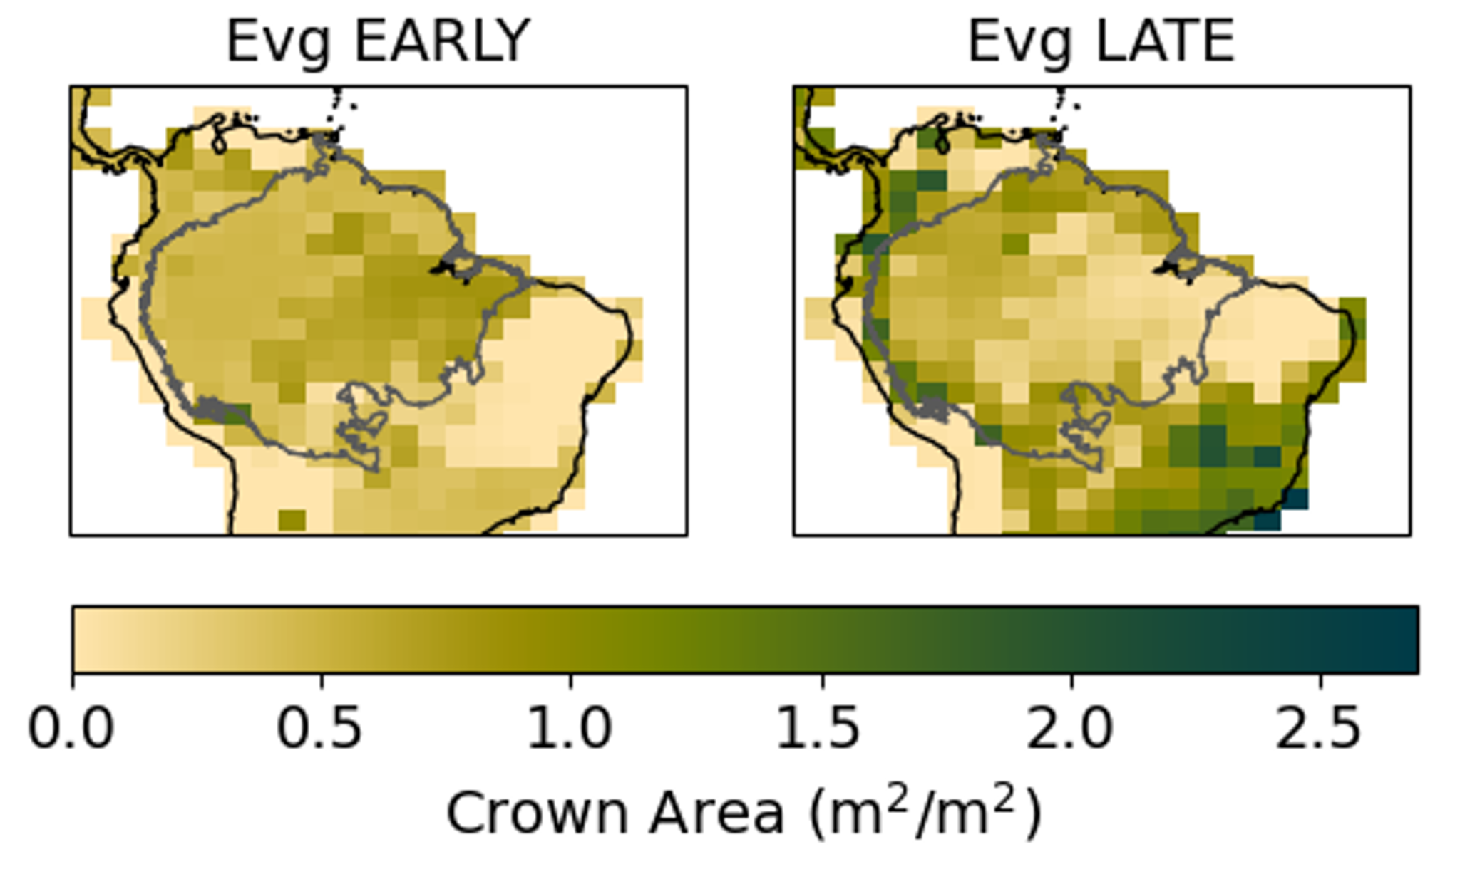
Plant Functional Types
Groups of similar species
Broad categories distinguishable from space (evergreen/deciduous, broadleaf/needleleaf)
Species that occupy a similar ecological niche
Functional groups based on trade-offs (slow/fast, drought tolerance, fire tolerance)
Defined in FATES by many functional trait
Kowalczyk et al. In prep.

Slide 7
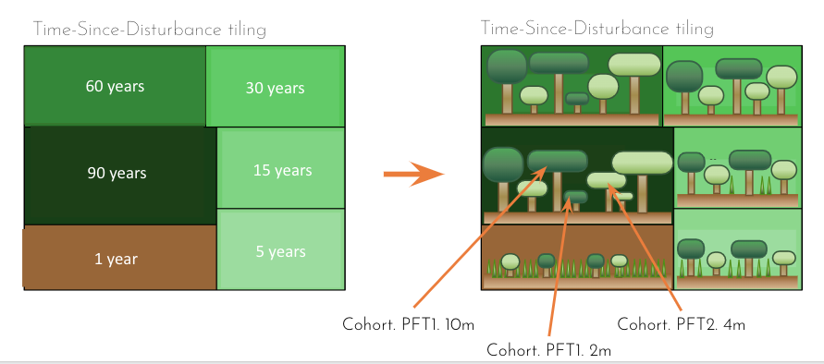
FATES patch and cohort structure
Patches - defined by age since last disturbance. Landscape is a mosaic of patches of different ages.
Cohorts - defined by size and PFT. Cohorts of different PFTs compete with one another within a patch.

Slide 8
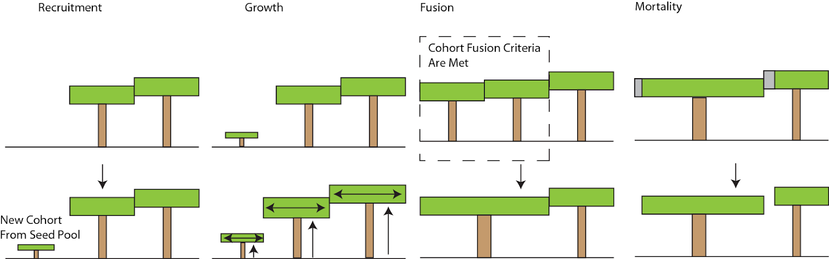
The life of a cohort
Notes:
Seed pool shared across patches

Slide 9
Model Hierarchy
CESM NorESM
E3SM
EARTH SYSTEM MODEL
(Ocean, atmosphere, land, ice, human)
CLM
ELM
LAND SURFACE MODEL
(Host Land Model)
FATES
DEMOGRAPHIC VEGETATION MODEL

Slide 10
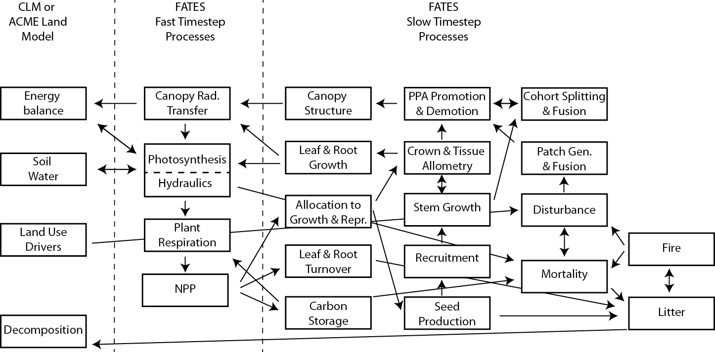
Processes in FATES
ELM or CLM
Cohort scale
Patch scale
Notes:
Multiple land use drivers modes - surface data set v LUH2
Key
PPA - perfect plasticity approximation

Slide 11
Recap
FATES is the vegetation component of a Land Surface Model (ELM) that itself is a component of an Earth System Model (E3SM)
FATES models PFTs - groups of species with similar characteristics
The landscape in FATES is a mosaic of patches in different successional stages
Patches are occupied by cohorts of different sizes and PFTs
There are many ways to run FATES depending on the science question

Slide 12
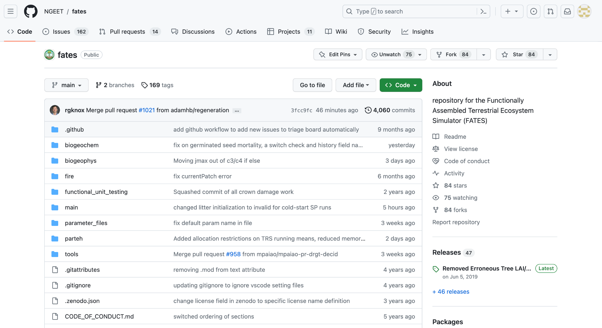
FATES code on GitHub
Tech note explains the science in FATES
Link to FATES Github repo

Slide 13
FATES Tutorial
Introduction to hpc

Slide 14
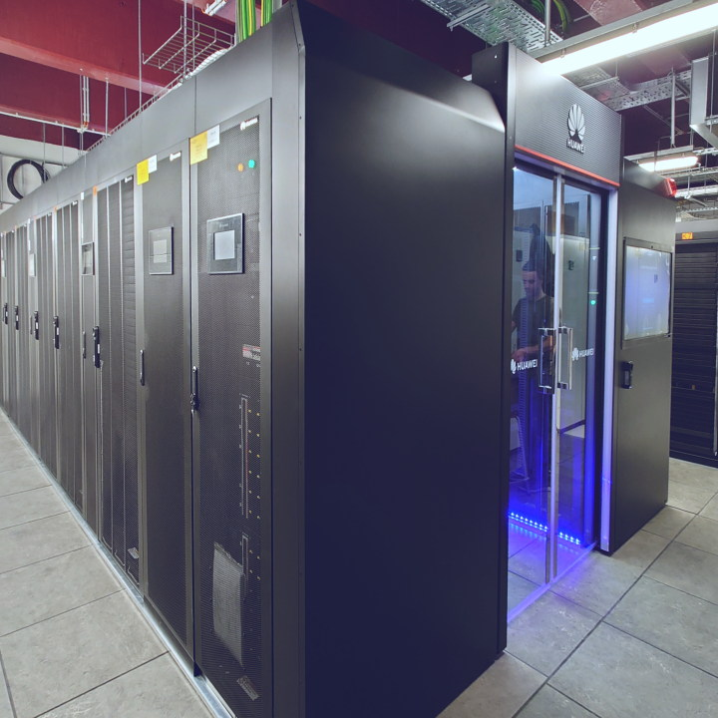
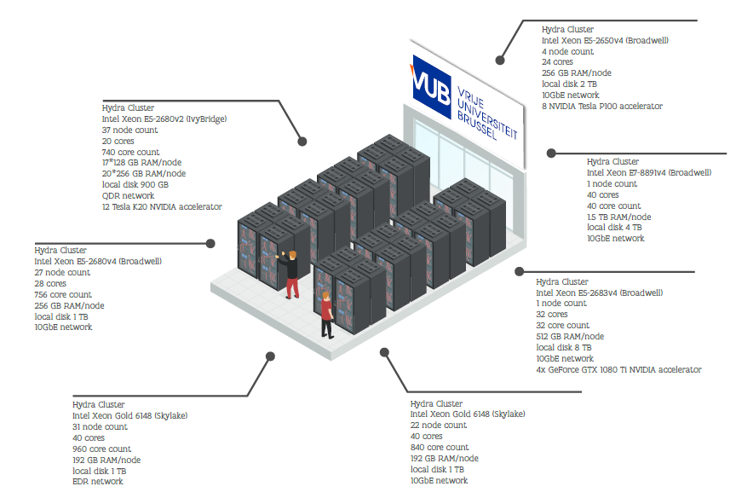
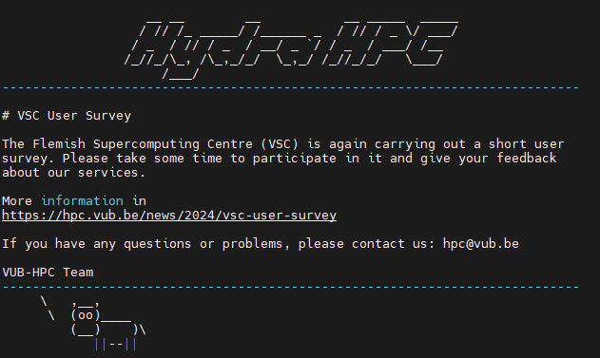
high performance computer (HPC)

Slide 15
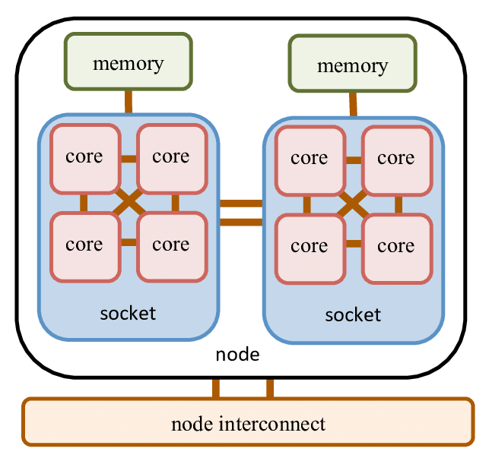
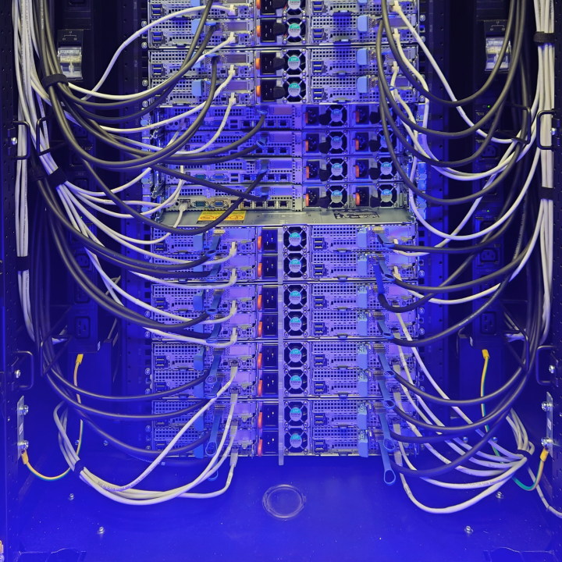
A. What is high performance computing (HPC)?
Centralized computer cluster
Racks filled with compute nodes
Nodes contain high-end CPU’s, GPU’s and lots of memory
Connected with high-speed networks
Runs software designed for HPC
1 node has multiple cores
e.g. laptop processor: 8 cores (11th gen i7 intel)
Notes:
Make comparison with laptop processors?

Slide 16
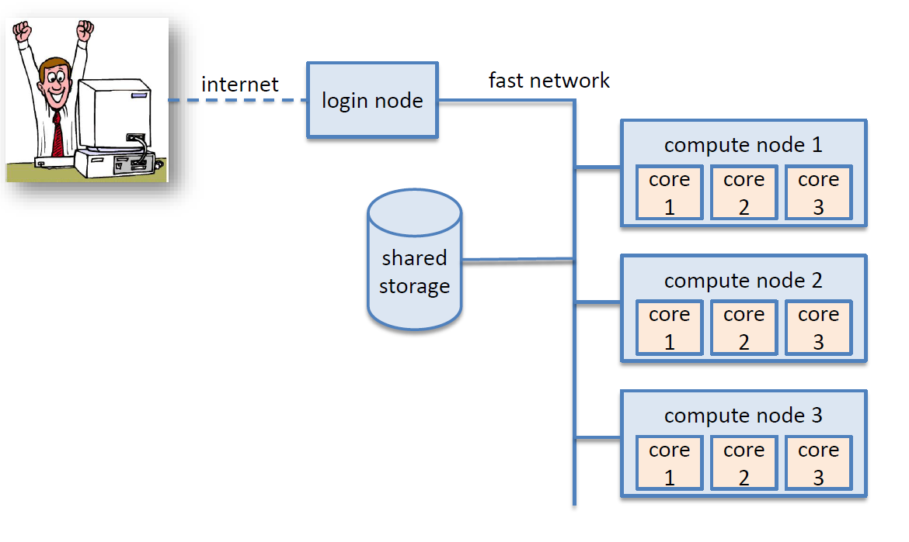

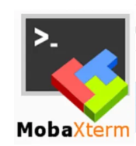
HPC Architecture
Compute node 1
With great power
comes great responsibility
Notes:
The HPC architecture
1 intel processor i7 8th generation: 6 cores. See the compute node as small computers (but with only the computational power).
Storage is centralized in a shared storage.

Slide 17
Access to hydra
More info: https://github.com/qforestlab/UGent-hpc-introduction
Need a vsc number
Ugent users means Ugent VSC_HOME and VSC_DATA directories
Inputdata will be located there
However we will set up and submit runs to tier-2 VUB (hydra)
Save outputs to VSC_SCRATCH which is local to hydra (!= Ugent VSC scratch)
Notes:
jessie: - stress that we build the containers already -
Outline
What are containers?
Why containers?
How this tutorial uses containers

Slide 18
The linux shell environment
Basic Unix commands:
- Say something: echo helloworld
- List files and directories in current directory: ls or ls –al
- Get into directory: cd output
- Present working directory: pwd
- Create a directory: mkdir directoryname
- Create/edit text file in current directory: vi filename
Open file with vi filename
Press i (insert) to edit
Press esc to stop editing
Press :q! (quit) to exit without modifications or :wq (write + quit) to exit and save any modifications
- Go out of current directory: cd ..
- Copy/paste file into directory: cp filename directoryname/filename (mv for cut/paste)
- Remove file: rm filename (cannot be undone!)
- Remove directory: rmdir directoryname (cannot be undone!)
Google/chatgpt are your best friends!

Slide 19
The linux shell environment
Additional commands:
- Get documentation for any command: ls --help
- Look up all the commands you used in the past: history
- Search for some specific string: grep –r "editor"
- Stack multiple commands in a row: ls | grep "first"
- Redirection your command output into a file: ls >> output_ls

Slide 20
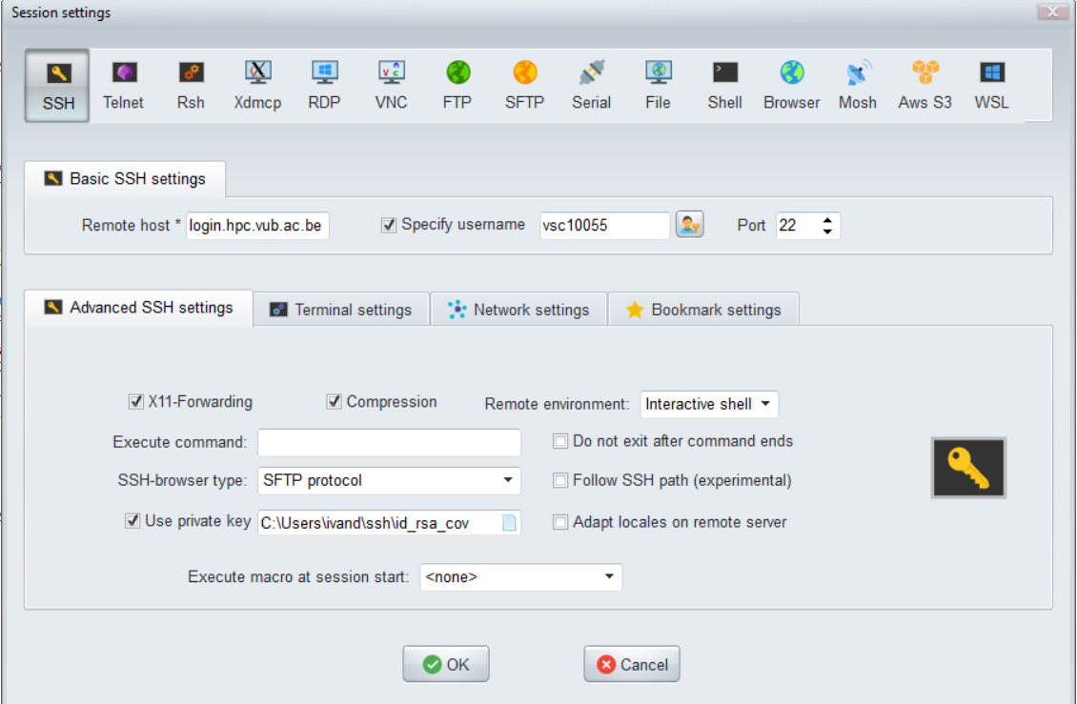


Recap: logging on into hydra
Start MobaXTerm
Click session
Click SSH
Remote host *: login.hpc.vub.ac.be
Username: <yourvscnumber>
Click ‘Advanced SSH settings’
SSH-browser type: SFTP protocol
Paste the path to your private key
Notes:
With demo

Slide 21
Login to hydra from a mac/linux
Download Xquartz: https://www.xquartz.org/ and activate it
Open terminal
In terminal type: ssh –Y vscXXXXX@login.hpc.vub.ac.be
You’re connected to hydra!
From Linux: ssh –X vscXXXXX@login.hpc.vub.ac.be
If it doesn’t find your key try: a) ssh -X -i /path/to/your/key vscXXXXX@login.hpc.vub.be b) ssh-add /path/to/your/key
Notes:
Stop and ask students to log in

Slide 22
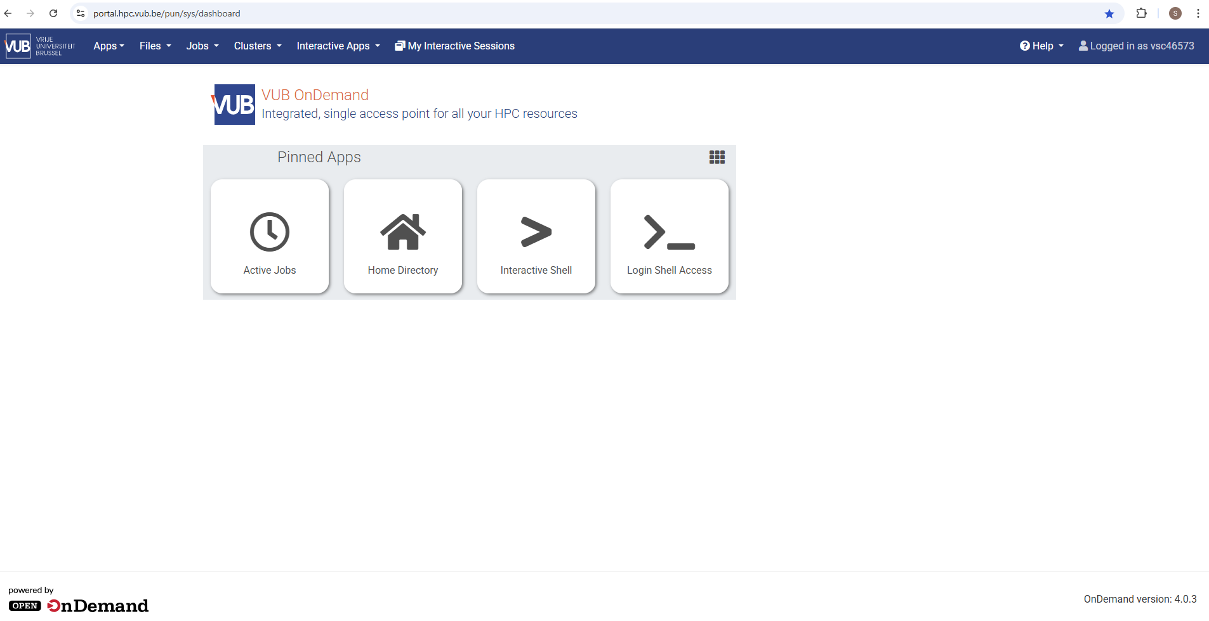
Web interface
https://portal.hpc.vub.be/

Slide 23
FATES Tutorial
Downloading the CESM source code

Slide 24
B. One-time setup (model installation and configuration)
- Load the required modules module load CESM-deps/2-foss-2024a
- All data files for CESM must be placed in $VSC_SCRATCH/cesm: mkdir $VSC_SCRATCH/cesm
- Create a convenient folder structure for model code, cases and inputs/outputs: mkdir $VSC_SCRATCH/cesm/cases mkdir $VSC_SCRATCH/cesm/output mkdir $VSC_SCRATCH/cesm/sources ln -sf /data/gent/vo/000/gvo00074/inputdata_cesm $VSC_SCRATCH/cesm/inputdata

Slide 25
B. One-time setup (model installation and configuration)
- Download the source code of CESM into $VSC_SCRATCH/cesm/sources: cd $VSC_SCRATCH/cesm/sources git clone -b ctsm5.2.0 https://github.com/ESCOMP/CTSM ctsm-5.2.0
- Download missing components:
cd ctsm-5.2.0 ./manage_externals/checkout_externals
- Add the configuration settings for Hydra HPC to your CESM/CIME source code:
update-cesm-machines -m ctsm $EBROOTCESMMINDEPS/machines/
Notes:
If error:
Machine hydra not found
Update-cesm-machines
If not working, try:
Remove folder cesm/sources (rm –r ~/cesm/sources) and repeat from step 4

Slide 26
FATES Tutorial
Running a default CLM run

Slide 27
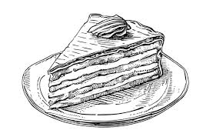
CESM workflow: Super Quick Start
Performing a simulation with CESM/CLM only requires 4 steps
Creating a case with ./create_newcase
Set up the case with ./case.setup
Build the executable (compile) with ./case.build
Submit the case to the batch queue to run the model with ./case.submit
Notes:
Overview slide

Slide 28
C. CESM workflow
Creating a case with ./create_newcase
Set up the case with ./case.setup
Build the executable (compile) with ./case.build
Submit the case to the batch queue to run the model with ./case.submit

Slide 29
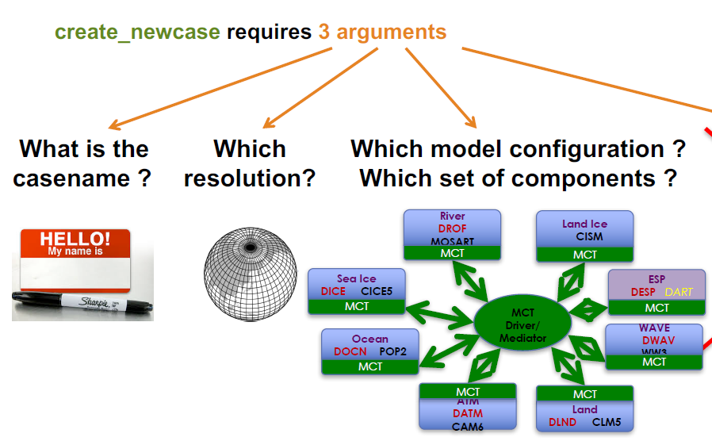
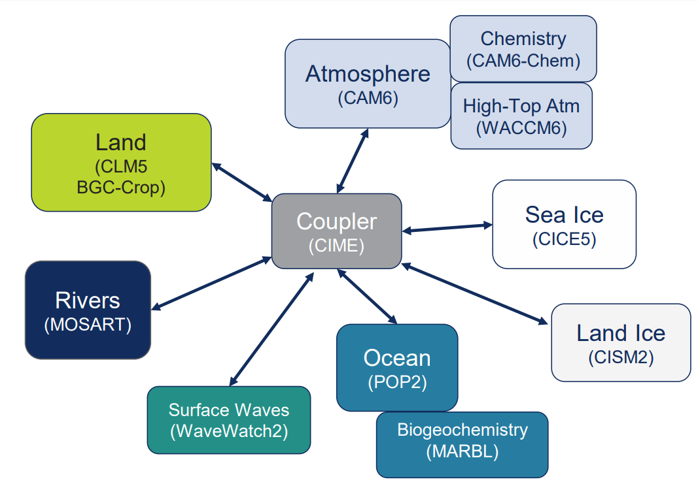
First things first: What’s a case?
A case defines the model architecture for your simulation.
./create_newcase requires 3 arguments:
Give your case a name
Specify spatial resolution (lat/lon)
Specify model components to run
Notes:
./create_newcase takes 3 arguments: the casename, the compset and the resolution

Slide 30
Creating a new case
./create_newcase --case $VSC_SCRATCH/cesm/cases/control --res f19_g17 --compset I2000Clm50BgcCrop --compiler gnu
--case: CASENAME argument Here you define the name and the location of the case being created
Our case → ‘control’
Notes:
./create_newcase takes 3 arguments: the casename, the compset and the resolution

Slide 31
Creating a new case
./create_newcase --case $VSC_SCRATCH/cesm/cases/control --res f19_g17 --compset I2000Clm50BgcCrop --compiler gnu
--res: RESOLUTION argument
Here you define the resolution of the grid
In our case: f19_g17 corresponds to a 1.9°x2.5° grid Many more possibilities (although not all supported):
http://www.cesm.ucar.edu/models/cesm2/config/grids.html

Slide 32
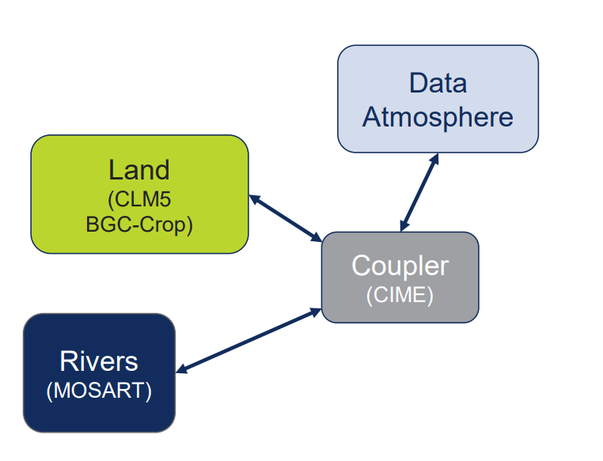
Creating a new case
./create_newcase --case $VSC_SCRATCH/cesm/cases/control --res f19_g17 --compset I2000Clm50BgcCrop --compiler gnu –machine hydra
--compset: COMPONENT SET argument
Here you specify which component models, forcing scenarios and physics options for the model.
All possible compsets: http://www.cesm.ucar.edu/models/cesm2/config/compsets.html
prescribed
Our control compset: I2000Clm50BgcCrop
Notes:
Does anyone remember which component of the model we were going to run?

Slide 33
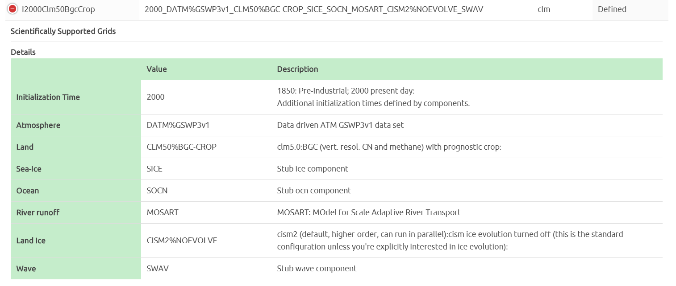
Compset short name
Compset long name
All possible compsets: http://www.cesm.ucar.edu/models/cesm2/config/compsets.html

Slide 34
Compset short name
Compset long name
All possible compsets: http://www.cesm.ucar.edu/models/cesm2/config/compsets.html

Slide 35
Compset short name
Compset long name
All possible compsets: http://www.cesm.ucar.edu/models/cesm2/config/compsets.html

Slide 36
Compset short name
Compset long name
All possible compsets: http://www.cesm.ucar.edu/models/cesm2/config/compsets.html

Slide 37
1. Creating a case
Navigate to cesm source code*: cd $VSC_SCRATCH/cesm/sources/ctsm-5.2.0/cime/scripts
Invoke the create a newcase-script ./create_newcase --case $VSC_SCRATCH/cesm/cases/control --res f19_g17 --compset I2000Clm50Fates --compiler gnu --machine hydra --run-unsupported
Go to the cases directory* and view the different files in your newly created case!
cd $VSC_SCRATCH/cesm/cases/control ls
Your turn!!
Notes:
Explain the files in a case directory later (when building).

Slide 38
C. CESM workflow
Creating a case with ./create_newcase
Set up the case with ./case.setup
Build the executable (compile) with ./case.build
Submit the case to the batch queue to run the model with ./case.submit

Slide 39
2. Set up the case
Before setting up the model run, we need to specify the run configurations (e.g., computational resources to use, how long should be the run, etc.):
Open the env_run.xml file and try to find:
- What is the default year your simulation will start?
- For how long it will run (a few days, months or years)?
Notes:
Explain what is in case directory (only scripts, and settings files).

Slide 40
2. Set up the case
Instead of changing model run configuration by hand it is preferred to use the ./xmlchange tool:
First, we turn the short-term archiver off by setting: ./xmlchange DOUT_S=FALSE
./xmlquery DOUT_S
In the env_*.xml files (controlling how model is compiled and run) We will issue a 12-months run. Change the settings in the .xml file using ./xmlchange command. ./xmlchange STOP_N=12,STOP_OPTION=nmonths
We also change the resources allocated to the job​ ./xmlchange NTASKS=4,JOB_WALLCLOCK_TIME=24:00:00
Notes:
Explain what is in case directory (only scripts, and settings files).

Slide 41
2. Set up the case
After selecting run option, we can proceed with model setup: ./case.setup
After invoking case setup, check the content of your case: which files are added?
Notes:
Explain what is in case directory (only scripts, and settings files).

Slide 42
C. CESM workflow
Creating a case with ./create.case
Set up the case with ./case.setup
Build the executable (compile) with ./case.build
Submit the case to the batch queue to run the model with ./case.submit

Slide 43
3. Build the case
The case.build command builds the individual component libraries and model executable:
./case.build
Your build succeeded if this message appears: MODEL BUILD HAS FINISHED SUCCESSFULLY
Building will take a few min In the meantime, open a second window in MobaXTerm and go to your case directory

Slide 44
CLM source code and input data
Source code Have a look at the CLM source code (in Fortran90 programming language) cd $VSC_SCRATCH/cesm/sources/ctsm-5.2.0/src/fates/biogeophys/ vi FatesPlantHydraulicsMod.F90 Check also other source code files ! Make sure to not change anything!
Input data Which input data do you think CLM needs?
Have a look at the input data for CLM and browse around: cd $VSC_SCRATCH/cesm/inputdata/lnd/clm2/surfdata_map
and start discovering the files with ncview (won’t work via web interface ☹)
Notes:
Question: which types of input data would the model need?
topography, land use maps (transient?), lake depths, population density, percentage of sand in soil, …
A: initial states, land use maps, … (prepare better!)

Slide 45
Basic Model Modifications
The model and the compset we are using already contains default values for many of the model features (e.g. CO2 levels, irrigation, radiative properties of the surface).
Users can change these variables values through the namelists (controlling what we ask from the model components).
In the case of CLM model, we can change namelist variables in user_nl_clm: vi user_nl_clm CLM namelists: http://www.cesm.ucar.edu/models/cesm2/settings/current/clm5_0_nml.html
Notes:
Explain here the content of a case directory (different types of files).

Slide 46
C. CESM workflow
Creating a case with ./create_newcase
Set up the case with ./case.setup
Build the executable (compile) with ./case.build
Submit the case to the batch queue to run the model with ./case.submit

Slide 47
4. Submit the case to the queue
A batch queue is a data structure maintained by a job scheduler to run jobs. How fast your job will run depends on your requested resources (memory, #CPU’s, walltime) During this session, we have priority.
Submit your case as a job to the batch queue ./case.submit
Check the state of your job with the command squeue mysqueue
To delete a job from the queue scancel <jobid> in this case 6031806
time use of your case is CPU time ≠ walltime

Slide 48
D. Check the output
When the model run completed, go to your work directory (in this directory the model has actually run and produced output data) cd $VSC_SCRATCH/cesm/output/control/run There should be some netCDF files visible. Open the main clm output ncview control.clm2.h0.0001-01.nc
Which time period does this file cover?
This file contains all output variables. You find an overview of the variables by running
ncdump –h control.clm2.h0.0001-01.nc

Slide 49
CESM Directory structure and shortcuts
CESM SCRIPTS
from where you make a new case (downloaded) cd ~/cesm/sources/cesm-2.2.2/cime/scripts
3. CASES DIRECTORY from where your case is set up, build and submitted. cd ~/cesm/cases
2. INPUTDATA DIRECTORY from where the input data is loaded directory is central, the same for everyone. cd ~/cesm/inputdata
4. OUTPUT DIRECTORY where the model is run, and outputs are saved. cd ~/cesm/output

Slide 50
Useful links
CLM5 namelists: https://www.cesm.ucar.edu/models/cesm2/settings/2.2.0/clm5_0_nml.html
CESM2 compsets: https://www.cesm.ucar.edu/models/cesm2/config/compsets.html
CLM5 documentation: https://escomp.github.io/ctsm-docs/versions/release-clm5.0/html/tech_note/index.html
CESM2 website: http://www.cesm.ucar.edu/models/cesm2/
Overview of output fields in clm5-outputvars.txt on Github
Some example plotting scripts for global CLM runs (https://github.com/sdeherto/CLM-FATES4UGent/tree/main/plotting)

Slide 51
FATES Tutorial
Setting up a site level FATES run

Slide 52
Setting up a FATES run
We will start by running FATES over a single site (in contrast to default global simulations by CLM)
This has some benefits as we can directly relate model simulations to observations in the field
E.g. inventory files, local meteo data, etc.
We will do a test simulation over Panama BCI using inventory data and local meteo data from the nearby meteo station
Afterwards you can explore some of your own interests with the model

Slide 53
Climate data
Solar, precipitation, wind, temperature through time
Surface File
Information on soils and other land characteristics
Host Land Model
Runs FATES
Domain File
Information on where FATES should run (lat, lon)
Parameter file
PFT and site level parameters
Inventory initialization data
Data on tree size distributions

Slide 54
Climate data
Solar, precipitation, wind, temperature through time
Surface File
Information on soils and other land characteristics
Host Land Model
Runs FATES
Domain File
Information on where FATES should run (lat, lon)
Parameter file
PFT and site level parameters
Inventory initialization data
Data on tree size distributions

Slide 55
Tools for modifying the parameter file
Before running FATES we need to generate a parameter file that describes the traits of each Plant Functional Type (PFT) in our simulation.
Tools for modifying parameter files are in the tools directory of the FATES repository. Also see the Read the Docs - Modifying the Parameter File.
FatesPFTIndexSwapper.py takes an input file and produces an output file with any combination of PFTs from the input file, including replicated PFTs.
First lets make a parameter file with a single tropical PFT…

Slide 56
Tools for modifying the parameter file
First we generate a subsirectory to store our parameter files
mkdir $VSC_SCRATCH/cesm/params
Copy the original file from our default simulation
Cd $VSC_SCRATCH/cesm/params/
cp $VSC_SCRATCH/cesm/inputdata/lnd/clm2/paramdata/fates_params_api.32.0.0_12pft_c231215.nc fates_params_default.nc
FATES parameter files are in netcdf format (.nc) or human readable versions (.cdl). To convert the default cdl file to the netcdf version FATES can read, we use ncgen from the NCO tools language
From .nc to .cdl
ncdump fates_params_default.nc > fates_params_default.cdl
From .cdl to .nc
ncgen -o fates_params_default.nc fates_params_default.cdl
!! Check your changes by typing ls !!

Slide 57
Tools for modifying the parameter file
If you open the .cdl file with vi (in the container) you’ll see it has twelve PFTs (described here). To convert it to a single PFT file we use FatesPFTIndexSwapper.py which is located in tools in the FATES directory.
First copy it to the current location (indicated by the . )
cp $VSC_SCRATCH/cesm/sources/ctsm-5.2.0/src/fates/tools/FatesPFTIndexSwapper.py .
Load scipy and then run the script:
ml SciPy-bundle/2023.07-gfbf-2023a
./FatesPFTIndexSwapper.py --fin=fates_params_default.nc --fout=fates_params_default-1pft.nc --pft-indices=1

Slide 58
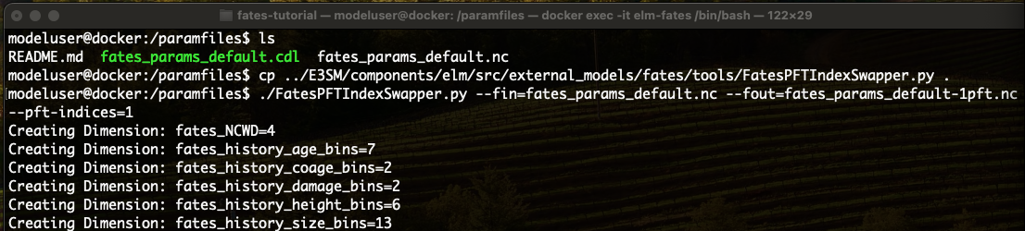
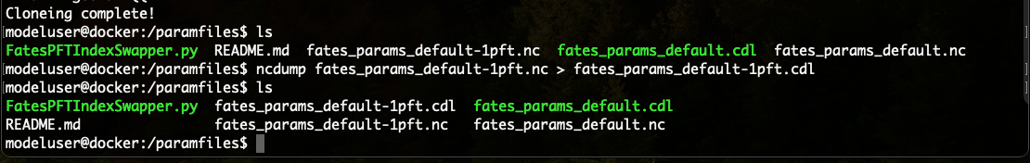
Tools for modifying the parameter file
Make the 1 PFT file
Make it human readable

Slide 59
The create script
The create script tells your computer how to run FATES
You can find some examples of FATES create scripts which combine all four run steps described before on github (https://github.com/sdeherto/CLM-FATES4UGent/tree/main/runscripts).
We will start with create_clm-fates-bci_jra-init.sh
A detailed description of the script (ELM version) is in Read the Docs under Create Scripts.
This script builds and submits a run at Barro Colorado Island (BCI), initializing with inventory data.

Slide 60
Starting the FATES run
To run the create script and launch a FATES run:
cd $VSC_SCRATCH/cesm
mkdir runscripts
mkdir sitedata
Upload all files under sitedata and runscripts on github to those directories
To add some instructions on how to get this from github once github page is online
git clone https://github.com/sdeherto/CLM-FATES4UGent.git
cd $VSC_SCRATCH/cesm/CLM-FATES4UGent
cp –r runscripts $VSC_SCRATCH/cesm/runscripts
cp –r sitedata $VSC_SCRATCH/cesm/sitedata
Notes:
Jessie to demo

Slide 61
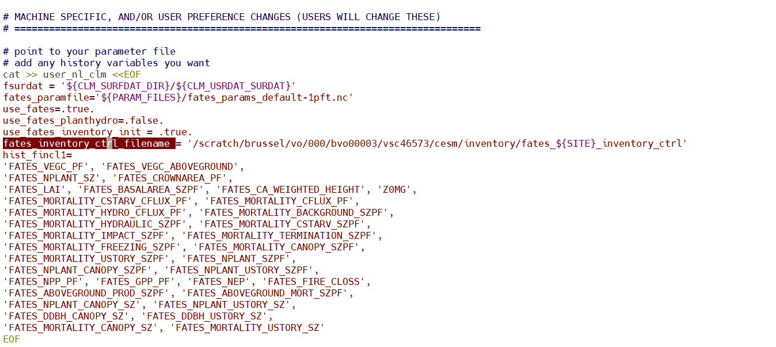
Tailor the script to your user
Some paths are hard coded with a vsc number which you need to change, first open the runscript to edit:
vi create_clm-fates-bci_jra-init.sh
On line 85 you need to change the following path to include your vsc number in stead of vsc46573
Notes:
Jessie to demo

Slide 62
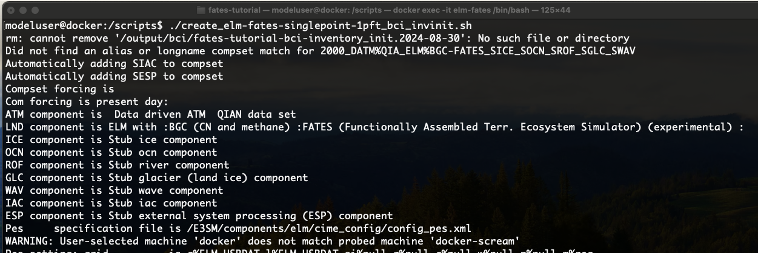
Starting the FATES run
To run the create script and launch a FATES run, move into the runscripts folder and type the following into the command line:
chmod u+x create_clm-fates-bci_jra-init.sh
./create_clm-fates-bci_jra-init.sh
The case will start to compile and you’ll see a lot of text zoom by
Notes:
Jessie to demo

Slide 63
Starting the FATES run
Monitor your job progress by checking
squeue
When the status is R, you can check if it has worked by opening a new terminal window, then change directory to the case that was built under output/ and go to the run directory (change the date to match your case):
cd output/fates-tutorial-bci_jra-inventory_init.2024-08-30/run
Run ls again, you should see files ending in elm.h0.1900-01.nc appearing - one per month.
Now go take a break and wait for the run to finish!
Notes:
Jessie to demo

Slide 64
FATES Tutorial
Visualizing FATES outputs

Slide 65
Visualizing results from the first run
Before we can process the simulation we need to combine the monthly files into a single file using nco tools.
In the elm-fates container, change directory into the output directory and to the run directory in your case
cd output/fates-tutorial-bci_jra-inventory_init.2024-08-30/run
Type the following command, replacing the file names with the name of your files (use tab complete to avoid mistakes):
This command below is one line!
ncrcat -h fates-tutorial-bci_jra-inventory_init.2024-08-30.elm.h0.190*.nc
fates-tutorial-bci_jra-inventory_init.2024-08-30.sofar.nc
See Read the Docs FATES History Outputs for more instructions on how to concatenate output files and change output file frequency.

Slide 66
Visualizing results from the first run
An example script to help you get started with visualizing results is in the jupyter book Lesson 3.
https://github.com/NGEET/fates-tutorial/tree/main/fates-tutorial-jupyter-book
Both R and python versions are available.
You can run these via the web interface, otherwise take some output files offline for running these
Notes:
Greg to demo

Slide 67
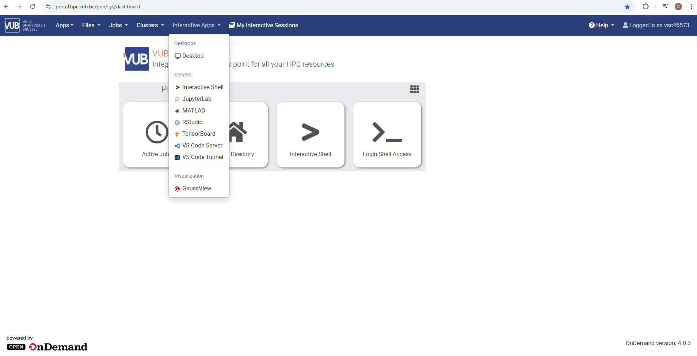
Visualizing results from the first run
Notes:
Greg to demo

Slide 68
FATES code on GitHub
Tech note explains the science in FATES
Link to FATES Github repo

Slide 69
Setting up a personalised run

Slide 70
Climate data
Solar, precipitation, wind, temperature through time
Surface File
Information on soils and other land characteristics
Host Land Model
Runs FATES
Domain File
Information on where FATES should run (lat, lon)
Parameter file
PFT and site level parameters
Inventory initialization data
Data on tree size distributions

Slide 71
FATES initialization modes
Information on the state of the ecosystem is read in from a previous run
Restart from a previous run
Simulation A at the end of the run
Simulation B at the start of the run
Notes:
Hybrid run - new case, branch run - restart.

Slide 72
FATES initialization modes
Restart from a previous run
Cold-start from bare ground
Start with the smallest size class at a specified density and allow trees to grow to a full forest

Slide 73
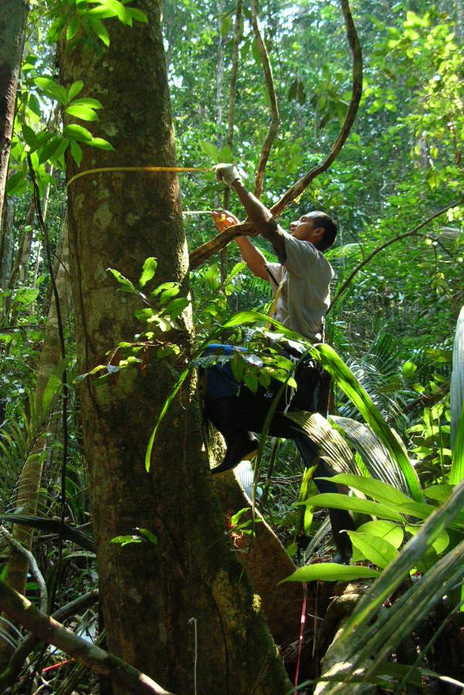
FATES initialization modes
Restart from a previous run
Cold-start from bare ground
Inventory initialization
Mateiro Joao Batista in the Manaus plot. Photo credit Kyle Harms
Read in size distributions from inventory data - start with a mature forest

Slide 74
FATES initialization modes
Restart from a previous run
Cold-start from bare ground
Inventory initialization
Mateiro Joao Batista in the Manaus plot. Photo credit Kyle Harms
This requires three files:
patch file - .pss - patch structure
cohort file - .css - cohort structure
control file - location of sites and files
Read in size distributions from inventory data - start with a mature forest

Slide 75
Climate data
Solar, precipitation, wind, temperature through time
Surface File
Information on soils and other land characteristics
Host Land Model
Runs FATES
Domain File
Information on where FATES should run (lat, lon)
Parameter file
PFT and site level parameters
Inventory initialization data
Data on tree size distributions

Slide 76
Inventory initialisation
Inventory data requires intensive field campaign and is not available for all sites
If you have these data available for a site you need to convert them to the model specific format
Some scripts and explanation on how to do this are available here https://fates-users-guide.readthedocs.io/projects/tutorial/en/latest/inventory_data.html

Slide 77
Inventory initialisation
The test script we will use create_clm-fates-bci_jra-init.sh will initialise from inventory data that is provided
You will need to update the following file to ensure that it points to the inventory files in your folders
vi $VSC_SCRATCH/cesm/inventory/fates_bci_jra_inventory_ctrl
And then change the paths to the .pss and .css files to include your own vsc number

Slide 78
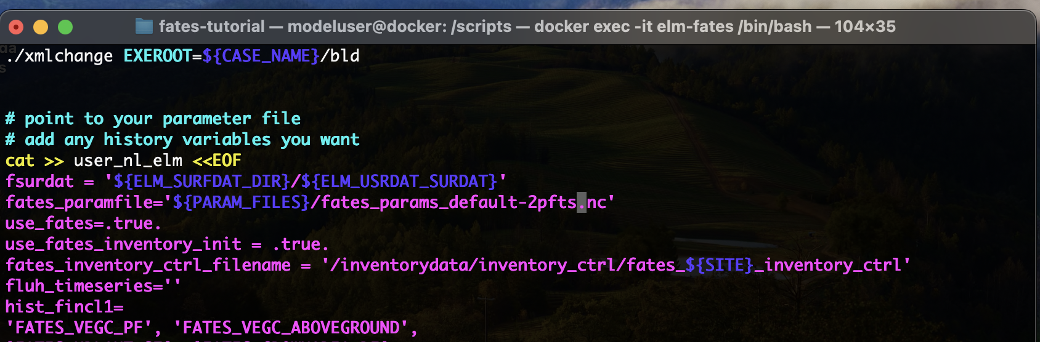
Optional: Change to bare-ground spin-up
use_fates_inventory_init = .false.
Not for this tutorial but when no inventory data is available (=most of the time)
Change this to use_fates_inventory_init = .false.

Slide 79
Running FATES
Different model parameters
Different model setup
Restart from a previous run (requires a previous run)
Cold-start from bare ground
Inventory initialization (requires field data)
Different site location (tropical forest vs temperate forest)
Different climate data
Notes:
Greg to demo live

Slide 80
Climate data
Solar, precipitation, wind, temperature through time
Surface File
Information on soils and other land characteristics
Host Land Model
Runs FATES
Domain File
Information on where FATES should run (lat, lon)
Parameter file
PFT and site level parameters
Inventory initialization data
Data on tree size distributions

Slide 81
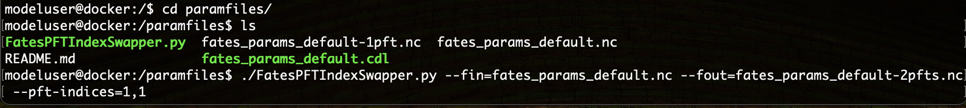
Modifying the parameter file
Make a two PFT parameter file and alter some traits so that we have an early successional and late successional PFT.
In the params directory create a two PFT parameter file.
cd params
./FatesPFTIndexSwapper.py --fin=fates_params_default.nc --fout=fates_params-2pfts.nc --pft-indices=1,1

Slide 82
Modifying the parameter file
The FATES parameter file is in netcdf format. We can convert it to a human readable format using ncdump. This is part of the NCO language which is loaded in your container.
ncdump fates_params_default-2pfts.nc > fates_params_default-2pfts.cdl
Open the new cdl file and start making changes to parameters that affect coexistence. You can do this inside the container using vi, or outside the container in param_files using your favourite text editor.
Or use the modify_fates_paramfile.py script (see next slide)
WHEN YOU HAVE FINISHED MODIFYING THE .CDL FILE YOU NEED TO REMAKE THE .NC FILE USING ncgen

Slide 83
Modifying the parameter file
First, copy the modify_fates_paramfile.py to your /params folder first
cp $VSC_SCRATCH/cesm/sources/ctsm-5.2.0/src/fates/tools/modify_fates_paramfile.py .
modify_fates_paramfile.py script modifies the parameter file. It takes the following flags:
--var - variable
--pft - PFT number If missing script assumes a global parameter
--fin - input filename
--fout - output filename
--val - new value
--O - overwrite the output file
The full FATES parameter file is found in the FATES repo on GitHub here.

Slide 84
Setting up a new simulation to compare
We need to modify the create script. Inside the container, change directory to the scripts directory then make a copy with a new clear name.
cd scripts
cp create_elm-fates-singlepoint-1pft_bci_invinit.sh create_elm-fates-singlepoint-2pft_bci_invinit.sh
Don’t forget to do this every time you create a new script!!

Slide 85
Setting up a new run
To set up a new run there are a few things to change in the create script:
Change TAG - this means FATES will create a new case and not overwrite your previous simulations based on the TAG name.
Set the number of years to run the simulation by changing STOP_N and REST_N
Point to a new parameter file (see next slide) - if you made a new parameter file then be sure to point to it in the create script.
Add any history variables you might want in the section where we edit user_nl_elm

Slide 86
Point to the new parameter file in your create script
Once you are done modifying your parameter file save it then change directory back to the runscripts directory.
Modify the line in your new create script that specifies the parameter file. Point to the new two pft parameter file.
Also change the tag - export TAG=
Change this line to point to your new 2 pft file

Slide 87
Climate data
Solar, precipitation, wind, temperature through time
Surface File
Information on soils and other land characteristics
Host Land Model
Runs FATES
Domain File
Information on where FATES should run (lat, lon)
Parameter file
PFT and site level parameters
Inventory initialization data
Data on tree size distributions

Slide 88
Setting up FATES at a new site
Surface files:
soil and other land properties
Domain files:
sets the domain over which FATES runs
Climate data:
solar, precipitation, wind, humidity - minimum 6 hourly frequency
More information is found in the Read the Docs under Setting up FATES at a New Site

Slide 89
Setting up FATES at a new site
Surface files and domain files are located under /sitedata/ followed by your site name.
Climate data for each site are located in the same directory under CLM1PT_data.
These are .nc files so the easiest way to inspect these is with the NCO command ncks -m - this prints the metadata for a file, e.g.
ncks -m domain_bci_fates_tutorial.nc

Slide 90
Setting up FATES at a new site/region
You can also start off from some of the example scripts provided in the runscripts directory
create_clm-fates-yangambi.sh This will set up a run over Yangambi DRC using global reanalysis data
create_clm-fates-1pft_yangambi_flux.sh (TODO) This will set up a run over Yangambi DRC using local fluxtower data
create_clm-fates-africa.sh This will set up a regional run over Tropical Africa using global reanalysis data
create_clm-fates-1pft_global.sh This will set up a global run using global reanalysis data, this is similar to what we setup for control but now in a scripted form.

Slide 91
Some info on regional runs
These runs are setup very similarly to a site level run with the only difference that they run over a region in stead of a single point
This implies that you have to provide a file that describes which grid is used, this is called a mesh file and is created based on your surface file (see next steps)
These runs can be useful if you want to run FATES spatially explicit but are only interested in a specific region across the globe

Slide 92
Setting up FATES at a new site/region (optional)
Note that for the scripts provided all surface and domain files are provided
However CESM comes out of the box with tools to create new site and region level files
First you need to get the CTSM modules installed, on hydra this should be done via conda (https://hpc.vub.be/docs/software/additional_software/)
You can find instructions for installing this here :
https://escomp.github.io/CTSM/users_guide/using-clm-tools/using-ctsm-pylib.html#using-ctsm-pylib
Once installed, add the following three lines to your .bashrc
module load Mamba
source $EBROOTMAMBA/etc/profile.d/conda.sh
conda activate ctsm_pylib

Slide 93
Setting up FATES at a new site (optional)
Then you are all set to use these tools, for a site level case, navigate to
cd $VSC_SCRATCH/cesm/sources/ctsm-5.2.0/tools/site_and_regional
Then run (this may take a while)
./subset_data point --lat 8.95 --lon 280.2 --site bci_subset --create-surface --create-datm --create-domain --dompft 1 --overwrite --datm-syr 2003 --datm-eyr 2015 --create-user-mods --outdir $VSC_SCRATCH/cesm/sitedata/bci_test --inputdata-dir $VSC_SCRATCH/cesm/inputdata
This will generate new files under sitedata that can be used to set up a run

Slide 94
Setting up a new site run (optional)
To set up a new run there are a few things to change in the create script:
Start from the create_clm-fates-1pft_yangambi.sh (rename to your site)
Change SITE - this automatically updates TAG as well.
Make sure the surface and domain files point to your newly generated files
Also ensure that the coordinates match by updating PTS_LON and PTS_LAT
Set the number of years to run the simulation by changing STOP_N and REST_N
Add any history variables you might want in the section where we edit user_nl_elm

Slide 95
Setting up FATES at a new region (optional)
Then you are all set to use these tools, for a site level case, navigate to
cd $VSC_SCRATCH/cesm/sources/ctsm-5.2.0/tools/site_and_regional
Then run
./subset_data region --create-surface --lat1 -25 --lat2 25 --lon1 1 --lon2 45 --overwrite --verbose --outdir $VSC_SCRATCH/cesm/sitedata/africa --inputdata-dir $VSC_SCRATCH/cesm/inputdata
Then from within the new region’s directory, create the mesh file
module load NCO
cp =$VSC_SCRATCH/cesm/sitedata/scrip.nc ./
ncks --rgr infer --rgr scrip=scrip.nc <fsurdat_generated_in_previous_step> lnd_mesh.nc
ESMF_Scrip2Unstruct scrip.nc lnd_mesh.nc 0

Slide 96
Setting up a new regional run (optional)
To set up a new run there are a few things to change in the create script:
Start from the create_clm-fates-1pft_africa.sh (rename to your region)
Change SITE - this automatically updates TAG as well.
Make sure the surface and mesh files point to your newly generated files
Set the number of years to run the simulation by changing STOP_N and REST_N
Add any history variables you might want in the section where we edit user_nl_elm

Slide 97
Setting up FATES at a new site - BEYOND THE TUTORIAL
To set up FATES at a new site beyond the tutorial you’ll need to generate your own surface data file, domain file, and climate data.
You can use the jupyter notebooks in the tools section of the fates-tutorial:
Make met (meterological) data and make surface and domain files.
These scripts are not interactive through the website. The best way to run them is to launch jupyter through the container.
You will need to change these file paths to point to data that you download from here: https://ftp.cgd.ucar.edu/cesm/inputdata/
You’ll need to download the surface and domain files as well as the climate data - beware the climate data is very large!

Slide 98
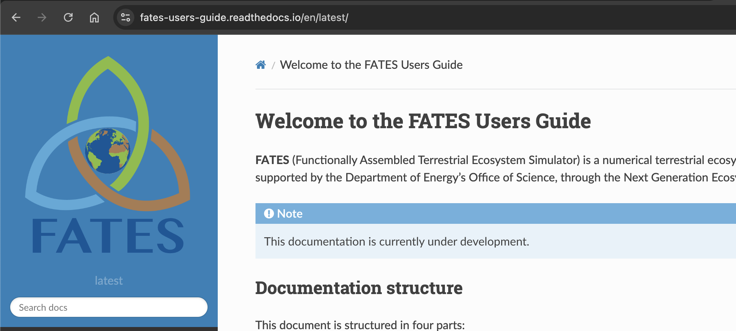
Getting help with FATES
How to use FATES: FATES User’s Guide
Tutorial, Developer’s Guide and Technical Doc are all searchable via user’s guide
All are under development and we welcome contributions

Slide 99
FATES code on GitHub
Tech note explains the science in FATES
Link to FATES Github repo

Slide 100

Getting help with FATES - Github
Asking questions/getting help: Github Discussions Board
The best way to reach us!
Subsections: Ideas, Q&A, Announcements, Papers and more
Found a bug: Submit a Github Issue
If you are not sure, it’s ok to start a new discussion thread
More detail is always better
Staying up to date: Github Tags
Semantic Versioning
HLM-FATES Application Program Interface (API) updated often (~2 months)
FATES User’s Guide compatibility table

Slide 101
Interacting with the Community
FATES Model Google Group
Request to join: https://groups.google.com/g/fates_model
FATES Modeling Community Call
Format
Model updates and announcements
Invited speakers on related topics of interest
“Office-hours”
Time: 11 AM Pacific Time every other Thursday
Announced on the Model Google Group

Slide 102
Interacting with the Community - Earth System Models
E3SM
Github Discussion: https://github.com/E3SM-Project/E3SM/discussions
Documentation: https://docs.e3sm.org/E3SM/
Community Terrestrial System Model (CTSM)
Github Discussion: https://github.com/ESCOMP/CTSM/discussions
Documentation: https://escomp.github.io/ctsm-docs/versions/master/html/index.html
Community Land Model Central European Time zone call
Lead: Rosie Fisher, CICERO
Common Infrastructure for Modeling the Earth (CIME)
All ESMs that support FATES use CIME
Case setup, build, submission, configuration
Documentation: https://esmci.github.io/cime/versions/master/html/index.html

Slide 103
Extra slides

Slide 104
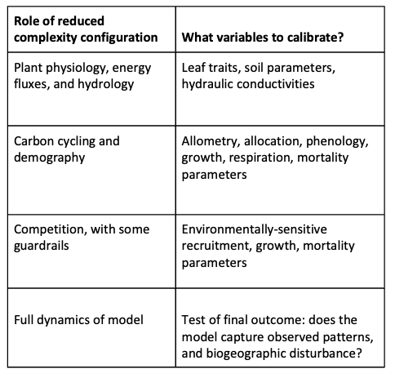
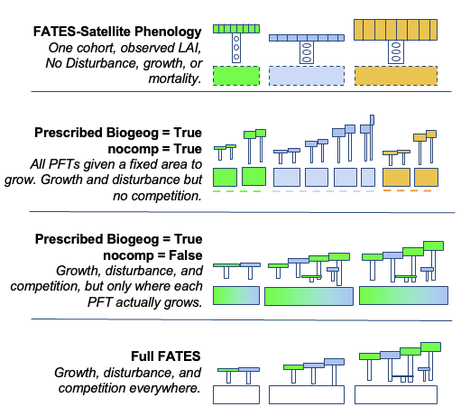
FATES in “Reduced Complexity Modes” - Stepwise calibration

Slide 105
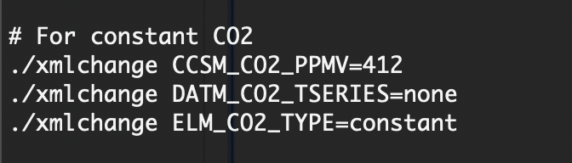
CO₂ time series
In your create scripts you will see a few lines like this:
For constant CO₂ you can set this number here

Slide 106
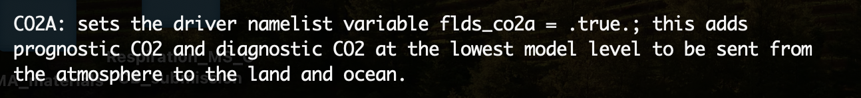
CO₂ time series
This will set the directory path to look up the forcing data file that supplies the 20th century transient CO2 values from CMIP6
For a “transient” time series of CO₂:
./xmlchange CCSM_BGC=CO2A
./xmlchange CLM_CO2_TYPE=diagnostic
./xmlchange DATM_CO2_TSERIES=20tr

Slide 107
FATES Tutorial
Lesson 6 - Visualizing multidimensional FATES outputs

Slide 108
Visualizing results (recap)
Before we can process the simulation we need to combine the monthly files into a single file using nco tools.
In the elm-fates container, change directory into the output directory and to the run directory in your case
cd output/bci/fates-tutorial-bci-inventory_init.2024-08-30/run
Type the following command, replacing the file names with the name of your files (use tab complete to avoid mistakes):
This command below is one line!
ncrcat -h fates-tutorial-bci-inventory_init.2024-08-30.elm.h0.190*.nc
fates-tutorial-bci-inventory_init.2024-08-30.sofar.nc
See Read the Docs FATES History Outputs for more instructions on how to concatenate output files and change output file frequency.

Slide 109
Visualizing a two PFT run
FATES outputs that end in _PF are output along the PFT dimension.
Outputs that end in _SZPF are output along the size x PFT dimension.
The scripts in lesson 6 of the Jupyter book have examples of plotting multi-dimensional FATES outputs.
More information can be found in the Read the Docs under FATES History Outputs

Slide 110
Challenges - Exploring other case output
Using jupyter, explore what history output variables are available in your output data
R
names(fates$var) to get variables
ncatt_get(fates, ‘variablename’) to get long name
Python
list(fates.variables)
fates.VARIABLENAME.long_name
Pick a new variable to explore in the notebook
Note: What is the dimensionality of the variable?

Slide 111
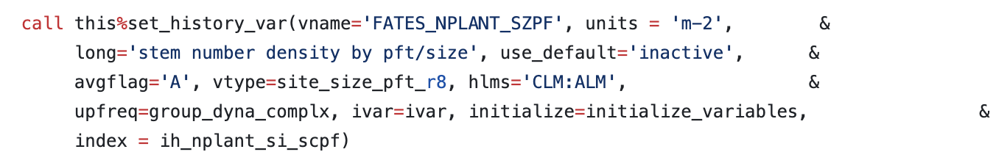
Challenges - More history output variables!
FATES has lots of different multi-dimensional variables beyond size x PFT
2D examples: canopy layer x leaf layer (CLLL), size class bin x age bin (SCAG)
3D examples: canopy layer x leaf layer x PFT (CLLLPF)
Full history file is here, look at the bottom of the file to see the full list with the descriptions.
Recall: FATES has “active” and “inactive” history output variables
To add an inactive variable, add it to your run script where we edit user_nl_elm
Removing default variables: add hist_empty_htapes = .true.

Slide 112
Setting up a new run with inventory initialisation
To set up a new run there are a few things to change in the create script:
Change SITE - this automatically updates TAG as well.
If you want to do a simulation with inventory initialization but multiple PFTs you can either assign each species to a PFT based on knowledge of its biology, or set PFT=0 in the .css file. This makes multiple copies of each cohort, one for each PFT.
Set the number of years to run the simulation by changing STOP_N and REST_N
Point to a new parameter file - if you made a new parameter file then be sure to point to it in the create script.
Add any history variables you might want in the section where we edit user_nl_elm

