Slide 1

FINORA REQUIREMENTS
Finora Project Requirements
By:
Samuel Martin
Steven De Jesus
Wilfredo Cedano Ventura
William Hite
Notes:
This part of the requirements covers the financial transactions that power Finora. I will explain how users review and manage their transaction history, then show how they add income and expenses. These features work together to keep the user’s budget balance and financial records current.

Slide 2
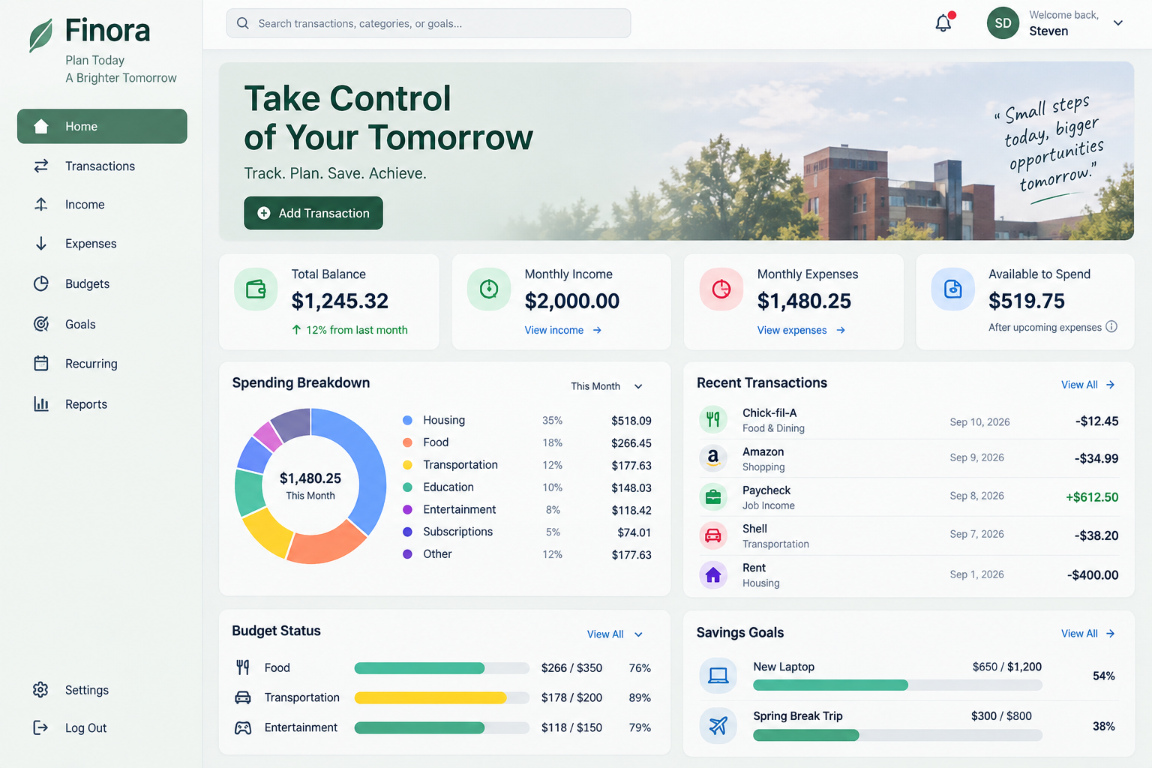
Introduction to Finora
AI Generated
Prototype

Slide 3
Finora
THE PROBLEM
PURPOSE
College students often manage limited or irregular income while facing education and everyday living costs.
Money may come from employment, financial aid, scholarships, refunds, or other sources.
It can be difficult to know what is truly available to spend after upcoming obligations are considered.
Organize income, expenses, budgets, and savings goals in one place.
Provide a clearer picture of spending patterns and financial obligations.
Help students make more informed financial decisions and develop healthier habits.
Focus: understand what is realistically available to spend.

Slide 4
Tools & technologies
01
Application
02
Data & Access
TypeScript
HTML + CSS
React
Next.js
Bootstrap
Supabase
SQL
Supabase Authentication
03
Development
04
Deployment & Team
Visual Studio Code
Windows
Git + GitHub
Vercel
Discord + Text Messaging
ChatGPT Free

Slide 5
User Accounts and Authentication
01
Finora needs a way to keep the financial information of users separate.
02
For this reason, Finora will store a unique email and password to represent each user.
03
Finora will send a user’s a one-time password when creating an account to ensure they have access to their email.
02

Slide 6
The Financial Dashboard
01
The Financial dashboard will be on the homepage of the website and provide a brief overview of users’ financial status.
02
Finora will keep track of the user’s account balance and remaining budget and update both based on their transactions.
03
The values found by Finora will then be displayed on the dashboard.
04

Slide 7
The Financial Dashboard
01
Some transactions will be automatically repeated, such as a subscription.
02
Finora will take this and the current account balance to estimate the user’s account balance at the end of the month.
03
Finora will do the same thing with the budget and display how far over or under budget the user is expected to be.
06

Slide 8
The Financial Dashboard
01
Finora will keep track of user purchases and provide predefined categories for them.
02
Finora will generate a pie chart of the user’s spending by category in a month.
03
This will help the user to easily notice if they are spending too much in one area.
09

Slide 9
Financial Warnings
01
Using the budget set by the user and tracking user transactions will allow Finora to detect when the user is approaching their budget.
.
02
Finora will notify the user that they are nearing the limit of their budget when it detects they have spent 80% of what is allotted for the month.
03
Finora will also notify the user if they are approaching some limit on spending in a particular category even if they are not going over budget.
11

Slide 10
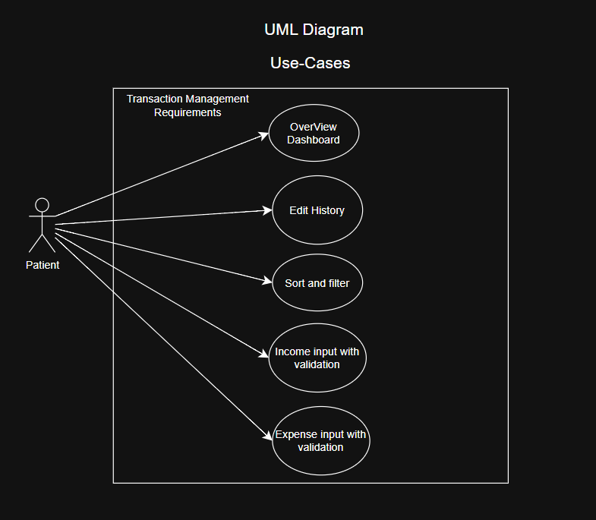
Transaction Management UML – Use Case Diagram
Interaction
Notes:
UML use cases are a type of behavioral diagram that visually and maps out how the user interact with a system's core functions.

Slide 11
Overview - Transaction history and management
Balance | Current: 1,578
MANAGEMENT
NAME | CATEGORY | FREQUENCY | DATE | AMOUNT
Paycheck | Employment | Monthly | Sept. 1 | +$2,000
Rent | Housing | Monthly | Sept. 3 | -$850
Groceries | Food | Just once | Sept. 5 | -$72
Scholarship | Scholarship | Yearly | Sept. 8 | +$500
Edit
Existing values open prefilled. Confirm saves the update.
Remove
A confirmation popup prevents accidental deletion.
Notes:
The page retrieves prior transactions from the database and shows the details needed to understand each balance change.
The transaction history page gives users one place to review earlier financial activity. Finora retrieves the records from the database and displays the transaction name, amount, category, frequency, and date. These fields make it clear why the balance changed and whether the transaction will repeat. Users can also correct a record through Edit. The popup opens with the existing values already filled in, and Confirm updates the database. Remove opens a second confirmation popup, so a user does not erase a transaction by mistake. Cancel closes either popup without making a change. The sample records on this slide only illustrate the planned layout.

Slide 12
Finding and organizing transactions
SORT
FILTER
INCLUDE / EXCLUDE
Date is the default
Expense + income categories
One filter, two views
Newest records appear first
Sort by
Food, housing, tuition, employment, financial aid, scholarships, other and the remaining defined categories.
INCLUDE
EXCLUDE
Reverse order
Only matching records remain visible.
Notes:
Sorting and filtering keep a long transaction list usable without changing the stored records.
As the user adds more records, the history needs tools for finding the right transaction. Date is the default sort, with the newest items first. The user can switch the sort to name, amount, category, or frequency, and a separate button reverses the order. When two records have the same priority, the system applies the secondary sequence specified in the requirements. Filtering focuses the list on one category, including both expense and income categories. The include and exclude control changes the meaning of that filter. Include shows the selected category. Exclude hides that category and keeps the rest. The filter changes only what the user sees. It does not delete or modify any record.
Two views: Include shows the chosen category. Exclude hides it and shows everything else.

Slide 13
Income tracking
Add income
$ +
AMOUNT
DATE
$ 0.00
Select a date
Validation before saving
CATEGORY
SOURCE OR DESCRIPTION
Amount must be greater than zero
Date and category are required
Invalid entries show an error message
Employment
Employer, scholarship, side work...
Cancel
Add Income
Employment Financial aid Scholarships Allowance Self employment Other income
Notes:
Income Tracking records money coming into the account. When the user chooses Add Income, the form asks for the amount, date, category, and a source or description. The predefined categories include employment, financial aid, scholarships, allowance, self employment, and other income. Before saving, Finora checks that the amount is greater than zero and that the user selected both a date and a category. Missing or invalid information produces an error message. If the entry passes validation, Add Income saves it to the database and adds it to the user's transaction history. Cancel closes the form without saving.
Valid entries become part of the user's transaction history.

Slide 14
Expense tracking
$ −
Add expense
AMOUNT
DATE
Expense rules
$ 0.00
Select a date
Amount must be greater than zero
Date and category are required
Description remains optional
CATEGORY
DESCRIPTION
Food
Optional details
Cancel
Add Expense
Categories: food, housing, transportation, tuition, entertainment, utilities, subscriptions, and other.
Valid income and expense entries feed the same transaction history and update the balance.
Notes:
Expense Tracking follows the same workflow, but it records money leaving the account. The user enters an amount, chooses a date and expense category, and can add an optional description. The categories cover common student expenses such as food, housing, transportation, tuition, entertainment, utilities, subscriptions, and other. The amount must be greater than zero, and the date and category are required. Invalid information causes an error message, while a valid entry saves to the user's records. Once saved, the expense appears in transaction history and reduces the calculated balance. Together, income and expense tracking provide the records that the management page can sort, filter, edit, or remove.

Slide 15
Budget Planner - Overview
Plan and set limits for each month
Monthly Budget
Category Budget
Opt-In for email notifications
Display for created Budgets
Create Budget
AMOUNT
START DATE
$ 4,00.00
Select a date
CATEGORY
Food
☑
I would like to receive email
notifications
Employment Financial aid Scholarships Allowance Self employment Other income
Cancel
Create Budget

Slide 16
Budget Planner
Create Budget
Buttons to Create & Modify Budgets
Webpage Display:
  Total Budget
  Amount spent
  Amount remaining
  Percentage used
  Warning label if spending approaches or exceeds Budget
+
Total Budget
AMOUNT:
SPENT:
PERCENTAGE:
$ 2,000
Edit
$ 985.01
Delete
49%
Food
AMOUNT:
SPENT:
PERCENTAGE:
$ 500
Edit
$ 154.71
31%
Delete
Entertainment
AMOUNT:
SPENT:
PERCENTAGE:
$ 100
Edit
$ 291.15
Delete
291%

Slide 17
Recurring Expenses
Expense name
Expense amount
Expense frequency (weekly, monthly, annual)
Expense category
Start date
Create Recurring Expense
EXPENSE NAME
AMOUNT
Netflix
$26.99
FREQUENCY
START DATE
Monthly
Select a date
CATEGORY
Entertainment
Cancel
Create
Employment Financial aid Scholarships Allowance Self employment Other income

Slide 18
Recurring Expenses - Dashboard
Create, edit, and delete recurring expenses.
View upcoming expenses
Sorted based on next payment
Create Recurring Expense
+
Rent
AMOUNT:
NEXT PAYMENT:
CATEGORY:
$ 500
Edit
12/01/26
Delete
Monthly
Housing
Netflix
AMOUNT:
NEXT PAYMENT:
CATEGORY:
$ 26.99
Edit
12/01/26
Monthly
Entertainment
Delete
Dropbox
AMOUNT:
NEXT PAYMENT:
CATEGORY:
$ 180
Edit
05/19/27
Delete
Annually
Utility

Slide 19

Questions?

