Slide 1



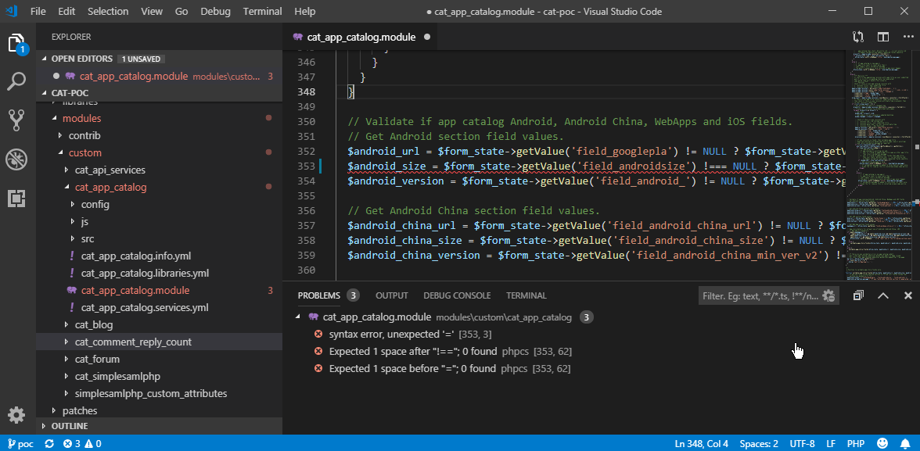




Software Stack
Development accelerators
Drupal coding standards integrated into IDE
Drupal coding standards integrated into Git
Code debugger integrated into IDE
Drupal Console - CLI
Automation scripts to import database
Standardized software platform
XAMPP (Apache 2.4, PHP 7.2, MySQL 5.5)
Git 2.18, Composer 1.7
Visual Studio Code 1.30
Drupal Coding Standards - www.drupal.org/docs/develop/standards

