Slide 1

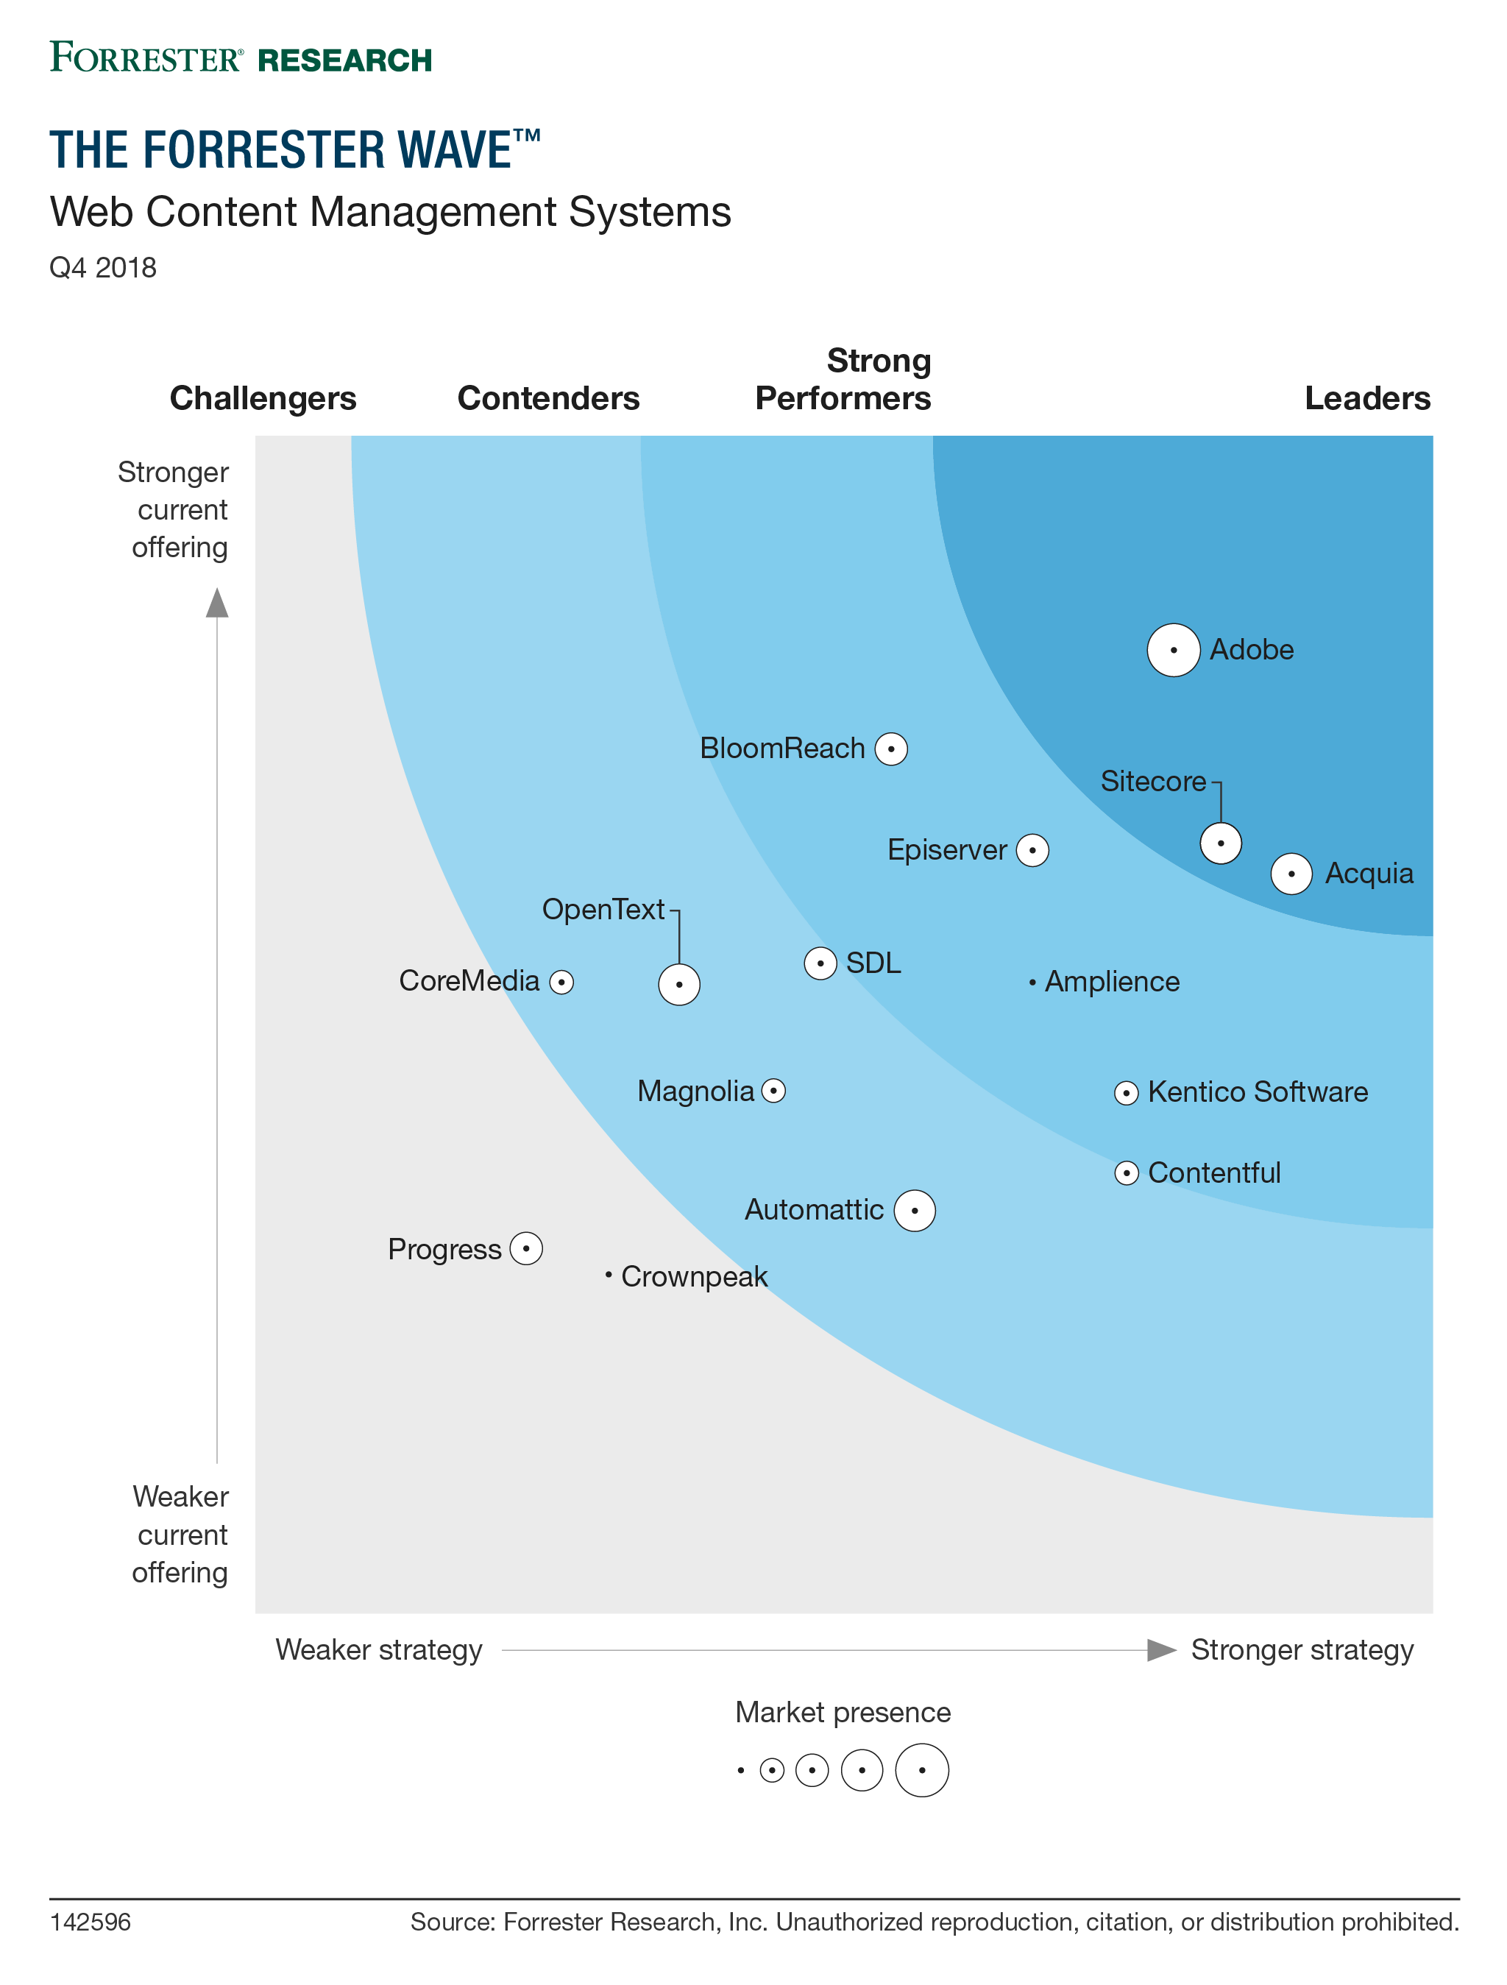
Why Drupal?
WCM – Forrester Q4 2018 – Leader – Acquia Drupal
Inexpensive compared to systems like AEM
Open Source model provides one of the largest WCM communities in the world
High Interoperability
https://youtu.be/LMzlsit1Hjw
WCM – Gartner 2018 – Magic Quadrant – Acquia Drupal

