Slide 1
Recipe Master
Stay Home, Stay Healthy

Slide 2
Elevator pitch

Slide 3
Concept
AS A USER, I want to make meals with the food I have at home, so that I can save money, reduce waste, and eat healthy.
Description
Recipe Master allows a user to enter their ingredients into a list, from which the website will query a food API to display 4 random recipes that use the listed ingredients, and displays nutrition info.
Motivation for development?
Sometimes I have ingredients at home that sit for a long time or expire, now I have a tool that helps find ways to use them
Inspiration for new recipe’s I’ve never made before

Slide 4
Process
Technologies used
HTML
CSS
Javascript
jQuery
Ajax
API Keys:
U.S. Department of Agriculture FoodData Central
Recipe Puppy
Bulma as a CSS framework
Font awesome for icons and fonts
Google Fonts

Slide 5
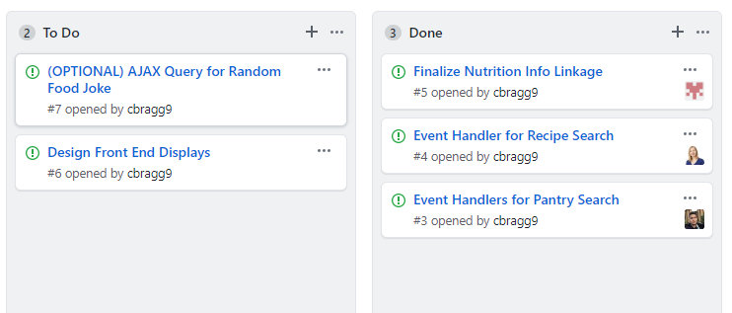
Process
Breakdown of tasks and roles
When we discussed tasks and who those are going t be assigned to we decided to go work and practice our weaker side. So whoever was good in JS focused on front-end (HTML and css) and vice versa. Created individual branches on GitHub. Despite the task split we helped and supported each other.
Additionally, we used the GitHub Projects/Issues to assign tasks.
It was an awesome team work!

Slide 6
Process
Successes
Team communication
Get the website work
Responsive design
Challenges
GIT-GIT-GIT - there are still a lot to learn here
Learn new css framework - Bulma
Create modals and make it work
Design UI/UX for web page to look good and user-friendly
Working on individual tasks is good and bad. Needs to be careful and follow teammates' code
Using JS to create HTML elements

Slide 7
Demo

Slide 8
Directions for Future Development
Additional front-end work, responsiveness
Error handling (pantry list item repeats, bogus entries)
Total recipe nutrition instead of by ingredient
Modals for recipe’s when you click into them
Better API’s (Recipe Puppy broken links/missing img’s)
Add a webpage for drink recipes
Shopping list for missing ingredients

Slide 9
Links
Deployed
https://cbragg9.github.io/Recipe-Master/
GitHub repo
https://github.com/cbragg9/Recipe-Master

