Slide 1
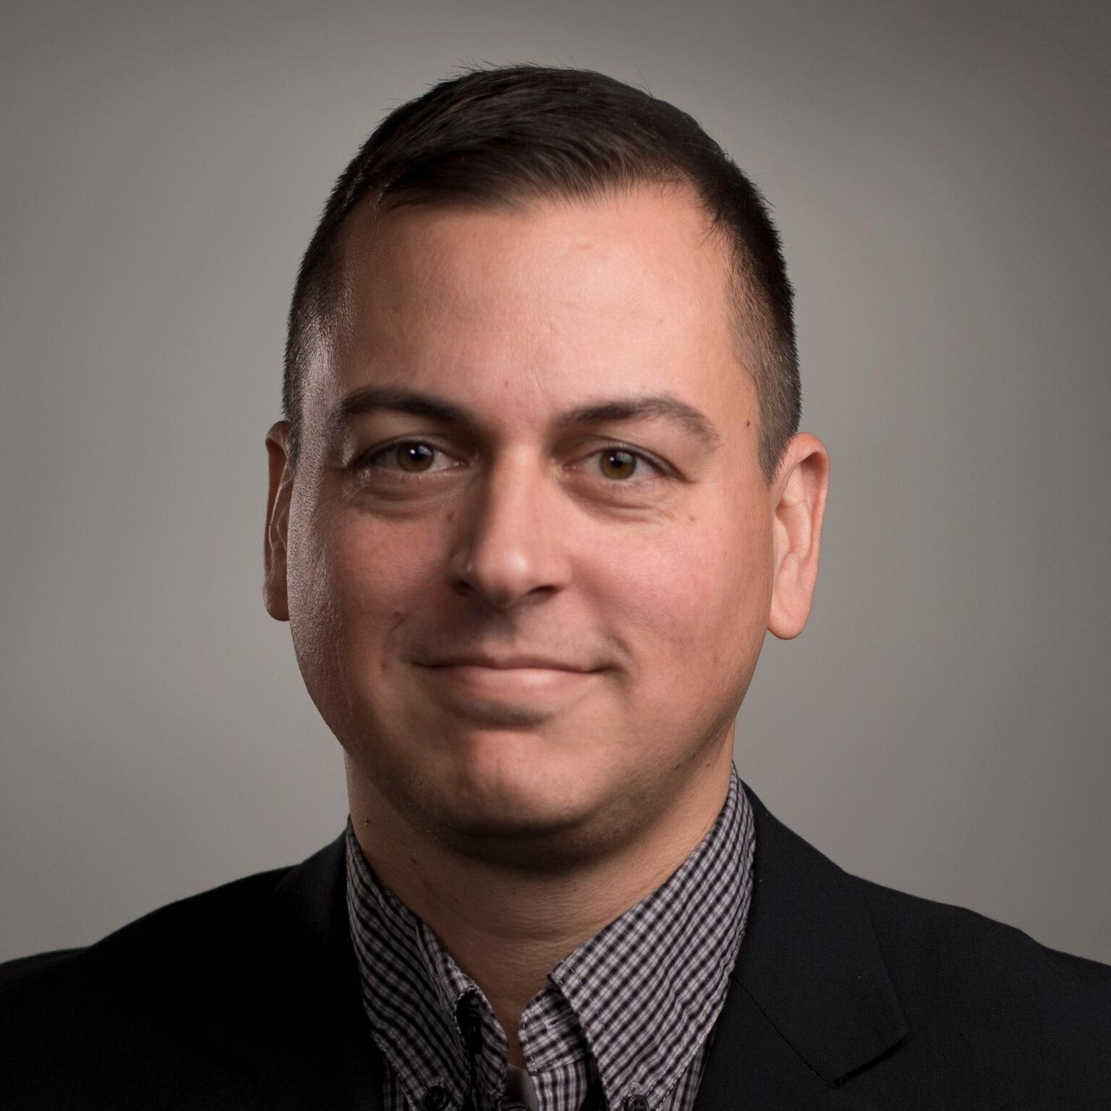
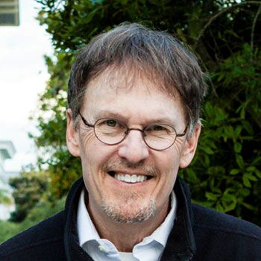
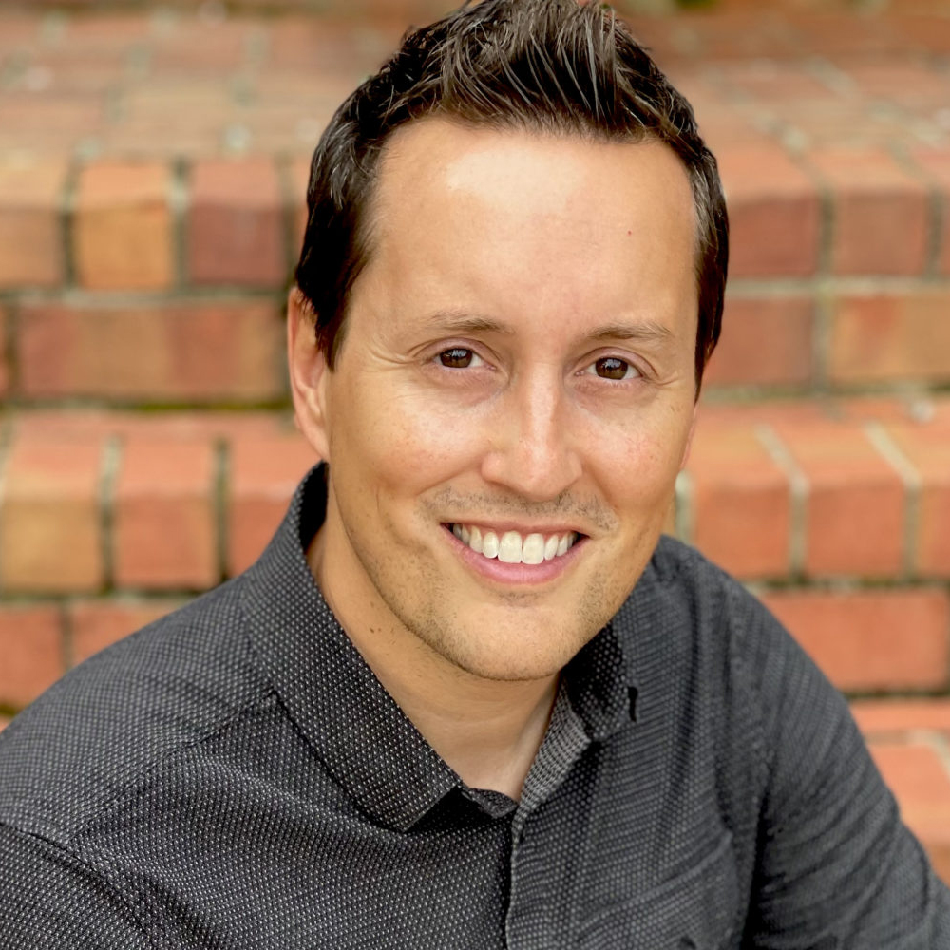
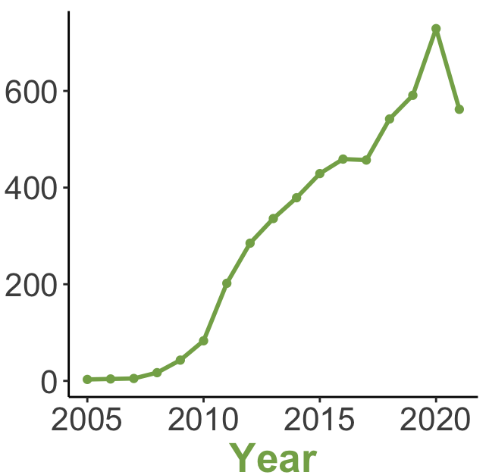
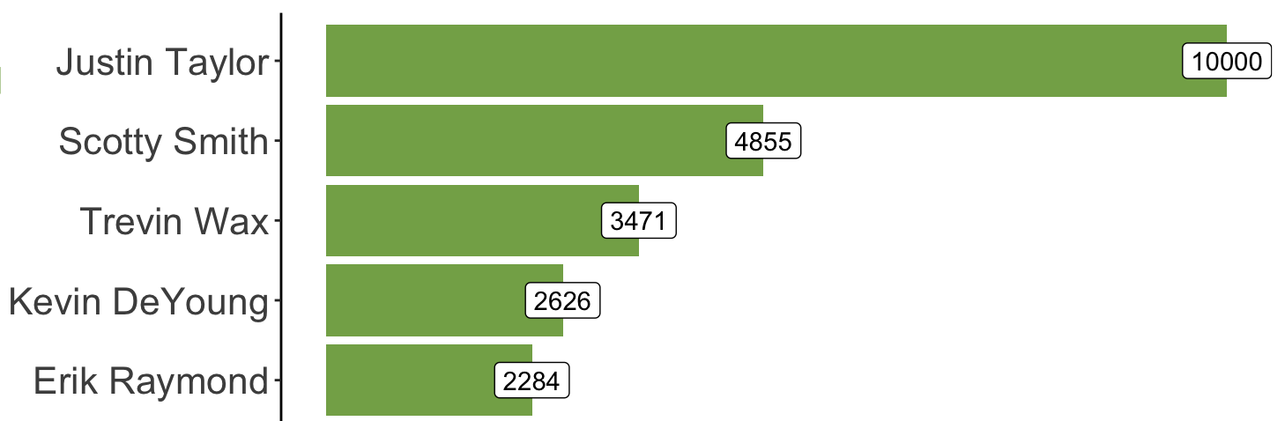
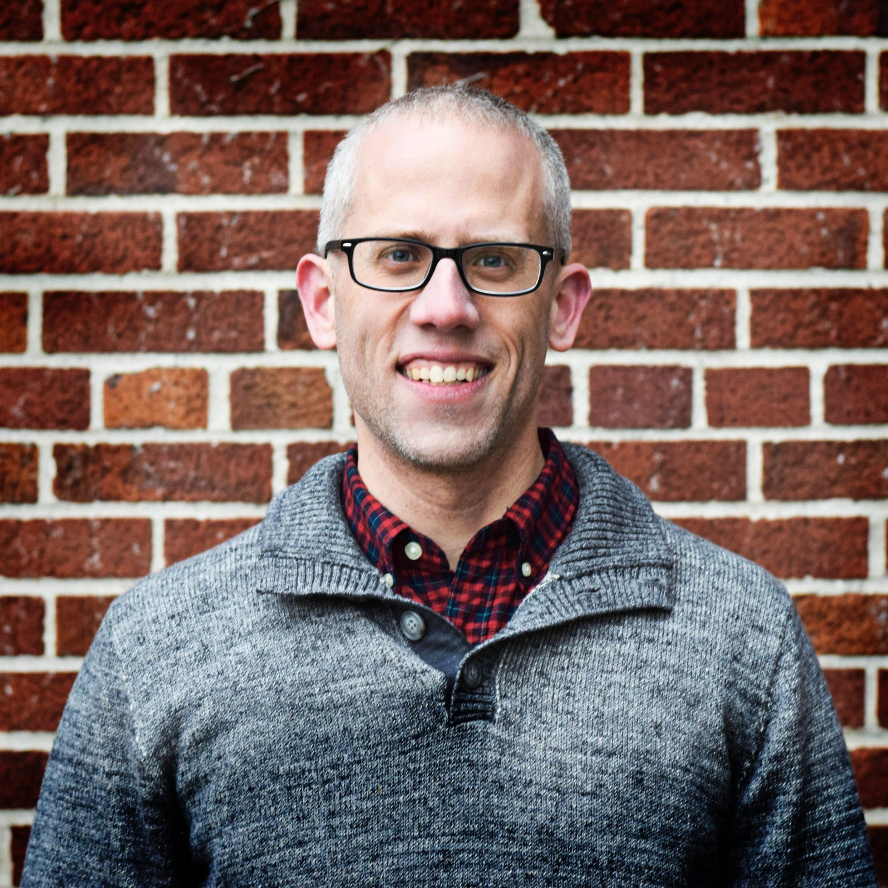
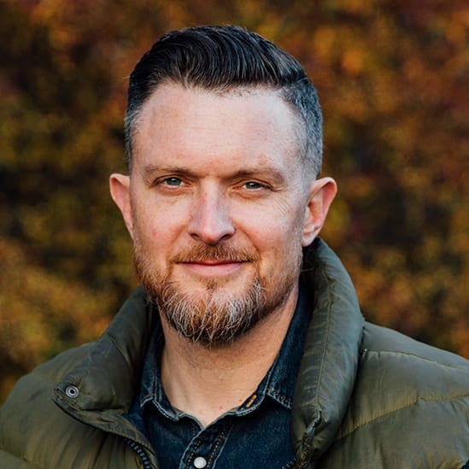
2,388 TGC Contributors
3 people produced over 80% of content
< 1%
Yearly unique contributors grew since 2005
17% other
14% sermons
39% of publications
were articles
11% podcasts
19% blogs
Top 5 contributors (by volume)

Slide 2



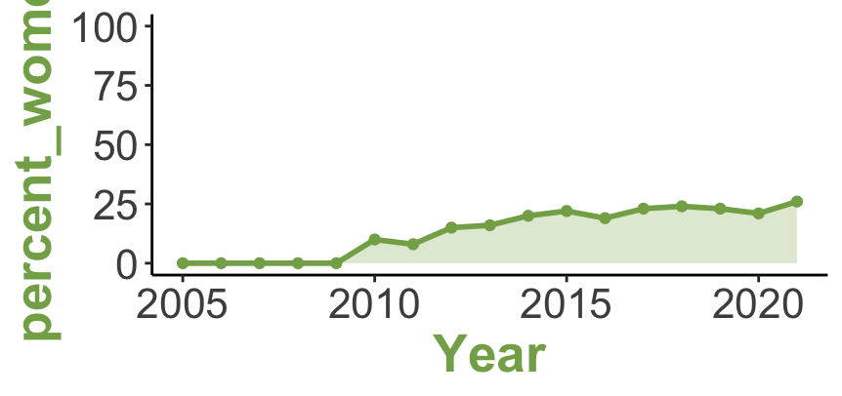
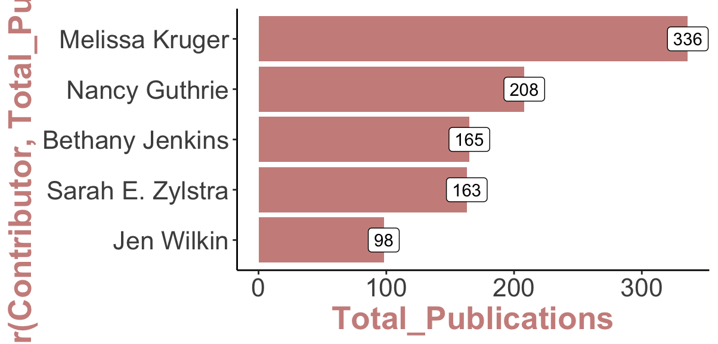
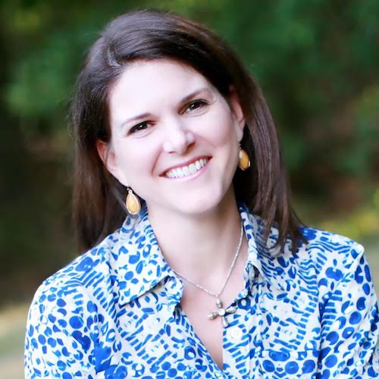
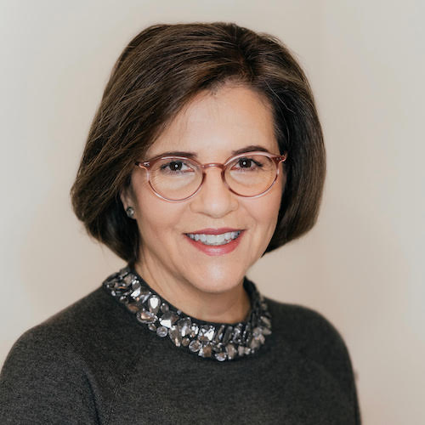
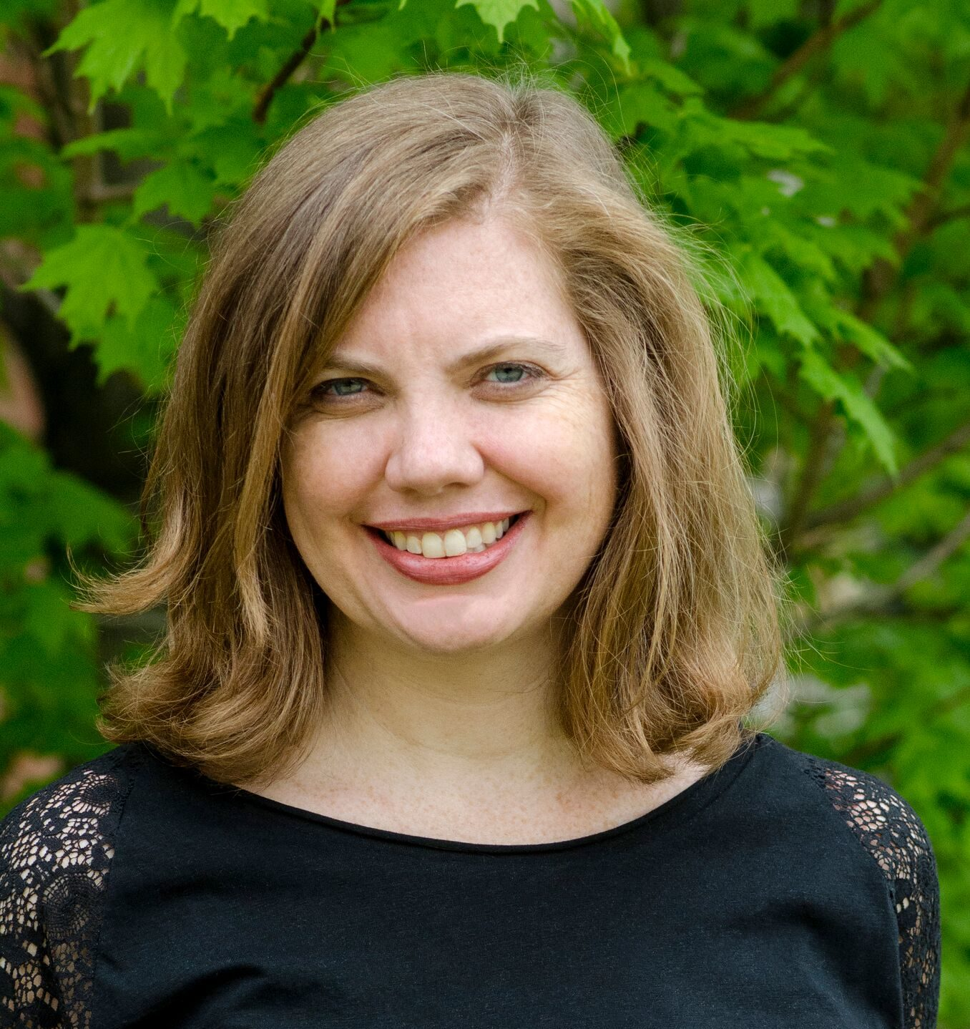
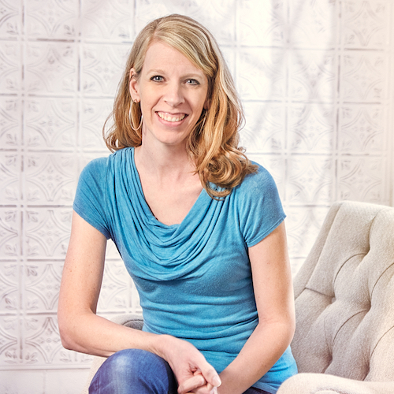
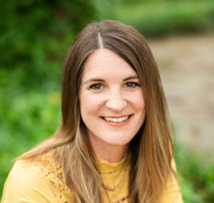
Female TGC Contributors
22%
of contributors
are women
15%
of all publications have female contributors
% female contributors grew from 0 to 26%
Top contributors (by volume)

Slide 3
Female TGC Contributors
with Ph.D.’s
5%
of female bios mention earned or in-progress Ph.D.’s
Anne Rathbone
Amanda Dalla Villa Adams
Jenny-Lyn de Klerk
Sherrene DeLong
Julie Dykes
Christina Edmondson
Ashley Hales
Sharon Hodde Miller
Sharon James
Jeany Jun
Joanne Jung
Jenn Kintner
Lauren Green McAfee
Sara Helms McCarty
Latoya McCutcheon
Lydia McGrew
Rebecca McLaughlin
Kathleen Nielson
A. L. Phillips
Naomi Reese
Michelle Reyes
Kelly Simpson
Claire Smith
Mary Willson Hannah

Slide 4





Gender & TGC Bios
1.6x
more likely to mention graduate degrees
3x
more likely to mention Ph.D.’s
men
women
1.5x
more likely to use relational words
Common word pairs*
is a .
lives in
can find
a writer
on Instagram
husband and
is the .
pastor of
of the
church in
professor of
theological seminary
Common Professional Titles
Pastor
Author
Author/writer
Director
Professor
Director

