Slide 1
Heatmap

Slide 2
Overview
One of the major questions for the project was what locations in the LA area experienced higher amounts of parking citations.
By identifying these areas, the city could plan to build more parking in the area or open up certain streets in order to mitigate the load, especially during the week as more people commute into the city.
To answer this question, an interactive heatmap that layered onto a map of the LA area was created. The intensity of the heatmap was tied to the number of citations in an area.

Slide 3
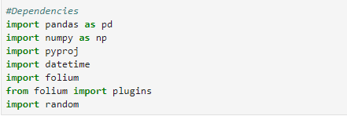
Libraries/Dependencies
Below are all the libraries used to help create the heatmap.

Slide 4
Gather + Cleanup
To begin creating the heatmap, a random sample of 500K (out of 9.2MM) rows from the CSV were read since the heatmap function in folium would not work with more than this many points of data.
After this, similar as for the other charts, the nonessential columns were dropped and then all rows with missing data were dropped as well.
Next, any rows that included a Latitude or Longitude value of 99999 were dropped as this was the datasets version of missing data for these columns.

Slide 5
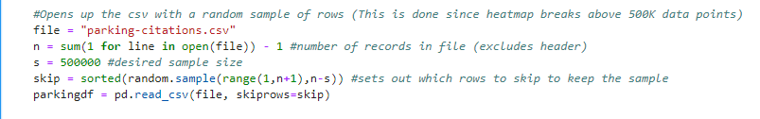
Code: Taking a Random Sample

Slide 6
Gather + Cleanup (cont.)
Once the unusable rows were removed, the Lat/Long values were converted to a decimal value so that folium could understand them. The columns were also renamed since the dataset had them backwards.
This concluded the cleanup for the heatmap. At the end, the number of columns left were checked to ensure that there was a robust enough dataset left after all of the removals.
On average, the remaining dataset retained ~450K out of the original 500K rows.

Slide 7
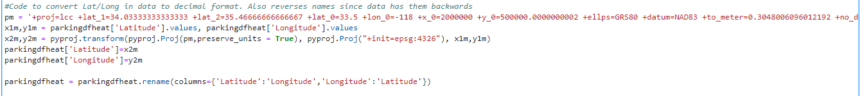
Code: Lat/Long Conversion

Slide 8
Data Analysis
To create the heatmap, a blank map of LA was created in folium first.
The Lat/Long values were converted into a matrix that was then used in the HeatMap function in folium.
The maximum intensity value for the heatmap was set to 25, meaning that 25 citations in an area yielded the darkest coloring.
The folium heatmap has the functionality to zoom in and out, and the intensity levels are averaged at farther zoom levels to allow the maximum intensity to remain relevant at all zoom levels.

Slide 9

Code: Create Heatmap

