Slide 1
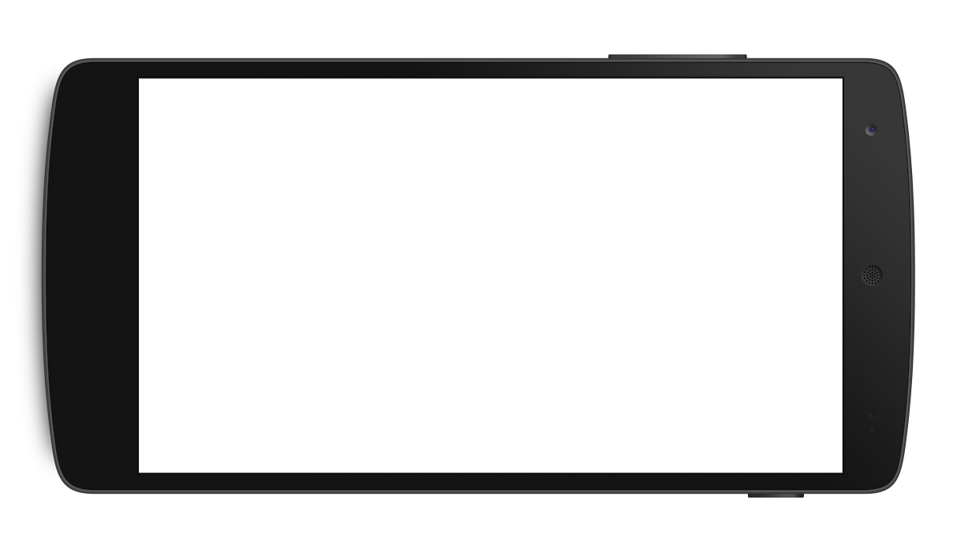
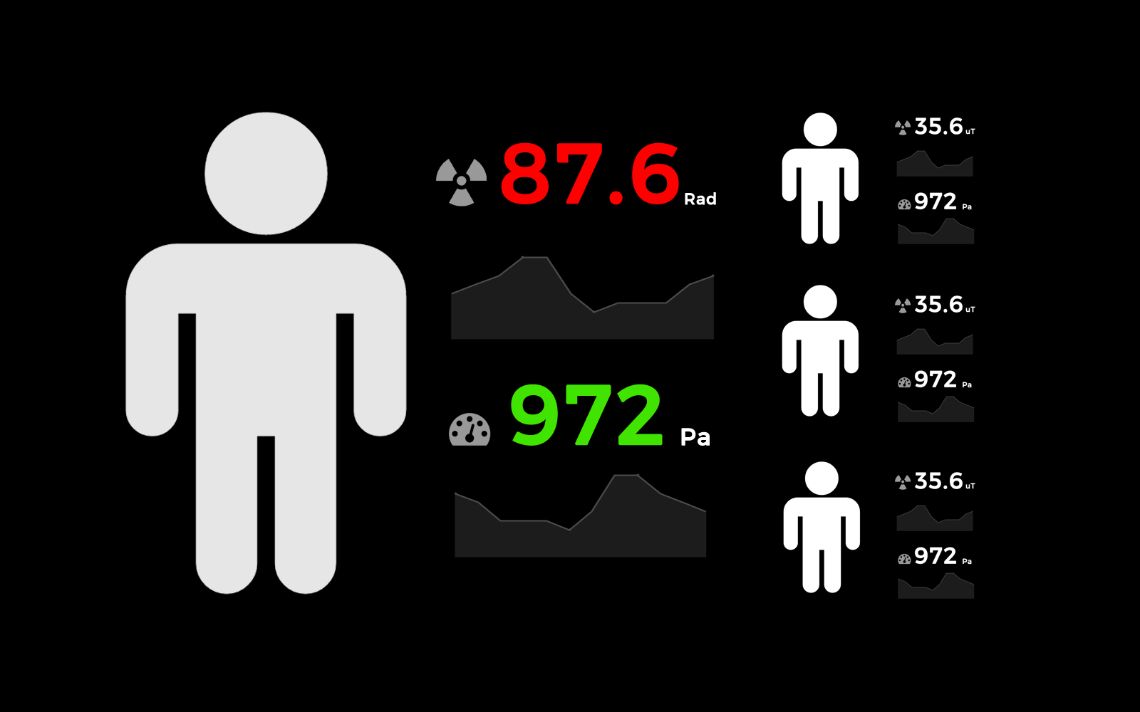


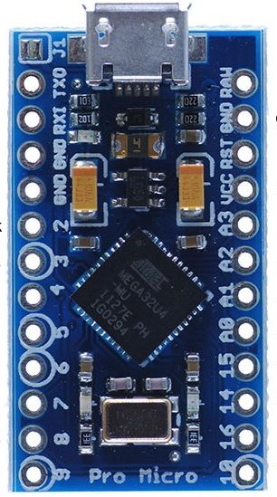

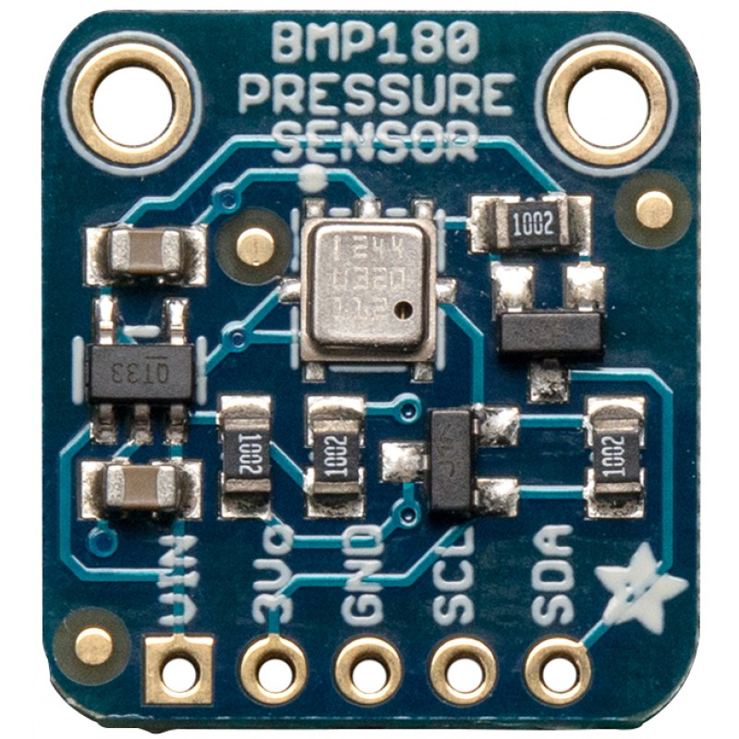
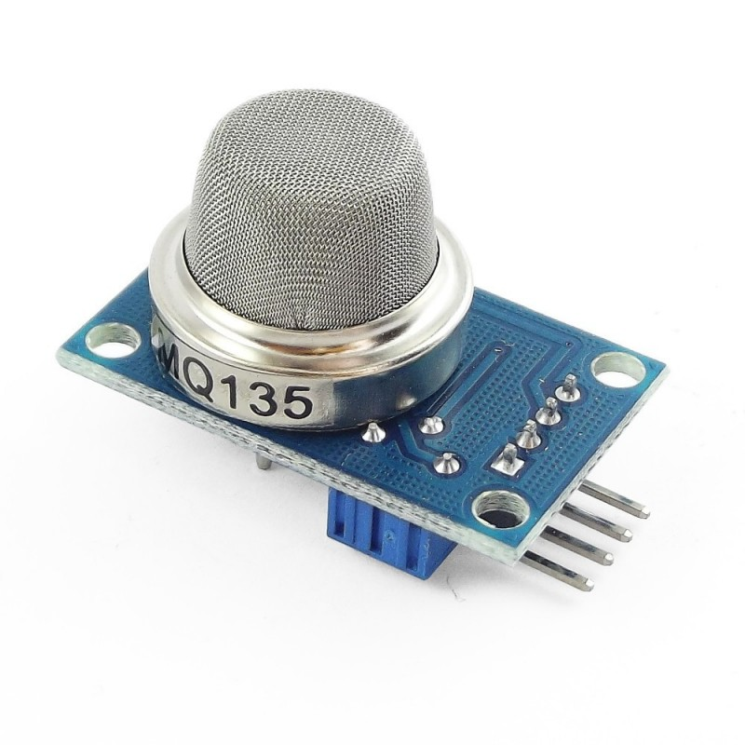
T.E.A.M.S - SOLUTION SCHEMATIC
USB
ON-THE-GO
Consumer-level
Radiation Sensor
Consumer Handheld
BMP-180
Pressure
Sensor
Power
Interface
USB and Network Connectivity
Microcontroller
(Pro Micro)
16MHz / 5V
24 Pins
MQ-135
Hazardous
Gas Chemistry

