Slide 1
Working with downscaled climate projections in R
Ralph Trancoso^{1,2}, Sarah Chapman^{1,2}, Rohan Eccles¹
1 Climate Projections & Services team, Queensland Treasury
2 School of the Environment, University of Queensland

Slide 2



Who are we?
Science leader,
coordinator
Applied climate science
Ralph Trancoso
Sarah Chapman
Hydrologist,
Climate extremes
Rohan Eccles

Slide 3
Who are you?

Slide 4

Open-source geospatial tools for conservation under climate change - A Koala case study
Session 1 | Session 2 | Session 3 | Session 4 | Session 5
Intro to geospatial data and tools | Downscaled climate projections | Koala SDMs | Spatial conservation planning | Making maps with QGIS
Jason Flower, Mitch Rudge, Catherine Kim, EcoCommons team | Ralph Trancoso, Sarah Chapman, Rohan Eccles | Charlotte Patterson, Scott Forrest | Brooke Williams, Caitie Kuemple | Emma Hain, Nyall Dawson, Jason Flower

Slide 5

Outline
https://github.com/sdesrosiers1989/ICCB_Projections
Background on downscaled climate projections
R scripts (~ 30 mins each)
Importing, plotting, subsetting climate projections
Calculating ensemble mean
Validating data and calculating bioclimatic indices
Start installing packages while we talk!
terra, dplyr, sf, ggplot2, dismo, rasterVis, reshape

Slide 6
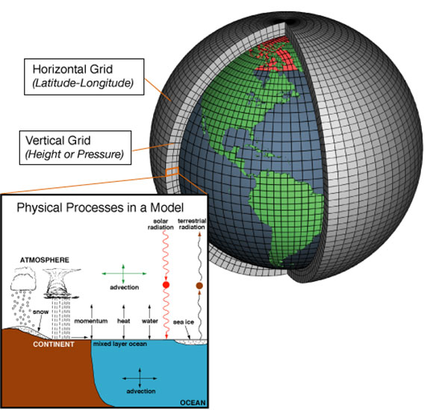
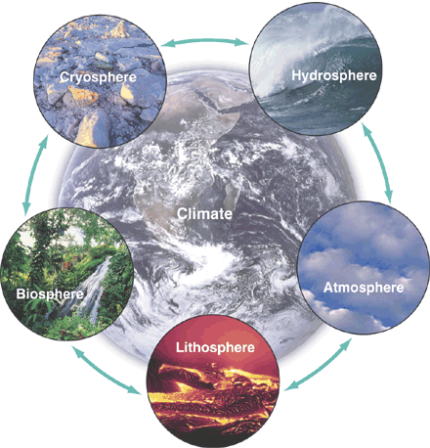
What is a climate model?

Slide 7
What are downscaled climate projections?
Global climate models (GCMs) have a spatial resolution of 100 – 200km
CMIP (Coupled Model Intercomparison Project) – major international modelling effort which feeds into IPCC reports
Currently on CMIP6
Dynamical downscaling – running a higher resolution model with the inputs of a coarser resolution model (i.e., GCM) to improve the resolution of your data

Slide 8
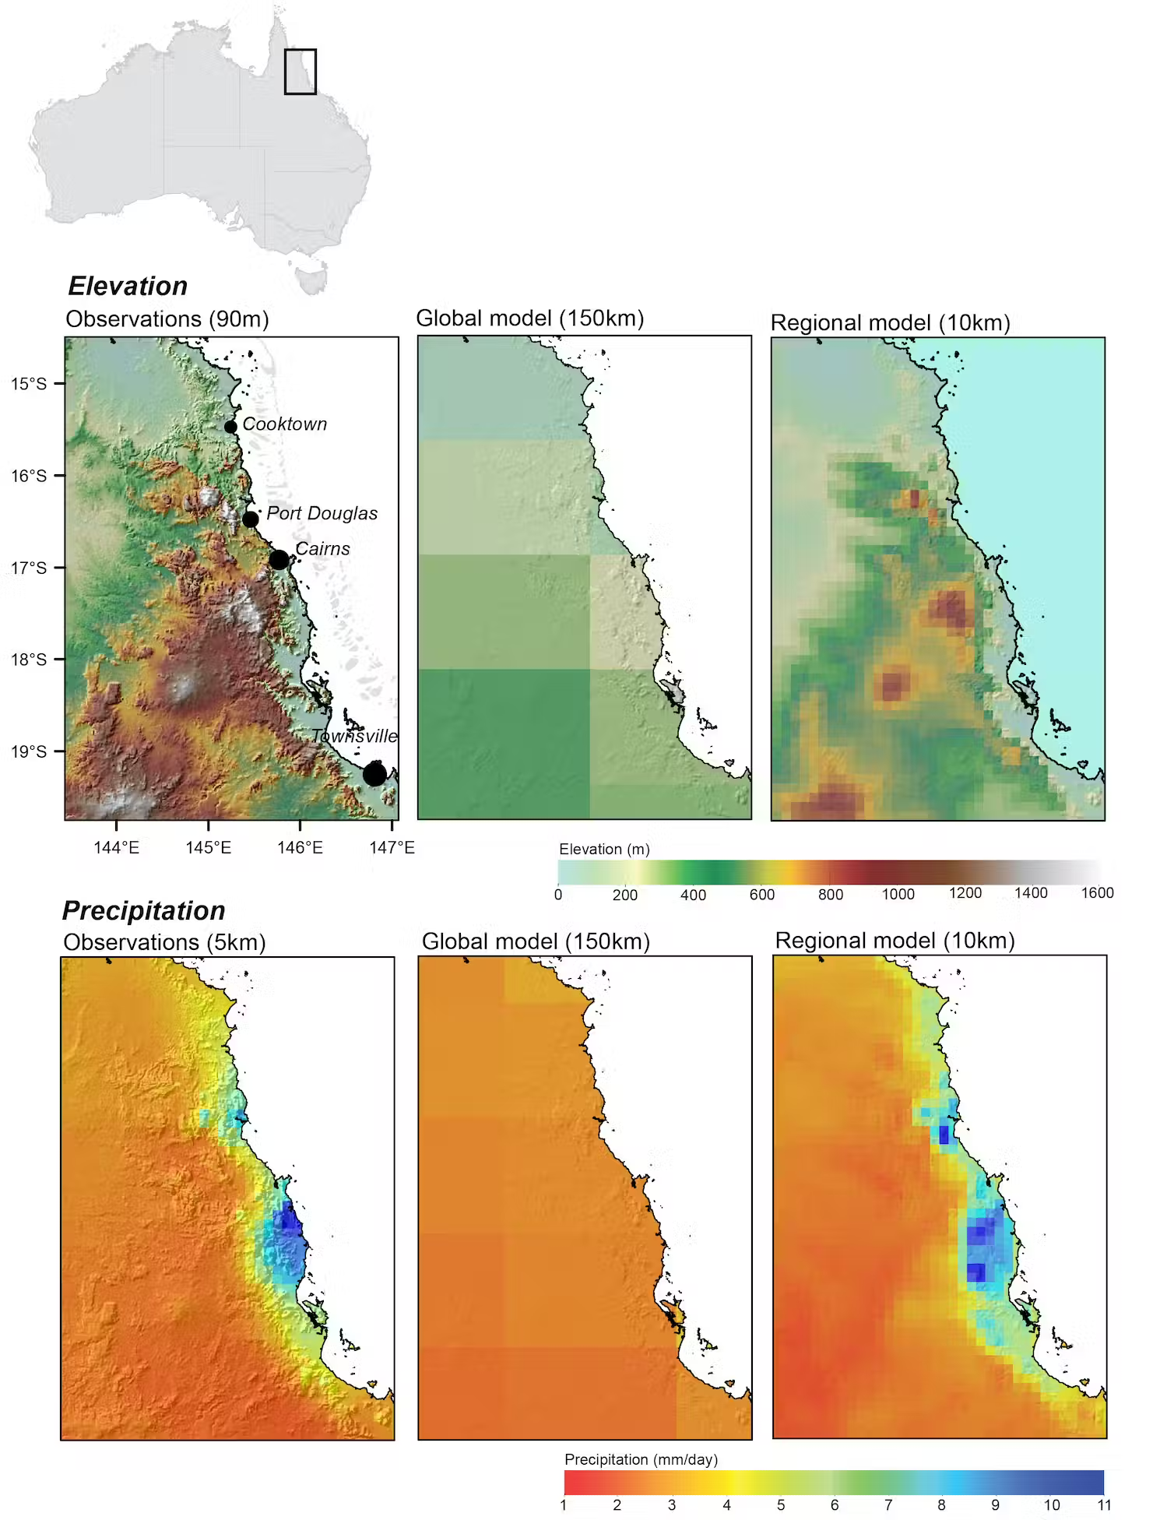
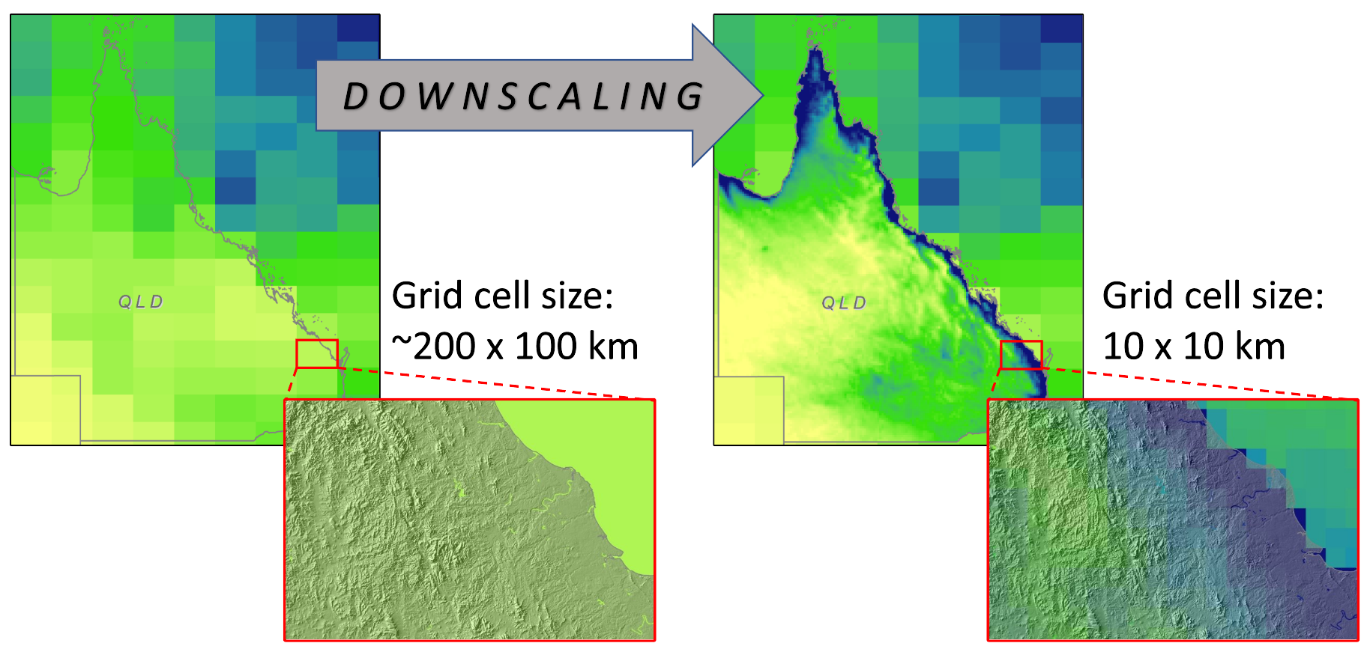
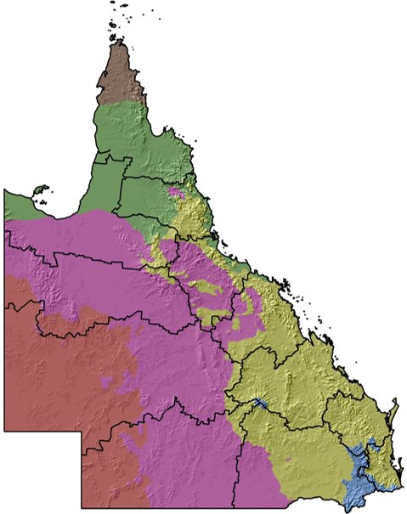

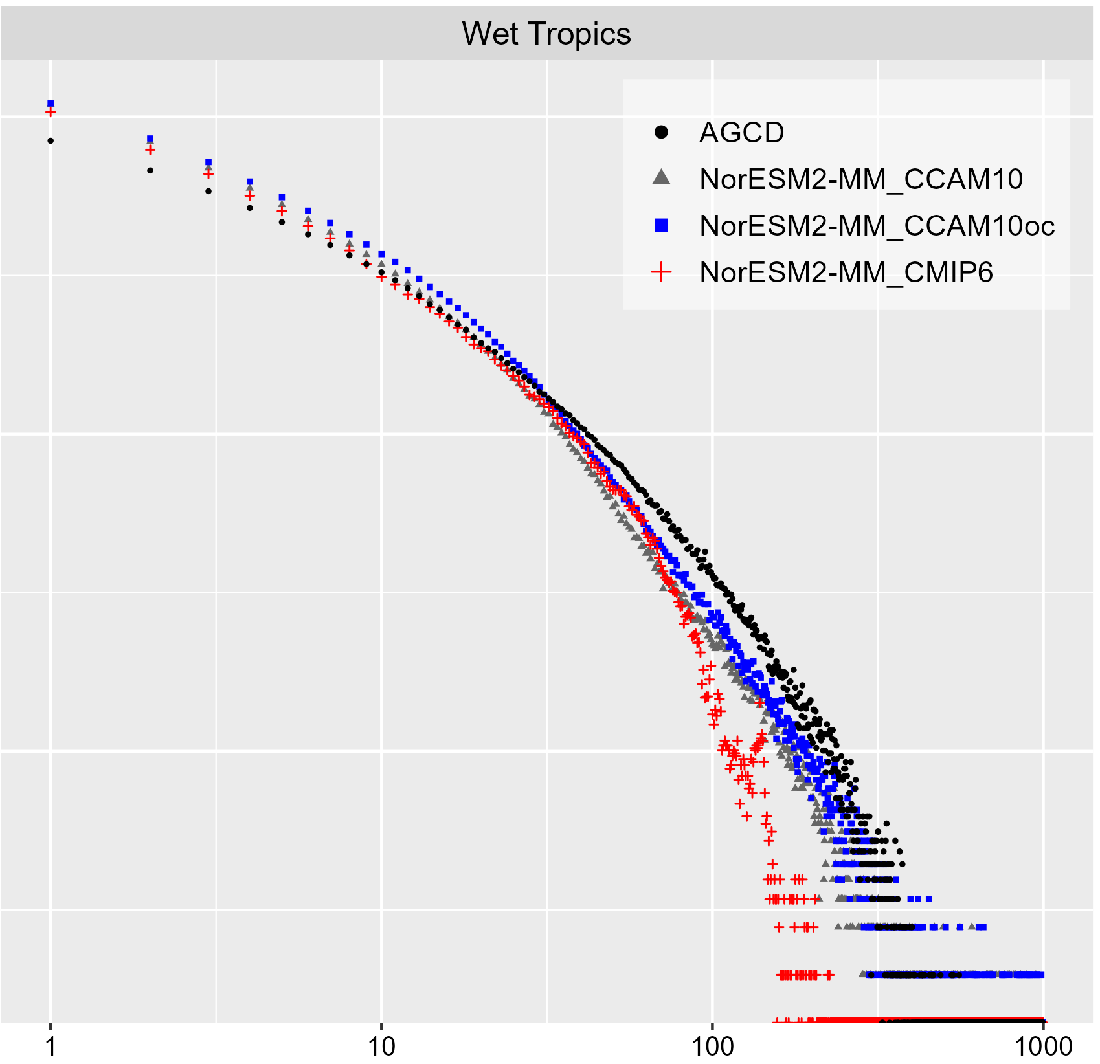

Why downscaling?
2) Global models misrepresent our landscapes and regional climate granularity
1) Global models do not represent well our climate
3) QLD climate and features are unique
4) Global models underestimate extremes and risks
CLIMATE REGIONS
Precipitation Intensity(mm/day)
Equatorial
Sub-tropical
Savannah
Tropical
Temperate
Arid

Slide 9
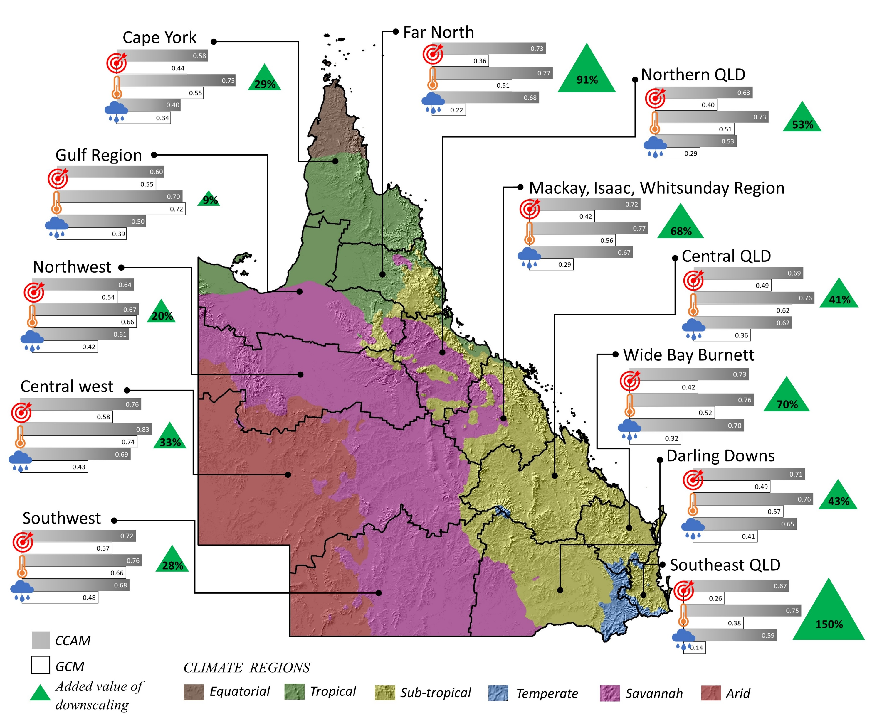
Downscaling improvements to performance
Downscaling improved performance in all regions of Queensland
Largest improvement along coasts, mountains, for extremes
Data available: https://dx.doi.org/10.25914/8fve-1910

Slide 10
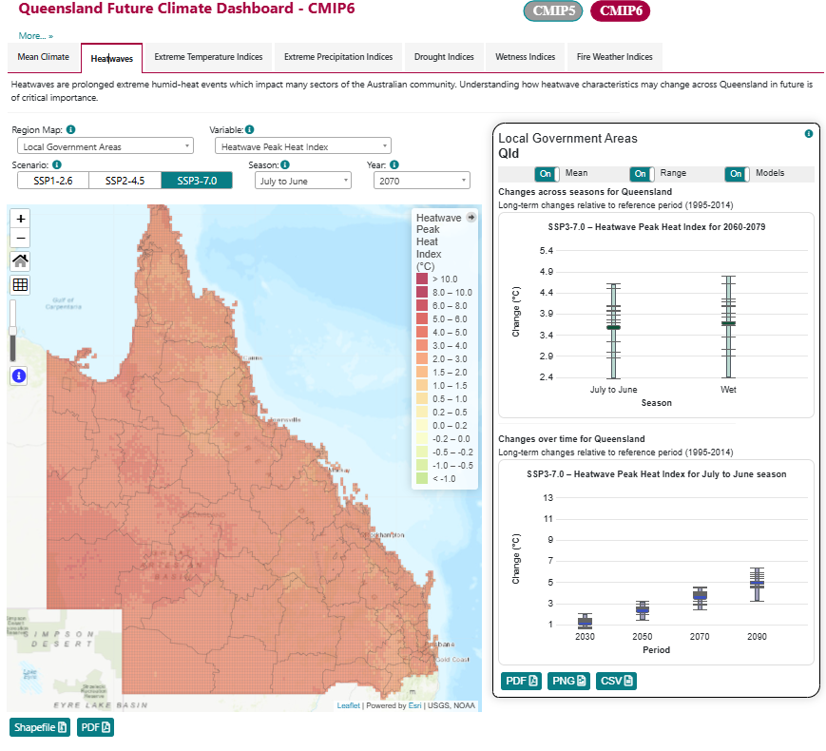
CMIP6 Dashboard
Three climate change scenarios (SSP126, 245, 370)
15 simulations per scenario
Multiple regions
LGAs
NRMs
River basins
etc
Multiple indices
Large model range!
https://longpaddock.qld.gov.au/qld-future-climate/

Slide 11
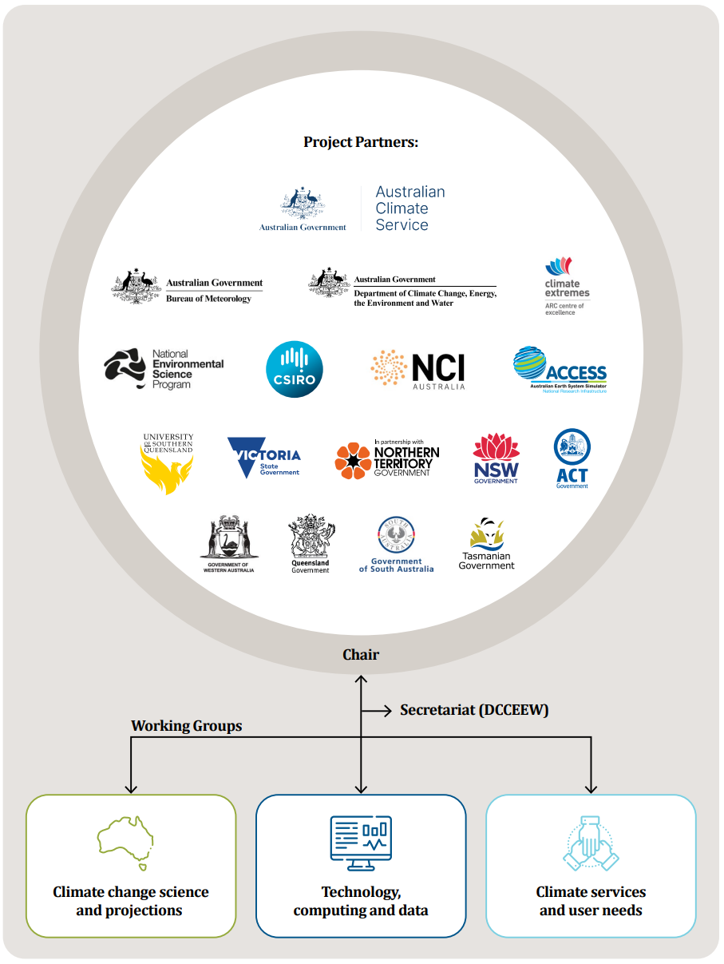
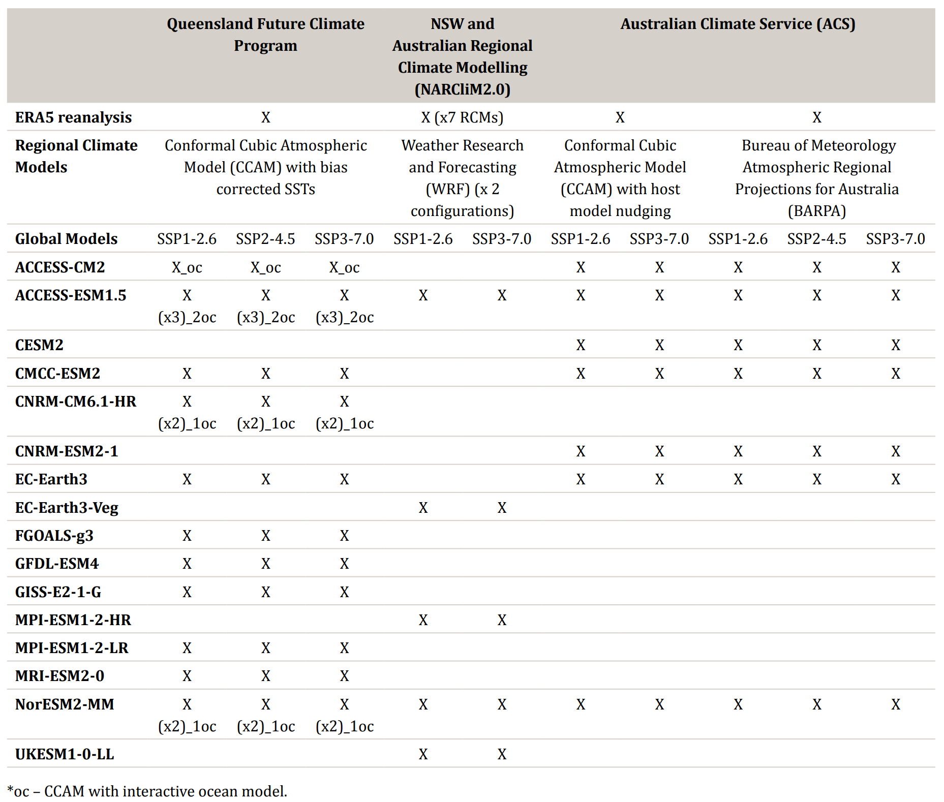
National Partnership for Climate Projections

Slide 12
What are we doing today?
Import climate data into R
Three models: ACCESS-ESM1-5, EC-Earth3, GFDL-ESM4
Climate scenarios: SSP370
If you have time the data folder includes SSP126 and SSP245
Plot the data
Calculate climate change impacts
Validate the data against observations
Calculate bioclimatic indices

Slide 13
What does a more realistic workflow look like?
Find your data
Evaluate against observations
Chapman, S., Syktus, J., Trancoso, R., Thatcher, M., Toombs, N., Wong, K. K.-H., & Takbash, A. (2023). Evaluation of Dynamically Downscaled CMIP6-CCAM Models Over Australia. Earth’s Future, 11(11), e2023EF003548. https://doi.org/10.1029/2023EF003548
Bias correct if required for your application
Tomorrow you will be using bioclimatic indices our team prepared. This dataset has been statistically downscaled (5 km) and bias corrected. Data will be available on EcoCommons.
Evaluate some more
Calculate your indices
Calculate ensemble mean at the end

Slide 14
Questions?

Slide 15
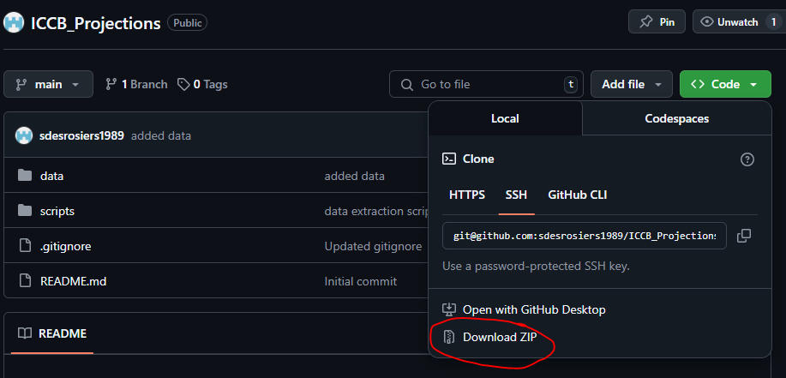
Getting started
https://github.com/sdesrosiers1989/ICCB_Projections

Slide 16
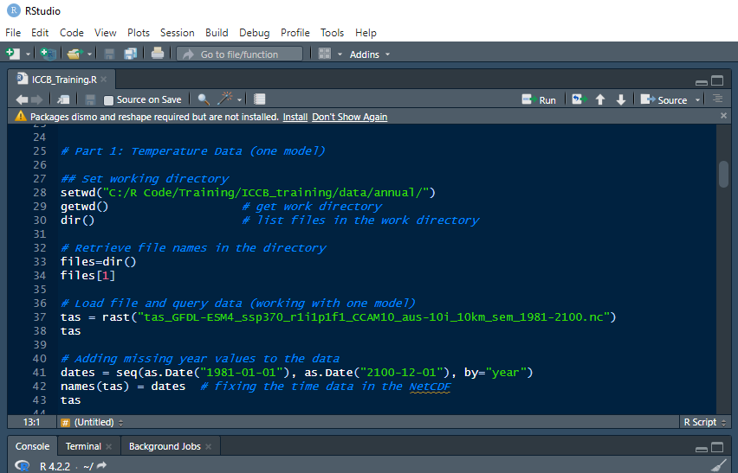
Prepare your files
Unzip the folder
Move it to wherever you want it (make sure you can find it!)
Open RStudio
In RStudio, open the script ‘ICCB_Training.R’

Slide 17
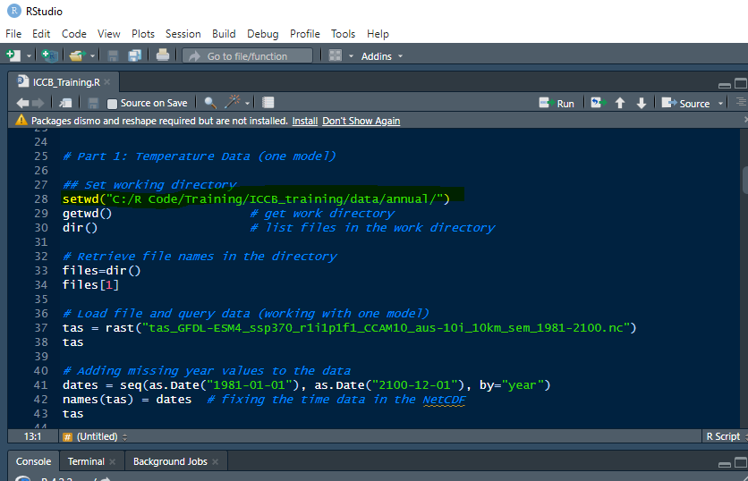
Set your working directory
Install any packages you are missing (code at the beginning of the script)
Import your packages
Change wd to where you put the data
dir() should now show you the data files

Slide 18
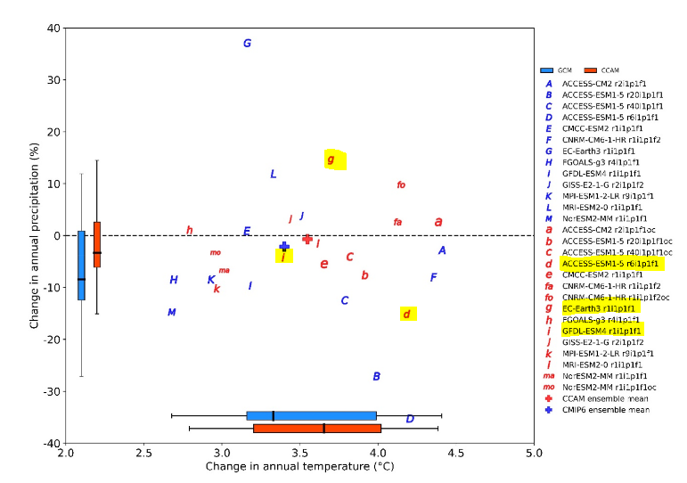
Datasets - models
Annual temperature and precipitation for Queensland for 3 climate models for SSP370 1981 - 2100
ACCESS-ESM1-5 – a dry model
EC-Earth3 – a wet model
GFDL-ESM4 – in the middle (this is the model we’re starting with)
Storyline approach can help address ensemble range

Slide 19
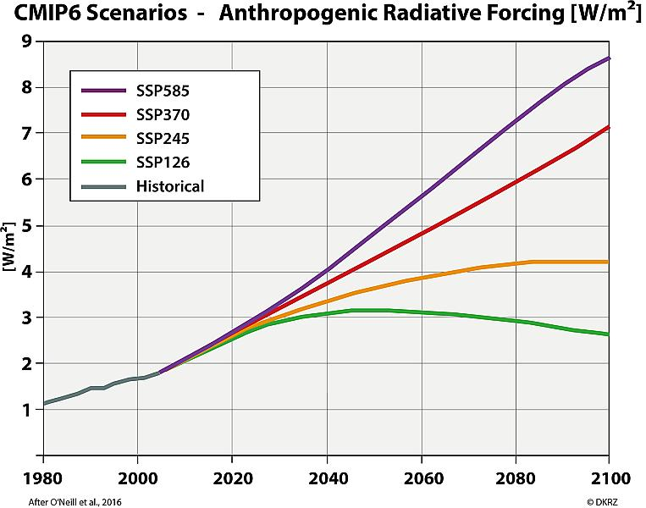
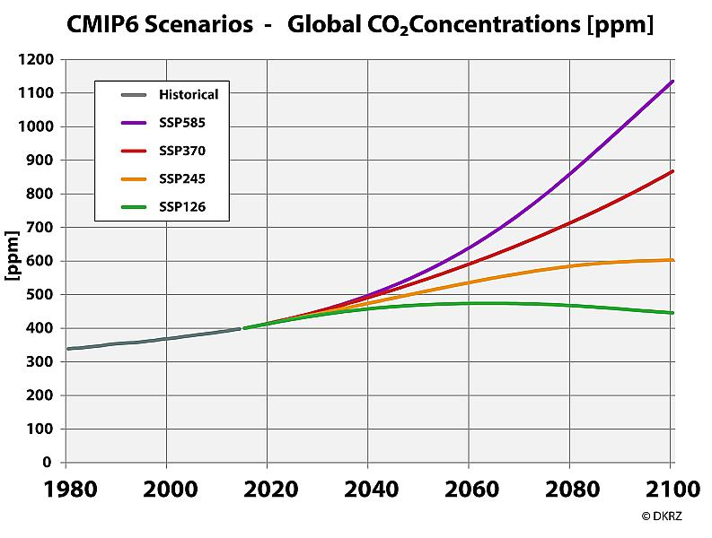
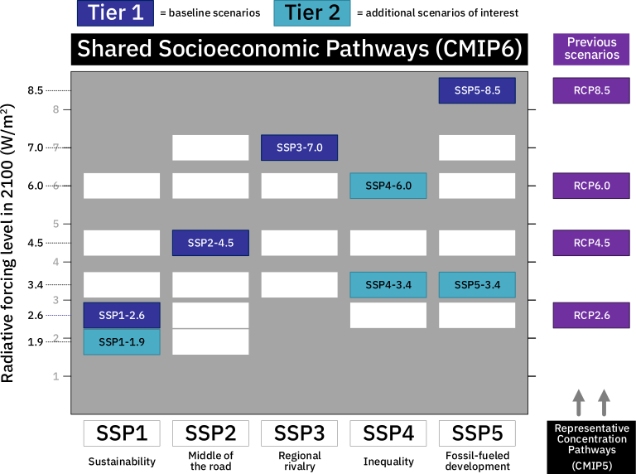
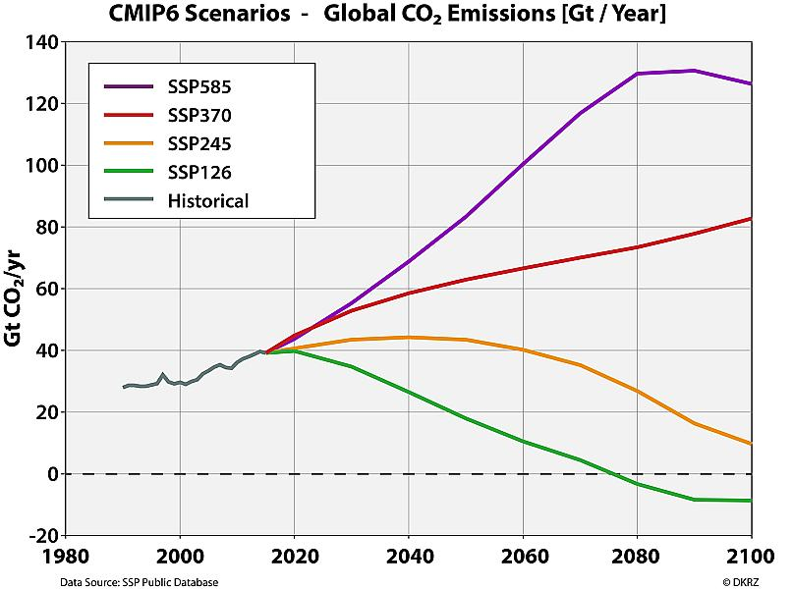
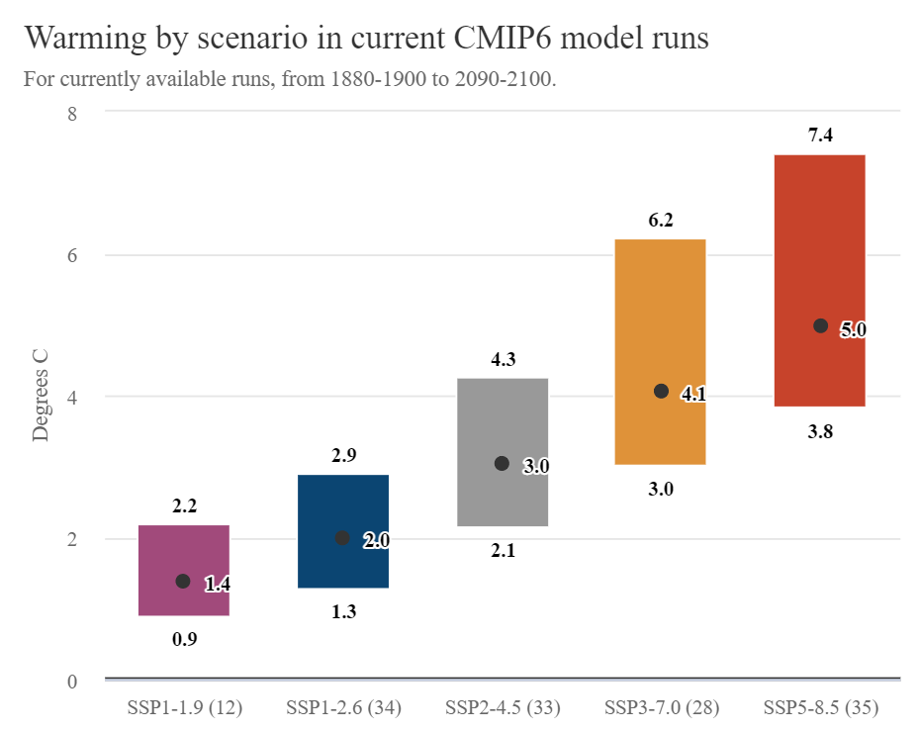
Datasets – climate change scenarios
SSP1-2.6: Sustainability
SSP2-4.5: Middle of the road
SSP3-7.0: Regional rivalry

Slide 20
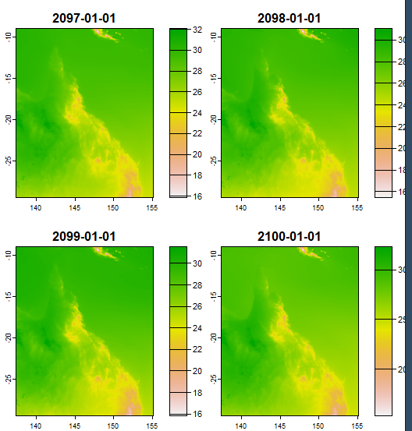
Part 1: What does your data look like?

Slide 21
Your turn!
Can you modify this plot? Add a title, modify the colours
Can you plot the other models? How do they compare to this one?
Hints:
plot(main = “title”)
plot(col=brewer.pal(11, “YlOrRd”). See https://colorbrewer2.org/ for ideas!
plot multi-panel figures using par(mfrow = c(nrows, ncols))
R is widely used – there’s lot of information on the internet!

Slide 22
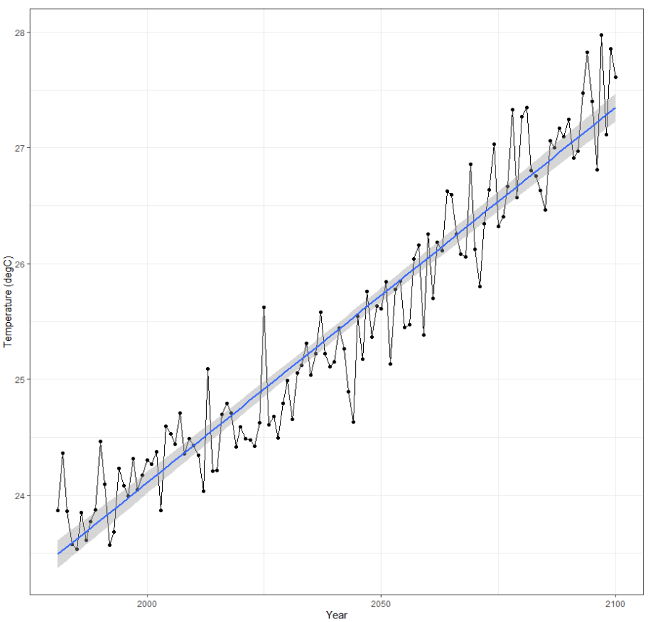
What does your data look like?
Do these values make sense?
Want to customize your plot further?
https://ggplot2.tidyverse.org/articles/ggplot2.html
ggplot2 is a very popular package. You’ll find many examples online!

Slide 23
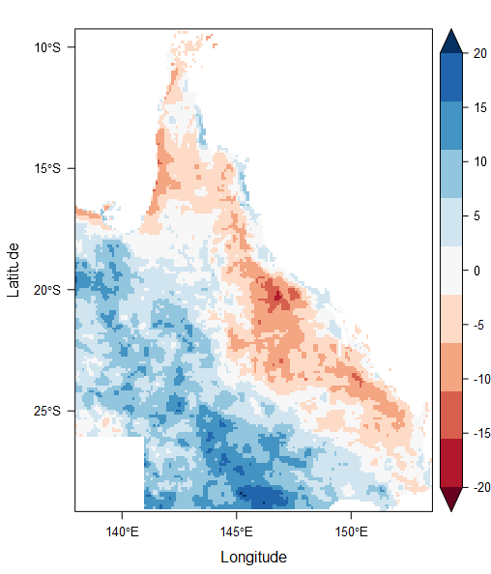
Part 2: What does your data look like?
Do these values make sense?
How does the ensemble mean compare to the values for individual models?

Slide 24
Your turn!
Can you modify this plot? Add a title and change the colours.
Can you plot multiple models on one figure? Is that helpful?
What do the other scenarios look like? SSP126 and SSP245 are in the data folder. Try plotting them!
There’s lots of information available online:
https://oscarperpinan.github.io/rastervis/#levelplot
https://colorbrewer2.org/

Slide 25
Part 3: Validation and Bioclimatic indicators
Indices relevant to species which are derived from monthly rainfall and temperature
BIO10 = Mean Temperature of Warmest Quarter
BIO11 = Mean Temperature of Coldest Quarter
BIO12 = Annual Precipitation
BIO13 = Precipitation of Wettest Month
BIO14 = Precipitation of Driest Month
BIO15 = Precipitation Seasonality (Coefficient of Variation)
BIO16 = Precipitation of Wettest Quarter
BIO17 = Precipitation of Driest Quarter
BIO18 = Precipitation of Warmest Quarter
BIO19 = Precipitation of Coldest Quarter
BIO1 = Annual Mean Temperature
BIO2 = Mean Diurnal Range (Mean of monthly (max temp - min temp))
BIO3 = Isothermality (BIO2/BIO7) (×100)
BIO4 = Temperature Seasonality (standard deviation ×100)
BIO5 = Max Temperature of Warmest Month
BIO6 = Min Temperature of Coldest Month
BIO7 = Temperature Annual Range (BIO5-BIO6)
BIO8 = Mean Temperature of Wettest Quarter
BIO9 = Mean Temperature of Driest Quarter

Slide 26
Input data
GFDL-ESM4 model – monthly tasmax, tasmin, precipitation
Due to the size of this dataset we’ve subset it to SEQ
Tomorrow you will use bioclimatic indicators based on a bias-corrected and statistically downscaled version of this dataset
Statistical downscaling
Process of downscaling that relies on statistical relationships between the model and observations in the historical period
Assumes relationship remains the same in the future

Slide 27
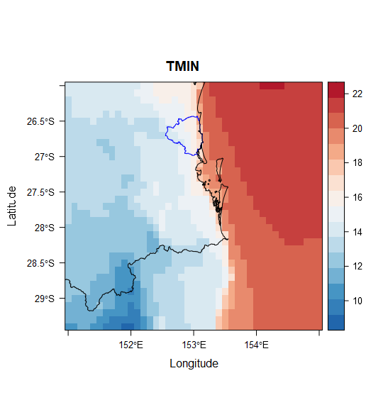
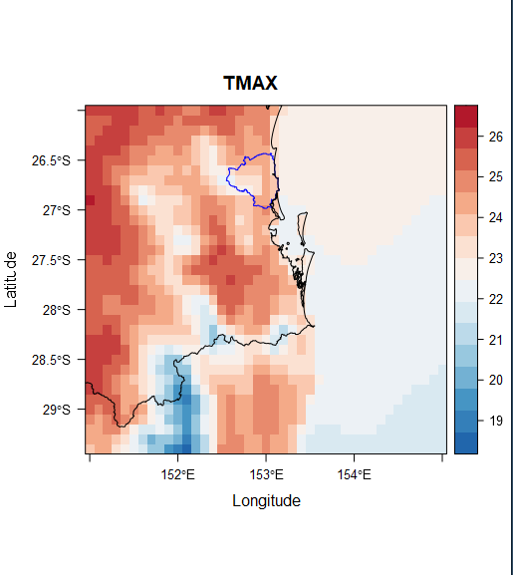
What does your data look like?

Slide 28
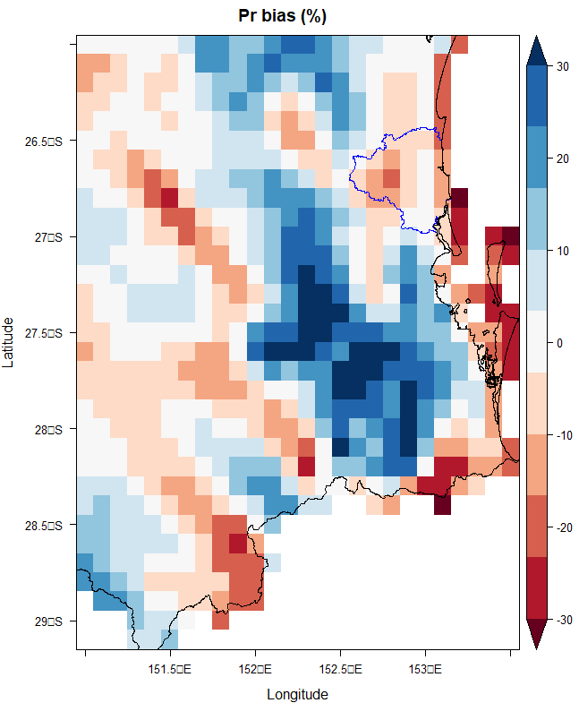

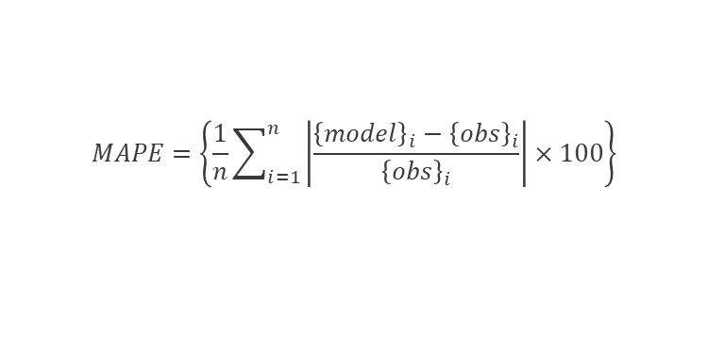
Validating the data
Ensure observations and modelled data are comparable
Spatial resolution
Temporal resolution
Quantifying performance:
$$RMSE=\sqrt{\left\{\sum_{i=1}^{n}{\frac{{\left({\left\{model\right\}}_{i}−{\left\{obs\right\}}_{i}\right)}^{2}}{n}}\right\} }$$
$$MAPE=\left\{\frac{1}{n}\sum_{i=1}^{n}{\left|\frac{{\left\{model\right\}}_{i}−{\left\{obs\right\}}_{i}}{{\left\{obs\right\}}_{i}}\right|}×100\right\}$$

Slide 29
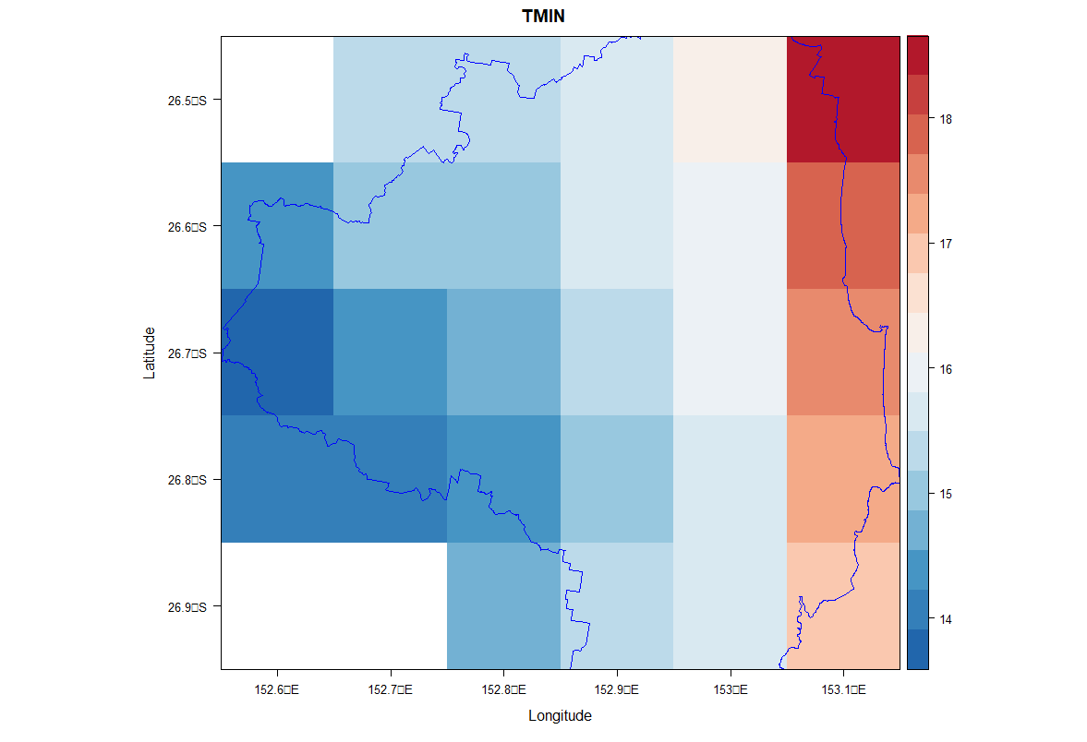
Spatial Averages
Average of cut raster considers all cells
terra::extract weights the mean by the area within the shapefile
More precise results, especially for smaller shapefiles

Slide 30
What does your data look like?
What are the final bioclimatic indicators?
How are they changing over time?
Do these changes make sense?

Slide 31
Final tips
There’s a lot of data available. Think about the question you’re asking and what you need before getting the data.
Always check your units
Plotting is a good way to check your data to make sure the numbers make sense
Calculate ensemble average at the end!
If you work with python and R – the indexing is different!

