Slide 1
An Intro to GraphQL!
Shreyas Devalapurkar

Slide 2

The WHO Shreyas Devalapurkar Software Engineer @ Team Apple (Justice)

Slide 3

The WHAT
A query language for your API
Built by Facebook and currently used by:

Slide 4
The WHY
Ask for what you need, get that. Exactly that.
Get many resources. One request.

Slide 5
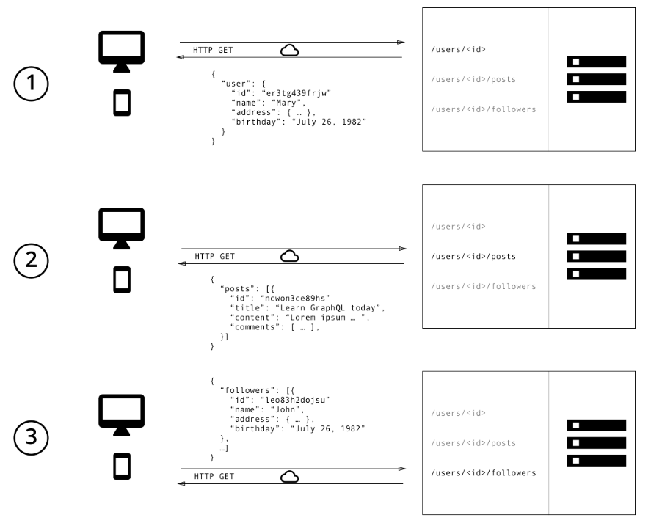
Our Internal Photo App API: NTTGram

Slide 6
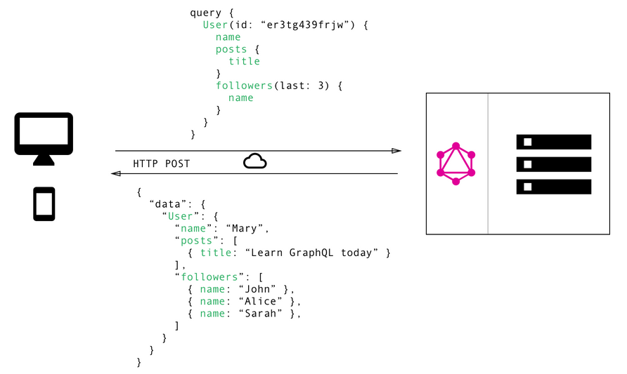
Our Internal Photo App API: NTTGram

Slide 7
The HOW
A data description language -> Schema.
A query resolution mechanism -> Resolvers.
A query language and data format -> Queries.

Slide 8
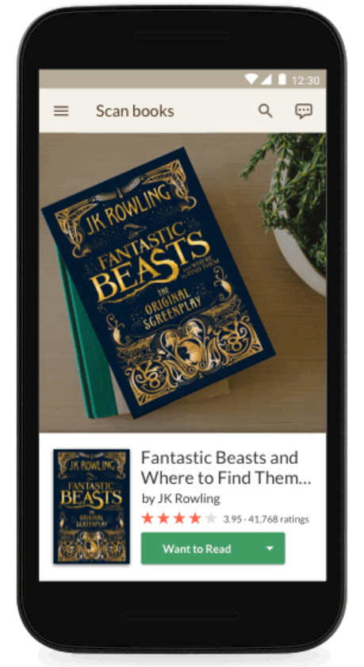
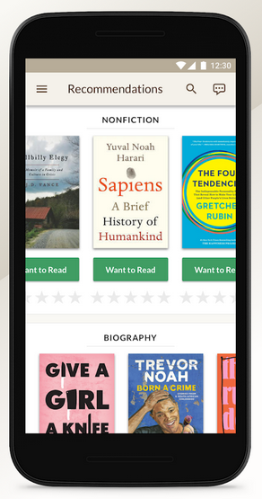
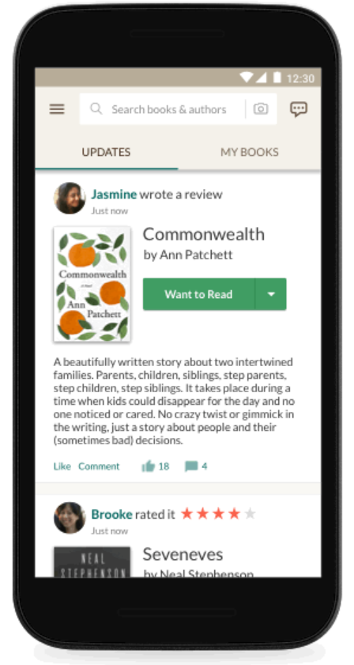
Let’s Build Goodreads

Slide 9
Deeper Dive
We need a schema to describe the data we need to provide.
Note: We are modelling how data is related together, not implementing how data is related together.
For every type and for every field on that type, GraphQL is going to execute a resolver for that field.
Queries! Time to get the data from our API.

Slide 10


Slide 11
Advantages of GraphQL
Clients can dictate exactly what they need from the server and receive that data in a predictable way.
No more overfetching of data. AKA: Downloading superfluous data.
No more underfetching of data. AKA: The n+1 problem.
Strongly typed, allowing consumers to know what form data exists in.
Rapid product iterations on frontend.

Slide 12
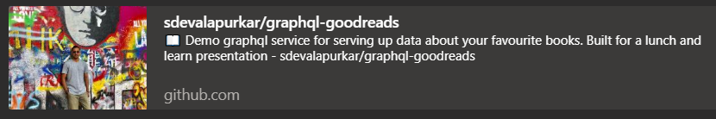
For Reference
https://github.com/sdevalapurkar/graphql-goodreads

Slide 13
Acknowledgements
I would sincerely like to thank:
Alex Joyeux – Team Pomme
James Jose - Career Mentor

Slide 14
Thank you!! and Questions??
Hope that was enjoyable! Thank you all.
Have a great rest of your day.
Any questions?

