Slide 1

OPENSTUDIO / SEED 2026
Free studio.
Premium intelligence.
A local-first DAW that acquires creators with real utility—then monetizes AI, cloud APIs and premium plugins.
Notes:
[Sources]
- Internal: OpenStudio logo and product thesis supplied by the project repository.
[/Sources]

Slide 2
Music creation has split into two incomplete workflows
LEGACY DAWs
AI GENERATORS
Professional control.
High cost and fragmented add-ons.
Instant ideation.
Shallow production control.
Pitch, virtual guitar rigs and specialized creation tools often sit behind paid editions or separate purchases.
Generation is fast, but recording, deep editing, plugins and finishing still move into another toolchain.
THE GAP — one creation-to-production workflow, useful before the paywall.
02
OPENSTUDIO / CONFIDENTIAL
02
Notes:
[Sources]
- https://www.steinberg.net/cubase/compare-editions/
- https://kb.avid.com/pkb/articles/en_US/Knowledge/Pro-Tools-Intro-FAQ
- https://suno.com/pricing
- https://suno.com/release-notes/introducing-suno-studio
- Internal: OpenStudio positioning is a management thesis, not a claim of feature-quality equivalence.
[/Sources]

Slide 3
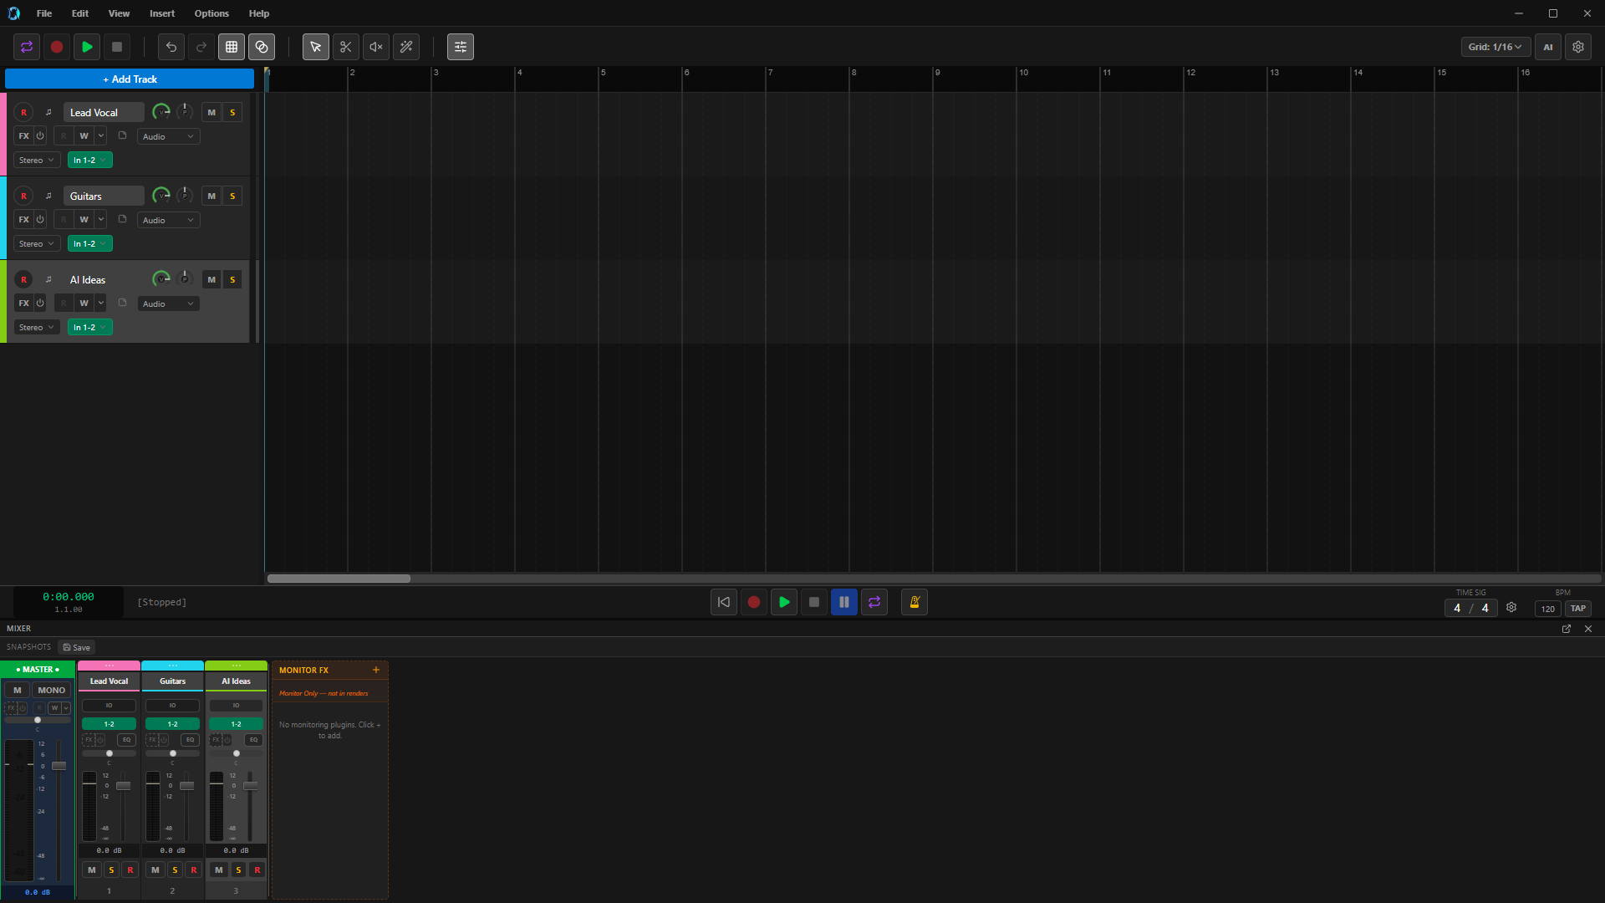
The core studio already runs
WORKING DEVELOPMENT BUILD
Record. Edit. Mix. Master.
JUCE audio engine + React workflow
• Multitrack recording and mixing
• MIDI editor and graphical pitch pipeline
• VST3 / CLAP / LV2 hosting
• AI generation and source variation
• NAM guitar rig with pedals, cab, EQ and post FX
97
286
374
C++ source / header files
TypeScript / TSX files
Native bridge registrations
OPENSTUDIO / CONFIDENTIAL
03
Notes:
[Sources]
- Internal: Live local capture: .codex_tmp/fundraising_deck/assets/openstudio-main-daw-1920x1080.png
- Internal: Feature scope: OpenStudio Source/ and frontend/src/ implementation.
[/Sources]

Slide 4
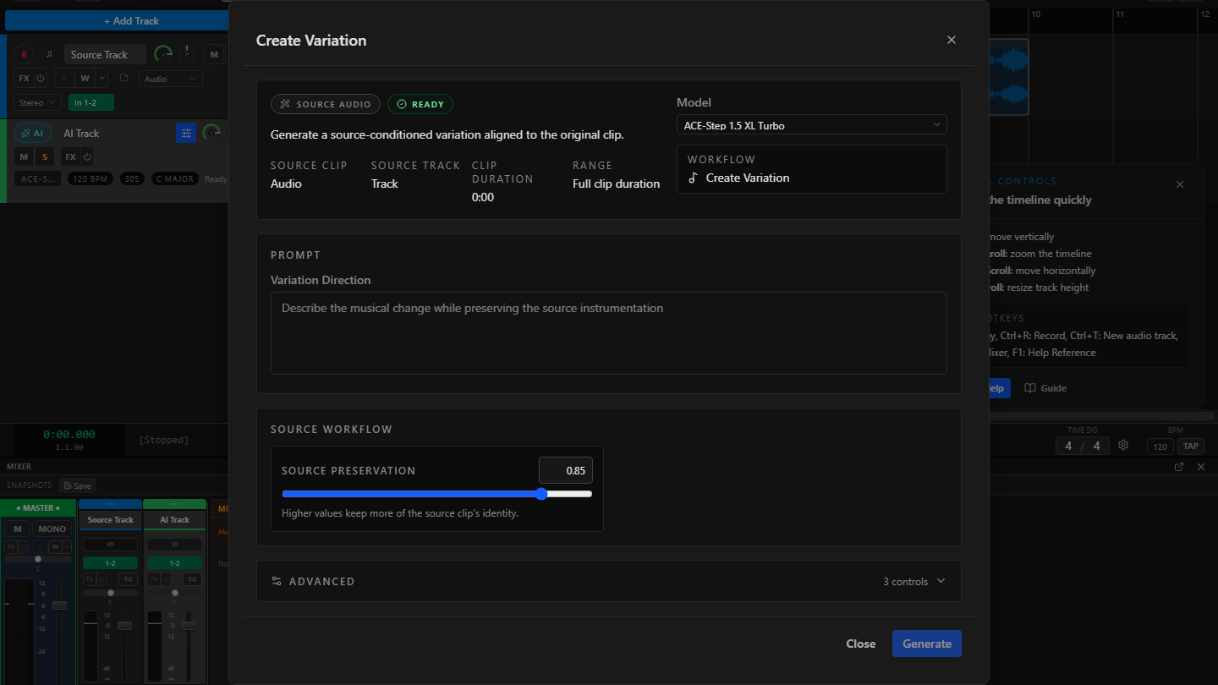
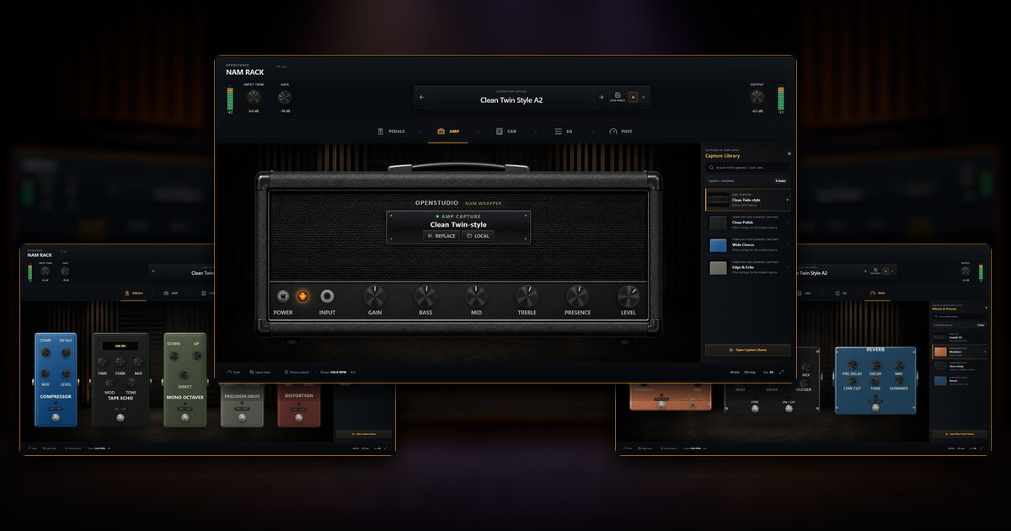
The acquisition wedge is a $0 first-year studio
$0
~$604
REAPER + Melodyne Assistant + Guitar Rig Pro + 1 year Suno Pro
vs.
OpenStudio core
illustrative first-year stack
List-price illustration only; not feature or quality equivalence.
AI CREATE / VARIATION
NAM GUITAR RIG
04
OPENSTUDIO / CONFIDENTIAL
04
Notes:
[Sources]
- https://www.reaper.fm/purchase.php
- https://shop.celemony.com/cgi-bin/WebObjects/CelemonyShop.woa/wa/shopEntry?article=520&task=displayDetail
- https://www.native-instruments.com/en/pricing/guitar-rig-6-pro/
- https://suno.com/pricing
- Internal: AI capture: repository QA fixture; NAM composite: repo-documented current-development-build capture.
[/Sources]

Slide 5
OpenStudio wins on breadth before the paywall
Competitors offer depth in parts; OpenStudio bundles the creation-to-production workflow for free.
CAPABILITY | OPENSTUDIO | CUBASE | PRO TOOLS | REAPER | SUNO | UDIO
DAW + recording | INCLUDED FREE | Paid | Free / 8 tracks | 60-day eval | Browser Studio / paid | Not core
MIDI note editing | INCLUDED FREE | Paid | Free / limited | Included in eval | Export only / Premier | Not core
Graphical pitch workflow | INCLUDED FREE | VariAudio / paid | Melodyne separate | Basic ReaTune | Basic Studio tools / paid | Not core
AI music generation | FREE / OPTIONAL* | Not core | Not core | Not core | Free / credit-limited | Free / credit-limited
Integrated guitar rig | INCLUDED FREE | Paid suite | Limited amps | Plugins separate | Not core | Not core
VST3 / CLAP / LV2 hosting | INCLUDED FREE | VST3 / paid | AAX / paid | Included in eval | No | No
* Current development scope. “Included” describes access, not parity with every specialist product.
05
OPENSTUDIO / CONFIDENTIAL
05
Notes:
[Sources]
- https://www.steinberg.net/cubase/compare-editions/
- https://kb.avid.com/pkb/articles/en_US/Knowledge/Pro-Tools-Intro-FAQ
- https://www.cockos.com/reaper/purchase.php
- https://suno.com/pricing
- https://suno.com/release-notes/introducing-suno-studio
- https://help.udio.com/en/articles/10739199-changing-or-canceling-your-subscription
- Internal: OpenStudio feature access based on the current source tree and local development build.
[/Sources]

Slide 6
Three tailwinds meet in one product
OpenStudio sits at the intersection—not the sum—of established DAW spend, high-growth music AI and India’s expanding creator base.
$4.4B → $8.9B
$0.96B → $2.79B
4.12M
Global DAW market
2025 → 2033
Generative AI in music
2026 → 2030
Indian creators in 2025
66% outside metros
06
OPENSTUDIO / CONFIDENTIAL
06
Notes:
[Sources]
- https://www.grandviewresearch.com/industry-analysis/digital-audio-workstation-market-report
- https://www.grandviewresearch.com/industry-analysis/generative-ai-in-music-market-report
- https://prodcd.isb.edu/media/ykmjlwaj/india_creator_economy_interactive_report.html
[/Sources]

Slide 7
Incumbent adoption validates willingness to pay
Share of DAW mentions in a 2025 professional-user survey
The signal is economic, not just technical
Creators already pay for production workflows and AI output. OpenStudio’s opportunity is to enter earlier—with a useful free core.
2M paid
$300M ARR
$5.4B valuation
$417M revenue
$55M net income
Suno · company / CEO-reported
Profit not disclosed
Avid FY2022 · all products
2023 take-private: ~$1.4B
Survey is self-selected, multi-answer and pro/post-skewed—not global market share. *Cubase + Nuendo.
Udio: $10M seed; revenue / profit not disclosed. Steinberg and Cockos product economics not disclosed.
07
OPENSTUDIO / CONFIDENTIAL
07
Notes:
[Sources]
- https://www.production-expert.com/production-expert-1/2025-daw-survey-the-results
- https://www.wmg.com/news/warner-music-group-and-suno-forge-groundbreaking-partnership
- https://techcrunch.com/2026/02/27/ai-music-generator-suno-hits-2-million-paid-subscribers-and-300m-in-annual-recurring-revenue/
- https://suno.com/blog/series-d-announcement
- https://www.sec.gov/Archives/edgar/data/896841/000089684123000019/avid-20221231.htm
- https://newsroom.notified.com/avid-technology-inc/posts/pressreleases/stg-completes-acquisition-of-avid-technology
[/Sources]

Slide 8
Indian Classical is a model gap—not a genre filter
General-purpose music AI underrepresents the structures that matter: raga, tala, shruti, improvisation and ornamentation.
86%
~5%
40%
Analyzed dataset hours
focused on the Global North
South Asian representation
across analyzed music data
Best stylistic fidelity in a
2026 South Asian benchmark
Licensed / opt-in performances → raga + tala + ornament-aware models → premium creator tools + API
08
OPENSTUDIO / CONFIDENTIAL
08
Notes:
[Sources]
- https://arxiv.org/abs/2412.04100
- https://arxiv.org/abs/2606.05522
- https://mtg.github.io/saraga/
- https://compmusic.upf.edu/node/328
- Internal: The moat statement is a product thesis. Academic representation gaps do not by themselves prove commercial demand.
[/Sources]

Slide 9
Free acquisition creates paid conversion moments
01 ACQUIRE
02 ACTIVATE
03 CONVERT
A genuinely useful free studio
Creator colleges · guitar communities · regional-language educators · open-source channels
First-session success
Record or import · create a variation · edit pitch / MIDI · shape a guitar tone
Pay at the value boundary
Commercial AI · more compute · cloud collaboration · API access · premium plugins
YEAR 1 BASE FUNNEL — 180k registrations · 60k average MAU · 3.5% paid conversion
09
OPENSTUDIO / CONFIDENTIAL
09
Notes:
[Sources]
- https://chartmogul.com/blog/freemium-business-model/
- https://openviewpartners.com/blog/your-guide-to-product-led-growth-benchmarks/
- Internal: OpenStudio Year 1 funnel is a management projection.
[/Sources]

Slide 10
Charge for compute and commercial leverage—not the core studio
OPENSTUDIO FREE
CREATOR AI
PRO AI + CLOUD
DAW + recording
MIDI + pitch editor
NAM guitar rig
Plugin hosting
Limited cloud trial
Commercial AI credits
Higher-quality generation
Stem separation
Indian-model packs
$90 annual
More compute
Private projects
Batch + cloud workflows
API priority
$190 annual
Full local studio
₹499 / mo India
₹999 / mo India
$0
$9 / mo
$19 / mo
ADDITIONAL ARPU — $39–$99 premium plugins · API from $49 / month + metered usage
10
OPENSTUDIO / CONFIDENTIAL
10
Notes:
[Sources]
- https://suno.com/pricing
- https://help.udio.com/en/articles/10739199-changing-or-canceling-your-subscription
- https://help.bandlab.com/hc/en-us/articles/20758981227033-BandLab-Membership-FAQ
- https://elevenlabs.io/pricing/api
- https://soundraw.io/api
- Internal: OpenStudio prices are recommended launch tests, not current revenue or finalized pricing.
- Internal: Commercialization assumes a compliant dual-license and/or separately architected proprietary service/plugin layer; legal review is required.
[/Sources]

Slide 11
A small share can support a real business
Base-case revenue mix ($M)
Base assumptions
Average MAU 60k → 400k
Paid conversion 3.5% → 5.0%
Blended paid ARPU $9 → $10 / month
Gross margin 74.5% → 77.8%
$0.35M
$4.40M
YEAR 1 REVENUE
−$0.39M EBITDA
Investment year
YEAR 3 REVENUE
+$0.47M EBITDA
10.8% margin
Year 3 base revenue is ~0.1% of the broader 2025 DAW market estimate.
11
OPENSTUDIO / CONFIDENTIAL
11
Notes:
[Sources]
- https://www.grandviewresearch.com/industry-analysis/digital-audio-workstation-market-report
- https://chartmogul.com/blog/freemium-business-model/
- https://openviewpartners.com/blog/your-guide-to-product-led-growth-benchmarks/
- https://www.fexant.com/bank/RBI
- Internal: All OpenStudio figures are management projections. Year 1 = months 1–12 after commercial launch; Year 3 = months 25–36.
- Internal: FX planning assumption: ₹96/US$. Revenue excludes GST/VAT.
- Internal: Base-case Year 1: $351k revenue, -$388.5k EBITDA. Year 3: $4.404M revenue, +$474.7k EBITDA.
[/Sources]

Slide 12
24 months turns the free wedge into a paid platform
0–6 MONTHS
6–12 MONTHS
12–24 MONTHS
Stabilize + launch
Installers · onboarding · audio QA · licensing / service boundary · consented analytics
Monetize
Paid AI tiers · credit metering · commercial rights · plugin store · creator community
Defend + scale
Licensed Indian corpus · raga / tala models · cloud API · enterprise pilots
USE OF FUNDS 40% ML + DATA · 30% PRODUCT · 20% GTM · 10% CLOUD / LEGAL / OPS
12
OPENSTUDIO / CONFIDENTIAL
12
Notes:
[Sources]
- Internal: Roadmap, timing and allocation are proposed management plans and should be revised during fundraising diligence.
- Internal: The current codebase is AGPLv3-compatible; paid services/plugins require a deliberate licensing and architecture strategy with counsel.
[/Sources]

Slide 13
OPENSTUDIO / PROPOSED SEED
Raising $1.5M
24 months to launch paid AI, build the Indian-Classical model moat, and pursue a $4.4M Year-3 base case.
openstudio.org.in
Notes:
[Sources]
- Internal: The $1.5M raise, 24-month runway and Year-3 target are proposed management plans, not commitments.
[/Sources]

