Slide 1

OPENSTUDIO / SEED 2026
Free studio.
Premium intelligence.
A local-first DAW that acquires creators with real utility—then monetizes AI, cloud APIs and premium plugins.
Notes:
[Sources]
- Internal: OpenStudio logo and product thesis supplied by the project repository.
[/Sources]

Slide 2

Music creation has split into two incomplete workflows
LEGACY DAWs
AI GENERATORS
Professional control.
High cost and fragmented add-ons.
Instant ideation.
Shallow production control.
Pitch, virtual guitar rigs and specialized creation tools often sit behind paid editions or separate purchases.
Generation is fast, but recording, deep editing, plugins and finishing still move into another toolchain.
THE GAP — one creation-to-production workflow, useful before the paywall.
02
OPENSTUDIO / CONFIDENTIAL
02
Notes:
[Sources]
- https://www.steinberg.net/cubase/compare-editions/
- https://kb.avid.com/pkb/articles/en_US/Knowledge/Pro-Tools-Intro-FAQ
- https://suno.com/pricing
- https://suno.com/release-notes/introducing-suno-studio
- Internal: OpenStudio positioning is a management thesis, not a claim of feature-quality equivalence.
[/Sources]

Slide 3
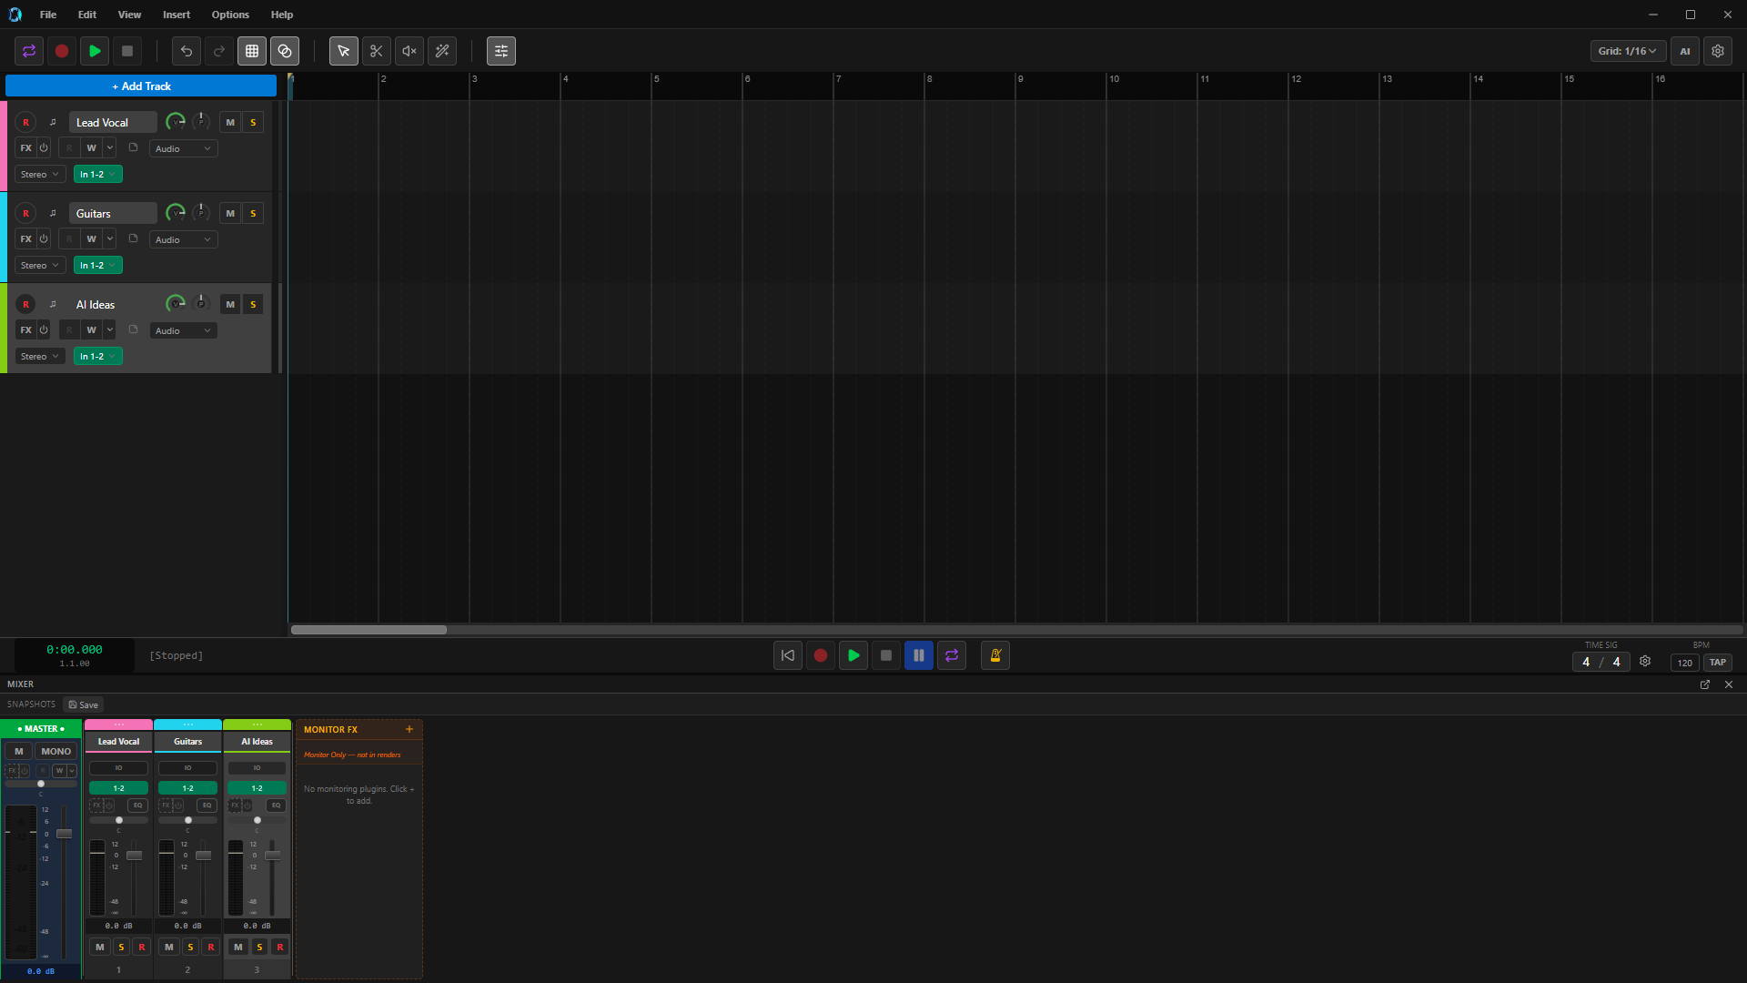

The core studio already runs
WORKING DEVELOPMENT BUILD
Record. Edit. Mix. Master.
JUCE audio engine + React workflow
• Multitrack recording and mixing
• MIDI editor and graphical pitch pipeline
• VST3 / CLAP / LV2 hosting
• AI generation and source variation
• NAM guitar rig with pedals, cab, EQ and post FX
97
286
374
C++ source / header files
TypeScript / TSX files
Native bridge registrations
OPENSTUDIO / CONFIDENTIAL
03
Notes:
[Sources]
- Internal: Live local capture: .codex_tmp/fundraising_deck/assets/openstudio-main-daw-1920x1080.png
- Internal: Feature scope: OpenStudio Source/ and frontend/src/ implementation.
[/Sources]

Slide 4

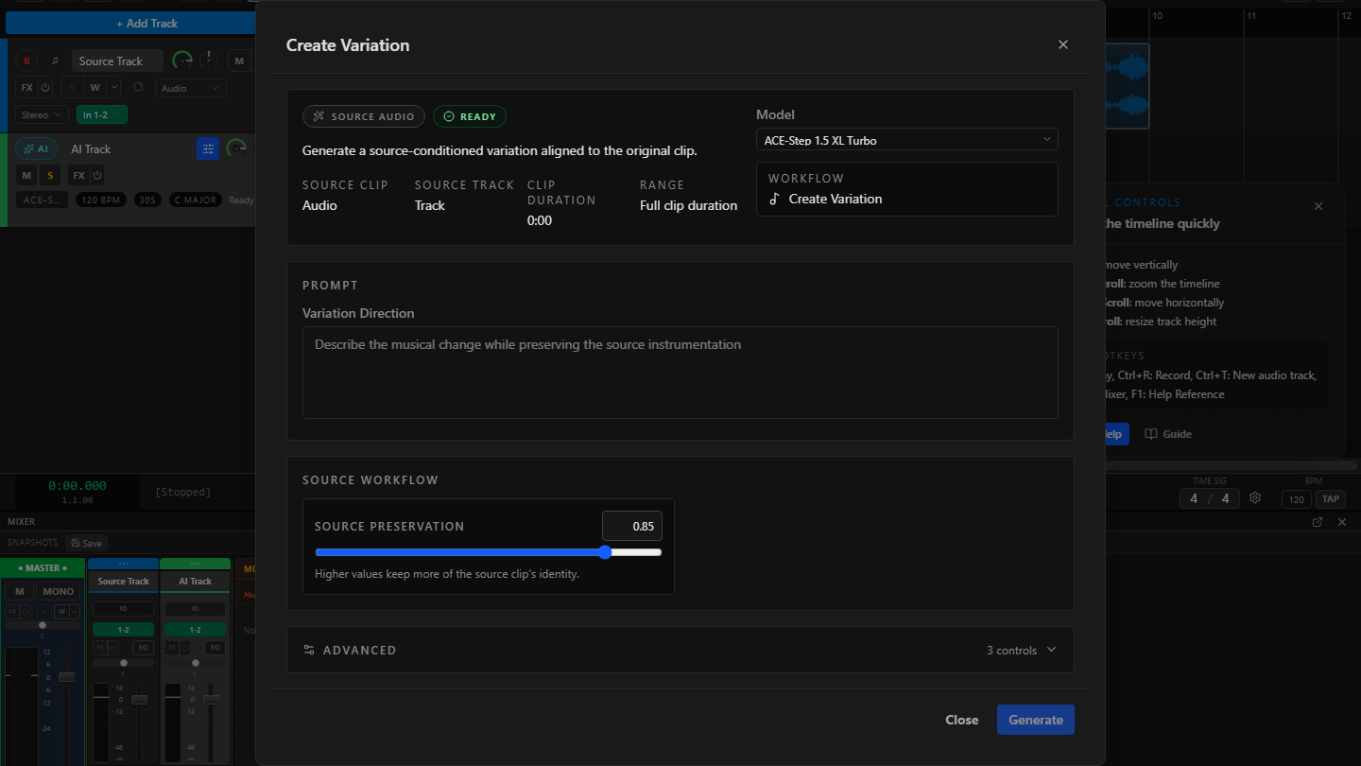
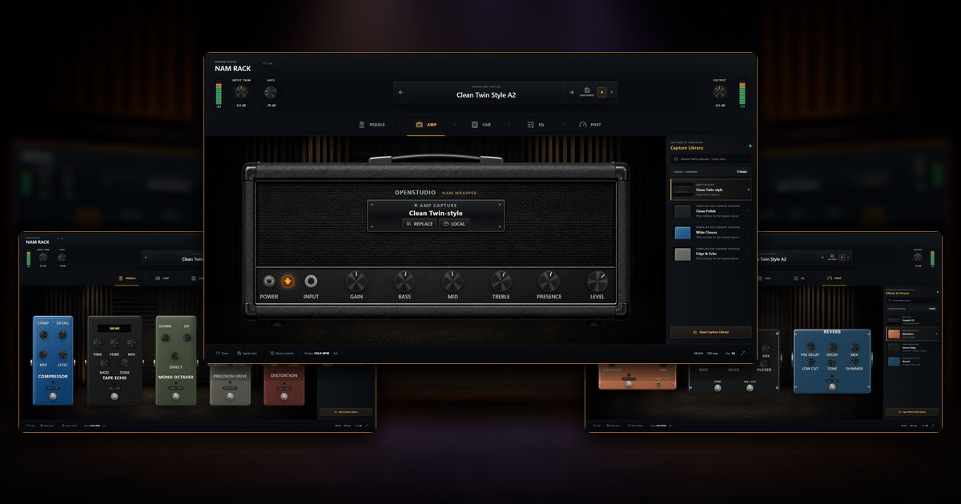
The acquisition wedge is a $0 first-year studio
$0
~$604
REAPER + Melodyne Assistant + Guitar Rig Pro + 1 year Suno Pro
vs.
OpenStudio core
illustrative first-year stack
List-price illustration only; not feature or quality equivalence.
AI CREATE / VARIATION
NAM GUITAR RIG
04
OPENSTUDIO / CONFIDENTIAL
04
Notes:
[Sources]
- https://www.reaper.fm/purchase.php
- https://shop.celemony.com/cgi-bin/WebObjects/CelemonyShop.woa/wa/shopEntry?article=520&task=displayDetail
- https://www.native-instruments.com/en/pricing/guitar-rig-6-pro/
- https://suno.com/pricing
- Internal: AI capture: repository QA fixture; NAM composite: repo-documented current-development-build capture.
[/Sources]

Slide 5
OpenStudio wins on breadth before the paywall
Competitors offer depth in parts; OpenStudio bundles the creation-to-production workflow for free.
CAPABILITY | OPENSTUDIO | CUBASE | PRO TOOLS | REAPER | SUNO | UDIO
DAW + recording | INCLUDED FREE | Paid | Free / 8 tracks | 60-day eval | Browser Studio / paid | Not core
MIDI note editing | INCLUDED FREE | Paid | Free / limited | Included in eval | Export only / Premier | Not core
Graphical pitch workflow | INCLUDED FREE | VariAudio / paid | Melodyne separate | Basic ReaTune | Basic Studio tools / paid | Not core
AI music generation | FREE / OPTIONAL* | Not core | Not core | Not core | Free / credit-limited | Free / credit-limited
Integrated guitar rig | INCLUDED FREE | Paid suite | Limited amps | Plugins separate | Not core | Not core
VST3 / CLAP / LV2 hosting | INCLUDED FREE | VST3 / paid | AAX / paid | Included in eval | No | No
* Current development scope. “Included” describes access, not parity with every specialist product.
05
OPENSTUDIO / CONFIDENTIAL
05
Notes:
[Sources]
- https://www.steinberg.net/cubase/compare-editions/
- https://kb.avid.com/pkb/articles/en_US/Knowledge/Pro-Tools-Intro-FAQ
- https://www.cockos.com/reaper/purchase.php
- https://suno.com/pricing
- https://suno.com/release-notes/introducing-suno-studio
- https://help.udio.com/en/articles/10739199-changing-or-canceling-your-subscription
- Internal: OpenStudio feature access based on the current source tree and local development build.
[/Sources]

Slide 6
Three tailwinds meet in one product
OpenStudio sits at the intersection—not the sum—of established DAW spend, high-growth music AI and India’s expanding creator base.
$4.4B → $8.9B
$0.96B → $2.79B
4.12M
Global DAW market
2025 → 2033
Generative AI in music
2026 → 2030
Indian creators in 2025
66% outside metros
06
OPENSTUDIO / CONFIDENTIAL
06
Notes:
[Sources]
- https://www.grandviewresearch.com/industry-analysis/digital-audio-workstation-market-report
- https://www.grandviewresearch.com/industry-analysis/generative-ai-in-music-market-report
- https://prodcd.isb.edu/media/ykmjlwaj/india_creator_economy_interactive_report.html
[/Sources]

Slide 7

Incumbent adoption validates willingness to pay
Share of DAW mentions in a 2025 professional-user survey
The signal is economic, not just technical
Creators already pay for production workflows and AI output. OpenStudio’s opportunity is to enter earlier—with a useful free core.
2M paid
$300M ARR
$5.4B valuation
$417M revenue
$55M net income
Suno · company / CEO-reported
Profit not disclosed
Avid FY2022 · all products
2023 take-private: ~$1.4B
Survey is self-selected, multi-answer and pro/post-skewed—not global market share. *Cubase + Nuendo.
Udio: $10M seed; revenue / profit not disclosed. Steinberg and Cockos product economics not disclosed.
07
OPENSTUDIO / CONFIDENTIAL
07
Notes:
[Sources]
- https://www.production-expert.com/production-expert-1/2025-daw-survey-the-results
- https://www.wmg.com/news/warner-music-group-and-suno-forge-groundbreaking-partnership
- https://techcrunch.com/2026/02/27/ai-music-generator-suno-hits-2-million-paid-subscribers-and-300m-in-annual-recurring-revenue/
- https://suno.com/blog/series-d-announcement
- https://www.sec.gov/Archives/edgar/data/896841/000089684123000019/avid-20221231.htm
- https://newsroom.notified.com/avid-technology-inc/posts/pressreleases/stg-completes-acquisition-of-avid-technology
[/Sources]

Slide 8
Indian Classical is a model gap—not a genre filter
General-purpose music AI underrepresents the structures that matter: raga, tala, shruti, improvisation and ornamentation.
86%
~5%
40%
Analyzed dataset hours
focused on the Global North
South Asian representation
across analyzed music data
Best stylistic fidelity in a
2026 South Asian benchmark
Licensed / opt-in performances → raga + tala + ornament-aware models → premium creator tools + API
08
OPENSTUDIO / CONFIDENTIAL
08
Notes:
[Sources]
- https://arxiv.org/abs/2412.04100
- https://arxiv.org/abs/2606.05522
- https://mtg.github.io/saraga/
- https://compmusic.upf.edu/node/328
- Internal: The moat statement is a product thesis. Academic representation gaps do not by themselves prove commercial demand.
[/Sources]

Slide 9

Free acquisition creates paid conversion moments
01 ACQUIRE
02 ACTIVATE
03 CONVERT
A genuinely useful free studio
Creator colleges · guitar communities · regional-language educators · open-source channels
First-session success
Record or import · create a variation · edit pitch / MIDI · shape a guitar tone
Pay at the value boundary
Commercial AI · more compute · cloud collaboration · API access · premium plugins
YEAR 1 PLANNING FUNNEL — 30k average MAU · 2.5% paid / MAU · $7.50 blended ARPU
09
OPENSTUDIO / CONFIDENTIAL
09
Notes:
[Sources]
- https://chartmogul.com/reports/saas-conversion-report/
- https://www.revenuecat.com/state-of-subscription-apps-2026-utilities
- Internal: This is a management planning case, not current traction.
- Internal: Paid / MAU means active paying subscribers divided by average monthly active users.
- Internal: The forecast resets after month 6 using D30/D90 retention, paid churn, AI variable cost, CAC, and plugin/API demand.
[/Sources]

Slide 10
Charge for compute and commercial leverage—not the core studio
OPENSTUDIO FREE
CREATOR AI
PRO AI + CLOUD
DAW + recording
MIDI + pitch editor
NAM guitar rig
Plugin hosting
Limited cloud trial
Commercial AI credits
Higher-quality generation
Stem separation
Indian-model packs
$90 annual
More compute
Private projects
Batch + cloud workflows
API priority
$190 annual
Full local studio
₹499 / mo India
₹999 / mo India
$0
$9 / mo
$19 / mo
ADDITIONAL ARPU — $39–$99 premium plugins · API from $49 / month + metered usage
10
OPENSTUDIO / CONFIDENTIAL
10
Notes:
[Sources]
- https://suno.com/pricing
- https://help.udio.com/en/articles/10739199-changing-or-canceling-your-subscription
- https://help.bandlab.com/hc/en-us/articles/20758981227033-BandLab-Membership-FAQ
- https://elevenlabs.io/pricing/api
- https://soundraw.io/api
- https://www.gnu.org/licenses/gpl-faq.en.html
- https://juce.com/get-juce/
- Internal: OpenStudio prices are recommended launch tests, not current revenue or finalized pricing.
- Internal: Blended ARPU includes India pricing, annual discounts, refunds, and tier mix.
- Internal: Before paid launch, counsel should confirm the AGPLv3 commercialization boundary and JUCE licensing. Proprietary services/plugins must be separately architected, dual-licensed, and/or distributed under the appropriate commercial licenses.
[/Sources]

Slide 11
A measured plan preserves meaningful upside
Revenue scenarios by stream ($M)
Planning assumptions
MAU 30k → 250k
Paid / MAU 2.5% → 3.5%
Paid ARPU $7.50 → $8.50 / mo
Plugin attach 2% → 3% · API 8 → 75
$0.12M
$1.65M
YEAR 1 PLAN
Upside $0.35M
Investment phase
YEAR 3 PLAN
Upside $4.40M
Upside EBITDA +$0.47M
Y3 plan ≈0.04% of DAW market; upside ≈0.10%. Reforecast at month 6.
11
OPENSTUDIO / CONFIDENTIAL
11
Notes:
[Sources]
- https://www.grandviewresearch.com/industry-analysis/digital-audio-workstation-market-report
- https://chartmogul.com/reports/saas-conversion-report/
- https://www.revenuecat.com/state-of-subscription-apps-2026-utilities
- https://elevenlabs.io/pricing/api
- Internal: All OpenStudio figures are management projections. Year 1 is months 1–12 after commercial launch; Year 3 is months 25–36.
- Internal: Planning Y1 = $67.5k subscriptions + $29.4k plugins + $19.2k API = $116.1k. Subscriptions: 30k × 2.5% × $7.50 × 12. Plugins: 30k × 2% × $49. API: 8 × $200 × 12.
- Internal: Planning Y3 = $892.5k subscriptions + $517.5k plugins + $240k API = $1.65M. Subscriptions: 250k × 3.5% × $8.50 × 12. Plugins: 250k × 3% × $69. API: 75 × $266.67 × 12.
- Internal: Management upside retains the previous projection: $351k Y1 and $4.404M Y3, with +$474.7k Y3 EBITDA. Planning-case profitability is not asserted until churn, CAC, AI COGS, tax/refunds, and staffing are modeled.
- Internal: Forecast resets after month 6 using D30/D90 retention, paid churn, AI variable cost, CAC, and plugin/API demand.
[/Sources]

Slide 12

$1.5M funds an 18–24 month milestone plan
0–6 MONTHS
6–12 MONTHS
12–24 MONTHS
Launch + validate
Installers · onboarding · audio QA · AGPL/JUCE boundary · consented analytics · forecast rebase
Prove monetization
Paid AI tiers · credit metering · premium plugins · 10k MAU · ≥2% paid / MAU
Defend + scale
Licensed Indian corpus · raga / tala models · cloud API · 20 paying API customers
MILESTONE ROUND 40% ML + DATA · 30% PRODUCT · 20% GTM · 10% CLOUD / LEGAL / OPS
12
OPENSTUDIO / CONFIDENTIAL
12
Notes:
[Sources]
- https://www.gnu.org/licenses/gpl-faq.en.html
- https://juce.com/get-juce/
- Internal: The forecast is rebased after month 6 using measured activation, D30/D90 retention, paid churn, inference cost, CAC, and plugin/API demand.
- Internal: Before scaling, management targets ≥25% D30 retention among activated beta users, ≥2% active paid / MAU, ≥70% three-month paid retention, AI variable cost below 25% of subscription revenue, and evidence from paying API customers.
- Internal: The current codebase is AGPLv3. Paid services/plugins require a counsel-approved architecture and licensing strategy, including JUCE licensing where applicable.
- Internal: Roadmap, timing, milestones, and allocations are proposed management plans.
[/Sources]

Slide 13
OPENSTUDIO / PROPOSED SEED
Raising $1.5M
18–24 months to prove retention, launch paid AI, and earn a $4.40M Year-3 upside.
openstudio.org.in
Notes:
[Sources]
- Internal: The $1.5M raise is proposed as an 18–24 month milestone round.
- Internal: The $1.65M Year-3 planning case and $4.404M management upside are projections, not commitments; runway depends on actual hiring, cloud, data, and legal costs.
[/Sources]

