Slide 1

INC5000_Analysis & Visualization
By: Karine Piccoli & Sashi Devulapalli
7_25_2020

Slide 2
IMPLEMENTATION APPROACH
Google Trends – Food data
Google Trends – Travel data
INC5000 2019 Fastest Growing Companies
Movie data - Kaggle

Slide 3
Why INC5000 data?
Understand Growth by industry
Industries Vs Revenue
Revenue Vs Growth
INSIGHT(S)
For job aspirants

Slide 4
Overview
Performed analysis & visualization in Tableau
Load the data in pgadmin
Extracted and Transformed data using Python
Obtained INC5000 data from data.world. Analyzed data

Slide 5
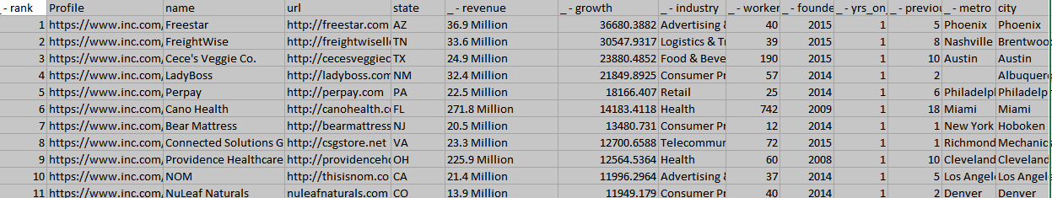
Code snippet – Source data - CSV

Slide 6
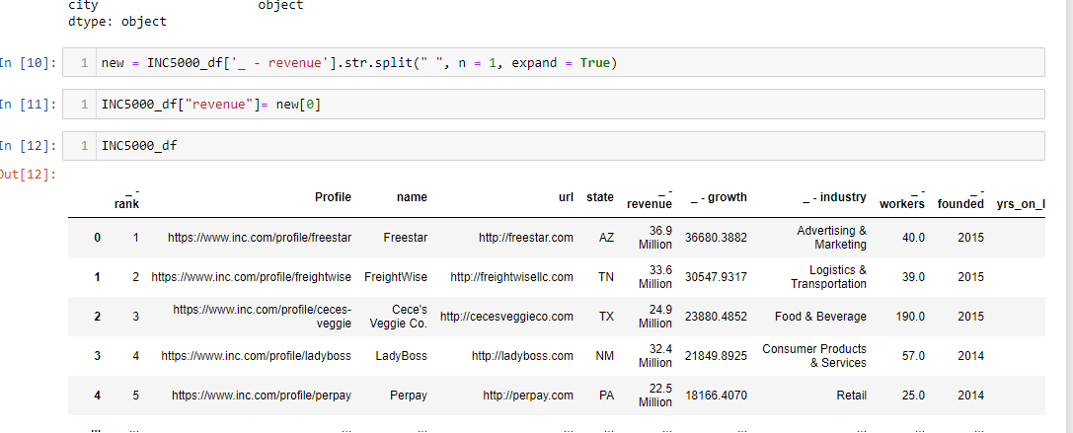
Code Snippet – Data Transformation

Slide 7
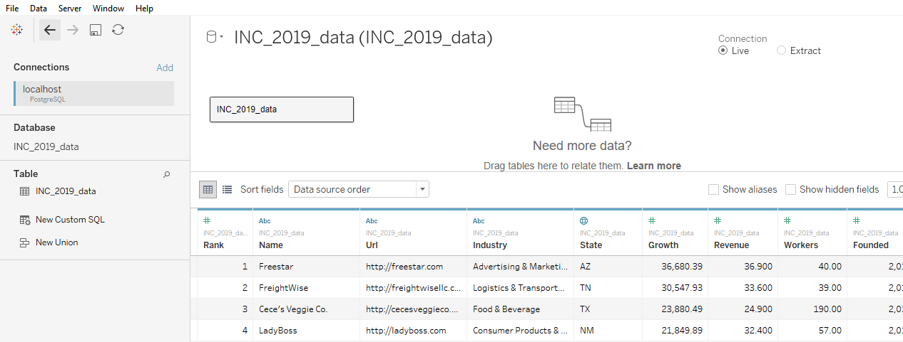
Load Data & Visualization

Slide 8
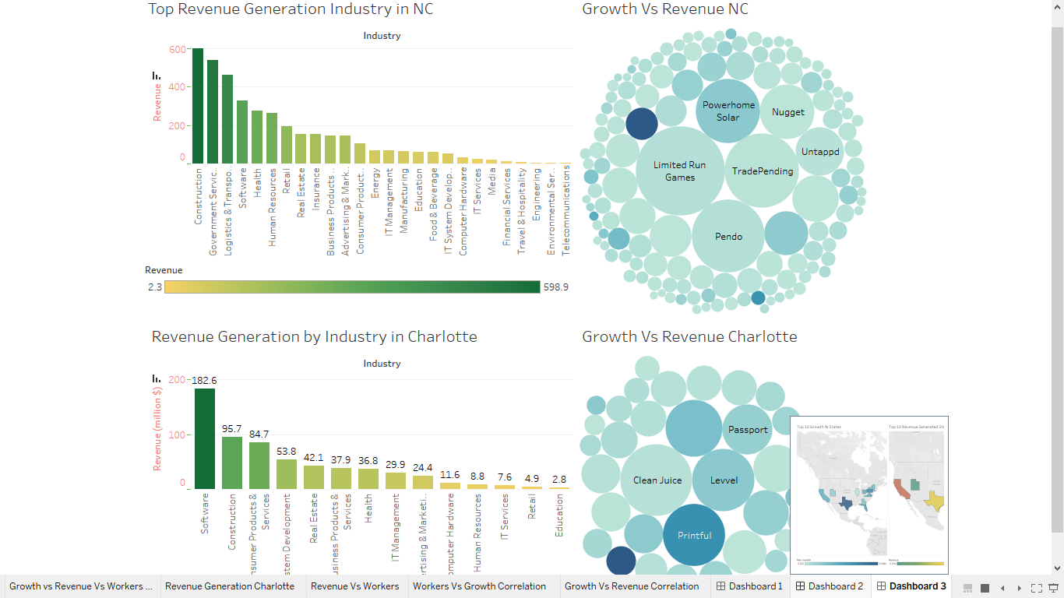
Data Visualization

Slide 9
Question 1
Amongst the top 5000 most successful private companies in U.S. for the year 2019,which of the following is the highest revenue generation state?
California
New York
Texas
Florida

Slide 10
Question 1
Amongst the top 5000 most successful private companies in U.S. for the year 2019,which of the following is the highest revenue generation state?
Answer: California

Slide 11
Question 2
What is the top revenue generation industry in North Carolina based on INC5000 companies list for 2019?
a)Software
b)Construction
c)Government Services
d)Logistics &Transportation

Slide 12
Question 2
What is the top revenue generation industry in North Carolina based on INC5000 companies list for 2019?
Answer: Construction

Slide 13
Question 3
What is the top revenue generation industry in Charlotte based on INC5000 companies list for 2019?
Construction
Software
Consumer products & services
Advertising & Marketing

Slide 14
Question 3
What is the top revenue generation industry in Charlotte based on INC5000 companies list for 2019?
Answer: Software

Slide 15
Next steps….. Tableau

Slide 16
Observations
AvidXchange has the highest revenue amongst the Software companies in INC5000 list for Charlotte.
Based on the revenue and workers correlation, 91% of variation of increase in workers is dependent on the variation of increase in Revenue.
67% of variation of growth is dependent upon the variation of increase in revenue.
Amongst the top 5000 most successful private companies, California ranks 1st in revenue generation and software.

Slide 17

Questions

