Slide 1

Chatbot Project with NLP

Slide 2
Introduction
This project involves creating a chatbot named 'Ruby' that uses Natural Language Understanding (NLU) to interact with users. The chatbot is designed to recognize user intents and extract entities, allowing it to respond appropriately in a conversational context.

Slide 3
Project Objectives
Develop a rule-based NLU system for intent recognition and entity extraction
Enable the chatbot to handle common conversational tasks
Integrate basic conversational AI techniques to enhance user experience
Provide a foundation for further improvements using machine learning

Slide 4
NLU Components
1. Intent Recognition: Identifies the user's goal or intent based on their input.
2. Entity Extraction: Extracts specific data like names, dates, and locations from user input.
3. Text Preprocessing: Includes tokenization, lemmatization, and stopword removal to prepare text for analysis.
4. Contextual Understanding: Maintains conversation context for coherent multi-turn dialogues.

Slide 5
Implementation
1. Data Preparation: Collected and preprocessed text data
2. Rule-Based NLU: Implemented intent recognition and entity extraction using keyword matching
3. Chatbot Logic: Developed a simple response system to handle different user inputs
4. Testing: Evaluated the chatbot's performance and refined its responses

Slide 6
Future Enhancements
Machine Learning Integration: Use ML models for more accurate intent and entity recognition
01
Advanced NLU Techniques: Implement NER and sentiment analysis
02
Dialog Management: Develop a sophisticated dialog management system
03
Multimodal Interaction: Expand interaction capabilities to include voice and image inputs
04

Slide 7
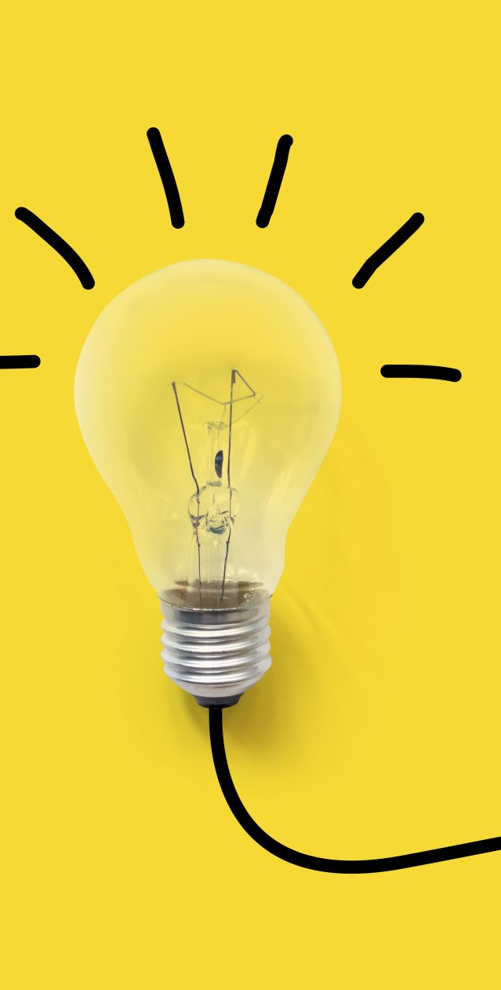
Conclusion
The chatbot project demonstrates the application of NLU in creating conversational agents. By integrating more advanced techniques and continuously refining the system, the chatbot can become a versatile and user-friendly tool capable of handling a wide range of queries.

