Slide 1
Centers for Medicare and Medicaid Services
Group 3:
Kosta Tarasov
Fengchu Lai
Gabriel Plic
Jennie Nguyen

Slide 2
Table of Contents
Background information
Business problems and requirements
Business impact and persona
Dataset description
Dimensional Model
Method
Data Tools
Visualizations
Key takeaways

Slide 3
Background Information
We are a dedicated team of data scientists and engineers hired by The Centers for Medicare & Medicaid Services (CMS) to generate useful business insights
CMS: an agency within the U.S. Department of Health and Human Services
CMS conducts US healthcare programs including Medicare and Medicaid, oversees healthcare regulatory standards

Slide 4
Business Problems and Requirements
Problem: To determine the profession and earnings of the all the doctors that are getting paid by state by analyzing CMS data
Requirements:
- Total doctors and companies by state
- Number of doctors per state, by specialty
- Funding by state, broken down into general pay and research
- No identification of doctors by name

Slide 5
Business Impact
Risks:
- Data Privacy
- Data Accuracy
Costs:
- Data Infrastructure
Benefits:
- Transparency & Accountability
- Policy Making/Enforcement

Slide 6
Business Persona
Main users of the system:
- Public Health Officials: Use the data to ensure compliance with healthcare standards and fairness in provider payments
- Doctors: Interested in understanding how their payments compare with others across different states or specialties
System Actors:
- Data Engineers: Structure and manage vast amounts of data into usable formats
- Data Scientists: Analyze the data to identify trends, correlations, and insights

Slide 7
Datasets Description
Source: CMS Open Payments Data portal
Two dataset types
Span over 5 years
Over 52 million rows

Slide 8
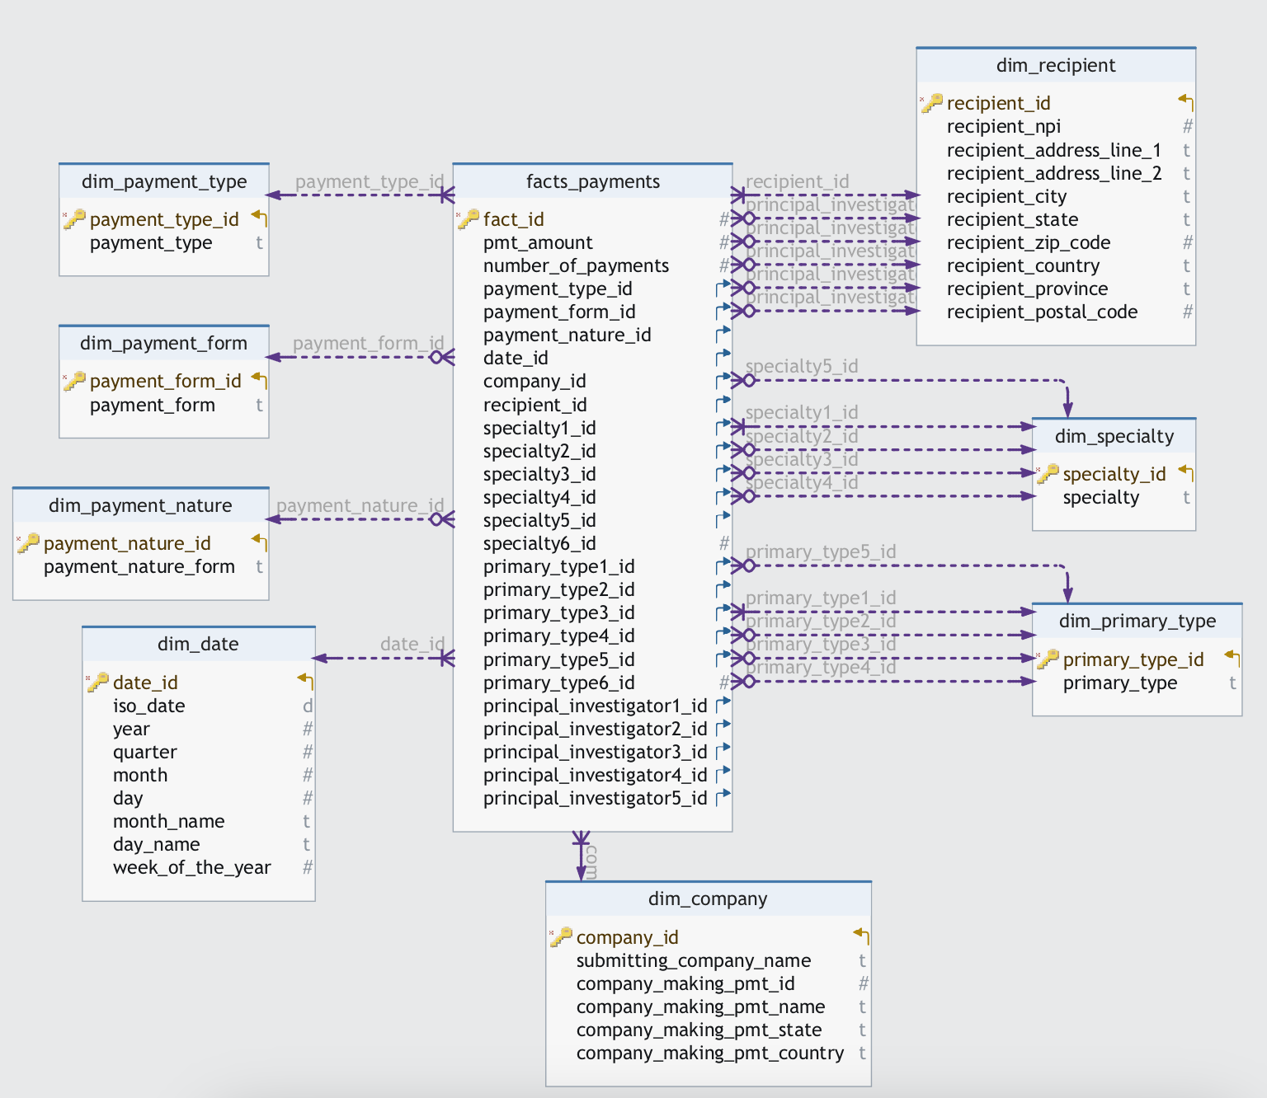
Dimensional Model

Slide 9
Methods: ELT
ELT Process: Extract, Load, Transform
Why ELT?
Preserves data integrity by extracting raw data first
Enables scalable storage and processing
Simplifies pipeline and leverages warehouse computing power for transformations
Extract
Extract data from sources
Load
Load data to DW
Transformation
Data transformation

Slide 10




Data Tools
Snowflake DW
Sources
Azure
Container
Python Script
Tableau
DBT
Data storage: Azure Container
Data processing: Snowflake Data Warehouse
Data orchestration: DBT (Data Build Tool)
Data Visualization: Tableau

Slide 11
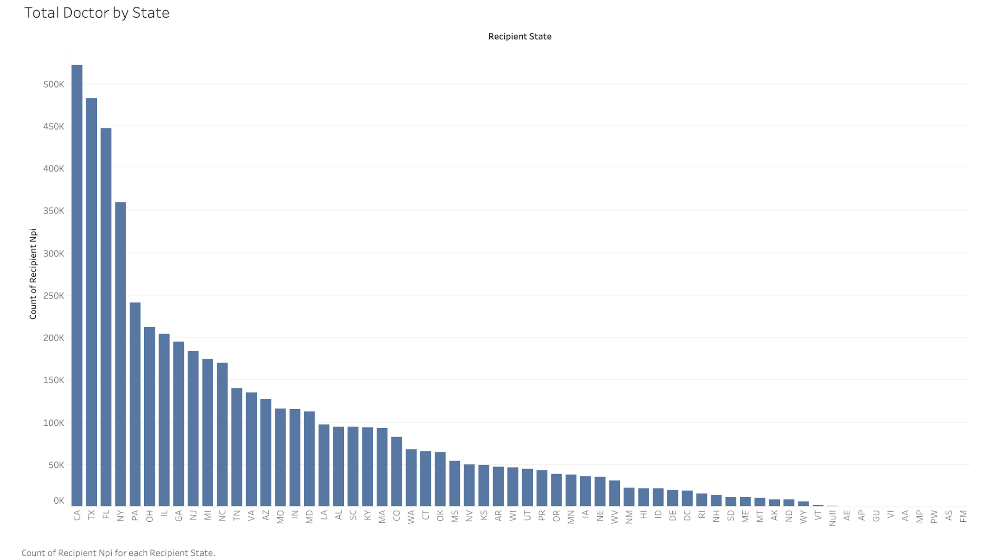
The bar chart shows where doctors are across states
California leads with over 500,000 doctors
Texas and Florida follow with significant numbers
Other states show a gradual decrease in doctor counts
Some states have only a few hundred doctors

Slide 12
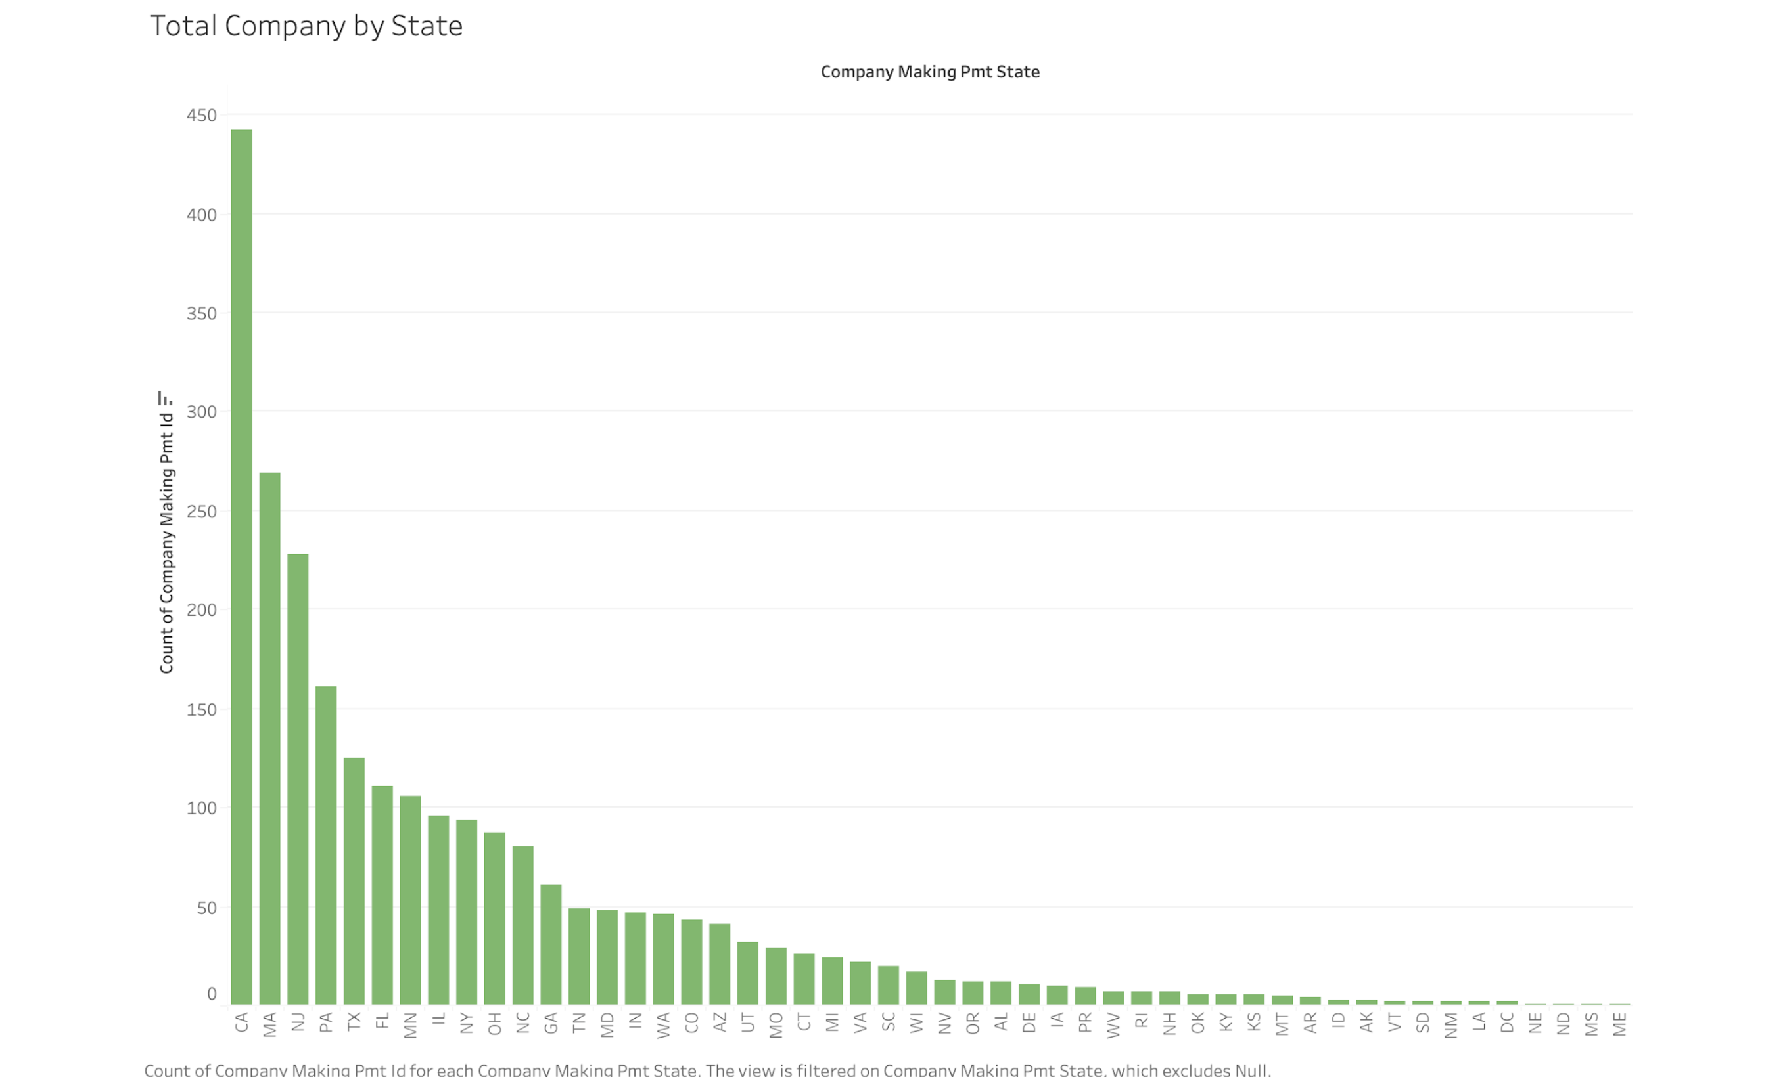
The graph shows company distribution and concentration
California leads with around 450 companies
Counts decrease gradually for other states
Many states have fewer than 50 companies

Slide 13
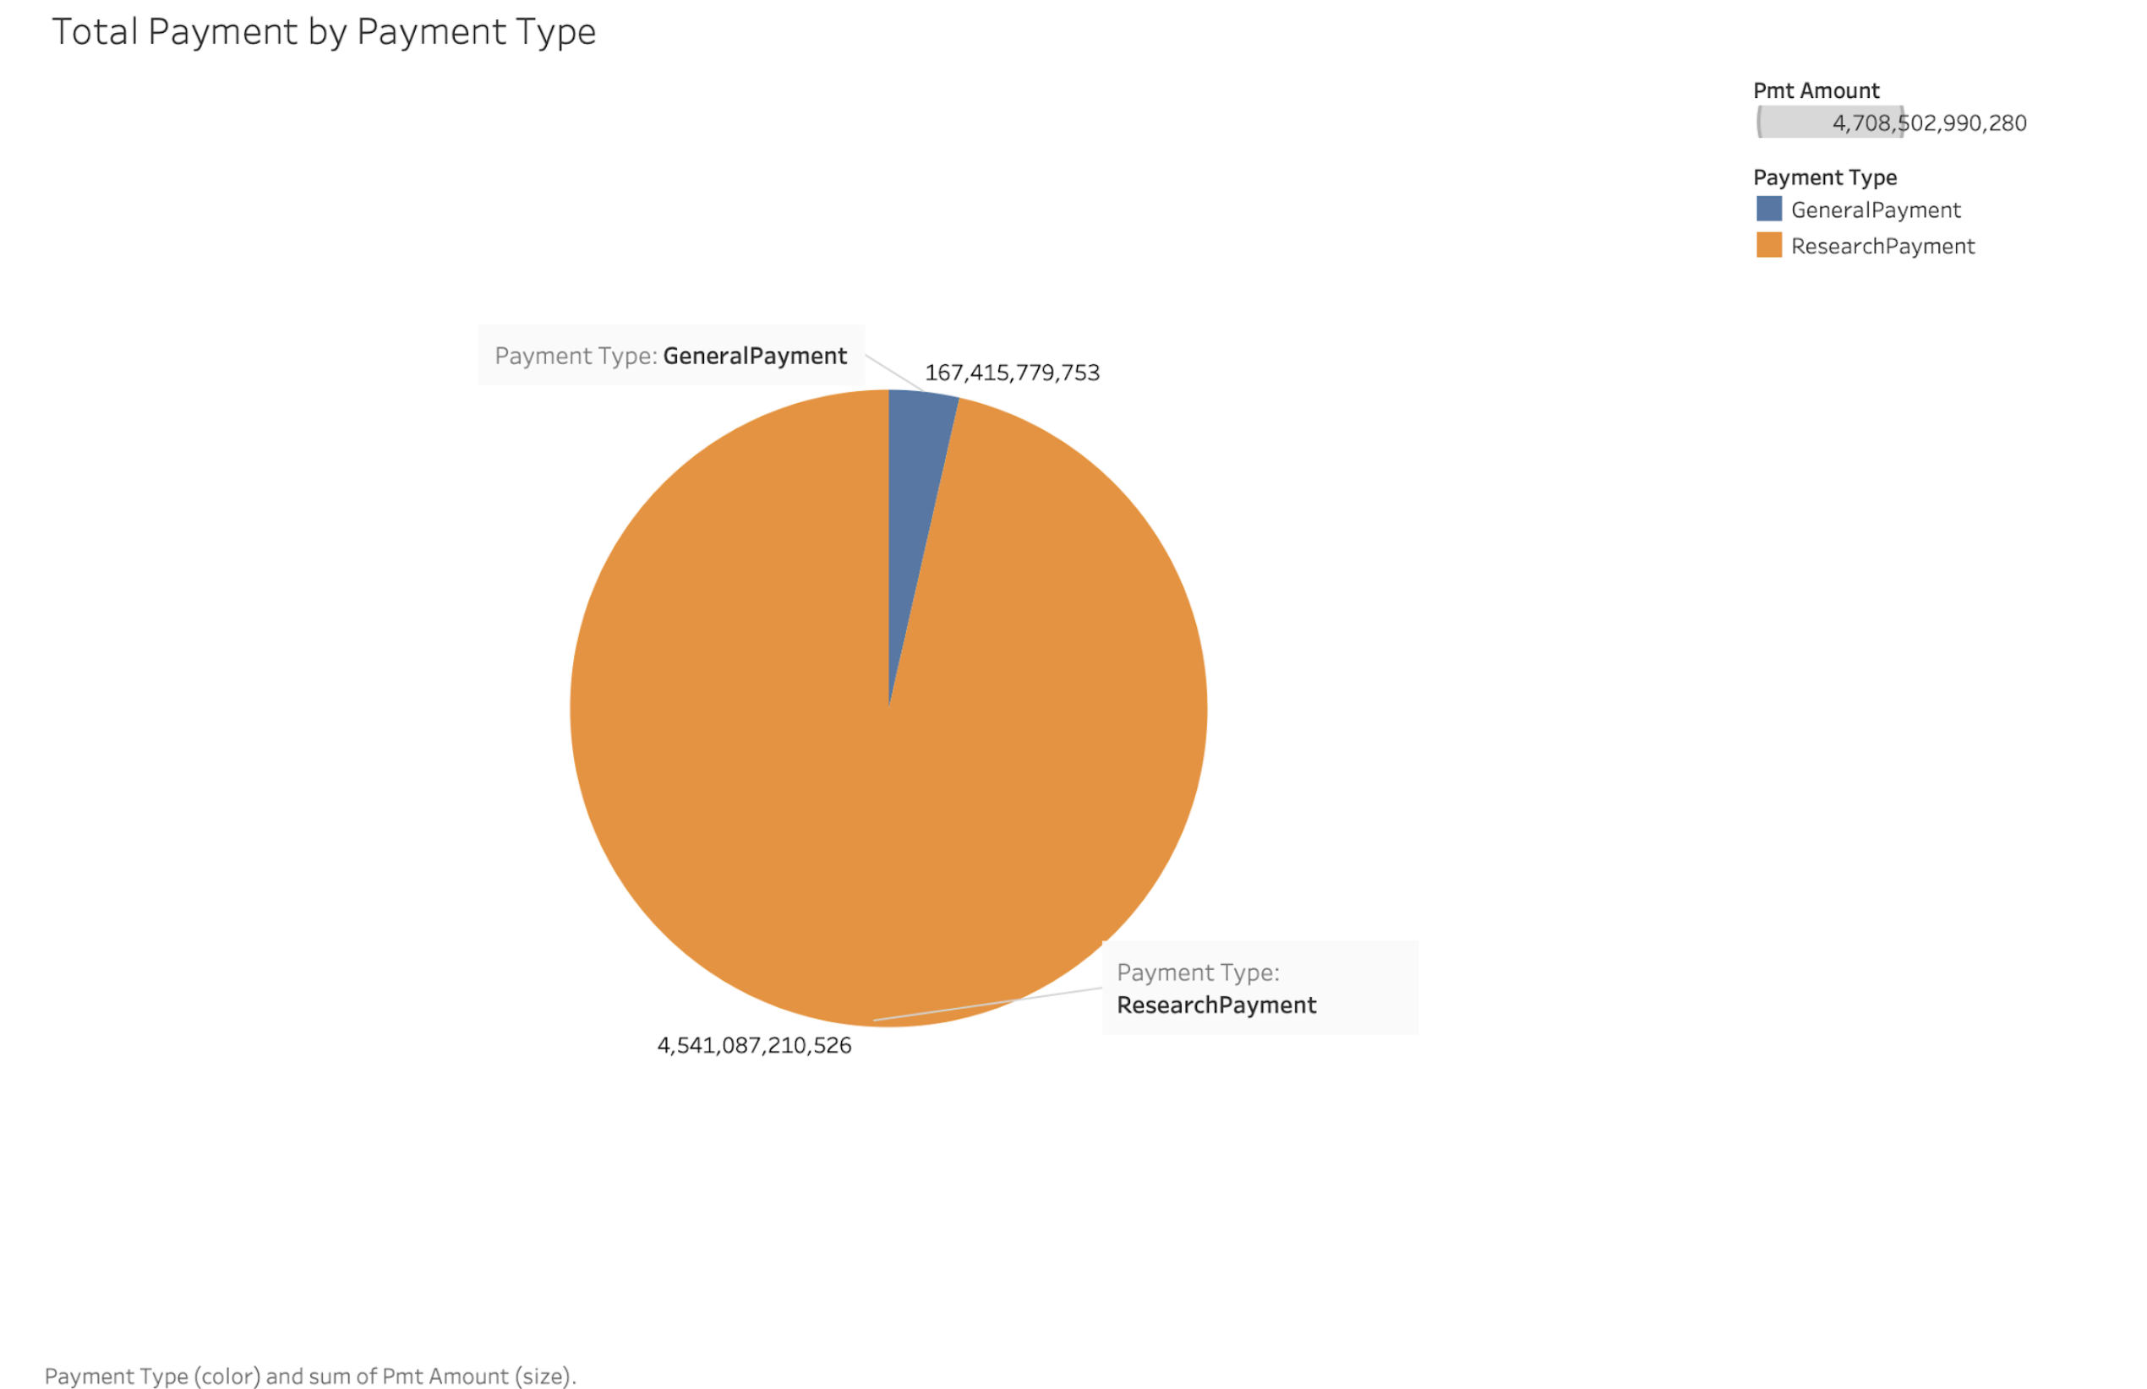
The pie chart displays payment amounts split by type: GeneralPayment and ResearchPayment, ResearchPayment accounts for $4.5T, represented by the large orange slice, GeneralPayment amounts to $167B, depicted by the smaller blue slice
Research payment constitutes the majority, while General Payment forms a significant but smaller portion.

Slide 14
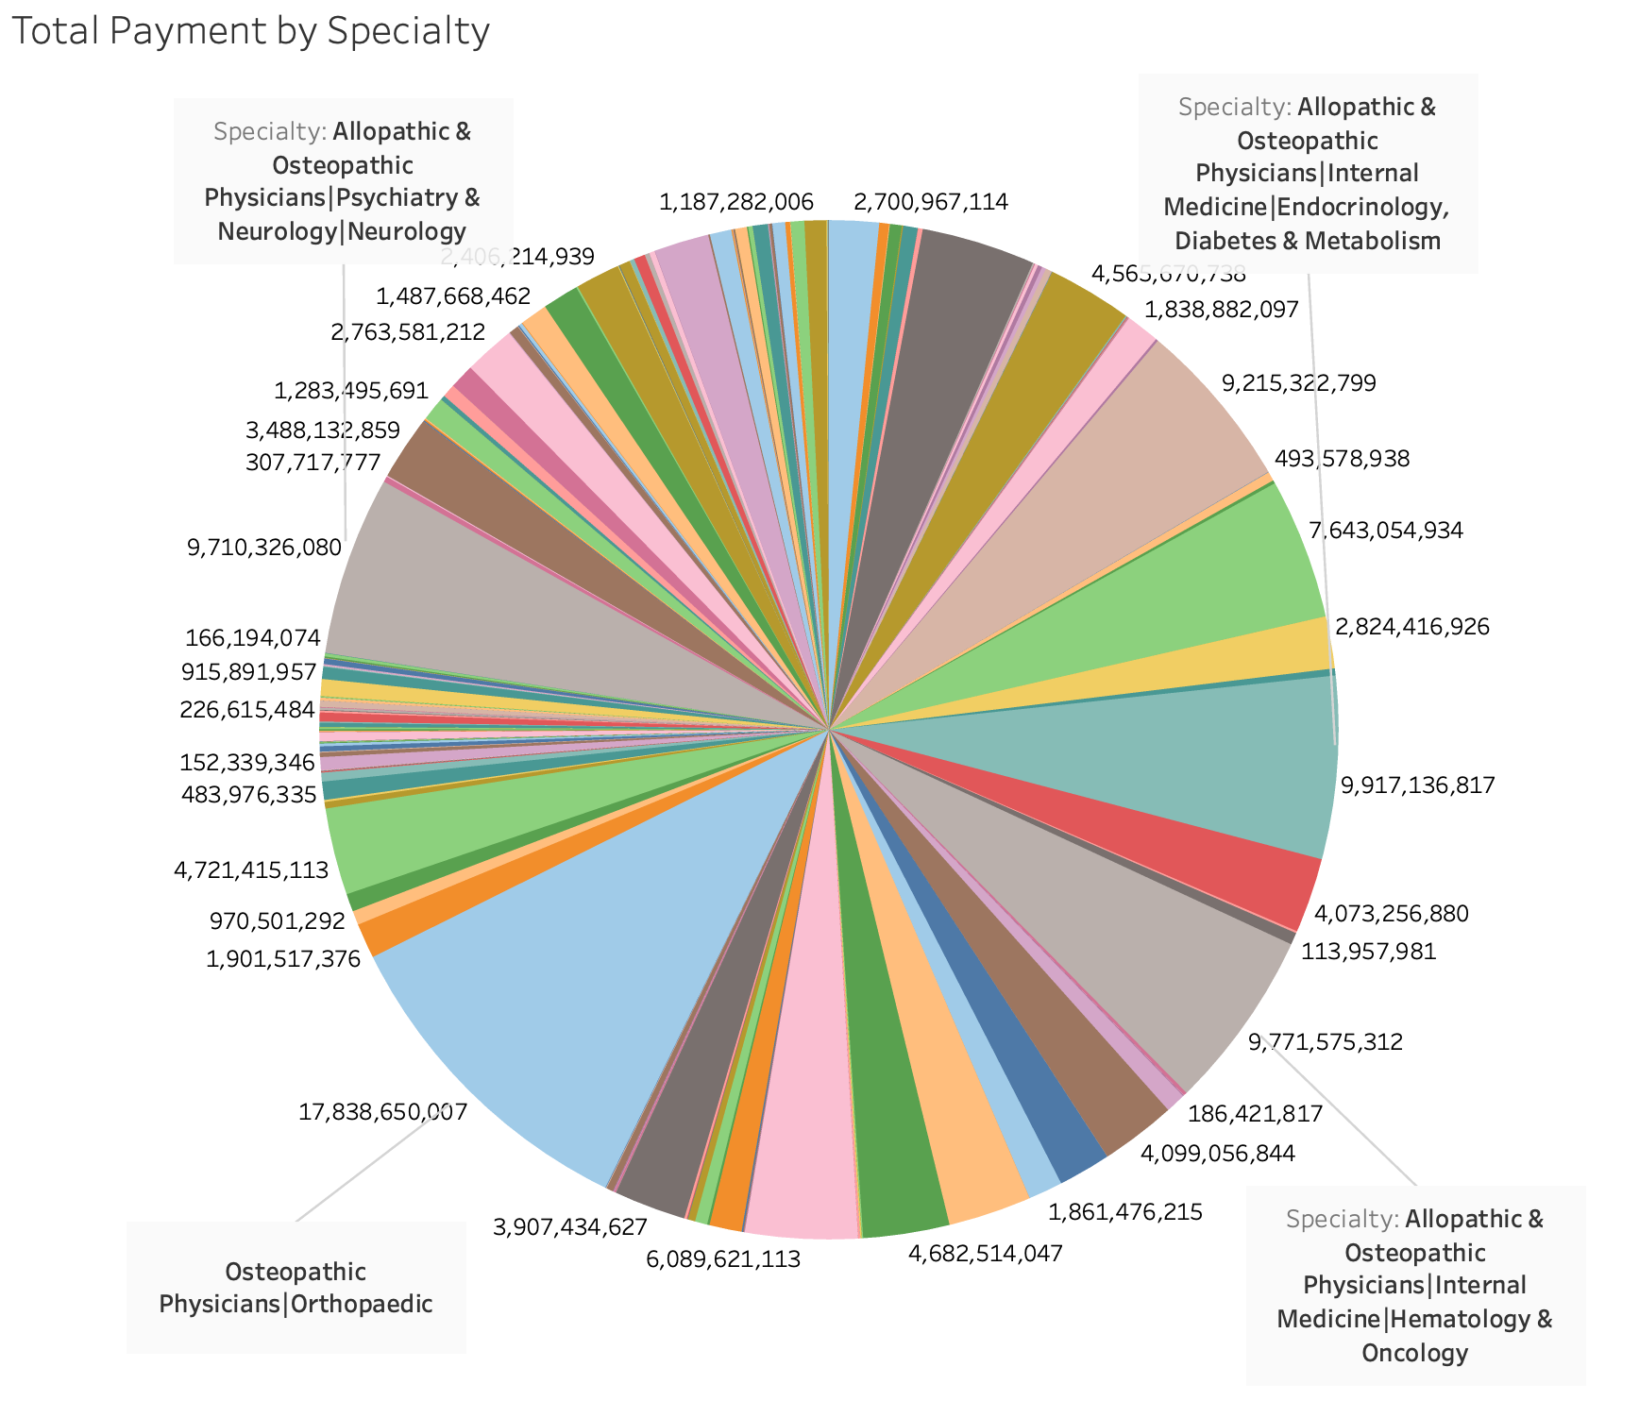
This chart showcases payment distribution across medical fields
Each segment represents a different specialty
Significant amounts like $1.48B for Neurology and $1.83B for Endocrinology, Diabetes & Metabolism indicate substantial financial allocations
Highlights the importance of investments in healthcare across various specialties

Slide 15
Key Takeaways
Healthcare Distribution Disparity
Payment Allocation Insight
Specialty Investment Focus

Slide 16
Thank you for your attention
Group 3

