Slide 1

Ohio High School Graduate Outcomes
Data Source: https://erdc.wa.gov/publications-and-reports/high-school-graduate-outcomes

Slide 2
Agenda
Enrollment After High School Graduation
Postsecondary Persistence After the First Year
Highest Degree 8 Years After High School Graduation
Median Earning 15 Years After High School Graduation

Slide 3
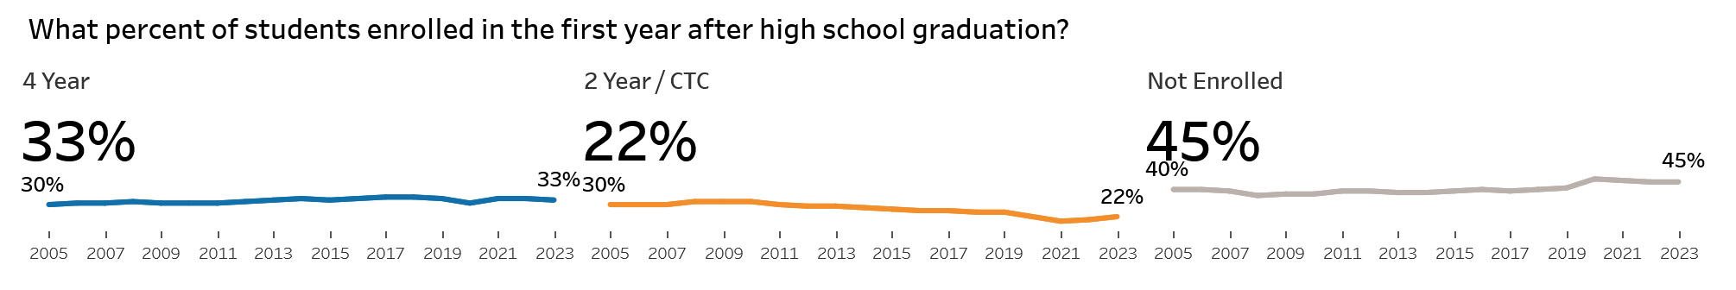
1). Enrollment After High School Graduation
4-year institutions steady at 33%, and 2-year institutions declined 8% since 2005.
Non-enrollment remained steady from 2005-2019 at ~40%, after which increased to a steady 45%.
Data Source: https://erdc.wa.gov/publications-and-reports/high-school-graduate-outcomes

Slide 4
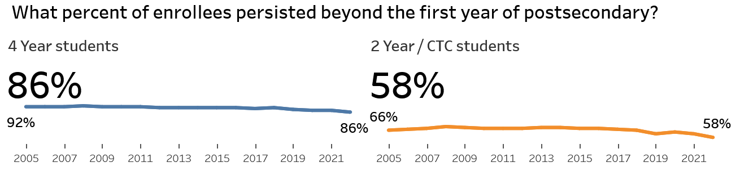
2). Postsecondary Persistence After the First Year
First-year retention is higher at 4-year institutions (86-92%) compared to 2-year institutions (58-68%).
Data Source: https://erdc.wa.gov/publications-and-reports/high-school-graduate-outcomes

Slide 5
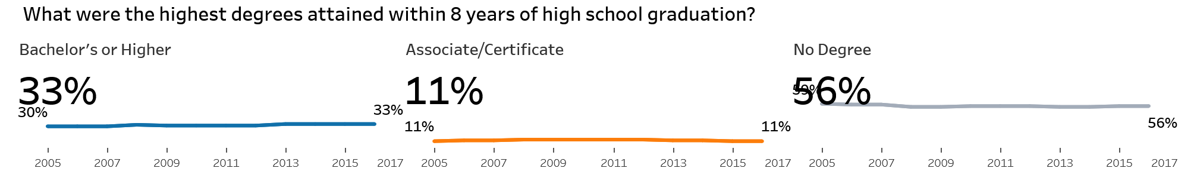
3). Highest Degree 8 Years After High School Graduation
Degree attainment remains stable over time, with ~33% earning a bachelor’s or higher, ~11% completing an associate/certificate, and up to ~60% not obtaining a credential within eight years.
Data Source: https://erdc.wa.gov/publications-and-reports/high-school-graduate-outcomes

Slide 6
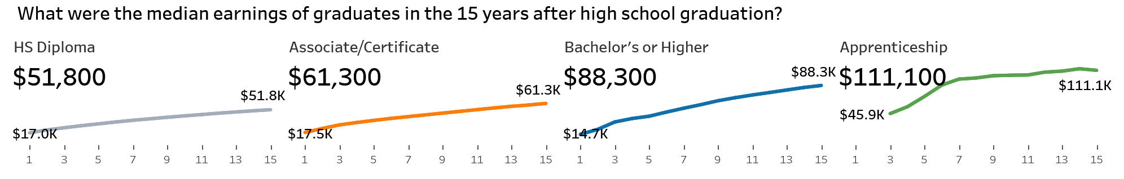
4). Median Earning 15 Years After High School Graduation
Across the board median earnings increase, and higher education lead to higher growth and levels of median earnings.
Apprenticeships incur the highest returns and fastest wage growth, followed by bachelors or higher degrees.
Data Source: https://erdc.wa.gov/publications-and-reports/high-school-graduate-outcomes

Slide 7
Thank you

Slide 8
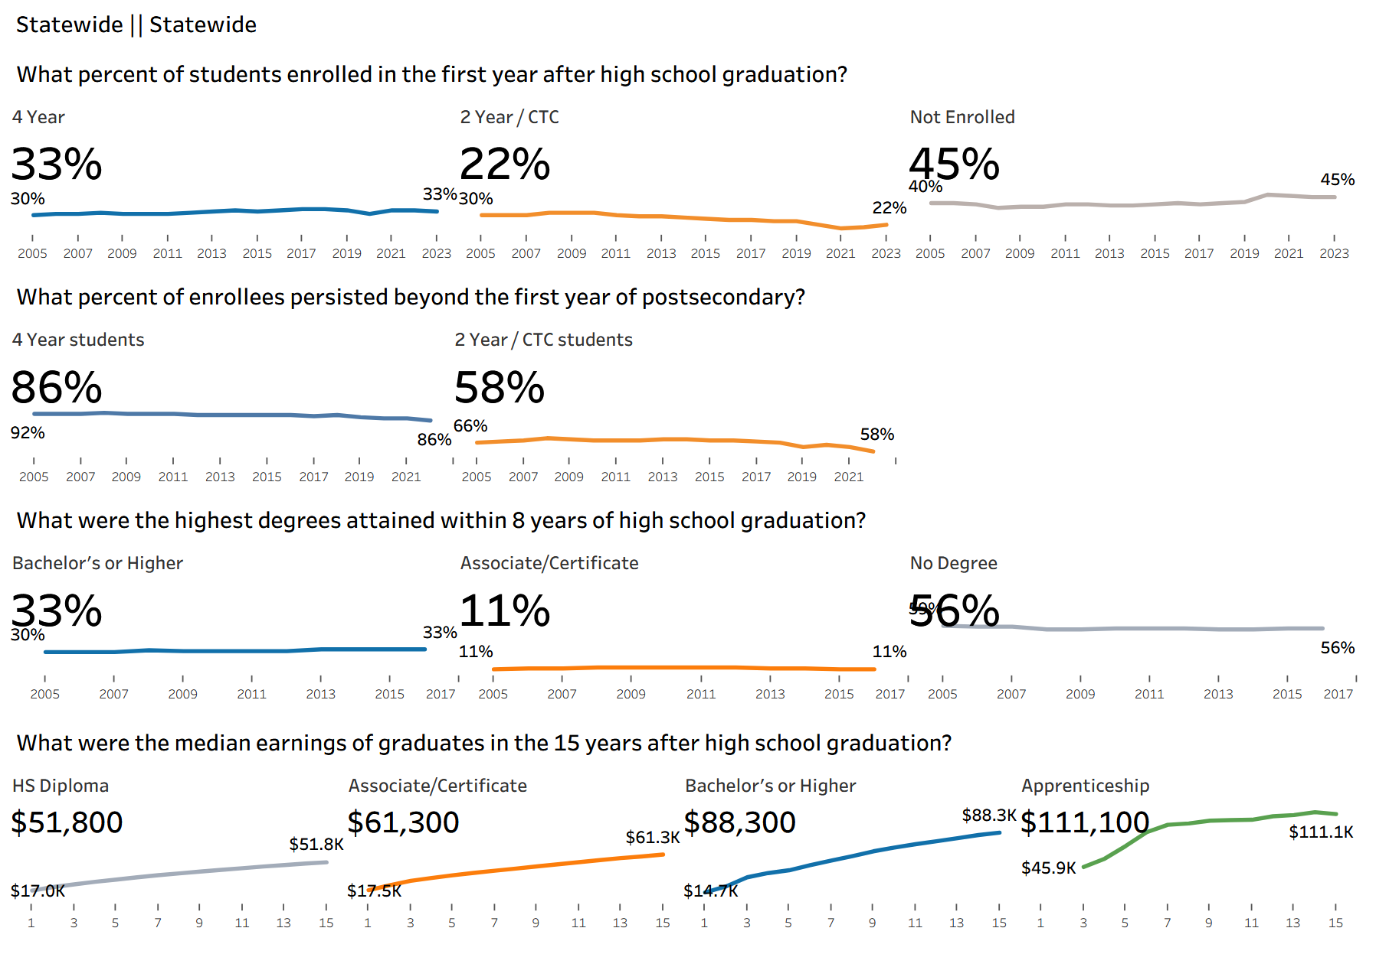
Data Source: https://erdc.wa.gov/publications-and-reports/high-school-graduate-outcomes

