Slide 1
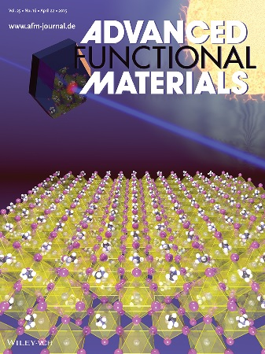
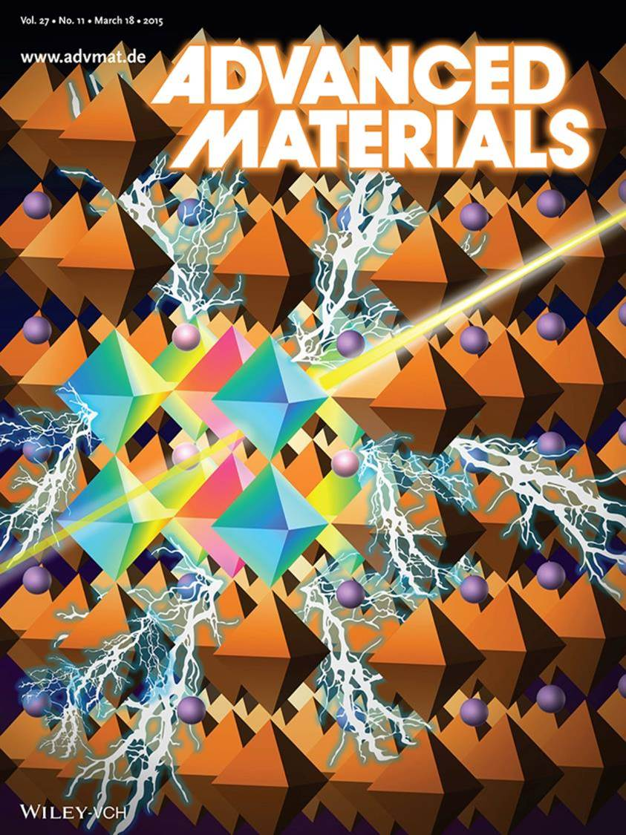
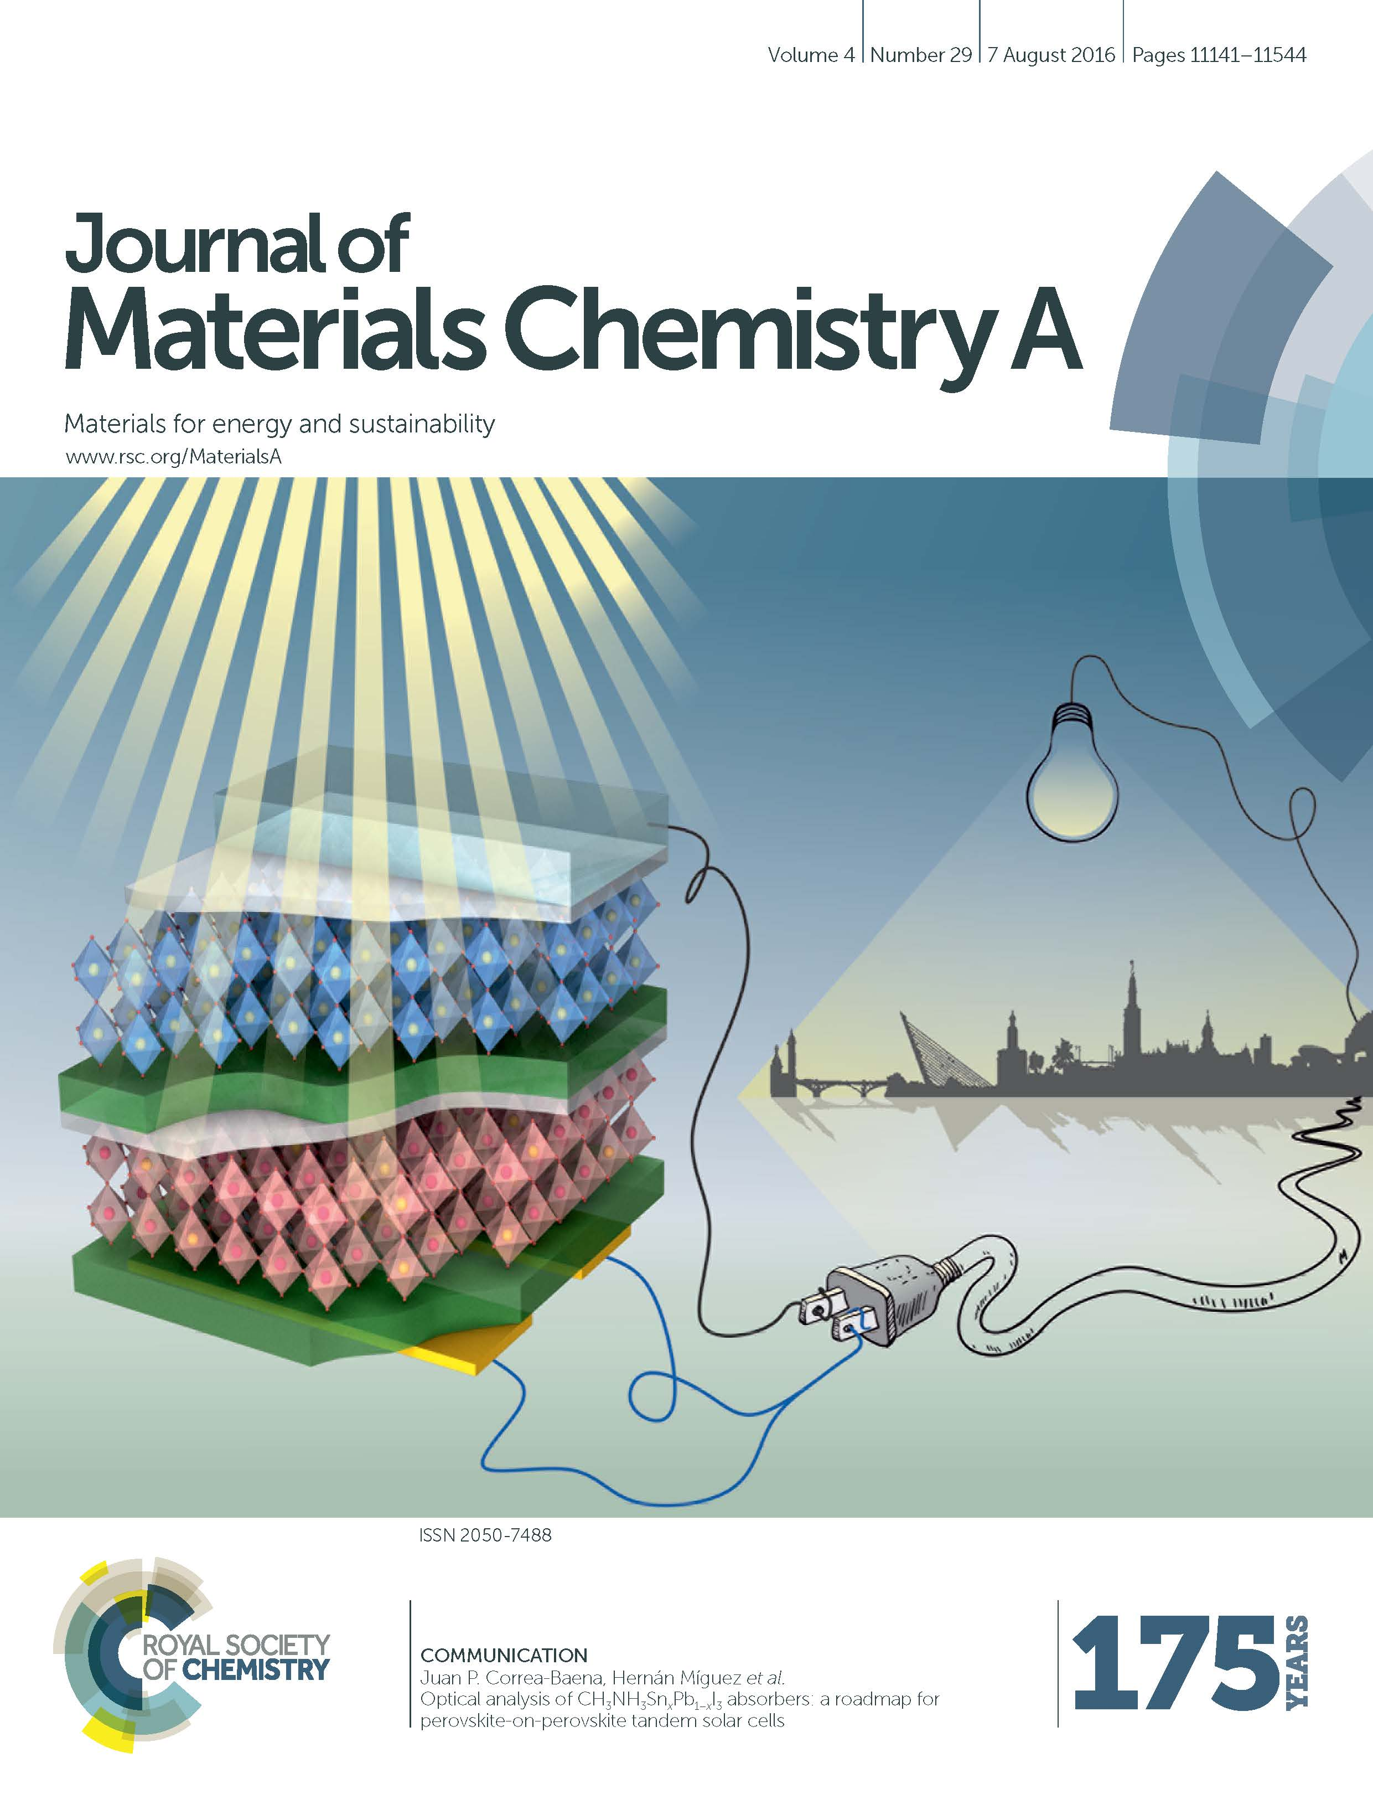
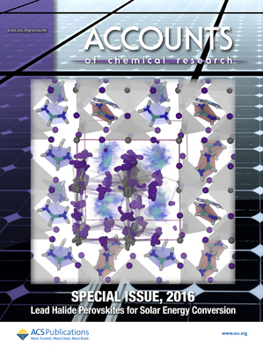
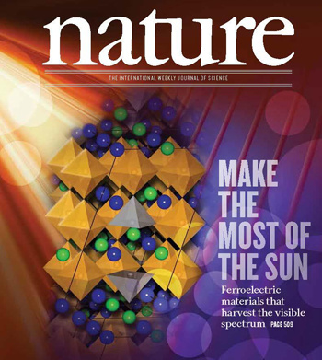
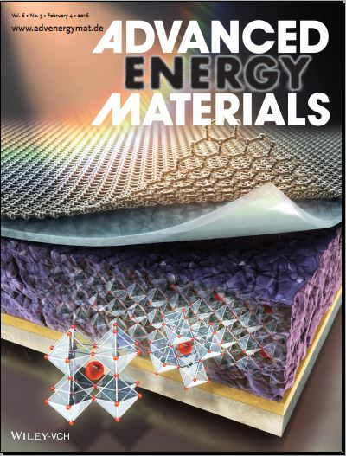
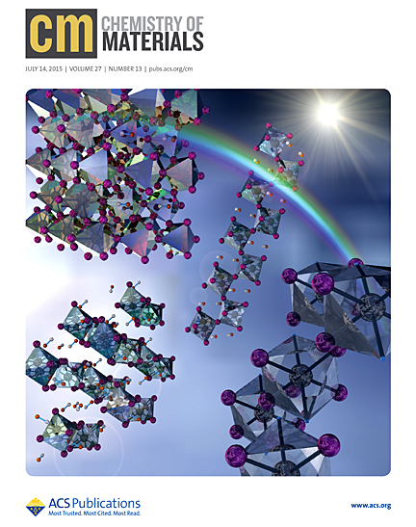
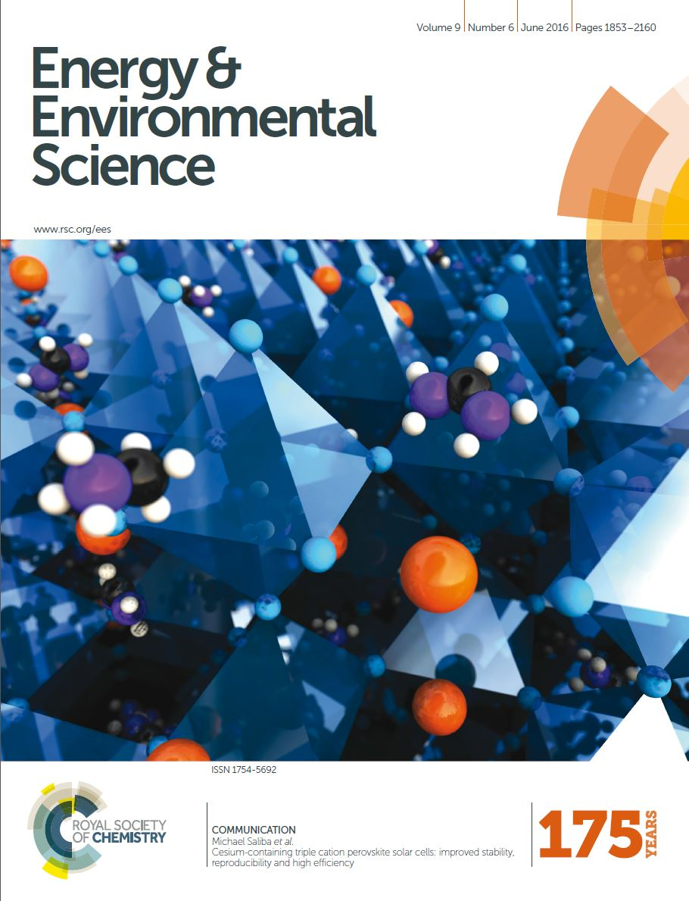
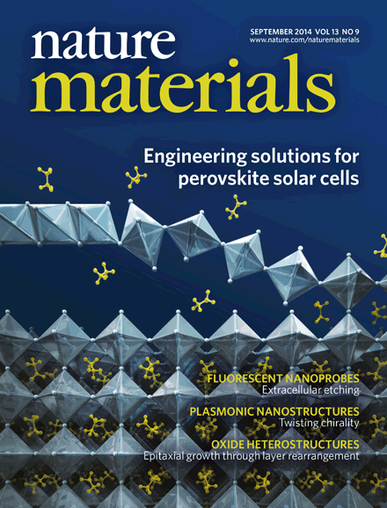

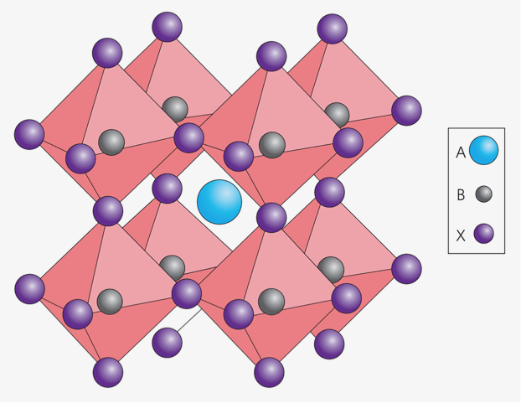
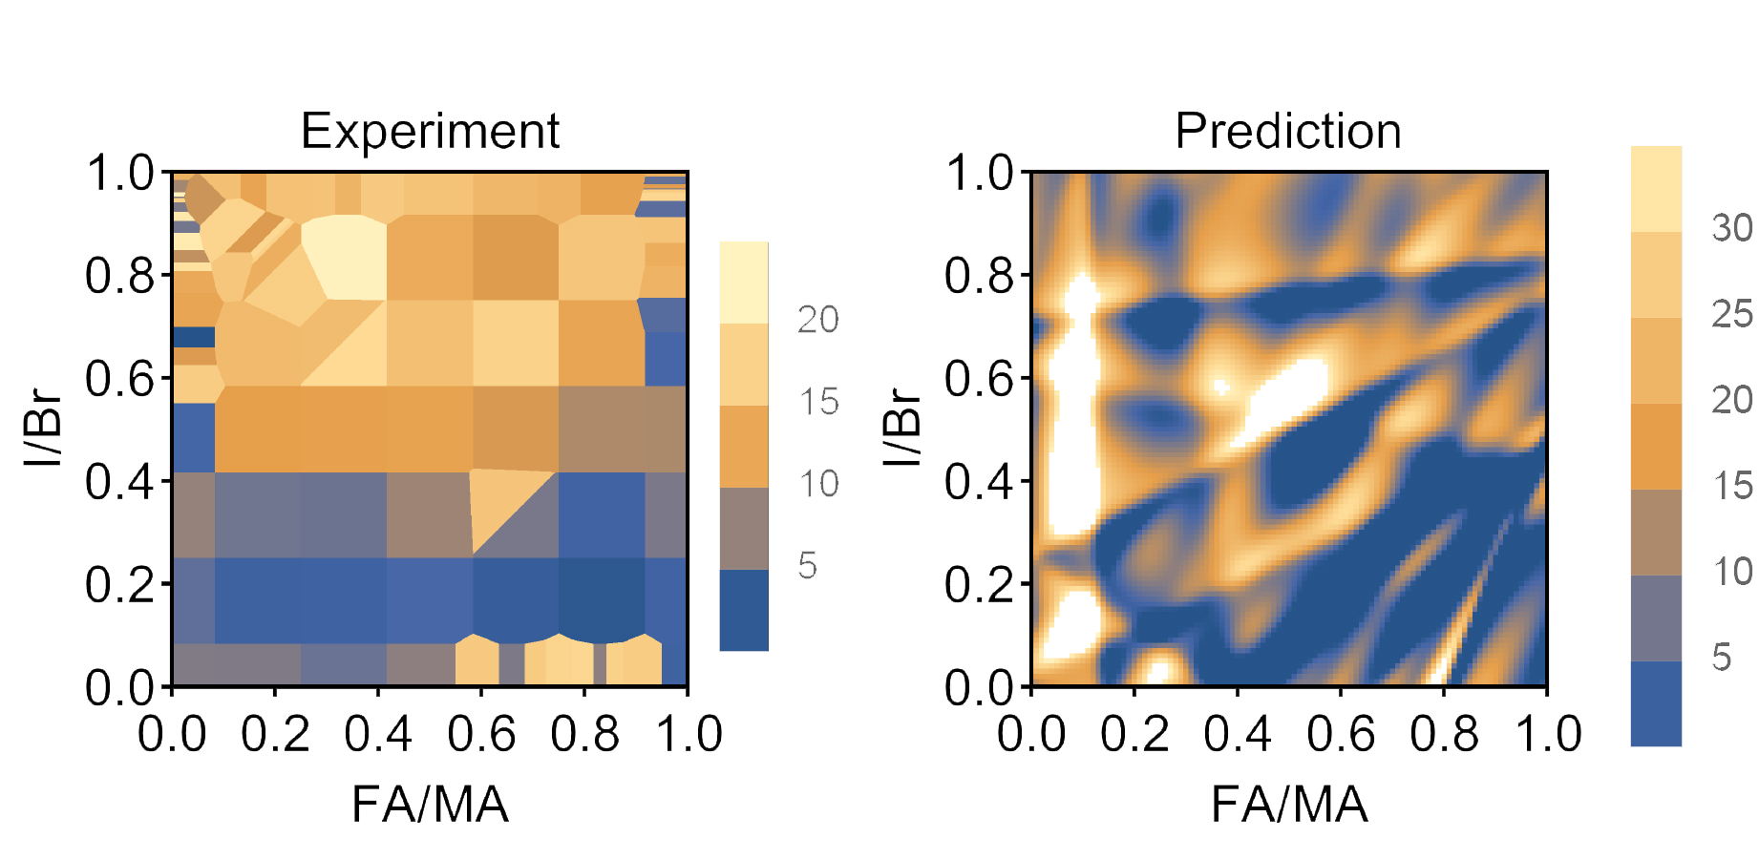


Data Driven Design of Perovskites
Hongbin Liu¹, Yongquan Xie², Sarah D. Floris¹
¹ Department of Chemistry, ² Department of Material Science & Engineering
Goal: finding the optimal formula for the hybrid organic inorganic perovskites (HOIPs) for solar cell energy conversion by using statistical.
Data: Published articles from 2015-17.
Methods: LASSO, SVR, Kernel Ridge Regression, Neural Networks.
Difficulty: Efficient data structures.

